Slide 1
Histology of Respiratory System
Function
Inspiration of air, gas exchange, expiration of CO₂
Chemoreceptors of sense of smell
Phonation

Slide 2
The parts of the respiratory system
The respiratory system is divided into two parts:
Upper respiratory tract: This includes :
Nose. mouth,
and the beginning of the trachea.
Lower respiratory tract
It includes the trachea, the bronchi, broncheoli and the lungs.
The trachea :It connecting the throat to the bronchi.
The bronchi : It divides into two bronchi (tubes).
The broncheoli :the bronchi branches off into smaller tubes called broncheoli which end in the pulmonary alveolus.
The Lungs: The structure of the lungs includes the bronchial tree – air tubes branching off from the bronchi into smaller and smaller air tubes, each one ending in a pulmonary alveolus.

Slide 3
Respiratory
system
Conducting
portion
Conducts , Filter
Warms & moistens air
Respiratory
portion
Gas exchange & secretion of surfactant

Slide 4
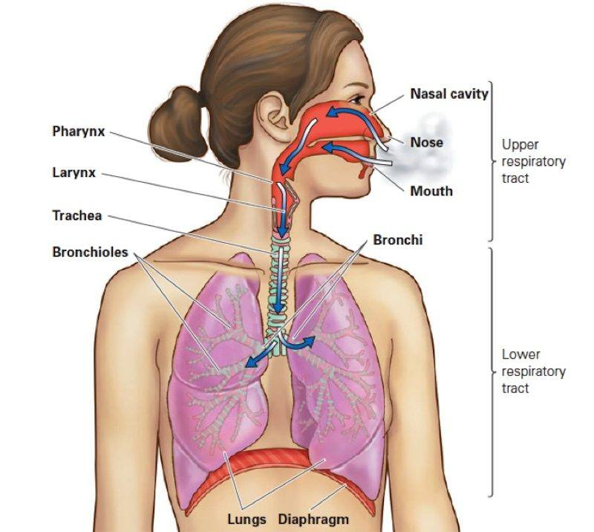

Slide 5
The conducting portion includes:
Nasal cavity
pharynx
Larynx
Trachea
Primary bronchi (RT +LT)
2ry , 3ry bronchi
Bronchioles
Terminal bronchioles
Function of conducting portion:
Conduction of air
Conditioning of air
Structure / Function of conducting portion:
1- Conduction of air:
Cartilages to prevent collapse,
Elastic & smooth ms. fibers for flexibility
2- Conditioning of air:
Nasal hairs: clean & trap large particles
Capillaries: adjust temperature
Respiratory mucosa: adjust moisture & filters air

Slide 6
The respiratory portion includes:
Respiratory bronchioles
Alveolar ducts
Alveolar sacs
Alveoli
Function of respiratory portion:
O₂/CO₂ exchange take place between blood & inspired air

Slide 7
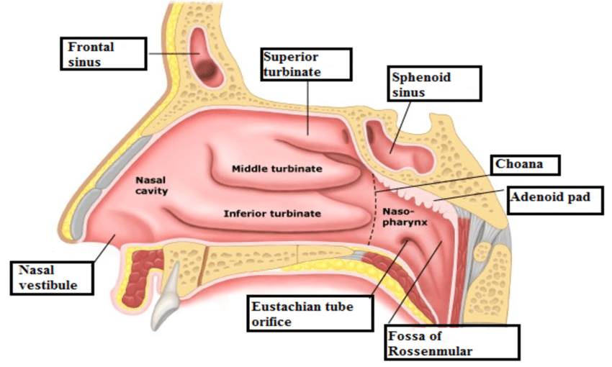
Nasal cavities
Consists of:
Vestibule
Respiratory area
Olfactory area
Vestibule:
Is the anterior part
Formed of skin + sebaceous gland + hair
Lined with keratinizes stratified squamous epithelium

Slide 8
The Nasal Cavities
2 cavities separated by nasal septum
Their lateral walls contain
3 bony projections
(conchae) superior, middle, inferior
The conchae increase the surface
area for better conditioning of
the inspired air
Superior one covered with Olfactory epithelium
Middle & inferior covered with Respiratory epithelium= a ciliated pseudostratified columnar epithelium

Slide 9
The olfactory epithelium
Site : Covers the roof of nasal cavities & superior conchae.
Contains chemoreceptors of smell
3 cell types are present:
Olfactory receptor neurons
Supporting (sustentacular) cells
Basal cells
The olfactory mucosa consists of:
1- The epithelium rests on
2- lamina propria which contains:
Bowman’s glands, secrete serous fluid → surface
BV & olfactory nerve fibers

Slide 10
The olfactory epithelium

Slide 11
The respiratory epithelium
The respiratory epithelium is a tissue that lines the respiratory system.
Pseudo-stratified columnar ciliated + goblet cells
Role of the respiratory epithelium are:
1- It serves as a protective barrier and,
2- It also provides moisture.
The olfactory epithelium:
Specialized Pseudo stratified columnar + chemoreceptors & NO goblet cells

Slide 12
Paranasal sinuses
Frontal, ethmoidal, sphenoidal
maxillary
Skull cavities open in nasal cavitiy
Lined with thin respiratory epithelium with few goblet cells which is very adherent to the periosteum
Inflammation = sinusitis -------severe pain

Slide 13
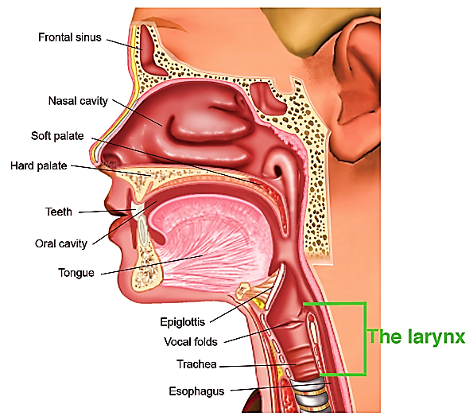
Larynx:
At the beginning of trachea
Its beginning is guarded by epiglottis
Has 2 functions:
production of voice (vocal cords)
Prevent food from entering the trachea
(epiglottis has elastic cartilage in its
lamina propria)
Lined with respiratory epithelium

Slide 14
Trachea
Tube extends from larynx & ends by dividing into 2 bronchi
Kept open by about 20 C- shaped
Cartilage rings (hyaline cartilage)
Its wall is formed of 4 layers:
Mucosa
Submucosa
Hyaline cartilage
adventitia

Slide 15
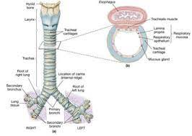
Trachea:
Mucosa: respiratory epithelium + lamina propria
Submucosa: loose CT. contain
tracheal glands (mucus gland)
Cartilage layer: C- shaped cartilage
rings, the gap between cartilage ends
connected by elastic ligament &
Trachialis ms (smooth ms)
Adventitia: loose CT

Slide 16
Trachea

Slide 17
Bronchial tree
Primary (Extra pulmonary) bronchi
Secondary (Intra-pulmonary) bronchi
Bronchioles
Terminal bronchioles
1ry bronchi: RT & LF→ similar to trachea
(but cartilage is complete ring)
2ry bronchi: within the lung → divide into 3ry bronchi
Its wall is formed of 4 layers (NO submucosa)
Mucosa
Musculosa
Cartilage plates
Adventitia

Slide 18
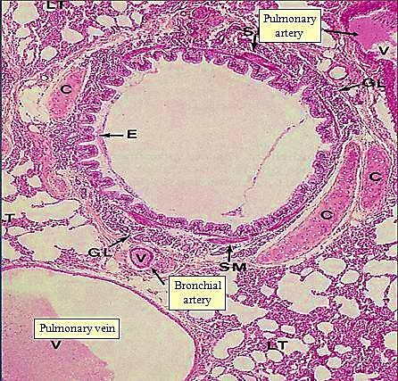
Structure of 2ry & 3ry bronchi
Mucosa: respiratory epith +↓goblet cells
lamina propria has MALT
(mucosa associated lymphatic tissue)
Musculosa: spiral layers of
smooth ms. encircling the
mucosa
Cartilage plates:
adventitia:
Structure of 2ry bronchi

Slide 19
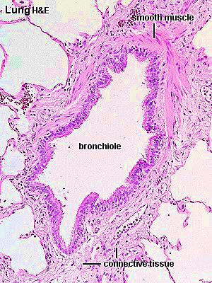
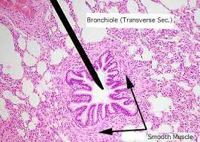
Bronchioles
Small airways ↓ 0.5 mm
Its wall has No (submucosa, cartilage,
lymphatic nodules)
Its wall formed of 3 layers
Mucosa:
Simple columnar ciliated + Clara cells
Musculosa:
complete layer of circularly arranged s.ms.
Adventitia:
CT layer

Slide 20
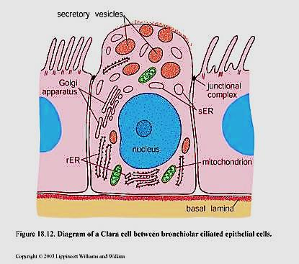
Clara cells
Secretory cells with Dome shaped apex
They also present in terminal bronchioles
Protein Secreting cell prevent alveolar collapse

Slide 21
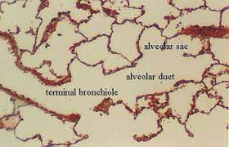
Terminal bronchioles:
The smallest & last part of conducting portion
Lining epithelium: simple cubical p. ciliated + Clara cells

Slide 22
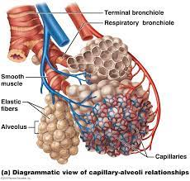
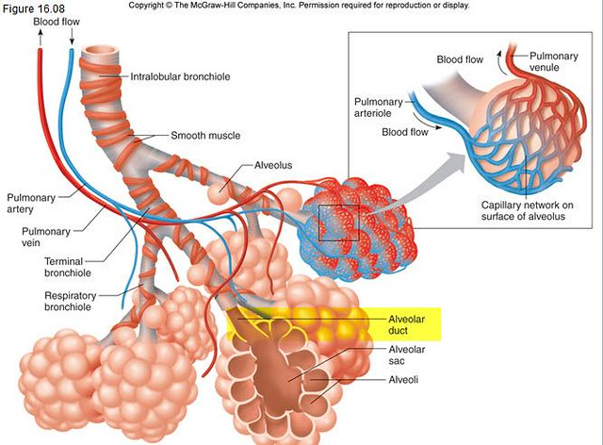
respiratory portion
where gas exchange takes place
Includes:
Respiratory bronchioles
Alveolar ducts
Alveolar sacs
Alveoli

Slide 23
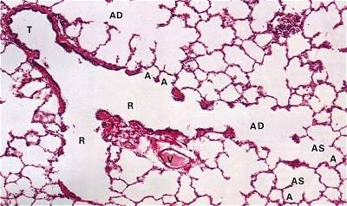
Alveoli
Sac like structures
Responsible for gas exchange
They separated by thin septa called
inter-alveolar septa
Lined with 2 type of cells:
Type I pneumocyte
Type II pneumocyte

Slide 24
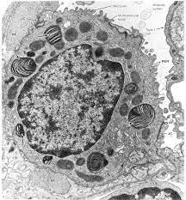
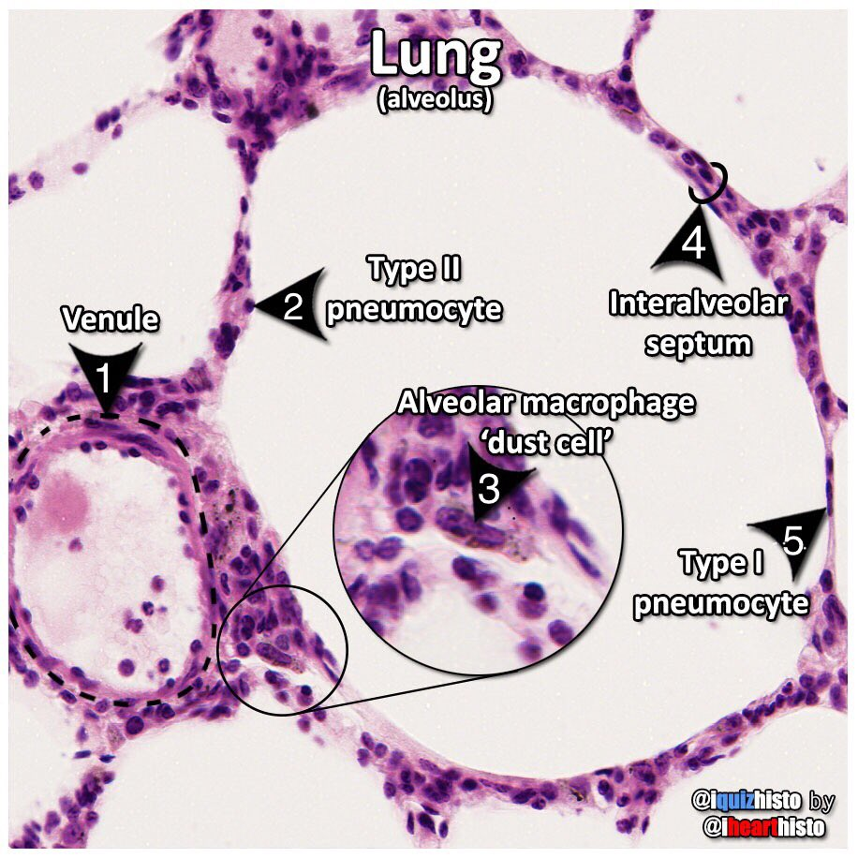
Type I pneumocytes
Type II pneumocytes
Most cells (97%)
Flat simple squamous cells e flat nuclei
Function: Gas exchange
3%
Cuboidal cells e central nuclei & foamy cytoplasm
Function: Secrete surfactant + stem cells

Slide 25
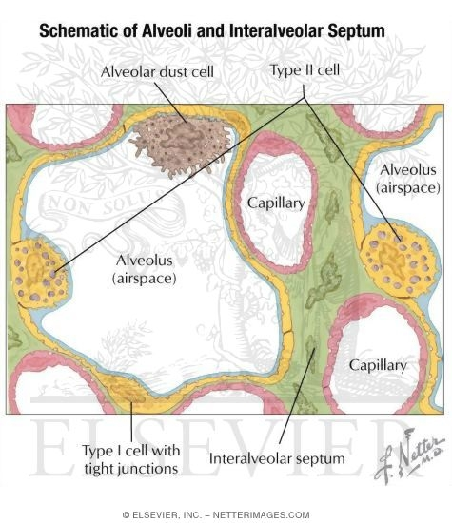
Interalveolar septum
Def : The wall between two adjacent alveoli
Content :
Pores
Capillary network
Elastic & reticular fibers
Cells ( alveolar macrophages- fibroblast = interstitial cells

Slide 26
Epithelial transitions
The respiratory system provides beautiful examples of epithelial transitions.
The pseudostratified ciliated columnar epithelium of the trachea and bronchi gives way to a simple columnar ciliated epithelium in the bronchioles and then to the simple squamous epithelium of the alveolar ducts and alveoli.
The ciliated cells undergo a gradual reduction in height from trachea to terminal and respiratory bronchiole.

Slide 27
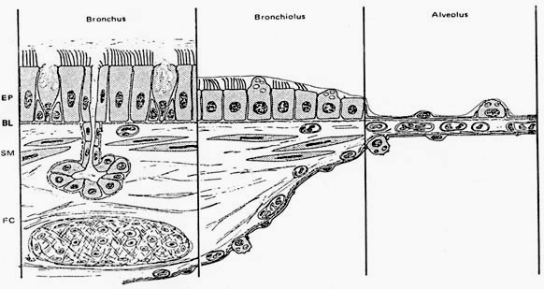
Change of airway wall structure at three principal levels in the lung. The epithelium (EP) gradually reduces from pseudostratified to cuboidal and then to squamous, but retains its organization as a mosaic of lining and secretory cells. The smooth-muscle layer (SM) disappears in the alveoli.

