Slide 1
Orientation to Gram Positive Bacteria of Medical Importance
Dr. Mohammad Odibate
Mutah University
Faculty of Medicine
Departement of Microbiolgy

Slide 2
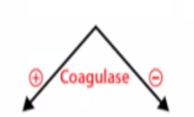

Slide 3
Gram Positive bacilli
Nonsporing
Spore-forming
Regular shape
And staining properties
Bacillus
Clostrridium
Irregular shape
and acid fast
Corynbacterium
Propionibacterium
Listeria
Acid fast
Mycobcateria

Slide 4
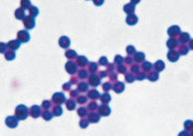
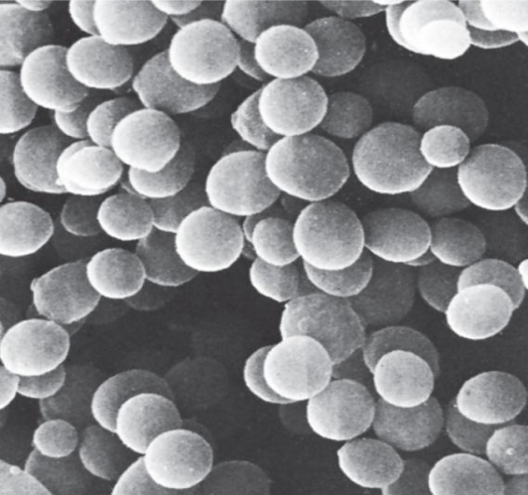
Staphylococci
Medically Important Gram-Positive Cocci
General Characteristics
Common inhabitant of the skin and mucous membranes.
Spherical cells arranged in irregular clusters.
Produces many virulence factors.

Slide 5
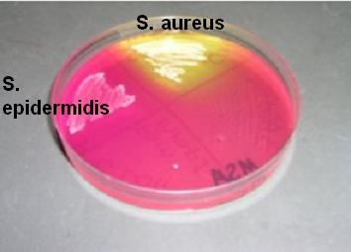
Staphylococci aureus
Medically Important Gram-Positive Cocci
Diseases:
Food poisoning.
Localized infections (Abscess formation).
Spreading infections (Necrotizing infections).
Systemic infections (ex. Osteomyelitis).

Slide 6
Coagulase-negative staphylococcus
Medically Important Gram-Positive Cocci
Frequently involved in nosocomial and opportunistic infections.
S. epidermidis – lives on skin and mucous membranes; endocarditis, bacteremia, UTI.
S. saprophyticus – infrequently lives on skin, intestine, vagina; UTI.

Slide 7
Streptococci
Medically Important Gram-Positive Cocci
Gram-positive cocci
Catalase & Coagulase negative
Sensitive to drying, heat, and disinfectants
Classification
α-hemolytic: partial hemolysis of RBCs
β-hemolytic: complete hemolysis of RBCs
γ-hemolytic: no hemolysis of RBCs

Slide 8
Medically Important Gram-Positive Cocci
Streptococci
S. pyogenes (Group A sterp):
Group-A streptococci (GAS).
β- hemolytic.
Most serious streptococcal pathogen.
Inhabits throat, nasopharynx, occasionally skin.
Diseases:
Pharyngitis.
Skin infections.
Necrotizing infections.
Systemic infections

Slide 9
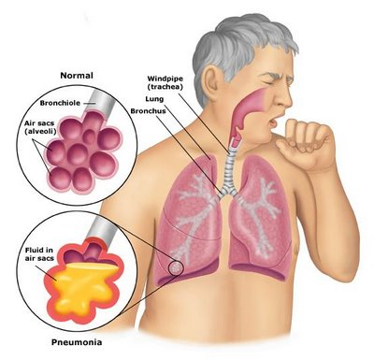
Medically Important Gram-Positive Cocci
Streptococcus pneumoniae
Pneumonia: inflammatory condition of the lung.
Inhabits nasopharynx of healthy people.
May also infect brain: (pneumococcal meningitis) and blood stream (pneumococcus septicemia).

Slide 10
Gram Positive bacilli
Nonsporing
Spore-forming
Regular shape
And staining properties
Bacillus
Clostrridium
Irregular shape
and acid fast
Corynbacterium
Propionibacterium
Listeria
Acid fast
Mycobcateria

Slide 11
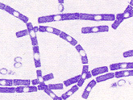
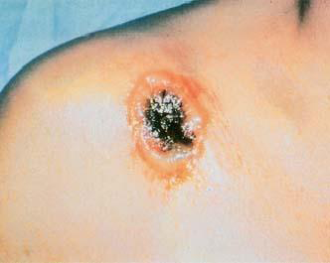
Bacillus anthracis
Medically Important Gram-Positive Bacilli
Large, block-shaped rods
Central spores
Virulence factors –polypeptide capsule/exotoxins
3 types of anthrax:
Cutaneous–spores enter through skin, black sore; least dangerous.
Pulmonary–inhalation of spores.
Gastrointestinal–ingested spores.

Slide 12
Bacillus cereus
Medically Important Gram-Positive Bacilli
Grows in foods, spores survive cooking/ reheating.
Food poisoning.
Ingestion of toxin-containing food causes nausea, vomiting, abdominal cramps, diarrhea; 24 hour duration.
No treatment.
Increasingly reported in immunosuppressed.
Notes:
Common airborne /dustborne; usual methods of disinfection/ antisepsis: ineffective

Slide 13
Medically Important Gram-Positive Bacilli
Clostridium difficile
Normal flora colon, in low numbers.
Causes antibiotic associated colitis
Due to treatment with broad-spectrum antibiotics that kills other bacteria: C. difficile overgrowth
Enterotoxins that damage intestines.
Major cause of diarrhea in hospitals.
Treatment: stop antimicrobials/fluid electrolyte replacement.

Slide 14
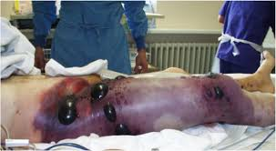
Medically Important Gram-Positive Bacilli
Clostridium perfringens (Gas Gangrene)
Soft tissue :wound infections: myonecrosis.
Predisposing factors: infection of all types of wounds.
Virulence factors (lytic enzymes)
Treatment: antibiotics/amputation
Notes:
toxins
alpha toxin –causes RBC rupture, edema and tissue destruction
Collagenase
Hyaluronidase
Dnase

Slide 15
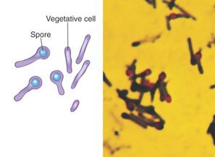
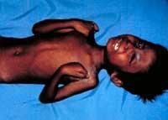
Medically Important Gram-Positive Bacilli
Clostridium tetani: Tetanus
Common resident: of soil and GI tracts of animals.
Causes tetanus or lockjaw, a neuromuscular disease.
Most commonly among IV drug abusers and neonates in developing countries.

Slide 16
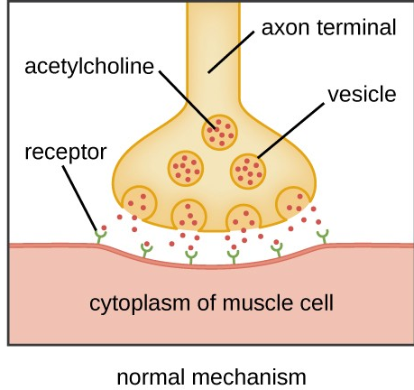
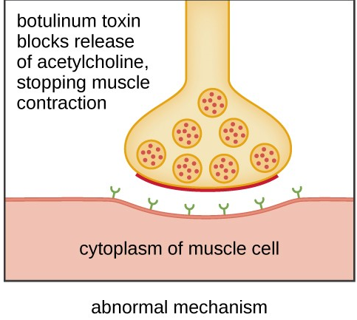
Medically Important Gram-Positive Bacilli
Clostridium Botulinum: Flaccid paralysis
Botulism–intoxication associated with inadequate food preservation
Toxin carried to neuromuscular junctions: blocks the release of acetylcholine: necessary for muscle contraction to occur.
Clinically
Double or blurred vision
Difficulty swallowing
Neuromuscular symptoms

Slide 17
Gram Positive bacilli
Nonsporing
Spore-forming
Regular shape
And staining properties
Bacillus
Clostrridium
Irregular shape
and acid fast
Corynbacterium
Propionibacterium
Listeria
Acid fast
Mycobcateria

Slide 18
Gram Positive Non-Spore-Formers
Medically Important Gram-Positive Bacilli
Listeria monocytogenes:
Found in soil, water, luncheon meats, hot- dogs, cheese.
Resistant to long storage and refrigeration, heat, salt, pH extremes and bile.

Slide 19
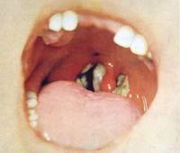
Gram Positive Non-Spore-Formers
Medically Important Gram-Positive Bacilli
Corynbacterium diptheriae:
Virulence factors: diphtherotoxin.
Vaccine (DPT).
Causes a pseudomembrane which can cause asphyxiation.
Acquired via respiratory droplets from carriers or actively infected individuals.

Slide 20
Gram Positive bacilli
Nonsporing
Spore-forming
Regular shape
And staining properties
Bacillus
Clostrridium
Irregular shape
and acid fast
Corynbacterium
Propionibacterium
Listeria
Acid fast
Mycobcateria

Slide 21
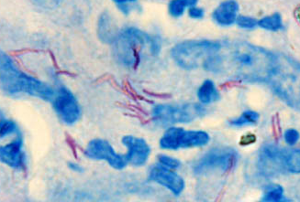
Gram Positive Non-Spore-Formers
Medically Important Gram-Positive Bacilli
Mycobacterium:
Gram-positive irregular bacilli.
Acid-fast staining: mycolic acids.
Strict aerobes.
Grow slowly.
Virulence factors -contain complex waxes and other factor that prevent destruction by lysosomes or macrophages.

