Slide 1
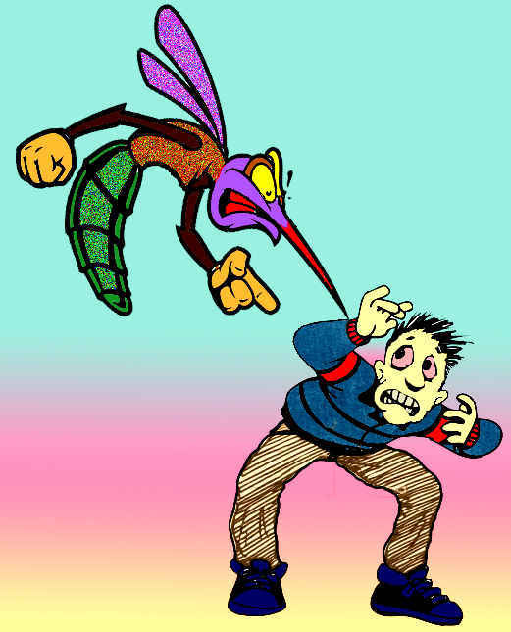
Plasmodium and Babesia
Presented by
Associate Professor Dina Abou Rayia

Slide 2
General characters:
1- No special organs for locomotion (move by gliding) in some stages of their life cycle.
2- Multiply by alternation of sexual and asexual generations.

Slide 3
Plasmodia
Malaria parasites
Plasmodium vivax
Plasmodium ovale
Plasmodium malariae
Plasmodium falciparum
Causes
Causes
Causes
Causes
Benign tertian malaria
Benign tertian malaria
Benign quartan malaria
Malignant malaria
tertian or sub tertian

Slide 4
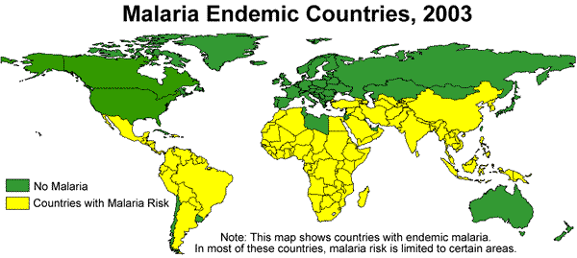
Malaria endemic areas

Slide 5
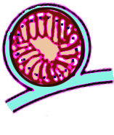
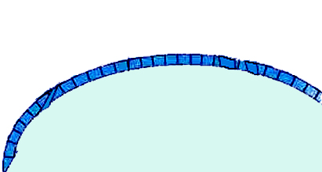
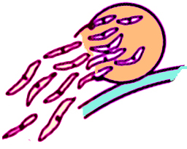
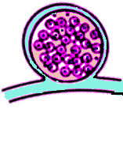
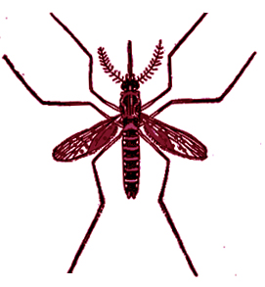
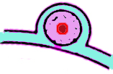
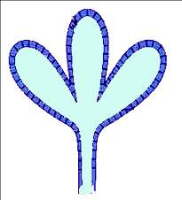
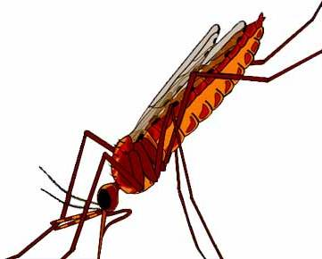
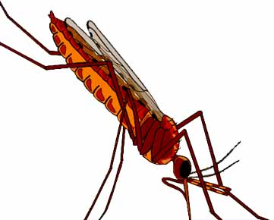
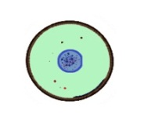
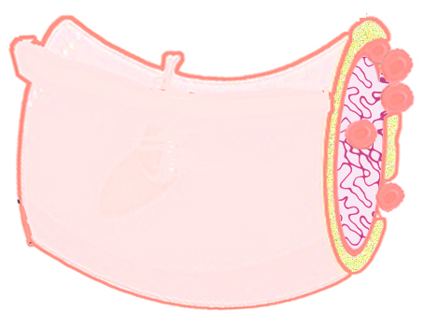
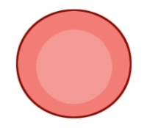
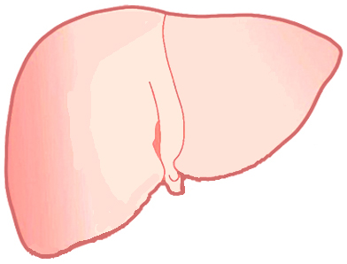
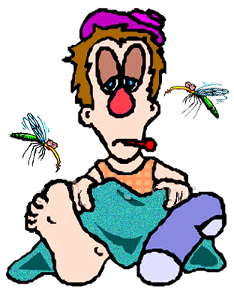
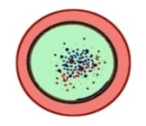
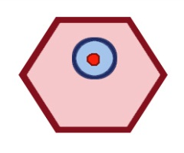
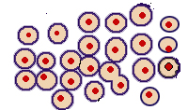
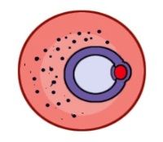
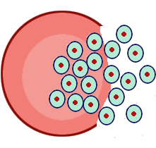
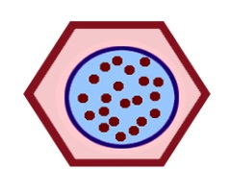
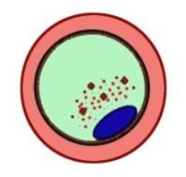
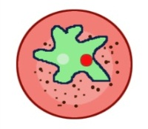
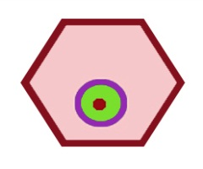
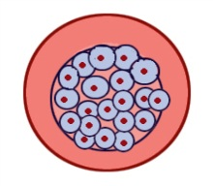
Life Cycle of Human Plasmodia
D.H
HEPATIC PHASE
I.H
ERYTHROCYTIC PHASE

Slide 6
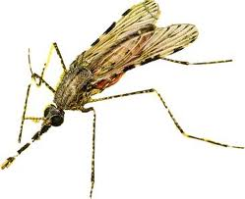
Life cycle
The life cycle of malaria passes in 2 alternate hosts
Man (I.H)
Female Anopheles (D.H)
The asexual cycle (Schizogony) takes place ends by the formation of male and female gametocytes (Gametogony).
The sexual cycle (Sporogony) takes place.

Slide 7
Life cycle of malaria parasites in man
Intrinsic cycle
Asexual cycle
in the liver
Asexual cycle
in RBCs
Gametogony
Exo-erythrocytic schizogonoy (liver phase)
Erythrocytic schizogony
(blood phase)
Formation of male and female gametocytes in infected RBCs
Primary tissue phase
Secondary tissue phase
Relapse occurs with P. vivax and
P. ovale

Slide 8
Life cycle of malaria parasites
in mosquito
Extrinsic cycle or Sporogony
Start when female Anopheles bites infected person for blood meal that containing all stages of malaria parasite. All the stages are digested in the stomach of the mosquito except the gametocytes (I.S to mosquito).
End by Fertilization between microgamete & the macrogamete forming a zygote  elongated ookinete  spherical oocyst  sporocyst containing a large number of sickle- shaped sporozoites (I.S to man).

Slide 9
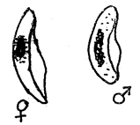
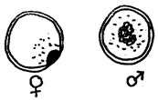
Plasmodium falciparum | Plasmodium malariae | Plasmodium ovale | Plasmodium vivax
 |  |  |  | Trophozoite (ring stage)
 |  |  |  | Mature trophozoite
 |  |  |  | Schizont
 |  |  |  | Gametocyte
Infect young RBCs
Old RBCs
All RBCs ages

Slide 10
Mode of transmission
Bite of female Anopheles
Blood transfusion
Congenital transmission
Contaminated syringes
as in addicts
Organ transplant
????? Hepatic phase
causes erythrocytic schizogony cycle only as the merozoites that released from RBCs never invade the liver cells
Infective stages ???????????????????

Slide 11
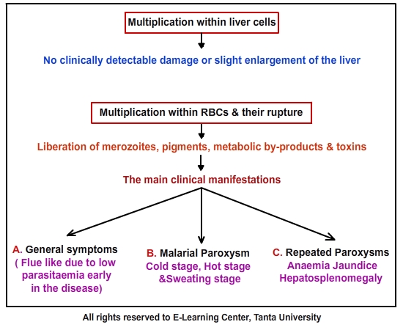
Pathogenesis

Slide 12
Clinical pictures
1) General symptoms in all types of malaria
A- Prodromal symptoms
(Low parasitemia and asynchronous RBCs rupture )
C - Repeated paroxysms
(Anemia, jaundice, hepatosplenomegaly)
B- Malarial paroxysm
Due to synchronous rupture of a large number of parasitized RBCs and liberation of merozoites with malarial pigment and toxin into the circulation.
Low grade fever, malaise, headache and pain in bone and joints.
Cold stage (1/2- one hour): Sensation of cold, shivering and the patient is feverish. The skin is pale and cyanotic.
Hot stage (1-4 hours): High fever (40 C° or more), hot dry skin, flushed face, headache and pain in limbs and back .
Sweating stage (1-4 hours): Profuse sweating with ↓ temperature, moist and coal skin).

Slide 13
N.B. The patient becomes normal and temperature is normal till the second paroxysm occurs. Malaria paroxysms occur for at least 2 weeks or more with decreasing intensity then stop.
The attacks recur at the following interval
In benign tertian malaria
(P. vivax&p. ovale)
In benign quartan malaria
(P. malariae)
In malignant malaria
(P. falciparum)
The attack is repeated every 3 days
The attack is repeated every 4 days
The attack is irregular

Slide 14
2) Specific symptoms
Cerebral malaria: headache, high fever, convulsion, paralysis, coma and death.
Algid malaria :shock, collapse , sudden  in blood pressure due to adrenal insufficiency
Gastrointestinal malaria: diarrhoea or dysentery with bloody loose stool  malabsorption and dehydration
Congenital malaria  abortion.
In P. malariae
In P. falciparum
Antigen antibody complex is deposited in the kidney glomeruli  nephrotic syndrome with the occurrence of edema and protein and cast in urine.
Adhesion phenomena (pernicious syndrome) occurs in infected RBCs containing trophozoites and schizonts. RBCs clump together and stick to the endothelium of the blood vessels  vascular obstruction of small blood vessels of internal organs  tissue anoxia of organs including brain, kidney, GIT, heart, lung, liver and adrenal
Black water fever
Acute intravascular haemolysis of infected RBCs severe anaemia, fever, jaundice, haemoglobinuria (dark red urine) and acute renal failure due to inadequate quinine treatment.

Slide 15
Why Plasmodium falciparum causes malignant malaria and is more dangerous ???????????
Differences between malarial relapse and recrudescence ?????

Slide 16
Laboratory Diagnosis
Direct
Indirect
Microscopic: Thin and thick blood films stained with Giemsa and Leishman reveal different stages (rings, trophozoites, schizonts and gametocytes) in all types of malaria except in P. falciparum only rings and gametocytes are seen in the peripheral blood (due to adhesion phenomena).
1-Serological tests: CFT, IHT, ELISA, FAT, or rapid strip or dip stick test to detect circulating antigens using monoclonal antibodies.
2-Molecular diagnosis: by PCR.

Slide 17
Treatment
Tissue schizonticide and hypnozoiticides
Blood schizonticides
Treatment of complications
Chemoprophylaxis
Blood transfusion in severe anaemia.
Haemodialysis in renal failure.
Weekly mefloquine
Daily doxycycline
Primaquine
Chloroquine-sensitive
Chloroquine-resistant
It is also gametocidal
Chloroquine
Fansidar: Pyrimethamine &sulphadoxine
Artemisinin-based: Pyrimethamine/
sulphadoxine + artesunate
Mefloquine:
When and How long?????

Slide 18
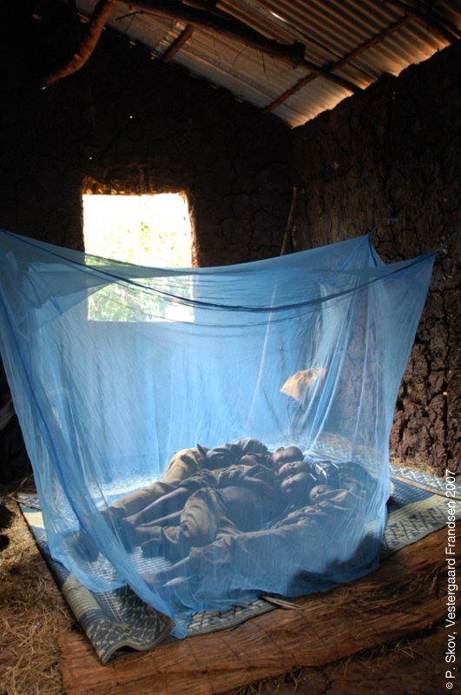
Malaria- Prevention
Key methods to prevent malaria transmission are:
Long lasting insecticide impregnated nets (LLINs)
Indoor residual spraying
Mosquito repellents
Preventative drug treatments

Slide 19
Babesia
Babesia species cause a disease known as babesiosis.
Causative organisms:
Babesia microti
Babesia divergens (commonly affects splenectomized- persons)
Habitat: RBCs.
D.H and vector of transmission: Hard tick
I.H: Cattle and rodents and occasionally man.

Slide 20
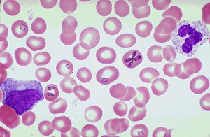
Differences between Babesia and Plasmodium
No hepatic stage.
Merozoites arranged in pairs or Maltese cross
No pigments
Vector is the hard tick

Slide 21
Mode of transmission:
1- Bite of hard tick (sporozoites)
2- Blood transmission (erythrocytic stages)
Pathogenesis & symptomatology
Disease : Babesiosis.
The parasite invades the RBCs where it multiplies by budding  the cell ruptures and the released parasites invade other cells leading to anaemia, jaundice, and hepatosplenomegaly.

Slide 22
Laboratory diagnosis
Direct
Indirect
Stained blood film by Giemsa or Leishman to detect the intraerythrocytic paraites.
Animal inoculation : blood sample is injected intraperitoneally in hamester, the parasites can be detected in animal blood after 2 weeks in positive cases.
Serological tests
PCR to detect Babesia DNA

Slide 23
Treatment
Quinine + clindamycin.
Exchange blood transfusion in severe cases

Slide 25
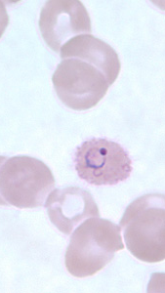
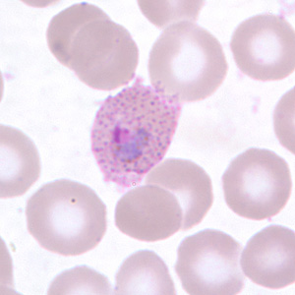
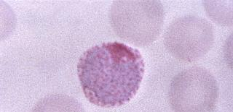
Guess the stage?

Slide 26
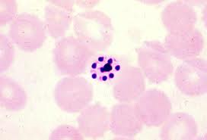
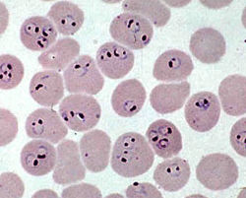
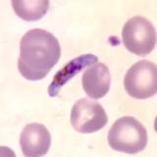
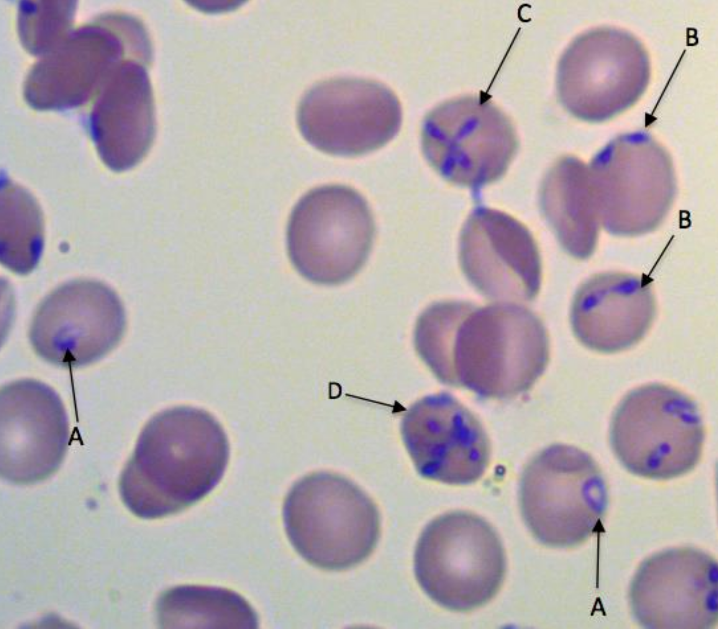
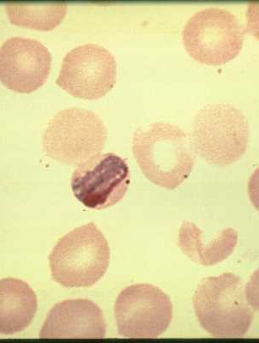
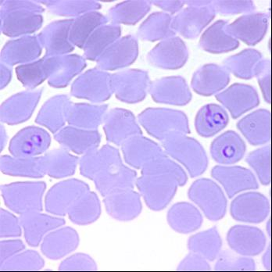
Guess what is this?

