Slide 1
First & Second Recurrent Pregnancy Loss & Cervical Incompetence
Crucial points that will direct you in this seminar: GA, hx
Supervised by : Dr. Malek Alqasem
Done by :
Ansam Alzubaidi
Rand Abuali
Hamza Aladaileh
Ahmad Almaaitah
التبييض

Slide 2
OUTLINE
Introduction
Epidemiology
Etiology and risk factors
Clinical approach

Slide 3
INTRODUCTION
Definition of miscarriage:
The termination of pregnancy before the age of viability (GA 24) or with fetal weight of <500 g.
*Ectopic and molar pregnancies should not be included in the definition.
Definition of recurrent pregnancy loss :
Two or more failed clinical pregnancies as documented by ultrasonography
or histopathologic examination
Incidence :5-15%
Two consecutive pregnancy losses : 2%
Three consecutive pregnancy losses : 0.4 – 1%

Slide 4
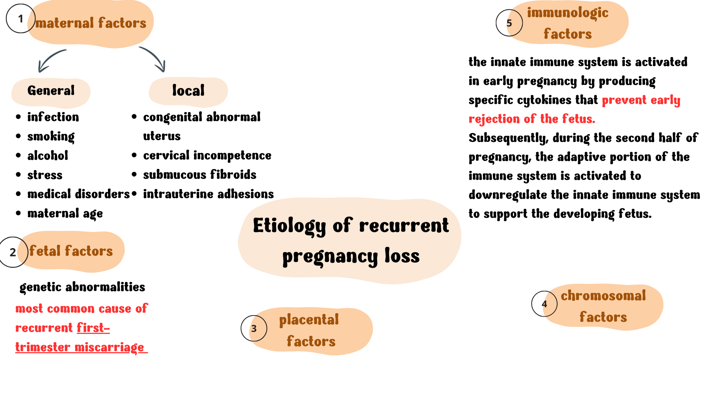
Blighted ovum.
Needs Karyotyping

Slide 5
Causes of first trimester recurrent pregnancy loss | Causes of second trimester recurrent pregnancy loss
Most common is genetics (structural chromosomal abnormalities) | Most common is anatomical (cervical insufficiency)
Immunologic factors | Immunologic factors
Thrombophilia and fibrinolytic factors | Thrombophilia and fibrinolytic factors
Endocrine factors | Endocrine factors
Environmental and chemical stress | Environmental and chemical stress
Anatomical | Genetics
Infections | Infections
Unexplained | Unexplained

Slide 6
RISK FACTORS
Previous pregnancy loss
Early gestational age
Smoking , alcohol , caffeine
BMI > 25
fever
prolonged time to pregnancy
celiac disease
low folate levels

Slide 7
GENETIC FACTORS
Abnormalities of chromosome number or structure are the most common cause of spontaneous abortions in first trimester.
Embryonic chromosomal abnormalities (most common is autosomal trisomy)
In couples with recurrent miscarriage, chromosomal abnormalities of the embryo account for 30–57% of further miscarriages.
The risk of miscarriage resulting from chromosomal abnormalities of the embryo increases with advancing maternal age.
However, it is important to note that as the number of miscarriages increases, the risk of euploid pregnancy loss increases .
Parental Chromosomal rearrangements: more commonly maternal in origin 95% .
2-5% of couples with recurrent miscarriages, one of the partners carries a balanced structural chromosomal anomaly, most commonly a balanced reciprocal or Robertsonian translocation.

Slide 8
Endocrine Factors
Diabetes mellitus
Thyroid disease
PCOS
Luteal phase defect (LPD)
Hyperprolactinemia
A.
B.
C.
D.
E.

Slide 9
A. Diabetes Mellitus
Women with diabetes who have high haemoglobin A1c levels in the first trimester are at risk of miscarriage and fetal congenital anomalies.
However, well-controlled diabetes mellitus is not a risk factor for recurrent miscarriage
The most important point is preconception counseling and early screening & preparation to achieve controlled DM (HbA1c<6)
If HbA1c is > 6 , advice her NOT to become pregnant as if she get pregnant , the risk of congenital anomalies is increased .

Slide 10
B. Thyroid Disorders
No direct evidence suggests that thyroid disease is associated with recurrent miscarriages but some studies have correlated to Anti-thyroid antibodies and recurrent miscarriage.
If a patient already have
hyperthyroidism (graves) 🡪 Treatment during pregnancy should be drug therapy, aiming to maintain maternal fT3 and fT4 levels in the high/normal range
hypothyroidism (hashimito thyroiditis) 🡪 continue thyroid replacement therapy during pregnancy and biochemical euthyroidism is the aim (TSH <4 mmol/l)
* because metabolic demands increase in pregnancy, thyroid-stimulating hormone (TSH) and FT4 levels are commonly followed every 6 to 8 weeks.

Slide 11
C. PCOS
Hypersecretion of LH thought to cause pregnancy loss because low levels of estrogen and progesterone .
The miscarriage rate in PCOS is 20 to 40 %
An elevated free androgen index appears to be a prognostic factor for a subsequent miscarriage in women with recurrent miscarriage
Investigations:
hormonal assay, LH:FSH ratio (1.5 :1 normally , in pcos 3:1 ), U\S
Diagnosis :-
Clinically (criteria), Hormones result, U/S findings (2 out of 3 is diagnostic)
Treatment :
insulin sensitizing agents ( metformin in 1st TM ) , ovulation induction and IVF

Slide 12
D. LUTEAL PHASE DEFECT
Is a defective corpus luteum with insufficient progesterone production leading to inadequate endometrial maturation.
23-60% of recurrent miscarriage cases
Investigations :
Serum progesterone level at day 21.(not predictive of pregnancy outcome)
Endometrial biopsy ( in the past )
Basal body temperature
No Evidence for Treatment by progesterone
The only indication to give progesterone in 1st trimester is IVF .

Slide 13
E. HYPERPROLACTINEMIA
Excess prolactin level 🡪 inhibits GnRH release 🡪 abnormal FSH and LH secretions 🡪 decrease estrogen 🡪 amenorrhea & galactorrhea,
Causes :
Physiologically during pregnancy and lactation but not very high
Primary hypothyroidism ( TRH increases )
Drugs : dopamine antagonists
Pituitary adenoma
Investigation: Prolactin level , MRI
Normal circulating levels of prolactin may play an important role in maintaining early pregnancy.
Management :- Bromocriptene (dopamine agonist) to lower prolactin levels may lead to a higher successful rate of pregnancy (86%) compared to non corrected cases (52%)

Slide 14
ANATOMICAL FACTORS
Congenital uterine malformations
Leiomyomas
Cervical insufficiency
Intrauterine adhesions
Fixed retroverted retroflexed uterus (RVF)
Endometrial polyps

Slide 15
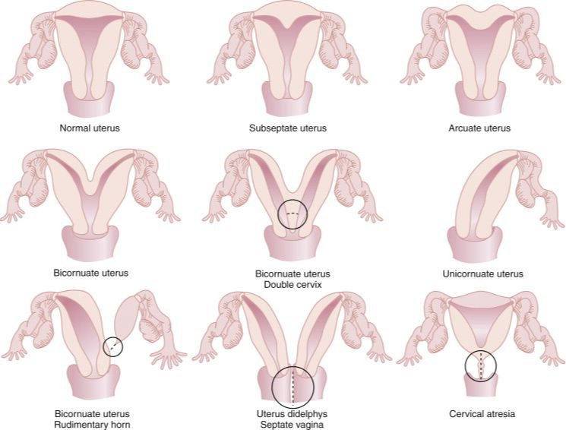
A. UTERINE ANOMALIES

Slide 16
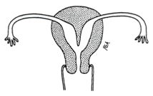
Septate uterus
One external surface with two endometrial cavities
Due to partial or complete defect in canalization or resorption of the midline septum between the two müllerian ducts.
The most common uterine anomaly, and carries the poorest outcomes of uterine anomalies in women with RPL
Mainly associated with 2nd trimester miscarriages
Proposed mechanism: Poor blood supply to the septum interferes with implantation.
Imaging: HSG, U/S or hysteroscopy
Treatment: Surgical repair (hyesteroscopic metroplasty)
Associated with cervical weakness, so: elective cerclage in week 12

Slide 17
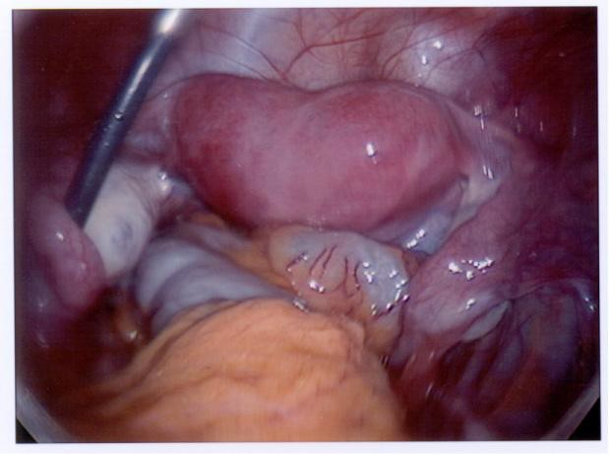
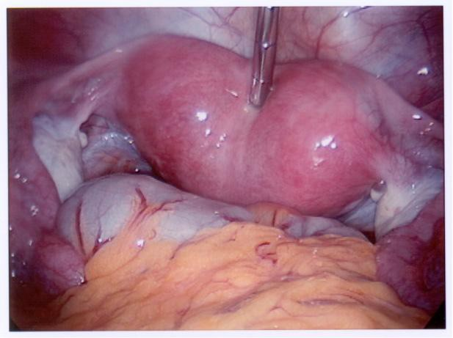

Slide 18
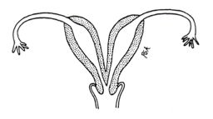
Bicornuate uterus
Commonly referred to as heart shaped uterus; where two horns form at the upper part of the uterus because
of partial fusion of the müllerian ducts.
Associated with RPL, preterm labor and malpresentation.
Investigations:
HSG and U/S are the best screening tools for uterine anomalies.
MRI is the best noninvasive method to diagnose uterine anomalies. Laparoscopy is the gold standard.
20-30% of patients with uterine anomalies have associated renal anomalies. Do a renal U/S.
Treatment: Uterine reunification by laparotomy (not recommended anymore, because it ends with lots of complications like adhesions, ectopic pregnancy and early pregnancy ruptured uterus).

Slide 19
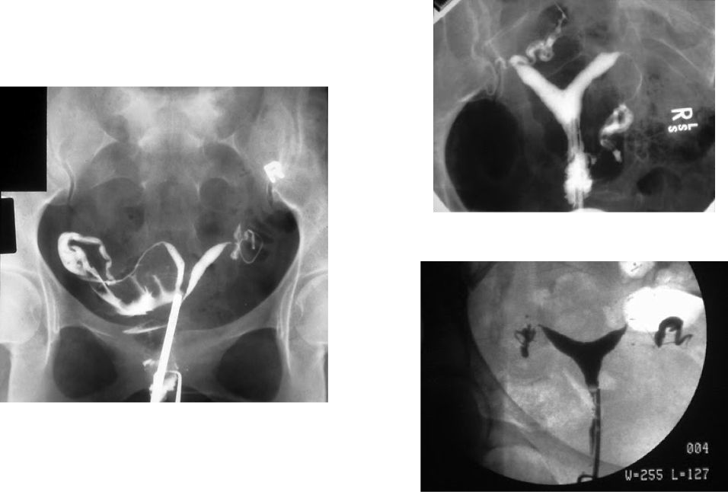

Slide 20
B. LEIOMYOMAS
Submucosal fibroids interfere with implantation due to their position, defective endometrial receptivity overlying the fibroid or degeneration with increased cytokine production.
Their rapid growth caused by the hormones of pregnancy and the lack of space of the developing fetus are also causes for recurrent miscarriage.
Investigations: Transvaginal US, hysteroscopy or HSG
Treatment:
Hysteroscopic or abdominal myomectomy
In women planning for pregnancy, myomectomy to decrease pregnancy complications is not recommended.
In women with history of RPL or infertility, myomectomy is recommended for submucosal fibroids..

Slide 21
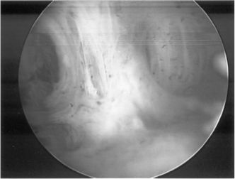
D. INTRAUTERINE ADHESIONS
aka Asherman’s syndrome
Mainly due to excessive curettage, which traumatizes the basalis layer, which heals by granulation tissue formation. Opposing granulation tissues bridge forming adhesions or dense connective tissue, essentially obliterating the uterine cavity
Associated symptoms: menstrual irregularity, secondary dysmenorrhea, infertility, secondary amenorrhea or oligomenorrhea, recurrent miscarriage.
Investigations: HSG, hysteroscopy
Treatment: Hysteroscopic lysis of adhesions
How to prevent recurrence?
Post-op estrogen
Post-op intrauterine Foley’s (for 10 days) or IUD (for 3 months).

Slide 22
INFECTIONS
Any severe infection that leads to bacteremia or viremia can cause sporadic miscarriage.
Bacterial vaginosis in the first trimester is a risk factor for second trimester miscarriage and preterm delivery.
This can be significantly reduced by early treatment with oral clindamycin.
Screening at 16 weeks GA if there is vaginal discharge
Some infections, such as Listeria monocytogenes, Toxoplasma gondii, cytomegalovirus, and primary genital herpes, are known to cause sporadic pregnancy loss, but no infectious agent has been proven to cause RPL.

Slide 23
2. THROMBOPHILIAS
Case 1: pt. come to the clinic with visible gestational sac and fetal pulsation, then in the next visit no gestational sac. Pt. Says its not the first time (recurrent) → Thrombophilia
Case 2: pregnant woman comes to the clinic at 15 week, US shows fetal death (bony parts detected)→ Thrombophilia
Two types:
Acquired thrombophilia (Antiphospholipid Syndrome )
Inherited thrombophilia
ممكن يصير مع المريضة بعمر متقدم بحيث يكون عندها أكثر من ولد وبعدين بلشت معها مشكلة الاجهاضات المتكررة
Secondary thrombophilia

Slide 24
A.ANTIPHOSPHOLIPID SYNDROME (APS)
Don’t forget to ask about FHx esp. in primigravida
5-15% of women with RPL may have APS.
Pregnancy morbidity in APS is defined as
Otherwise unexplained fetal death at ≥10 weeks gestation of a morphologically normal fetus, or
One or more premature births before 34 weeks of gestation because of eclampsia, preeclampsia, or placental insufficiency, or
Three or more embryonic (<10 week gestation) pregnancy losses unexplained by maternal or paternal chromosomal abnormalities or by maternal anatomic or hormonal causes

Slide 25
According to the revised Sapporo criteria, definite APS is considered if at least one of the following clinical criteria and at least one of the following laboratory criteria are satisfied:
Clinical — The presence of either vascular thrombosis or pregnancy morbidity
Thrombophilia highly suspected in:
1- Fetal death at term
2- Early preterm preeclampsia
3- Early HELLP
4- DVT/PE in pregnancy
5- Recurrent miscarriage
6- Fetal death at term

Slide 26
Laboratory — The presence of aPL, on two or more occasions at least 12 weeks apart and no more than five years prior to clinical manifestations, as demonstrated by one or more of the following
:
IgG and/or IgM aCL( Anticardiolipin Ab) in moderate or high titer
Antibodies to ß2-glycoprotein I (anti-β2GPI) of IgG or IgM isotype at a titer >99th percentile for the testing laboratory when tested according to recommended procedures
Lupus anticoagulant (LA) activity detected according to published guidelines
►
►
►

Slide 27
APS causes pregnancy morbidity by:
Affecting trophoblastic function and differentiation
Activating complement pathways at the maternal-fetal interface
Thrombosis of uteroplacental vasculature.

Slide 28
MANAGEMENT
Ladies meeting criteria: LMWH(when fetal heart is detected) + low-dose aminosalicylic acid(when pregnancy is diagnosed)
Ladies not meeting criteria: low-dose ASA
(Stop both at term. If scheduled delivery, stop ASA 7-10 days before, LMWH at least 24 hours before.)
Steroids have shown conflicting results in preventing adverse pregnancy outcomes in APS. In addition, it increases risk of PROM, preterm delivery, IUGR, PET, GDM, infections, maternal osteopenia.
Peripartum: stop heparin and ASA
Postpartum: lifelong warfarin should be resumed in ladies with history of vascular thrombosis.

Slide 29
B.INHERITED THROMBOPHILIAS
Factor V Leiden mutation, Prothrombin gene mutation, Protein C/S deficiency, Antithrombin III deficiency, and others.
May be associated with late pregnancy loss
Screening based on : 1.personal history of VTE associated w/ other non-recurrent risk factors AND 2.asymptomatic women (no prior VTE) planning a pregnancy who have a first degree relative with VTE before age 50 or a history of a high-risk thrombophilia.
In the absence of an obstetrical complication such as preeclampsia, abruption, or fetal growth restriction, do weekly assessments with nonstress tests beginning at ≥36 weeks of gestation and delivery at 39 weeks of gestation

Slide 30
CERVICAL INSUFFICIENCY
Case: pregnant women in the second trimester lost her healthy alive baby while she was shopping→ Cervical insufficiency
PAINLESS 2ND TRIMESTER MISCARRIAGE
i.e open internal os
Inability of the uterine cervix to retain a pregnancy in the absence of the signs and symptoms of clinical contractions, or labor, or both in the second trimester
The ultrasonographic finding of a short cervical length in the second trimester is associated with an increased risk of preterm birth but is not sufficient for the diagnosis of cervical insufficiency
What is the most common cause of healthy baby miscarriage in the 2nd tri.?
Your next Q will be is the cervix open or close?
If open→ cervical incompetence/ If closed→ thrombophilia

Slide 31
PATHOPHYSIOLOGY
Factors that may increase the risk of cervical insufficiency include
1-surgical trauma to the cervix from conization
2-loop electrosurgical excision procedures
3-mechanical dilation of the cervix during pregnancy termination
4-obstetric lacerations
Congenital:
müllerian anomalies, deficiencies in cervical collagen and elastin, and in utero exposure to diethylstilbestrol

Slide 32
DIAGNOSIS
Diagnosis is based on a history of painless cervical dilation after the first trimester with subsequent expulsion of the pregnancy in the second trimester, typically before 24 weeks of gestation, without contractions or labor and in the absence of other clear pathology (eg, bleeding, infection, ruptured membranes)
Advanced cervical dilation and effacement before 24 weeks of pregnancy without painful contractions, vaginal bleeding, ruptured membrane.

Slide 33
Assessment of cervical length in the second trimester and the identification of cervical shortening as an ultrasonographic diagnostic marker of cervical insufficiency less than 25 mm

Slide 34
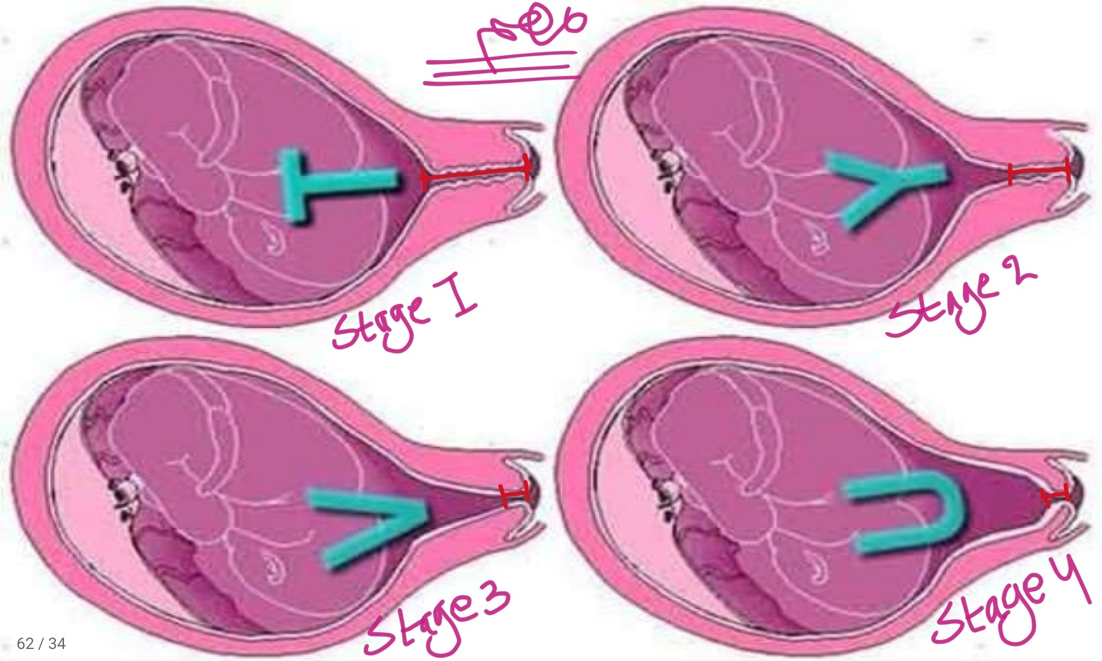
STAGES OF CERVICAL INCOMPETENCE

Slide 35
See the next slide
Once you detect the sludge, treat with antibiotics

Slide 36
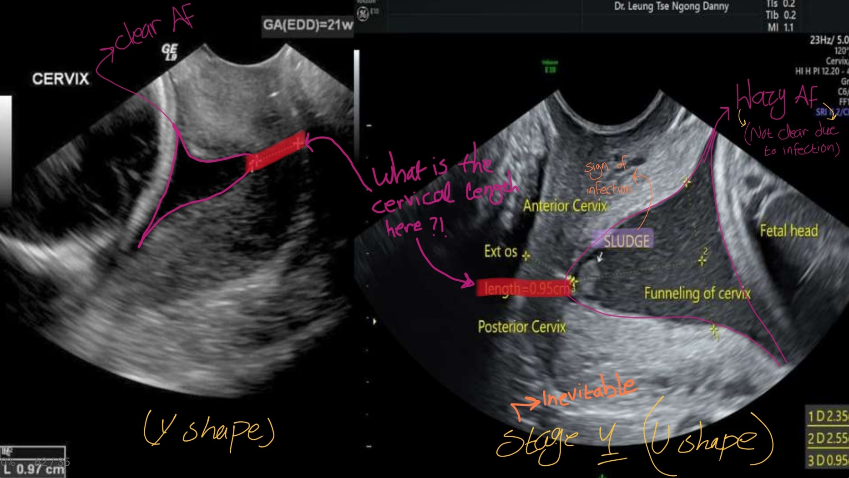

Slide 37
Various diagnostic tests in the nonpregnant woman have been suggested to confirm the presence of cervical insufficiency
Hysterosalpingography and radiographic imaging of balloon traction on the cervix
Assessment of the patulous cervix with Hegar or Pratt dilators
The use of a balloon elastance test, and use of graduated cervical dilators to calculate a cervical resistance index

Slide 38
INDICATIONS FOR CERVICAL CERCLAGE
Its not an indication for CS
The mode of delivery depend on the obstetric indications
How to know your stitch was truly indicated?
When you remove it (at term) the baby will be delivered immediately
History
History of one or more second-trimester pregnancy losses related to painless cervical dilation and in the absence of labor or abruptio placentae
Prior cerclage due to painless cervical dilation in the second trimester
History indicated cerclages typically are placed at approximately 13–14 weeks of gestation.
Physical Examination
Painless cervical dilation in the second trimester
cervical dilation in the absence of labor and abruptio placentae have historically been candidates for examination-indicated cerclage (known as emergency or rescue cerclage).
Ultrasonographic Finding With a History of Prior Preterm Birth
Current singleton pregnancy, prior spontaneous preterm birth at less than 34 weeks of gestation, and short cervical length (less than 25 mm) before 24 weeks of gestation

Slide 39
CERVICAL CERCLAGE
Classifications :
Elective – history based cervical incompetence
Emergency – U/S based cervical incompetence
Two approaches :
1) Transvaginal 2) Transabdominal

Slide 40
AIM OF CERCLAGE :
1) to strengthen the cervix
2) to prevent herniation of membranes through the cervix.

Slide 41
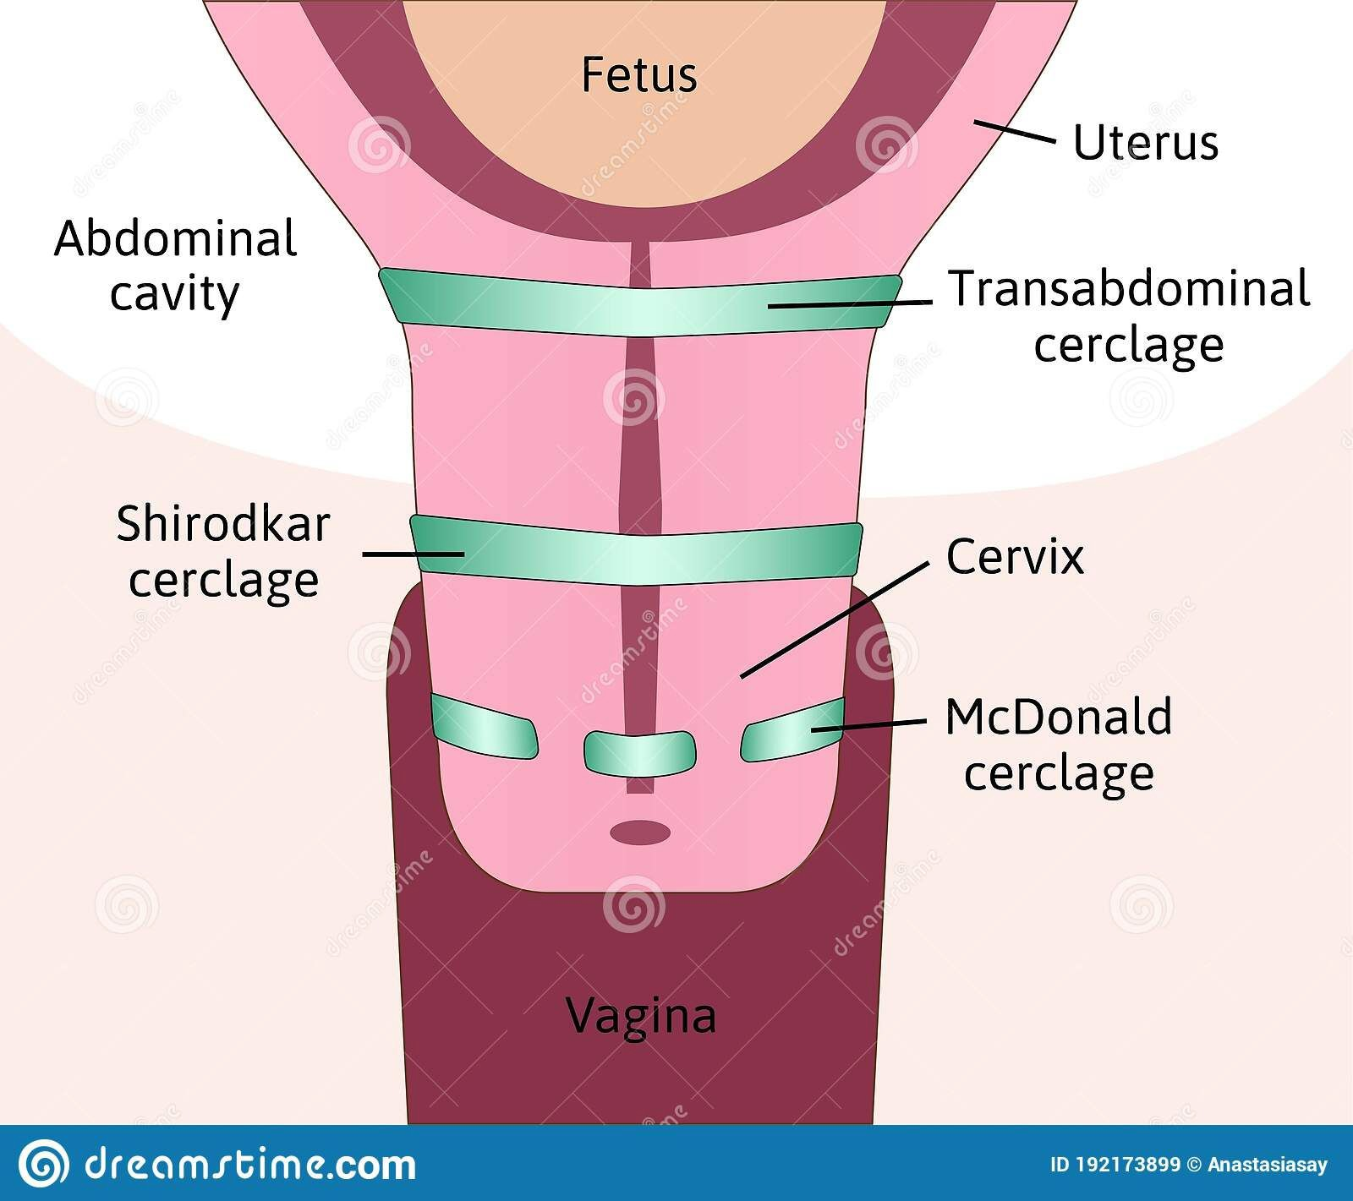
CERCLAGE OPERATION
Shirodkar operation- opening the anterior fornix and dissecting away the adjacent bladder before placing the suture submucosaly, tied interiorly and the knot buried by suturing the anterior fornix mucosal opening
Mac Donald technique- requires no bladder dissection and the cervix is closed by purse string sutures around the cervix

Slide 42
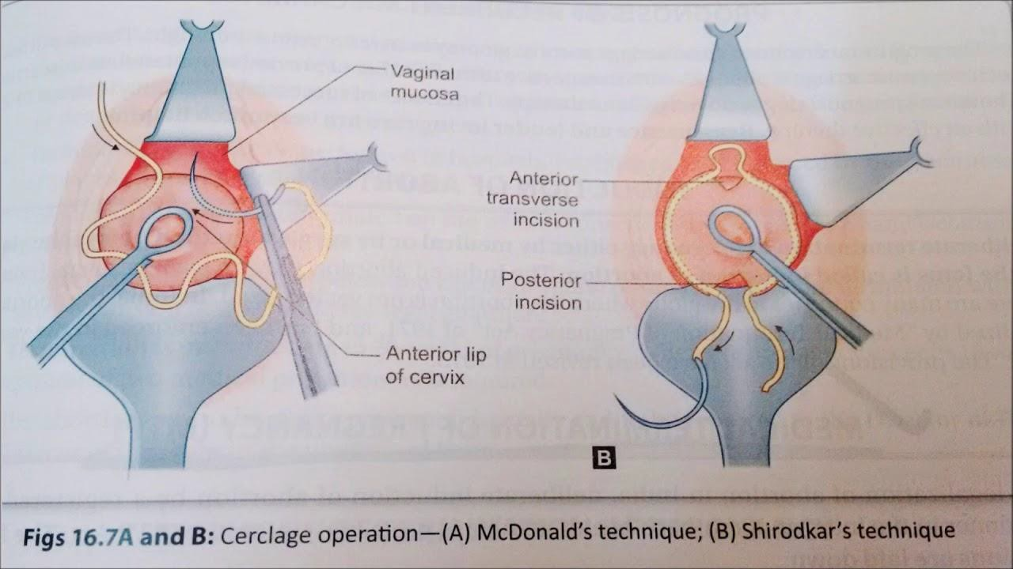

Slide 43
CIRCLAGE OPERATION
Principle-
A non absorbable encircling suture ( Nylon or Mersilene) is placed around the cervix at the level of internal os
Operates by interfering with the uterine polarity and the adjacent lower segment from being taken up.
Timing of operation
Elective cerclage-In proven cases around 14 weeks or at least 2 weeks earlier than the lowest period of previous wastage as early as 10th week.
Emergency cerclage- when the cervix is dilated and the membranes are bulging.(U/S)

Slide 44
CONTRAINDICATIONS FOR CERCLAGE
Intrauterine infections
Ruptured membranes
History of vaginal bleeding
Severe uterine irritability
Cervical dilatation >4 cm

Slide 45
COMPLICATIONS
Slipping or cutting through the suture
Bladder injury.
Chorioamniotis (it’s a foreign body)
Rupture of the membrane
Abortion /Preterm labour

Slide 46
POST OPERATIVE ADVICE
Bed rest
Tocolysis
To avoid intercourse
Report in case of leaking, bleeding, and pain
Stitch should be removed at 36 weeks or earlier when the labour starts

Slide 47
APPROACH TO RECURRENT MISCARRIAGE
History
Physical Examination
Investigations.

Slide 48
APPROACH TO RECURRENT MISCARRIAGE
History:
Patient profile:
Maternal and Paternal age.
Ethnicity
Occupation
Gravidity and Parity of the patient.
Detailed history about the previous miscarriages:
Number
Gestational Age
Diagnoses
Ultrasound scan finding or any other Investigations (if any is done)
Management

Slide 49
APPROACH TO RECURRENT MISCARRIAGE
History:
Details about all the previous live births (If any):
Gestational age
Complications during pregnancy and delivery
Mode of delivery
Weight of the baby
Current condition of the baby
Gynecological history:
Complete menstrual history
Cervical smear history
Contraceptive history
History of previous pelvic inflammatory disease
History of any infertility treatment

Slide 50
History:
The medical history:
Autoimmune diseases
Arthritis
Uncontrolled diabetes
Thyroid dysfunction
Vascular thrombosis
Skin disorders
The drug history:
Any regular medicine taken
History of drug allergy
The use of folic acid, advice daily intake of 400 microgram if the patient is trying for a pregnancy
The surgical history:
Previous abdominal surgery
Cervical surgery or uterine surgery
D&C
APPROACH TO RECURRENT MISCARRIAGE

Slide 51
APPROACH TO RECURRENT MISCARRIAGE
□ The family history
History regarding the medical conditions previously mentioned
Consanguinity
History of congenital abnormalities, recurrent miscarriage or pregnancy complications
□ The social history
Smoking
Alcohol intake
Caffeine consumption

Slide 52
APPROACH TO RECURRENT MISCARRIAGE
Physical Examination:
General examination
Abdominal examination
Pelvic examination
Speculum examination
Bimanual examination

Slide 53
GENETIC CAUSES:
Investigations:
Karyotyping:
Cytogenetic analysis should be performed on products of conception of the third and subsequent consecutive miscarriage(s). In addition to CGH array.
Parental peripheral blood karyotyping of both partners should be performed in couples with recurrent miscarriage where testing of products of conception reports an unbalanced structural chromosomal abnormality.

Slide 54
MANAGEMENT
The finding of an abnormal parental karyotype should prompt referral to a clinical geneticist.
Genetic counseling offers the couple a prognosis for the risk of future pregnancies with an unbalanced chromosome complement and the opportunity for familial chromosome studies.
Reproductive options in couples with chromosomal rearrangements include proceeding to a further natural pregnancy with or without a prenatal diagnosis test, gamete donation and adoption.
Pre-implantation genetic screening with in vitro fertilization treatment in women with unexplained recurrent miscarriage does not improve live birth rates.

Slide 55
ANATOMICAL CAUSES:
Investigations:
Anatomical factors
All women with recurrent first-trimester miscarriage and all women with one or more second-trimester miscarriages should have a pelvic ultrasound to assess uterine anatomy.
Suspected uterine anomalies may require further investigations to confirm the diagnosis, using hysterosalpingography (HSG) , sonohysterography hysteroscopy, laparoscopy or
three-dimensional pelvic ultrasound.

Slide 56
MANAGEMENT
Congenital uterine malformations
There is insufficient evidence to assess the effect of uterine septum resection in women with recurrent miscarriage and uterine septum to prevent further miscarriage.
Cervical weakness and cervical cerclage
Cervical cerclage is associated with potential hazards related to the surgery and the risk of stimulating uterine contractions and hence should be considered only in women who are likely to benefit.
In women with a singleton pregnancy and a history of one second-trimester miscarriage attributable to cervical factors , an ultrasound-indicated cerclage should be offered if a cervical length of 25mm or less is detected by transvaginal scan before 24 weeks of gestation.
Women with a history of second-trimester miscarriage and suspected cervical weakness who have not undergone a history-indicated cerclage may be offered serial cervical sonographic surveillance

Slide 57
ANTIPHOSPHOLIPID SYNDROME:
investigations:
Antiphospholipid antibodies:
All women with recurrent first-trimester miscarriage and all women with one or more second-trimester miscarriage (missed type) should be screened before pregnancy for antiphospholipid antibodies.
To diagnose antiphospholipid syndrome it is mandatory that the woman has two positive tests at least 12 weeks apart for either lupus anticoagulant or anticardiolipin antibodies of IgG/IgM class present in a medium or high titre over 40 g/l or ml/l, or above the 99th percentile.
The detection of antiphospholipid antibodies is subject to considerable inter-laboratory variation. This is a result of temporal fluctuation of antiphospholipid antibody titres in individual women, transient positivity secondary to infections, suboptimal sample collection and preparation and lack of standardisation of laboratory tests for their detection.

Slide 58
MANAGEMENT
Pregnant women with antiphospholipid syndrome should be considered for treatment with low-dose aspirin plus heparin to prevent further miscarriage.
Low-molecular-weight heparin is as safe as unfractionated heparin and has potential advantages during pregnancy, since it causes less heparin-induced thrombocytopenia, can be administered once daily and is associated with a lower risk of heparin-induced osteoporosis.
Neither corticosteroids nor intravenous immunoglobulin therapy improve the live birth rate of women with recurrent miscarriage associated with antiphospholipid antibodies compared with other treatment modalities; their use may provoke significant maternal and fetal morbidity.

Slide 59
ENDOCRINE CAUSES :
Management:
There is insufficient evidence to evaluate the effect of progesterone supplementation in pregnancy to prevent a miscarriage in women with recurrent miscarriage. (IVF ?)
There is insufficient evidence to evaluate the effect of hCG supplementation in pregnancy to prevent a miscarriage in women with recurrent miscarriage. (IVF ?)
There is insufficient evidence to evaluate the effect of metformin supplementation in pregnancy to prevent a miscarriage in women with recurrent miscarriage. (diabetic patient ?)
Suppression of high luteinising hormone levels among ovulatory women with recurrent miscarriage and polycystic ovaries does not improve the live birth rate
Management of high prolactin level esp in early pregnancy.

Slide 60
INHERITED THROMBOPHILIAS:
Investigations:
Women with second-trimester miscarriage should be screened for inherited thrombophilias including factor V Leiden, factor II (prothrombin) gene mutation and protein S.

Slide 61
MANAGEMENT
Heparin therapy (LMWH) during pregnancy may improve the live birth rate of women with second-trimester miscarriage associated with inherited thrombophilias.
There is insufficient evidence to evaluate the effect of heparin in pregnancy to prevent a miscarriage in women with recurrent first-trimester miscarriage associated with inherited thrombophilia

Slide 62
UNEXPLAINED RECURRENT MISCARRIAGE
A significant number of cases of recurrent miscarriage remain unexplained despite detailed investigation.
These women can be reassured that the prognosis for a successful future pregnancy with supportive care alone is in the region of 75%.
Paternal cell immunisation, third-party donor leucocytes, trophoblast membranes and intravenous immunoglobulin in women with previous unexplained recurrent miscarriage does not improve the live birth rate.

Slide 63
THANK YOU

