Slide 1
Ischemic Heart Disease
Ghadeer Hayel, MD
26/11/2020

Slide 2
Ischemic Heart Disease (IHD)
Ischemic heart disease (IHD) is a broad term encompassing several closely related syndromes caused by myocardial ischemia.
Myocardial ischemia: an imbalance between myocardial blood supply (perfusion) and cardiac demand for oxygenated blood. Which also reduces nutritional supply and waste removal.

Slide 3
Ischemic Heart Disease (IHD)
In 90% of cases, IHD is a consequence of reduced coronary blood flow secondary to obstructive atherosclerotic vascular disease
So IHD usually is synonymous with coronary artery disease (CAD).
Other 10% : increased demand, diminished blood volume, diminished oxygenation, or diminished oxygen-carrying capacity.
Mostly IHD are consequences of coronary atherosclerosis that has been gradually progressing for decades silently.

Slide 4
Cardiac syndromes:
IHD manifestations/ clinical presentations are a direct consequence of insufficient blood supply to the heart:
Angina pectoris.
Myocardial infarction (MI).
Chronic IHD with CHF.
Sudden cardiac death (SCD).
Acute coronary syndrome: any of the three catastrophic manifestations; unstable angina, MI, & SCD.

Slide 5
Epidemiology :
IHD is the leading cause of morbidity & mortality worldwide
Since peaking in 1963, the mortality of IHD in US has declined by 50%?:
Interventions to diminished risk factors (atherosclerosis risk factors): smoking cessation programs, hypertension & diabetes treatment, & cholesterol lowering agents.
To a lesser extent, diagnostic & therapeutic advances; aspirin prophylaxis, better arrhythmia control, CCUs, thrombolysis for MI, angioplasty & endovascular stenting, & CABG surgery.
Maintaining this downward is challenging; longevity of “baby boomers,” & the epidemic of obesity.

Slide 6
Pathogenesis
The dominant cause of IHD is inadequate coronary perfusion relative to myocardial demand→ the majority as a consequence of a preexisting (“fixed”) atherosclerotic occlusion of the coronary arteries & new, superimposed thrombosis and/or vasospasm.
Fixed obstructions <70% of a vessel lumen: typically asymptomatic, even with exertion.
Occlude > 70% of a vessel lumen “critical stenosis”, generally symptomatic with exertion.
Occludes > 90% of a vascular lumen: Symptoms even at rest

Slide 7
Pathogenesis - Collateral perfusion
IF an atherosclerotic lesion occludes a coronary artery at a sufficiently slow rate over years, other vessels undergo remodeling & provide compensatory blood flow to the area at risk → collateral perfusion can subsequently protect against MI.
With acute coronary blockage, there is no time for collateral flow to develop and infarction results.

Slide 8
Acute Plaque Change
In most patients, unstable angina, infarction, & sudden cardiac death occur because of abrupt plaque change followed by thrombosis—hence the term acute coronary syndrome.
Rupture, erosions, fissuring, or ulceration of plaques expose highly thrombogenic constituents or underlying subendothelial basement membrane → rapid thrombosis.
Also hemorrhage into the core of plaques can expand its volume → acutely exacerbating the luminal occlusion.

Slide 9
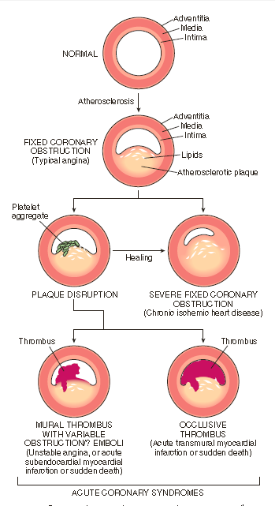

Slide 10
Angina Pectoris
An intermittent/recurrent (15sec-15min) crushing substernal chest pain (often radiates down the left arm or to the left jaw (referred pain)) caused by transient, reversible myocardial ischemia, that is insufficient to induce myocyte necrosis.
Ischemia-induced release of adenosine, bradykinin, & other molecules that stimulate autonomic nerves → causes PAIN.

Slide 11
Angina Pectoris - variants
Typical/stable angina: is predictable episodic chest pain ass./w particular levels of exertion or increased demand (e.g.,hypertension, tachycardia).
The most common form.
The pain usually is relieved by rest (reducing demand) or by drugs such as nitroglycerin (a vasodilator) → ↑ coronary perfusion.
Critical stenosis of one or more coronary artery (75% or more of lumen.)

Slide 12
Angina Pectoris - variants
Prinzmetal/Variant angina: occurs at rest & is caused by coronary artery spasm.
Spasms could occur on or near existing atherosclerotic plaques, but a completely normal vessel can be affected.
Responds promptly to vasodilators such as nitroglycerin & calcium channel blockers.
Uncommon.

Slide 13
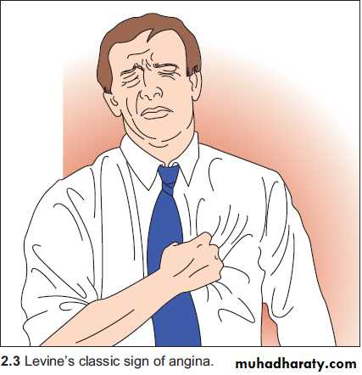
Angina Pectoris - variants
Unstable angina/Crescendo angina: characterized by chest pain that is increasing in frequency, severity, or time, & precipitated by progressively less exertion or even occurring at rest.
Ass./w plaque disruption & superimposed thrombosis, distal embolization of the thrombus, and/or vasospasm.
May be a forerunner of MI, portending complete vascular occlusion.

Slide 14
Myocardial Infarction
Called “heart attack,” .. necrosis of the heart muscle resulting from prolonged severe ischemia

Slide 15
Myocardial Infarction
The frequency rises progressively with aging & with increasing risk factors for atherosclerosis.
But approximately 10% of MIs occur before 40 years of age.
Men are at greater risk than women, but the gap narrows with age; women are protected against MI during reproductive years, menopause (↓estrogen production) is ass./w exacerbation of CAD.. IHD is the most common cause of death in older adult women.

Slide 16
Pathogenesis – Sequence of events underlies most MIs
Atheromatous plaque undergoes an acute change: intraplaque hemorrhage, erosion or ulceration, or rupture or fissuring. (Destabilized of atherosclerotic plaque).
Exposed subendothelial collagen & necrotic plaque contents → platelets adhere → platelets activated→ release their contents→ form microthrombi.
Vasospasm: stimulated by mediators released from platelets.
Coagulation: activated by tissue factor, adding to the thrombus.
In minutes the thrombus can expand to completely occlude lumen.

Slide 17
MI - Patterns of Infarction
The location, size, and morphologic features of an acute myocardial infarct depend on multiple factors:
Size and distribution of the involved vessel
Rate of development and duration of the occlusion
Metabolic demands of the myocardium (affected, for example, by blood pressure and heart rate)
Extent of collateral supply

Slide 18
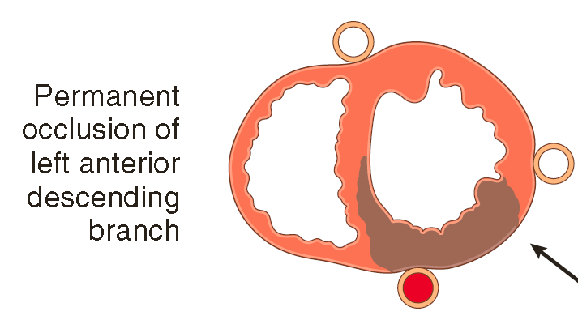
MI - Patterns of Infarction (distribution )
Acute occlusion of the proximal left anterior descending (LAD) artery causes 40%-50% of all MIs & typically results in infarction of anterior wall of left ventricle, anterior two thirds of ventricular septum, & most of the heart apex.

Slide 19
MI - Patterns of Infarction (size of vessel & collateral)
Transmural infarctions: involve the full thickness of the ventricle & are caused by epicardial vessel occlusion (without therapeutic intervention).
typically yield ST segment elevations on (ECG) .
Called ST-segment elevated MIs (STEMIs).

Slide 20
MI - Patterns of Infarction (size of vessel & collateral)
Subendocardial infarctions: limited to the inner third of myocardium.
No ST segment elevations on ECG “non–ST-segment elevated MIs”.
The most vulnerable region to hypoperfusion & hypoxia→ most distal to the epicardial vessels).
Causes 1. Transient decreases in oxygen delivery (hypotension, anemia, or pneumonia) or increases in oxygen demand (tachycardia or hypertension) can cause subendocardial ischemic injury in CAD w/o thrombus.
2. Or an occlusive thrombus lyses before a full-thickness infarction.

Slide 21
MI - Patterns of Infarction (size of vessel & collateral)

Slide 22
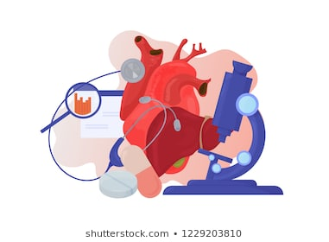
MORPHOLOGY

Slide 23
The gross and microscopic appearance of an MI depends on the age of the injury:
After 20-30 minutes: irreversible injury → cell death.
4 hours: only on E.M.: Sarcolemmal disruption; The earliest detectable feature of myocyte necrosis.
6-12 hours L.M.,: beginning of wavy fibers
12 to 24 hours grossly : an infarct usually can be identified by a red-blue discoloration caused by stagnated, trapped blood(dark mottling)

Slide 24
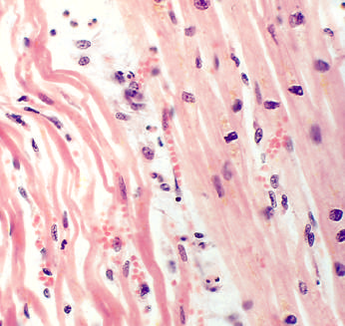

Slide 25
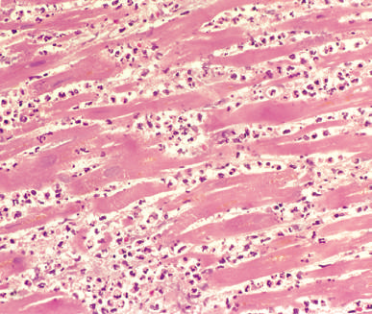
1–3 days:
yellow-tan infarct center Grossly,
& Coagulation necrosis with loss of nuclei and striations; interstitial infiltrate of neutrophils on L.M.

Slide 26
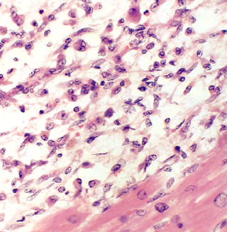
L.M.: Complete removal of necrotic myocytes by phagocytic macrophages (7 to 10 days).

Slide 27
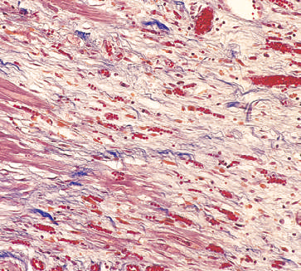
10-14 days: L.M.: well established granulation tissue with new blood vessels & collagen deposition.

Slide 28
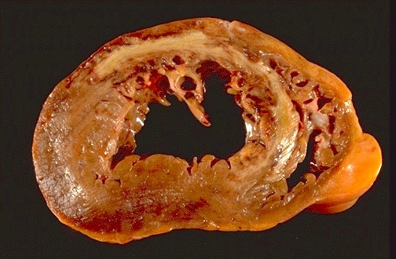
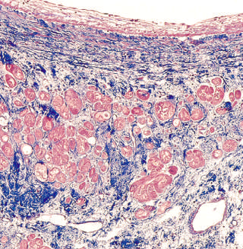
Within 2-8 weeks; Grossly gray white scar progressive from the periphery towards the center of the infarct.
Microscopically:
Healed MI (collagenous scar)

Slide 29
MI – Clinical features
Severe retrosternal pain radiate to the neck, jaw, epigastrium, or left arm.
Not relieved by rest or vasodilators, may persist for several hours (>20-30 min) .
Nausea, vomiting sweating & weakness may be accompanying symptoms.

Slide 30
MI – Clinical features
Electrocardiographic abnormalities are important for the diagnosis of MI; these include Q waves, ST segment changes, and T wave inversions (the latter two representing abnormalities in myocardial repolarization).
The laboratory evaluation of MI is based on measuring blood levels of macromolecules that leak out of injured myocardial cells through damaged cell membranes.
molecules include: myoglobin, cardiac troponins (higher specificity and sensitivity), creatine kinase (CK)

Slide 31
Consequences and Complications of MI
Arrhythmias. MIs lead to myocardial irritability & conduction disturbances → can cause sudden cardiac death.
The risk for serious arrhythmias (e.g., ventricular fibrillation) is greatest in the first hour & declines thereafter.
Mostly before reaching the hospital.
Contractile dysfunction. In general, MIs affect left ventricular pump function in proportion to the volume of damage.
Cardiogenic shock. has a nearly 70% mortality rate
it accounts for two thirds of in-hospital deaths in those patients admitted for MI

Slide 32
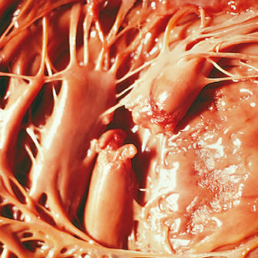
Consequences and Complications of MI
Papillary muscle dysfunction:
They rupture infrequently after MI..
but they often are dysfunctional & poorly contractile as a result of ischemia.

Slide 33
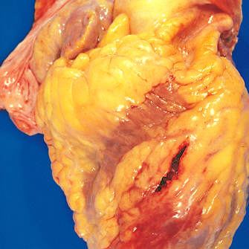
Consequences and Complications of MI
Myocardial rupture. 1-5% of MIs but is frequently fatal when it occurs.
Left ventricular free wall rupture is most common.
Rupture occurs most commonly in 3 to 7 days after infarction → healing process → lysis of necrotic myocardium is maximal & infarct has been converted to soft, friable granulation tissue.

Slide 34
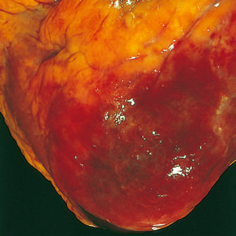
Consequences and Complications of MI
Pericarditis. Transmural MIs can elicit a fibrinohemorrhagic pericarditis.
Typically appears 2 to 3 days after infarction and then gradually resolves over the next few days

Slide 35
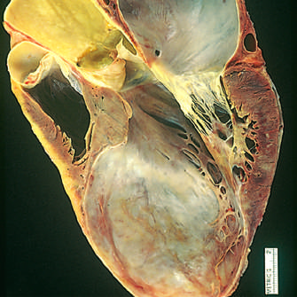
Consequences and Complications of MI
Ventricular aneurysm. A late complication, aneurysms of the ventricle most commonly result from a large transmural infarct that heals with the formation of a thinned wall of scar tissue, usually they do not rupture.

Slide 36
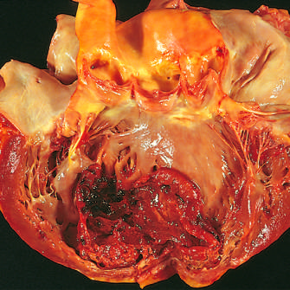
Consequences and Complications of MI
Mural thrombus. With any infarct, the combination of attenuated myocardial contractility (causing stasis), chamber dilation, & endocardial damage (causing a thrombogenic surface) can foster mural thrombosis eventually leading to left-sided thromboembolism.

Slide 37
Chronic Ischemic Heart Disease
Chronic IHD, also called ischemic cardiomyopathy, is a progressive heart failure secondary to ischemic myocardial damage.
Mostly there is a known clinical history of previous MI.
After prior infarction(s), chronic IHD appears when the compensatory mechanisms (e.g., hypertrophy) of residual myocardium begin to fail.

Slide 38
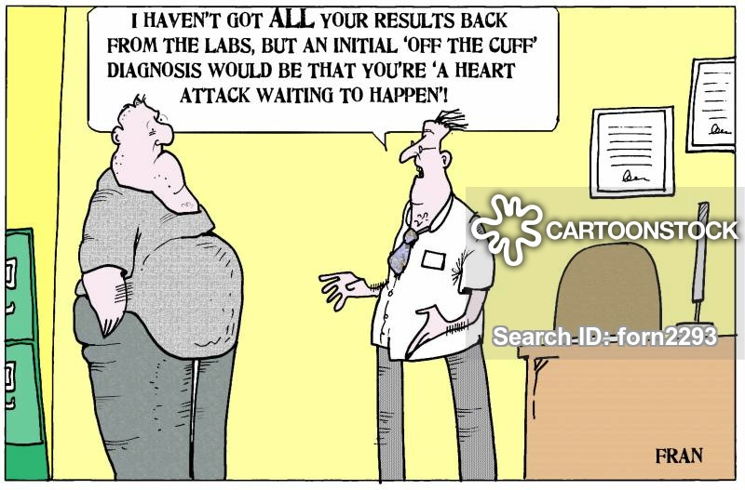
QUESTIONS?

