Slide 1
Asthma
Rami Almajali
(Dr Lina Slides)
19/12/2022

Slide 2
ASTHMA
Asthma is a heterogeneous disease, usually characterized by chronic airway inflammation.
It is defined by the history of respiratory symptoms such as wheeze, shortness of breath, chest tightness and cough that vary over time and in intensity, together with variable expiratory airflow limitation. (obstruction)
Asthma is the most common chronic disease of childhood.
Asthma is a common affecting 1–18% of the population in different countries .
Atopy is present in the majority of children with asthma who are over 3 years old, and allergen-specific sensitization is one of the most important risk factors for the development of asthma.
Notes:
Reversible airway obstruction but later on can progress to irreversible

Slide 3
Asthma phenotypes
Allergic asthma: this is the most easily recognized asthma phenotype, which often commences in childhood and is associated with a past and/or family history of allergic disease such as eczema, allergic rhinitis, or food or drug allergy. Examination of the induced sputum (BAL) of these patients before treatment often reveals eosinophilic airway inflammation. Patients with this asthma phenotype usually respond well to inhaled corticosteroid (ICS) treatment.
Non-allergic asthma: some patients have asthma that is not associated with allergy. The cellular profile of the sputum of these patients may be neutrophilic, eosinophilic or contain only a few inflammatory cells (paucigranulocytic). Patients with non-allergic asthma often demonstrate less short-term response to ICS.
Adult-onset (late-onset) asthma .
Asthma with persistent airflow limitation: some patients with long-standing asthma develop airflow limitation that is persistent or incompletely reversible. This is thought to be due to airway wall remodeling.
Asthma with obesity .
Notes:
GENA guidelines for allergic asthma
TX to prevent remodeling and irreversible airway obstruction

Slide 4
Pathophysiology
Interactions between environmental and genetic factors result in airway inflammation, limits airflow and leads to functional and structural changes in the airways in the form of Bronchospasm (EARLY PHASE 15-30m), mucosal edema, and mucus plugs(LATE PHASE 4-12hr) .
Hypersensitivity or susceptibility to a variety of provocative exposures or triggers can lead to airways inflammation, AHR, edema, basement membrane thickening, subepithelial collagen deposition, smooth muscle and mucous gland hypertrophy, bronchiolar muscular bands restriction and mucus hypersecretion.
A cellular inflammatory infiltrate and exudates distinguished by eosinophil, but also including other inflammatory cell types.

Slide 5
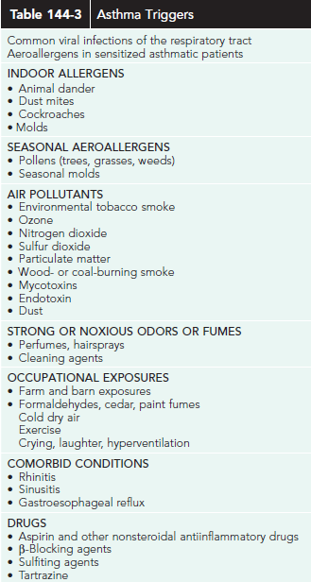
Notes:
Important to ask in HX
Rarely food allergy can trigger asthma but most commonly inhalational agents
Important in MG for avoidance

Slide 6
Pathophysiology
Airway obstruction causes increased resistance to airflow and decreased expiratory flow rates. These changes lead to a decreased ability to expel air and may result in hyperinflation.
The resulting overdistention helps maintain airway patency, improving expiratory flow; but also alters pulmonary mechanics and increases work of breathing.
Hyperinflation compensates for the airflow obstruction, but this later on causes alveolar hypoventilation.
Notes:
Hetergenous disease, involvement in lung and clinical presentation is variable, changes are not equal in the lung

Slide 7
Pathophysiology
Uneven changes in airflow resistance, the resulting uneven distribution of air, and alterations in circulation from increased intraalveolar pressure due to hyperinflation all lead to ventilation-perfusion mismatch.
In the early stages, when ventilation-perfusion mismatch results in hypoxia, hypercarbia is prevented by the ready diffusion of carbon dioxide across alveolar capillary membranes.
Hyperventilation triggered by the hypoxic drive also causes a decrease in PaCO2.
Thus, asthmatic patients who are in the early stages of an acute episode have hypoxemia in the absence of carbon dioxide retention. (good sign)

Slide 8
Pathophysiology
With worsening obstruction and increasing ventilation-perfusion mismatch, carbon dioxide retention occurs.
In the early stages of an acute episode, respiratory alkalosis results from hyperventilation.
Later, the increased work of breathing, increased oxygen consumption, and increased cardiac output result in metabolic acidosis. Respiratory failure leads to respiratory acidosis.
In some patients with chronic asthma, airflow limitation may be only partially reversible because of airway remodeling (hypertrophy and hyperplasia of smooth muscle, subepithelial fibrosis) that occurs with chronic untreated disease.

Slide 9
Wheezing in children younger than 5 years
Recurrent wheezing occurs in a large proportion of children 5 years and younger, typically with viral upper respiratory tract infections.
approximately 40% of children wheeze in their first year of life . ( not necessarily will progress to asthma )
Deciding when this is the initial presentation of asthma is difficult .
Notes:
Appropriate diagnosis of asthma happens after 5 years

Slide 10
Wheezing phenotypes in preschool children
Time trend-based classification :
Transient wheeze (symptoms began and ended before the age of 3 years);
Persistent wheeze (symptoms began before the age of 3 years and continued beyond the age of 6 years),
Late-onset wheeze (symptoms began after the age of 3 years).
Symptom-based classification:
1- episodic wheeze(viral induced wheeze ) (wheezing durin discrete time periods, often in association with URTI, with symptoms absent between episodes) .
2- multiple-trigger wheeze (episodic wheezing with symptoms also occurring between these episodes, e.g. during sleep or with triggers such as activity, laughing, or crying).
Notes:
Persistent and late onset have higher risk to progress to asthma ( important to adjust treatment for prevention)
Transient wheeze seen in post viral infection, low birth weight, premature, maternal smoking exposure

Slide 11
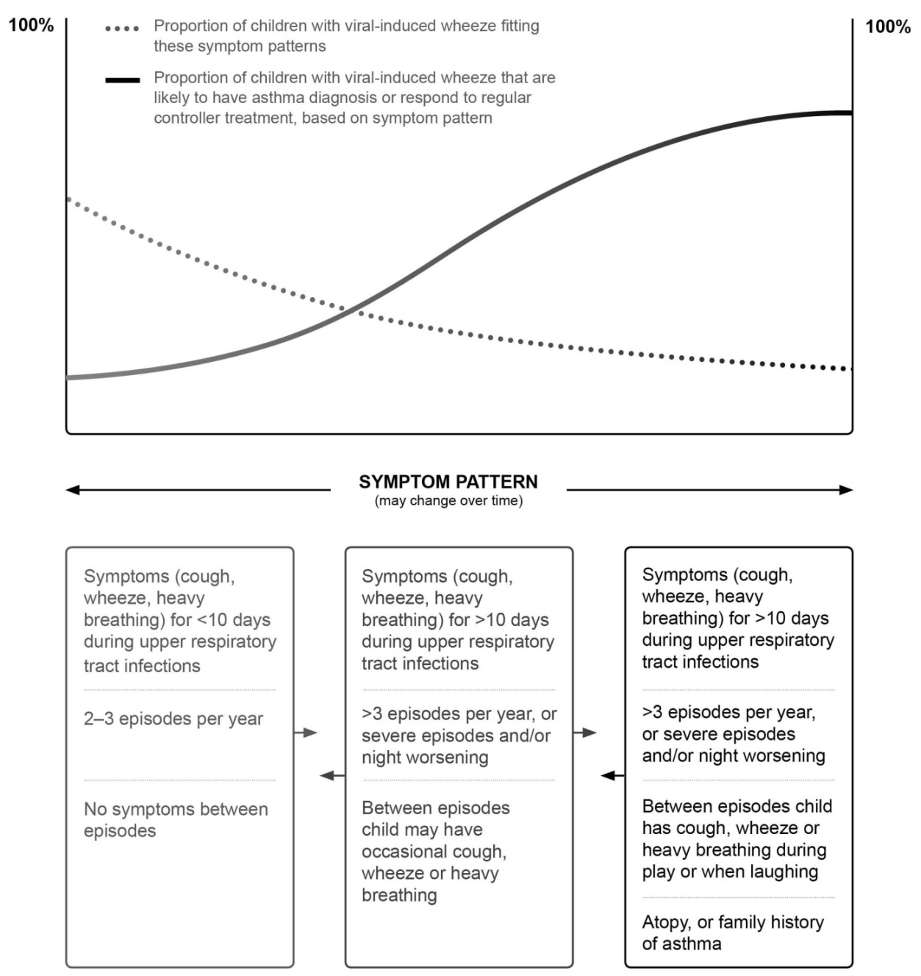
CLINICAL DIAGNOSIS OF ASTHMA

Slide 12
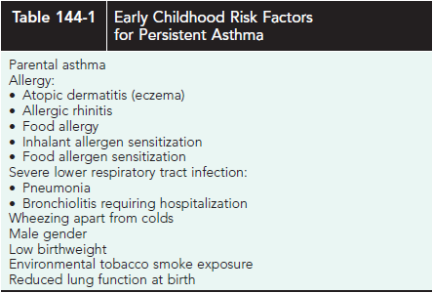
RISK FACTORS
Notes:
Personal history is as important of family history

Slide 13
CLINICAL DIAGNOSIS OF ASTHMA
It may be difficult to make a confident diagnosis of asthma in children 5 years and younger.
It is not possible to routinely assess airflow limitation in this age group.
A probability-based approach, based on the pattern of symptoms during and between viral respiratory infections may be helpful for discussion with parents/carers.
It is important to make decisions for each child individually, to avoid either over- or under-treatment.
Notes:
Diagnostic tests are not usually tolerated in pediatric patients

Slide 14
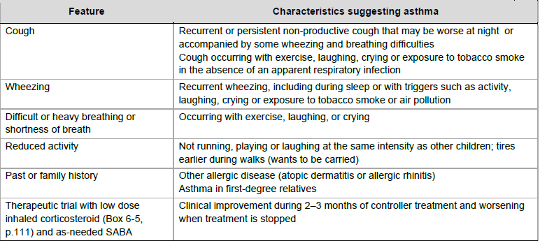
Symptoms suggestive of asthma in children 5 years and younger
Notes:
If it was productive it would be grey or whitish in color, chronic lasting more than 4 weeks, more in night time, increased with triggering factor, relieved by bronchodilators
Increasing number of attacks of wheezing, increased suspicion of asthma
Symptoms between attack and no complete resolution increases the suspicion of asthma

Slide 15
TESTS TO ASSIST IN DIAGNOSIS
While no tests diagnose asthma with certainty in children 5 years and younger, the following are useful adjuncts.
Therapeutic trial
A trial of treatment for at least 2–3 months with as-needed short-acting beta2-agonist (SABA) and regular low dose inhaled corticosteroids (ICS) may provide some guidance about the diagnosis of asthma.
Marked clinical improvement during treatment, and deterioration when treatment is stopped, support a diagnosis of asthma.
Notes:
Confirmatory tests; to prove element of airway limitation/obstruction

Slide 16
TESTS TO ASSIST IN DIAGNOSIS
Tests for atopy
Skin prick testing; less reliable for confirming atopy in infants ( less than 2 years )
allergen-specific immunoglobulin E.
Atopy is present in the majority of children with asthma once they are over 3 years of age; however, absence of atopy does not rule out a diagnosis of asthma.
Chest X-ray
To exclude structural abnormalities (e.g. congenital lobar emphysema, vascular ring) chronic infections such as tuberculosis, an inhaled foreign body, or other diagnoses.
Other imaging investigations may be appropriate, depending on the condition being considered.
Exhaled nitric oxide
Fractional concentration of exhaled nitric oxide (FENO) can be measured in young children with tidal breathing, and normal reference values have been published for children aged 1–5 years.
Notes:
We can give theraputic agent and assess if he improves

Slide 17
TESTS TO ASSIST IN DIAGNOSIS
Lung function testing
Due to the inability of most children 5 years and younger to perform reproducible expiratory maneuvers, lung function testing, bronchial provocation testing, and other physiological tests do not have a major role in the diagnosis of asthma at this age.
However, by 4–5 years of age, children are often capable of performing reproducible spirometry if coached by an experienced technician and with visual incentives.
Notes:
Spirometry not beneficial, PFT, variable in morning night. Could be normal so we do challenge test, provocative, by exercise
Patients come with acute exacerbation we start with treatment

Slide 18
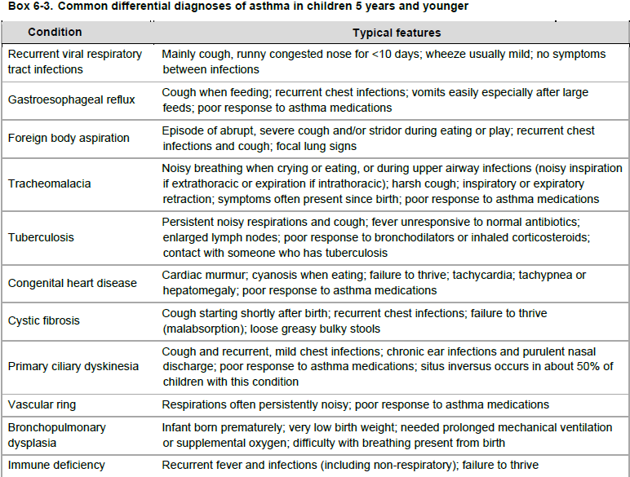

Slide 19
Key indications for referral of a child 5 years or younger for further diagnostic investigations:
Failure to thrive ( CF, ID)
Neonatal or very early onset of symptoms
Vomiting associated with respiratory symptoms (GER)
Continuous wheezing ( FIXED OBSTRUCTION)
Failure to respond to asthma controller medications
No association of symptoms with typical triggers, such as viral URTI
Focal lung or cardiovascular signs, or finger clubbing
Notes:
These make us think of other DDX
We see cushonid faces

Slide 20
GOALS OF ASTHMA MANAGEMENT
As with other age groups, the goals of asthma management in young children are:
To achieve good control of symptoms and maintain normal activity levels
To minimize future risk; that is to reduce the risk of flare-ups, maintain lung function and lung development as close to normal as possible,
Minimize medication side-effects.
The goals of asthma management are achieved through a partnership between the parent and the health professional team, with a cycle of:
Assess (diagnosis, symptom control, risk factors, inhaler technique, adherence, parent preference)
Adjust treatment (medications, non-pharmacological strategies, and treatment of modifiable risk factors)
Review response including medication effectiveness and side-effects.

Slide 21
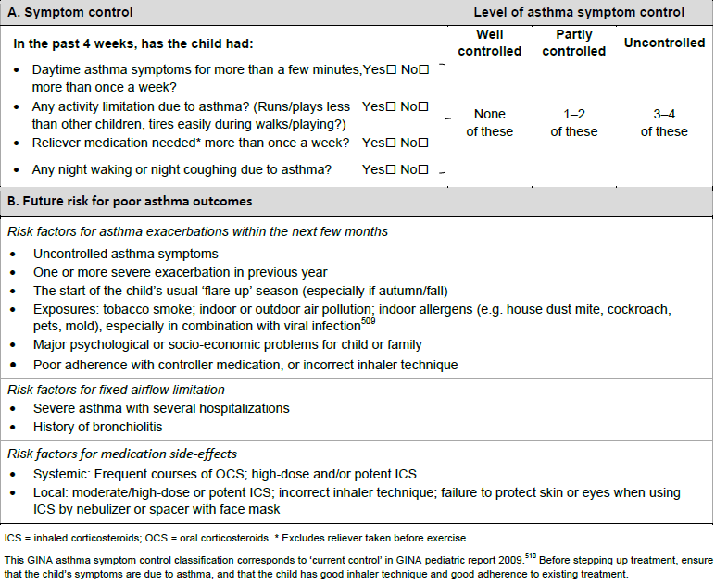
ASSESSMENT OF ASTHMA YOUNGER THAN 5 YEARS
Notes:
Awal 4 as2eleh kter mohemen, bns2lhom la hta nt2akad mn fa3eleyt el drugs, step up or step up down

Slide 22
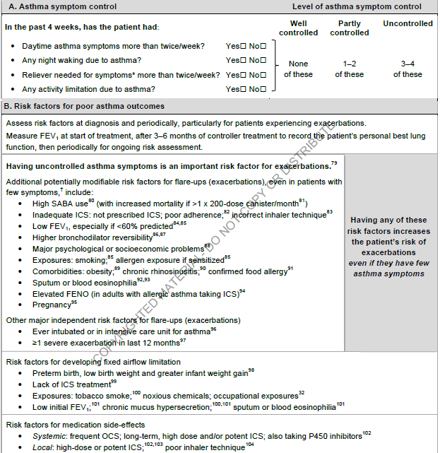
Assessment of asthma control in adults, adolescents and children 6–11 years

Slide 23
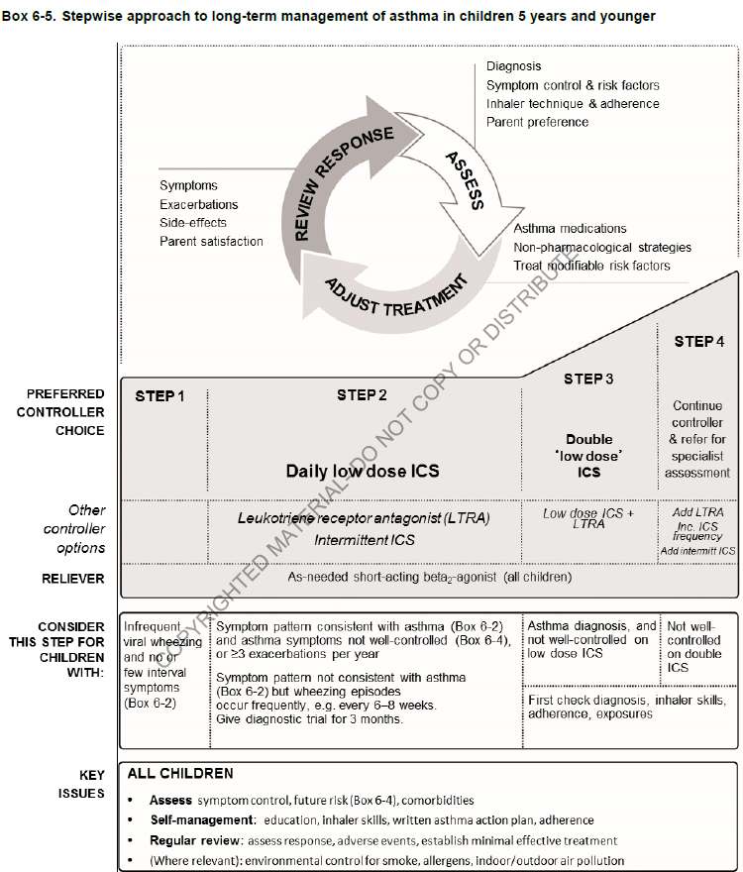
Notes:
( as needed, before exercise )Control medication during exacerbbation
Maintanence 3la ftra tweleh

Slide 24
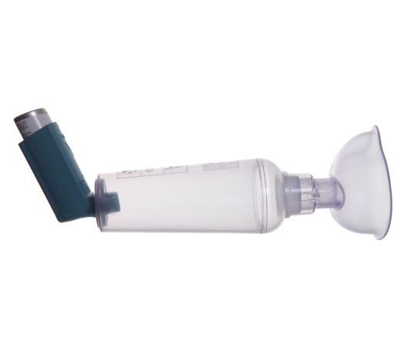
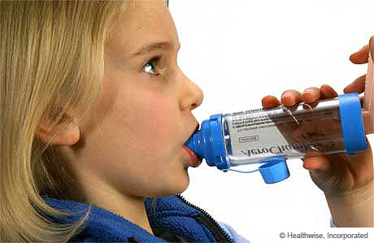
INHALER DEVICES

Slide 25
Long-Term Controller Medications
Inhaled Corticosteroids
The guidelines recommend daily ICS therapy as the treatment of choice for all patients with persistent asthma.
ICS therapy improves lung function as well as reduces asthma symptoms, AHR, and use of “rescue” medications; most importantly, it reduces urgent care visits, hospitalizations, and prednisone use for asthma exacerbations by approximately 50%.
Fluticasone, mometasone, ciclesonide, and, less, budesonide have greater anti-inflammatory potency and diminished systemic bioavailability for potential adverse effects, owing to extensive first pass hepatic metabolism.

Slide 26
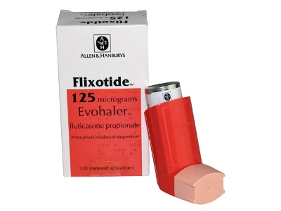
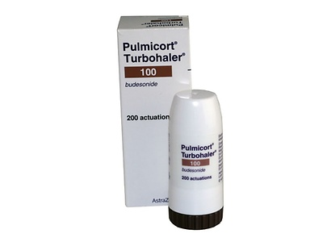
Inhaled Corticosteroids

Slide 27
Long-Term Controller Medications
Inhaled Corticosteroids
Generally, clinically significant adverse effects that occur with long-term systemic corticosteroid therapy have not been seen or have only very rarely been reported in children receiving ICSs in recommended doses.
The risk of adverse effects from ICS therapy is related to the dose and frequency with which ICSs are given.
The most commonly encountered adverse effects of ICSs are local: oral candidiasis (thrush) and dysphonia (hoarse voice). The incidence of these local effects can be greatly minimized by using a spacer with an MDI ICS, because spacers reduce oropharyngeal deposition of the drug and propellant. Mouth rinsing. Hoarsness of voice
The potential for growth suppression and osteoporosis with long term ICS use has been a concern. ( 1 cm bi saneh if daily )

Slide 28
Long-Term Controller Medications
Long-Acting Inhaled β-Agonists
LABAs (salmeterol, formoterol) are considered to be daily controller medications, not intended for use as rescue medication for acute asthma symptoms or exacerbations, nor as mono therapy for persistent asthma.
Controller formulations combines an ICS.
Both have a prolonged duration of effect, at least 12 hr.
So they suited for patients with nocturnal asthma and for individuals who require frequent SABA use during the day to prevent exercise-induced bronchospasm.
Some studies have reported a higher number of asthma-related deaths among patients receiving LABA therapy.
LABAs should be stopped once asthma control is achieved, and the asthma should be maintained with the use of an asthma controller agent (ICS).

Slide 29
Long-Term Controller Medications
Leukotriene-Modifying Agents
LTRAs have bronchodilator and targeted antiinflammatory properties and reduce exercise-, aspirin-, and allergen-induced bronchoconstriction. LTRAs are recommended as alternative treatment for mild persistent asthma and as add-on medication with ICS for moderate persistent asthma.
Montelukast is approved for children (6 months - ≥1 yr) of age and is administered once daily.
Zafirlukast is approved for children ≥5 yr of age and is administered twice daily.
LTRAs not have significant adverse effects, but case reports described:
Churg-Strauss–like vasculitis.
Montelukast has rarely been associated with mood changes and suicidality.

Slide 30
Long-Term Controller Medications
Anti–Immunoglobulin E (Omalizumab)
Omalizumab is a humanized monoclonal antibody that binds IgE, thereby preventing its binding to the high-affinity IgE receptor and blocking IgE-mediated allergic responses and inflammation.
It is FDA-approved for patients >12 yr old with moderate to severe asthma, documented hypersensitivity to a perennial aeroallergen, and inadequate disease control with inhaled and/or oral corticosteroids.
Anti IL-5 (mepolizumab)

Slide 31
Quick-Reliever Medications
Short-Acting Inhaled β-Agonists
Given their rapid onset of action, effectiveness, and 4-6 hr duration of action, SABAs (Salbutamol, albuterol, levalbuterol, terbutaline, pirbuterol) are the drugs of choice for acute asthma symptoms (“rescue” medication) and for preventing exercise-induced bronchospasm.
Overuse of β-agonists is associated with an increased risk of death or near-death episodes from asthma.

Slide 32
Quick-Reliever Medications
Anticholinergic Agents
As bronchodilators, the anticholinergic agents (ipratropium bromide) are less potent than the β-agonists.
Inhaled ipratropium is used primarily in the treatment of acute moderate to severe asthma.
When used in combination with albuterol, ipratropium can improve lung function and reduce the rate of hospitalization in children who present to the emergency department with acute asthma.
Although widely used in children with asthma exacerbations of all ages, it is approved by the FDA for use in children >12 yr of age.

Slide 33
Quick-Reliever Medications
Injectable sympathomimetic epinephrine
Bronchodilator
Adrenalin 1 mg/mL (1 : 1000); SC or IM: 0.01 mg/kg (max dose 0.5 mg); may repeat after 15-30 min.
For extreme circumstances (e.g., impending respiratory failure despite high-dose inhaled SABA, respiratory failure).

Slide 34
MANAGEMENT OF WORSENING ASTHMA AND EXACERBATIONS

Slide 35
DIAGNOSIS OF EXACERBATIONS
A flare-up or exacerbation of asthma in children 5 years and younger is defined as an acute or sub-acute deterioration in symptom control that is sufficient to cause distress or risk to health, and necessitates a visit to a health care provider or requires treatment with systemic corticosteroids.
Early symptoms of an exacerbation may include any of the following:
An acute or sub-acute increase in wheeze and shortness of breath
An increase in coughing, especially while the child is asleep
Lethargy or reduced exercise tolerance
Impairment of daily activities, including feeding
A poor response to reliever medication.
Upper respiratory symptoms frequently precede the onset of an asthma exacerbation.

Slide 36
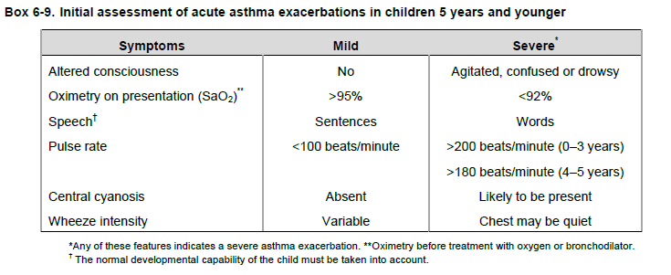
Initial treatment
Blood gas is important test to assess the severity of asthma exacerbation

Slide 37
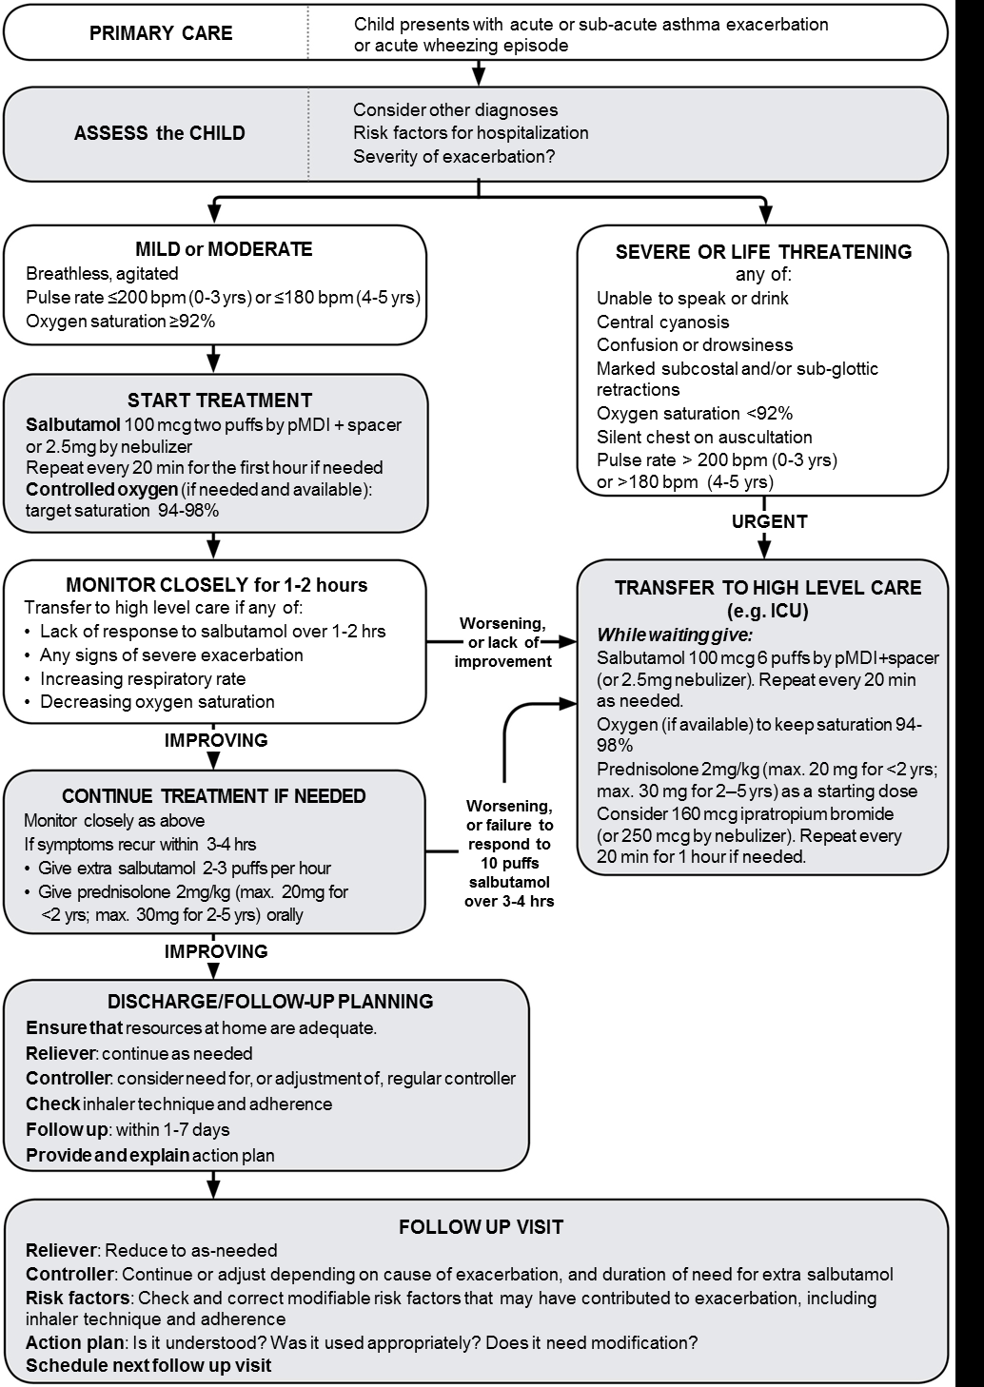

Slide 38
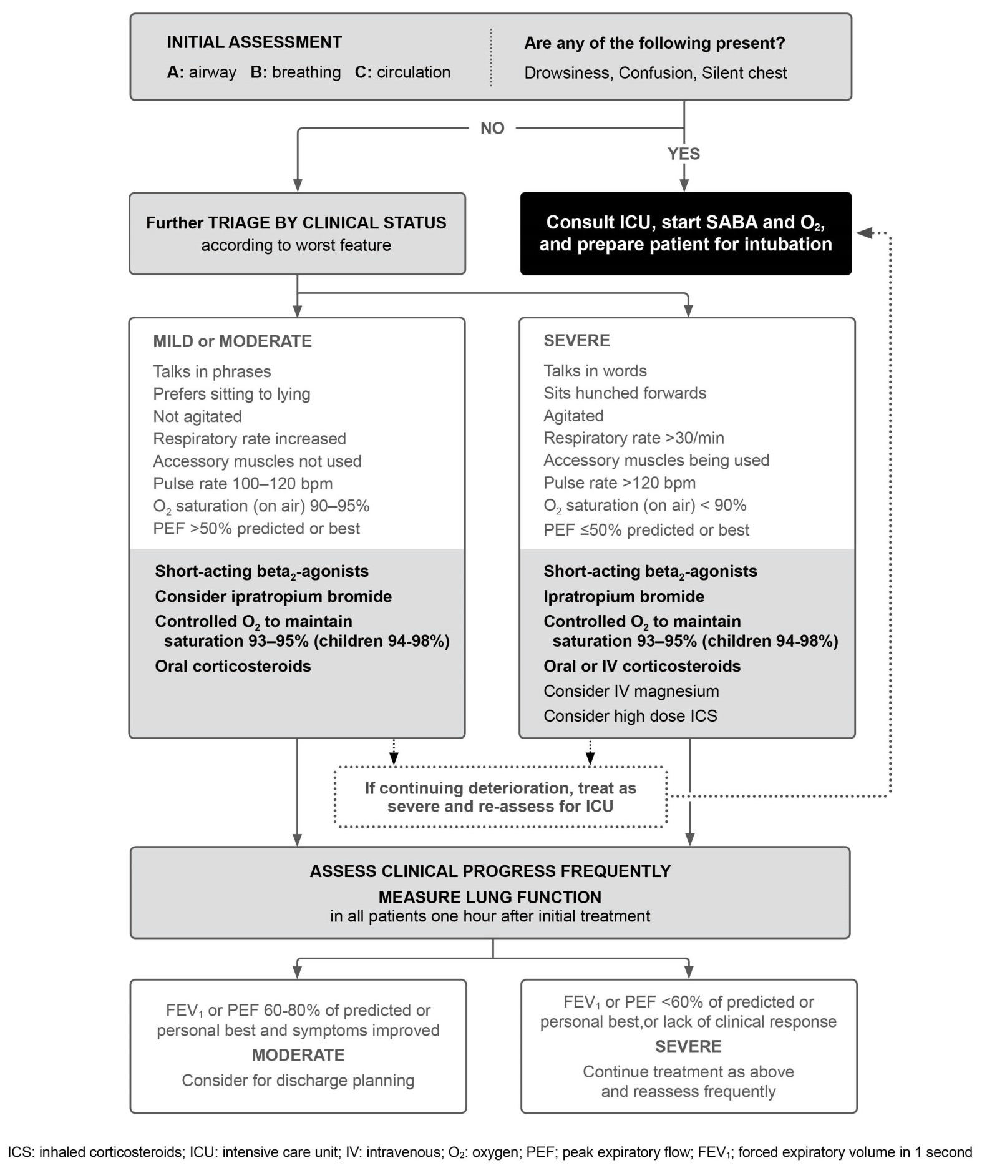
Box 4-4. Management of asthma exacerbations in acute care facility, e.g. emergency department for 6years and above

Slide 39
THANK YOU

