Slide 1
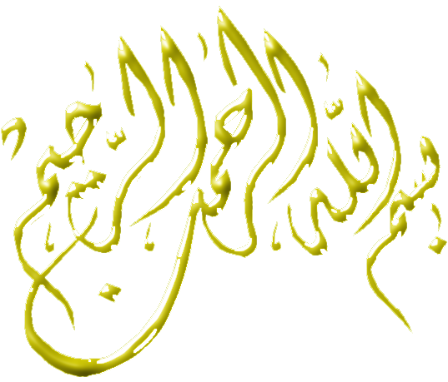

Slide 2
Cutaneous Larva
Migrans
&
Cutaneous Leishmaniasis

Slide 3
Larva migrans
Definition : It is an infection of human tissue by migrating larvae of non human nematodes. Rarely caused by larvae of human nematodes.
Larva migrans in man includes:
Cutaneous larva migrans
Visceral larva migrans.

Slide 4
Cutaneous larva migrans
(Creeping eruption, Plumber's itch, Sand worm)
Mode of infection
Human infection is caused by penetration of the skin by animal hookworm’s filariform larvae which are not adapted to man.
Infection occurs due to contact with contaminated soil (moist or sandy) with dog & cat excreta.
The larvae migrate in the superficial layers of the skin and not go beyond the basal layer of the skin and keep migrating in the epidermis without development and rarely reaching the circulation.
Hookaorms are Ancylostoma caninum & Ancylostoma braziliense

Slide 6
Pathogenesis and symptomatology
At the site of entry  red itchy papule  erythematous zigzag tunnel (1-2 mm)  vesicles  2^{ry} bacterial infection sever irritation and pruritis.
Larvae remain active, move very slowly in the epidermis layer only for several weeks or months till die.
Commonly affect the skin of feet, hands or buttocks and may advances to 1-2 cm / day.
The skin lesion heals leaving linear white scars at the affected sites.
Rarely larvae reach the lung  pulmonary symptoms, eosinophilia and pneumonitis.

Slide 7
CUTANEOUS LARVA MIGRANS
It penetrates the skin of man especially feet and legs
It fails to penetrate the skin fully
(not go beyond the epidermis)
Produce Zigzag tunnel

Slide 8
Laboratory diagnosis
Skin biopsy for larval identification.
No eosinophilia.
Treatment
Antihistaminics.
Antibiotics for
2^{ry}bacterial infection
Local freezing: Spray of skin by ethyl chloride (local freezing) or carbon dioxide snow which produce freezing of larvae till death skin bleb  larvae are lost with epidermal sloughs.
Thiabendasole
Ivermectin

Slide 9
Leishmaniasis classified into
Visceral Leishmaniasis
(Kala azar)
Cutaneous leishmaniasis
Mucocutaneous leishmaniasis
Caused by
Caused by
Caused by
L. tropica.
L. major.
L. aethiopica.
L. mexicana.
L. braziliensis.
L. Donovani
L. Infantum
L. chagasi
Old World Leishmaniais
New World Leishmaniasis

Slide 10
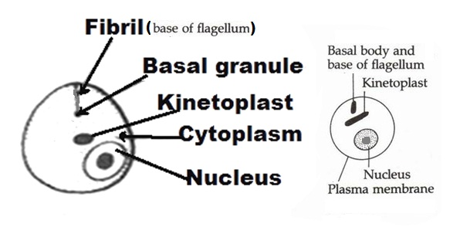
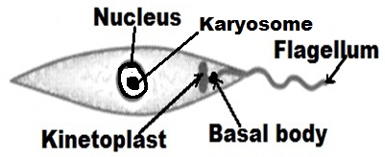
Old World Cutaneous Leishmaniasis
Morphological characters:
1- Amastigote 2- Promastigote
Shape: Oval Fusiform or spindle
Kinetoplast: Beside the nucleus At the anterior end
Flagellum: Absent Present
Nucleus: -Eccentric with central -Central with central
Karyosome Karyosome
Habitat: -Intracellular (macrophage) -Midgut of the insect
-Tissue culture -Culture media

Slide 11
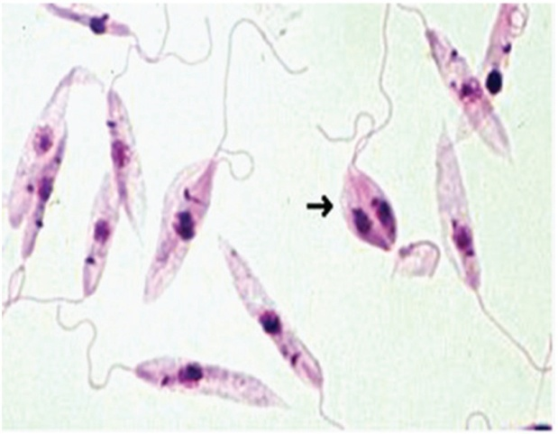
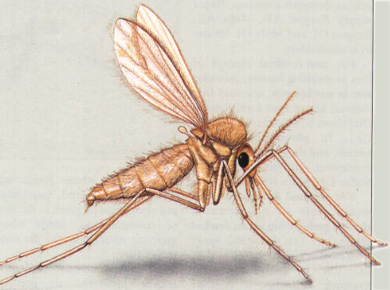
Mode of transmission
1- Bite of female sand fly (Phlebotomus species).
2- Direct contact with infected lesions.
3- Mechanical transmission by blood sucking fly as Stomoxys.
D.H:
Man
R.H:
Dogs in L. tropica.
Rodents in L. major & L. aethiopica.
I.S:
Metacyclic promastigotes in the mouth part of the female sand fly
Vector:
Female sand fly (Phlebotomus)

Slide 12
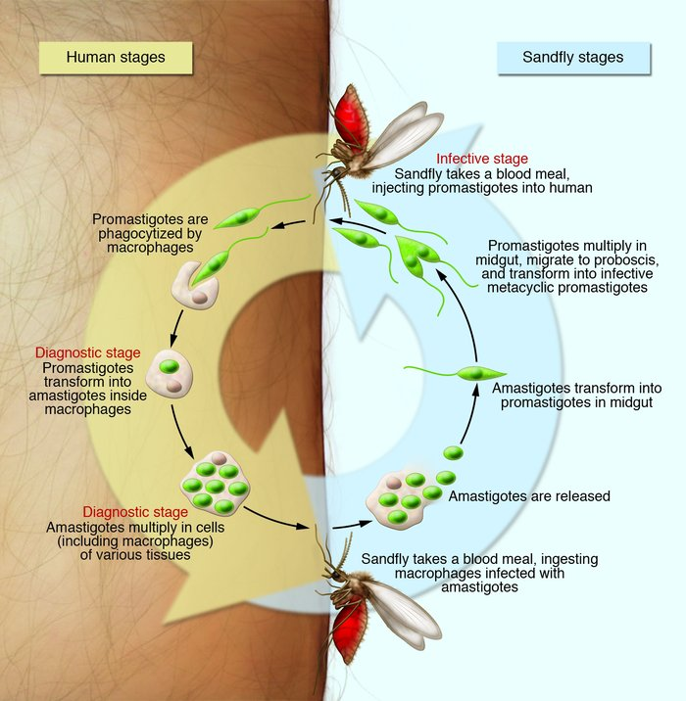

Slide 13
Pathogenesis & Symptomatology
1- Old World Cutaneous Leishmaniasis
L. tropica L. major L. aethiopica (Dry or urban CL) (Wet or rural CL) (lepromatous lesions) G.D: Middle East, Asia ,Africa Middle East, Asia, Africa East Africa in big cites (urban areas) in villages (rural areas) (Ethiopia & Kenya) Pathog. & Oriental sore (Baghdad The same as L. tropica Diffuse Cutaneous CL/P boil or Delhi boil) Except the followings: Leishmaniasis -Localized nodules at the (in the next slide) -Thickening of skin, bite site necrosis papules & multiple painless ulcer é sharp nodules like edges & raised indurated lepromatous leprosy margin. -2nd bacterial infection is common.

Slide 14
L. tropica L. major L. aethiopica (Dry or urban CL) (Wet or rural CL) (lepromatous lesion) -Has chronic course if - Has an acute course. -Usually affects immuno- untreated. compromised patients. -Has long I.P(2-12 ms). -Short I.P(2-6 ws). -No mucosal infection -Scanty exudate & slow -Serous exudate & rapid or ulceration healing (12 ms). healing (3-6 ms). -The ulcer mainly on -Usually on the lower -Mainly on face & limbs the face & limbs. limbs. -Single or multiple ulcers. - Multiple ulcers. -Usually multiple nodules -Heals spontaneously -Heals spontaneously -No spontaneous healing after 1-2 years giving living large disfiguring & can be relapse. depigmented disfiguring scars. scars. -Gives solid immunity to -Gives immunity against -No solid immunity L. tropica only. both L. major & L. tropica
Notes:
I P is incubation period

Slide 15
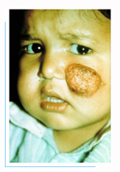
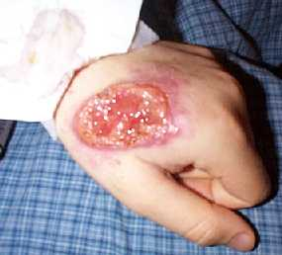
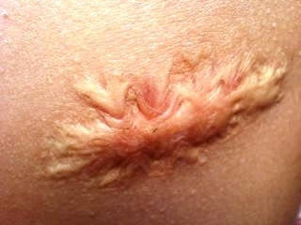
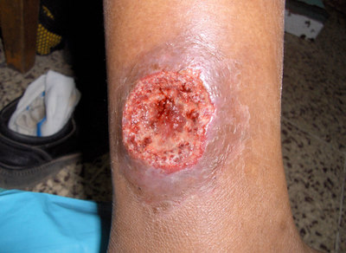
Oriental sore

Slide 16
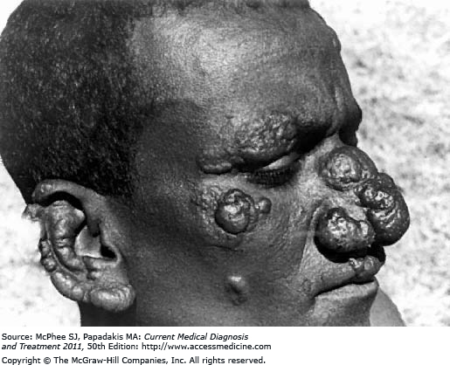
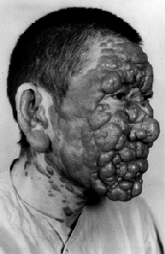
Leishmania aethiopica

Slide 17
New world cutaneous leishmaniasis
(American leishmaniasis)
New World Cutaneous Leishmaniasis
New World Mucocutaneous Leishmaniasis
Leishmania mexicana
Leishmania braziliensis
Chiclero ulcer or bay sore
Mucocutaneous Leishmaniasis
(Espundia)

Slide 18
Chiclero ulcer Espundia Caused by L. mexicana Caused by L. braziliensis -A small single nodule at the site of -Primary skin lesion: Nodule in sand fly bite  ulcerates. exposed regions  ulcerates. -Usually on the face & ear pinna - The ulcer with raised indurated  heals within 6 months. margin  heals in scar in months. -Ear lesion causes destruction of the -Secondary metastatic lesion: catilage of the ear pinna. The parasite migrates from the -Seen in chicleros who live in forests primary site to blood & lymph & collect gum from chicle trees. to mucocutaneous junctions. -Sites: nasal septum, lips, palate nasopharynx & larynx. -Deformity & 2nd bacterial infection. - Death from septicaemia and bronchopneumonia.

Slide 19
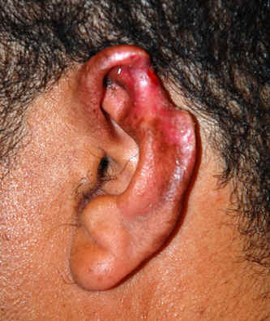
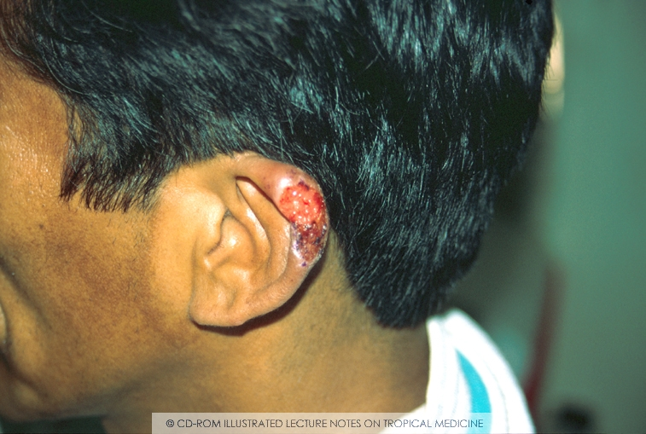
Chiclero ulcer
Espundia

Slide 20
Laboratory diagnosis
Direct
Indirect
1-Scraping the edge of the ulcer or aspiration by a needle (not the base as contains pus and necrotic tissues) and examined by :-
Direct smear stained by Giemsa or leishman.
Culture on NNN medium (amastigotes changes into
promastigotes).
2- Biopsy from the edge of the ulcer and examined by direct smear.
1-Immunodiagnosis:
Leishmanin I.D test (Montenegro test): Not a specific test. It is +ve with cutaneous and mucocutaneous leishmaniasis
but negative in diffuse cutaneous leishmaniasis.
Serological tests: Not useful for the diagnosis.
2- PCR: A reliable diagnostic test.
than routine smear and culture and it used also for species differentiation.

Slide 21
Treatment
1) Local
2) Chemotherapy
Cryosurgery, curettage or local application of heat to raise the intra- lesional temperature to 37- 43 ° C for 12 hours as amastigote do not grow above 33 ° C.
Surgical excision of the lesion.
Non-ulcerated lesion: Intra- lesional injection of pentavalent antimony compounds.
Ulcerated lesion: Should be treated with systemic pentavalent antimony compounds (ex. Pentostam).
Alternative drugs to pentostam: Amphotericin B, imidazoles or Allopurinol.
Antibiotics for secondary bacterial infection of lesions.

Slide 22
TRICHINELLA SPIRALIS A NEMATODE

Slide 34
Notes:
Xenodiagnosis is a diagnostic method used to document the presence of infectious disease microorganisms or pathogens by exposing possibly infected tissue to a vector and then examining the vector for the presence of the microorganisms or pathogens it may have ingested

