Slide 1
وسهلا
أهلا
الأستاذ الدكتور يوسف حسين
أستاذ التشريح وعلم الأجنة - كلية الطب – جامعة الزقازيق – مصر
رئيس قسم التشريح و الأنسجة و الأجنة - كلية الطب - جامعة مؤتة - الأردن
دكتوراة من جامعة كولونيا المانيا
اليوتيوب Prof. Dr. Youssef Hussein Anatomy
جروب الفيس د. يوسف حسين (استاذ التشريح)

Slide 2
The sites of articulation between 2 bones or more.
Joints

Slide 3
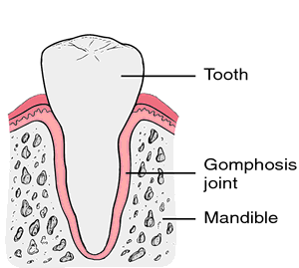
Classification of the joints
1- FIBROUS JOINTS
- The bones are connected together by fibrous tissue.
- There are no movements.
a) Sutures (synarthrosis) of the skull. It ossifies with age.
b) Gomphosis; do not ossify. It is a peg (teeth) and socket (cavity of the jaw) variety
Frontal bone
Coronal suture
Parietal bone
Partial bone
Sagittal suture
Notes:
Union of the halves of the frontal bone begins in the 2nd year. In most cases, the frontal suture is obliterated by the 8th year. However, in approximately 8% of people, a remnant of it, the metopic suture, persists.
Palpation of the fontanelles during infancy, especially the anterior and posterior ones, enables physicians to determine the:
Progress of growth of the frontal and parietal bones.
Degree of hydration of an infant (a depressed fontanelle indicates dehydration).
Level of intracranial pressure (a bulging fontanelle indicates increased pressure on the brain).

Slide 4
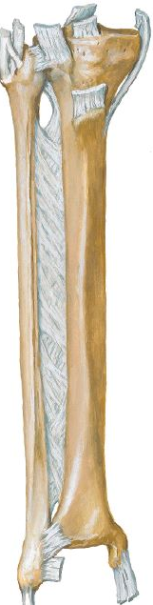
c) Syndesmosis; two adjacent bones are linked by strong membrane or ligaments
Middle and inferior tibiofibular joints
Middle radioulnar joint
- It does not ossify.
Middle tibiofibular joint
Middle radioulnar joint
Inferior tibiofibular joint

Slide 5
2- CARTILAGINOUS JOINTS
- The bones are connected together by cartilage.
Primary cartilaginous joint | Secondary cartilaginous joint
1- The bones are connected together by hyaline cartilage. 2- It ossified with age. 3- They are temporary joints. 4- They permit no movement 5- Examples, epiphyseal plate of long bone. | 1- The bones are connected together by fibrocartilage 2- It is never ossified. 3- They are permanent Joints. 4- They permit slight movement 5- Examples, a) Symphysis pubis, b) intervertebral discs

Slide 6
Synovial Joints
Diarthrosis

Slide 7
1- The articular surfaces are covered by hyaline cartilage.
* Features (Characters) of Synovial Joints
2- They have cavity between the ends of bones
5- The joint is surrounded by fibrous capsule.
3- The cavity is filled by synovial fluid that facilitates the movements of the joint.
6- Outside the capsule, a group of ligaments which support the joint.
4- The synovial fluid is secreted by a synovial membrane.
7- They permit wide range of movement.

Slide 8
Upper Limb
Lower Limb
Hip joint
Shoulder joint
Elbow joint
Knee joint
Wrist joint
Ankle joint

Slide 9
Classification (Types) of the Synovial Joints
A- According to articular parts into:
1- Simple joints; it consists of 2 articulating bones e.g. shoulder joint or hip joint.
2- Compound joints; it consists of more than 2 bones e.g. elbow joint or ankle joint.
3- Complex joints; which contain intra-capsular structures e.g. knee joint.
Hip joint
Knee joint
Elbow joint
Notes:
The elbow joint is a joint between the lower end of the humerus and upper ends of the radius and ulna. It actually includes two articulations (a) humero-ulnar articulation, between the trochlea of the humerus and trochlear notch of the ulna, and (b) humero-radial articulation, between the capitulum of the humerus and the head of radius
Articulation: This occurs between the trochlea and capitulum of the humerus and the trochlear notch of the ulna and the head of the radius. The articular surfaces are covered with hyaline cartilage
The complexity of elbow joint is further increased by its continuity with superior radio-ulnar joint. Thus there are three articulations in the elbow region, viz. (a) humero-ulnar, (b) humero-radial, and (c) superior (proximal) radio-ulnar. These are called cubital articulations
The upper articular surface is formed by the capitulum and the trochlea of the lower end of the humerus.
The lower articular surface is formed by the upper surface of the head of the radius and trochlear notch of the ulna.

Slide 10
B- According to degree of movements:
1- Plane Joints; It allows only gliding movements.
- E.g. intercarpal & intertarsal joints
2- Angular movements; they form angles between the articular bones (flexion and extension).
- E.g. elbow and knee joints.
3- Circumduction: They permit successive angular movements.
E.g. Shoulder, and hip joints.

Slide 11
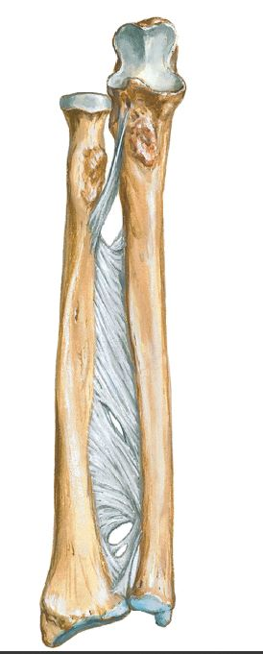
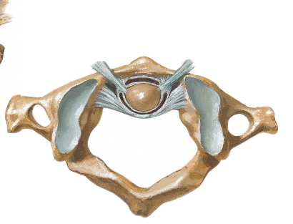
C- According to the axes of movement
Uniaxial joints
the movements occur around one axis only
1- Hinge joints: resemble hinges
- The allowed movements are flexion and extension
- e.g. elbow and Interphalangeal Joints.
2- Pivot joints:
- The allowed movements are rotation.
- e. g. Superior and inferior radio-ulnar joints; Atlantoaxial joint.

Slide 12
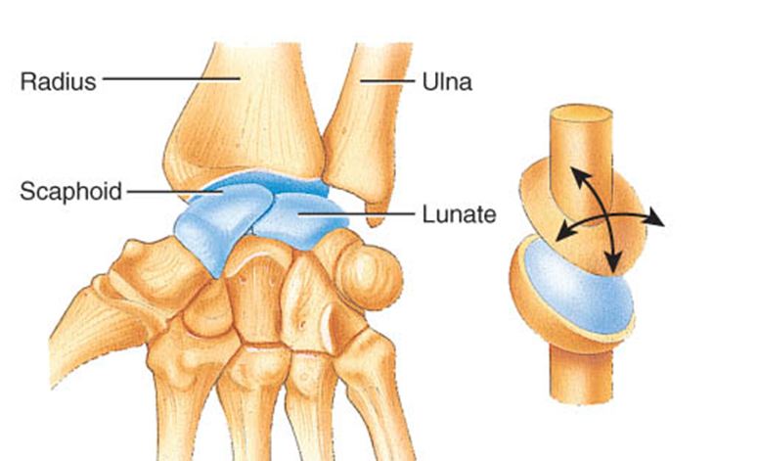
Biaxial joints
Movements occur around 2 axes;
1- Ellipsoid joint: One articular surface is convex, while the other is concave.
1- Flexion & extension occur around horizontal axis.
2- Adduction & abduction occur around antero-posterior axis.
e.g. Wrist joint and Metacarpophalangeal joint

Slide 13
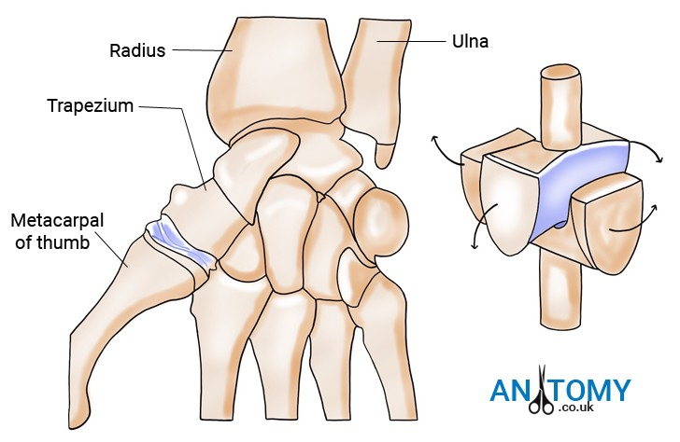
Biaxial joints
Movements occur around 2 axes
2- Saddle joint: Both articular surfaces are concavo-convex
1) Flexion, extension around horizontal axis.
2) Adduction, abduction around antero-posterior axis.
3) Slight rotation.
e.g. Carpometacarpal joint of the thumb.
N.B: Sternoclavicular Joint is a modified saddle synovial joint.

Slide 14
Biaxial joints
Movements occur around 2 axes
3- Modified hinge joints: knee joint.
1) Flexion, extension around horizontal axis.
2) Slight Rotation around the longitudinal axis.

Slide 15
Polyaxial Joints
Movements occur around more than 2 axes
- They are also called ball (rounded head) & socket (concave surface) joints.
They allow all types of movements.
e.g. shoulder & hip joints
Acetabulum
Head of femur
Hip joint

Slide 16
Thank you
Questions
I/Azzam - 2004

