Slide 1
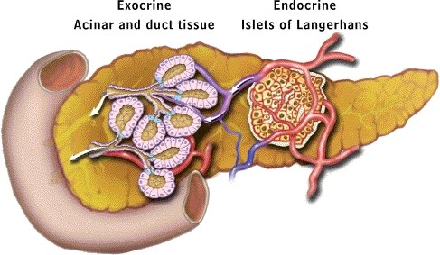
PANCREAS
Mixocrine gland
Tail
Body
Head

Slide 2
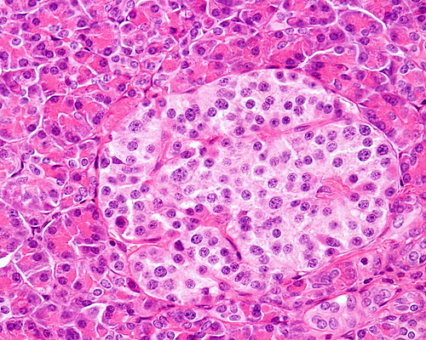
PANCREAS
Exocrine part→ pancreatic acini, majority of pancreas
Exocrine and endocrine gland.
The exocrine part produces pancreatic juice. Contain digestive enzymes
The endocrine part, ~1% , consists of the cells of the islands of Langerhans.
Endocrine part: Islets of Langerhans
Masses of pale staining cells scattered between the pancreatic acini
They are more in the tail than head of pancreas
The cells are separated by fenestrated
capillaries (highly vascularized)
Cells of islets of Langerhans are
Alpha, Beta, Delta, F (PP) cells
C.T contain B.Vs

Slide 3
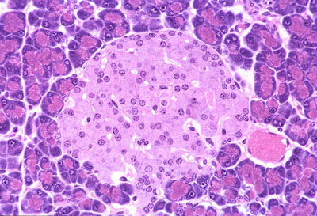
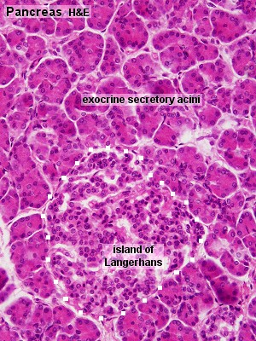
Structure :of the islands of Langerhans.
Stroma:
Surrounded by thin capsule
Parenchyma
cellular composition of the islands
70% beta-cells, insulin. Insulin stimulates
20% alpha-cells, glucagon.
5- 10 % delta-cells which secrete somatostatin,
F- cells (PP)
الفراغات البيضاء تمثل اماكن الاوعية الدموية
B.V
→Cells arranged in cords
B.V
بما ان العلاقة عكسية بين حجم الخلية وعددها, رح يكون حجم هاي الخلايا صغير
INSULIN→ released in state of high blood sugar level. GLUCAGON→ released in state of low blood sugar level. Alpha and Beta cells are most important 2 cells, and responsible for regulation of blood sugar level

Slide 4
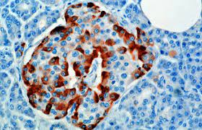
Beta (B) cells (70%):
Produce insulin which lower blood sugar
Cells are small in size, most numerous cell type, central in location in islets
Stain blue (H&E stain)
EM: appear in two functional stages active & resting
When active synthesize insulin. When resting packed with granules storing insulin
Cells divide at very slow rate
Alpha (A) cells (20%):
Produce glucagon which increase blood sugar
Cells larger in size, fewer in number, peripheral location in Islets
Stain pink (H&E stain)
Beta cells
Immunohistochemical stain
Alpha cells

Slide 5
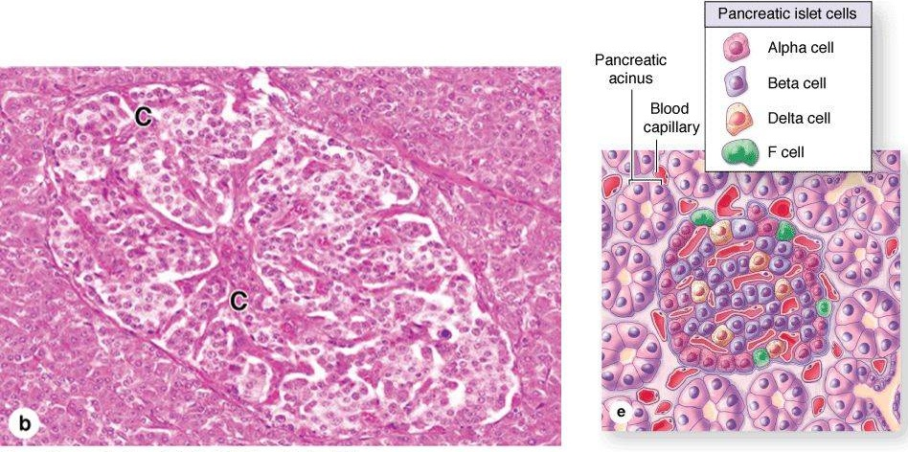
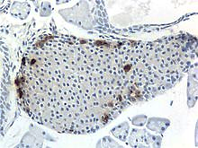
Delta cells:
Secret somatostatin ( growth inhibiting factor)
Cells scattered at periphery and less abundant
F (PP) cells:
Very few
Secrete pancreatic polypeptide h.
Regulate exocrine pancreas
secretions
Delta cells
PP cells

Slide 6
Regulation of blood glucose level
↑
Pancreas stimulated by feedback
↓

Slide 7
Abnormality of blood sugar level
Result→ normal blood sugar level
Result→ high blood sugar level

Slide 8
Diffuse neuroendocrine system
Apudocytes or APUD cells
Classification according to staining activity
Argentaffin cells: ppt silver in absence of reducing agent
Argyrophilic cells: ppt silver in presence of reducing agent
Chromaffin like cells: bind K dichromate
Mode of action
Endocrine → target organ
Paracrine → surrounding tissue
Autocrine → themselves
Neuroendocrine → neurosecretion
Argentaffin cells + Argyrophilic cells→ silver- loving cells

Slide 9
Distribution of APUD cells
Atrial naturetic polypeptides produced by modified cardiac muscles in R.A
GIT contains the majority of APUD cells
GIT (enteroendocrine cells) :
G cells EC cells
ECL cells D cells
S cells
Respiratory system
Bronchial Kulchitsky cells
Small granule cells
Neuroepithelial bodies
among tracheobronchial epithelium.
Other sites
Myocardium: → cardiodilatins and atrial naturetic polypeptides
Hypothalamus: supraoptic and paraventricular nuclei → oxytocin and vasopressin
Endocrine system: pinealocytes,parafollicular cells, chief cells, cells of islets of Langerhans and some adenohypophyseal and adrenal medullary chromaffin cells
APUD= Neuroendocrine cells= Enteroendocrine cells= chromaffin like cells= Argentaffin cells= Argyrophilic cells

Slide 10
Microscopic features
Two types:
Open type
Closed type
Electrolucent cytoplasm
Few small secretory granules at the base or vascular pole (to release its secretion directly to the blood)
Small infranuclear Golgi
Sparse rER
Para follicular cells of thyroid gland
Long, reach surface
Don’t reach surface
B.V
Apical microvilli
Apical part
APUD of small intestine

Slide 11
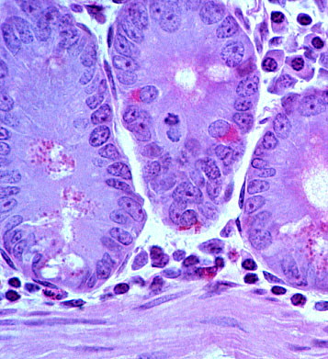
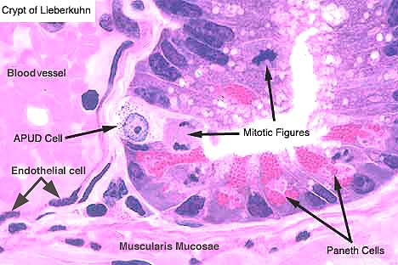
Enteroendocrine cells
Q: How to differentiate between APUD cells and Paneth cells?!
A: through the site of granules
Granules at the apex→ Paneth cells (to release its secretion into the lumen of glands)
Granules at the base→ APUD cells ( to release its secretion into blood)
Notes:
11

