Slide 1
Intra-uterine fetal death
Presented by:
Wasan alrawwad
Majd Majid
Farah Raed
Marwa Alkhresheh
Supervised by:
Dr. Malik Alqasem

Slide 2
Introduction, Etiology, and Risk factors
Diagnosis and Investigations
Management, Complications, and Considerations

Slide 3
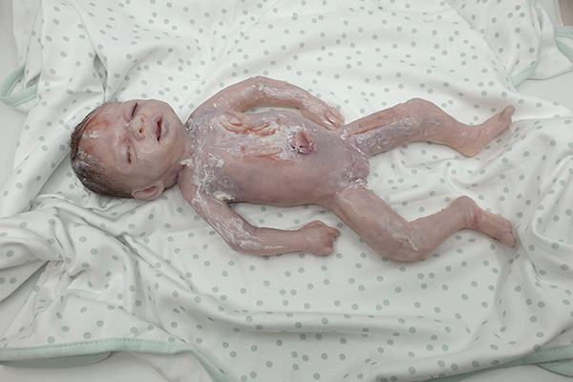
Stillbirth
DONE BY : wasan alrawwad

Slide 4
INTRODUCTION :
The term "stillbirth" generally refers to the delivery of a fetus ≥20 weeks of gestation with no signs of life.

Slide 5
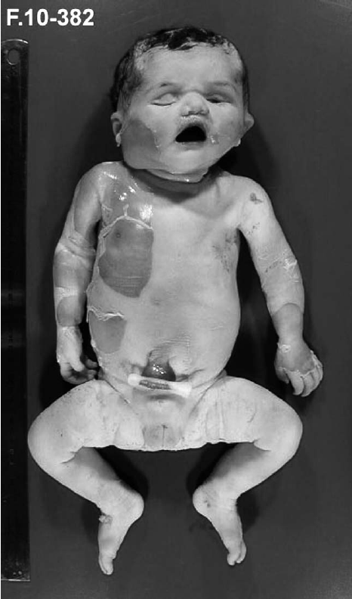
World Health Organization definitions :
WHO recommends defining stillbirth as a baby both with no signs of
life at or after 28 weeks of gestation.
Fetal death is define as : the intrauterine death of a fetus at any time during pregnancy.
Antepartum fetal death : is a death that occurs before the onset of labor .
Intrapartum fetal death: is a death that occurs during labor and thus may not show signs of maceration.
Notes:
Maceration :skin discoloration or darkening, redness, peeling, and breakdown(enzymatic autolysis)

Slide 6
United States National Center for Health Statistics definition :
A fetal death or loss that occurs after 20 weeks of pregnancy and/or ≥350 grams birth weight, and before or during delivery, with further division in to :
An early stillbirth is a fetal death occurring between 20 and 27 completed weeks of pregnancy.
A late stillbirth occurs between 28 and 36 completed pregnancy weeks.
A term stillbirth occurs between 37 or more completed pregnancy weeks..

Slide 7
INCIDENCE :
- Worldwide, the stillbirth rate has been falling from approximately 21.4 deaths per 1000 births in 2000 to approximately 13.9 deaths per 1000 births in 2019 .
- The reduction has been associated with improved access to antenatal care and skilled birth attendants and increased attention to known maternal risks for stillbirth.
- Rates of stillbirth in low-income countries have been higher than in high-income countries,with most stillbirths (77 percent) occurring in subSaharan Africa and South Asia
Notes:
Nepal, India, and Pakistan, thailnad

Slide 8
ETIOLOGIES :
- Stillbirth is the end result of a variety of maternal, fetal, and placental disorders, which can interact to contribute to fetal demise .
-The various causes of stillbirth appear to differ between low- and high-income countries ,and between early and late gestation . In low-income countries the obstructed/prolonged labor, preeclampsia, and infection have been reported as common causes of stillbirth .
In high-income countries the congenital or karyotype anomalies, placental problems associated with growth restriction, and maternal medical diseases appear to be common causes .
-Early gestational fetal mortality appears to be related to congenital anomalies, infections, intrauterine growth restriction, and underlying maternal medical conditions .
-Late gestational fetal mortality appears to be due to both maternal medical disorders and obstetric disorders that generally evolve around the time of delivery, such as placental abruption and previa, cord prolapse, marginal insertion of the umbilical cord into the placenta, other labor and delivery complications, or unexplained cause .

Slide 9
ETIOLOGIES :
1- Congenital anomalies : 20-50 percent of stillborns have a major malformation. This rate varies from country to country and is greatly influenced by the availability of prenatal diagnosis and pregnancy termination .
2- Fetal growth restriction :Death of a growth-restricted fetus is the second most common type of stillbirth .The stillbirth rate in such fetuses is estimated to be 10 to 47 per 1000 live births, and stillbirths increases with increasing severity of growth restriction.
3- Infection : Infection may lead to fetal demise as a result of severe systemic maternal illness (eg, pneumonia).. placental dysfunction due to placental infection (eg, malaria), or fetal systemic illness (eg, Escherichia coli, group B Streptococcus [GBS], cytomegalovirus [CMV], Zika virus).
Infection accounts for approximately 50 percent of stillbirths in low- and middle-income countries and 10 to 25 percent of stillbirths in high-income countries.
Notes:
Zika virus). By mosqutious

Slide 10
ETIOLOGIES :
4- Genetic abnormalities : Most aneuploidies are lethal in utero. Some aneuploidies (such as trisomy 21, 18, and 13 and monosomy X) confer an increased risk of fetal demise but can also result in live birth. Although death of a karyotypically abnormal embryo or fetus is most common in the first trimester, it can occur at all stages of pregnancy.
5- Hydrops fetalis : Hydrops fetalis may be due to immune or nonimmune etiologies and is often fatal.
6-Fetal arrhythmia : An unrecognized arrhythmia, such as long QT syndrome, may be a cause of unexplained fetal demise.
7- Abruptio placentae :Abruptio placentae occurs in approximately 1 percent of pregnancies but accounts for between 10 and 20 percent of all stillbirths .
The risk of stillbirth is highest when more than 50 percent of the placental surface becomes separated or when the abruption involves the central aspect of the placenta.

Slide 11
ETIOLOGIES :
8- Umbilical cord abnormalities : Umbilical cord complications , torsion, stricture, prolapse, single umbilical artery, histopathologic evidence of compromised fetal microcirculation) are often a cause of fetal death in the third trimester .
9- Placental abnormalities : Placental causes of stillbirth include abruptio placentae, ruptured vasa previa ,infection, neoplasm, structural or vascular malformations, vasculopathy, and infarction.
10- Fetomaternal hemorrhage : has been reported in up to 5 percent of stillborns .
Notes:
Fetomaternal hemorrhage : placental-decidual interface defict Kleihauer–Betke test: bright pink fetal cell

Slide 13
RISK FACTORS :
-They are divided in to maternal and fetal risk factors :
A- Maternal factors :
1- Sociodemographic factors :
A- Black race .
B- Younger and older age : The stillbirth rate is lowest for women ages 25 to 34 and higher for teenagers and women ≥35 years of age
C- Parity : increased risk for stillbirth among nulliparous women and parity ≥3 .
D- Adverse social and behavioral factors
2- Previous stillbirth : Women who experienced a stillbirth in their first pregnancy are three times more likely to experience a stillbirth in their second pregnancy compared with women who had a live birth in their first pregnancy .

Slide 22
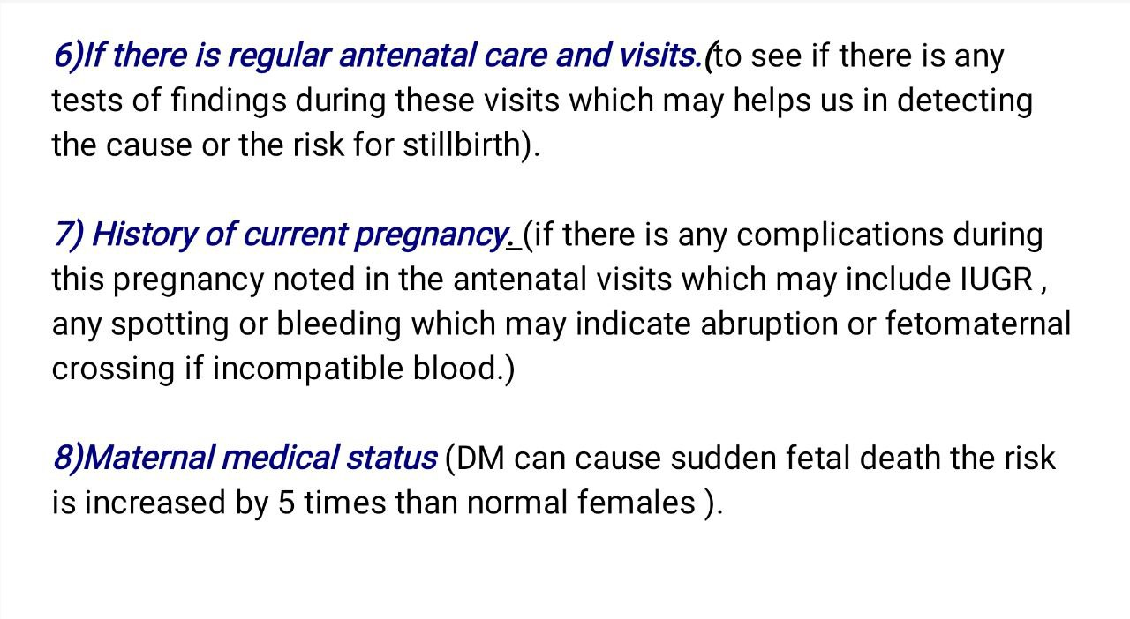

Slide 24
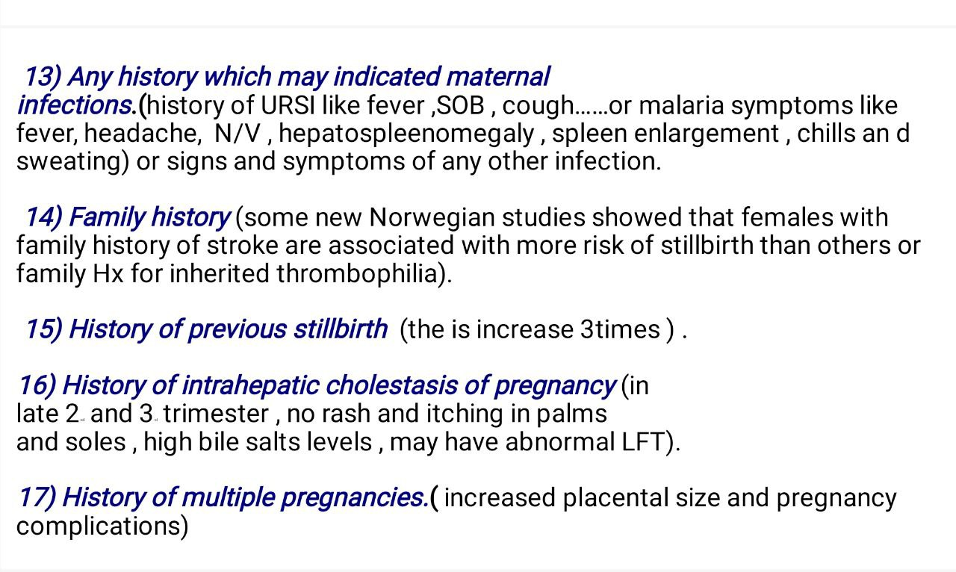

Slide 25
18) Social history :
If the patient is smoker.
Her BMI.
Her socio-economic status.

Slide 26
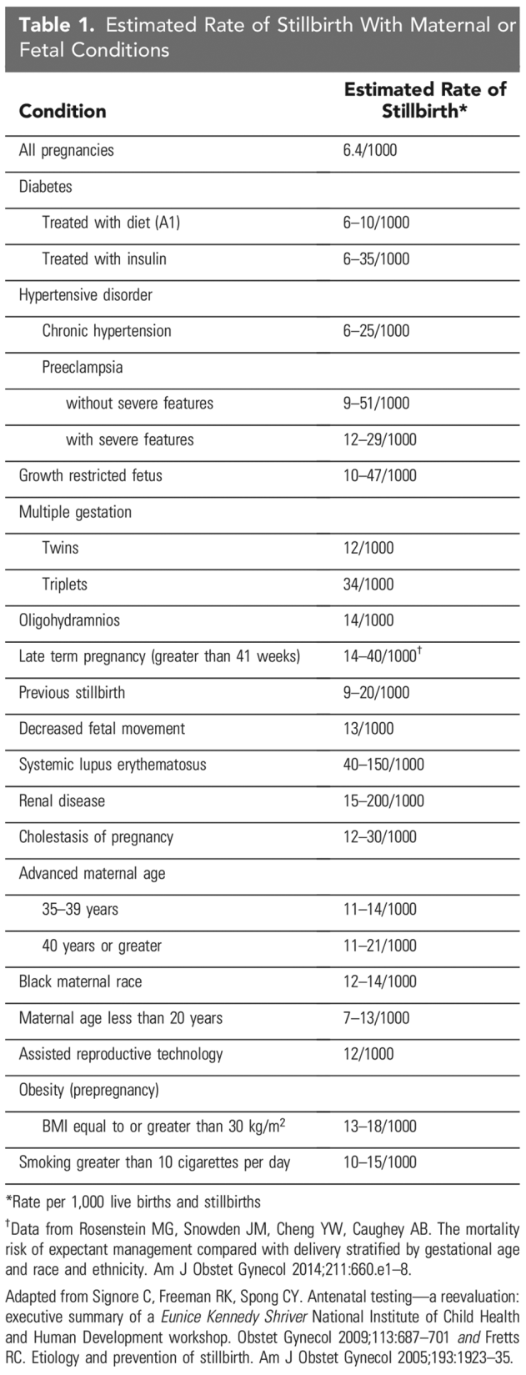

Slide 28
First: Break the bad news and support !
Almost one-half of late fetal deaths occur in apparently uncomplicated pregnancies. Most occur before labor begins, but a minority occur intrapartum.
Regardless of the timing, most parents are unprepared when told that the fetus has died..
The family's anticipation of a joyous birth is supplanted by sadness, despair, confusion, and loss, including loss of a desired child, loss of self-esteem as a parent, and loss of confidence in the ability to produce a healthy child
Psychological sequelae include : depression, posttraumatic stress disorder, and anxiety, which may adversely affect their relationship and a subsequent pregnancy.
Once fetal death has been confirmed , the parent(s) should be informed in person, expeditiously, in an empathetic and straightforward manner, in surroundings where they can react privately. Staying with the patient after delivering the diagnosis, possibly holding their hand, and spending as much time with them as they need, is important
Supporting parents and creating a trusting relationship can affect how they respond to bereavement

Slide 29
Management of Intrauterine fetal death !
** Breaking the Bad News
** Patient support
Delivery
*Post Partum Counseling
* Care after discharge

Slide 30
Communicate in a warm, sensitive, and genuine manner.
Provide information in understandable lay language, which may need to be repeated.
Minimize delays in delivering information.
Be aware of and respect parents' individual and changing emotional needs.
Discuss timing of induction.
Discuss what parents can expect (environment for delivery and postpartum care, physical condition of the baby, disposition of the baby).
Provide options for intrapartum and postpartum procedures and care.
Treat baby with respect.
Respect individual preferences about seeing and holding the baby. Seeing the stillborn is validation and evidence of the baby's birth, existence, and death. Not seeing the baby may cause regret for some parents but may be the right decision for others.
Collect memorabilia for the parents (eg, photographs, hand and footprints, locks of hair, hospital wristbands).
Provide information about referrals to psychologists, social workers, counselors, and support organizations that the parents can pursue if and when desired.
Provide information about practical issues, such as lactation, registration of the death and funeral preparation, contraception, when to expect results of testing, and future pregnancies.
Provide extra support during a subsequent pregnancy, particularly around the time of the previous loss.

Slide 31
Second : Birth (Timisng and route)
A)Timing:
*The parent(s) do not have to be rushed into making any decisions about in the absence of maternal medical concerns (sepsis, preeclampsia, placental abruption or membrane rupture)
When the parent(s) have accepted the diagnosis and are ready, a discussion about the timing of, and procedure for, birth can ensue.
*The patient who is a candidate for a vaginal birth should be told that if they are not induced, spontaneous labor begins in the majority of cases within 3 weeks of fetal death.
*Waiting for spontaneous labor to begin is an option and may avoid issues associated with induction; however, waiting also increases the risk of developing coagulation abnormalities, particularly if the dead fetus is retained for several weeks
*10% chance of maternal DIC within 4 weeks from the date of fetal death and an increasing chance thereafter
B)Route: Vaginal delivery unless there are absolute contraindications

Slide 32
Expectant management
the risk of expectant management for 48 hours is low.
10% chance of maternal DIC within 4 weeks from the date of fetal death and an increasing chance thereafter
Women who delay labour for periods longer than 48 hours should be advised to have testing for DIC (plt count and fibrinogen) twice weekly.
should be advised that the value of postmortem may be reduced and appearance of the baby may deteriorate.

Slide 33
Induction of birth (RCOG)
**Un-scared uterus :
A combination of mifepristone and a prostaglandin preparation should usually be recommended as the first-line intervention for induction of labour.
vaginal misoprostol is as effective as oral therapy but associated with fewer adverse effects.
dose should be adjusted according to gestational age (100 micrograms 6-hourly before 26+6 weeks, 25–50 micrograms 4-hourly at 27+0 weeks or more, up to 24 hours).
**woman with a history of lower segment CS:
Mifepristone can be used alone to increase the chance of labour significantly within 72 hours (avoiding the use of prostaglandin).
If single lower segment scar should be advised that, in general, induction of labour with prostaglandin is safe but not without risk.
If two previous LSCS should be advised that in general the absolute risk of induction of labour with prostaglandin is only a little higher than for women with a single previous LSCS.
more than two LSCS deliveries or atypical scars should be advised that the safety of induction of labour is unknown.

Slide 35
ACOG and uptodate Induction Vs Evacuation
1) Fetal death before 24 weeks —
***Method of Induction before 24 week gestation stillbirth :
misoprostol with mifepristone.
The addition of mifepristone appeared to reduce the time interval by about 7 hours compared with published regimens not including mifepristone, but there was no other apparent benefit.
Misoprostol (PGE1) used in preference to PGE2 because of its equivalent safety and efficacy and lower cost.

Slide 37
2) Fetal death after 24 weeks
●Favorable cervix (Bishop score ≥7 ): oxytocin.
●Unfavorable cervix (Bishop score< 7) :
1.initial dose of 50 mcg misoprostol vaginally
(**If resulted in effective contractions with cervical changes: Repeat same dose every 4 hours for a maximum of 6 doses).
(**If it does not lead to effective contractions or cervical changes within 4 hours : the second dose can be doubled (100 mcg) and then again to 200 mcg vaginally 4 hours after the 100 mcg dose).
2. Oxytocin can be initiated 4 hours after administration of the last misoprostol dose if needed for further augmentation of labor, especially once the cervix has dilated to 3 to 4 cm.
•The mean expulsion time is 10 to 11 hours, but if expulsion does not occur in the first 24 hours of induction, the misoprostol regimen can be repeated a second time.
Note: Uterine contraction frequency can be monitored manually; electronic uterine monitoring not used routinely when inducing patients with a fetal demise.
Adequate contraction : (≥2 contractions in 10 minutes)
Success has been reported for a wide variety of misoprostol doses, routes of and frequencies of administration The optimum regimen has not been established

Slide 38
After the delivery
Offer parents choices about viewing and holding their baby and avoid biasing their choice or making presumptions that limit their choices. We also offer placing a diaper on the baby and clothing the baby.
Discuss autopsy ( A "wrap-up" meeting is scheduled when all results of testing and the autopsy are available, which may take up to several months. However, parents should be informed as progress
is made along the way)
Breast engorgement and physiologic milk secretion :
It is essential that the mother be informed about the likelihood of postpartum milk leakage and breast engorgement. Mothers who do not receive this information are more likely to develop anger and other signs of emotional distress. Management options include pharmacological and supportive methods and it depends on patient choice : Applying ice packs covered in cloth peace, expressing small amount by hand to ease the pain, warm shower to allow breast to leak naturally, donating the milk. Pharmacological methods: analgesia for pain relief (ibuprofen/paractemol..) or suppressing the milk production by Cabergolin (Bromocriptine is no longer recommended as a lactation suppressant in some countries due to several maternal deaths, seizures and strokes.).
contact patients regularly after birth and schedule an early first postpartum visit. Talking regularly with patients during this time, and especially at the first postpartum visit, helps the provider discern their emotional status, whether signs of depression are present, and whether professional referral is indicated.
Support groups may be helpful for some parents

Slide 39
Risk of Stillbirth Recurrence Counseling and subsequent pregnancies
Patients who experience a stillbirth are almost 5 times more likely to experience a stillbirth in their next pregnancy than those who had a live birth. However, an individual patient's recurrence risk of stillbirth is affected by multiple factors, including maternal risks, gestational age, and characteristics of the stillbirth.
For stillbirths associated with specific conditions, such as hypertension or diabetes, the fetal surveillance should be part of the recommended management guidelines for such conditions.
For patients with a previous stillbirth at or after 32 weeks, once or twice weekly antenatal surveillance is recommended at 32 weeks or starting at 1–2 weeks before the gestational age of the previous stillbirth.
For prior stillbirth that occurred before 32 weeks of gestation, individualized timing of antenatal surveillance may be considered.

