Slide 1
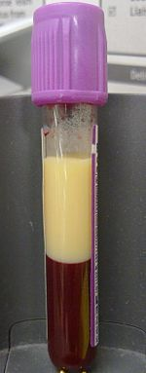
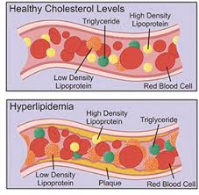
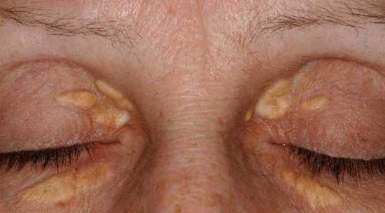
Hyperlipidemia

Slide 3
The story of lipids
Chylomicrons transport fats from the intestinal mucosa to the liver
In the liver, the chylomicrons release triglycerides and some cholesterol and become low-density lipoproteins (LDL).
LDL then carries fat and cholesterol to the body’s cells.
High-density lipoproteins (HDL) carry fat and cholesterol back to the liver for excretion.

Slide 5
The story of lipids (cont.)
When oxidized LDL cholesterol gets high, atheroma formation in the walls of arteries occurs, which causes atherosclerosis.
HDL cholesterol is able to go and remove cholesterol from the atheroma.
Atherogenic cholesterol → LDL, VLDL, IDL

Slide 6
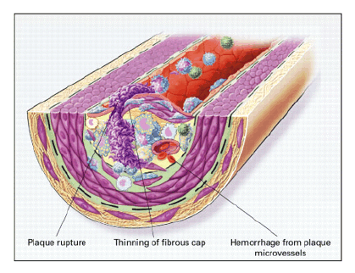
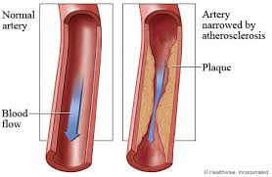
Atherosclerosis

Slide 7
Causes of Hyperlipidemia
Diet
Hypothyroidism
Nephrotic syndrome
Anorexia nervosa
Obstructive liver disease
Obesity
Diabetes mellitus
Pregnancy
Acute hepatitis
Systemic lupus erythematousus (SLE)
AIDS (protease inhibitors)

Slide 8
Dietary sources of Cholesterol
Type of Fat | Main Source | Effect on Cholesterol levels
Monounsaturated | Olives, olive oil, canola oil, peanut oil, cashews, almonds, peanuts and most other nuts; avocados | Lowers LDL, Raises HDL
Polyunsaturated | Corn, soybean, safflower and cottonseed oil; fish | Lowers LDL, Raises HDL
Saturated | Whole milk, butter, cheese, and ice cream; red meat; chocolate; coconuts, coconut milk, coconut oil , egg yolks, chicken skin | Raises both LDL and HDL
Trans | Most margarines; vegetable shortening; partially hydrogenated vegetable oil; deep-fried chips; many fast foods; most commercial baked goods | Raises LDL

Slide 9
Hereditary Causes of Hyperlipidemia
Familial Hypercholesterolemia
Codominant genetic disorder, coccurs in heterozygous form
Occurs in 1 in 500 individuals
Mutation in LDL receptor, resulting in elevated levels of LDL at birth and throughout life
High risk for atherosclerosis, tendon xanthomas (75% of patients), tuberous xanthomas and xanthelasmas of eyes.
Familial Combined Hyperlipidemia
Autosomal dominant
Increased secretions of VLDLs
Dysbetalipoproteinemia
Affects 1 in 10,000
Results in apo E2, a binding-defective form of apoE (which usually plays important role in catabolism of chylomicron and VLDL)
Increased risk for atherosclerosis, peripheral vascular disease
Tuberous xanthomas, striae palmaris

Slide 10
Checking lipids
Nonfasting lipid panel
measures HDL and total cholesterol
Fasting lipid panel
Measures HDL, total cholesterol and triglycerides
LDL cholesterol is calculated:
LDL cholesterol = total cholesterol – (HDL + triglycerides/5)

Slide 11
When to check lipid panel
Two different Recommendations
Adult Treatment Panel (ATP III) of the National Cholesterol Education Program (NCEP)
Beginning at age 20: obtain a fasting (9 to 12 hour) serum lipid profile consisting of total cholesterol, LDL, HDL and triglycerides
Repeat testing every 5 years for acceptable values
United States Preventative Services Task Force
Women aged 45 years and older, and men ages 35 years and older undergo screening with a total and HDL cholesterol every 5 years.
If total cholesterol > 200 or HDL <40, then a fasting panel should be obtained
Cholesterol screening should begin at 20 years in patients with a history of multiple cardiovascular risk factors, diabetes, or family history of either elevated cholesteral levels or premature cardiovascular disease.

Slide 12
Goals for Lipids
LDL
< 100 →Optimal
100-129 → Near optimal
130-159 → Borderline
160-189→ High
≥ 190 → Very High
Total Cholesterol
< 200 → Desirable
200-239 → Borderline
≥240 → High
HDL
< 40 → Low
≥ 60 → High
Serum Triglycerides
< 150 → normal
150-199 → Borderline
200-499 → High
≥ 500 → Very High

Slide 13
Determining Cholesterol Goal (LDL!)
Look at Joint National Committee (JNC) 7 Risk Factors
Cigarette smoking
Hypertension (BP ≥140/90 or on anti-hypertensives)
Low HDL cholesterol (< 40 mg/dL)
Family History of premature coronary heart disease (CHD) (CHD in first-degree male relative <55 or CHD in first-degree female relative < 65)
Age (men ≥ 45, women ≥ 55)

Slide 14
Determining Goal LDL
CHD
CHD Risk Equivalents:
Peripheral Vascular Disease
Cerebral Vascular Accident
Diabetes Mellitus

Slide 15
LDL Goals
0-1 Risk Factors:
LDL goal is 160
If LDL ≥ 160: Initiate TLC (therapeutic lifestyle changes)
If LDL ≥ 190: Initiate pharmaceutical treatment
2 + Risk Factors
LDL goal is 130
If LDL ≥ 130: Initiate TLC
If LDL ≥ 160: Initiate pharmaceutical treatment
CHD or CHD Risk Equivalent
LDL goal is 100 (or 70)
If LDL ≥ 100: Initiate TLC and pharmaceutical treatment

Slide 17
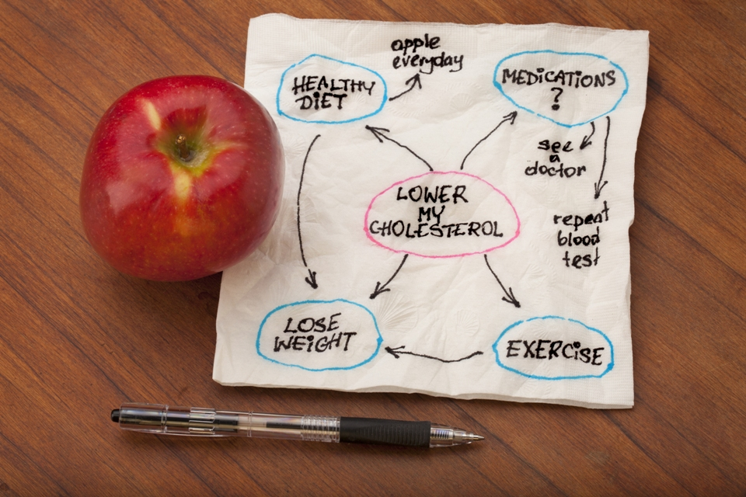

Slide 18
Treatment of Hyperlipidemia
Lifestyle modification
Low-cholesterol diet
Exercise

Slide 19
Medications for Hyperlipidemia
Drug Class | Agents | Effects (% change) | Side Effects
HMG CoA reductase inhibitors | Lovastatin Pravastatin | ↓LDL (18-55),↑ HDL (5-15) ↓ Triglycerides (7-30) | Myopathy, increased liver enzymes
Cholesterol absorption inhibitor | Ezetimibe | ↓ LDL( 14-18), ↑ HDL (1-3) ↓Triglyceride (2) | Headache, GI distress
Nicotinic Acid |  | ↓LDL (15-30), ↑ HDL (15-35) ↓ Triglyceride (20-50) | Flushing, Hyperglycemia, Hyperuricemia, GI distress, hepatotoxicity
Fibric Acids | Gemfibrozil Fenofibrate | ↓LDL (5-20), ↑HDL (10-20) ↓Triglyceride (20-50) | Dyspepsia, gallstones, myopathy
Bile Acid sequestrants | Cholestyramine | ↓ LDL ↑ HDL No change in triglycerides | GI distress, constipation, decreased absorption of other drugs

Slide 20
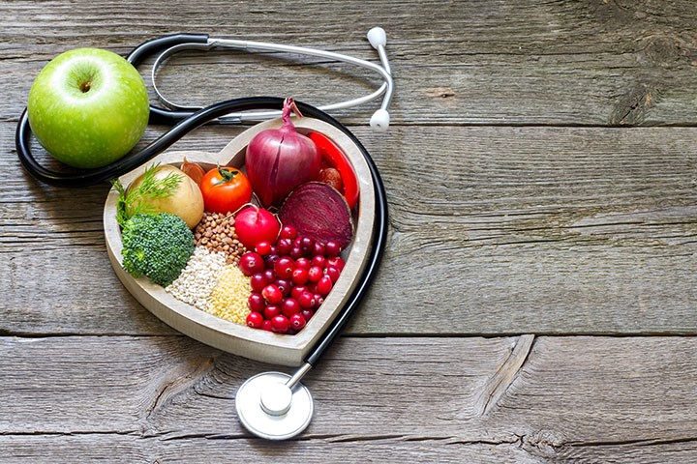

Slide 21
TLC
Therapeutic Lifestyle Changes
Lower your cholesterol, decrease risk for heart disease, and lose weight with the Therapeutic Lifestyle Changes (TLC) Diet, a weight-loss program created by the National Institute of Health (NIH) and endorsed by the American Heart Association. Following the TLC Diet is simple -- you’ll cut back on saturated fats, incorporate more fiber into your diet, and add regular exercise into your daily routine to get your health back on track.
How It Works:
First, know why you’re starting the TLC Diet to help determine your daily caloric intakes. If the objective is to lower LDL cholesterol, men should consume 2,500 calories per day and women should consume 1,800 calories per day. If the objective is to lower LDL cholesterol and lose weight, men should consume 1,600 calories per day and women should consume 1,200 calories per day.

Slide 22
There are a few rules from NIH you’ll need to follow each day when keeping to your calorie count:
Consume less than 7 % of your daily calories from saturated fat.
Consume less than 200 mg a day of cholesterol.
Consume 25-35 % of your daily calories from total fat (including the saturated fat calories).
Eat two grams per day of plant stanols or sterols if you want to lower LDL cholesterol. You can find these in things like orange juice, cereal, and granola bars.
Eat 10-25 grams per day of soluble fiber found in things like nuts, seeds, beans, and lentils if you want to lower your LDL cholesterol.

Slide 23
Eat no more than five ounces of meat, preferably skinless chicken or fish.
Eat two to three servings of low-fat or fat-free dairy per day.
Eat three to five servings of vegetables, dry beans, or peas per day.
Eat two to four servings of fruit per day.
Eat six or more servings of breads, cereals, or grains per day.
Eat no more than two egg yolks per week, including the yolks in baked goods and cooked or processed foods.
Plus, you should have 30 minutes of moderate-intensity exercise every day

Slide 24
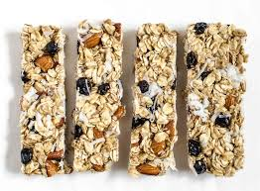
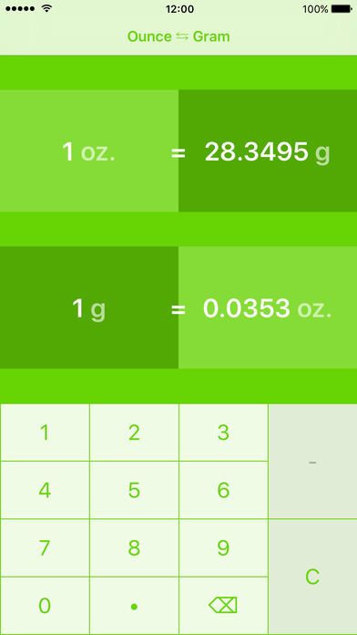
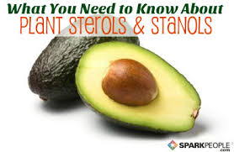

Slide 25
Cutting out bad fat from your diet will help to lower your cholesterol, since fat, especially saturated and trans fat, increases your LDL (bad cholesterol) which increases risk for heart disease. Plus, consuming more soluble fiber is also beneficial, as it can help reduce your risk for heart disease and fills you up so that you’ll eat fewer calories. Overall, eating a healthier diet and getting active for 30 minutes each day will improve your health and help you lose weight.
.

Slide 27
