Slide 1
Acute and Chronic Osteomyelitis
Supervised By: Dr. Abdulqader Al-Habashneh
Done By: Qabas Al-Hawamdeh

Slide 2
Introduction
The difference between bone infection and soft-tissue infection: bone consists of a collection of rigid compartments; it is more susceptible than soft tissues to vascular damage and cell death from the build-up of pressure in acute inflammation.
Unless it is rapidly suppressed, bone infection will lead to necrosis.
The honeycomb of inaccessible spaces (Cancellous Bone) also makes it very difficult to eradicate infection once it is established.
bone surfaces and foreign implants, protected from both host defences and antibiotics by a protein– polysaccharide slime (Biofilm).

Slide 3
Susceptibility to infection is increased by:
(a) Local factors such as; Trauma (esp. Open fractures), Poor circulation, Vascular disease, Chronic bone or joint disease, Surgery, Surgical prostheses and implants, and the Presence of foreign bodies.
(b) Systemic factors such as; Malnutrition, General illness, Diabetes, Sickle-cell disease, Rheumatoid disease, Corticosteroid administration and Immunosuppression.

Slide 4
Acute Pyogenic Infection: there is formation of pus which is often localized in an abscess. Pressure may rise within the abscess and infection may then extend directly along the tissue. It may also spread via lymphatics (causing lymphangitis and lymphadenopathy) or via the blood stream (bacteraemia and septicaemia).
Chronic Infection: there is formation of granulation tissue. It may be due to progression of acute infection or, chronic from the start depending on the type of organism and the host reaction, as in TB. Systemic effects are less acute.

Slide 5
The main principles of treatment:
(1) provide analgesia and general supportive measures
(2) rest the affected part
(3) initiate antibiotic treatment or chemotherapy
(4) evacuate pus and remove necrotic tissue
(5) stabilize the bone if it has fractured
(6) maintain soft-tissue and skin cover

Slide 6
Osteomyelitis
Osteo- : Bone
-Myelo- : Bone Marrow
-Itis : Inflamation
An inflamation of bone and bone marrow due to infection.

Slide 7
Epidemiology
Bone and joint infections from haematogenous spread remain common worldwide
The increased use of implants for joint replacement and fracture fixation is an important source of new infections
Immunocompromised patients are another increasing source (e.g. diabetes, cancer treatment)

Slide 8
The major Causative Organisms
Staphylococcus aureus is the most common organism.
In young children Haemophilus influenzae used to be a fairly common pathogen, but the introduction of H. influenzae type B vaccination reduced incidence of this infection.
Patients with sickle-cell anaemia are prone to infection by Salmonella typhi.
Unusual organisms are also found in heroin addicts and IV drug abusers.

Slide 9
Pathology
Methods of Entry and Spreading:
-Heamatogenous {Children}
-Direct extension (Contiguous local infection) {Adults}
-Direct implantation (Inoculation).
All these forms can progress to chronic osteomyelitis, if inadequetaly treated.
Osteomyelitis may spread to other Bones (metastatic osteomyelitis) should pay attention to them.

Slide 10
Acute osteomyelitis occurs when pathogenic organisms cause infection, leading to inflammation in the bone and surrounding tissues. The medullary bone may form abscesses and the infection may track through the cortex to form periosteal elevation and soft-tissue extension. This process will devascularise the bone, causing bone death.
Bacteria can adhere to dead bone or implant surfaces, forming a complex community enveloped in a polysaccharide matrix (Biofilm/Glycocalyx).
These bacteria alter their metabolic state, making them more resistant both to the host immune system and to antibiotics.
Toxins and lytic enzymes from bacteria cause early damage to articular cartilage.

Slide 11
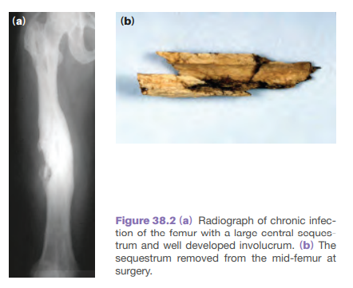
The infected bone reacts to the infection by separating dead fragments of bone (sequestration) and forming sinuses to drain pus and discharge small bone fragments. New bone is laid down around the infection from the periosteum (involucrum)​, and these indicate Chronicity.

Slide 12
The classical changes and progression:
Inflammation; earliest change, The intraosseous pressure rises, causing intense pain and obstruction of blood flow.
Suppuration; By the second day pus appears in the medulla and forces its way along the Volkmann canals to the surface, where it forms a subperiosteal abscess. It then may undergo spreading along the shaft, to re-enter the bone at another level, or bursts out into the soft tissues.
Necrosis; The rising intraosseous pressure, vascular stasis, infective thrombosis and periosteal stripping increasingly compromise the blood supply, by the end of 1 week there is usually evidence of necrosis.

Slide 13
New bone formation; New bone forms from the deep layer of the periosteum (Cambium), Involucrum may be seen.
- If the infection persists, pus may discharge through perforations (cloacae) in the involucrum and track by sinuses to the skin surface; the condition is now established as a chronic osteomyelitis.
Resolution; If the infection is controlled and intraosseous pressure released at an early stage.

Slide 14
Diagnosis
Diagnosis is predominantly clinical with confirmation using other tests.
In Adults; usually the cancellous bone is affected; Vertebrae and Feet.
In Children; usually the vascular bone is affected; Long bone metaphysis (esp. Proximal and distal femur and proximal tibia).

Slide 15
Acute Hematogenous Osteomyelitis
Acute osteomyelitis almost invariably occurs in children; when adults are affected it may be because of lowered resistance or local trauma.
C/F:
- Children over the age of 4 years are most commonly affected.
- severe pain, malaise and a fever (spiking); toxaemia may be marked. Sometimes a history of a preceding skin lesion, an injury or a sore throat may be obtained.
- gentlest manipulation is painful and joint movement is restricted (pseudoparalysis).
- Local redness, swelling, warmth and oedema are later signs and signify the presence of pus.

Slide 16
In infants; and especially in the newborn, the constitutional disturbance can be mild; the baby simply fails to thrive and is drowsy but irritable.
Suspicion should be aroused by a history of birth difficulties or umbilical artery catheterization.
There may be metaphyseal tenderness and resistance to joint movement.
In adults; the commonest site of haematogenous infection is the spine. Suspicious features are backache and a mild fever, possibly following a urological procedure.

Slide 17
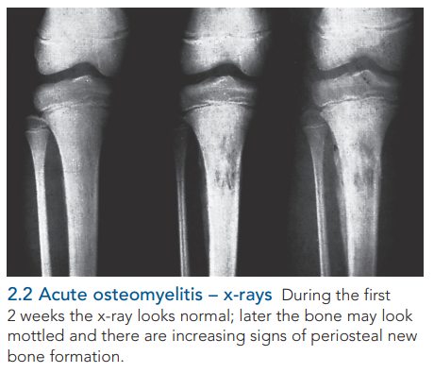
Investigations:
Imaging:
For the first 10 days plain x-rays show no abnormality
Radio-isotope scans may show increased activity but it is non specifc.
By the end of the second week there may be early radiographic signs of rarefaction of the metaphysis and periosteal new bone formation.
Magnetic resonance imaging (MRI) is the investigation of choice (Sensitve & Specific), and it may shows pathological changes before x-rays and can help to distinguish between bone and soft-tissue infection.

Slide 18
Laboratory investigations:
Elevated WBC, ESR, CRP.
Blood cultures.
Pus Aspiration; is the most certain way to confirm the clinical diagnosis is to aspirate from the subperiosteal abscess or the adjacent joint. The smear of the aspirate is examined immediately for cells and organisms, bacteriological examination, and tests for sensitivity to antibiotics are done.
N.B. CRP is a sensitive marker for monitoring progress during the course of treatment.

Slide 19
Treatment:
prompt administration of antibiotics is so vital that the result is not awaited before starting treatment (empirical therapy).
Then after sensetivity results arrive, treat specifically according to tests.
The drugs should be administered intravenously until the patient’s condition begins to improve and the CRP values return to normal levels (2-4 weeks).
Thereafter, the antibiotic should still be administered orally for at least another 3–6 weeks
Supportive treatment; Continuous bed rest, splinting, analgesics
Pus drainage should be seeked if no improvement within 36 hrs. Of treatment.

Slide 20
Complications:
■ Spread: infection may spread to the joint (septic arthritis) or to other bones (metastatic osteomyelitis).
■ Pathological fracture: occasionally the bone is so weakened that it fractures at the site of infection or operative perforation.
■ Growth disturbance: if the physis is damaged there may later be shortening or deformity.
■ Persistent infection: treatment must be prompt and effective. ‘Too little too late’ may result in chronic osteomyelitis.

Slide 21
Subacute haematogenous osteomyelitis
may present in a relatively mild form, presumably because the organism is less virulent or the patient more resistant.
Laboratory investigations are often negative.
The typical x-ray picture is of a small, oval cavity surrounded by sclerotic bone (Brodie’s abscess), but sometimes the lesion is more diffuse.
A radio-isotope scan will show increased activity.
If the condition is troublesome, the abscess is opened under antibiotic cover

Slide 22
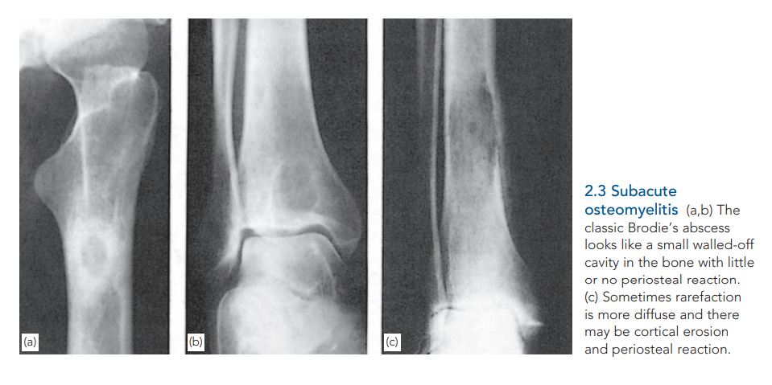
Treatment may be conservative if the diagnosis is not in doubt; Immobilization and antibiotics intravenously for 4 or 5 days and then orally for another 6 weeks often result in healing.
If the x-ray shows that there is no healing after conservative treatment, open curettage may be indicated; this is always followed by a further course of antibiotics.

Slide 23
Chronic Osteomyelitis
This used to be a common sequel to acute haematogenous osteomyelitis; nowadays it more frequently follows an open fracture or operation.
Bacteria can remain dormant for years, giving rise to recurrent acute flares and purulent discharges.
S. epidermidis is the commonest pathogen.

Slide 24
C/F:
recurrent bouts of pain, redness and tenderness at the affected site.
Investigations:
Classic signs are healed and discharging sinuses and x-ray features of bone rarefaction surrounded by dense sclerosis and cortical thickening; within that area there may be an obvious sequestrum.
Sinogram can help to localize the focus of active infection, and bone scans are useful in revealing hidden foci of inflammatory activity.
CT and MRI are invaluable in planning operative treatment.
Organisms cultured from discharging sinuses should be tested repeatedly for antibiotic sensitivity; with time, they often change their characteristics.

Slide 25
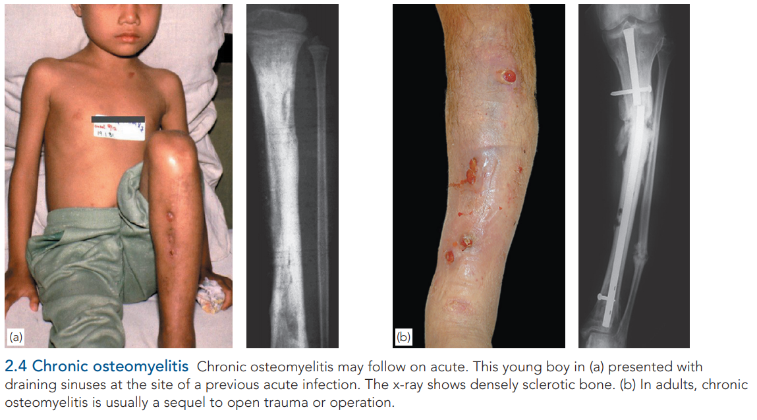
Treatment:
Treatment depends on the frequency of relapsing flare-ups, a flare often settles with a few days’ rest.
Treatment is almost always surgical, but it may conservative sometimes.
A sinus may be painless and need a dressing.
Abscess should udergo I&D.

Slide 26
Antibiotics are often used, though most fail to penetrate the barrier of fibrous tissue and bone sclerosis.
In refractory or frequently recurring cases it may be possible to excise the infected and/or devitalized segment of bone and then closing the gap surgically.
Chronic infection is seldom eradicated by antibiotics alone.
Yet bactericidal drugs are important as they; suppress the infection and prevent its spread to healthy bone, and control acute flares.
Debridement is repeated. Antibiotic cover is continued for at least 4 weeks after the last debridement.

Slide 27
 | Acute Osteomyelitis | Subacute Osteomyelitis | Chronic Osteomyelitis
Duration | < 2 weeks | 2-6 weeks | > 6 weeks
Clinical features | fever,malaise, localized joint pain with redness and swelling . | mild symptoms and Pain is the most common symptom. **Night pain that is relieved with aspirin is frequently reported. | recurrent bouts of pain, redness and tenderness at the affected site, healed and discharging sinuses
imaging findings | no findings on x-ray on mri there is marrow edema | Brodie's abscess | bone rarefaction , dense sclerosis , sequestrum , involucrum
Treatment | if marrow edema only then IV antibiotic and bed rest . if edema+pus then drainage+IV antibiotic . | same as acute | always surgery
NOTES | **mcc is staph aureus | **DDX are osteoid osteoma and non ossifying fibroma if Dx is in doubt do an open biopsy . **mcc is staph aureus. | **nowadays it more frequently follows an open fracture or operation. *mcc is S. epidermidis

Slide 28
References:
Apley and Solomon's Concise System of Orthopaedics and Trauma 4th edition.
Bailey & Love's Short Practice of Surgery 27th edition.
Oxford Handbook of Clinical Specialities 11th edition.

Slide 29
Thank You

