Slide 1
Drugs modifying cholinergic transmission
By
Dr.Nashwa Abo-Rayah
Assistant prof. (clinical &experimental pharmacology)
Mu’tah University- Faculty of Medicine

Slide 2
OBJECTIVES
1- The main neurotransmitter in the parasympathetic nervous system
2- Cholinergic receptors
3- definition of parasympathomimetic drugs
4- choline esters
5- cholinomimetic alkaloids
6- anticholinestrases
7- organophosphate poisoning
8- Alzihymer’s disease
9- Myasthenia gravis

Slide 3
The main neurotransmitter in the parasympathetic nervous system:
ACETYLCHOLINE
Cholinergic neuron (ACH is neurotransmitter): sites of acetylcholine:
1- parasympathetic nerve endings
2- some sympathetic nerve fibers (sympathetic cholinergic):
preganglionic fibers terminating in the adrenal medulla
Sweat glands: except sweat glands in palms and forehead which receive sympathetic adrenergic nerve fibers.
3- autonomic ganglia (both parasympathetic and sympathetic )
4- postganglionic fibers of the parasympathetic division, - voluntary
muscles of the somatic system (neuromuscular junction)
5- CNS: many functions especially memory (pathogenesis of Alzheimer disesse)

Slide 4
Is acetylcholine inhibitory or excitatory neurotransmitter?

Slide 5
Excitatory:
M1,3,5 receptors: increasing intracellular calcium ion
Nicotinic receptors: increasing intracellular sodium ion
Inhibitory:
M2,4: increasing potassium ion efflux.

Slide 7
Cholinergic receptors
Muscarinic: peripheral cholinergic receptors
Nicotinic : central cholinergic receptors
Nm: muscular: muscle contraction: increasing intracellular Na+.
Nn: neural: increase intracellular Na+
1- CNS stimulation
2- increase secretion of suprarenal gland
3- stimulation of autonomic ganglia

Slide 8
Muscarinic receptors

Slide 9
Characteristic | M₁ (neutral) | M₂ (cardiac) | M₃ (glandular/ smooth muscle | M₄ | M₅
Site | CNS, smooth muscles in Glands: gastric, salivary, endothelium | Heart: atria: SAN Presynaptic | Exocrine glands: gastric, salivary, etc. Smooth muscle: GI tract, eye Blood vessels: endothelium(not innervated??? | Presynaptic CNS | CNS
physiological action | CNS excitation Gastric secretion Increase release of EDRF | Cardiac inhibition Control of acetylcholine release (-ve feed back) | Gastric, salivary secretion; GI smooth muscle contraction; Ocular accomodation; Vasodilatation | Presynaptic inhibition of neurotransmitter release | CNS stimulation
Agonist (non-selective) | ACh; Carbachol; (Oxotremorine, | As M₁ | As M₁ | As M₁ | As M₁
Antagonist (non-selective except those in italics) | Atropine; Dicycloverine (dicyclomine); Ipratropium; Pirenzepine; | Atropine Ipratropium Gallamine | Atropine Ipratropium | Atropine Ipratropium | Atropine Ipratropium

Slide 10
Muscarinic Receptors
M₁ , M_{3,} M5 ↓
G_{q}
Activation of PLC
M₂ & M₄ ↓
G_{i}
Formation of IP₃
Formation of DAG
α subunit
β subunit
Release of
Intracellular
Calcium
Activation of
PKC
Inhibition of
Adenylyl Cyclase
Opening of
Potassium
Channels

Slide 12
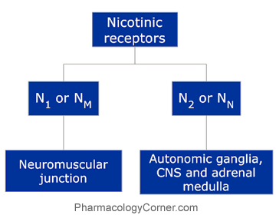

Slide 13
parasympathomimetics=Cholinomimetics= Parasympathetic stimulants or agonists:
Drugs that promote cholinergic transmission
Drugs when administered give an effect similar to stimulation of parasympathetic nervous system.

Slide 15
Pharmacological Action of ACh & Cholinomimetics:

Slide 16
(A) Muscarinic actions
Heart: M2
Decrease in heart rate ( sinus bradycardia): -ve chronotropic.
Increase atrial conductivity
Decrease in conductivity in A VN ( -ve dromotropic) .
No direct effect on ventricles

Slide 17
Blood Vessels: Vasodilatation of arterioles and venueles .
Blood pressure: Hypotension
Bronchi: Bronchoconstriction
Respiratory secretion: increase ciliary movement. Increase secretion

Slide 18
GIT:
Stimulation of the Motility of the smooth muscles of wall of GIT
Sphincters: relaxation
GIT Secretions: stimulation.
GENITOURINARY:
Detrusor muscle: stimulation.
Sphincter: relaxation
Trigone: urethral sphincter relaxation. This results in promotion of micturition.

Slide 19
EYE:
Twitches of upper eye lid (Nicotinic action).
Stimulation of constrictor pupillae muscle (miosis).
Spasm of ciliary muscle muscle (accomodation to near vision).
Improvement of Aqueous humour drainage (decrease
I.O.P).
Exocrine Glands:
Stimulation of all exocrine glands.
Sweat glands --------- Sweating.
Lacrymal glands ------ tears.
Salivary glands ------- salivation.
Bronchial and gastrointestinal gland

Slide 21
(B) Nicotinic Actions:
1-Skeletal muscle: Fasiculation and twitichs
2- Adrenal medulla: Release of adrenaline and noradrenaline.

Slide 22
3-Autonomic ganglia:
1- Small dose of ACH produces a decrease in blood pressure (hypotension) of short duration. This effect is mediated through stimulation of muscarinic receptors. This hypotensive effect is blocked after injection of atropine.
2- Large dose of ACH after injection of atropine: produces an increase instead of a decrease in the blood pressure. This effect is due to:
a- Stimulation of sympathetic ganglia resulting in the release of adrenaline and noradrenaline .
b- Stimulation of the adrenal medulla resulting in the release of adrenaline and noradrenaline

Slide 23
Acetylcholine reversal

Slide 24
I- Choline esters
1) Actylcholine.
2) Methacholine.
3) Carbachol.
4) Bethacholine (bethanechol)

Slide 25
General properties:
l- Presence of the B- methyl group (methacholine, bethanechol) reduces the potency of these drugs at the nicotinic receptors .
2- The carbamic acid esters (carbachol,bethanechol) are completely resistant to hydrolysis by cholinesterase enzyme and have longer duration of action.
3- They are effective orally & parentrally.
4- They are more selective in their actions.

Slide 26
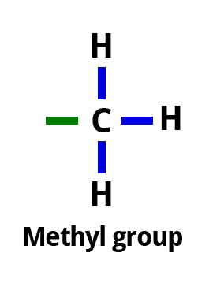
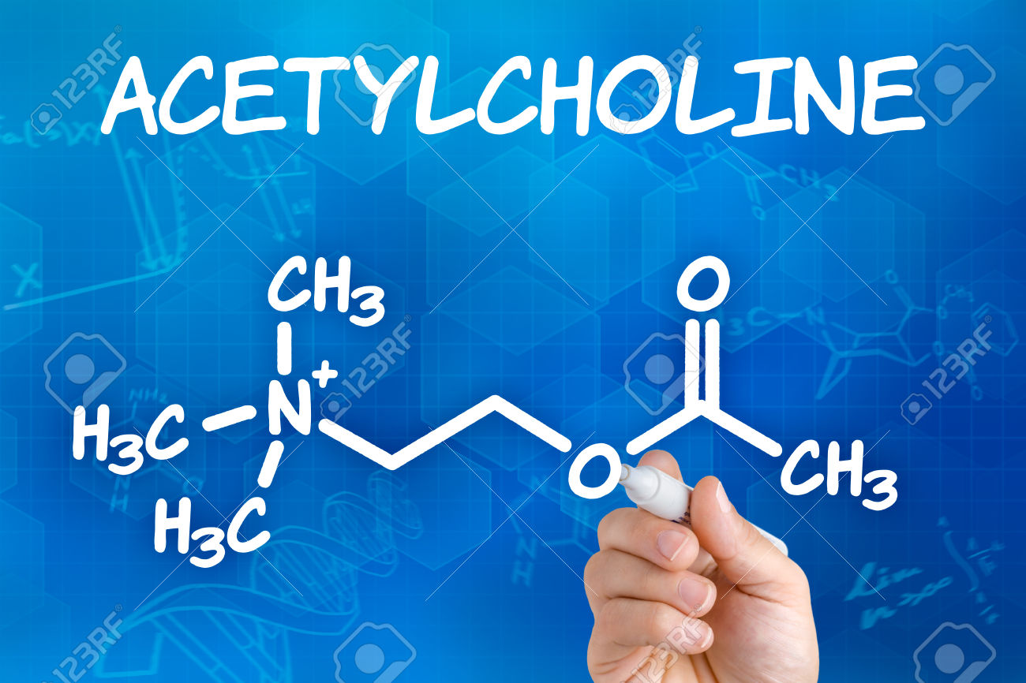
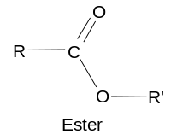
Carbamic acid ester
Ester of acetic acid with choline

Slide 28
Clinical Uses of Cholinesters:
l) Postoperative urine retention without obstructions (stone, constriction or enlarged prostate) e.g. bethacholine
2) Postoperative paralytic ileus or gastric atony e.g. bethacholine.
3) Open angle glaucoma.
4) Alternative with mydriatics to break adhesions between iris & lens.
5) Treatment of paroxysmal supraventricular tachycardia because they produce M2 mediated bradycardia.
6) Diagnosis of intermittent type of pheochromocytoma. Carbachol augments nicotinic receptor mediated adrenaline release from suprarenal gland. Increase in blood pressure by 30 mmHg systolic and to 15 mm Hg diastolic is diagnostic for pheochromocytoma
7) Treatment of xerophthalmia, xerostomia due to autoimmune parotitis and conjunctivitis) (SjOgren syndrome) (pilocarpine &cevimeline)

Slide 30
Contraindications of Cholinesters:
1) Angina pectoris (due to hypotension and coronary insufficiency).
2) Bronchial asthma (due to bronchoconstriction and increase in bronchial secretions
3) Hyperthyrodism (due to cardiac arrhythmia).
4) Peptic ulcer (due to ↑ gastric motility and secretions).
5) gastrointestinal and urinary hypotonia with organic obstruction

Slide 31
II- Pilocarpine (cholinomimetic alkaloid)
It is a tertiary amine alkaloid which possesses muscarinic activity.
Its action is similar to methacholine. It causes initial increase in blood pressure due to adrenaline release from suprarenal gland as a result of stimulation of nicotinic receptors in suprarenal gland followed by decrease due to M receptor mediated vasodilatation.
When applied locally in the eye produces miosis and fall in intraocular pressure .
It can be blocked by the muscarinic blocker ( atropine) .
It is resistant to hydrolysis by both pseudo & true-cholinesterase

Slide 32
Clinical Uses of Pilocarpine:
1) Glaucoma (open angle type) 1 % drops.
2) Alternative with mydriatics to break adhesions between iris and lens.
3) It is topically applied to promotion of hair growth in case of alopecia.
It acts by increasing blood flow of the scalp by local vasodilatation .
4) In treatment of atropine over-dosage.
5) sjugreen syndrome

Slide 34
III-Anticholinesterases

Slide 35
(Weak bond)
Produce transient carbamylation of the enzyme
(Usually toxin)
Produces permanent phosphorylation of the enzyme

Slide 36
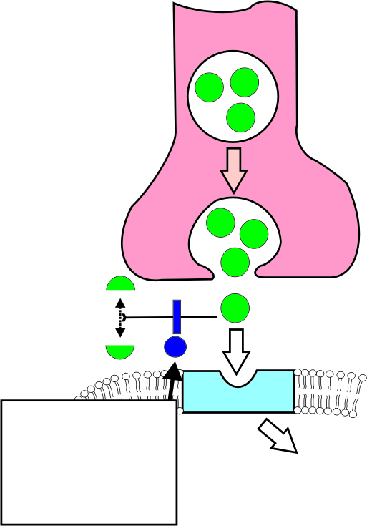
Mechanisms of action of indirect
(reversible) cholinergic agonists.
NEURON
Acetate
Acetylcholine
Choline
Echothiophate
Edrophonium
Neostigmine
Physostigmine
Increased
intracellular
response

Slide 37
(eserine)
From physiostgmine (neo)
One charge:ionized
Muscarinic and nicotinic
Inhibits both types of the enzyme
To increase Ach peripherally
1Anticholinestrase & direct stimulant of skeletal muscles
2- Administered with atropine?

Slide 38
**Main use to avoid systemic side effects, most powerful miotic

Slide 39
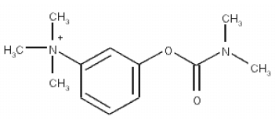
Neostigmine

Slide 41
Pyridostigmine is preferred over neostigmine in treatment of M.gravis?
1- more selective on skeletal muscle: no need for atropine administration (no sever muscarinic side effects)
2- longer duration of action: 5-6 hs while neostigmine duration of action is 2 hs.

Slide 42
Edrophonium (tensilon):
More selective than neostigmine and pyridostigmine: no muscarinic side effects.
Very Short duration of action: 5 min. Diagnosis
of M.Gravis: (tensilon test ): parental edrophonium
Improvement of M.gravis symptoms e.g.ptosis.
Differential diagnosis of Maythinic crisis and cholinergic crisis: tensilon test:
Improvement of symptoms in M.crisis
Worsening of symptoms in cholinergic crisis

Slide 43
Donibezil, rivastigmine: new drugs which are expensive.
Anticholinestrase activity is only central
No peripheral effects treatment of Alzihymerˊs disease: amnesia, dementia, loss of cognetive function due to degeneration of cholinergic neurons and accumulation of beta amyloid protein in CNS insulating neurons from each other.

Slide 45
Long - acting (Irreversible) Cholinesterase Inhibitors
Organophosphates:
1- Isoflurophate (DFP) Used in treatment of glucoma.
2- Echothiophate Used in treatment of glucoma: eye drops.(duration of action 2 weeks: not prefered)
3- Parathion Used as pesticides.
4- Malathion Used as pesticides.
5- nerve gases: sarin غاز الخردل, soman

Slide 47
Symptoms and Signs of organophosphate poisoning:
Rapid absorption even from skin with rapid accumulation in CNS.
1- Nausea, vomiting, abdominal colic and diarrhea.
2- Increase of salivation and sweating.
3- Tightness of the chest with dyspnea.
4- Bradycardia and hypotension.
5- Muscle twitches and convulsions.
6- Constricted pupil (miosis).
7- cause of death respiratory failure: bronchoconstriction, increased bronchial secretions, inhibition of RC, paralysis of resp.muscles.

Slide 49
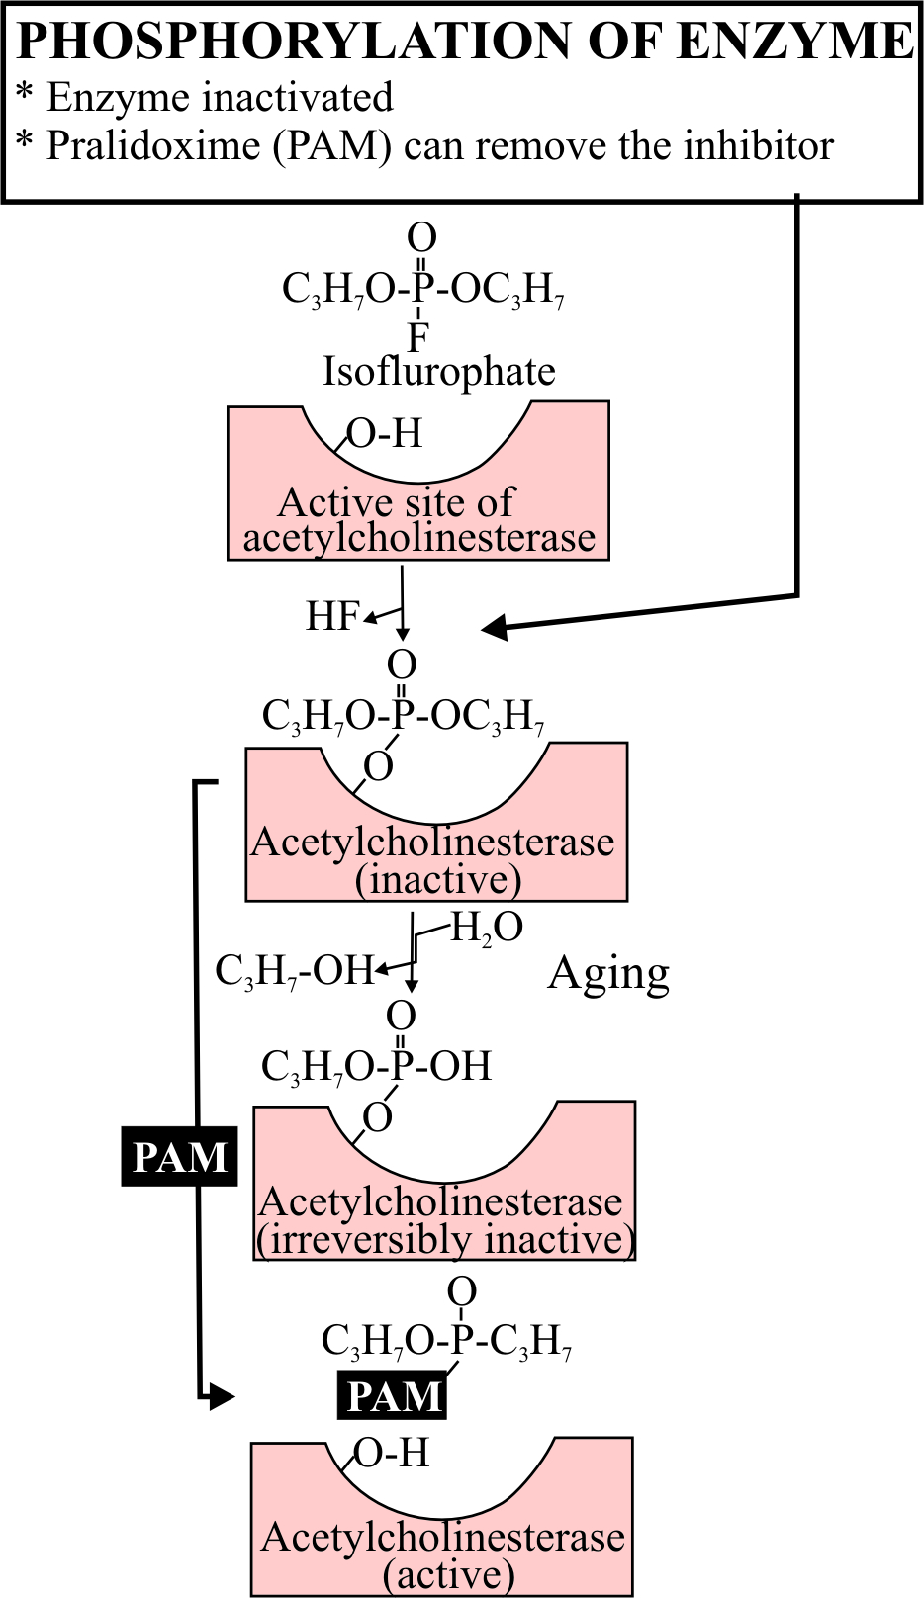
Covalent modification acetylcholinesterase by isoflurophate; also shown is the reactivation of the enzyme with pralidoxime.
Covalent bond takes 12 hours to produce complete inhibition of the enzyme: aging of the enzyme

Slide 50
Management of organophosphate poisoning:
Assessment of patient: ABC
A: air way B: breathing C: circulation: pulse, BP,
1- Endotrachial intubation with artificial respiration.
2- Atropine 2 mg I.V. repeated/5 min. until signs of atropinization appears. (dry mouth, dilated pupil and tachycardia, increase BP) FOLLOW UP FOR 24-48 hs. WHY? Life saving drug
3- diazepam (10 mg IV) preferred to barbiturates to treat convulsions.
4- Fresh blood transfusion.
5- Oximes (PAM, pralidoxime): CHOLINESTRASE REACTIVATORS: DEPHOSPHORYLATION: break the covalent bond.
The treatment with Oximes should be within hours (2gm in 5% Dextrose 100 ml I. V. drip in 20 min.). Oximes produce their effect through:-
a) Direct reaction with enzyme.
b) Direct reaction with inhibited enzyme.
c) Reactivation of inhibited enzyme.

Slide 51
Myasthenia gravis
It is an autoimmune disease (genetic) in which there is an antibody to the A.Ch. nicotinic Nm receptor system which impairs the responsiveness of the neuromuscular junction resulting in weakness and rapid fatigability of skeletal muscles.
More proximal muscles are affected: ptosis, weak mastication muscles, drop of mouth angle, shoulder girdle.
Bulbar muscles when affected: patient dies.

Slide 52
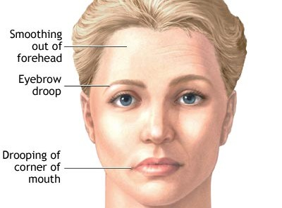
Manifestations of M.gravis

Slide 53
Causes:
1- Curare like substance circulating in blood.
2- Abnormal motor end plate poorly sensitive to A.Ch.
3- Decrease of ACh Concentration at nicotinic receptors at motor end plate.
4- Increase of ACh cholinesterase activity.
5- Autoimmune disease affects motor end plate.

Slide 54
Diagnosis
Neostigmine 1.5 mg + 0.6 mg atropine (to block muscarinic effect) are injected IM this improves muscle weakness.
Edrophonium 2 mg IV if the first dose is without effect 8 mg are injected after 45 seconds.

Slide 55
Treatment:
1- Anticholinesterases: e.g. neostigmine, pyridostigmine and ambenonium (Ambenonium was withdrawn from the market in the United States in 2010).why?
Atropine, belladonna, ganglionic blocking agents (eg, mecamylamine), quinine, or quinidine decrease effectiveness of ambenonium.
Cholinergic agents (eg, guanidine) because the risk of side effects may be increased
N.B. Excessive dosage of an anticholinesterase can lead to prolonged stimulation of nicotinic receptors (Nm) by ACh resulting in a depolarizing blockade of the neuromuscular junction. Therefore, muscle weakness in myasthenia gravis can be the result of either inadequate or excessive dosage of anticholinesterases (cholinergic crisis)
• An antimuscarinic agent is necessary to block the muscarinic effect of ACh especially if large doses of anticholinesterase are given e. g atropine or propantheline.

Slide 56
2- Immunosuppressive drugs:
Prednisolone, azathioprine and cyclosporine.
3- Thymectomy should be considered in myasthenia associated with a thymoma (tumor of the thymus gland)
4- Plasmapharesis to remove circulating antibodies directed against nicotinic receptors.
5- Artificial respiration in acute crises.
6- Potassium chloride because it promote depolarization of skeletal muscles.
7- Ephedrine due to its anti-fatigue effect via B2 mediated increase glycogenolysis and muscle blood flow and muscle potassium

Slide 57
Thank you

