Slide 2
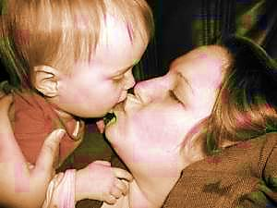
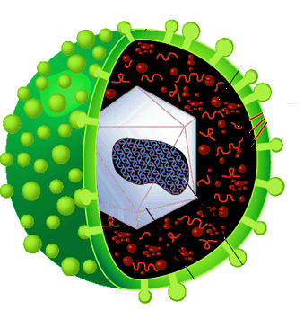
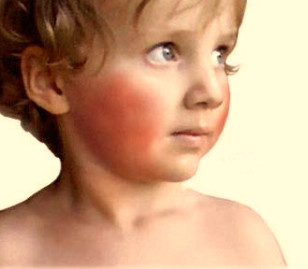
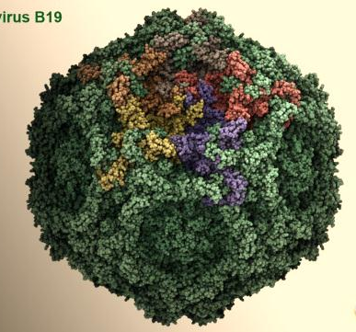
EPSTEIN BARR VIRUS & PARVOVIRUS
By:
Prof. Dr. Ghada Fahmy Helaly
HLS Module

Slide 3
EPSTEIN BARR VIRUS
EBV

Slide 4
Diseases
Infectious mononucleosis.
Burkitt’s lymphoma.
B-cell lymphomas.
Nasopharyngeal carcinoma.
Hairy leukoplakia.

Slide 5
Important Properties:
EBV is also called human herpesvirus 4 (HHV-4).
Infects mainly lymphoid cells, primarily B lymphocytes.
Infects the epithelial cells of the pharynx.
In latently infected cells, EBV DNA is in the nucleus, not integrated. Some genes are transcribed.

Slide 6
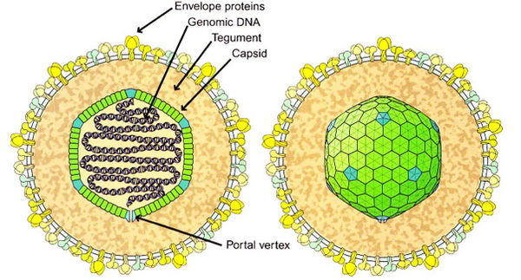
Structure and genome:
Prof. Dr. Ghada Fahmy Helaly
Ds linear DNA enveloped virus.
Approximately 122 - 180 nm in diameter.
The nucleocapsid is surrounded by a tegument made of protein.

Slide 7
EBV antigens and proteins:
A. Latent proteins:
EB viral nuclear antigen complex (EBNA)
Latent membrane protein (LMP)
Terminal protein
Lymphocyte-detected membrane antigen (LYDMA)
B. Lytic cycle proteins:
1. Membrane antigen (MA)
2. Early antigen complex (EA)
3. Viral capsid antigen complex (VCA)

Slide 8
Replicative Cycle:
EBV → naive B cells→ expresses its entire latency gene complex (type III latency)→ B-cell activation.
Type II latency: express only three viral proteins → induces the B cell to differentiate into a memory B cell.
Type I latency: express a single viral protein (EBNA1) .
Type 0 latency: down-regulate all viral proteins.

Slide 9
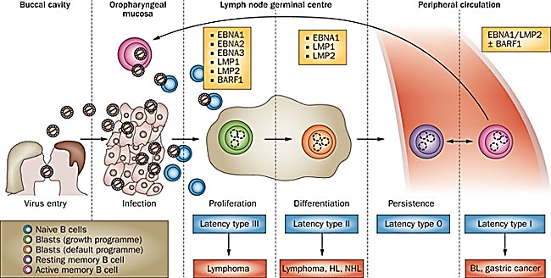
Infected B cells circulate through the oropharynx →epithelial cells → infect new hosts by salivary transfer.

Slide 10
Transmission & Epidemiology
Exchange of saliva (e.g., during kissing).
Blood transmission → very rare.
Objects such as drinking glass,….
EBV infection is worldwide.
In the first few years of life → asymptomatic.
Clinically apparent infectious mononucleosis is highest in those who are exposed to the virus later in life (e.g., college students).

Slide 11
Pathogenesis & Immunity
Oropharynx →blood→ B lymphocytes (Latent). Cytotoxic T lymphocytes “atypical lymphs” react against the infected B cells.
The immune response : IgM abs. to the VCA, IgG abs. to the VCA follows and persists for life.
Lifetime immunity is based on antibody to the viral membrane antigen.
Nonspecific heterophil antibodies →disappear within 6 months after recovery.

Slide 12
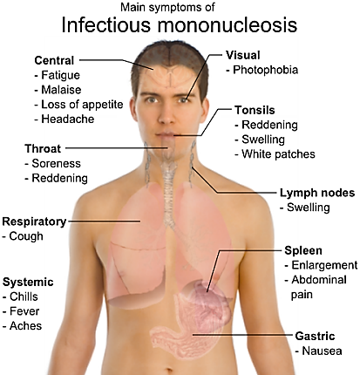
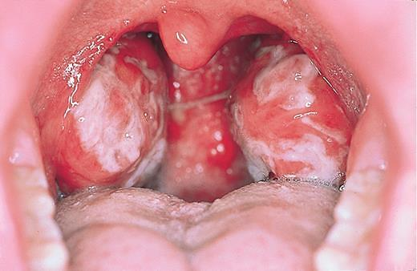
Clinical Findings:
Infectious mononucleosis :
High risk group: 17-25 ys
Acute, self-limiting
Fever, sore throat, lymphadenopathy, anorexia , lethargy and splenomegaly. Hepatitis is frequent; encephalitis in some patients.
Spontaneous recovery in 2 to 3 weeks.
Severe pharyngitis with diffuse pharyngeal inflammation and tonsillar swelling.

Slide 13
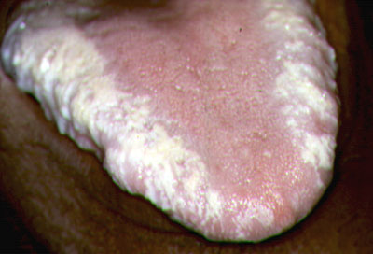
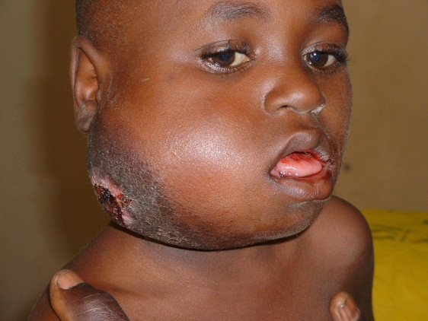
Hairy leukoplakia:
A whitish, non-malignant lesion with an irregular “hairy” surface on the lateral side of the tongue, in immuno-compromised individuals, especially AIDS patients.
Burkitt’s lymphoma, Hodgkin’s lymphoma, nasopharyngeal carcinoma.
post-transplant lymphoproliferative disorder (B-cell lymphoma).

Slide 14
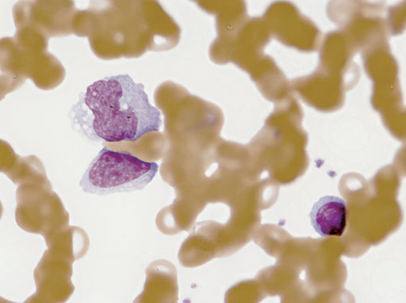
Laboratory Diagnosis:
1. Hematologic :
Absolute lymphocytosis with >10% abnormal lymphocytes.
Atypical lymph: are enlarged cells, expanded nucleus, and an abundant vacuolated cytoplasm.

Slide 15
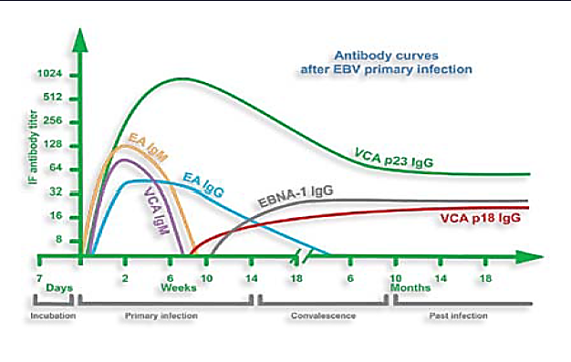
2. immunologic:
The heterophil antibody: early diagnosis of IM usually positive by week 2 of illness.
The EBV-specific antibody tests: The IgM VCA for early illness; IgG VCA for prior infection, antibodies to EA and EBNA.

Slide 16
Molecular assays:
Nucleic acid hybridization is the most sensitive mean of detecting EBV in patient materials.
EBER RNAs are abundantly expressed in both latently and lytically infected cells.

Slide 17
Treatment:
None! Self-limiting
Treat symptoms
Misdiagnosis with streptococcal infection
Acyclovir in high doses may be useful in life threatening EBV infections.

Slide 18
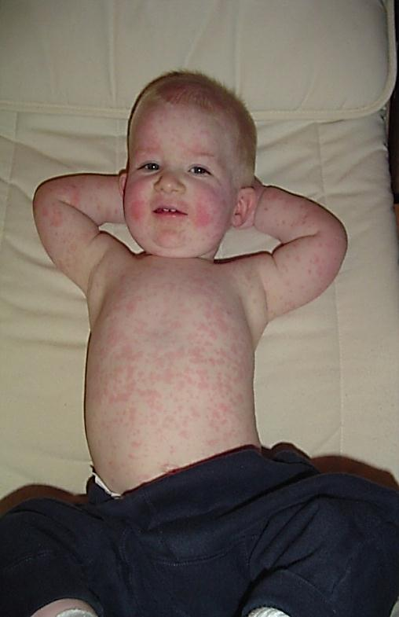
PARVOVIRUS
Parvovirus B19

Slide 19
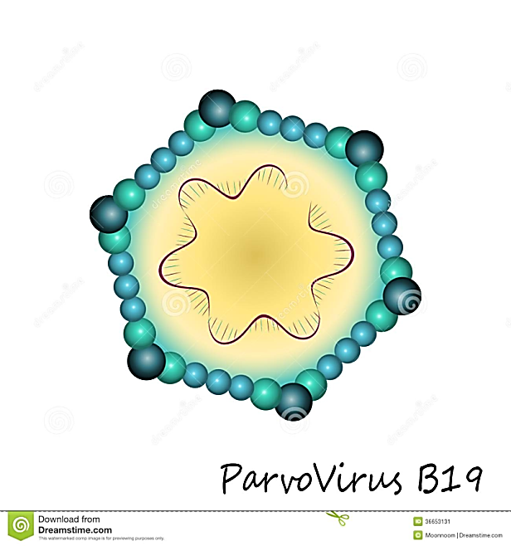
Diseases:
Erythema infectiosum (slapped cheek syndrome, fifth disease)
Aplastic anemia.
Hydrops fetalis.
Important properties:
A very small (22 nm), non-enveloped, icosahedral, with a single-stranded DNA genome, negative-sense, no virion polymerase. There is one serotype.

Slide 20
Transmission:
Respiratory route.
Trans-placental.
Blood donation.
Pathogenesis & Immunity:
B19 virus infects two types of cells:
Erythroblasts in the BM → aplastic anemia.
Endothelial cells →rash.
Immune complexes of virus and IgM or IgG →rash, arthritis.
Infection provides lifelong immunity against reinfection.

Slide 21
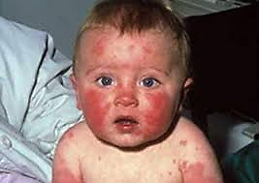
Clinical Findings:
(1): Erythema Infectiosum (Slapped Cheek Syndrome, Fifth Disease):
Mild disease, childhood, low-grade fever, coryza, and sore throat, rash
(2): Aplastic Anemia:
Children with chronic anemia → severe aplastic anemia (aplastic crisis)

Slide 22
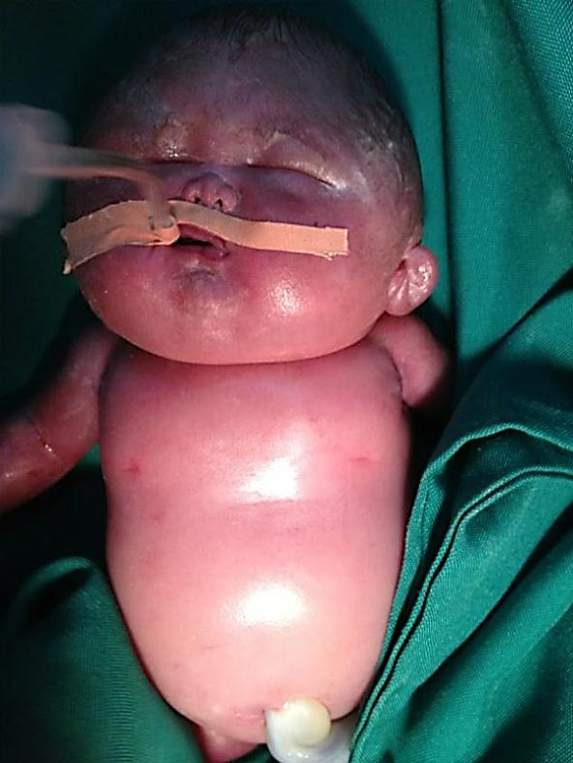
(4): Arthritis:
(3): Fetal Infections:
First trimester→ fetal death.
Second trimester →hydrops fetalis.
Adults, women, small joints of the hands and feet bilaterally.
(5): Chronic B19 Infection:
In immunodeficiencies: chronic anemia, leukopenia, or thrombocytopenia.

Slide 23
Laboratory Diagnosis:
IgM antibodies.
In immuno-compromised patients, viral DNA by PCR.
Fetal infection : PCR of amniotic fluid.
Treatment & Prevention:
No specific treatment.
Immune globulins in immunodeficiencies.
No vaccine.

Slide 24
Thank you

