Slide 1
Pneumothorax
HEBA MUBAIDEEN RAZAN TARAWNEH SUKAINA MADADHA
Dr.Mahmoud khasawneh

Slide 2
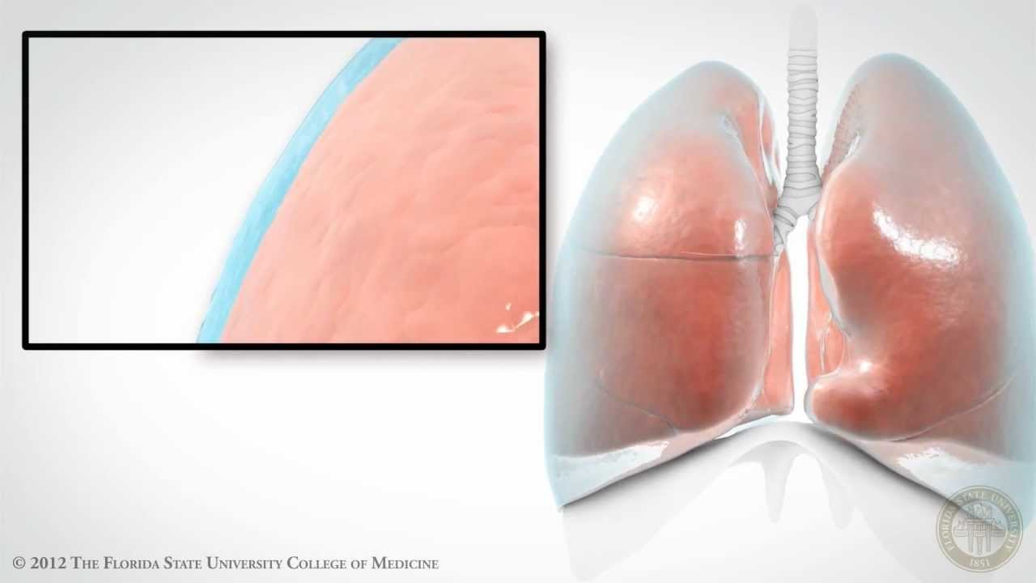
Pleural space
The tiny area between the two layers of the pleura (the thin covering that protects and cushions the lungs) between the lungs and chest cavity. The pleural space is normally filled with a small amount of fluid .

Slide 3
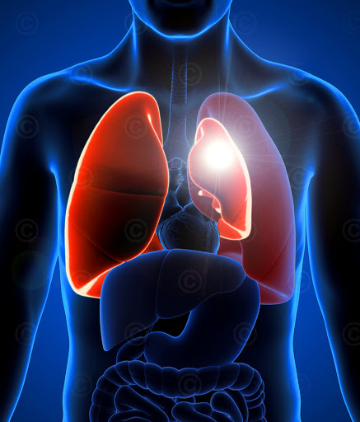
Definition
The presence of air in the pleural space, which can either occur spontaneously, or result from iatrogenic injury or trauma to the lung or chest wall .

Slide 4
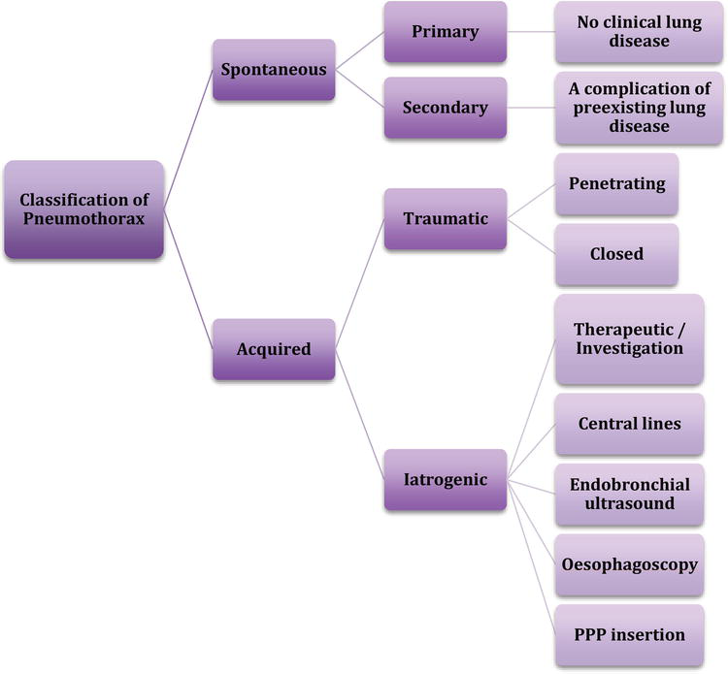

Slide 5
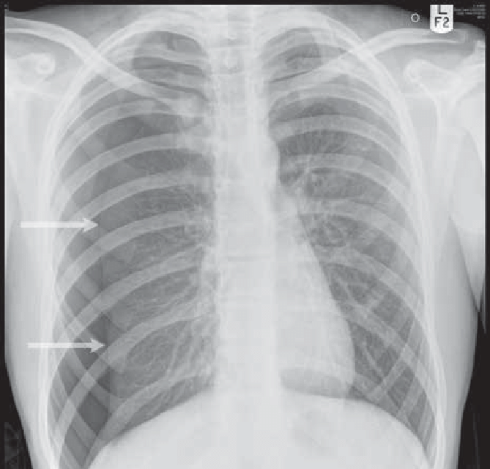
Types of spontaneous pneumothorax
Primary (simple) pneumothorax
Secondary (complicated) pneumothorax

Slide 6
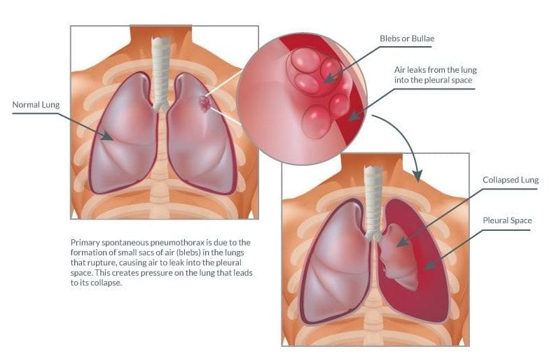
Primary spontaneous (simple) pneumothorax
Occurs without any underlying lung disease—that is, in “healthy” individuals Caused by spontaneous rupture of subpleural blebs (air-filled sacs on the lung)at the apex of lungs—escape of air from the lung into pleural space causes lung to collapse.
More common in tall, lean young men,These patients have sufficient pulmonary reserve (the other lung is normal), so severe respiratory distress does not occur in most cases.

Slide 7
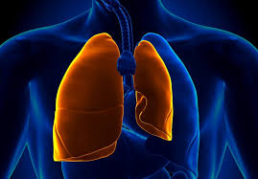
Secondary spontaneous(complicated) pneumothorax
Pneumothorax Occurs as a complication of underlying lung disease, most commonly COPD ;other underlying conditions include asthma, interstitial lung disease (ILD),neoplasms, CF, and tuberculosis (TB) .
Is more life threatening because of lack of pulmonary reserve in these patient (the other lung is not normal)

Slide 8
Traumatic pneumothorax
Closed pneumothorax: air enters through a hole in the lung (e.g., following blunt trauma) also may be from “ spontaneous pneumothorax”: bleb that ruptures and releases air into pleural space .
Open pneumothorax: air enters through a lesion in the chest wall , so body is shunting air through chest wall opening instead of trachea (e.g., following penetrating trauma)
Air enters the pleural space on inspiration and leaks to the exterior on expiration
Air shifts between the lungs

Slide 9
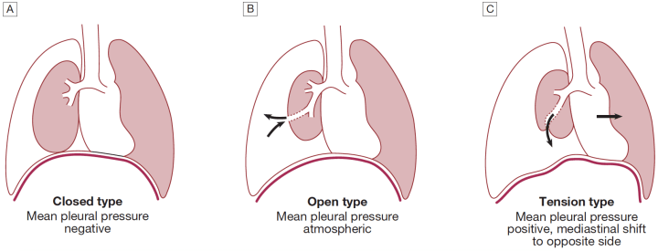
Another classification of pneumothorax

Slide 10
Use charts to explain your ideas
Closed pneumothorax | Open pneumothorax | Tension pneumothorax
The pleural tear is sealed | The pleural tear is open | The pleural tear act as a ball & valve mechanism
The pleural cavity pressure < the atmospheric pressure | The pleural cavity pressure = the atmospheric pressure | The pleural cavity pressure > the atmospheric pressure

Slide 11
Clinical Features
Physical signs
-Decreased breath sounds over the affected side.
-Hyperresonance over the chest.
-Decreased or absent tactile fremitus on the affected sided.
-Mediastinal shift toward the side of pneumothorax.
.
Symptoms
- Ipsilateral chest pain, usually sudden in onset
- Dyspnea
- Cough

Slide 12
Investigations

Slide 13
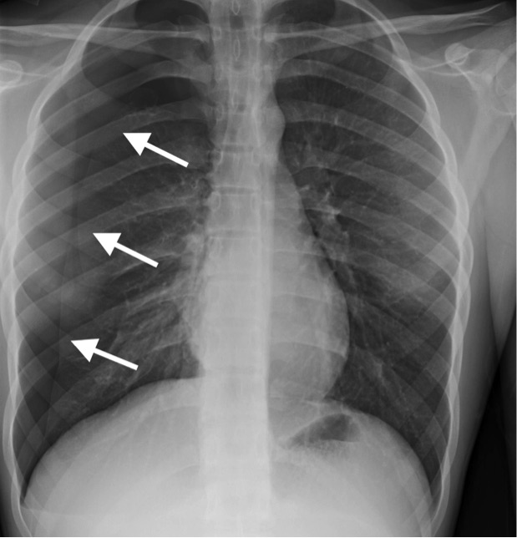
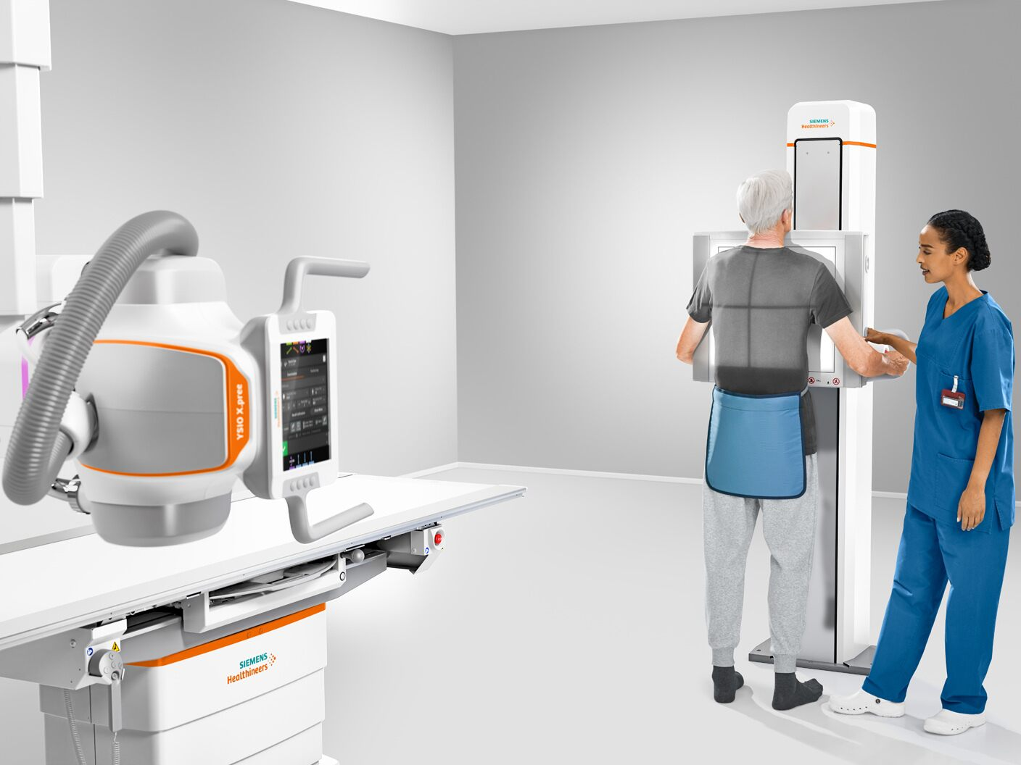
The chest X-ray shows the sharply defined edge of the deflated lung with complete translucency (no lung markings) between this and the chest wall .

Slide 14
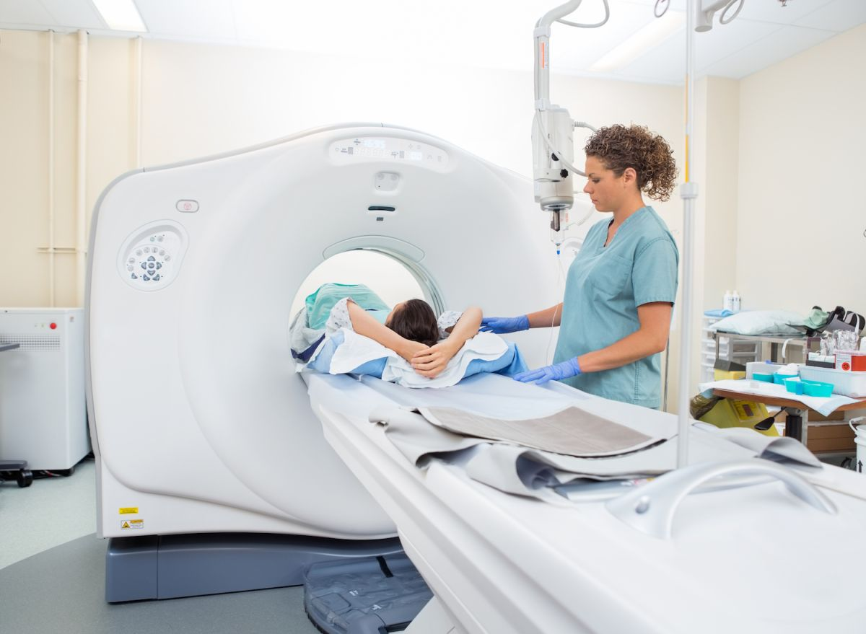
CT is used in difficult cases to avoid misdirected attempts at aspiration

Slide 15
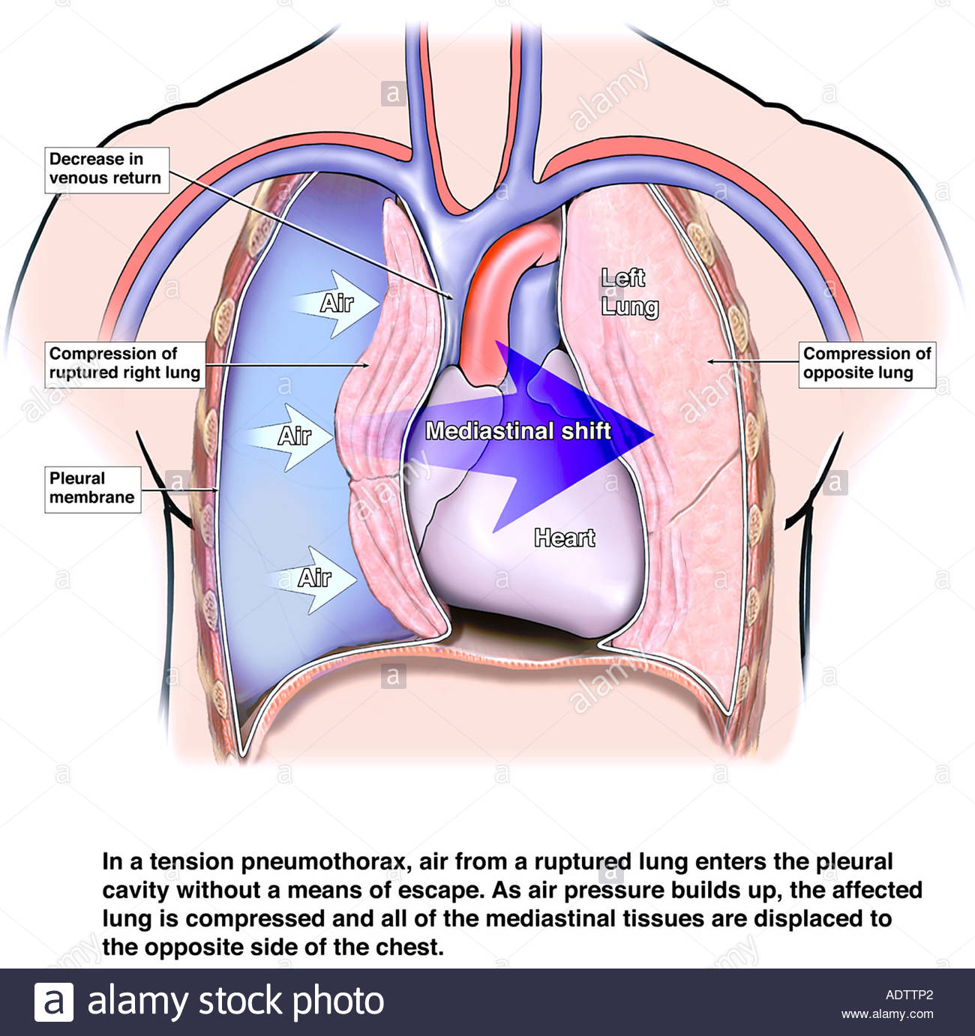
Tension Pneumothorax
Accumulation of air within the pleural space such that tissues surrounding the opening into the pleural cavity act as valves, allowing air to enter but not to escape.
- The accumulation of air under (positive) pressure in the pleural space collapses the ipsilateral lung and shifts the mediastinum away from the side of the pneumothorax.

Slide 16
Causes of Tension Pneumothorax
1. Mechanical ventilation with associated barotrauma
2.Cardiopulmonary resuscitation
3. Trauma

Slide 17
Clinical Features of Tension Pneumothorax
1) Hypotension—cardiac filling is impaired due to compression of the great veins
2) Distended neck veins
3) Shift of trachea away from the side of the pneumothorax on CXR
4) Decreased breath sounds on the affected side
5) Hyperresonance to percussion on the side of the pneumothorax

Slide 18
How to identify a pneumothorax ?

Slide 19
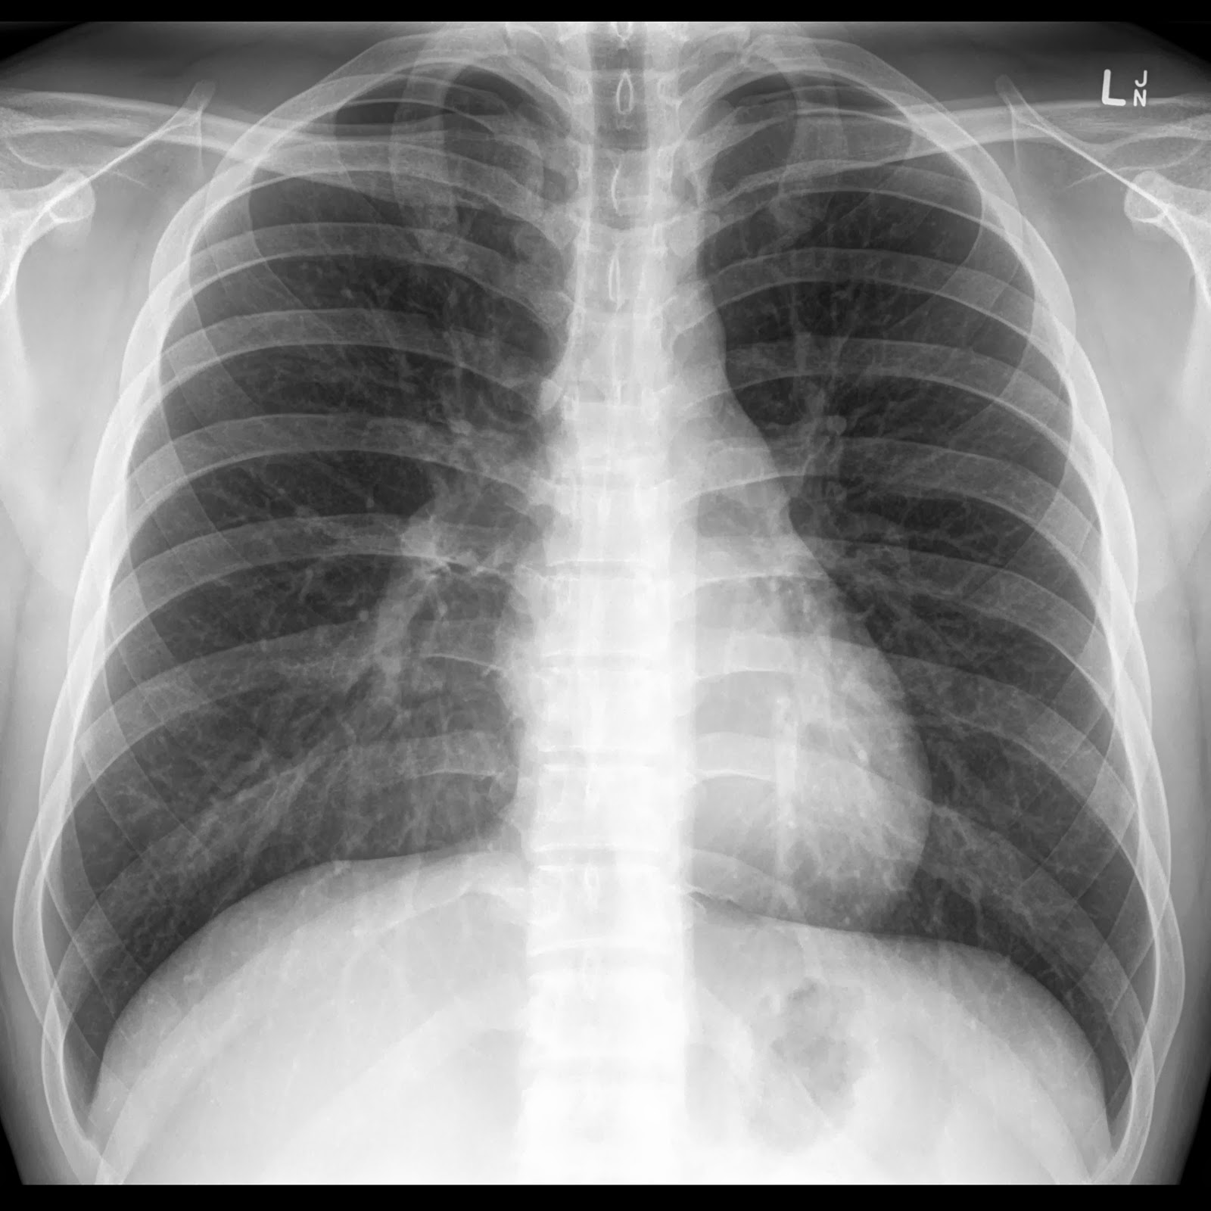
Our process is easy
first
Normal CXR

Slide 20
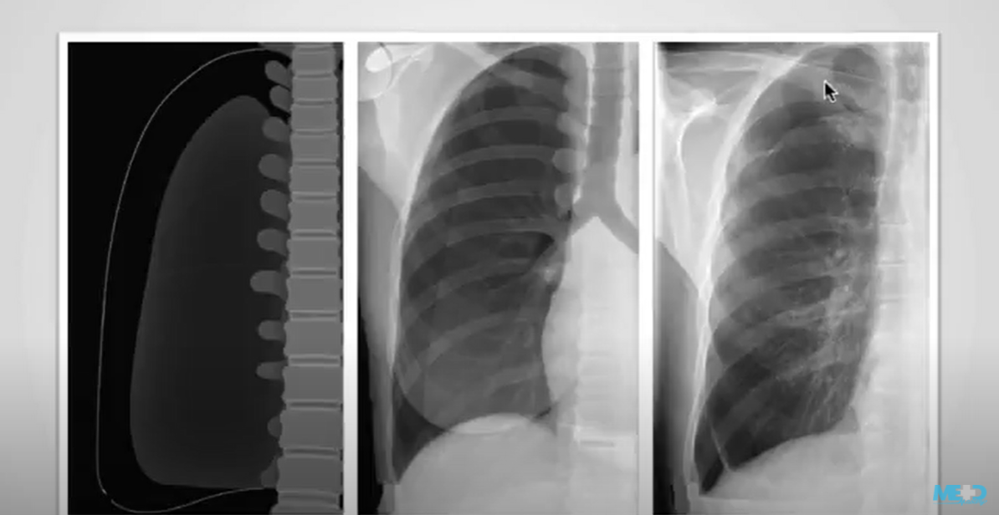
second
The pleural space is a potential space that air can accumulate in it ,when air enters into the pleural space it'll rise to the most Superior part of the thorax if further enter it accumulates in the lateral and even inferior parts .

Slide 21
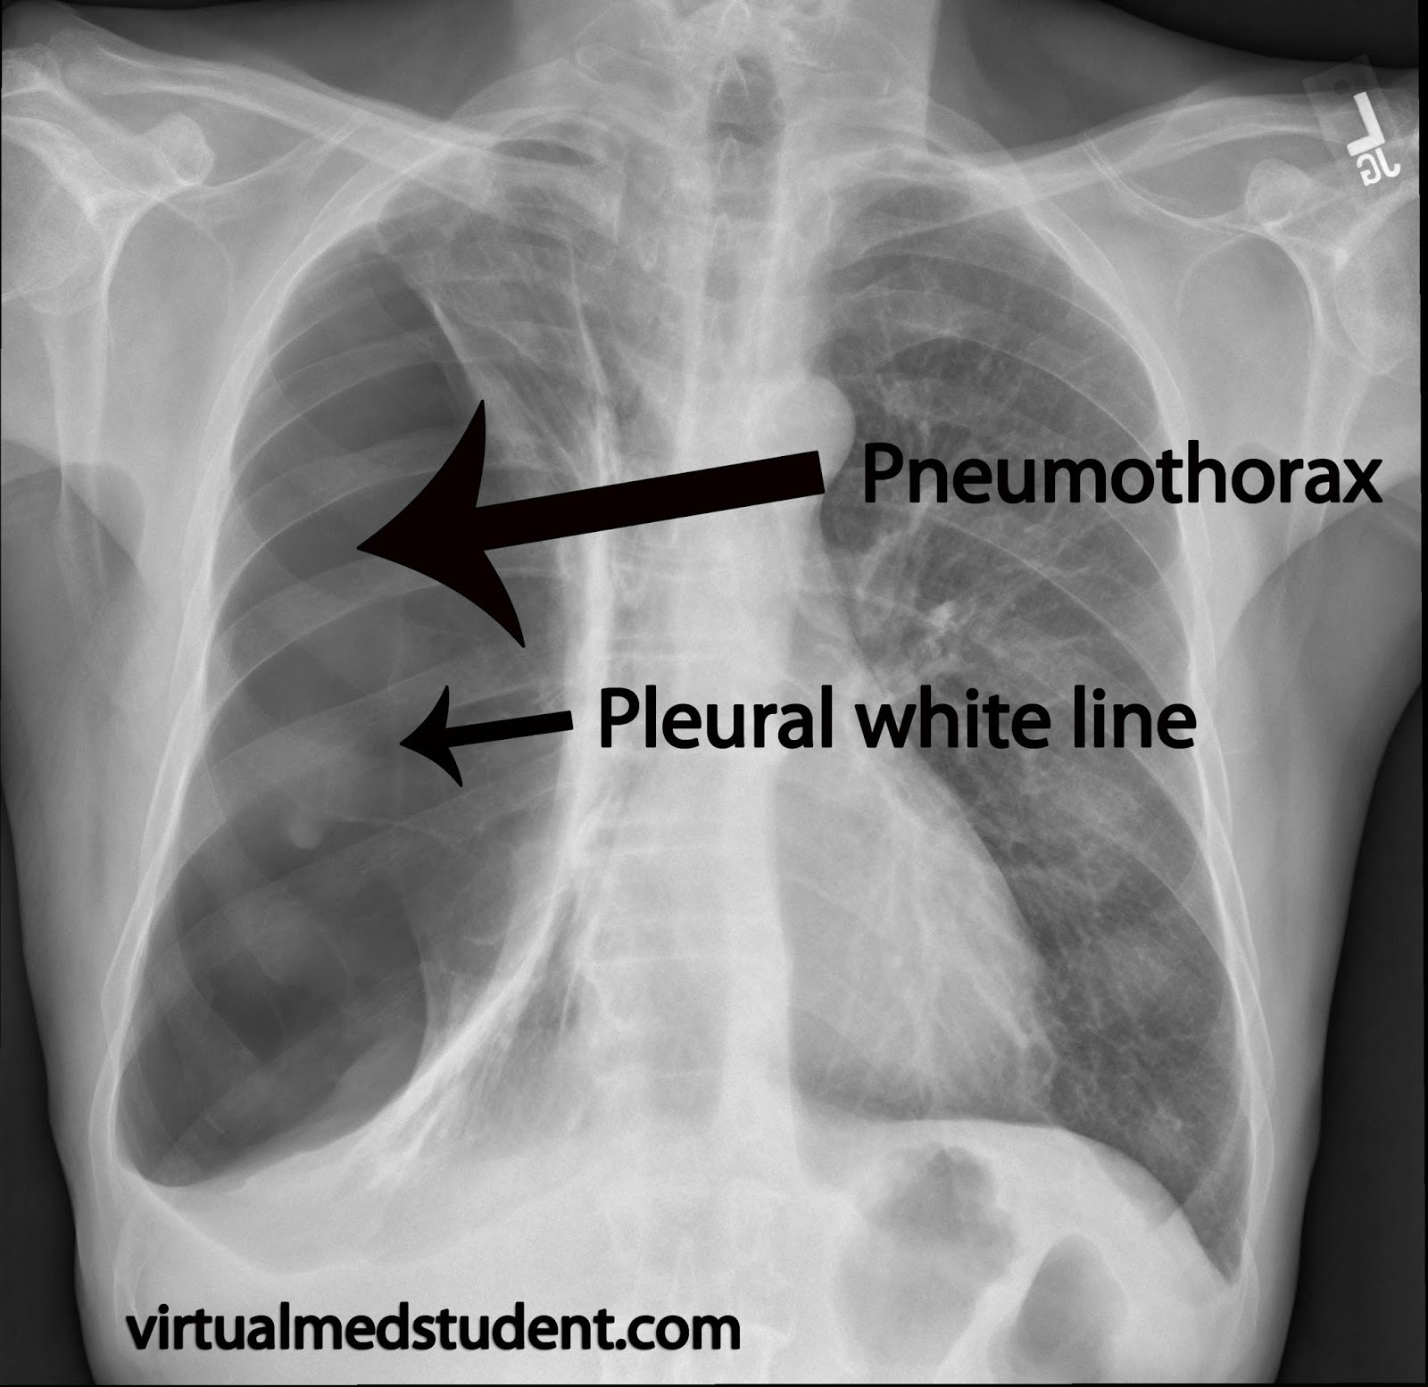
Recognizing apneumothorax Signs to look for : *Visualization of visceral pleural line must for diagnosis * absence of lung marking distal to visceral pleural line ( most time)
*periphral space is radio Lucent Compared to adjacent lung
* deep sulcus sign ( when the patient on supine position, it represent lucency in the lateral costophrenic angles )
* mediastinum shouldn’t shift away from pneumothorax unless tension pneumothorax is present

Slide 22
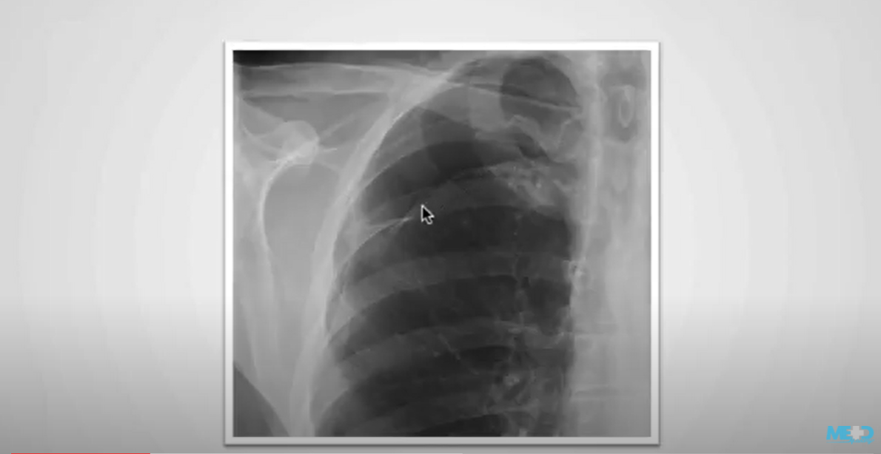
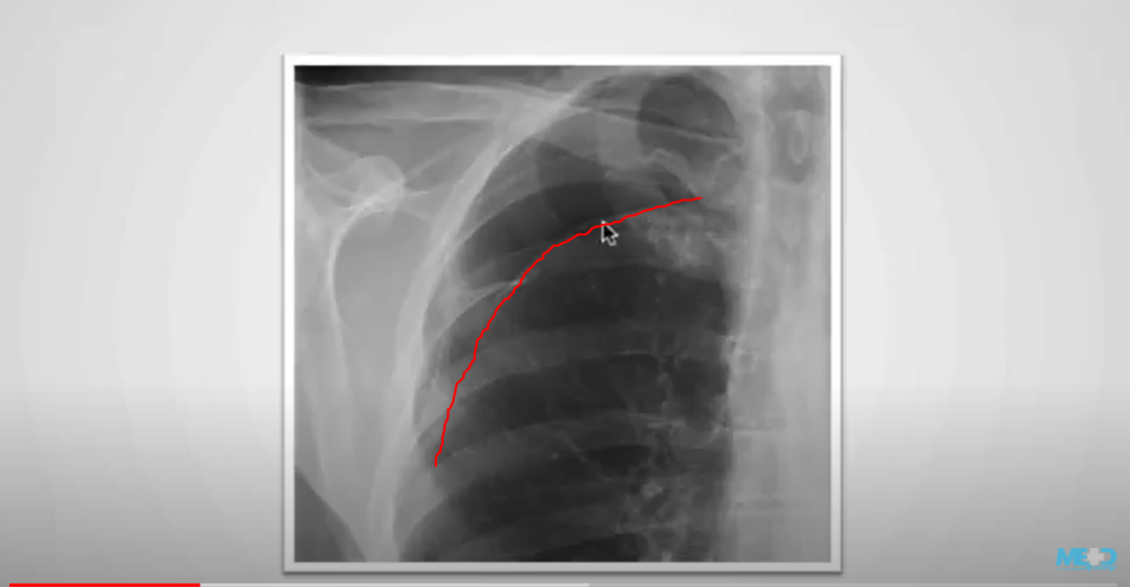
we can see the pneumothorax within the right Apex there are no vascular markings identified in this region but we can also identify the clear margin of the lung because we can identify the visceral pleura as this Thin Line outlining the lateral aspect of the lung

Slide 23
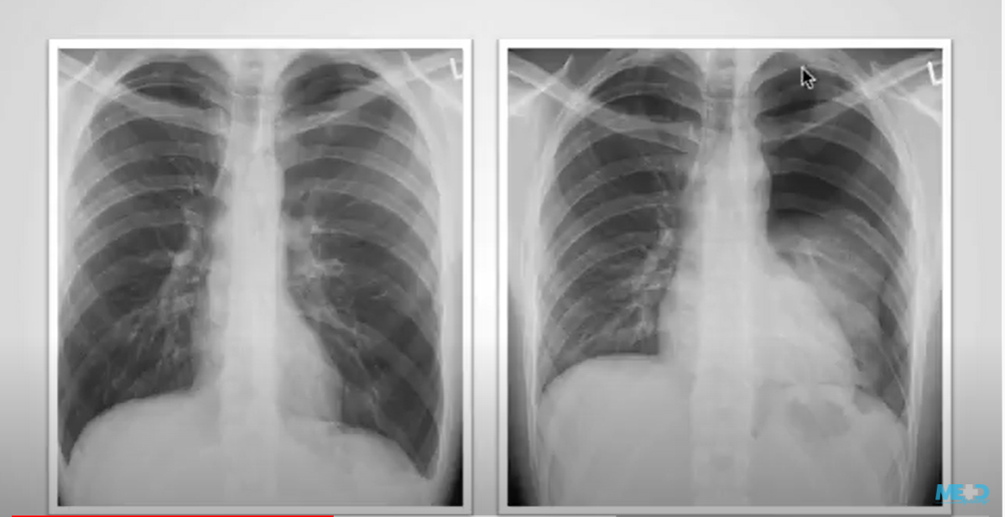
the expiratory film shows large left pneumothorax as well as significant volume loss within the left lung
it can be quite difficult to identify a pneumothorax on an inspiration film if pneumothorax is suspected an expiration film should also be ordered, because on expiration lungs will look whiter making a density difference between a pneumothorax and a lungs more evident and the size of the pneumothorax will appear large
________________________________

Slide 24
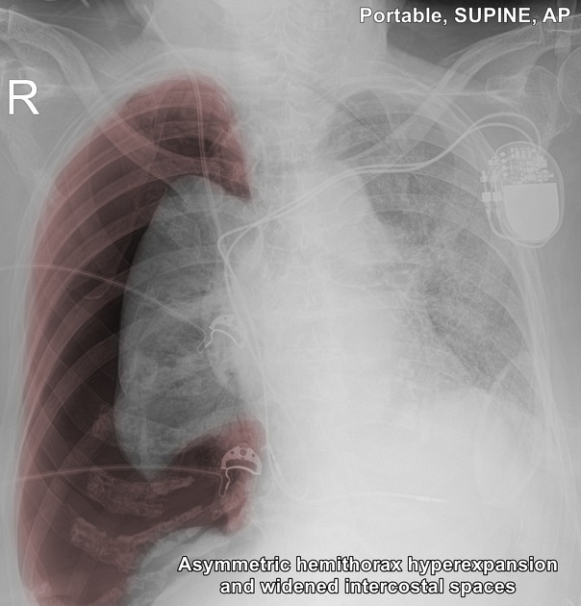
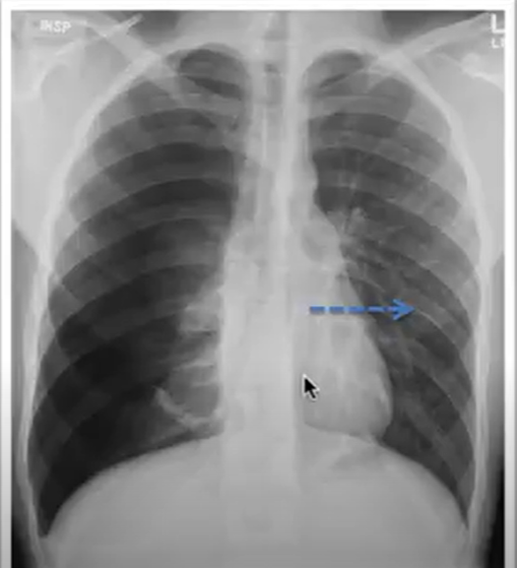
Tension pneumothorax
Tension pneumothorax is a pneumothorax that has increased in size significantly and causing displacement of the mediastinal structures ti the contralateral side when this happened there can be cardiovascular compromise and this is a medical emergency .

Slide 25
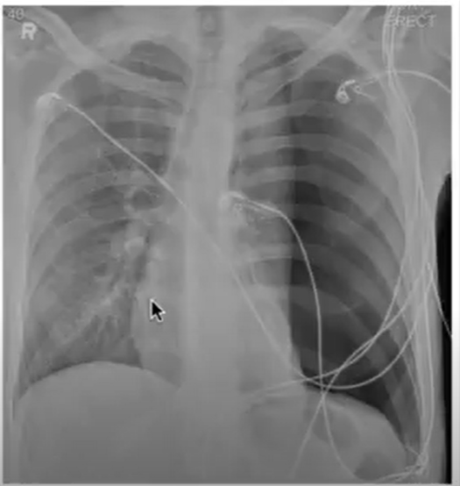
In this case the patient developed acute sharp chest pain we see a large pneumothorax which is causing collapse of the left lung and displacement of the mediastinal structures to the right this is a large tension pneumothorax .

Slide 26
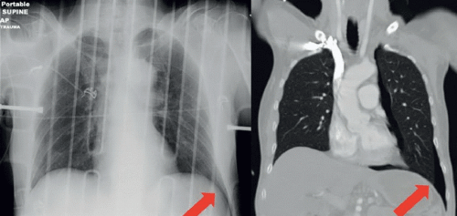
The deep sulcus sign describes a deep and lucent costophrenic angle that extends more inferiorly than usual.
On a supine plain chest film , it may be the only suggestion of a pneumothorax because air collects anteriorly and basally, within the non-dependent portions of the pleural space, as opposed to the apex when the patient is upright.

Slide 27
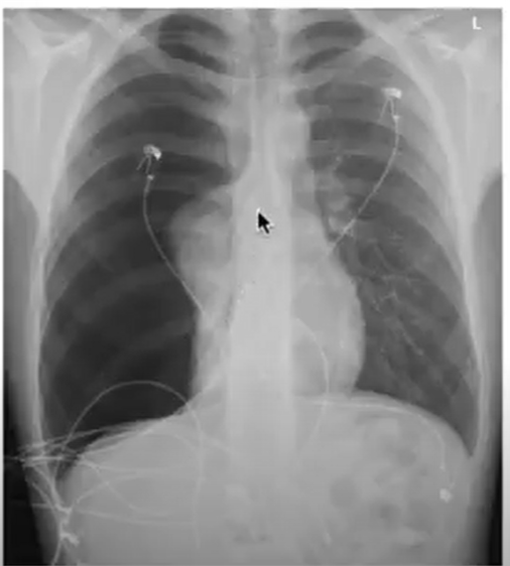
another example of a tension pneumothorax with significant collapse of the right lung and mediastinal shift to the left .

Slide 28
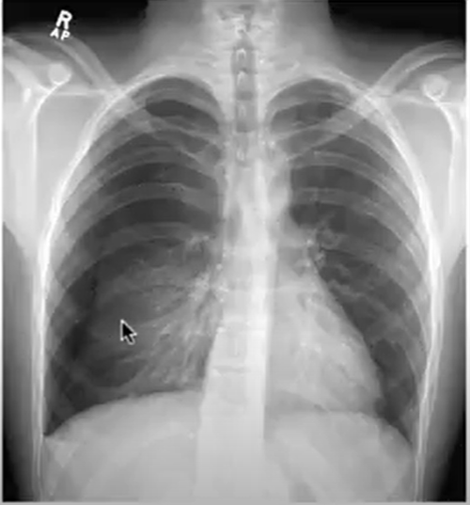
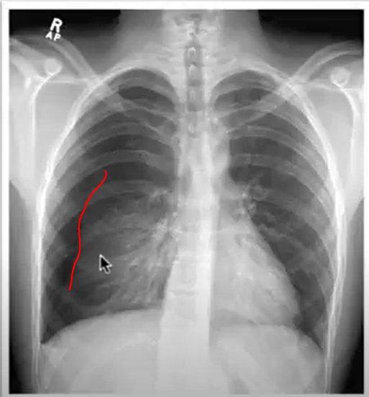
linear density extending superiorly this represents the edge of the lung and this is a pneumothorax expiration view exaggeration the appearance of the pneumothorax on the right

Slide 29
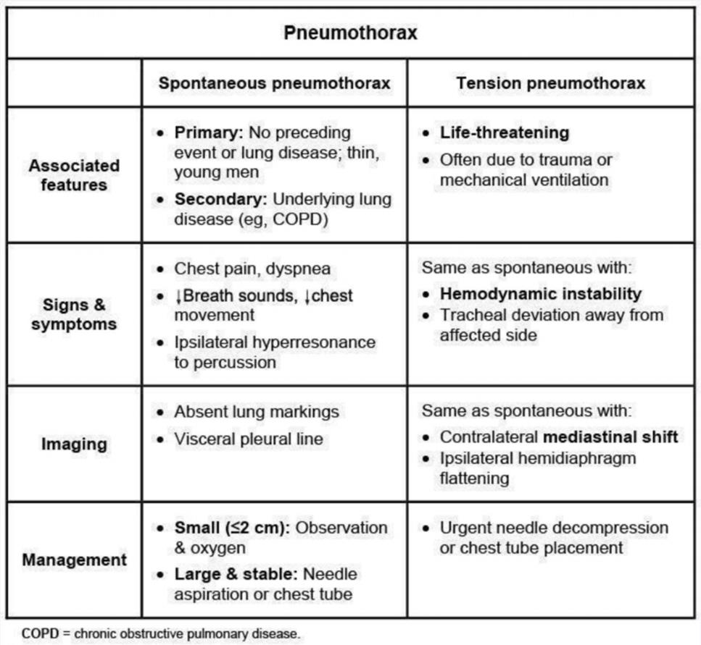

Slide 30
Treatment

Slide 31
Primary spontaneous pneumothorax
. If small and patient is asymptomatic: Observation—should resolve spontaneously in approximately 10 days,Small chest tube (with one-way valve) may benefit some patients.
If pneumothorax is larger and/or patient is symptomatic:Administration of supplemental oxygen, which helps with resorption of pleural air Needle aspiration or chest tube insertion to allow air to be released and lung to reexpand
Secondary spontaneous pneumothorax
Chest tube drainage

Slide 32
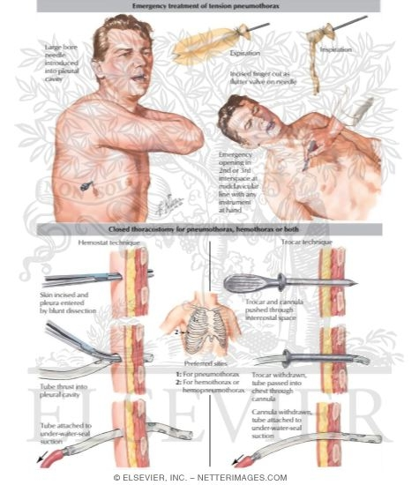
Tension Pneumothorax
Must be treated as a medical emergency—If the tension in the pleural space is not relieved, the patient is likely to die of hemodynamic compromise (in adequate cardiac output or hypoxemia).
Immediately perform chest decompression with a large-bore needle (in the second or third intercostal space in the midclavicular line), followed immediately chest tube placement.

Slide 33
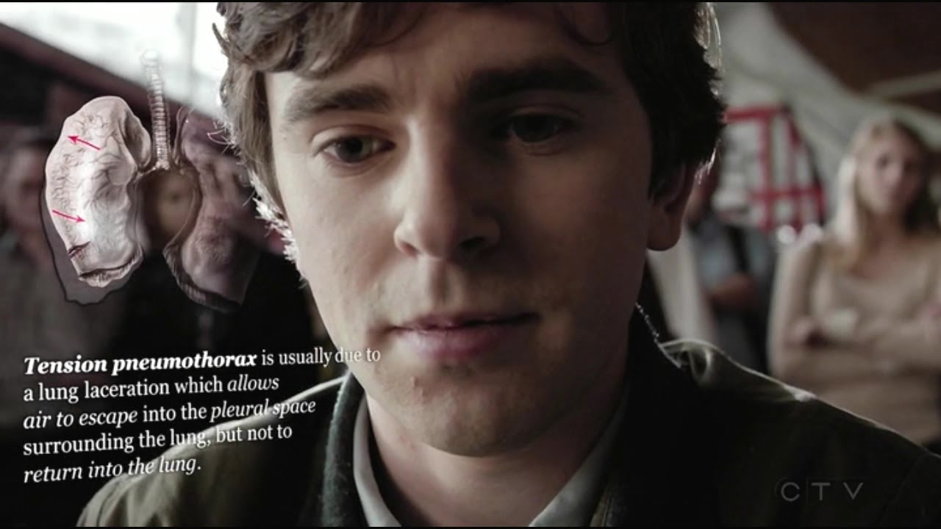

Slide 35
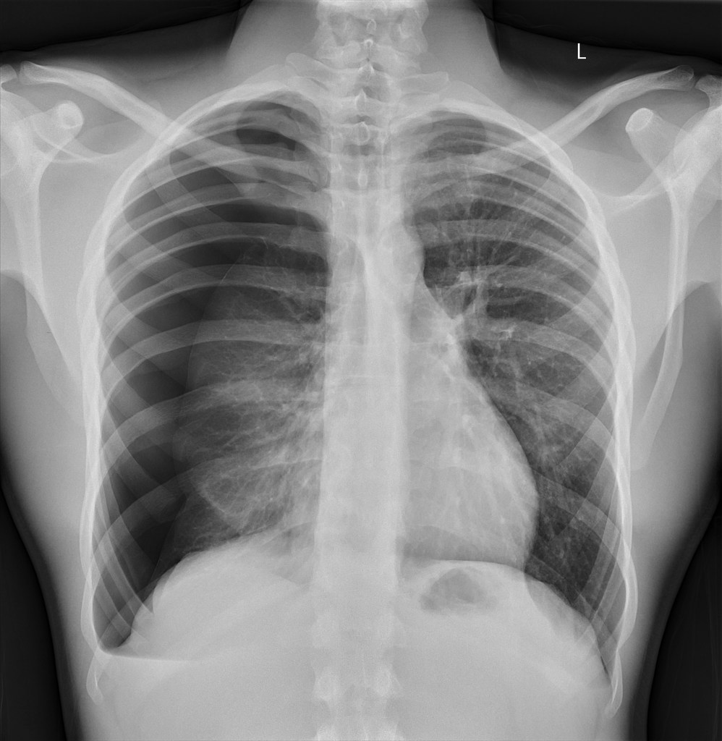
CASE :
-A 20 year old male , came to the emergency room with a Sudden onset shortness of breath while playing football His CXR →
-What is your Dx ?
-Large right pneumothorax with evidence of tension - mediastinal shift to the left and slight hyperexpansion of the right hemithorax.

Slide 36
THANK YOU .

