Slide 1
General Microbiology 2020-2021 Orientation to Gram Negative Bacteria of Medical Importance
Dr. Mohammad Odibate
Department of Microbiology and immunology
Faculty of Medicine, Mu’tah University

Slide 2
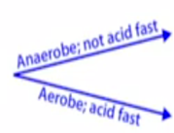
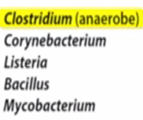
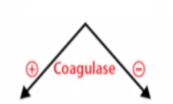

Slide 3
Medically Important Gram-Negative Bacteria
Gram-Negative Bacteria
Rods
Shigella
Escherichia coli
Salmonella
Yersinia entercolitica
Klebsiella
Proteus
Citrobactor
Serratia
Pseudomonas
Enterobacter
Diplococci
Coccoid Rods
Bordetella pertussis
Haemophilus influenzae
Brucella
Pasteurella
Neisseria gonorrhoeae
Neisseria meningitidis

Slide 4
Medically Important Gram-Negative Bacteria
Gram-Negative Bacteria
Vibrio cholera
(Comma Shaped)
Campylobacter jejuni
(helical-shaped)
Helicobacter pylori
(helical-shaped)
Obligate intracellular parasites
Chlamydia
(Gram neg-coccobacillus)
Rickettsia
(highly pleomorphic )
Coxiella
(Gram neg rod)
Spiral in Shape
Treponema
Borrelia
Leptospira
Notes:
Coxiea Gram-negative, aerobic, rod
Chlamydia Gram-negative coccobacillus
Rekittsia ighly pleomorphic bacteria that can be present as cocci (0.1 μm in diameter), rods

Slide 5
Medically Important Gram-Negative Bacteria
Gram-Negative Bacteria
Rods
Shigella
Escherichia coli
Salmonella
Yersinia entercolitica
Klebsiella
Proteus
Citrobactor
Serratia
Pseudomonas
Enterobacter
Diplococci
Coccoid Rods
Bordetella pertussis
Haemophilus influenzae
Brucella
Pasteurella
Neisseria gonorrhoeae
Neisseria meningitidis

Slide 6
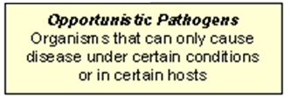
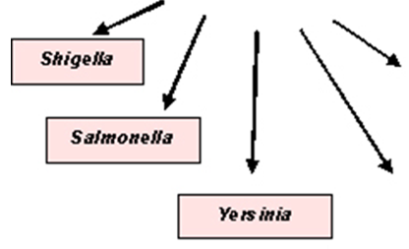
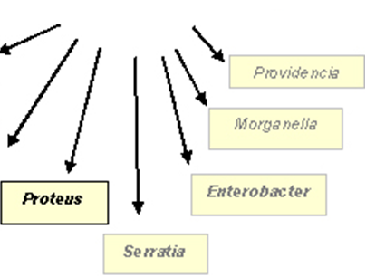
Enterobacteriaceae and disease

Slide 7
Enterobacteriaceae
Ubiquious (they are everywhere) - soil, water, vegetation, normal intestinal flora
~40 genera, 150 species
Oxidase negative - no cytochrome oxidase
Members of family commonly associated with human disease:
Escherichia
Salmonella
Shigella
Yersinia
Klebsiella
Serratia
Proteus

Slide 8
Common” organisms associated with enteric infections
 | I | II | III
Mechanism: | Non-inflammatory (enterotoxin) | Inflammatory (invasive, cytotoxin) | Penetrating (invasive, spread)
Location: | proximal small bowel | colon | distal small bowel
Illness: | Diarrhea | Dysentery | Enteric fever
Stool exam: | no fecal leukocytes | blood, fecal PMNs (polymorphonuclear leukocytes = neutrophils) | fecal mononuclear leukocytes (monocytes, lymphocytes)
Example organisms: | V. cholerae E. coli Salmonella Campylobacter | Shigella Invasive E. coli S. enteritidis | S. typhi Y. enterocolitica

Slide 9
Medically Important Gram-Negative Bacteria
Gram-Negative Bacteria
Rods
Shigella
Escherichia coli
Salmonella
Yersinia entercolitica
Klebsiella
Proteus
Citrobactor
Serratia
Pseudomonas
Enterobacter
Diplococci
Coccoid Rods
Bordetella pertussis
Haemophilus influenzae
Brucella
Pasteurella
Neisseria gonorrhoeae
Neisseria meningitidis

Slide 10
Pseudomonads
Gram-negative, aerobic bacilli.
Ubiquitous in soil, decaying organic matter, and almost every moist environment.
Problematic in hospitals because they can be found in numerous locations.
Opportunistic pathogens.

Slide 11
Medically Important Gram-Negative Bacteria
Gram-Negative Bacteria
Rods
Shigella
Escherichia coli
Salmonella
Yersinia entercolitica
Klebsiella
Proteus
Citrobactor
Serratia
Pseudomonas
Enterobacter
Diplococci
Coccoid Rods
Bordetella pertussis
Haemophilus influenzae
Brucella
Pasteurella
Neisseria gonorrhoeae
Neisseria meningitidis

Slide 12
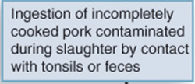
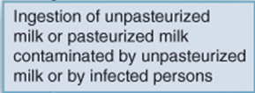
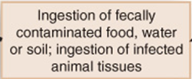
Y. enterocolitica transmission

Slide 13
Medically Important Gram-Negative Bacteria
Gram-Negative Bacteria
Rods
Shigella
Escherichia coli
Salmonella
Yersinia entercolitica
Klebsiella
Proteus
Citrobactor
Serratia
Pseudomonas
Enterobacter
Diplococci
Coccoid Rods
Bordetella pertussis
Haemophilus influenzae
Brucella
Pasteurella
Neisseria gonorrhoeae
Neisseria meningitidis

Slide 14
Neisseria
Two major pathogenic species
N. gonorrheae:
associated with Sexually Transmitted Diseases (STDs).
N. meningitidis:
associated with respiratory and CNS infections.

Slide 15
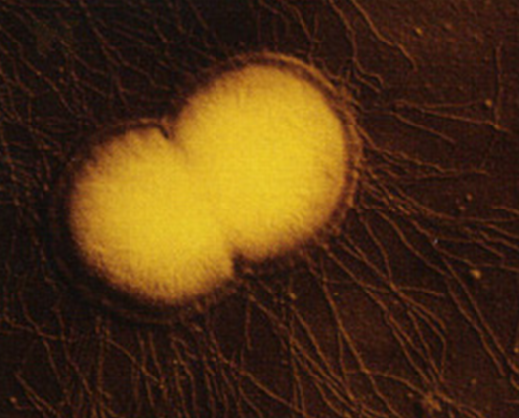
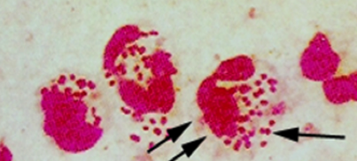
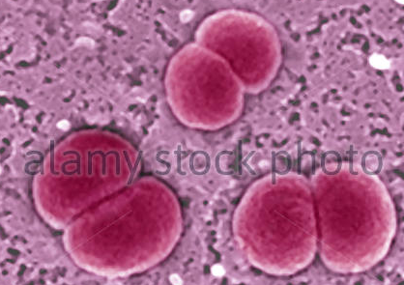
Neisseria
Gram-negative intracellular diplococcus (Kidney-haped)
Evades host response through alteration of surface structures

Slide 16
Medically Important Gram-Negative Bacteria
Gram-Negative Bacteria
Rods
Shigella
Escherichia coli
Salmonella
Yersinia entercolitica
Klebsiella
Proteus
Citrobactor
Serratia
Pseudomonas
Enterobacter
Diplococci
Coccoid Rods
Bordetella pertussis
Haemophilus influenzae
Brucella
Pasteurella
Neisseria gonorrhoeae
Neisseria meningitidis

Slide 17
Haemophilus influenzae
Haemophilus: Blood –Loving Bacilli
Fastidious: require some chemicals from blood for their metabolism
H. influenzae: bacterial meningitis: children 3 months to 5 years: antibiotic, vaccine

Slide 18
Haemophilus influenzae
Most strains have a polysaccharide capsule that resists phagocytosis.
Colonize the mucous membranes of humans and some animals.
H.influenzae type b is the most significant
Was the most common form of meningitis in infants prior to the use of an effective vaccine
Use of the Hib vaccine has eliminated much of the disease caused by H.influenzae b

Slide 19
Medically Important Gram-Negative Bacteria
Gram-Negative Bacteria
Rods
Shigella
Escherichia coli
Salmonella
Yersinia entercolitica
Klebsiella
Proteus
Citrobactor
Serratia
Pseudomonas
Enterobacter
Diplococci
Coccoid Rods
Bordetella pertussis
Haemophilus influenzae
Brucella
Pasteurella
Neisseria gonorrhoeae
Neisseria meningitidis

Slide 20
Bordetella
Small, aerobic, nonmotile coccobacillus
B. pertussis:
Causes pertussis, also called whopping cough.
Most cases of disease are in children.
Bacteria are first inhaled in aerosols and multiply in epithelial cells.
Then progress through three stages of disease.

Slide 21
Medically Important Gram-Negative Bacteria
Gram-Negative Bacteria
Rods
Shigella
Escherichia coli
Salmonella
Yersinia entercolitica
Klebsiella
Proteus
Citrobactor
Serratia
Pseudomonas
Enterobacter
Diplococci
Coccoid Rods
Bordetella pertussis
Haemophilus influenzae
Brucella
Pasteurella
Neisseria gonorrhoeae
Neisseria meningitidis

Slide 22
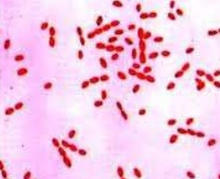
Brucella
Causes Brucellosis in man following ingestion of contaminated milk or cheese from goats and cows.
Clinical manifestations range from subclinical, to chronic with low grade symptoms of low fever and muscular stiffness, to acute with fever and chills.

Slide 23
Medically Important Gram-Negative Bacteria
Gram-Negative Bacteria
Vibrio cholera
(Comma Shaped)
Campylobacter jejuni
(helical-shaped)
Helicobacter pylori
(helical-shaped)
Obligate intracellular parasites
Chlamydia
(Gram neg-coccobacillus)
Rickettsia
(highly pleomorphic )
Coxiella
(Gram neg rod)
Spiral in Shape
Treponema
Borrelia
Leptospira
Notes:
Coxiea Gram-negative, aerobic, rod
Chlamydia Gram-negative coccobacillus
Rekittsia ighly pleomorphic bacteria that can be present as cocci (0.1 μm in diameter), rods

Slide 24
Vibrio
Members of this genus share many characteristics with enteric bacteria such as Escherichia and Salmonella.
Vibrio cholerae is the most common species to infect humans:
Causes cholera.
Humans become infected with V. cholerae by ingesting contaminated food and water.
Found most often in communities with poor sewage and water treatment.

Slide 25
Medically Important Gram-Negative Bacteria
Gram-Negative Bacteria
Vibrio cholera
(Comma Shaped)
Campylobacter jejuni
(helical-shaped)
Helicobacter pylori
(helical-shaped)
Obligate intracellular parasites
Chlamydia
(Gram neg-coccobacillus)
Rickettsia
(highly pleomorphic )
Coxiella
(Gram neg rod)
Spiral in Shape
Treponema
Borrelia
Leptospira
Notes:
Coxiea Gram-negative, aerobic, rod
Chlamydia Gram-negative coccobacillus
Rekittsia ighly pleomorphic bacteria that can be present as cocci (0.1 μm in diameter), rods

Slide 26
Helicobacter pylori
Slightly helical, highly motile bacterium that colonizes the stomach of its hosts.
Causes most (if not all) peptic ulcers.
H.pylori produces numerous virulence factors that enable it to colonize the stomach.
Coffee drinking, smoking, and drinking alcohol increase your risk for an ulcer.
Simple blood, breath, and stool tests can determine if you are infected with H. pylori.
The most accurate way to diagnose is through upper endoscopy.

Slide 27
Medically Important Gram-Negative Bacteria
Gram-Negative Bacteria
Comma Shaped
Vibrio cholera
Campylobacter jejuni
Helicobacter pylori
Obligate intracellular parasites
Chlamydia
(Gram neg-coccobacillus)
Rickettsia
(highly pleomorphic )
Coxiella
(Gram neg rod)
Spiral in Shape
Treponema
Borrelia
Leptospira
Notes:
Coxiea Gram-negative, aerobic, rod
Chlamydia Gram-negative coccobacillus
Rekittsia ighly pleomorphic bacteria that can be present as cocci (0.1 μm in diameter), rods

Slide 28
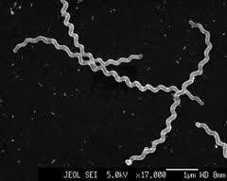
Spirochetes
Thin, tightly coiled, helically shaped bacteria
Moves in a corkscrew fashion through its environment
This movement is thought to enable pathogenic spirochetes to burrow through their hosts’ tissues
3 genera cause human disease
Treponema, Borrelia, and Leptospira

Slide 29
Medically Important Gram-Negative Bacteria
Gram-Negative Bacteria
Comma Shaped
Vibrio cholera
Campylobacter jejuni
Helicobacter pylori
iiiiiiiiiiiiiiiiiiiiiiiiiiiiiiiiiiiiiiiiiiiiiiiiiiiiiiiiiiiiiii
Obligate intracellular parasites
Chlamydia
(Gram neg-coccobacillus)
Rickettsia
(highly pleomorphic )
Coxiella
(Gram neg rod)
Spiral in Shape
Treponema
Borrelia
Leptospira
Notes:
Coxiea Gram-negative, aerobic, rod
Chlamydia Gram-negative coccobacillus
Rekittsia ighly pleomorphic bacteria that can be present as cocci (0.1 μm in diameter), rods

Slide 30
Chlamydia
Grow and multiply only within the vesicles of host cells
Causes two main types of disease
Sexually transmitted diseases:
Causes the most common sexually transmitted disease in the United States.
Ocular disease called trachoma:
Occur particularly in children.
Endemic in crowded, poor communities with poor hygiene, inadequate sanitation, and inferior medical care

Slide 31
Rickettsias
Extremely small (not much bigger than a smallpox virus)
Obligate intracellular parasites
Unusual because they have functional genes for protein synthesis, ATP production, and reproduction
Rickettsia causes disease in humans.
Notes:
Appear almost wall-less due to the small amount of peptidoglycan present

Slide 32
Legionella pneumophila
Aerobic, Gram negative bacilli.
Universal inhabitants of water.
Humans acquire the disease by inhaling the bacteria in aerosols from various water sources.
Causes Legionnaires’ disease
Results in pneumonia
Immunocompromised individuals are more susceptible

