Slide 1
Congenital immunodeficiency disorders

Slide 2
Introduction
Congenital immunodeficiency disorders are characterized by a deficiency, absence, or defect in one or more of the main components of the immune system.
These disorders are genetically determined and typically manifest during infancy and childhood as frequent, chronic, opportunistic infections also Resistant to treatment or Caused by unusual organisms.

Slide 3
Who is expected to have immunodeficiency
Two or more sepsis or meningitis per life
Two or more systemic infections within one year: Pneumonia, sinusitis, Cellulitis, abscess
Four or more new ear infections within 1 year.
Two or more months on antibiotics with little effect
Unsual site: Brain, liver
Persistent thrush in mouth or fungal infection on skin
Unusual severity
Unusual organism
FTT with dysmorphic features
A family history of immunodeficiency

Slide 4
Types of congenital immunodefiiency
Congenital B- cell immunodeficiency
Congenital T- cell and mixed immunodeficiency disorders
Congenital combined immunodeficiency
Congenital complement disorders
Congenital Phagocytic disorders

Slide 5
Congenital B-cell immunodeficiencies
Age of onset: beyond 6 months
Characteristic infections: Sinubacterial infections, respiratory infections, encapsulated bateria Enteroviruses (hepatits A, coxackie, etc), Giardia lambia
Low CD19, CD20, CD21
Low Immunoglobulins (or some of them according to type)
Low immunoglobulin response after vaccine (DT)

Slide 6
A) Selective IgA deficiency:
Most common primary immunodeficiency that is characterized by a near or total absence of serum and secretory IgA
Mostly AD
Clinical features :
Often asymptomatic , but may manifest with sinusitis or respiratory infections (S. pneumoniae, H. influenzae), chronic diarrhea (Giardiasis)
Associated with celiac disease, food allergy, asthma, and other autoimmune diseaases
Diagnosis: Decreased serum IgA levels and normal other immunoglublin levels
Treatment:
IVIG is not effective, as 99% of IG are IgG type
To prevent transfusion reactions, IgA-deficient patients must be given washed blood products without IgA or obtain blood from an IgA-deficient donor.
Treatment of infections
Treatment of infections
Intravenous infusion of IgA is not recommended because of the risk of anaphylactic reactions (caused by the production of anti-IgA antibodies).

Slide 7
B) Bruton agammaglobulinemia (X-linked agammaglobulinemia)
X-linked recessive disease, due to defect in Bruton tyrosine kinase (BTK), B cells can not progress from Prophase to prephase
Clinical features:
Onset is > 6 months after birth
Recurrent sinubacterial infections, respiratory infections, encapsulated bacteria Enteroviruses, Giardia lambia
Absent Lymph tissue: lymph nodes and tonsils
Diagnosis:
Flow cytometry low (CD19, CD20, and CD21)
Low all immunoglobulins (IgG, IgM, IgA, IgD)
Normal T cells markers
Treatment : IVIG

Slide 8
C) Common variable immunodeficiency :
B cells are unable to differentiate into plasma cells, resulting in low immunoglobulins of all classes.
Usually presents later than other B-cell defects (usually at 20–35 years of age)
Clinical features :
Recurrent sinubacterial infections, respiratory infections, encapsulated bacteria Enteroviruses, Giardia lambia
Autoimmune disorders in 25% (e.g., rheumatoid arthritis, autoimmune hemolytic anemia, immune thrombocytopenia, vitiligo)
splenomegaly
May evolve to lymphoma
Diagnosis :
Low low levels of IgG, IgA, and IgM
Treatment : IVIG

Slide 9
D) Hyper-IgM syndrome
It is characterized by a class-switching defect of Th cells.
X-linked recessive: most common type, due to defective CD40 receptor (CD L)on T cells resulting in abnormal interaction between CD4 T cells and B cells
AR: less common, defect of CD40 synthesis on B cells
Clinical presentation :
Recurrent sinopulmonary infections (commonly Pneumocystis jirovecii and Histoplasma) Cryptosporidium enteritis, CMV hepatitis Failure to thrive
Recurrent sinubacterial infections, respiratory infections, encapsulated bacteria Enteroviruses, Giardia lambia
Neutropenia in 50%
Diagnosis :
↓ IgG, IgA, IgE,↑ IgM
Treatment :
IVIG
Prophylactic antibiotics for Pneumocystis jirovecii
Recombinant human G-CSF for neutropenia
Stem cell transplantation may be curative.

Slide 10
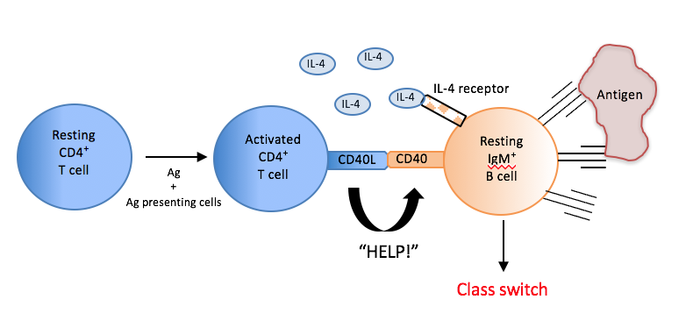

Slide 11
Congenital T-cell immunodeficiencies and Mixed disorders
Early onset (before 6 months)
Characteristic infections:
Viral infections: EBV, CMV, HSV, VZV
Fungal infections: Aspergillus, Candida
Bacterial: Salmonella, Syphilis, T.B
Protozoa: Pneumocystis jirovecii, Toxoplasmosis, cryptosporidium
Low absolute lymphocytic count (ALC) is characteristic
Low CD3, CD4, CD8
No induration response after C.albican intradermal test

Slide 12
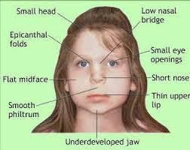
A) DiGeorge syndrome:
Autosomal dominant; microdeletion at chromosome 22 (22q11.2), resulting in defective development of the third and fourth pharyngeal pouches leading to hypoplastic thymus and parathyroids

Slide 13
CATCH 22
Cardiac anomalies Conotruncal abnormalities (e.g., tetralogy of Fallot or persistent truncus arteriosus) Ventricular septal defect (VSD) Atrial septal defect (ASD)
Anomalous face: low set ears, hypertelorism, downward slanting of palpebral fissure, short smooth philtrum, fish mouth
Thymus aplasia/hypoplasia: recurrent infections (viral/fungal/PCP pneumonia) due to T-cell deficiency
Cleft palate
Hypoparathyroidism: hypocalcemia with tetany

Slide 14
A) DiGeorge syndrome:
Diagnosis:
Detection of 22q11.2 deletion via fluorescence in situ hybridization (FISH)
↓ PTH and Ca2+ ↓
Low T-lymphocyte count
CXR: absence of thymic shadow
Treatment :
Immune deficiency treatment Antibiotics, virostatics, and antimycotics PCP prophylaxis Consider bone marrow transplant and/or IVIG Possible thymus transplantation
Prognosis: poor if not treated (patients usually do not survive beyond childhood)

Slide 15
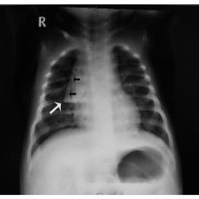
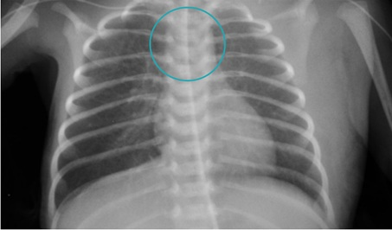
Sail sign (thymus) No sail sign

Slide 16
B. IL-12 receptor deficiency:
AR, Impaired Th1 response due to ↓ IL-12 receptors
Clinical features :
The age of onset varies (depends on the age at exposure to causative pathogens): ∼ 1–3 years of age
Features of disseminated disease Mycobacterial infections (e.g., developing tuberculosis after BCG vaccination) and Fungal infections
Diagnosis: ↓ IFN-γ
Treatment: antibiotics and IFN-γ therapy

Slide 17
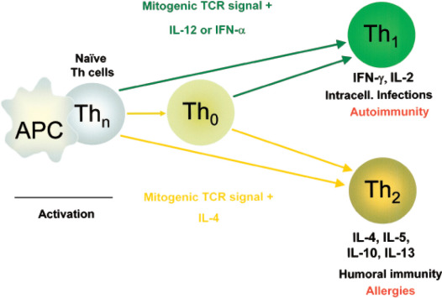
B. IL-12 receptor deficiency:
Normally, macrophages and APC release IL-12 → Th0 cells transformation to T1 type → release of IFN-γ to activate macrophages
Defective IL-12 receptors: macrophages cannot activate Th0 to transform to Th1 → low IFN-γ → no cytotoxicity in cells infected with intracellular pathogens (e.g., Mycobacteria)

Slide 18
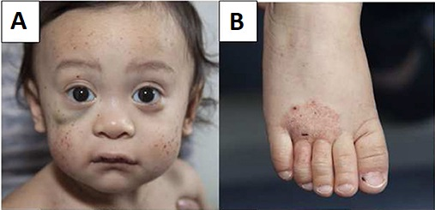
C) Wiskott-Aldrich syndrome (WAS)
X-linked
Mutation on WAS gene: leukocytes and platelets unable to recognize actin cytoskeleton-> defective antigen presentation
Triad of : Thrombocytopenia, eczema, immunodeficiency
Onset after birth
Diagnosis
Low IgM, normal IgG, High IgE, IgA
Thrombocytopenia
Genetic analysis (confirmatory test): mutated WASp gene
Treatmentx:
BMT
IVIG, Prophylactic antibiotics and platelets transfusion

Slide 19
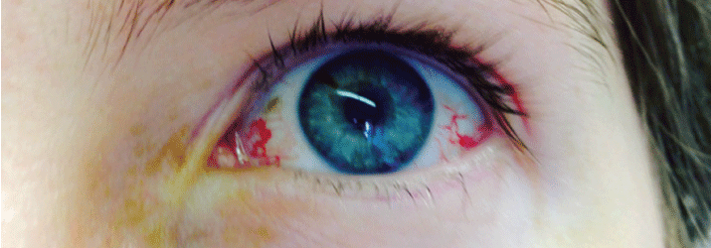
D) Ataxia telangiectasia
AR, defect in ATM gene ---> Defect in dsDNA repair ---> accumulation of DNA breaks
Clinical presentation:
triad of : Progressive ataxia due to cerebellar atrophy, oculocutaneous telangiectasia and low IgA deficiency (ear infections, sinusitis, pneumonia)
Increased risk of malignancy (e.g., lymphoma and leukemia) and ncreased sensitivity to radiation
Diagnosis :
Low IgA, IgG, IgE
lymphopenia
High AFP
Genetic study for ATM gene
MRI: cerebellar (vermis) atrophy
Treatment
Antibiotic therapy: for acute infection and/or prophylaxis
IVIG therapy, depending on the severity of Ig deficiency
Prognosis: Variable rate of progression Affected individuals typically require a wheelchair by adolescence. Malignancy is the most common cause of death. [33] Average life expectancy: 25 years of age

Slide 20
D) Severe combined immunodeficiency (SCID)
A rare genetic condition caused by numerous genetic mutations that result in the defective development of functional B cells and T cells.
Most common defect is X-linked recessive: mutations in the gene encoding the common gamma chain → defective gamma chain receptor in IL-2R
Less common Autosomal recessive Adenosine deaminase (ADA) deficiency → accumulation of toxic metabolites (deoxyadenosine and dATP) and disrupted purine metabolism → Clinical features :
Severe, recurrent infections: bacterial diarrhea, chronic candidiasis (thrush), viral and protozoal infections, and FTT . Lymph nodes and tonsils may be absent

Slide 21
3.Congenital combined immunodeficiencies
Diagnosis
Flow cytometry: absent T and B cells markers
CXR: absent thymic shadow
Genetic diagnosis
Treatment :
Bone marrow transplant or stem cell transplantation
IVIG, PCP prophylaxis
Prognosis: often fatal in the first year of life if left untreated

Slide 22
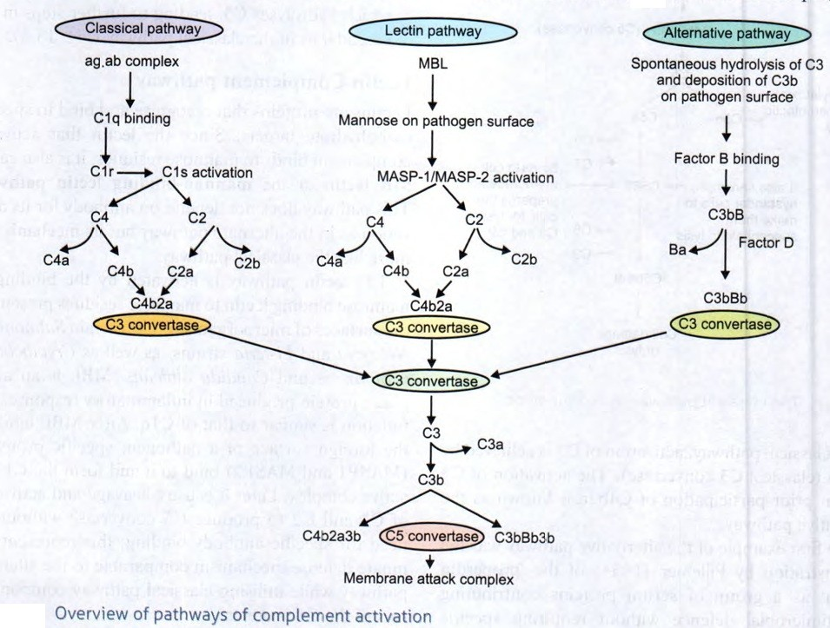
Complement disorders

Slide 23
A. C1 esterase inhibitor deficiency:
AD, Unregulated activation of kallikrein → ↑ bradykinin → angioedema
Clinical feature: Recurrent angioedemas provoked by triggers, e.g., trauma, surgery, infections, and drugs Airway edemas can be life-threatening.
Diagnosis : low CH50 assay screening test, ↑Bradykinin, levels Low CD2, C4 levels
Treatment : FFP for acute attack and Danazol for prophylaxis: increases level of C1 esterase inhibtor

Slide 24
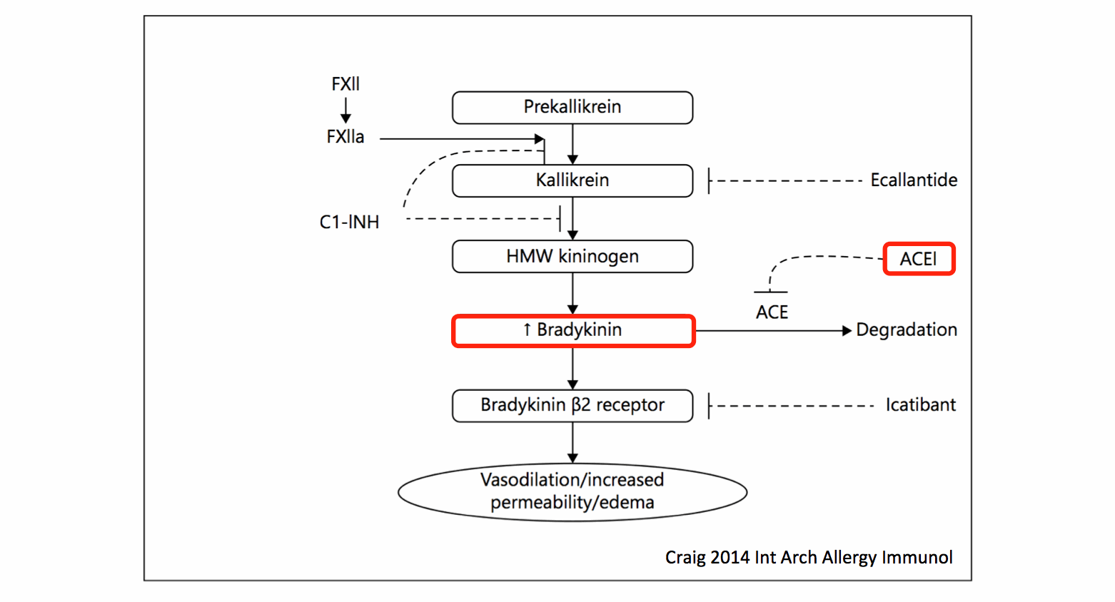

Slide 25
B. Other Complement disorders
C1, C2, C4: recurrent sinopulmonary infections + O. Media + encapsulated infections
Increased immune complexes disease ---> SLE
C3: risk of encapsulated infections (impaired opsonization mediated by C3b)
C5-C9 (Membrane attack complex): recurrent Nisseria meningitidis
All are associated with low CH50

Slide 26
Congenital neutrophil and phagocyte disorders

Slide 27
A) Chronic granulomatous disease (CGD)
X-linked (70%) or AR , defect in NAPDH oxidase, no H2O2 and bleach ---> no oxygen dependant killing
Recurrent Catalase positive infections : Staph aureus, B . Cepacia, Serratia, Nocardia , Sallmonela , Aspergellus.
Lymphadenopathy and splenomegaly
Diagnosis
Dihydrorhdmine DHR test = measure H2O2 in phagocytes
NBT test (may be inaccurate)
Genetic diagnosis
Treatment
Prophylaxis (bactrim and itraconazole daily decrease infection 70%
Weekly INF-G
BMT curative

Slide 28
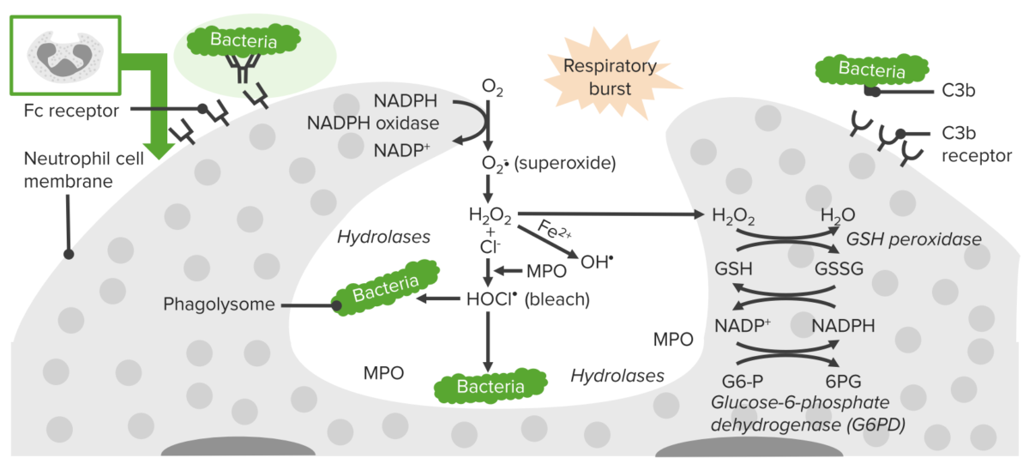

Slide 29
B) Leukocyte adhesion deficiency 1
AR, Absent LFA-1 (CD18) protein → impaired leukocyte migration
Clinical feature :Recurrent nonsuppurative bacterial infections of skin and GI system, and Delayed separation of the umbilical cord
Diagnosis :
Leukocytosis
Flow cytometry: absent CD18
Treatment :Treatment of infections and Bone marrow transplant

Slide 30
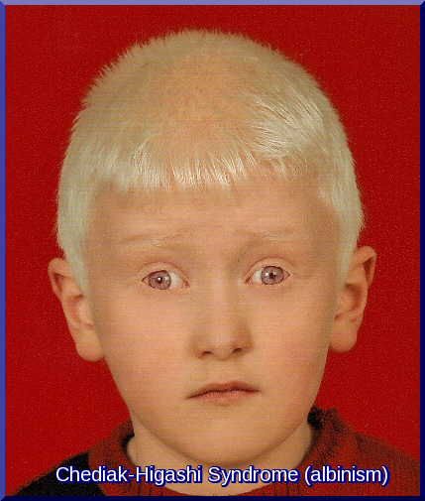
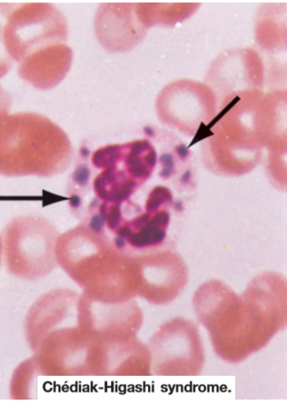
C) Chédiak-Higashi syndrome:
AR, Defect in phagosomes lysosomes fusion (LYST gene)
Clinical presentation:
Partial Albinism
Pyogenic infection: cutaneous and sinopulmonary infections esp. staph and GAS
Peripheral neuropathy
Diagnosis:
Peripheral smear: giant cytoplasmic granules in granulocytes and platelets
Mild coagulation abnormalities
Treatment: BMT

Slide 31
D) hyper-IgE syndrome (Job syndrome) :
AD, Deficiency in Th17 due to STAT3 mutation -> impaired PMN recruitment and chemotaxis
Clinical features:
Recurrent bacterial (staphylococcal) infections (Cold abscess)
Retained primary teeth
Coarse facial features: Broad nose
Eczema
Hyper IgE (eosinophilia)
Fractures, scoliosis
Onset after birth
Diagnosis :↑ IgE , eosinophilia and genetic diagnosis
Treatment: Antibiotics and prophylaxis (with penicillinase-resistant antibiotics) IVIG

Slide 32
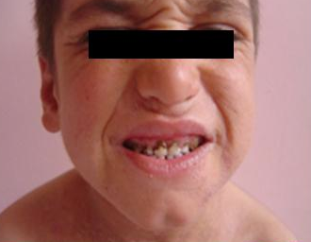

Slide 33
E) Severe congenital neutropenia
AR or AD Bone marrow failure of myeloid lineage
Clinical feature : Recurrent bacterial infections, e.g. gingivitis, otitis media, respiratory infections, and cellulitis (Streptococcus and Staphylococcus) Oral ulcerations
Diagnosis : Absolute neutropenia, eosinophilia, monocytosis, high platelets
Treatment : G-CSF and BMT

Slide 34
F) Cyclic neutropenia
AD
Every 21 days +- 3
Mouth ulcers, stomatitis, pharyngitis, pneumonia
Risk of C.perfringis sepsis
Tx: G-CSF

Slide 35
Initial Screening Immunologic Testing
CBC:
ALC: (normal result rules against T-cell defect)
ANC (normal result rules against congenital or acquired
Leukoytosis> 50000: LAD
Platelet count (normal result excludes Wiskott-Aldrich syndrome)
ESR: (normal result indicates chronic bacterial or fungal infection unlikely)

Slide 36
Initial Screening Immunologic Testing
B) Screening Tests for B-Cell Defects
IgG, IgA, IgM (low in most antibody defects)
Isohemagglutinins (low in agammaglobulinemia)
Antibody titers tetanus, diphtheria, Haemophilus influenzae , and pneumococcus (low in most antibody defects)
C) Screening Tests for T-Cell Defects
Absolute lymphocyte count (normal result indicates T-cell defect unlikely)
Flow cytometry to examine for the presence of naïve T cells (CD3+ CD45RA+ cells)

Slide 37
Initial Screening Immunologic Testing
D)Screening Tests for Phagocytic Cell Defects
Microscopy (abnormal in some neutropenias)
Respiratory burst assay (abnormal in chronic granulomatous disease)
E)Screening Test for Complement Deficiency
CH50 (nearly absent in classical pathway and terminal component deficiencies)
AH50 (nearly absent in alternative pathway and terminal component deficiencies)
F )Chest x-ray may be useful in some infants; an absent thymic shadow suggests a T-cell disorder, especially if the x-ray is obtained before onset of infection or other stresses that may shrink the thymus.
Lateral pharyngeal x-ray may show absence of adenoidal tissue.

Slide 38
IVIG
Indications:
Children with severe hypogammaglobulinemia
ITP
Kawasaki disease
(HIV) infection with antibody deficiency (IgG concentration <400 mg/dL)
Guillain-Barré syndrome
Refractory dermatomyositis and polymyositis
Chronic inflammatory demyelinating polyneuropathy
Side effect:
Anaphylaxis
Aseptic meningitis
Fluid overload
Acute renal failure
Fever, systemic reaction (vomiting)

Slide 39
Vaccination in immunodeficiency
No live vaccines for primary B and T cells immunodeficiency
In complement disorders: All vaccines are efficient, pneumococcal and meningococcal vaccines should be absolutely administered
In phagocytic disorders: Live bacterial vaccines (BCG, typhoid fever) are avoider
No live vaccines for any receiving steroids 2mg/kg/day or 20 mg/day for 14 days, Live vaccines should not be administered in these individuals until at least one month after steroid discontinuation.
No OPV for any contact of immunodeficiency
HIV can receive MMR and varicella if T cell count > 200/mm
Vaccinated babies against varicella should avoid contact with immunodeficiency for 3 weeks

Slide 40
Thank you

