Slide 1
أرشيف العظام
وتين آخر قروب

Slide 2
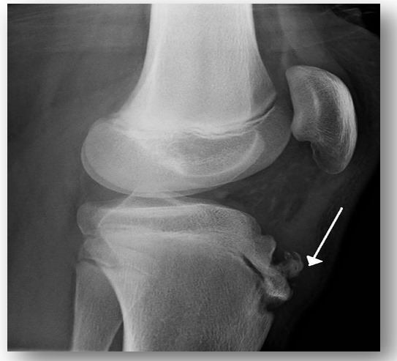
MC age of this disease--> 14

Slide 3
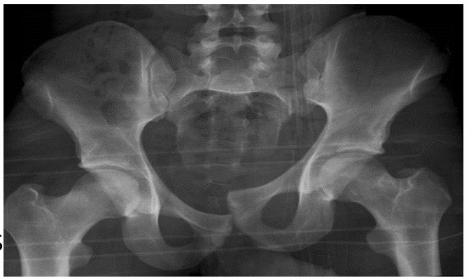
Mechanismof injury :
vertical shear

Slide 4
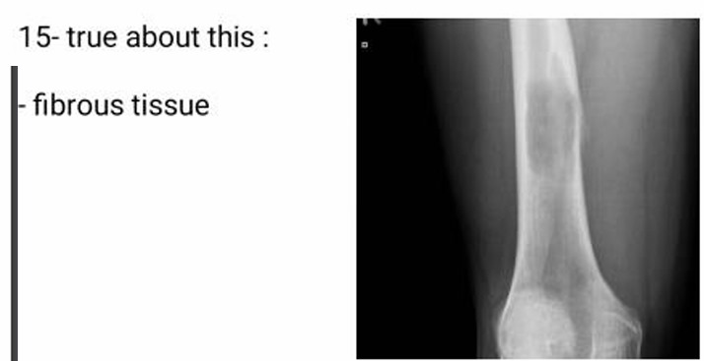

Slide 5
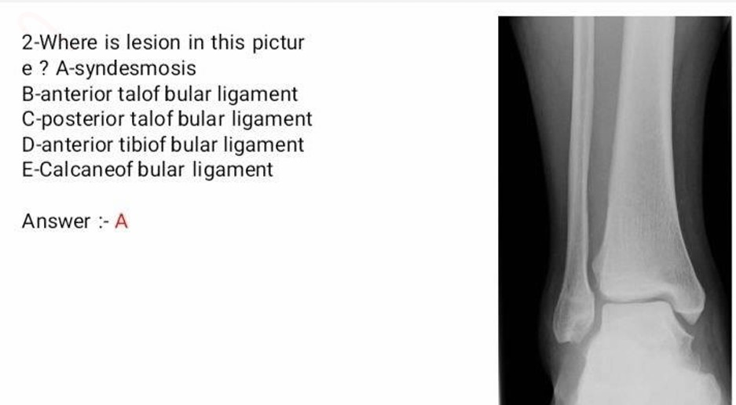

Slide 8
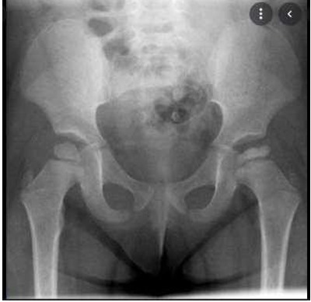
perthis disease

Slide 10
Shoulder dislocation in pediatric, most common nerve injury → axillary nerve injury
All of the following are true about pediatric fracture, except: treatment of plastic deformity (manipulation) can be do in the clinic ✅✅
Shortening deformity

Slide 11
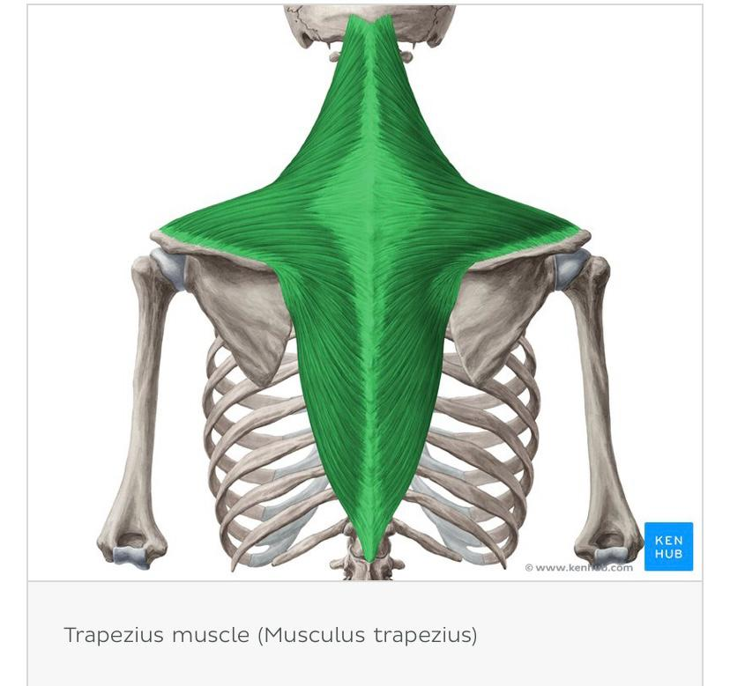
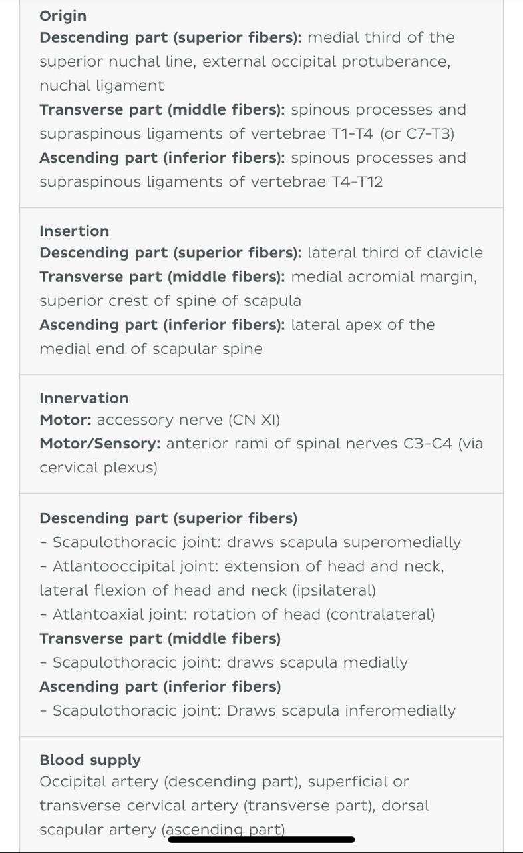

Slide 12
