Slide 1
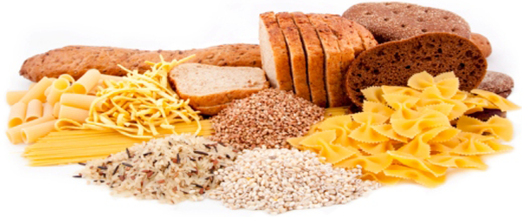
Carbohydrates
Dr. Nesrin Mwafi
Biochemistry & Molecular Biology Department
Faculty of Medicine, Mutah University

Slide 2
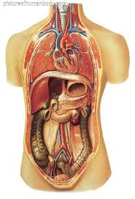
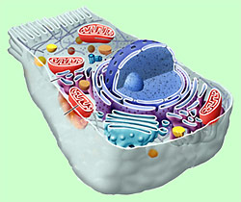
Major Types of Macromolecules
Proteins
Nucleic acids
Lipids
Carbohydrates

Slide 3
Classification of Carbohydrates
Carbohydrates are “Sugars” or “Saccharides” consist of the empirical formula (CH₂O)n where n ≥ 3.
Carbohydrates
C
H2O

Slide 4
Classification of Carbohydrates
Carbohydrates are “Sugars” or “Saccharides” consist of the empirical formula (CH₂O)n where n ≥ 3.
Monosaccharides: The basic units of CHO which cannot be hydrolyzed into smaller sugars like glucose, galactose and fructose
Disaccharides: contain two monosaccharides covalently linked by glycosidic bond like sucrose which consists of glucose and fructose
Polysaccharides: are polymeric molecules composed of long chains of monosaccharides linked together via glycosidic bonds like starch, cellulose and glycogen

Slide 5
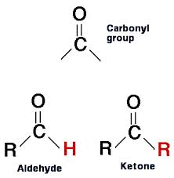
Monosaccharides
They are classified according to the number of carbon atoms: trioses, tetroses, pentoses, hexoses …..etc
Also classified according to the chemical nature of the carbonyl group C=O either to Aldoses (the carbonyl group is an aldehyde) or Ketoses (the carbonyl group is a ketone)
Aldehyde: R¹ = H, alkyl or aryl
Ketone: R¹ and R² = alkyl or aryl
R¹
R¹
R²

Slide 6
Monosaccharides
Hexose C₆H₁₂O₆
O
H
1
CH₂OH
1
H
2
OH
2
O
OH
3
H
OH
3
H
Hexoaldose\Aldohexose
Fischer projections
Hexoketose\Ketohexose
H
4
OH
H
4
OH
H
5
OH
H
5
OH
6
6
CH₂OH
CH₂OH
D-glucose
“grape or blood sugar”
D-fructose
“fruit sugar”

Slide 7
Isomerization
Isomers: are molecules with same molecular
formula but different chemical structures
Constitutional (structural) isomers: atoms and functional groups bind together in different ways (e.g. glucose and fructose)
Stereroisomers (spatial isomers): differ in the configuration of atoms rather than the order of atomic connectivity
Chiral carbon: asymmetric carbon atom attached to 4 different groups of atoms
The number of stereoisomers for any given molecules = 2^{n} where n represents the number of chiral centers

Slide 8
Isomerization
O
H
1
H
2
OH
OH
3
H
Number of stereoisomers = 2⁴
= 16
H
4
OH
H
5
OH
6
CH₂OH
D-glucose

Slide 9
Isomerization
Enantiomers: are two stereoisomers that are mirror images to each other but not superimposable

Slide 10
D/L Monosaccharides
1
1
CHO
mirror
CHO
H
2
OH
HO
2
H
3
3
CH₂OH
CH₂OH
D-glyceraldehyde
L-glyceraldehyde
CH₂OH
CH₂OH
1
1
2
O
mirror
2
O
OH
3
H
H
3
OH
H
4
OH
HO
4
H
H
5
OH
HO
5
H
6
6
CH₂OH
CH₂OH
D-fructose
L-fructose

Slide 11
D/L Monosaccharides
1
1
CHO
CHO
mirror
H
2
OH
HO
2
H
OH
3
H
H
3
OH
H
4
OH
HO
4
H
H
5
OH
HO
5
H
6
6
CH₂OH
CH₂OH
D-glucose
L-glucose

Slide 12
Isomerization
Enantiomers: are two stereoisomers that are mirror images to each other but not superimposable
D- (dexter)/L- (laevus) Nomenclature system: commonly used to assign the configurations in sugars and amino acids
As a rule of thumb: if the farthest chiral atom from the highest oxidized carbon (i.e. carbonyl group) has –OH group on the right side, the configuration is D. If it is on the left, the configuration is L.
Most naturally occurring sugars are D-isomers while most naturally occurring amino acids are L-isomers.

Slide 13
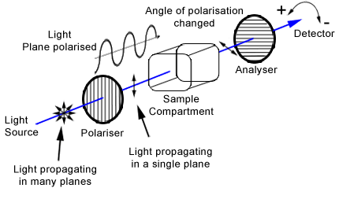
Monosaccharides
Enantiomers are optically active and can rotate the polarized light plane either clockwise or counterclockwise
Racemic mixture contains equal amounts of each enantiomer

Slide 14
Monosaccharides
Enantiomers are optically active and can rotate the polarized light plane either clockwise or counterclockwise
(+)/(-) nomenclature system: if one enantiomer rotates the light clockwise, it is labeled (+) or (d) (dextrorotatory). The second mirror image enantiomer is labeled (-) or (l) laevorotatory.
by chance, it was found that D-glyceraldehyde is in fact the dextrorotatory isomer.
D/L system should not be confused with +/- or d/l system. For example, D-fructose (laevulose) is levorotatory whereas D-glucose (dextrose) is dextrorotatory.

Slide 15
Monosaccharides
Epimers: are stereoisomers that differ in the configurations of atoms at only one stereogenic center (chiral center in CHO). They are not mirror image isomers.
1
1
1
CHO
CHO
CHO
H
2
OH
H
2
OH
OH
2
H
OH
3
H
OH
3
H
OH
3
H
H
4
OH
OH
4
H
H
4
OH
H
5
OH
H
5
OH
H
5
OH
6
6
6
CH₂OH
CH₂OH
CH₂OH
D-glucose
D-galactose
D-mannose

Slide 16
Hemiacetal & Hemiketal

Slide 17
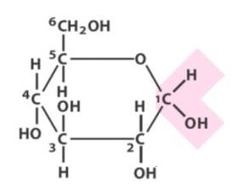
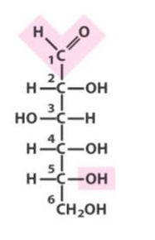
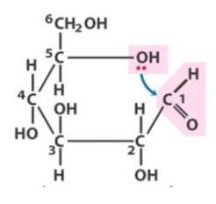
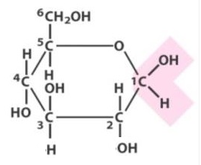
Monosaccharide cyclization
Linear form
anomeric
carbon
cyclization
α-D-glucose
Haworth projection
cyclization
D-glucose
Fisher projection
β-D-glucose

Slide 18
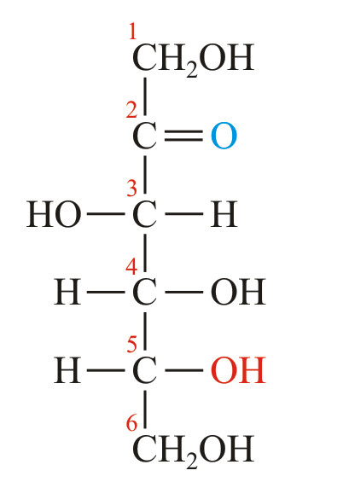
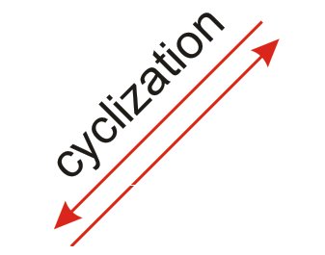
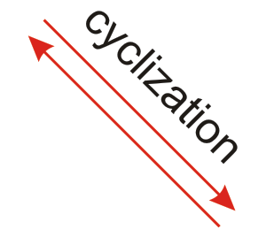
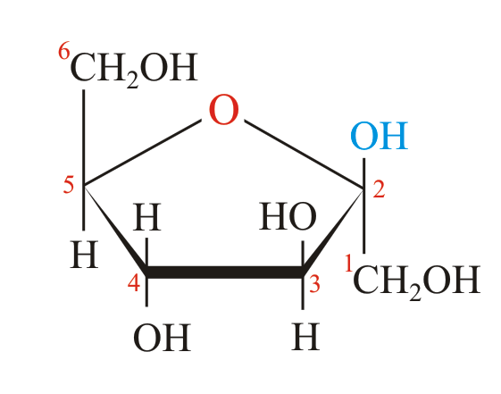
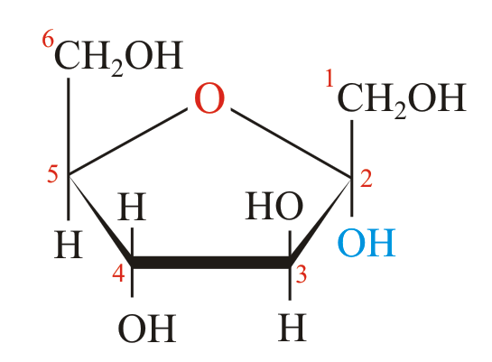
Monosaccharide cyclization
D-fructose
Linear form
α-D-fructose
β-D-fructose

Slide 19
Pyranoses & Furanoses
Sugars with six-membered rings are known as pyranoses
(e.g. glucopyranose) as they resemble the heterocyclic
compound pyran.
α-D-glucopyranose
Sugars with five -membered rings are known as furanoses
(e.g. fructofuranose) as they resemble the heterocyclic
compound furan.
α-D-fructofuranose

Slide 20
Anomers
In cyclic sugars, the carbonyl carbon becomes a chiral center (asymmetric carbon) with two possible configurations: α and β. This new carbon is called anomeric carbon.
Anomers are pair of stereoisomers that differ in spatial arrangement of atoms at the anomeric carbon. In α-anomer, the OH group of the anomeric carbon is projecting down the plane of the ring and on the opposite side of the terminal CH₂OH group (in Fisher projection) and vise versa in β-anomer.
The anomers freely interconvert in aqueous solution, e.g. at equilibrium D-glucose is a mixture of β-anomer (63.6%), α-anomer (36.4%) and extremely tiny amounts of the straight chain.

Slide 21
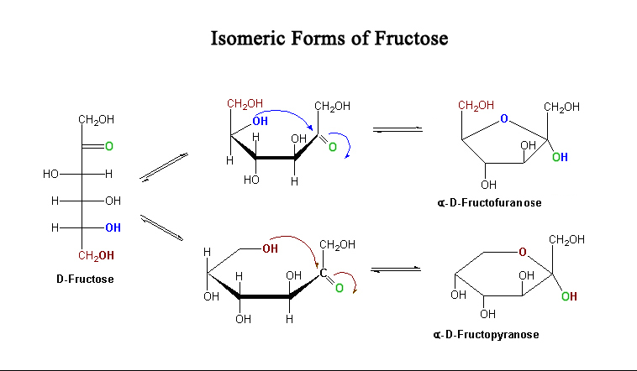
Pyranoses & Furanoses
Hexose or pentose can exist in pyranose and furanose forms (the most stable rings). e.g in solution, glucose and fructose are mostly pyranoses whereas ribose is mostly furanose
1
2
3
4
5
6

Slide 22
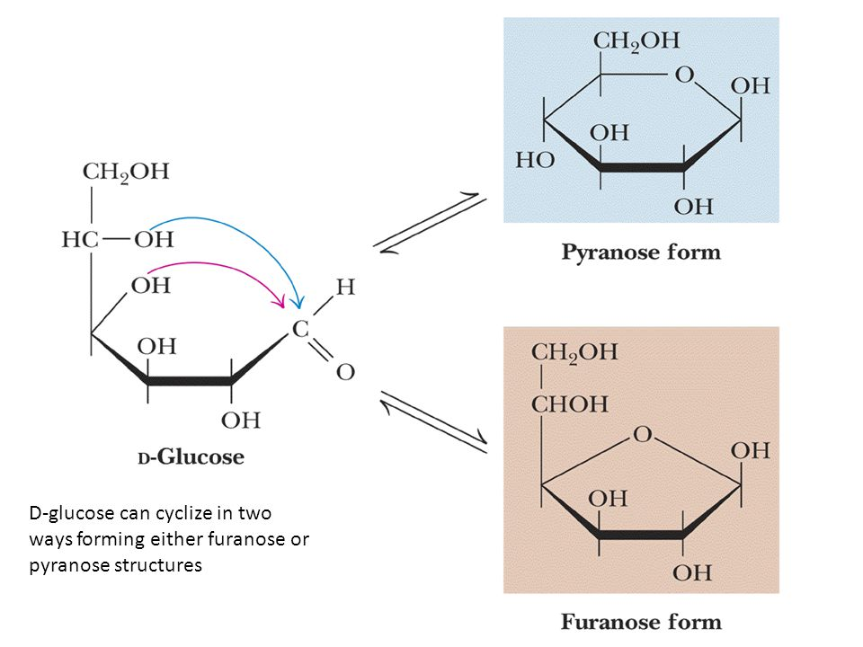
Pyranoses & Furanoses
β-D-glucopyranose
β-D-glucofuranose

Slide 23
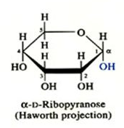
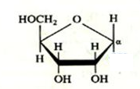
Pyranoses & Furanoses
H
O
1
H
2
OH
H
3
OH
H
4
OH
5
CH₂OH
D-ribose
Fisher projection
OH

Slide 24
Haworth Projection
Haworth projection is a simple 3D way to represent the cyclic monosaccharides. The OH groups on the right-hand side of Fisher projection are down in Haworth projection and vise versa. The dark line indicates atoms that are closer to the observer.
Fisher projection
Haworth projection
β-D-fructose
D-fructose

Slide 25
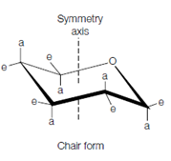
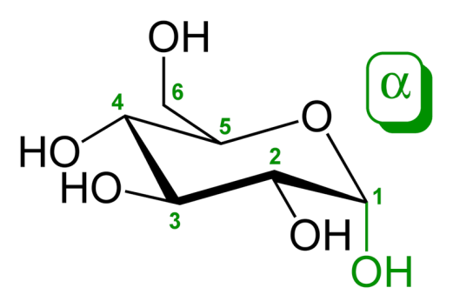
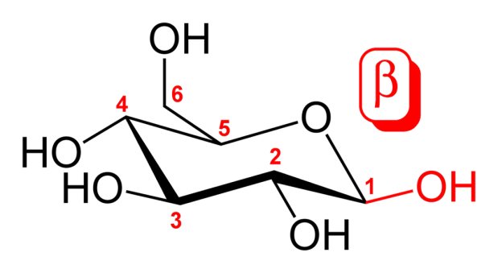
Conformers
The geometry of the carbon atoms of monosaccharide ring is tetrahedral (bond angles are close to 109.5⁰), so sugar rings are not actually planar. For example, pyranoses take on either Chair or Boat conformations (conformational isomers or conformers).
a: axial
e: equatorial
Chair form of α-D-glucose
Chair form of β-D-glucose
Boat form of β-D-glucose

Slide 26
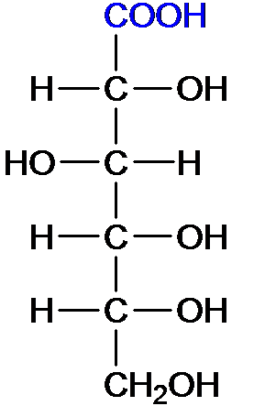
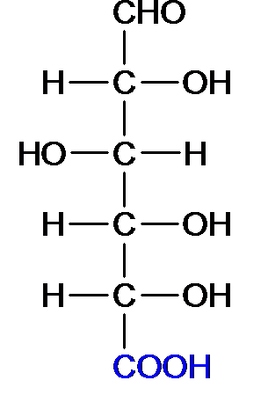
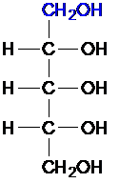
Sugar Modification
Aldonic acids : oxidation of
aldehyde (C1) to carboxylic acid; e.g. D-gluconic acid
Uronic acids : oxidation of
OH at (C6) to carboxylic acid;
e.g. D-glucuronic acid
Alditols : reduction of
carbonyl group to alcohol;
e.g. D-ribitol and D-glycerol
D-ribitol

Slide 27
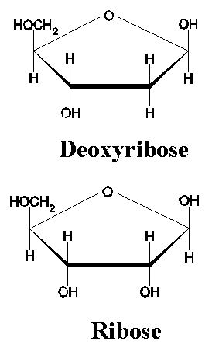
Sugar Modification
Deoxy sugars : OH group is
replaced by H; e.g. β-D-2-deoxyribose
Amino sugars : one or more OH groups are replaced by
amino group which is often acetylated; e.g. α-D-glucosamine and α-D-N-acetylglucosamine.

