Slide 1
LeArning Disabilities
Supervised by:Dr.Najib Alqsous
Presented by : Eyad Farfoura
Qusai Alkhatib

Slide 2
Definition
Group of neurological disorders that result from the problem of storing,processing and producing information. And difficulty acquiring school skills or academic skills.
Children with learning disabilities are not dumb or lazy . Infact, they usually have average or above average intelligence. Their brains just process informations differently.

Slide 3
Learning disability VS learning disorder
Learning disorder is a diagnostic term. A psychiatric diagnoses a person with a learning disorder based on a list of symptoms.
Learning disability is a legal,social term. A public school identifies a student with a learning disability

Slide 4
Specific learning disorder
Definition
Types
Etiology
Epidemiology
Development and course
DSM5 criteria
Severity
Differential diagnosis
Treatment

Slide 5
Definition of SLD
Specific learning disorders are neurodevelopmental disorders that are typically diagnosed in early school-aged children, although may not be recognized until adulthood. They are characterized by a persistent impairment in at least one of three major areas: reading, written expression, and/or math.

Slide 6
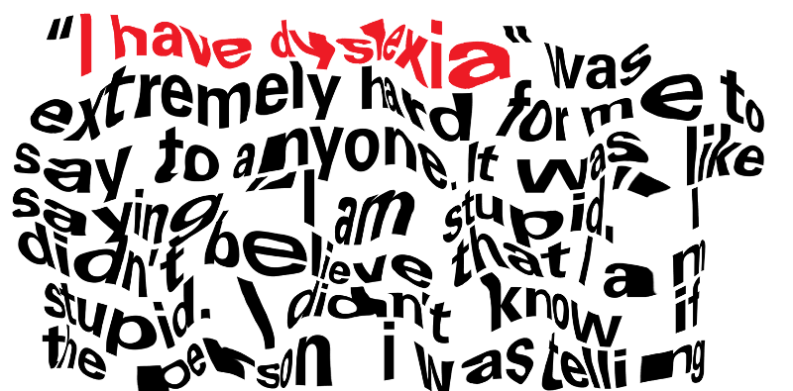
Dyslexia
Difficulty learning reading.
Symptoms in children with dyslexia:
difficulty in recognizing words
Slow and inaccurate reading
poor comprehension
difficulties with spelling
*most common learning disability, with 20 percent of children in special education for a learning disability estimated to have dyslexia.

Slide 7
What you feel while reading or trying to read this is actually what a child with dyslexia experience every time he reads.

Slide 12
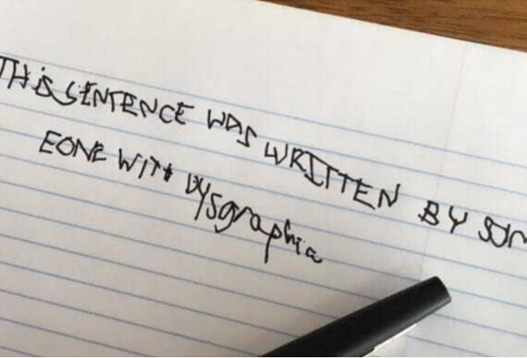
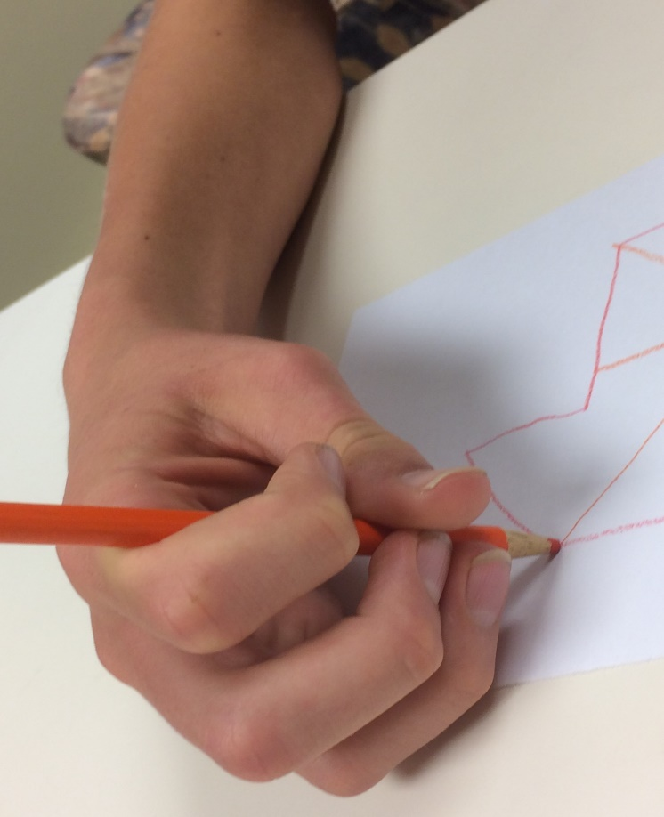
Dysgraphia
Symptoms in a child with dysgraphia:
1)Difficulty in writing letters
2)Trouble in spacing letters correctly on the page
3)Difficulty in writing in a straight line
4)Difficulty holding and controlling a pencil or other writing tool
Difficulty learning to write.
All dyslexics have dysgraphia but not the opposite

Slide 14
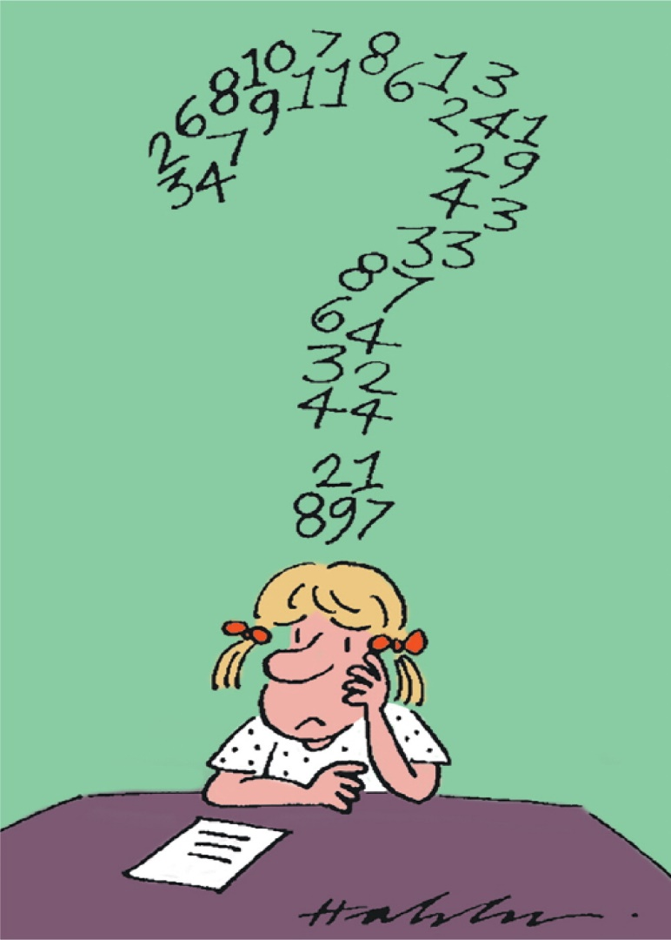
Dyscalculia
Difficulty understanding numbers and doing mathematical calculations.
Symptoms in children with dyscalculia:
1)Difficulty reading analog clocks
2)Difficulty finding what number is larger
3)Difficulty in multiplication,substraction,addition and division tables
4)Difficulty with tie,directios,recalling schedules and sequences of events

Slide 15
Dyspraxia
Developmental co-ordination disorder (DCD), also known as dyspraxia, is a condition affecting physical co-ordination. It causes a child to perform less well than expected in daily activities for their age, and appear to move clumsily.
It can affect your co-ordination skills – such as tasks requiring balance, playing sports or learning to drive a car. Dyspraxia can also affect your fine motor skills, such as writing or using small objects.
Children with verbal dyspraxia have problems with coordinating their muscle to produce speech sounds and words. They have difficulties in producing clear, fluent speech or saying certain words or sentences. Children with verbal dyspraxia might speak slowly

Slide 16
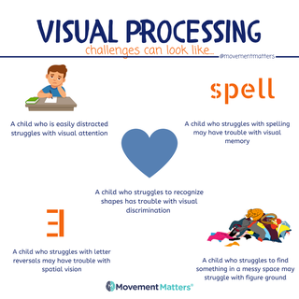
Visual processing disorders
The inability to differentiate between foreground and background as well as similar looking numbers,letters,shapes,objects and symbols.

Slide 17
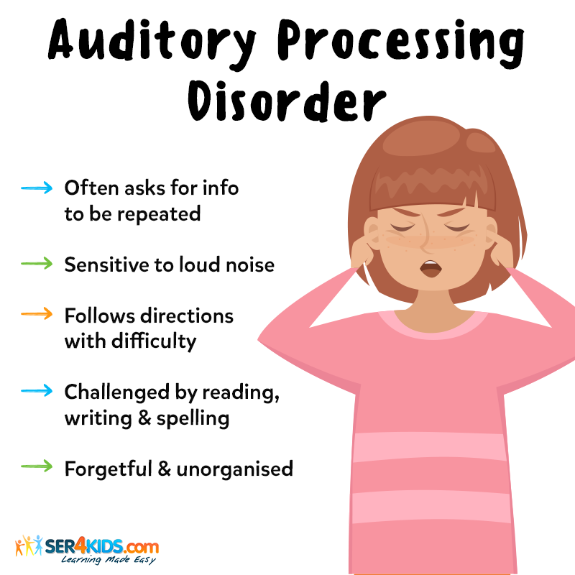
Auditory processing disorder
Trouble distinguishing similar sounds or confusing the sequence of spoken or heard sounds.

Slide 18
Nonverbal learning disabilities
The inability to recall the names or words for common objects.

Slide 19
Notes:
Environmental exposure to toxins (lead)

Slide 20
Epidemiology
Learning disorders are among the most frequently diagnosed developmental disorders in childhood.
Prevalence in school age children: 5–15%
Males are two times more affected than females
Commonly co-occurs with other neurodevelopmental disorders, such as ADHD(in one third of patients), communication disorders, developmental coordination disorder, autistic spectrum disorder
Also comorbid with other mental disorders, including anxiety, depressive, and bipolar disorders

Slide 21
DSM5 criteria for diagnosis
A)Difficulties learning and using academic skills, as indicated by the presence of at least one of the following symptoms that have persisted for at least 6 months, despite the provision of interventions that target those difficulties:
1-Inaccurate or slow and effortful word reading (e.g. - reads single words aloud incorrectly or slowly and hesitantly, frequently guesses words, has difficulty sounding out words).
2-Difficulty understanding the meaning of what is read (e.g. - may read text accurately but not understand the sequence, relationships, inferences, or deeper meanings of what is read).
3-Difficulties with spelling (e.g. - may add, omit, or substitute vowels or consonants).
4-Difficulties with written expression (e.g. - makes multiple grammatical or punctuation errors within sentences; employs poor paragraph organization; written expression of ideas lacks clarity).
5-Difficulties mastering number sense, number facts, or calculation (e.g. - has poor understanding of numbers, their magnitude, and relationships; counts on fingers to add single-digit numbers instead of recalling the math fact as peers do).
6-Difficulties with mathematical reasoning (e.g. - has severe difficulty applying mathematical concepts, facts, or procedures to solve quantitative problems).
B)The affected academic skills are substantially and quantifiably below those expected for the individual’s chronological age, and cause significant interference with academic or occupational performance or with activities of daily living.
C)The learning difficulties begin during school-age years but may not become fully manifest until the demands for those affected academic skills exceed the individual’s limited capacities (e.g. - as in timed tests, reading or writing lengthy complex reports for a tight deadline, excessively heavy academic loads).
D)The learning difficulties are not better accounted for by intellectual disabilities, sensory (visual or auditory) disorders, other mental or neurological disorders, psychosocial adversity, lack of proficiency in the language of academic instruction, or inadequate educational instruction.

Slide 22
Severity
Some difficulties with learning in one or two academic areas, but may be able to compensate.
Significant difficulties with learning, requiring some specialized teaching and some accommodations or supportive services
Severe difficulties with learning, affecting several academic areas and requiring ongoing intensive specialized teaching
mild
moderate
severe

Slide 23
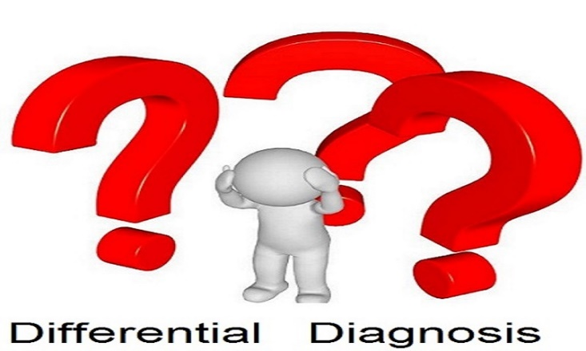
Normal variation in academic attainment.
Intellectual disability.
Neurological or sensory disorders.
ADHD.
Psychotic disorder.

Slide 24
Development , course and prognosis
SLD is lifelong, but the course and clinical expression is variable.
Depending on the range and severity of the disability,comorbidities and available support system and intervention.
Changes in manifestation of symptoms occur with age,so that the individual can have a persistent or shifting array of learning difficulties across the lifespan.
the earlier the diagnosis for SLD, the better the prognosis. As early diagnosis allows for early intervention and many who receive early intervention are actually able to do well academically and go on to pursue higher education.

Slide 25
Treatment
Intense educational interventions (special classrooms, remedials, or Systematic individualized education tailored to child’s specific needs ”1 to 1 tutoring”) and behavioral techniques.
Some tips:
Slow down instructions
Keep eye contact to make sure the student is engaged
Know your student and build rapport
Practice small games before playing on a larger scale
Peering partners may be affective
BE PATIENT

Slide 26
Children with learning disabilities can sill be gifted and talented.
Alexander Graham Bell
Struggled with traditional schooling and it’s believed that he had dyslexia.
Leonardo Da Vinci
Considered to have had learning disability and particularly dyslexia. He overcame his disability by creating arts.
Pablo Picasso
He had difficulties in reading and it’s believed that he was showing symptoms of ADHD.

