Slide 1
Introduction What is Public Health?
Dr. Israa Al-Rawashdeh MD,MPH,PhD
Faculty of Medicine
Mutah University
2019

Slide 2
Course title: Public health Course code: 1506202
Credit hours: 2 hours

Slide 3
Objectives of this lecture:
To identify concepts of health, disease, public health and other related concepts.
To be introduced to a brief history of public health.
To acknowledge the importance of public health in a community.
To identify how public health approach works.

Slide 4
Health
Feeling healthy is core to our everyday lives
“A state of complete physical, mental and social well being and not merely the absence of disease or infirmity”.
The World Health Organization (WHO), 1948
Recently this statement has been expanded to include the ability to lead a “socially and economically productive life”.
Another definition of health is that
“ health is a successful adaptation of the human body to stresses and stimuli (in the environment) to which it is exposed, such that it expresses adequate functioning under given genetic and environmental conditions”
Notes:
Too idealistic, different perceptions of health to different people, differentiate physical and mental, difficult to measure (operationalise)!

Slide 5
Spectrum of Health
There is no single cut-off point.
The lowest point on the health-disease spectrum is death and the highest point corresponds to the WHO definition of positive health.
There are degrees or "levels of health", as there are degrees or severity of illness.
It implies that health is a state, not to be attained once and for all, but ever to be promoted, preserved, and restored when impaired.
Health is a dynamic phenomenon
The primary focus of today’s medical care system is (sick)!

Slide 6
Health
Health is multidimensional .
The WHO definition mentions three specific dimensions (physical, mental, and social), some other dimensions like spiritual, emotional may also be included.
Physical health- is concerned with anatomical integrity and physiological functioning of the body. It means the ability to perform routine tasks without any physical restriction. E.g., Physical fitness is needed to walk from place to place.
Mental Health- is the ability to learn and think clearly and coherently. E.g., a person who is not mentally fit could not learn something new at a pace in which an ordinary normal person learns.
Social health- is the ability to make and maintain acceptable interaction with other people. E.g. to celebrate during festivals; to mourn when a close family member dies; to create and maintain friendship and intimacy, etc.
Emotional health - is the ability of expressing emotions in the appropriate way, for example to fear, to be happy, and to be angry. The response of the body should be suitable with that of the stimuli. Emotional health is related to mental health and includes feelings. It also means maintaining one’s own integrity in the presence of stressful situation such as tension, depression and anxiety.
Spiritual Health - Some people relate health with religion; for others it has to do with personal values, beliefs, principles and ways of achieving mental satisfaction, in which all are related to their spiritual wellbeing.

Slide 7
DETERMINANTS OF HEALTH
They are the product of a complex interaction of different factors: this is true at both individual and population levels.
These can be grouped into categories:

Slide 9
DETERMINANTS OF HEALTH
Human Biology: there are factors, which are genetically transmitted from parents to offspring. As a result, there is a chance of transferring defective trait. The modern medicine does not have a significant role in these cases.
Genetic Counselling: For instance during marriage parents could be made aware of their genetic component in order to overcome some risks that could arise.
Genetic Engineering: may have a role in cases like Breast cancer.
B. Life style (Behaviour): is an action that has a specific frequency, duration, and purpose, whether conscious or unconscious. It is associated with practice. It is what we do and how we act. Recently life style by itself received an increased amount of attention as a major determinant of health. Life style of individuals affects their health directly or indirectly. For example: Cigarette smoking Unsafe sport practice Eating contaminated food, etc.

Slide 10
DETERMINANTS OF HEALTH
Ecologic or Environment: is all that which is external to the individual human host. Those are factors outside the human body that could influence health include:
Life support, food, water, air etc.
Physical factors, climate, Rain fall
Biological factors: microorganisms, toxins, Biological waste,
economic e.g. Crowding, income level,
Chemical factors: industrial wastes, agricultural wastes, air pollution, etc
Socio – cultural determinants include the beliefs, traditions, and social customs in the community.
D. Health care organizations in terms of their resource in human power, equipment, money and so on determine the health of people. It is concerned with the
Availability of health service People living in areas where there is no access to health service are affected by health problems and have lower health status than those with accessible health services.
Acceptability of the service by the community
Physical Accessibility : in terms of physical distance, finance etc
Quality of care that mainly focuses on the comprehensiveness, continuity and integration of the health care

Slide 11
What is Public Health?

Slide 12
Imagine yourself a clinician in your clinic:
You make all you can to make the
sick individual in front of you better!
You are committed to your job and
very busy treating those who come for help!
You have similar attitude for other patients sitting outside
In the waiting room!
BUT, what about those who have not come to you?

Slide 13
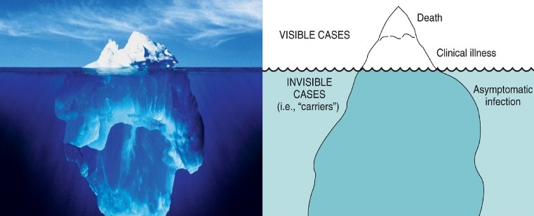

Slide 14
Clinical Medicine and Public Health
Clinical medicine is concerned with diagnosing and treating diseases in individual patients. It has evolved from primarily a medical and nursing service to involve a highly complex team of professionals.
Public health refers to the health status of a defined group of people and the governmental actions and conditions to promote, protect and preserve their health.

Slide 15
Clinical medicine Vs Public health
Items | Public health | Clinical medicine
Objective | prevent diseases | cure diseases
Customers | All community (healthy and diseased) | Individuals (diseased only)
Methods of diagnosis | Demographics Vital statistics Epidemiology | Individual data: History, clinical exam, laboratory investigations
Management | Community health programs | Medical/surgical treatment
Evaluation | Assessment of health programs and health status of a community | Follow up of patients
Branches | Epidemiology, environmental health, management, health services, statistics…… | Internal medicine, surgery, pediatrics, gynecology…

Slide 16
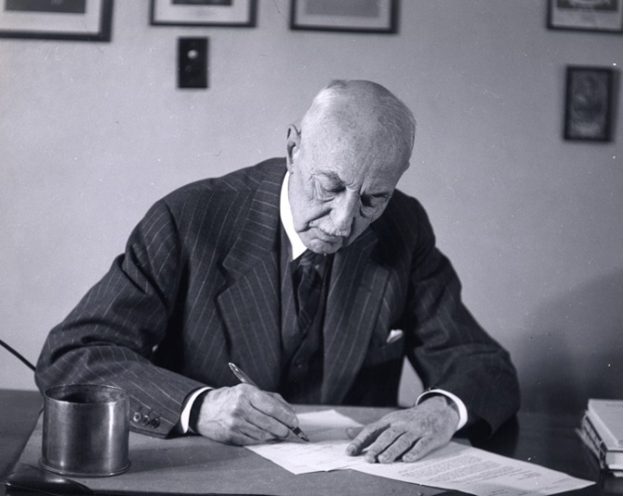
Public Health Defined
“The science and art of preventing disease, prolonging life, and promoting health through the organised efforts and informed choices of society, organizations, public and private communities, and individuals.”
—CEA Winslow
Winslow CEA. The untilled field of public health. Mod Med 1920;2:183–91.

Slide 17
Public Health : is the science of protecting and improving the health of communities through education, promotion of healthy lifestyles, and research for disease and injury prevention.
Public health professionals analyze the effect on health of genetics, personal choice and the environment in order to develop programs that protect the health of your family and community.
Overall, public health is concerned with protecting the health of entire populations.

Slide 18
What is a population?
Several ways to define a population:
An administrative area:
- A health centre catchment area
- A district
- A governorate
- A country
B) A specific population group:
- Children
- Mothers
- Workers
- Seniors

Slide 19
C) A specific disease group
- Tuberculosis
- Diabetes Mellitus
- Cancer…etc.
Population: a group who have at least one common factor.
Aim of public health: provide best health for everyone, everywhere!

Slide 20
The Historical Development of Modern Public Health
The history of public health goes back to almost as long as history of civilization.
1800s-1900s: The Industrial Revolution--population growth—Insanitary conditions—infectious diseases—emergence of epidemics such as cholera--low life expectancy-- key element in the emergence of the Great Sanitary Awakening.
Edwin Chadwick: Public Health Act 1848-
Dr. John Snow: The outbreak of cholera epidemic 1854 (The Broad Street pump)
Louis Pasteur (The germ theory) 1864 .
The beginning of the modern public health movement.
Early public health work focused on the prevention of infectious diseases.

Slide 21
The Broad Street pump

Slide 22
The Historical Development of Modern Public Health
A new concept of disease etiology “multi-factorial causation” .
Modern life and risk factors-Globalisation-
Twentieth century has been the period of health resources development (1900-1960), social engineering (1960 - 1973), health promotion (Primary Health Care), and market period (1985 and beyond).

Slide 23
Health promotion
Is a guiding concept involving activities intended to enhance individual and community health well-being.
It seeks to increase involvement and control of the individual and the community in their own health.
It acts to improve health and social welfare, and to reduce specific determinants of diseases and risk factors that adversely affect the health, well-being, and productive capacities of an individual or society, setting targets based on the size of the problem but also the feasibility of successful interventions, in a cost-effective way.
Health promotion is a key element in public health and is applicable in the community, clinics or hospitals, and in all other service settings. Raising awareness informing people about health and lifestyle factors that might put them at risk requires teaching.

Slide 24
Prevention
There are three levels of prevention:
Primary Prevention refers to those activities that are undertaken to prevent the disease and injury from occurring. It works with both the individual and the community. It may be directed at the host, to increase resistance to the agent (such as immunization or cessation of smoking), or may be directed at environmental activities to reduce conditions favorable to the vector for a biological agent, such as mosquito vectors of malaria.
Secondary Prevention is the early diagnosis and management to prevent complications from a disease. It includes steps to isolate cases and treat or immunize contacts to prevent further epidemic outbreaks.
Tertiary Prevention involves activities directed at the host and also at the environment in order to promote rehabilitation, restoration, and maintenance of maximum function after the disease and its complications have stabilized. Providing a wheelchair, special toilet facilities, doors, ramps, and transportation services for paraplegics are often the most vital factors for rehabilitation.
Rehabilitation is the process of restoring a person’s social identity by repossession of his/her normal roles and functions in society. It involves the restoration and maintenance of a patient’s physical, psychological, social, emotional, and vocational abilities. Interventions are directed towards the consequences of disease and injury.

Slide 25
Public health approach

Slide 26
A Public Health System Is Complex
Mosques
Community Centers
Police
Emergency
Airports
Health Department
Home Health
Hospitals
Schools
Parks
Doctors
Jails
Elected Officials
Mass Transit
CHCs
Environmental Health
Civic Groups
Fire
Local Health
Laboratory Facilities
Drug Treatment
Employers
Economic Development
Mental Health

Slide 27
Three Core Functions of Public Health
Systematically collect, analyze, and make available information on healthy communities and Identify problems related to the public’s health, and measure their extent
Assessment
Policy
Development
Prioritize problems, find possible solutions, set regulations to achieve change, and predict effect on the population using of a scientific knowledge base (Evidence based Public Health) in policy and decision making
Assurance
Ensure provision of services to those in need, widespread adoption and dissemination.
Ensure provision of technical assistance and evaluation.
Institute of Medicine. The future of public health. Washington, DC: National Academies Press; 1988.
27

Slide 28
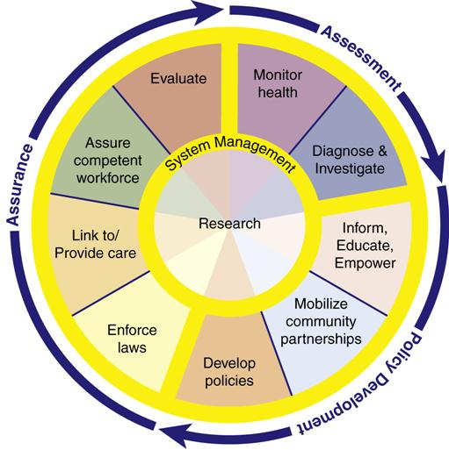
The 10 Essential Public Health Services describe the public health activities that all communities should undertake:
Monitor health status to identify and solve community health problems
Diagnose and investigate health problems and health hazards in the community
Inform, educate, and empower people about health issues
Mobilize community partnerships and action to identify and solve health problems
Develop policies and plans that support individual and community health efforts
Enforce laws and regulations that protect health and ensure safety
Link people to needed personal health services and assure the provision of health care when otherwise unavailable
Assure competent public and personal health care workforce
Evaluate effectiveness, accessibility, and quality of personal and population-based health services
Research for new insights and innovative solutions to health problems

Slide 29
Thank you

