Slide 1
Vitamins Fat soluble vitamins (Vit.K and Vit.E) Lecture 1 (20 slides)
Dr. Eman Shaat
Professor of Biochemistry & Molecular biology

Slide 2
Vitamins
Water-soluble vitamins
Found in watery parts of foods (hydrophilic)
After absorbed move directly into blood
Transported freely in blood. Some Vits require carrier .
Not stored
Needed more regularly – every 1-3 days; because not stored
Deficiencies fast to develop; because not stored
Toxicities less likely
Usually no precursors
Urine excretion
Fat-soluble vitamins
Found in fats and oils of foods (hydrophobic).
After absorbed enter lymph, then blood
Protein carriers for transport
Stored (fatty tissue/liver)
Doesn’t need as regularly - weekly, monthly; because stored.
Deficiencies slow to develop; because stored
Toxicities more likely; because stored
Precursors
Fecal excretion

Slide 3
Vitamins
Organic compounds
Cannot be synthesized in ample amounts in the body. Required in small amounts
Deficiencies can result in potentially serious consequences.
Provitamin (precursor) vs Preformed vitamin (vitamins found in foods in their active form)
vitamins can be destroyed by: Heat, Light (ultraviolet), Oxygen.
Fat-soluble vitamins tend to be more stable.
Whole foods: Fruits, vegetables, and whole grains.
Vitamins from animal foods are generally more bioavailable than those in plant foods.
Vitamins grouped into two major categories:
Fat-soluble (4 fat soluble) Vitamin A, D, E, K.
Water-soluble (9 water soluble)

Slide 4
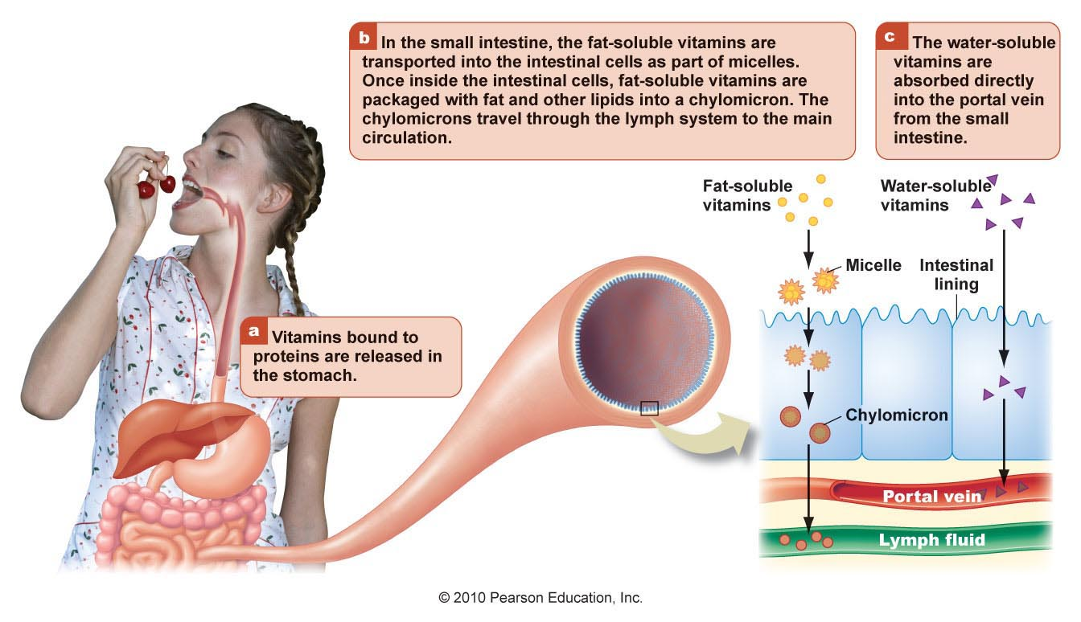
Digesting and absorbing vitamins

Slide 6
FAT SOLUBLE VITAMINS
They are non polar.
All of them are isoprene derivatives.
require micelles to be absorbed.
are transported to the liver in chylomicrons.
They are stored either in the liver (A, D and K) or in adipose tissue (E) for varying periods of time.
In blood they are transported by lipoproteins or specific binding proteins.
They are mainly excreted in feces.
Toxicity occurs from over dosage.
No specific coenzyme function has yet been found for the fat soluble vitamins EXCEPT vitamin K.

Slide 7
Fat soluble vitamins Vitamin K

Slide 8
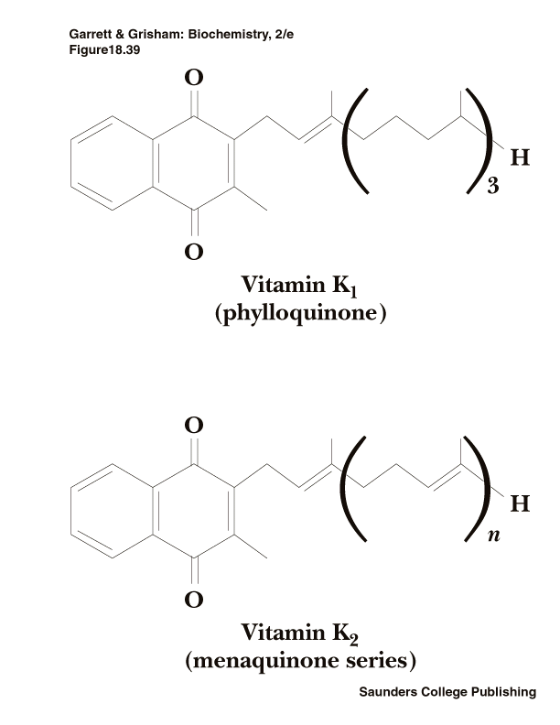
Vitamin K: chemical structure, Sources & function
Vitamin K₁ is abundant in vegetable oils and green leafy vegetables e.g. Spinach, also in cabbage, cauliflower and peas.
Vitamin K₂ is synthesized by intestinal flora and is found in animal tissues. Putrefied fish meal is a rich source.
Good sources of vitamin K include tomatoes, cheese, egg yolk, and liver. Breast milk is NOT a good source of vitamin K.
Vitamin K is required for post translational modifications of several proteins required in the coagulation cascade. It converts blood clotting factors (II, VII, IX and X) to the active state.
All these factors are proteins synthesized in the liver in an inactive precursor form.

Slide 9
Vitamin K: Mechanism of vitamin K-dependent activation for prothrombin
Prothrombin is synthesized in the liver in an inactive precursor form called Pre-prothrombin.
Pre-prothrombin (prothrombin precursor) to prothrombin Requiring vitamin K-dependent carboxylation (of specific glutamic acid residues to γ-carboxyglutamic)
Pre-prothrombin Prothrombin
(Glutamate) (γ caboxyglutamate)
γ
O2
β
α
Vit. K-dependent
carboxylase

Slide 10
Vitamin K: Mechanism of vitamin K-dependent activation for prothrombin
Ca++
3. The γ-carboxygulatmic acid residues are good chelators which allow prothrombin (active) to bind (chelate) calcium.
4. Prothrombin-Ca++-complex binds to Phospholipid membrane where proteolytic conversion to thrombin can occur.
Summary of function:
Vitamin K is an essential cofactor for the carboxylase enzyme in specific protein molecules such as:
Blood clotting factors (II,VII, IX, X).
Bone calcium-binding proteins as Osteocalcin.
The product of Growth arrest specific gene Gas6 which is involved in differentiation & development of nervous system.

Slide 11
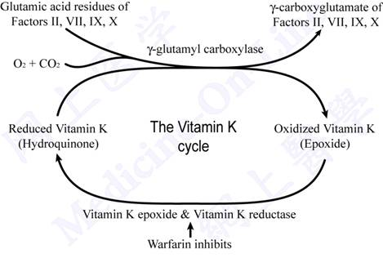
Vitamin K cycle
Role of liver in blood clotting:
Site of clotting factors synthesis.
Site of bile salts synthesis (to help vit. K absorption).
Liver failure: results in severe bleeding problems.
,,,

Slide 12
Vitamin K: Anti-coagulants
Dicumarol & warfarin are antagonists of vitamin K (anti-coagulants).
Are used to reduce blood coagulation in patients at risk of thrombosis.
Thus, vitamin K is the antidote to an overdose of warfarin.
Deficiency
Causes:
Primary deficiency: rare
Secondary deficiency:
Fat malabsorption.
In newborn who lack bacterial colonization.
long-term or high-dose administration of antibiotics (they kill the bacteria in large intestine).
Anticoagulant Therapy.
in patients suffering from Liver diseases (obstructive jaundice).

Slide 13
Vitamin K: Deficiency
Manifested by:
Bleeding tendency (GIT, ecchymoses) from minor wounds. . Nose & gum bleeding. Heavy menstrual bleeding.
Increased risk for osteoporosis.
Diagnosed by:
prolonged blood coagulation time: prolonged prothrombin time (↑↑ PT). [ blood takes 10-13.5 sec to clot].
Prevention: single shot of vit. K at birth in newborn.
End of vitamin K

Slide 14
Fat soluble vitamins Vitamin E

Slide 15
Vitamin E: Chemical structure & sources
Vitamin E is a family of α−, β−, γ−, δ− tocopherols which are derivatives of an alcohol.
The highest biological activity has α-tocoferol.
Plant sources:
Vegetable oils
Nuts
Whole grains
Leafy green vegetables as green lettuce leaves .
Animal sources:
Egg yolk, liver, meat, fish.
[Freezing may destroy Vitamin E]

Slide 16
Metabolism of vitamin E
Absorption of vitamin E from the intestine depends on micelle formation.
Chylomicrons carry tocopherol from the enterocyte to the liver.
Vitamin E is transported in the blood by the plasma lipoproteins.
Upon reaching the liver, alpha-tocopherol is preferentially taken up by alpha-tocopherol transfer protein (α-TTP). Then either sulfated or glycuronidated. This renders the molecules water-soluble and leads to excretion via urine.
Unabsorbed vitamin E is excreted via feces.

Slide 17
Vitamin E: Functions
Tocopherols have antioxidant activity i.e. they react very readily with molecular oxygen and free radicals, thus prevent autoxidation of tissues.
Vit. E acts as lipid-soluble antioxidant that concentrate in cell membranes particularly important in those parts of the body where large amounts of oxygen are present, including the lungs and the RBCs.
Vitamin E prevents oxidation of :
PUFAs in all membranes. This prevents hemolysis of RBCs by H2O2 .
LDL (low density lipoprotein). Oxidized LDL may be more atherogenic (Vit.E may protect against coronary heart disease).
DNA. (may help prevent DNA damage & cancer).
Vitamin E and immunity: Vit. E has an ability to modulate host immune functions. It plays a role in differentiation of T cells. It blocks the release of pro-inflammatory cytokines (as IL-1, IL-6) by monocytes and macrophages.

Slide 18
Free Radicals and antioxidants
Free Radicals are By-products of the body’s metabolic reactions.
Cells contain many potentially oxidizable substrates such as polyunsaturated fatty acids (PUFAs), proteins, and DNA.
Anti-oxidants: Group of compounds that neutralizes free radicals, helping to counteract the oxidation that takes place in cells. E.g.
Vitamins E: it is an example of a phenolic antioxidant. They donate the hydrogen from the hydroxyl (-OH) group on the ring structure to free radicals, which then become un-reactive. On donating the hydrogen, the phenolic compound itself becomes a relatively free radical.
Vitamins C. Vit. C is involved in the regeneration of vit. E
Carotenoids as beta carotene
If exposure to free radicals exceed the protective capacity of the antioxidant defense system, a phenomenon often referred to as oxidative stress.

Slide 19
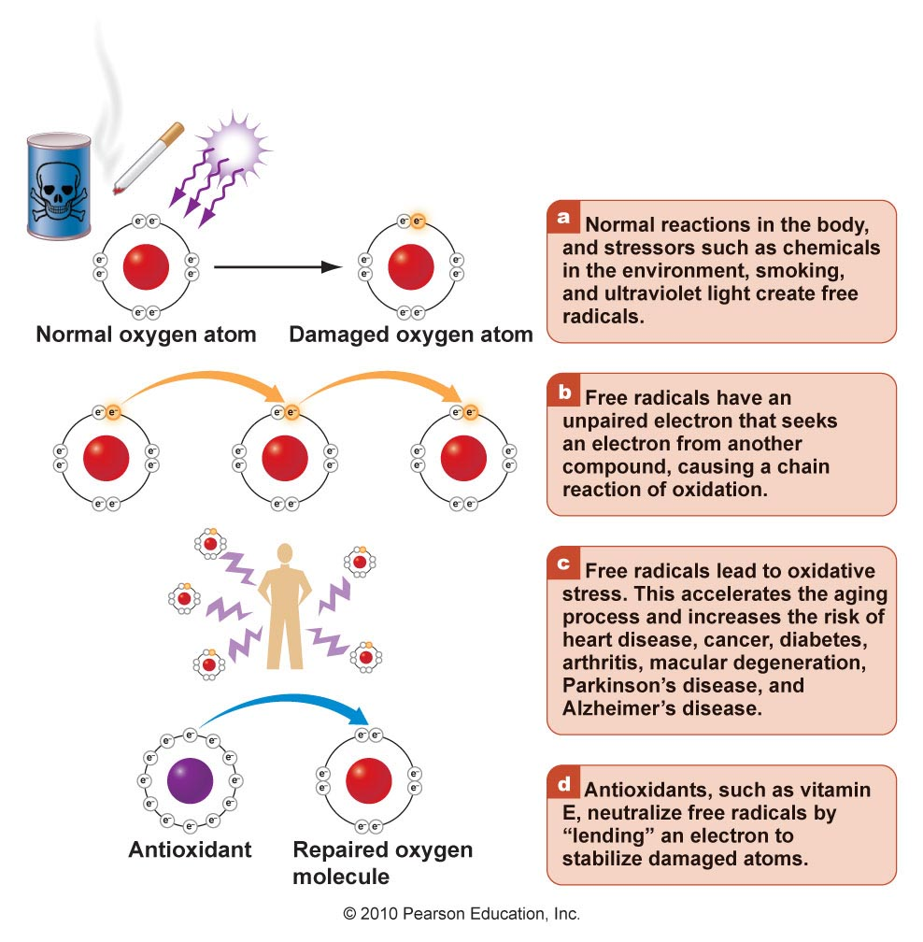

Slide 20
Vitamin E: deficiency
Causes:
Severe malabsorption.
Chronic liver disease. [They suffer deficiency because they are unable to absorb the vitamin or transport it.]
Premature infants are born with inadequate reserve of the vitamin.
Manifestations:
Muscle weakness & neurological problems. Due to nerve and muscle membrane damage.
Ataxia (unstable gait).
Hemolytic anemia. The RBC membranes are abnormally fragile as a result of lipid peroxidation. It can be corrected by vitamin E supplementation.
End of vitamin E

