Slide 1
Urinary Incontinence
Dr. Fadi Sawaqed
Associate professor
Functional and Neuro-Urology

Slide 2
Definition of Urinary Incontinence
“ The involuntary loss of urine
which is objectively demonstrable
and a social or hygienic problem.”
* The International Continence Society

Slide 3
URINARY INCONTINENCE
Common
Treatable
Significant Effect on Quality of Life (QoL)

Slide 4
Prevalence
Community: 17% older men, up to 30% older women
Hospital: up to 50% older men and women

Slide 5
Prevalence of Incontinence in Women

Slide 6
Aging Changes
Decreased bladder capacity
Reduced voiding volume
Reduced flow rates
Increased urine production at night
* Nordling, J Experimental Gerontology, 2002, 37:991

Slide 7
Reversible causes of UI
- Delirium or Drugs
- Restricted mobility
- Infection, impaction
- Polyuria

Slide 8
CAUSES OF PERSISTANT
UI
Stress
Urge/OAB
Functional
Overflow

Slide 9
Urge UI
Abrams P et al. Urology. 2003;61:37-49. Ouslander J. N Engl J Med. 2004;350(8):786-799.
The complaint of involuntary leakage accompanied by or immediately preceded by urgency
Involuntary detrusor
contractions
Urethral pressure

Slide 10
Overactive bladder
Includes urinary urgency with or without urge incontinence, urinary frequency, and nocturia
Associated with involuntary contractions of the detrusor muscle

Slide 11
Stress UI
Abrams P et al. Urology. 2003;61:37-49.
The complaint of involuntary leakage with effort or exertion or on sneezing or coughing
Sudden increase in
abdominal pressure
Urethral pressure

Slide 12
Mixed UI
Abrams P et al. Urology. 2003;61:37-49. Chaliha C et al. Urology. 2004;63:51-57.
The complaint of involuntary leakage associated with urgency and also with exertion, effort, sneezing, or coughing
Sudden increase in
abdominal pressure
Involuntary detrusor
contractions
Urethral pressure

Slide 13
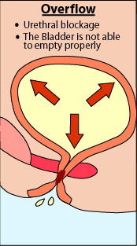
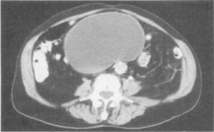
Overflow
Urethral blockage
The Bladder is not able
to empty properly
Neurogenic/Atonic
Obstruction

Slide 14
Functional Incontinence
Immobility
Diminished vision
Aphasia
Environment
Psychological

Slide 15
Basic Evaluation of UI
History: Type, Frequency, Severity, Bladder diary
Physical examination, especially Genitourinary and Neurological
Bladder stress test
Postvoid residual
Urinalysis, urine culture if indicated
BUN, creatinine, fasting glucose

Slide 16
Office Evaluation of UI
Identify presence of UI
Assess for reversible causes and treat
If UI persistent, determine type and initiate treatment
Identify patient who needs further evaluation and referral

Slide 17
Referral Criteria
Recurrent urinary tract infections
Hematuria
Elevated postvoid residual or other
evidence of possible obstruction
Recent gynecological or urological
surgery or pelvic radiation
Failed treatment of stress or urge UI

Slide 18
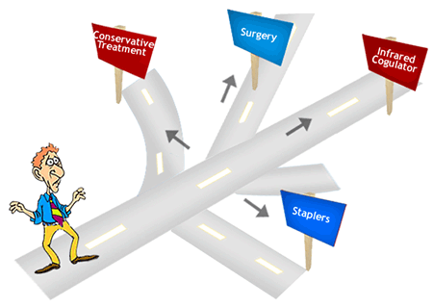
Treatment Options
Behavioral
Pharmacological
Functional Electrical Stimulation
Surgery

Slide 19
Behavioral Treatments for UI
BEHAVIORAL
TREATMENTS
FOR UI
Self-management
techniques
Timed or
scheduled
voiding
Pelvic floor muscle
exercise with
or without
biofeedback

Slide 20
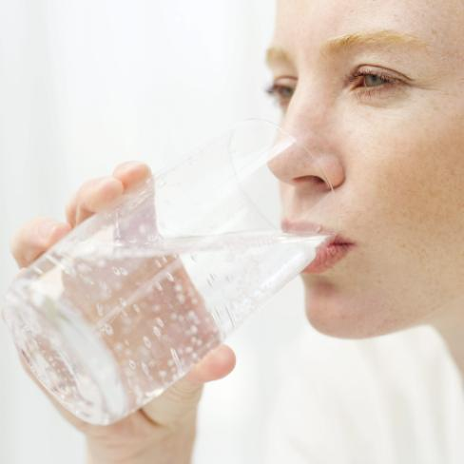
Self Management
Fluid Intake
Don’t reduce amount
Do not drink fluids 2 hr before bedtime
Avoid: caffeine, alcohol, nicotine

Slide 21
Timed/Scheduled Voiding
Scheduled voiding with systematic delay of voiding
Schedule based on time interval pt can manage in daytime
Void at scheduled time even if urge not present; suppress urge if not time with “Quick Kegels”
Increase voiding interval by 30 min each week until continent for up to 4 hr

Slide 22
Pelvic Muscle Exercises
Isolation of the pelvic muscles
Avoidance of abdominal, buttock or thigh muscle contractions
Moderate repetitions of strongest contraction possible
Ability to hold contraction 10 seconds, repeat in groups of 10-30 TID

Slide 23
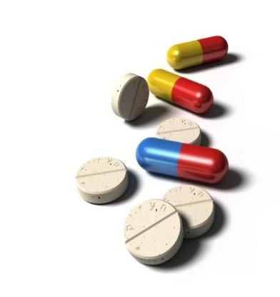
Medical Treatment for UI: What Works
Stress UI
Alpha adrenergic agents?
Estrogen?
Combination therapy?

Slide 24
Alpha Adrenergic Drugs
Phenylpropanoloamine
Once a first line drug
8 randomized controlled trials
Study duration: 2-6 weeks
% cure: 0-14
% side effects: 5-33%
WITHDRAWN FROM MARKET due to report of hemorrhagic stroke

Slide 25
Duloxetine (Cymbalta)
FDA application for stress UI withdrawn
Warning for liver dysfunction, alcohol

Slide 26
Estrogen
Combined study with Phenylpropanolamine suggested improvement in combination
Improves urogenital atrophy
Heart and Estrogen/Progestin Replacement Study 2001: 4 yr, randomized trial, 2763 postmenopausal women <80 given combined HRT or placebo for ischemic heart disease.
55% had >1 episode UI/week
HRT group had worsening stress and urge UI sx

Slide 27
Surgery and procedures for stress incontinence
Colposuspension. Colposuspension involves making a cut in your lower tummy (abdomen), lifting the neck of your bladder, and stitching it in this lifted position. ...
Sling surgery. ...
Vaginal mesh surgery (tape surgery) ...
Urethral bulking agents. ...
Artificial urinary sphincter.

Slide 28
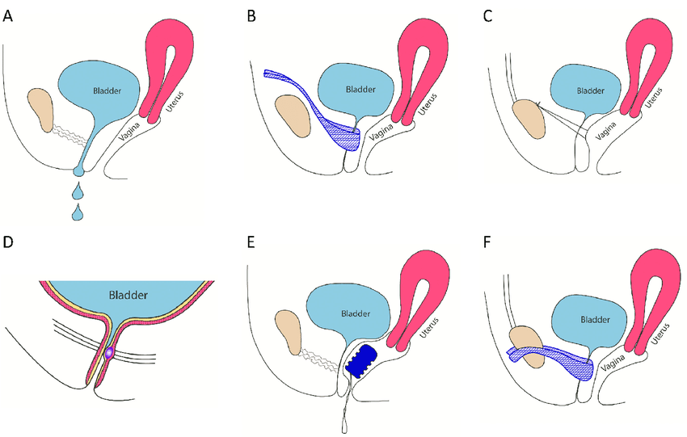
Surgery and procedures for stress incontinence
(A) Stress urinary incontinence: Urine loss while coughing, sneezing or during physical activities (sports).
(B) TVT surgery: A tape is inserted vaginally around the urethra and retropubically positioned behind the pubic bone.
(C) Colposuspension: The loose approximation of the lateral edges of the vaginal wall to Cooper's ligament results in a hammock-like suspension of the urethra to the anterior vaginal wall (according to Burch).
(D) Intraurethral injection of the polyacrylamide hydrogel (PAHG) into the midurethra results in the coaptation of the urethra.
(E) Vaginal pessary (RECA fem®): Continence by pessary insertion.
(F) TOT: A tape is inserted vaginally around the urethra and positioned by the transobturator approach along both sides of the pubic bone.

Slide 29
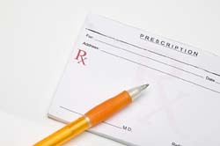
Medical Treatment of Overactive Bladder
Anticholinergic Drugs are mainstay
Oxybutynin IR 2.5-5 mg bid-qid
Ditropan XL 5-20 mg daily
Oxytrol patch TDS 3.9 mg 2x/wk
Tolterodine tartrate IR 1-2 mg bid
Detrol LA 2-4 mg daily
New Drugs:
Trospium chloride (Sanctura) 20 mg bid
Darifenicin (Enablex) 7.5-15 mg daily
Solefenicin (Vesicare) 5-10 mg daily
Beta-AR agonists
Botulinumtoxin A

Slide 30
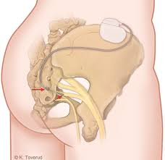
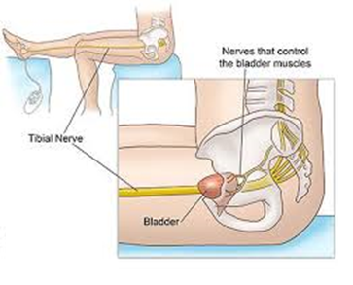
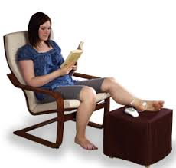
neuromodulation
percutaneous tibial nerve stimulation (PTNS),
sacral neuromodu­lation (SNM)

