Slide 1
WELCOME NEW CLASS
WELCOME NEW CLASS

Slide 2
Think positive
Best wishes
Best wishes

Slide 3
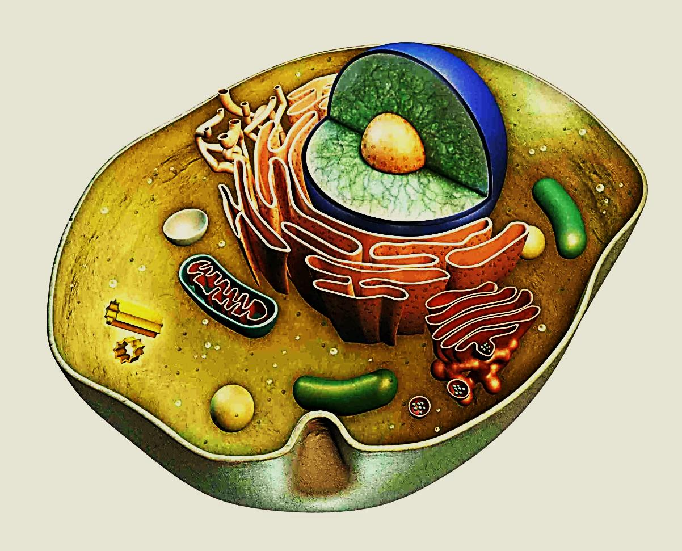
Introduction to cell biology

Slide 4
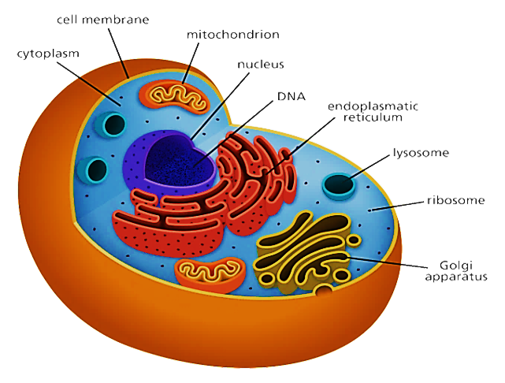
Cell biology:
The study of normal cells structures & functions
(Cellular & Molecular levels)
The cell is the smallest & the basic unit of a living body
Every living body is made of different cells
Cells varies in size from 4 to 200 microns.
The living organisms are either unicellular or multicellular
The cell can't be seen by naked eye but by microscope

Slide 5
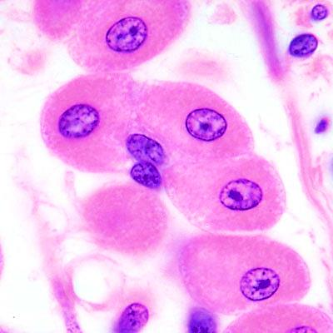
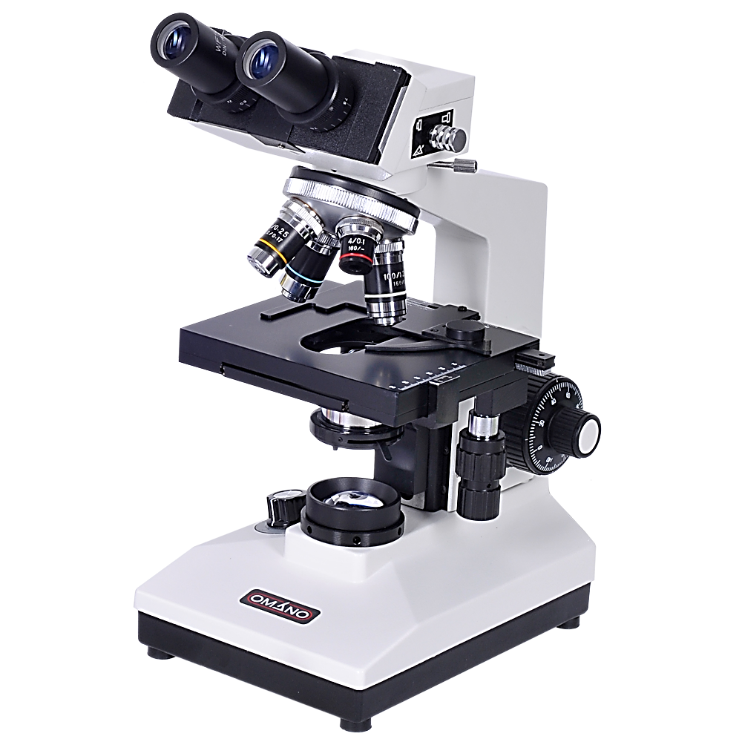
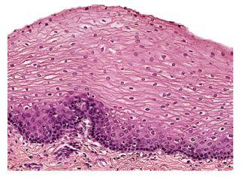
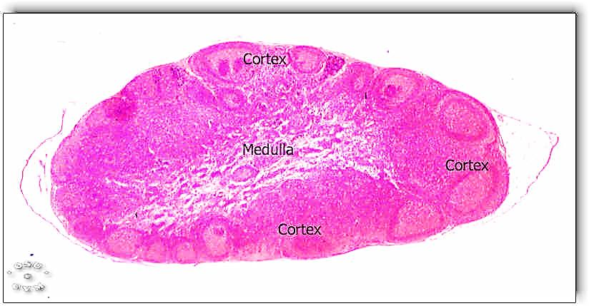
Histology ( histo: tissue, ology : science):
Microscopic study of tissues of the body and how these tissues form the organs
cells
tissue
organ

Slide 6
Methods of studying cell biology
Cell culture: isolating the cells to study under controlled conditions ( i.e. preserved homeostatic conditions)
Cell fractionation: breaking the cells subsequently to their components by centrifugation
Chromatography: separating the molecules in a mixture based on their physical & chemical properties ( in case of proteins we uses gel instead of paper)

Slide 7
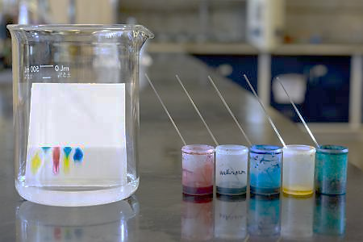

Slide 8
Electrophoresis: separating charging molecules using an electrical field ( size & charge)
Genetic technology: study the gene structure and function ( Isolating gene, determine unknown DNA sequence, copy genes & DNA sequence = cloning)
Small animal imaging (SAI): examine the biological processes from the molecular to the organ system level in living animals. Is important for preclinical studies e.g. Positron emission tomography ( PET /scan), MRI, CT

Slide 9
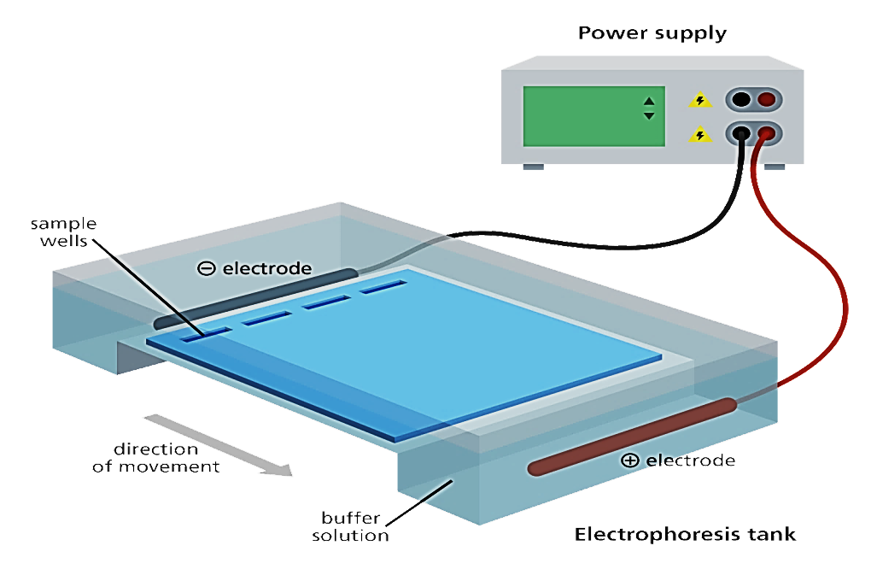
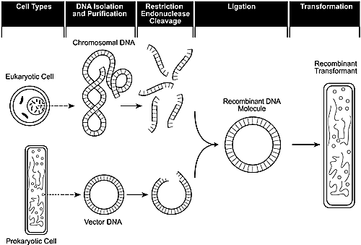
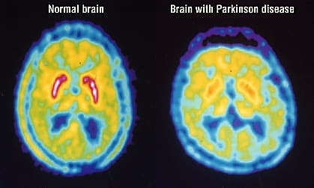
Gel electrophoresis
recombinant DNA technology
Positron emission tomography (PET/Scan)

Slide 10
Body
Cells
extracellular matrix

Slide 11
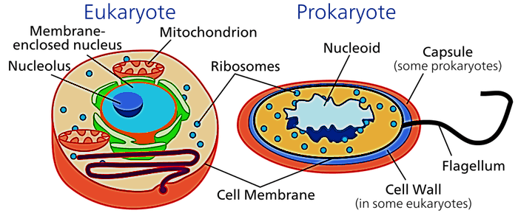
1- The cell
The cells in general are classified into :
1.Prokaryote
2.Eukaryote
Prokaryotic cell:
lacks the nucleus, the genetic materials are scattered in the cytoplasm (nucleoid) & has No membrane bounded organelles
Eukaryotic cell
contains nucleus & membrane bounded organelles.
Both ( Pro & Eu ) share 4 key elements ( cell membrane, cytoplasm, genetic material, ribosomes)

Slide 12
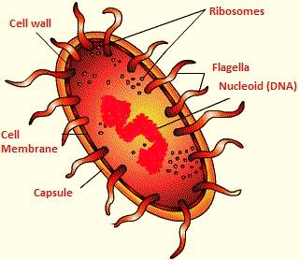
Prokaryote cell
The DNA strand is circular and is called genophore and found in area called nucleoid
Binary fission

Slide 13
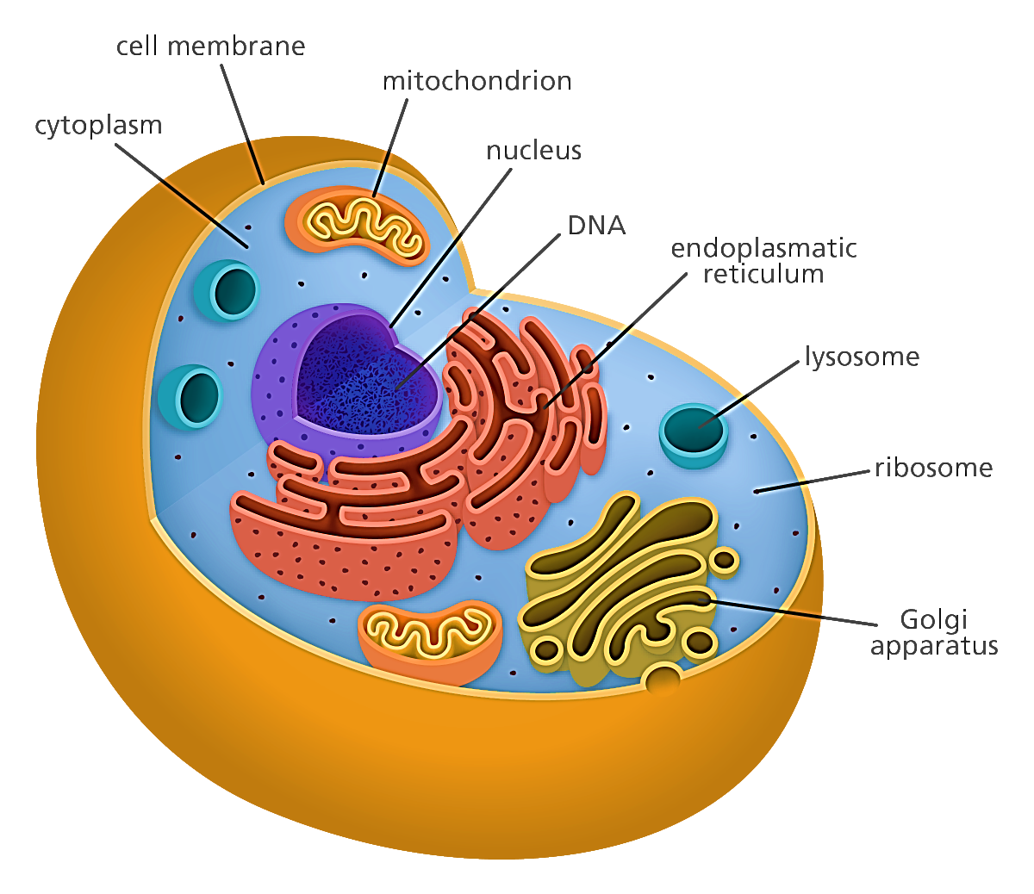
Eukaryote cell
Equivalent lengths:
1 millimeter (mm) = 1000 micrometer (micron)
1 micrometer (um)= 1000 nanometer
1 nanometer(nm)= 10 angstrom

Slide 14
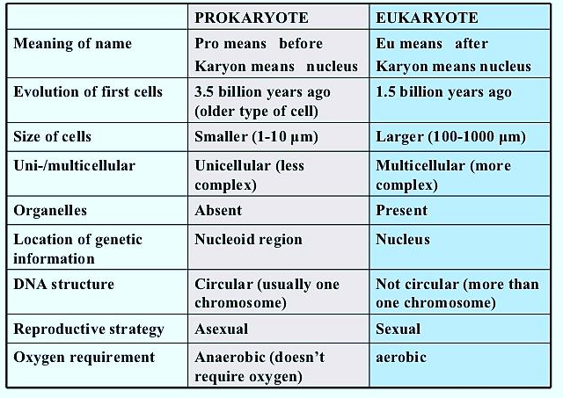
Prokaryote vs. eukaryote

Slide 15
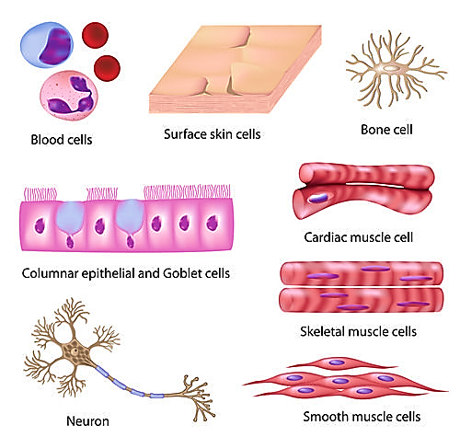
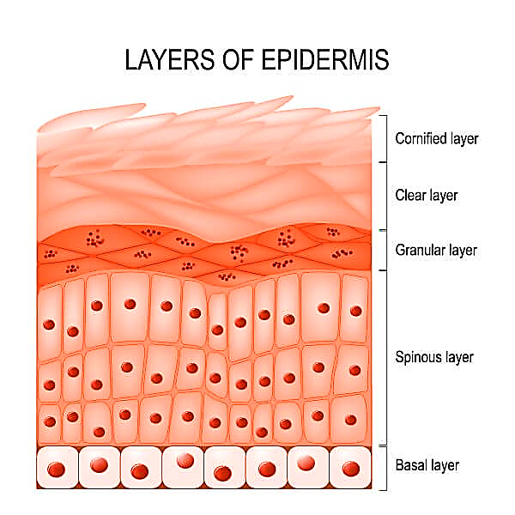
Different cells of the body

Slide 16
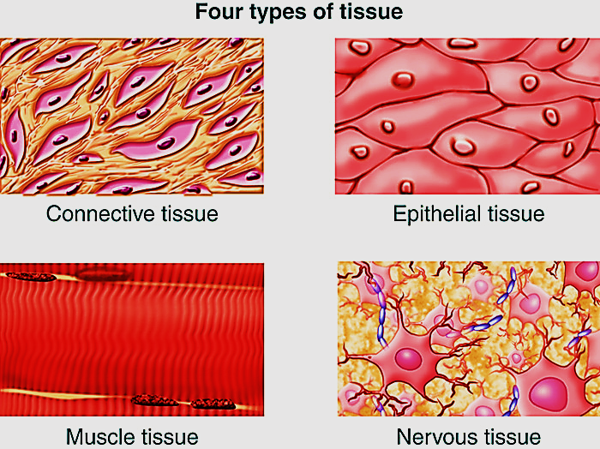
2-
1-
3-
4 -

Slide 17
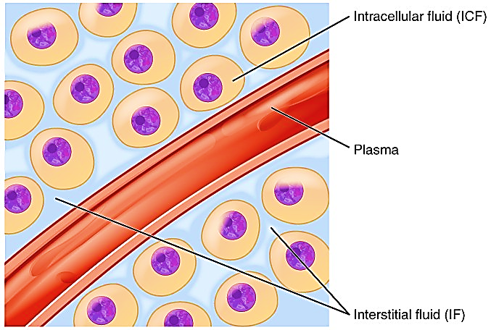
2- Extracellular matrix (ECM)
is the non-cellular component that fills spaces between cells & is secreted by the cells of the tissue
beside its supportive role it is required
for tissue morphogenesis, communication
differentiation & homeostasis
Extracellular matrix is either:
1- Interstitial fluid: thin layer of fluid surrounds the body cells : H₂O, proteins, electrolytes, acids, hormones , waste materials
2- basement membrane: is sheet-like depositions of ECM at the base of cells … only found under epithelial cells
(plasma membrane VS. basal lamina Vs. basement membrane)

Slide 18
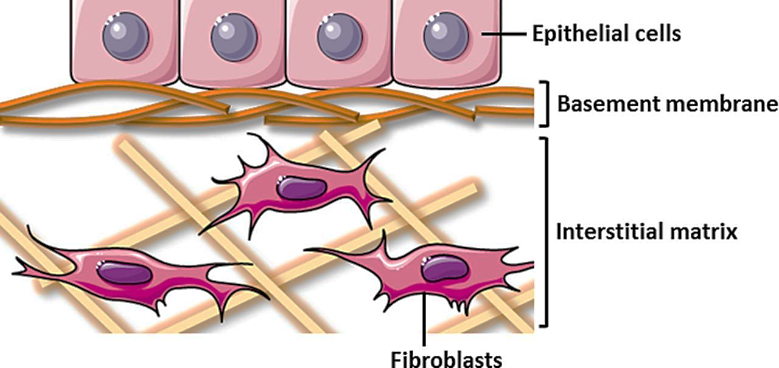
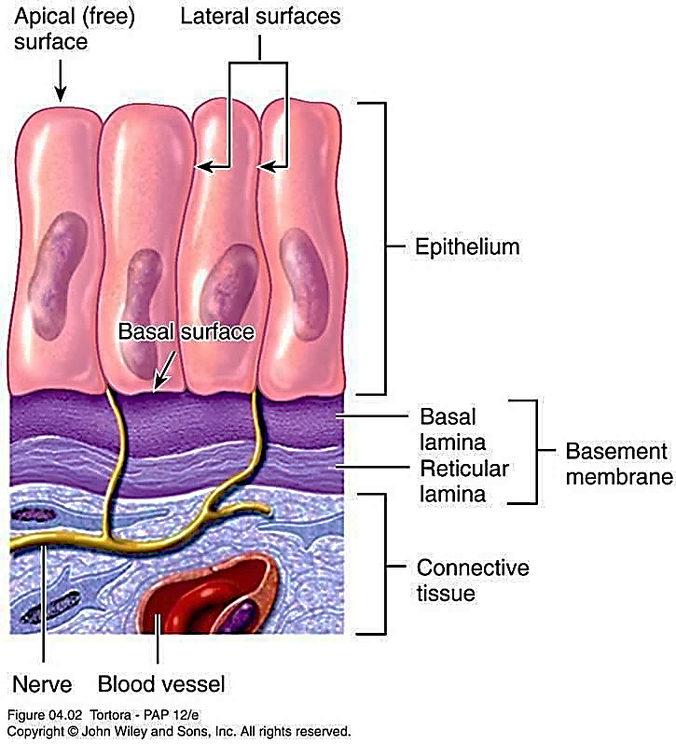
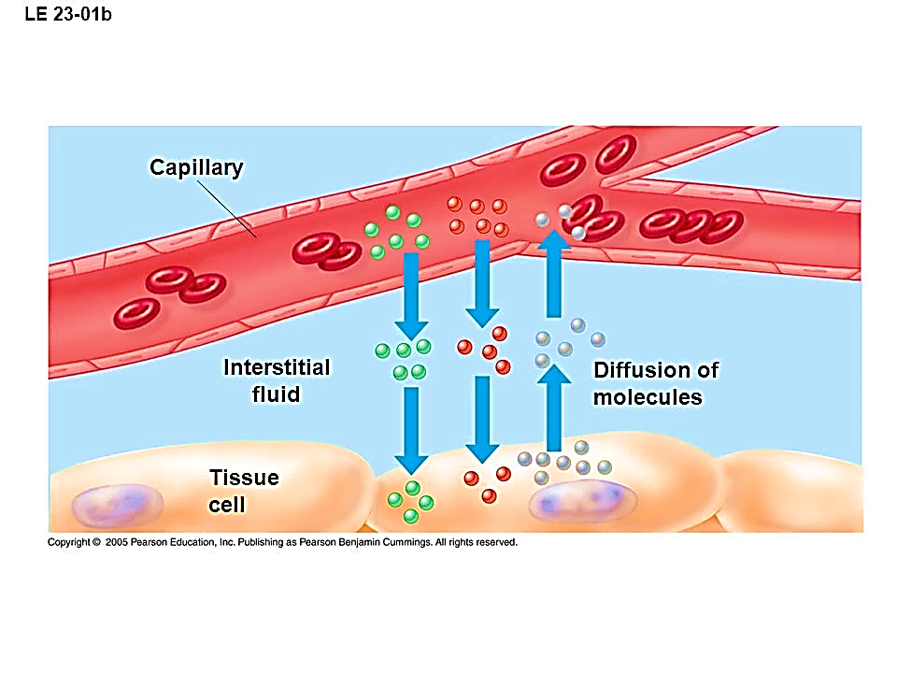
Interstitial matrix & basement membrane

Slide 19
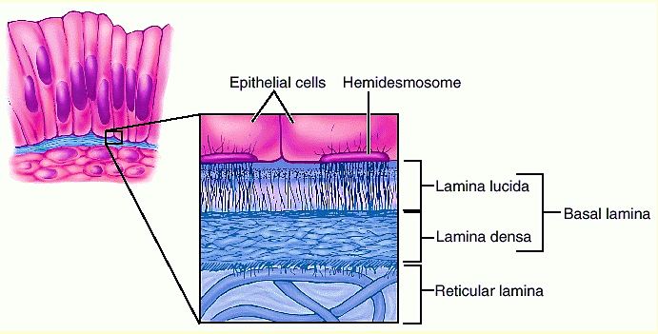
Most epithelial cells are separated from the connective tissue beneath it by a sheet of extracellular material called basement membrane
The basement membrane is usually visible with light microscope
Is formed by 2 layers basal lamina & reticular lamina
Function of basement membrane :1- Anchoring epithelial cells to underlying tissue, 2- pathway for cell migration, 3- wound healing, 4- barrier between epithelial cells & CT, 5- participate in filtration of blood in kidney, 6- early stages in cancer called carcinoma in situ ( limited to epithelial layer)

Slide 20
The basal lamina itself is visible with EM about 20 -100 nm in thickness. secreted by epithelial cells
Basal lamina consists of delicate network of fine filaments lamina densa & an electro lucent layer on one or both sides called lamina lucida
NB: in diabetes mellitus , the basement membrane of small blood vessels especially in retina & kidney became thick

Slide 21
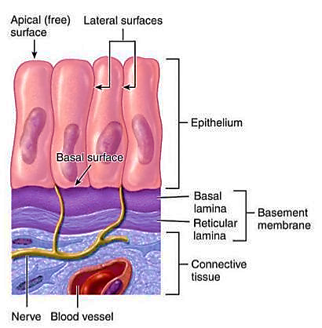
The main components of basal lamina are: type IV (4) collagen, laminin ( glycoprotein), entactin, and proteoglycan
The reticular lamina is formed by reticular fibers, usually thicker than basal lamina, secreted by connective tissue cells (fibroblasts)

Slide 22
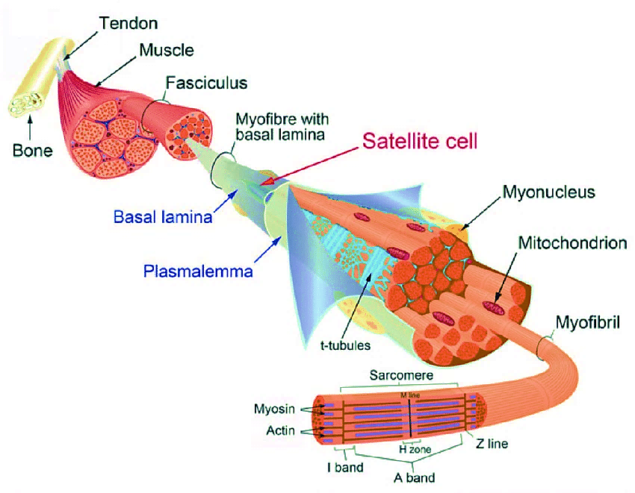
The muscle fibers are coated by an extracellular matrix material called the basement membrane , which composed of 2 layers: an internal basal lamina directly attached to plasma membrane of myofibrils (Sarcolemma), and an external reticular lamina.
Extracellular matrix surrounding muscle fibers is composed of: type 4 collagen, laminins, fibronectin, & proteoglycans. ECM gives mechanical support to myofibers during
contraction, gives support to nerves &
vessels present in skeletal muscle tissue,
& act as a barrier between endothelium
and muscle cell surface and in signaling
Epithelial cells are tightly bound
together, the ECM is scanty consisting
mainly of basal lamina

Slide 23
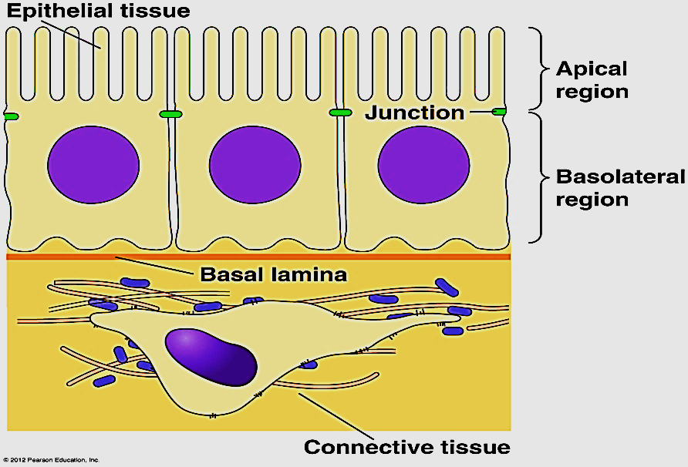
ECM amount varies according to tissue type (minimal in epithelium and plenty in connective tissue
ECM consistency varies:
It may be jelly like e.g. connective tissue proper
It may be rubbery e.g. cartilage
It may be hard e.g. bone
It may be fluid e.g. blood
Functions:
1-Support of cells
2-Supply of nutrition and oxygen, communication
3-Removal of waste products

Slide 24
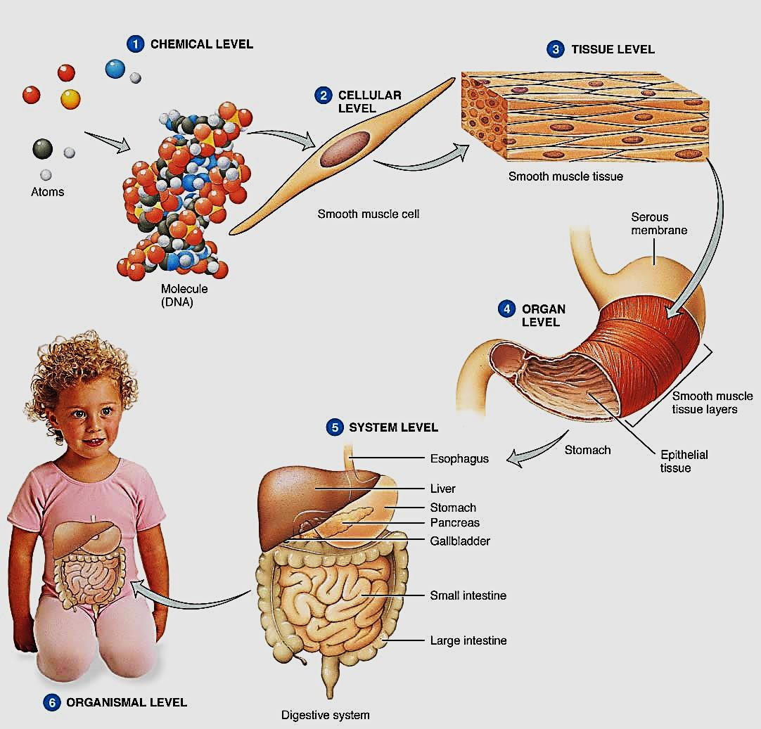
Organization of the human body
Human body is organized as follow:
1. Cells
2. Tissues
3. Organs
4. Systems

Slide 25
Tissues
All organs of the body are composed of 4 basic tissues in various combinations.
Each basic tissue is formed of special types of cells have the same general features and perform specific functions.
The four basic tissues are:
Epithelial tissue
Connective tissue
Muscular tissue
Nervous tissue

Slide 26
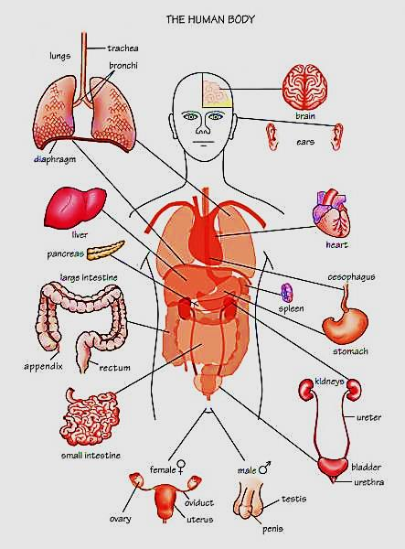
Organs
Each organ is formed of different kinds of tissues that perform together a special function.
Examples of organs :
The kidney
The liver
The lung
The stomach…..etc

Slide 27
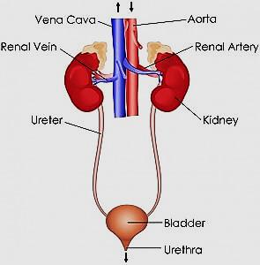
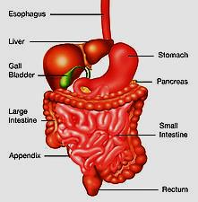
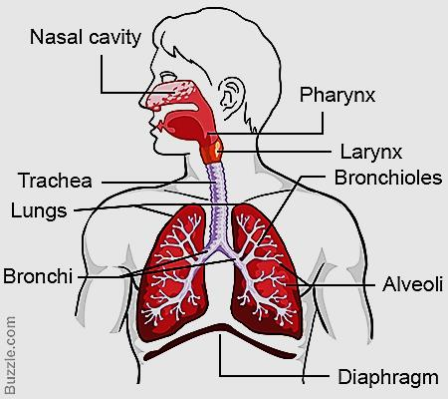
Systems
A system is an organization of different organs that together perform integrated complex functions of the body.
Examples of systems :
The urinary system
The digestive system
The respiratory system…..etc.

Slide 28
Microscopy
Is the standard optical instrument for generating magnified image & to examination of histological
Types:
Light microscope (LM)
Phase contrast microscope
Differential interphase microscope
Fluorescence microscope
Confocal microscope
Electron microscope (Transmission and scanning)

Slide 29
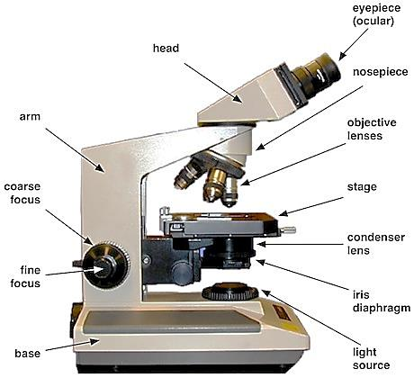
1- Light microscopy (LM)
The widely used microscope
LM uses visible light source + condenser lens
(to send light through the object).
The image of this object is
magnified by two sets of lenses:
Ocular lens (10)
Objective lenses (5 ,10 , 40)
Total magnification power = 1 x 2
e.g.10 X40 =400X times

Slide 30
The capacity of microscopes depends on:
Magnification power: the power to enlarge objects .
2. The resolution power : is the smallest distance between two particles that can still be seen by eye or camera as two separate entities & not a as single object ( done by : lenses)
The magnification is of value only when accompanied by high resolution.
The resolution power of:
Healthy naked eye = 0.2 millimeter
L M = 0.2 micrometer (um)
EM = 0.2 nanometer (nm)

Slide 31
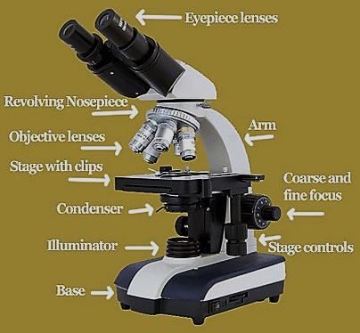
Equivalent lengths:
1 millimeter (mm) = 1000 micrometer (micron)
1 micrometer (um)= 1000 nanometer
1 nanometer(nm)= 10 angstrom
Binocular light microscopy

Slide 32
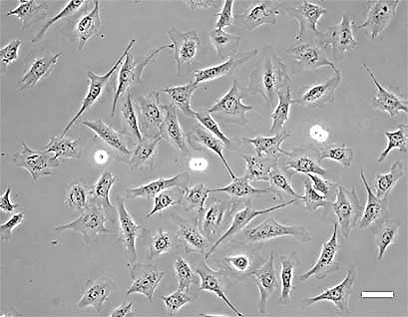
2-Phase contrast microscope
It depends on the idea that some lens systems can produce visible images from transparent objects (unstained).
The principal is that light changes speed when passes through cellular and extracellular structures & with different refractive indices.
Objects appear lighter
or darker to each others.
It is useful in examining living cells & tissue cultures e.g. blood cells and sperms

Slide 33
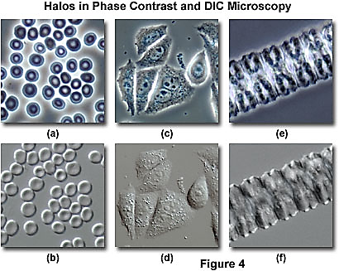
3- Differential interphase contrast microscope
The interphase microscope (Nomarski microscopy) is a version of phase contrast microscope ( used for transparent or unstained samples).
The obtained image appears to have three dimensional characters.
It utilizes two separate
beams of light.
DIC microscopy

Slide 34
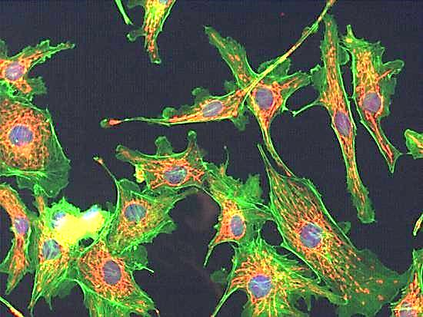
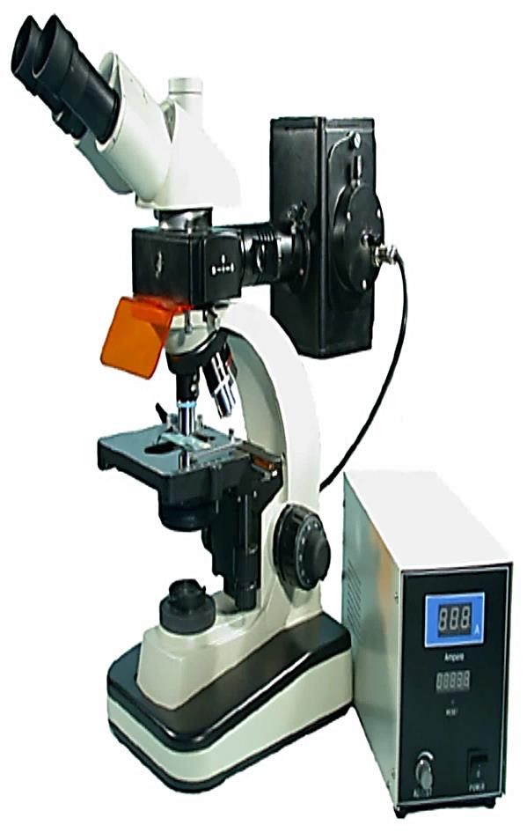
4- Fluorescence microscopy
Certain substances absorb invisible
ultraviolet light of short wavelength
and emit (reflect) it as visible light of long
wavelength and are known to exhibit fluorescence (physical property).
This microscope is provided with
special lamp that can emit ultraviolet
rays which pass through the tissue.
Fluorescent stains are used : Acridine orange,
DAPI ( immuno-histological techniques)
It can be used to visualize DNA, RNA, proteins
and antigen antibody complex (antibodies
labeled with fluorescence)

Slide 35
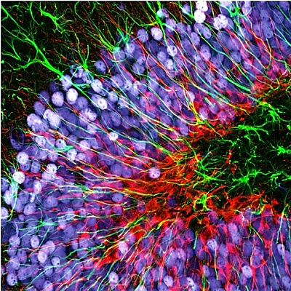
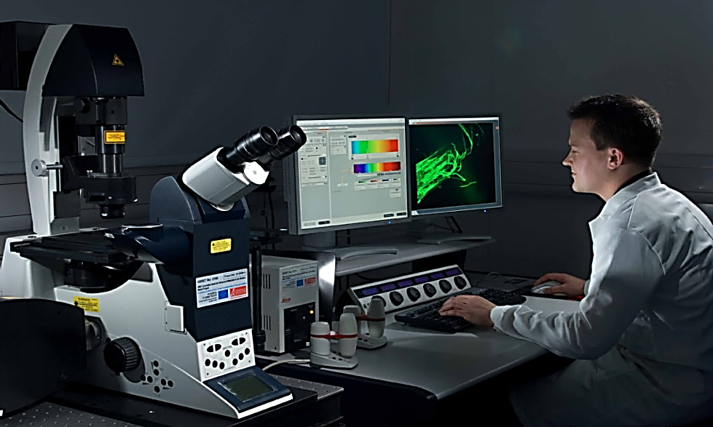
5- Confocal laser microscope (3D)
* The illumination is provided by a laser source.
The specimen should be labeled by fluorescent molecules
Uses: increase optical resolution and contrast (better image)
The LASER light passes through a small hole (to avoid photo bleaching) to examine fine details
It is connected to a computer system to reconstruct full image of the specimen

Slide 36
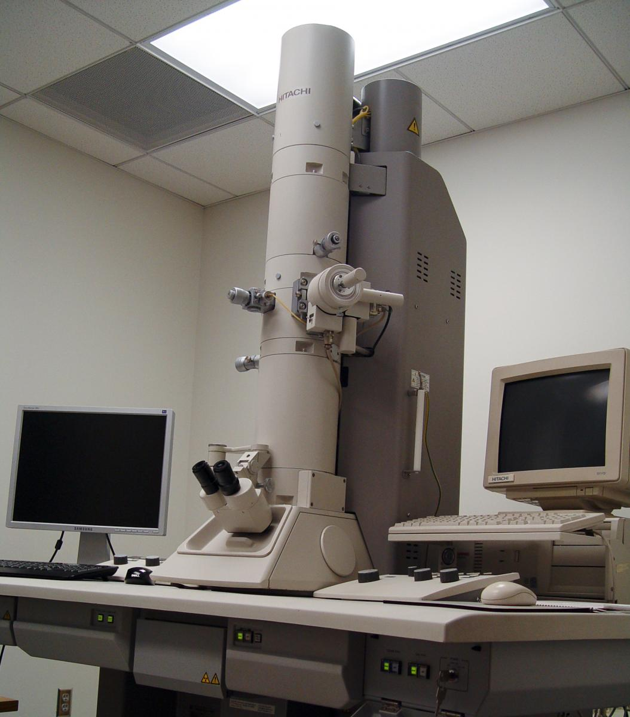
6- The Electron Microscope (EM)
Technique is used to obtain high resolution images
Beam of electrons is used as source of light
The image is formed from the interaction
of the electrons with the specimen as
the beam travelling through it
Beam passes through a vacuum tube
The lenses are electromagnetic
coils instead of glass lenses

Slide 37
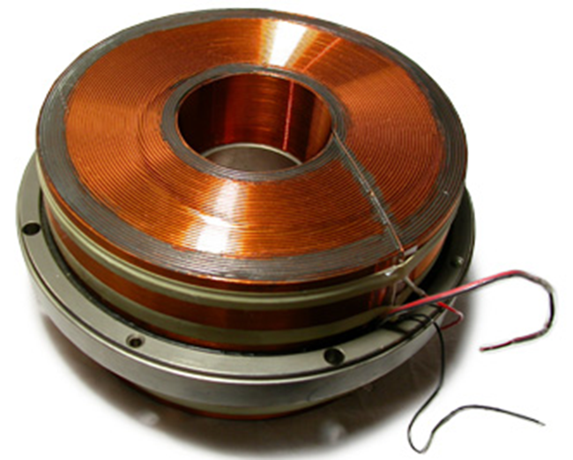
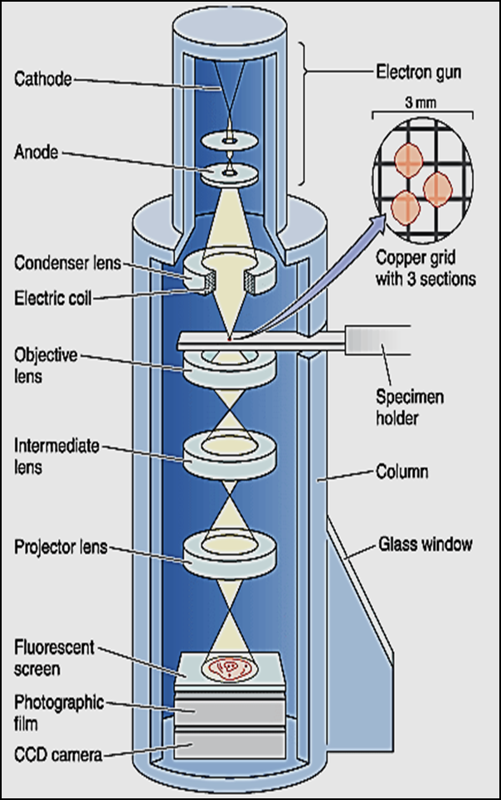
The lenses are electromagnetic coils instead of glass lenses
Electromagnetic lens
Illuminating system consists of:
Consists of: electron gun &
condenser lens
Condenser lens is capable of
generating circular magnetic felid that
act to focus electrons on the specimen

Slide 38
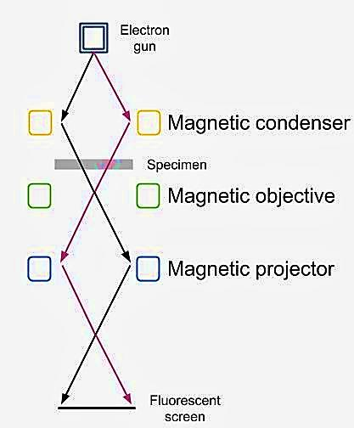
Imaging system consists of :
A- Another electromagnetic lenses (2-3)
B- Screen
The objective lens is used to refocusing
the electrons after they pass through
the specimen & form image
The projector lens is to enlarge the
image of the object and projecting it
into the fluorescent screen

Slide 39
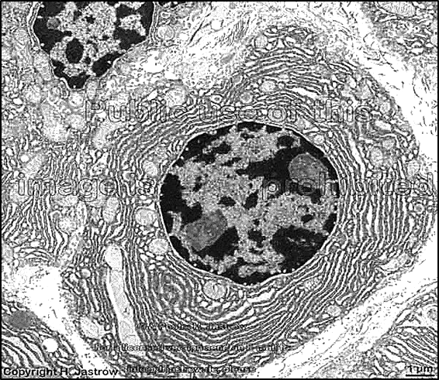
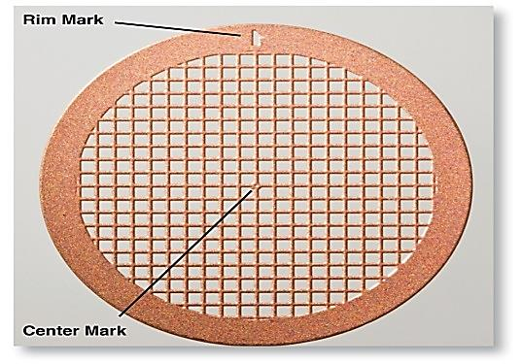
The image appears on screen plate which glows when being hit by electrons
Images can be detected as:
Light areas (electron lucent) &
dark areas (electron dense)
Corresponding to areas through
which electrons readily passed
The tissues and cells need special
preparation & then cut into
very thin sections
(ultra thin sections = 0.01 of the micron)
Then collected on a copper metal grid
Embedding in resin
Copper grid slides

Slide 40
During preparation sections are stained with salts of heavy metals like lead nitrate and uranyl acetate that precipitate in tissues.
EM can magnify the image thousands of times(up to 200.000 times).
The resolution power = 0.2 nanometer(nm)
For permanent records, photos are made

Slide 41
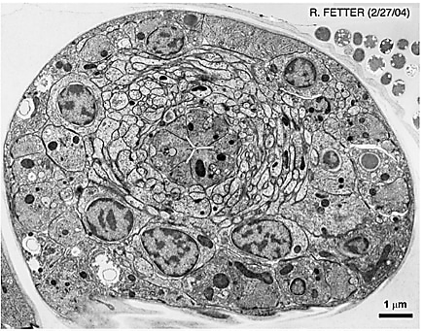
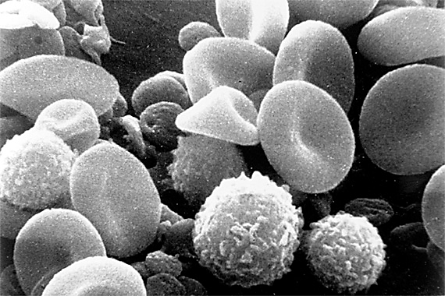
Types of EM
Transmission EM (TEM) :where electron beams pass through the specimen. It shows the details of internal structures of cells. Resolution power: 0.2 nanometer
Scanning EM (SEM) :a special type of EM where electron beams are reflected from the surface of coated specimen. This gives a three dimensional image of a specimen. Resolution power: 10 nanometer
TEM
SEM

Slide 42
LM & EM

Slide 43
Thank you

