Slide 1
Tobacco and Cardiovascular Disease
Dr. Israa Al-Rawashdeh MD, MPH ,PhD
Faculty of Medicine
Mutah University
2021

Slide 2
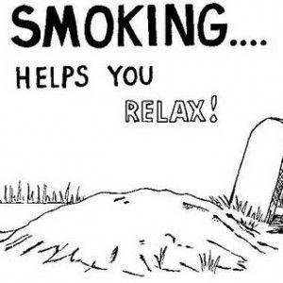
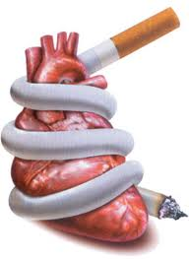
Background
Prolonged smoking is an important cause of premature mortality and disability worldwide.
22% of the world's population aged 15+ are smokers.
Tobacco kills more than 8 million people each year:
7 million of those deaths → result of direct tobacco use, ≈1.2 million →result of second-hand smoke.
Around 80% of smokers live in low- and middle-income countries (populations that are targets of intensive tobacco industry marketing).

Slide 3
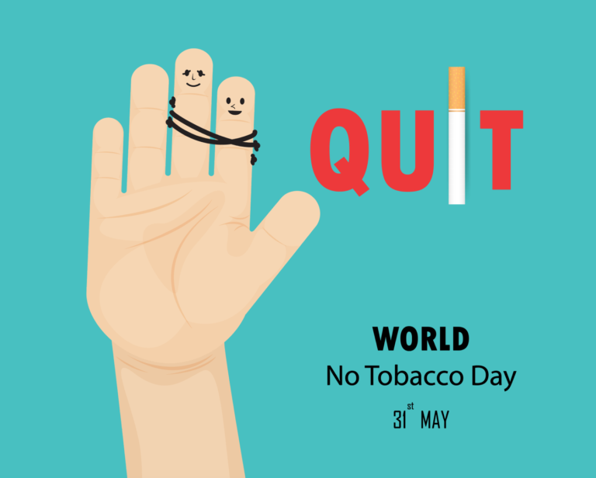
TOBACCO – A MAJOR CAUSE OF AVOIDABLE BURDEN OF DISEASE
Cardiovascular disease (CVD) is the world’s leading cause of death.
Tobacco is the single most preventable cause of CVDs
Tobacco is the leading cause of premature death from CVD→25% of deaths at ages 35–69 years.
Tobacco related deaths are projected to increase to 10 million annually by 2030 if current trends continue.

Slide 4
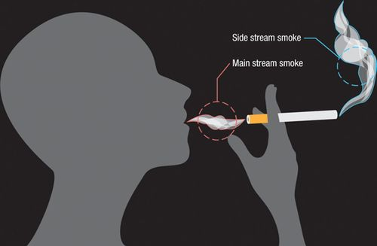
PATHOPHYSIOLOGY AND MECHANISMS
Burning tobacco products produce two forms of smoke:
Mainstream smoke: is inhaled and exhaled by the smoker.
Sidestream smoke: comes from the burning end of the cigarette (more toxic than mainstream smoke)

Slide 5
PATHOPHYSIOLOGY AND MECHANISMS
More than 7,000 chemicals in cigarette smoke→mediate the pathophysiology of CVD.
Cigarette smoking is divided into two phases:
a particulate phase.
a gas phase.

Slide 6
PATHOPHYSIOLOGY AND MECHANISMS
The particulate phase : contains nicotine and the total aerosol residue (tar)→together contribute to heart disease through the following pathway:
Inflammation, impairment of the endothelium ↑enhanced formation of clots and reduced level of high-density lipoprotein (HDL) cholesterol .
The gas phase contains the poisonous gas carbon monoxide (CO), along with other gases.
CO replaces oxygen in the blood→ reducing the availability of oxygen for the heart muscle and other body tissues.

Slide 7
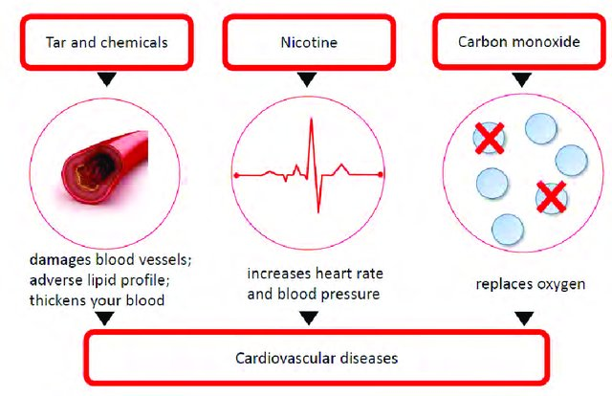

Slide 8
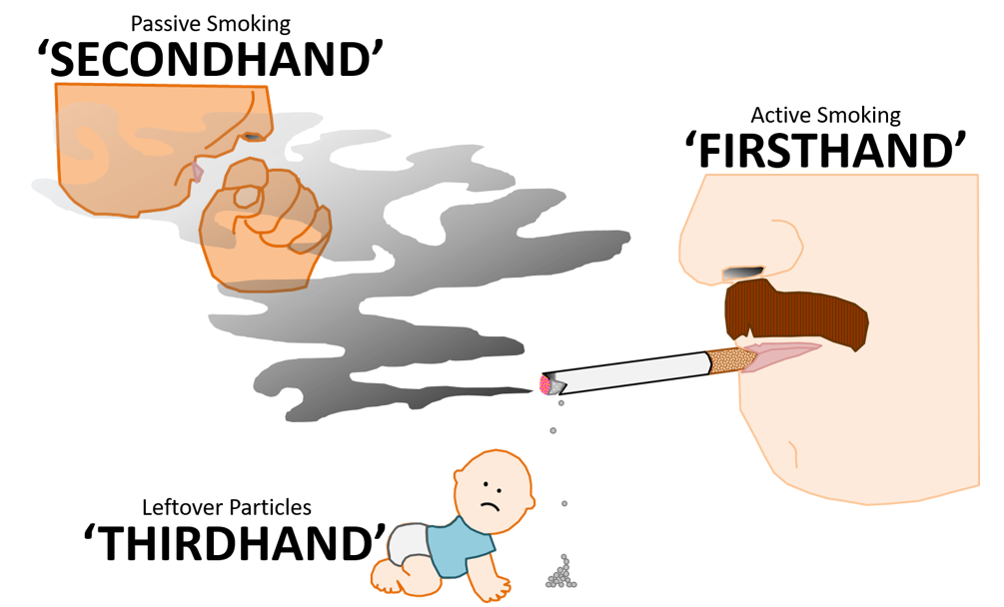
FORMS OF TOBACCO USE
Tobacco is consumed worldwide in many forms other than cigarettes, both smoked and smokeless.
Firsthand smoke: inhaled directly by a smoker
Secondhand Smoke:
AKA environmental tobacco smoke/Passive smoking.
Secondhand smoke has physiological effects similar to those of active smoke.
Exposure to second-hand smoke can cause coronary heart disease, increasing the risk of disease by approximately 25–30%
Thirdhand Smoke:
The lasting or residual nicotine and other chemicals left on indoor surfaces after tobacco smoke is finished.
Third-hand smoke can get trapped in hair, skin, fabric, carpet, furniture, and toys.

Slide 9
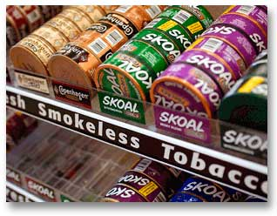
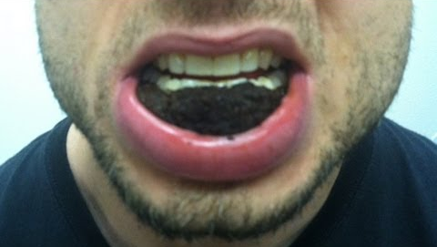
SMOKELESS TOBACCO
Smokeless tobacco is a tobacco product that is used by means other than smoking → chewing, sniffing, or placing the product between gum and the cheek or lip.
Includes heavy metals (cadmium ) and additives (liquorice or punk ash) affect the CVS adversely.
Smokeless tobacco also cause heart disease by acutely elevating blood pressure and contributing to chronic hypertension.
Smokeless tobacco use is increasing in many parts of the world, and in some countries (e.g. Bangladesh, India) it is more commonly used than smoked tobacco.

Slide 10
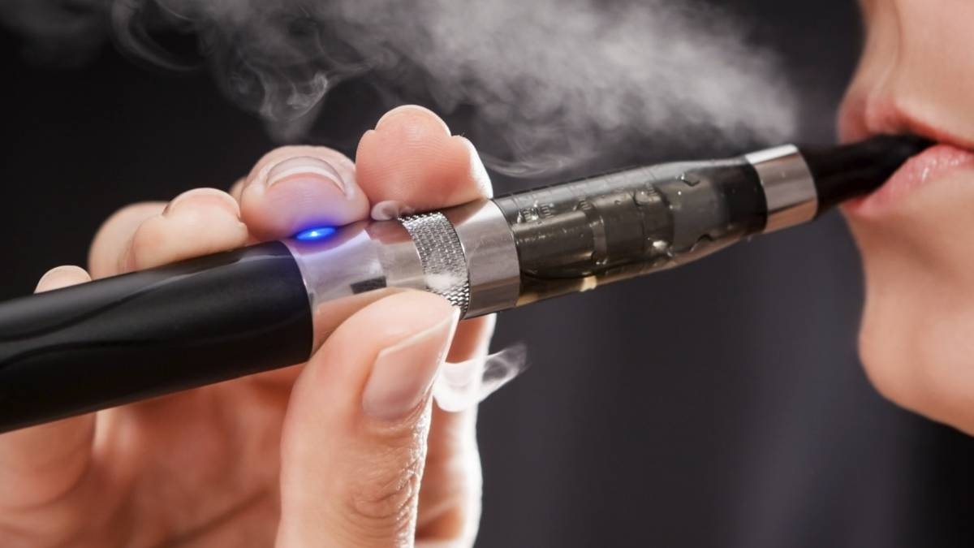
ELECTRONIC NICOTINE DELIVERY SYSTEMS (ENDS)
Introduced in 2007.
known as e-cigarettes-→ battery-operated devices that heat a solution, or e-liquid, to generate an aerosolized mixture containing flavoured liquids and nicotine inhaled by the user
The CVS is very sensitive to nicotine and these other chemicals, and the body experiences direct effects from ENDS use (e.g. narrowing of the arteries, increased heart rate and blood pressure).

Slide 11
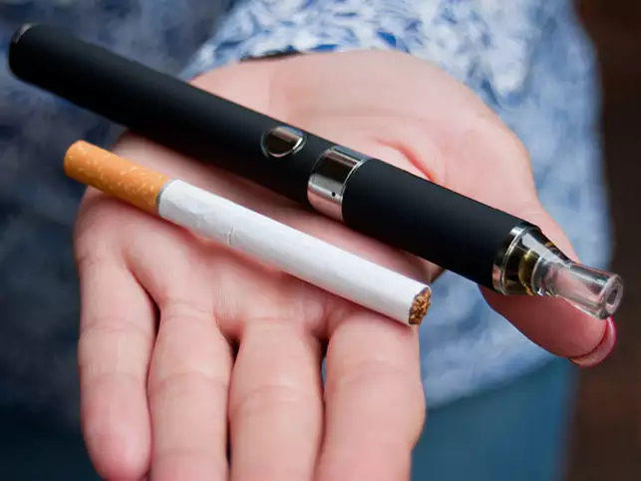
ELECTRONIC NICOTINE DELIVERY SYSTEMS
Non-users, including children and young people, are at risk of CVD through second-hand vaping.
Still, long-term health effects of use of ENDS are unknown.

Slide 12
SOCIOECONOMIC DIMENSIONS OF TOBACCO-USE-RELATED CVS DISEASES
Many socioeconomic factors modify the relationship between tobacco use and CVD.
Examples:
Age (young male smokers are at higher risk of sudden death)
Gender (smoking women have more risk for coronary heart disease)
Ethnicity (South Asians→ greater risks)
In most societies, smoking is more prevalent among the poor and disadvantaged groups

Slide 13
CARDIOVASCULAR BENEFITS OF TOBACCO USE CESSATION
There is evidence for the cardiovascular benefits of tobacco cessation, particularly cigarette smoking.
Smoking cessation benefits all users, irrespective of form, duration, and age.
Cardiovascular benefits are consistent and achieved early after tobacco cessation.
In general, smoking cessation has clearly been shown to prolong life, especially when it occurs early in life.

Slide 14
Within 20 minutes: Blood pressure decreases and body temperature and heart rate return to normal. Within 12 hours, the carbon monoxide level in blood drops to normal. Within 24 hours. Risk of myocardial infarction decreases.
Time to Cardiovascular Benefit of Smoking Cessation after Last Cigarette
Within 1 year. risk of coronary heart disease is half that of a person who smokes
At 5 years. Stroke risk is reduced to that of someone who has never smoked.
Within 15 years. Coronary heart disease risk is the same as a person who has never smoked.

Slide 15
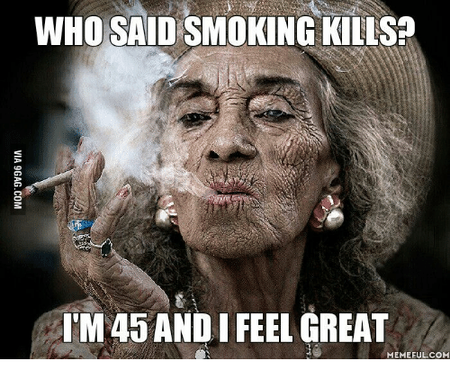
PEOPLE OF ALL AGES WHO HAVE ALREADY DEVELOPED HEALTH PROBLEMS RELATED TO TOBACCO USE CAN STILL BENEFIT FROM QUITTING.
Benefits in comparison with those who continue to use tobacco
Aged about 30: gain almost 10 years of life expectancy
Aged about 40: gain nine years of life expectancy
Aged about 50: gain six years of life expectancy
Aged about 60: gain three years of life expectancy
After the onset of life-threatening disease: rapid benefit – people who quit tobacco after a myocardial infarction reduce their chances of death by between 36% and 46%.

Slide 16
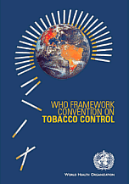
Solutions: WHO FRAMEWORK CONVENTION ON TOBACCO CONTROL
The First Public Health agreement under WHO
Aim ⇨ protect present and future generations from the consequences of tobacco
Unique ⇨ introduced urgency into tobacco control; negotiated; binding international law; comprehensive approach.

Slide 17
WHO recommends a four-steps strategy:
1 Ban advertising and expand public health information:
■ Forbid all forms of advertising and promotional distribution of tobacco products and sponsorship of sporting events, etc.
■ Disseminate public health information – with special attention to youths, provide credible information about the health and other ill effects of smoking. Health warnings on all tobacco products . media campaigns
2 Use taxes and regulations to reduce consumption:
■ Increased taxation – this usually reduces demand for tobacco products.
■ Regulation to reduce public and workplace smoking –message that smoking is an undesirable activity.

Slide 18
WHO recommends a four-steps strategy:
3 Encourage cessation of tobacco use:
■ Promote the production and sale of less harmful and less expensive ways of delivering nicotine through patches, tablets, inhalers or other means.
■ Expand free smoking cessation services and products.
4 Build anti-tobacco partnerships:
■ Fund transition to other employment for tobacco farmers and others who would lose income as a result of tobacco control.
■ Mobilize civil society and other groups to promote the message: ‘Tobacco or Health’. prevent tobacco industry lobbying

Slide 19
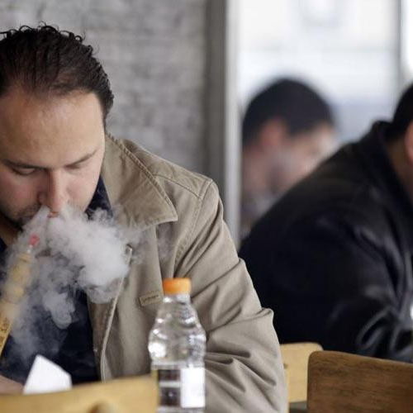
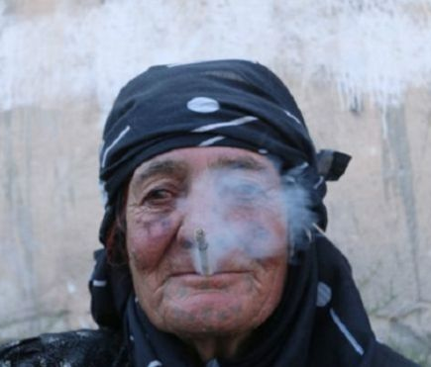
Smoking in Jordan
Jordan is mentioned among the countries with high smoking prevalence and medium consumption (10-20 cigarettes per day per smoker.
42.2% of people (55.9% of men and 23.7% of women) aged 15 and above in Jordan smoke tobacco.
Among those who smoked tobacco, 35.2% smoked cigarettes, and 15.2% smoked water-pipe.
Smoking cost the country 1 billion Jordanian dinars (JD) in 2012, including money spent on tobacco and smoking-related diseases, which amounted to approximately 5% of the gross domestic product.
Jordan adopted the National tobacco control strategy for 2017-2019→based on WHO’s strategy, a comprehensive set of tobacco control measures. The strategy seeks to decrease tobacco use by 30% by 2025

Slide 21
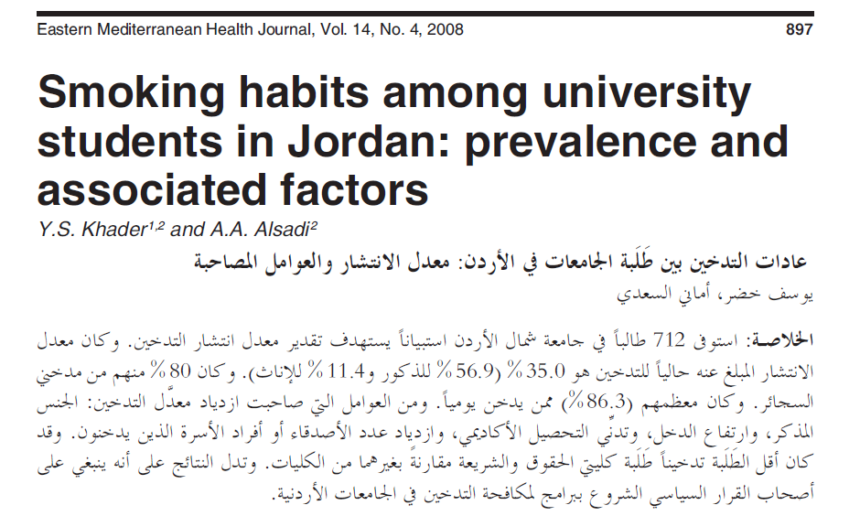
35.0% of University students in Jordan are smokers (56.9% for males and 11.4% for females). About 80% use cigarettes.
The majority (86.3%) of smokers smoked daily.
Male sex, higher income, lower academic attainment and higher number of friends or family members who smoke were associated with increased prevalence of smoking.
After CHD occurrence only 29.7% of the patients quit smoking, while 60.7% continued smoking, and 9.6% relapsed.
The most frequent reasons given by smokers for not quitting smoking were "do not incline to stop smoking" (25.6%) and “craving for a cigarette” (25%).

Slide 22
http://jordantimes.com/news/local/tobacco-has-so-far-claimed-lives-9027-jordanians-2021-%E2%80%94-health-ministry

Slide 23
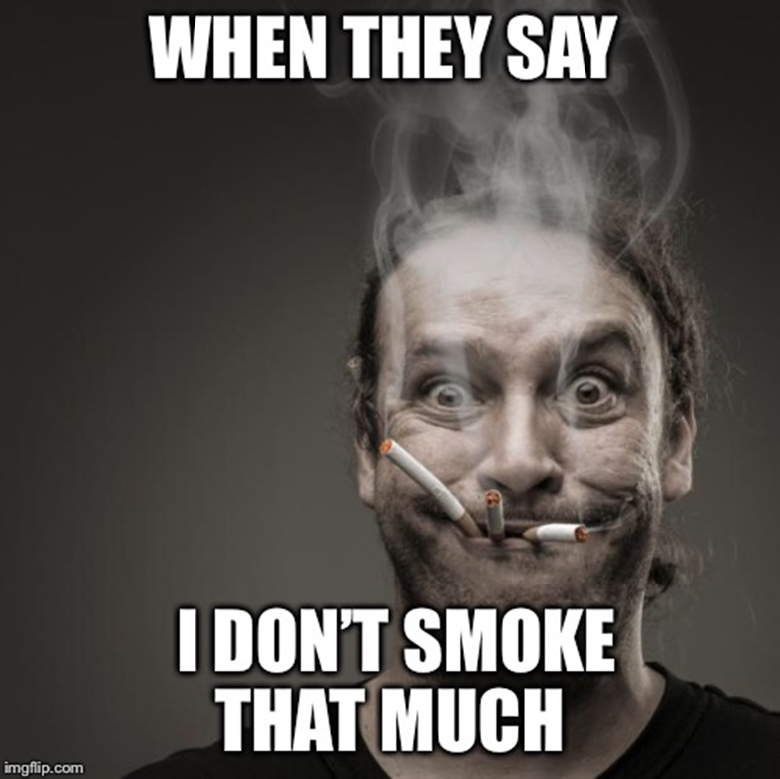
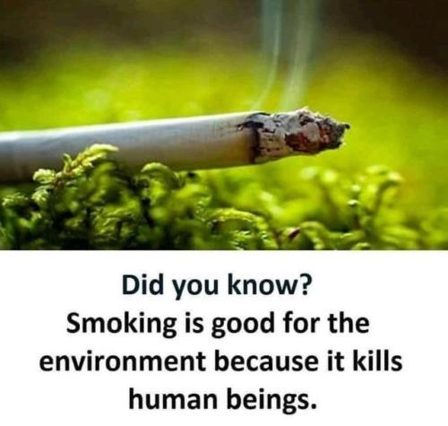
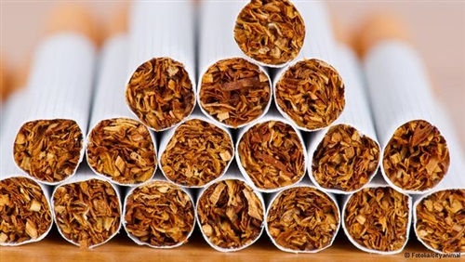
Thank you

