Slide 1
urogenital system-I. Breast
Dr.Eman Kreishan, M.D.
28/4/2022.

Slide 2
Overview( anatomy, histology).
Clinical Presentations of Breast Disease.
Stromal Neoplasms.
Benign Epithelial Lesions.
Carcinoma.

Slide 3
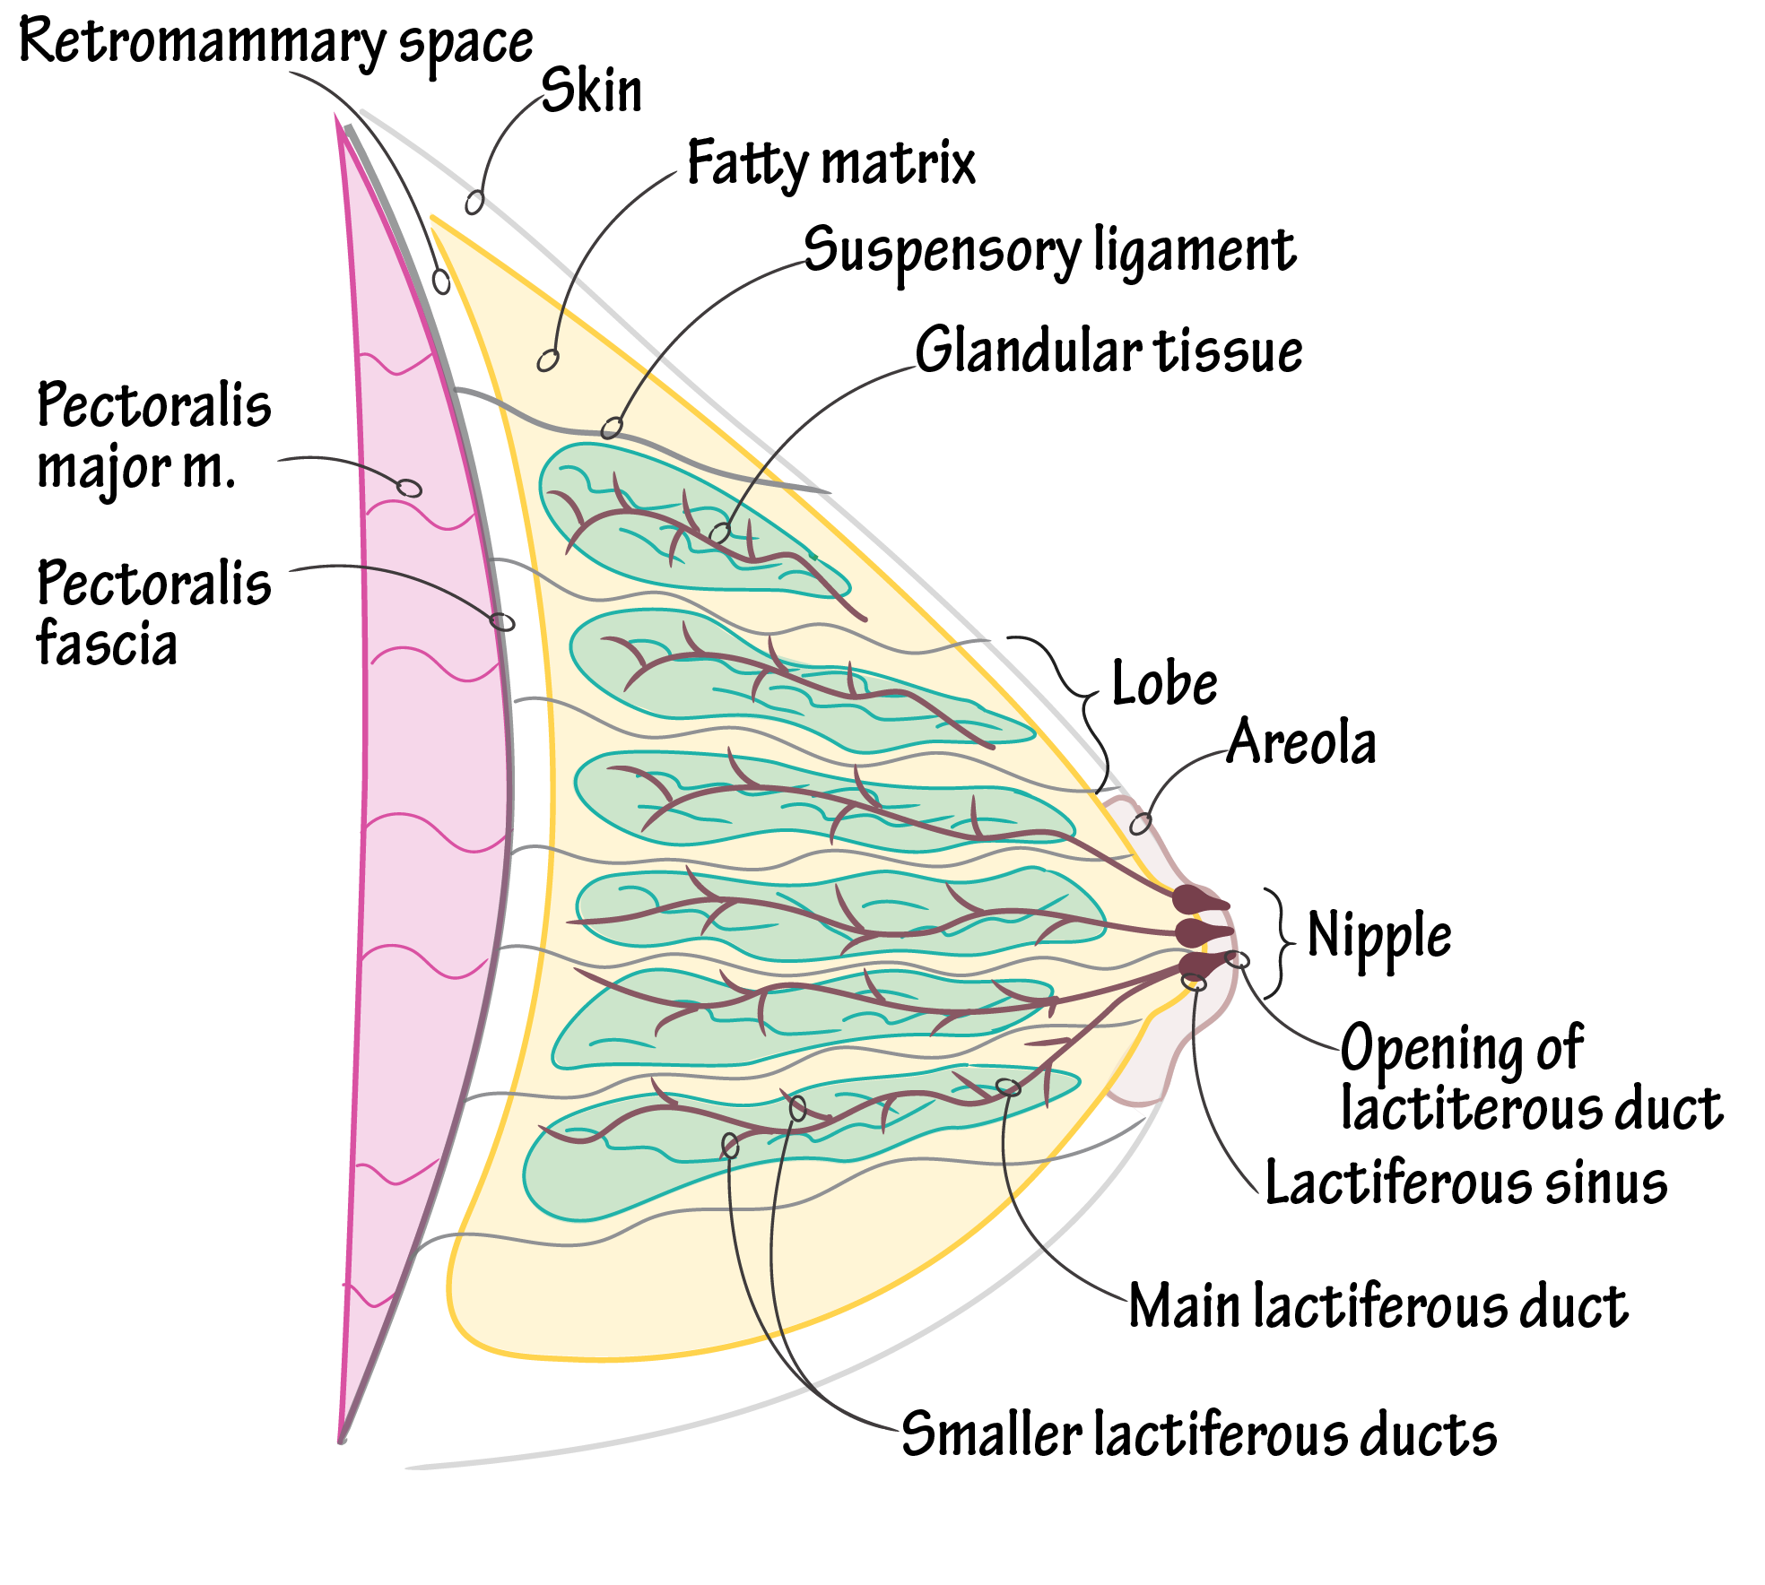
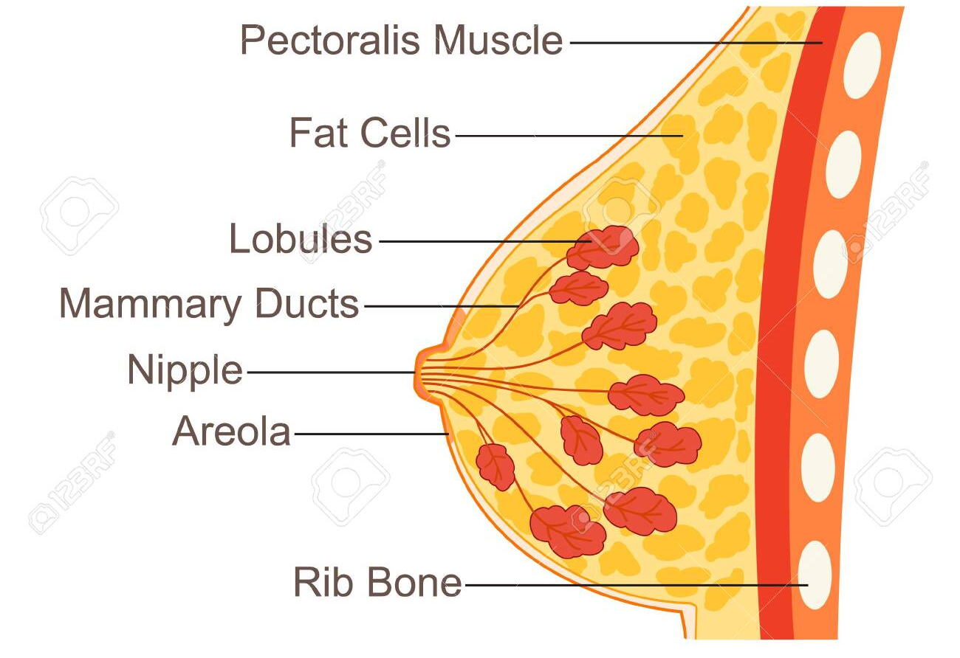
Overview …anatomy.

Slide 4
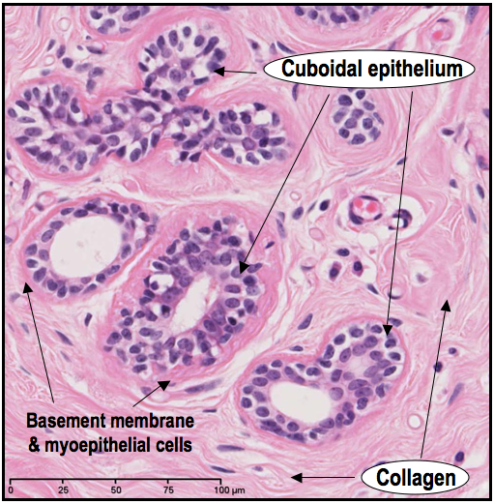
Overview …histology

Slide 6
Nipple..histology

Slide 7
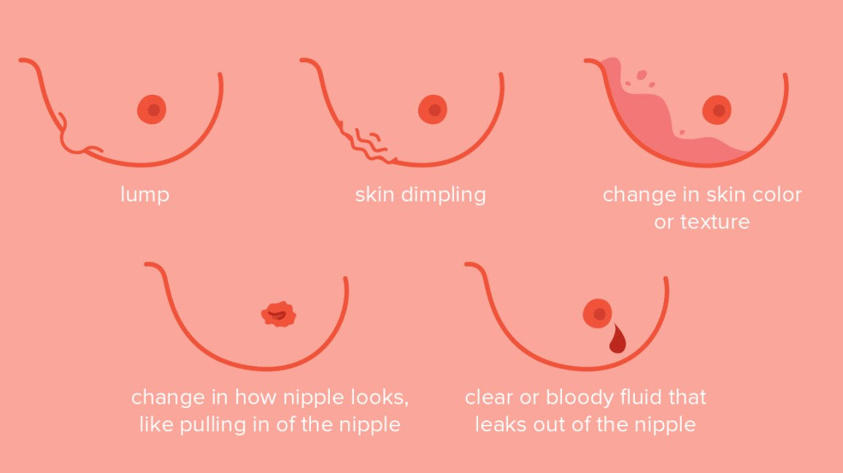
Common clinical presentation
of breast disease

Slide 8
Abnormal mammogram
Aimed to detect early, nonpalpable asymptomatic breast carcinomas before metastatic spread has occurred.
average size of invasive carcinomas detected by mammography is about 1 cm.

Slide 9
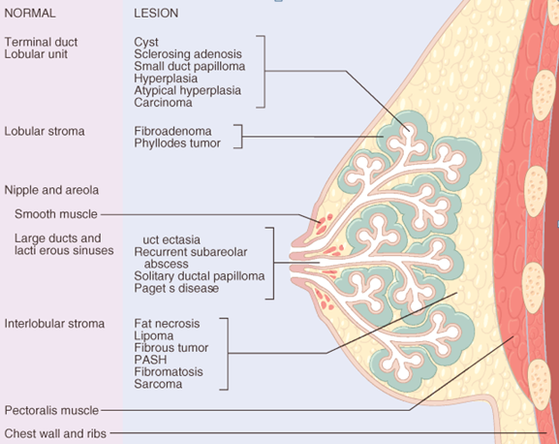
Breast lesion can be classified
according to the anatomical location

Slide 10
I. Stromal neoplasms
The two types of stroma in the breast, intralobular & interlobular, give rise to different types of neoplasms.
Intralobular (specialized )stroma:
(1) benign fibroadenomas (2) phyllodes tumors
Interlobular stroma:
Same connective tissue tumors in other body sites (hemangiomas & angiosarcomas)

Slide 11
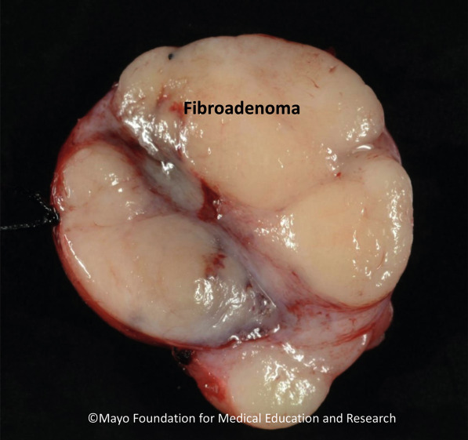
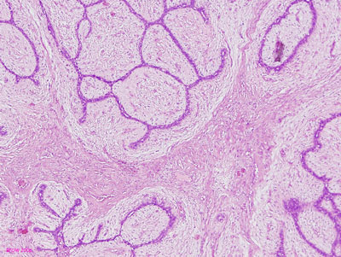
a. fibroadenomas
The most common benign tumor of the breast.
Affecting reproductive age.
Estrogen sensitive.
Gross: well-circumscribed & freely mobile (breast mouse).
Microscopic: Low cellularity, intralobular fibroblasts proliferate →push & distort epithelial cells (elongated slitlike structures instead of round acini) & rare mitoses.

Slide 12
b. Phyllodes tumors
Less common, older age group.
Microscopic: Highly cellular -stromal cells outgrow epithelial cells- resulting in bulbous nodules stromal cells covered by epithelium ( leaflike morphology (Greek: phyllodes)
Mitoses can be seen, & Infiltrative borders , Tends to recur locally.
High grade forms : sarcoma like & ass with metastasis 2%.

Slide 13
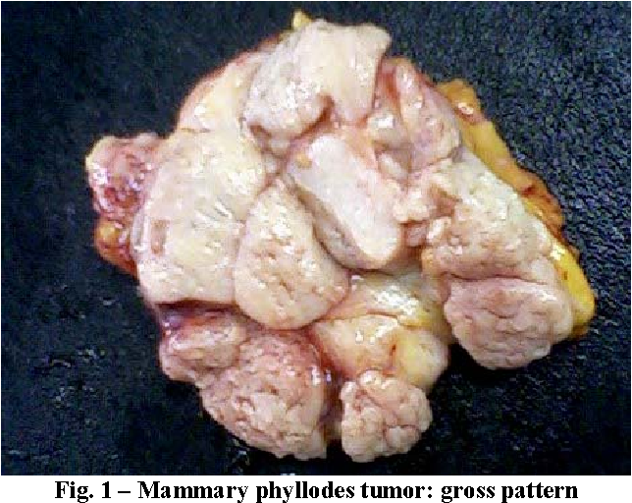
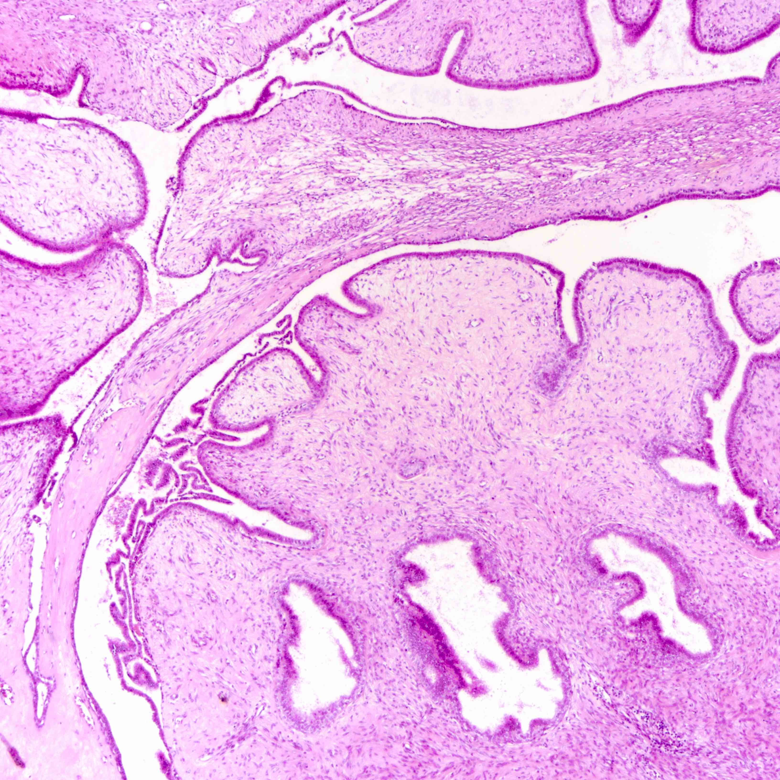

Slide 14
II. Benign epithelial lesions
Divided into three groups each associated with a different degree of breast cancer risk :
Nonproliferative disease: no ↑ in breast cancer risk.
Proliferative disease without atypia: polyclonal hyperplasia with minimal ↑ risk of breast cancer.
Proliferative disease with atypia: monoclonal precancers, a modest ↑ in breast cancer risk in both breasts.

Slide 15
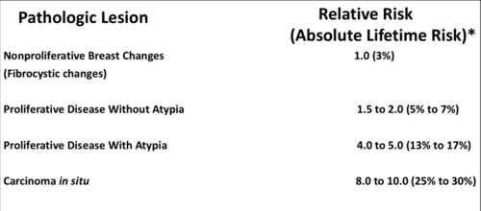

Slide 16
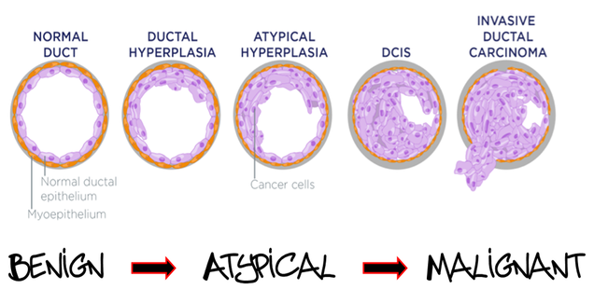

Slide 17
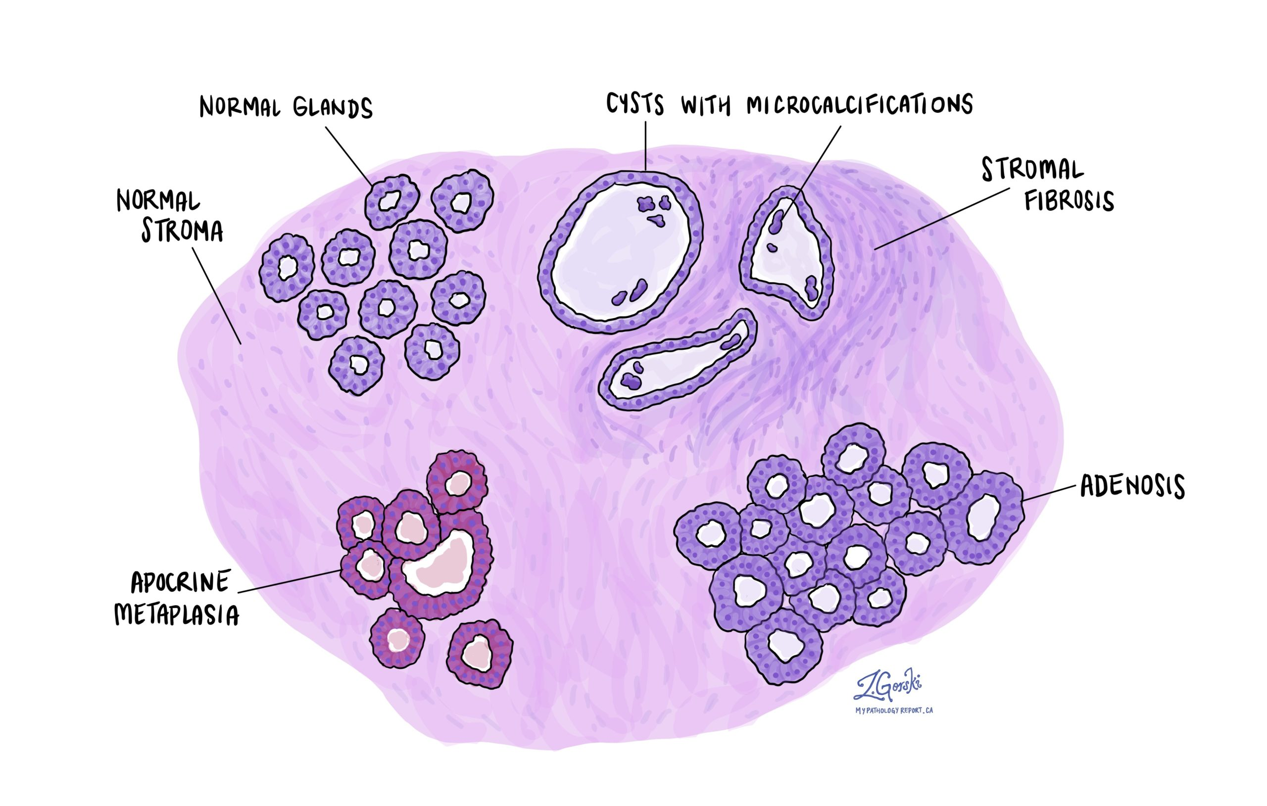
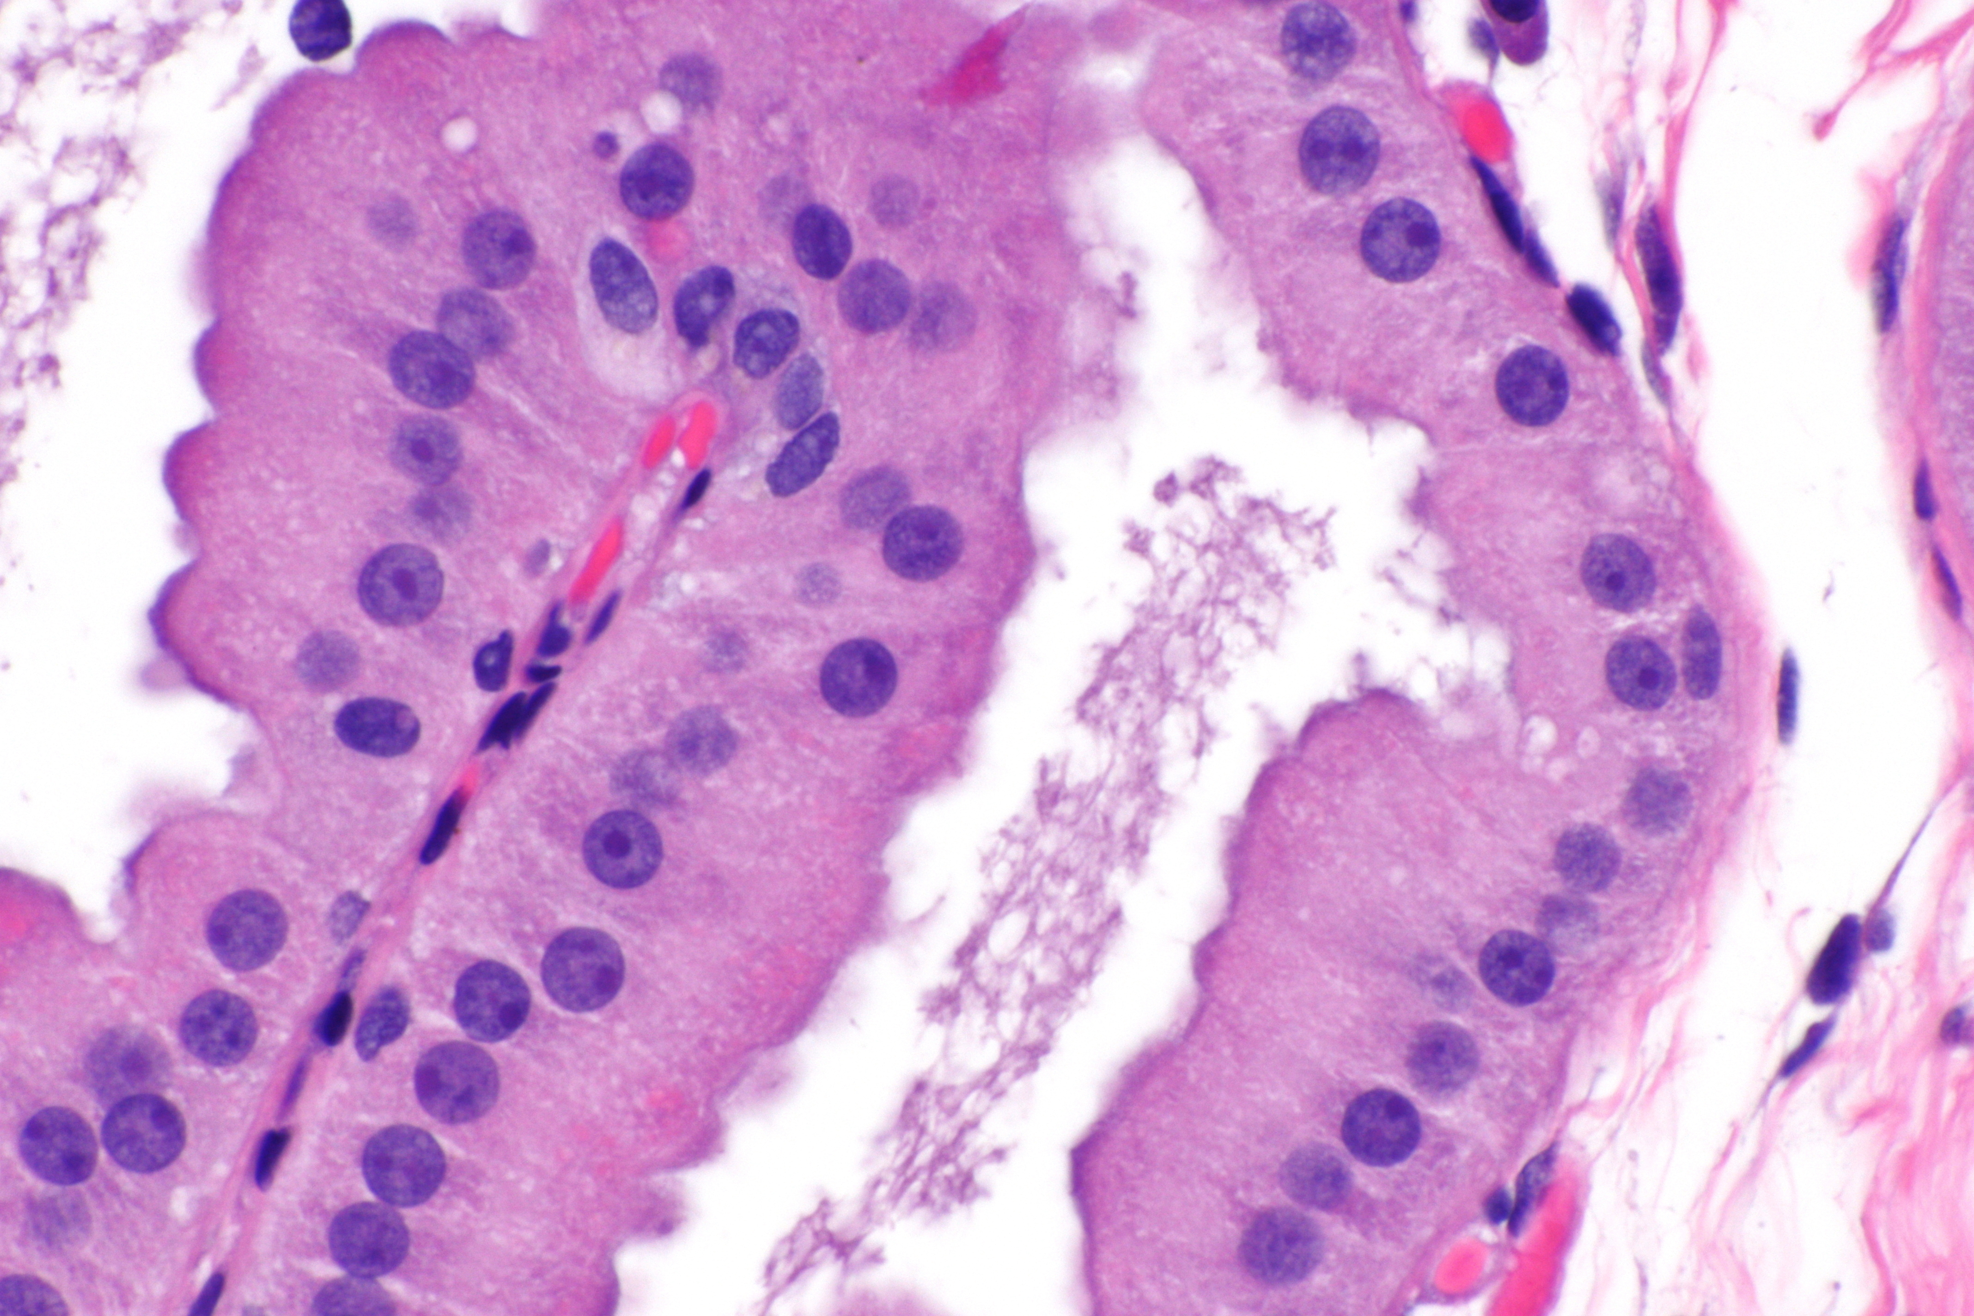
A. Nonproliferative disease - fibrocystic changes
Nonproliferative →contain single layers of epithelial cells.
Presentation: breast lumpiness (palpable nodularity.)
characterized by :
Adenosis.
fibrosis .
cyst formation.
Apocrine mataplasia.

Slide 18
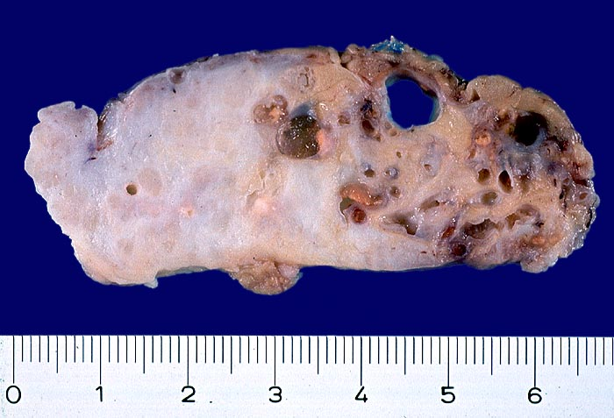

Slide 19
B. Proliferative disease without atypia
Epithelial hyperplasia.
Sclerosing adenosis
Papilloma.

Slide 20
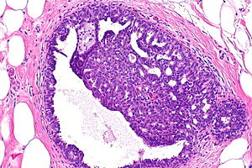
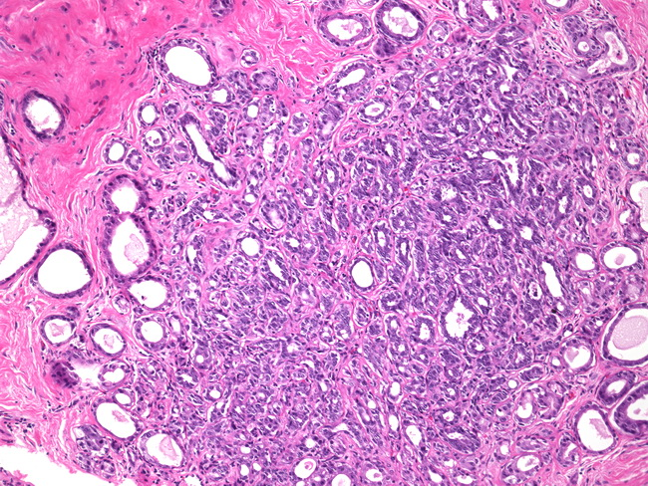
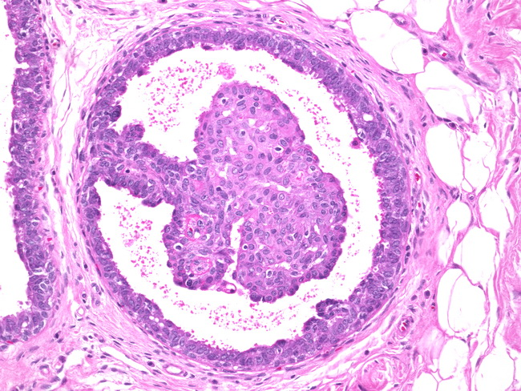
B. Proliferative disease without atypia

Slide 21
C. Proliferative disease with atypia
Atypical lobular hyperplasia (ALH) resembles lobular carcinoma in situ (LCIS).
Atypical ductal hyperplasia (ADH) resembles ductal carcinoma in situ (DCIS)
Clonal proliferations having some, but not all, histologic features that are required for the diagnosis of carcinoma in situ (LCIS or DCIS)

Slide 22
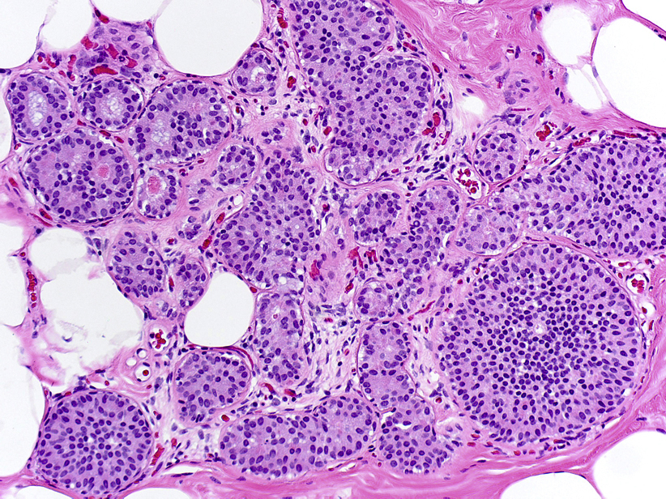
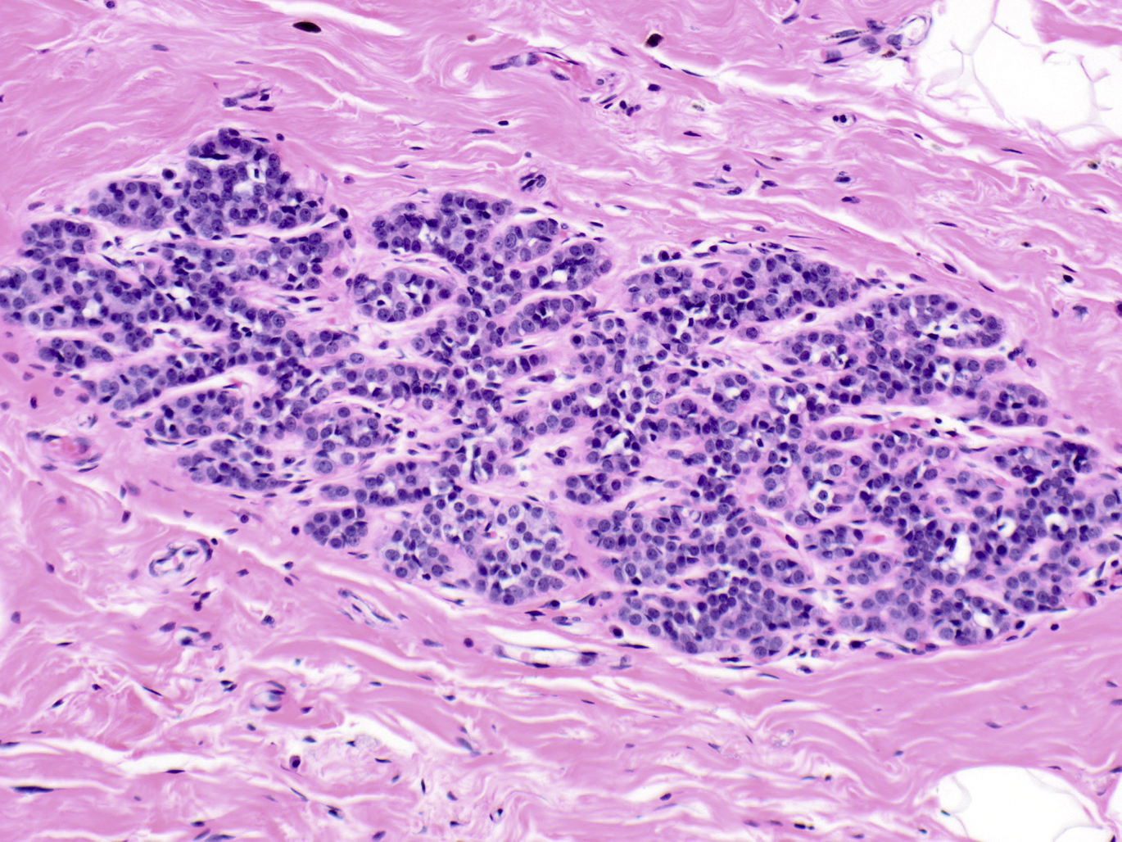
ADH
ALH

Slide 23
Breast carcinoma
The most common malignancy of women globally. (excluding nonmelanoma skin cancer)
2nd most common cause of cancer deaths in women. (2nd to lung cancer)
Worldwide incidence and mortality is increasing at an alarming rate.

Slide 24
Risk factors

Slide 25
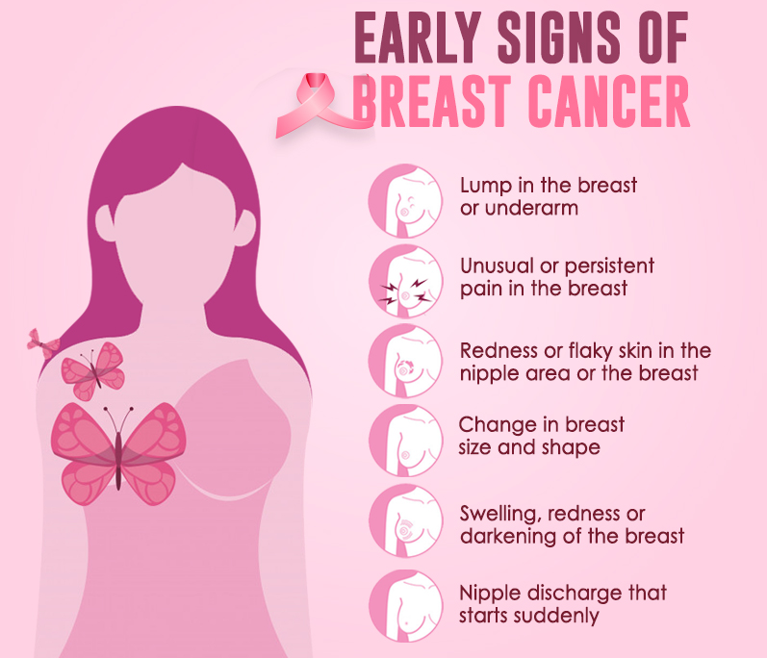
The most common location of tumors in breast is upper outer quadrant (50%), followed by the central portion (20%).

Slide 26
Pathogenesis/genetics
Some Familial cases are ass with mutations of :
BRCA1 & BRCA2 tumor suppressor genes ( susceptibility to breast Ca. & ovarian serous Ca).
familial germiline mutations; TP53 & PTEN.
The pathways in which familial breast cancer genes function also are often disturbed in sporadic breast cancers.

Slide 27
Pathogenesis/HER2 gene
A common clinically important driver mutation in breast Ca is the amplification of the HER2 gene.
HER2 is a receptor tyrosine kinase that promotes cell proliferation & opposes apoptosis.
Cancers overexpress HER2 are distinct & highly proliferative.
Used to have poor prognosis → the availability of HER2 targeting therapeutic agents → markedly improved prognosis in patients w HER2-amplified tumor

Slide 28
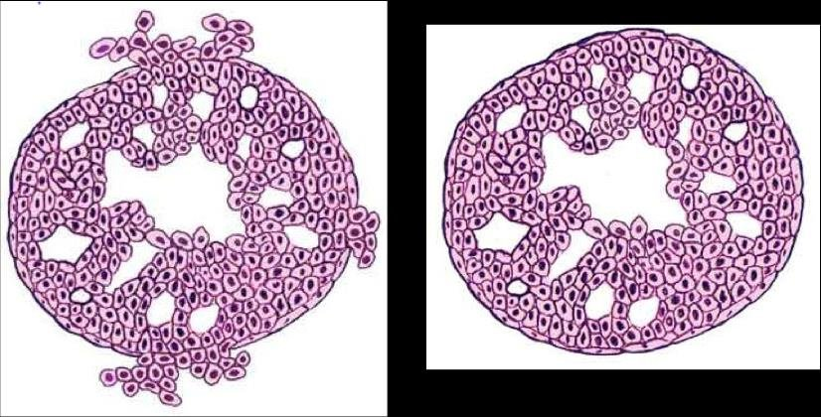
morphology
the main forms of breast carcinoma are as follows:(depend on B.M status):
Noninvasive
Ductal carcinoma in situ (DCIS)
Lobular carcinoma in situ (LCIS)
Invasive
Invasive mammary carcinoma , NOS( 70-80%).
Invasive carcinoma of special type (lobular, medullary, secretory, mucinous)

Slide 29
Noninvasive (in Situ) Carcinoma
Malignant clonal proliferation of epithelial cells within the lobules & ducts.
Both types of CIS arise from cells in the terminal duct
Both “respect” the basement membrane & do not invade into stroma or lymphovascular channels.

Slide 30
Ductal carcinoma in situ (DCIS) is a neoplastic proliferation of mammary ductal epithelial cells confined to the ductal-lobular system without evidence of invasion through the basement membrane into the surrounding stroma
CRIBRIFORM
PAPILLARY
SOLID

Slide 31
Lobulocentric proliferation of small uniform cells which fill and distend most of the acini in the involved lobule
LCIS

Slide 32
Invasive ductal carcinoma (IDC)
All carcinomas that cannot be subclassified into one of the specialized types, 70-80%.
Associated with DCIS (precursor).
Gross: Mostly produce a desmoplastic response that replaces normal breast fat (& a mammographic density) & appear as a hard, palpable infiltrative mass.
Microscopic: ranging from well-developed tubules & low-grade nuclei to tumors consisting of sheets of anaplastic cells.

Slide 33
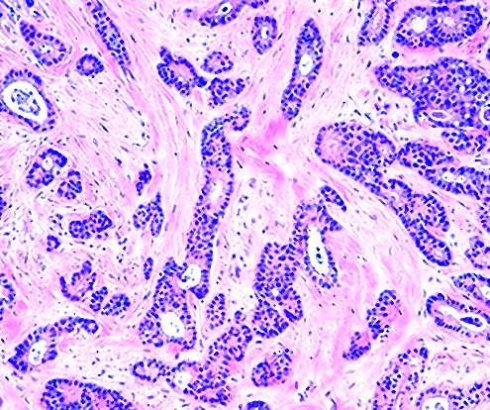

Slide 34
Invasive lobular carcinoma
Infiltrating cells similar to tumor cells in LCIS, ~10-15%.
Associated with LCIS (precursor),
Cells invade stroma individually.
Most manifest as palpable masses or mammographic densities (as IDC).
Commonly multicentric or bilateral.
Almost all lobular carcinomas express hormone receptors, HER2 overexpression is rare.

Slide 35
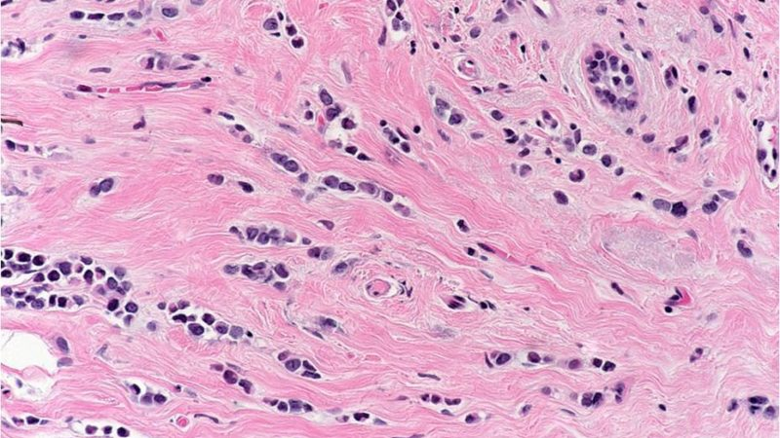

Slide 36
Inflammatory carcinoma
Defined by its clinical presentation.
Presentation: breast swollen & erythematous, skin thickening → Peau d'orange
Microscopic: Invasive carcinoma, generally poorly differentiated & diffusely infiltrates and obstructs dermal lymphatic spaces, causing the “inflamed” appearance; true inflammation is absent.
Most of these have distant metastases & the prognosis is extremely poor.

Slide 37
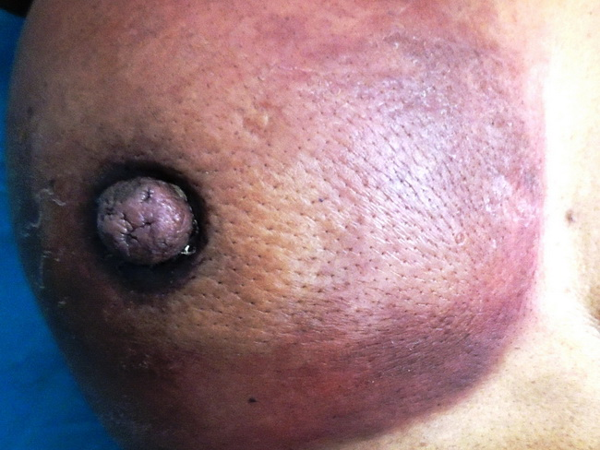
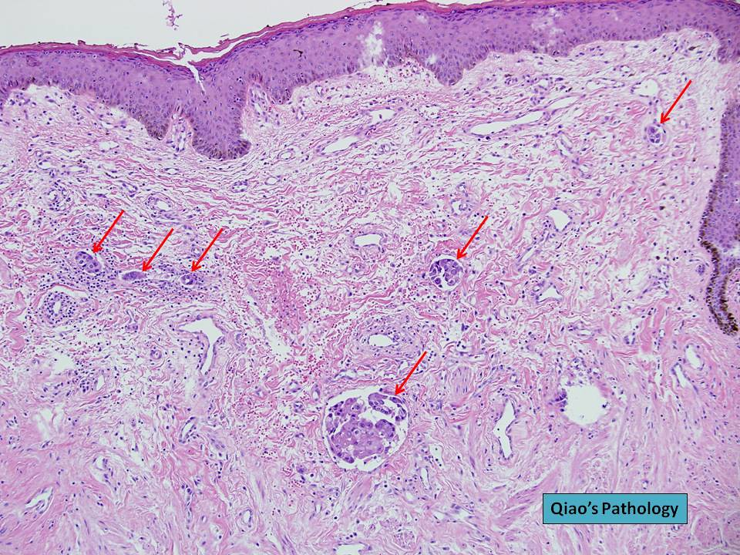

Slide 38
The most clinically useful classification of breast cancers → based on expression of hormone receptors {estrogen (ER) & progesterone (PR) receptors & the expression of the human epidermal growth factor receptor 2 (HER2, ERBB2):
ER positive (HER2 –ve ; 50%–65% of cancers).
HER2 positive (ER +ve or –ve ; 10-20% of cancers).
Triple negative (ER, PR, & HER2 –ve ; 10-20%of cancers).

Slide 39
Hormonal therapy
Hormone receptor positive breast carcinomas may be treated with neoadjuvant endocrine therapy with lower toxicity and cost than the alternative of neoadjuvant chemotherapy

Slide 40
clinical outcome
Patients with distant metastases have very poor survival.
Favored metastasis are the bone, lungs, skeleton, liver.
Axillary lymph node status is the most important prognostic factor for invasive carcinoma in the absence of distant ( risk ↑with ↑ size of the primary tumor).

Slide 41
clinical outcome
predicted based on:
Biologic type: evaluated by a combination of histologic appearance, grade, expression of hormone receptors, & expression of HER2.
Tumor stage: a measure of the extent of tumor at time of diagnosis. (primary tumor (T), involvement of regional lymph nodes (N),& presence of distant metastases (M)) + The majority of cancers first metastasize to regional (axillary) nodes

Slide 42
clinical outcome
The availability of treatment modalities: 80% of women with breast cancer who receive optimal therapy will survive.

