Slide 1
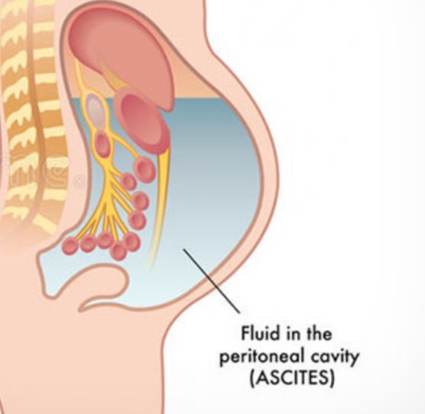
Ascites
Supervised by:-Meeran albataineh
Presented by:- Jaser Younes
Ammar Alsarhan
Rama Shamayleh

Slide 2
Ascites
Ascites is defined as the pathologic accumulation of fluid in the peritoneal cavity. It is the most common complication of cirrhosis
Small amounts of ascites are asymptomatic, but with larger accumulations of fluid more than 1 L there is :
* abdominal distension
*fullness in the flanks
* shifting dullness on percussion
* fluid thrill/ fluid wave when . Ascites marked

Slide 3
Feature of ascites
Eversion of umbilicus .
Herniae.
Abdominal striae.
Divarication of recti and scrotal edema.
Dilated superficial abdominal veins due to portal hypertension.

Slide 4
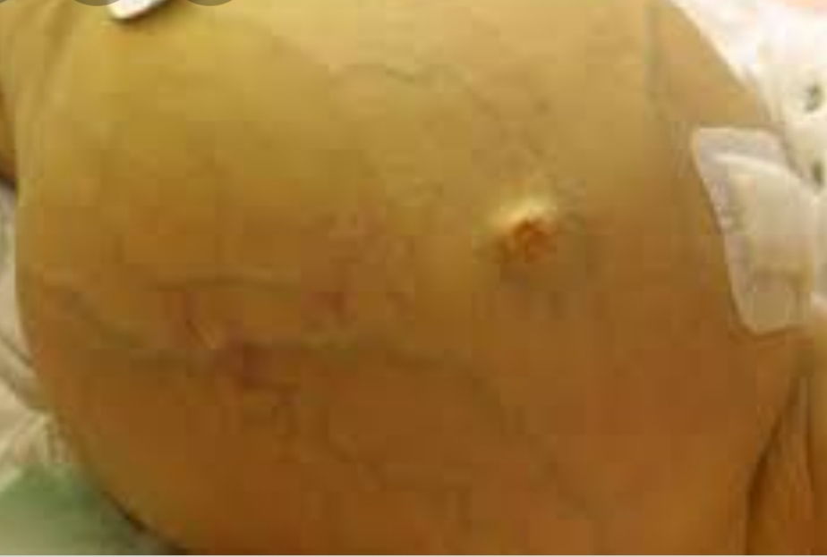
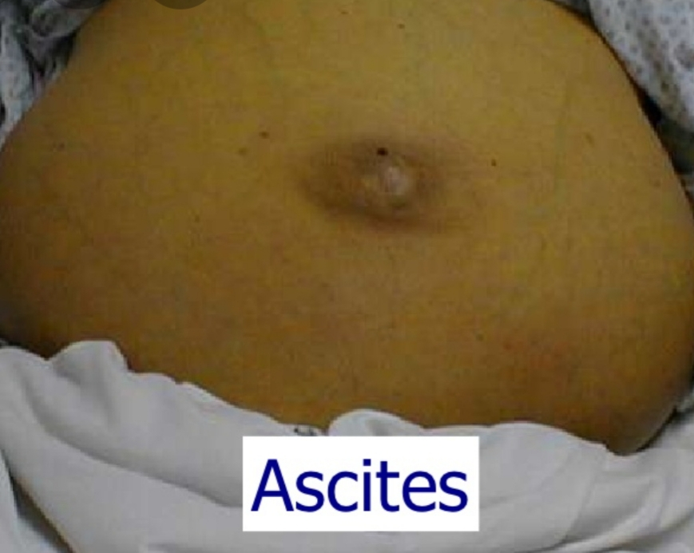
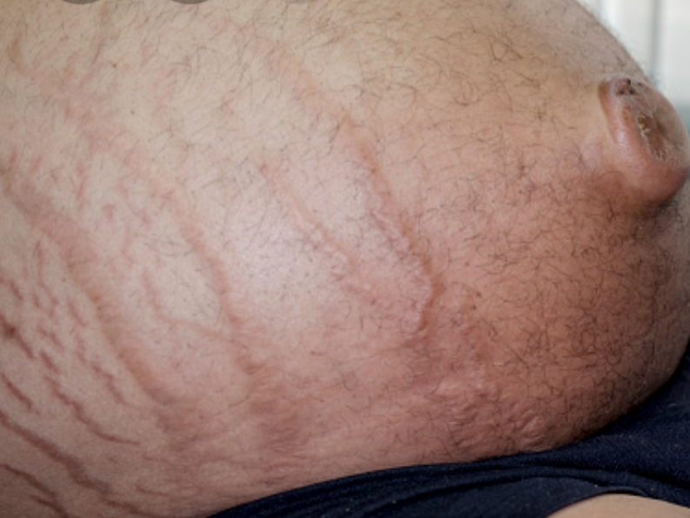

Slide 5
Causes:
SAAG=serum albumin consentration - ascites albumin consentration
Causes of high serum ascites albumin gradient(SAAG) are:
Heart failure - Hepatic cirrhosis. (hydrostatic pressure imbalance)
Cause of low Serum ascites albumin gradient (SAAG) are:
Malignant * hepatic
* peritoneal (oncotic pressure imbalance)
Other causes :
Acute pancreatitis
Lymphatic obstruction
Hepatic venous occlusion as( budd-chiari syndrome )
Notes:
SAAG = (serum albumin) − (albumin level of ascitic fluid).
Transudate is extravascular fluid with low protein content and a low specific gravity. It results from increased fluid pressures or diminished colloid oncotic forces in the plasma.
Exudative :fluid with high protein content and high specific gravity .it results from increase vessel permeability for protein

Slide 7
These systems tend to normalise arterial pressure but produce salt and water retention. In this setting the combination of splanchnic arterial vasodilation and portal hypertension alters intestinal capillary permeability promoting accumulation fluid within perineum.

Slide 8
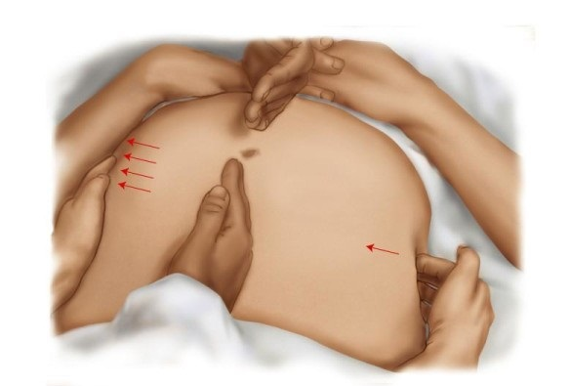
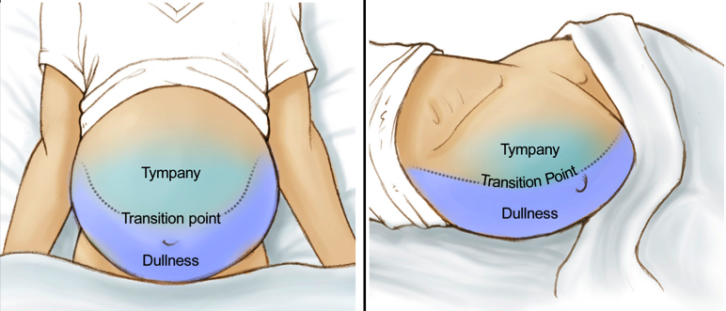
Physical examination
Transmitted thrill/fluid wave
Shifting dullness
In ascites the dullness shifting in More dependant side , while tympany Shift to top

Slide 9
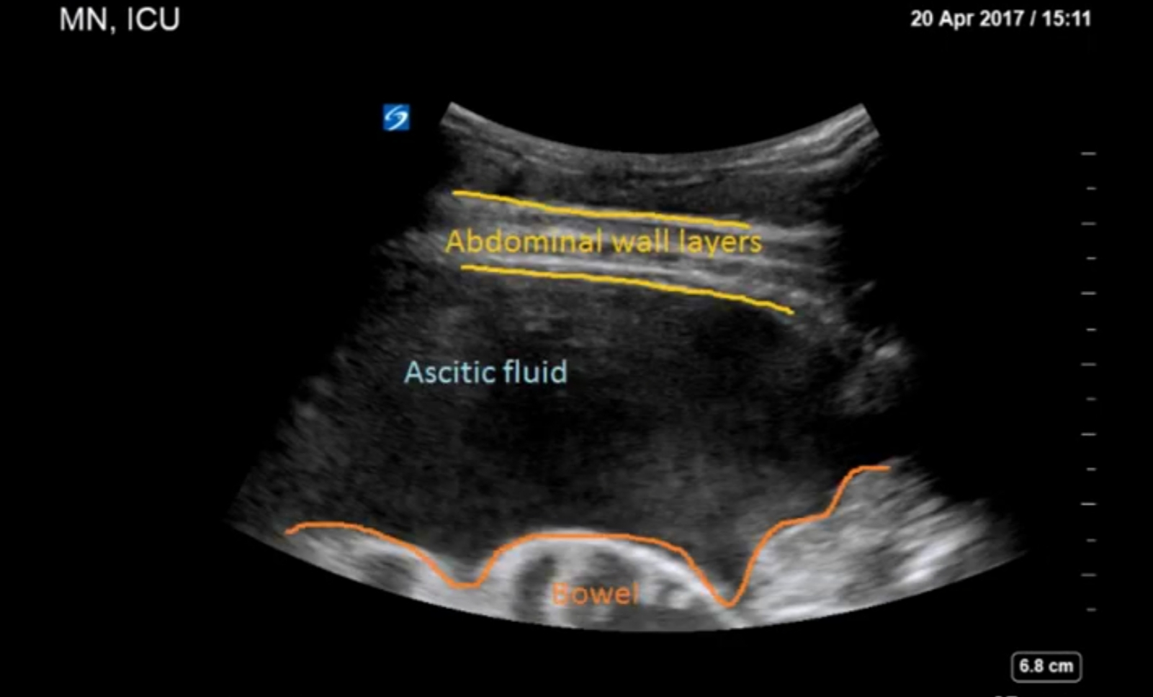
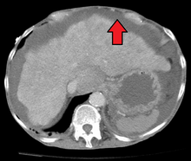
Investigation ultrasonography : is the best mean of detecting ascites particularly in the obese patient and those with small volumes of fluid . Paracentesis :can be used to obtain ascites fluid for analysis (Peritoneal cavity is punctured by needle to sample peritoneal fluid) . Pleural effusion are found in 10% of patient usually in right side ( hepatic hydrothorax) most small and identified only on chest x ray but occasionally a massive hydro thorax occurred. Pleural effusion in left side should not be assumed to be due to the ascites . CT: The most sensitive technique

Slide 10
Fluid analysis
(SAAG) can be a useful tool to distinguish ascites of different etiologies
Transudative: protein concentration < 25 g/L (2.5 g/dL)) and relatively few cells so SAAG > 11 g/L (1.1 g/dL) which caused by Venous outflow obstruction due to cardiac failure or hepatic venous outflow obstruction
exudative :protein concentration > 25 g/L (2.5 g/dL) or a SAAG of < 11 g/L (1.1 g/dL) raises the possibility of infection (especially tuberculosis), malignancy, pancreatic ascites or, rarely, hypothyroidism
triglyceride at a level > 1.1 g/L (110 mg/dL suggests anatomical or functional abnormality of lymphatic drainage from the abdomen. The ascites in this context has a characteristic milky-white appearance.

Slide 11
Management
Treatment of transudative ascites :
on restricting sodium and water intake
promoting urine output with diuretics
if necessary, removing ascites directly by paracentesis
During management of ascites, the patient should be weighed regularly. Diuretics should be titrated to remove no more than 1 L of fluid daily, so body weight should not fall by more than 1 kg daily to avoid excessive fluid depletion.
Treatment of exudative ascites :
is treated with paracentesis

Slide 12
Sodium and water restriction
Restriction of dietary sodium intake is essential to achieve negative sodium balance and a few patients can be managed satisfactorily by this alone
. Restriction of sodium intake to 100 mmol/24 hrs (‘no added salt diet’) is usually adequate.
Drugs containing relatively large amounts of sodium, and those promoting sodium retention, such as non-steroidal anti-inflammatory drugs (NSAIDs), must be avoided
Restriction of water intake to 1.0–1.5 L/24 hrs is necessary only if the plasma sodium falls below 125 mmol/L

Slide 13
Drugs containing relatively large amount of sodium :
1) Alginates : salt of Alginic acid
Alginic acid, is a naturally occurring, edible polysaccharide found in brown algae. With metals such as sodium and calcium, its salts are known as alginates.
2) Antacids : systemic antacids MAINLY

Slide 14
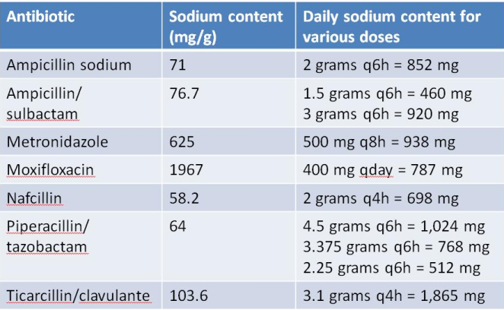
Drugs containing relatively large amount of sodium :
3) Antibiotics :
antibiotics are often prepared in diluents
that differ in sodium content and volume.
4) Phenytoin :
Phenytoin is an anti-epileptic drug,
also called an anticonvulsant.
Phenytoin works by slowing down impulses in the brain that cause seizures
by causing voltage-dependent block of voltage gated sodium channels
It may also be used for certain heart arrhythmias or neuropathic pain

Slide 15
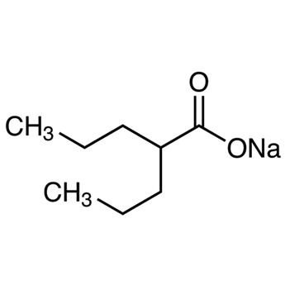
Drugs containing relatively large amount of sodium :
5) Effervescent preparations :
Usually, these tablets are prepared by compressing the active ingredients with mixture of sodium bicarbonate and organic acids such as citric and tartaric acid.
( e.g., Aspirin – calcium – paracetamol )
** Effervescent tablets are designed to release carbon dioxide upon contact with water,
promoting their dis-integration
6) Sodium valproate :
It is used to treat epilepsy and bipolar disorder,
and occasionally used to prevent migraine headaches

Slide 16
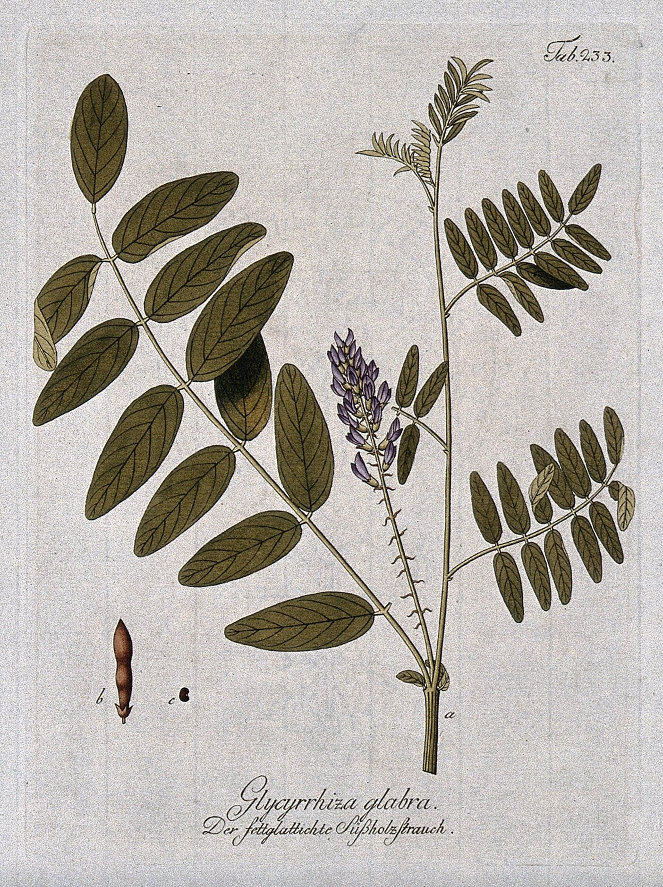
Drugs causing sodium retention :
1) Carbenoxolone (CBX) :
It has a steroid-like structure,
similar to substances found in the root of the licorice plant. (عرق السوس )
It’s used for the treatment of peptic, esophageal and oral ulceration.
2) Glucocorticoids :
Glucocorticoids stimulate renal sodium transport by
increasing the activity of the basolateral membrane Na,K-ATPase

Slide 17
Drugs causing sodium retention :
3) Metoclopramide :
It produces a transient increase in plasma aldosterone
and may cause fluid retention and volume overload in susceptible patients
4) NSAIDs : لا يوجد نظرية موحدة و مؤكدة
NSAIDs are inhibitors of COX-1 and COX-2,
and by doing so they decrease prostaglandin formation.
In the kidney, where the major form is PGE2,
this decrease will potentially cause sodium retention,
as well as water retention and increased renal vascular resistance.
5) oestrogens :
There is evidence that estrogen-related sodium retention is mediated through a consequence of changes in aldosterone distal tubule binding sites.

Slide 18
Diuretics
Most patients require diuretics in addition to sodium restriction
Diuresis may be improved if patients are rested in bed,
perhaps because renal blood flow increases in the horizontal position
Spironolactone (100–400 mg/day): (potassium-sparing diuretics)
is the first-line drug because it is a powerful aldosterone antagonist
SIDE EFFECT: painful gynecomastia and hyperkalemia
2) amiloride (5–10 mg/day) (potassium-sparing diuretics)
can be substitution for spironolactone

Slide 19
Diuretics
3) Furosemide (loop diuretics):
but these can lead to fluid and electrolyte imbalance and renal dysfunction
-------------------------------------------------------------------------------------------------------------------------
Patients who do not respond to doses of
- 400 mg spironolactone
- 160 mg furosemide
or who are unable to tolerate these doses
due to : hyponatremia or renal impairment,
are considered to have refractory or diuretic-resistant ascites and should be
treated by other measures

Slide 20
Paracentesis
First-line treatment of refractory ascites is large-volume paracentesis.
Paracentesis to dryness is safe, provided the circulation is supported with an IV colloid such as human albumin (6–8 g albumin for each one liter of aspirated fluid if 5 L removed at once ) .
Paracentesis can be used as an initial therapy
or when other treatments fail

Slide 21
Complications of Ascites :
Bacterial infections, such as spontaneous bacterial peritonitis (SBP)
It is infection of ascites fluid without detectable intra abdominal infection and caused usually by E.coli
# Mechanism of SBP :
Translocation of gut bacteria through :
intestinal wall 🡪 colonize mesenteric LN 🡪 blood circulation 🡪 ascitic fluid
# Hematogenous Signs & Symptoms :
fever / abdominal pain and tenderness / rebound tenderness / no bowel sounds / altered mental status
# Diagnosis is based on :
1.Positive ascitic bacterial culture (monomicrobial)
2.Elevated absolute PMN count in ascitic fluid (more than 250cells /mm3)
# Treatment : broad-spectrum antibiotics, such as cefotaxime (5-10 days)

Slide 22
Complications of Ascites :
Hepatorenal Syndrome, a rare type of progressive Renal failure
# It is an acute reversible form of RF in patient with cirrhosis
# Cause: unknown
# Triggers:
- Refractory ascites
- Large volume paracentesis without albumin replacement
- Spontaneous bacterial peritonitis ( SBP )
# Caused by combination of VD in splanchnic and VC in renal circulation
# The first line of treatment : vasopressin (Terlipressin) and albumin
# Liver transplantation is the best option esp. for type 1

Slide 23
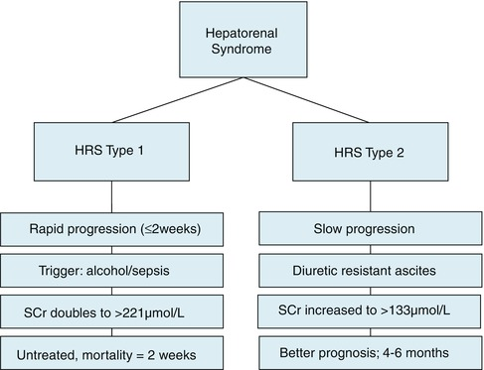
Complications
Renal failure (RF)
It can be due to vasodilatation from sepsis and/or pre-renal due to hepatorenal syndrome ,
which occurs in 10% of patients with advanced cirrhosis complicated by ascites.

Slide 24
Thank U

