Slide 1
Child’s Healthcare
Dr. Israa Al-Rawashdeh MD, MPH ,PhD
Faculty of Medicine
Mutah University
2020

Slide 2
Definitions:
A child is a person 18 years or younger unless national law defines a person to be an adult at an earlier age.
An infant is a child younger than one year of age
An adolescent is a person aged 10 to 18 years inclusive.

Slide 3
Why focus on child’s health?
Major proportion of the populations, (Jordan: 34% <14 years)
One of the most vulnerable segments of the population.
A child is dependant on adults for optimal development and survival.
Critical years of life: biologic immaturity (immunity)—increased risk of infectious diseases and rapid growth and development (e.g. brain).
Childhood illness contribute substantially to the global burden of disease.
Majority of child deaths are preventable and treatable.
A good measure of societal development.

Slide 4
Child Mortality indicators
Under-five mortality rate U5MR - Probability of dying between birth and exactly five years of age expressed per 1,000 live births.
Infant mortality rate IMR - Probability of dying between birth and exactly one year of age expressed per 1,000 live births
Neonatal mortality rate NMR: Probability of dying during the first 28 days of life, expressed per 1,000 live births. (early and late)
Post Neonatal mortality rate PNMR: Probability of dying between 28 days and exactly one year of age expressed per 1,000 live births

Slide 7
Scope of the Problem
The world made remarkable progress in child survival in the past 30 years (1 in 27 children died before reaching age five in 2019, compared to 1 in 11 in 1990).
5.2 million children under age five died in 2019—50% of those deaths occurred in sub-Saharan Africa.
The global under-five mortality rate from (93 deaths per 1,000 live births in 1990 to 38 in 2019).
In 2019 alone14,000 under-five deaths occurred every day → preventable causes.
UN report

Slide 8
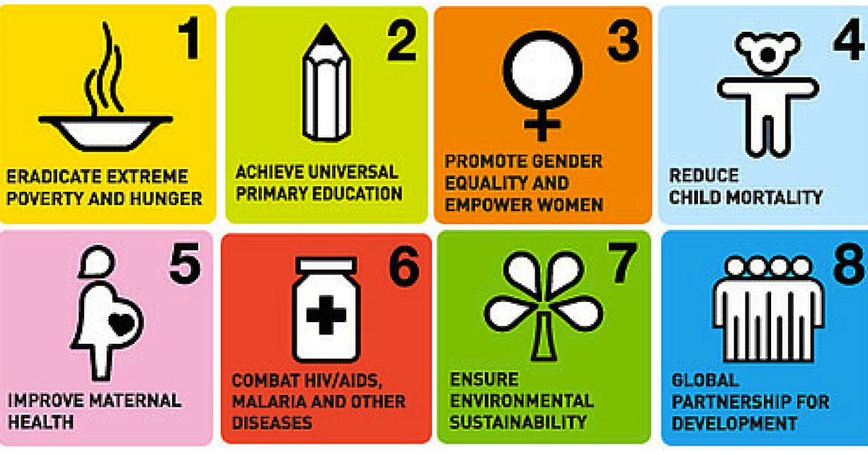
Hope---SDGs
MDG 4: The child mortality rate has reduced by more than half over the past 25 years – falling from 90 to 43 deaths per 1,000 live births – but it has failed to meet the MDG target of a drop of two-thirds.

Slide 9
Causes of death
Differ by age group
Common problems that occur beyond the neonatal period tend to be more easily addressed by public health strategies while neonatal problems may require more clinical based interventions.
Most interventions aimed at decreasing neonatal mortality are linked to prenatal and maternal care interventions.

Slide 10
Leading causes of death in children under-5 years
Preterm birth complications (being born before the 37th week of gestation). risk of: birth asphyxia, birth injuries, underdeveloped organ failures, and infectious diseases.
Acute respiratory infections (Pneumonia),
Congenital anomalies: physical or genetic abnormalities present at birth and include neural tube defects, heart defects, Down syndrome, microcephaly and others.
Diarrhoea
Infectious diseases: measles, malaria.
*Injuries play a more prominent role in the deaths of older children.
(WHO, 2018)

Slide 12
Factors that Affect the Health of Children
1. Biological
2. Socio-economic
3. Cultural

Slide 13
Biological:
Birth Weight: low birth weight (< 2.5 kg) & high birth weight (> 4 kg)
Age of The Mother : <19 years) or >over 40 years
High Fertility
Birth Order: Mortality risk increased after the third birth.
Repeated pregnancies
Birth Spacing: < 1 year = 2-4 times risk
Mutiple Births: more risk due to low birth weight
Family Size: 3 or more children, more frequent/prolonged illness

Slide 14
2. Socio-economic Factors
Low income countries (poverty)
Rural areas
Low education (maternal)
Poor and inadequate nutrition
Breast vs formula milk use
Health care quality
Environmental conditions (Conflict/War/Disaster)
Violence (wife beating, infanticide)

Slide 15
3. Cultural Factors
Religion
Customs and traditions
Early marriages
Sex of child
Motherhood traditions (cleanliness, eating, clothing, child care)

Slide 16
Morbidity
Common diseases with low fatality but cause significant disability.
Not evident if we only consider U5MR, IMR,NMR!
Examples:
- Vit. A deficiency: leading cause of preventable blindness worldwide.
Iodine deficiency: preventable cause of developmental delay.
Iron deficiency: affects >50% of children—anemia, decreased performance at school
Helminthic infections: anemia, poor growth, decreased learning.

Slide 18
In Jordan ,
. Under five mortality and infant mortality decreased between 1997 and 2012, but not enough to meet the targets of the MDGs.
Infant mortality rate: 17/1000 live births.
Under-5 child mortality rate: 21 per 1,000 live births.
Neonatal deaths are underreported in Jordan (families are responsible for registering births and deaths rather than health facilities and institutions).
Mortality of children under 5 is nearly three times higher among children in the poorest households (29 deaths per 1,000 live births) than the wealthiest households (11 deaths per 1,000 live births).
By governorate, NMR range from 26 deaths per 1,000 live births (Ajloun ) and 7.4 per 1,000 ( Ma'an) (UNICEF and John Snow Inc., 2013).

Slide 19
Health Services
A. Preventive and promotive care.
B. Care in illness
C. Monitoring of growth and development
The main functions can be summarized as follows:

Slide 20
A. Preventive and promotive care.
It includes:
Immunization
Health check up
Health education
Nutritional education

Slide 21
Seven preventable diseases are responsible for most childhood morbidity and mortality.
These are TB, diphtheria, pertussis, neonatal tetanus, poliomyelitis, measles and viral hepatitis B.
Children can be protected by a fairly cheap and simple program on immunization before they are one year old.

Slide 22
Health check up
A newborn has to be examined at least twice; once within the first 24 hours after birth and just before discharge.
Monthly health check-ups should be done during infancy as well as in all visits to the clinic including routine immunization sessions.
The health check- up → helpful in identifying at risk children, who can be followed more closely by appropriate screening or diagnostic tests and / or paid home visits if needed.

Slide 23
At risk children include:
Birth weight < 2500 grams.
Twins.
Artificial feeding.
Weight below 60% of the expected weight for age.
Failure to gain weight for three successive months.
Children having protein energy malnutrition (PEM).
Children having diarrhea or ARI.

Slide 24
Newborn Screening Program in Jordan
The purpose is to screen for congenital and heritable disorders.
Identification is a multi-step process:
(1) Blood specimens from infants are analyzed by the laboratory
(2) If a result is abnormal, laboratory staff notifies case management / Clinic
(3) The clinic provides follow-up to assist linking families with appropriate providers to confirm the test results.
The National Newborn Screening Project covers nearly 29 conditions. These include twenty inborn errors of metabolism, three hemoglobinopathies (including Sickle Cell disease), two endocrine disorders (HT), one hearing loss disease and three other metabolic disorders.
These disorders may cause severe mental retardation, illness, or death if not treated in the early stages. If treated, infants may live relatively normal resulting in savings in medical costs over time.

Slide 26
Child rearing: cleaning, bathing, as well as the importance of exposure to the ultraviolet rays of the sun.
Immunization: benefits, timing and possible side effects.
Family planning: it is indirectly related to child’s health

Slide 27
(Breast-feeding)
Breast milk fully meets the nutritional requirements of the infant in the first few months of life.
Average mother secrete 450- 600ml of milk daily – 1.1gm protein/100ml – 70 kcals/100ml
PROMOTES bonding between mother and infant, prevents malnutrition and reduces infant mortality, naturally encourages birth spacing. Also, could prevent deaths of at least one million children a year.
SUCKING helps in the development of jaws and teeth, PROTECTS babies from the tendency to obesity.
Yet breast feeding practice is not uniformly common in many developing countries for several reasons:
o Hospitals and maternity clinics promote bottle-feeding, because of the aggressive marketing by infant formula manufacturers, who provide free or low-cost supplies.
o Other practices, such as separating babies from mothers at birth, which inhibit breast feeding.

Slide 28
Initiation and Maintenance of Breast feeding
The decision of breast- feeding should be made during antenatal period by the help of the obstetrician and pediatrician.
Breast Feeding Guidelines:
1. Begin breast feeding as soon as possible, preferably within the first half-hour after delivery.
2. Breast feeding should be on demand, whenever the infant is hungry, both day and night.
3. Exclusive breast feeding through the first 6 months of life.
4. Appropriate complementary semi-solid food should be started after 6 months of age, but the breast milk should be offered first.
5. Breast-feeding should be continued throughout the second year of life.
6. Position the infant so that its mouth covers both the nipple and areola, and latches on properly.
7. Avoid the use of bottles or pacifiers.
8. The mother’s food and fluids should meet her needs during lactation.

Slide 29
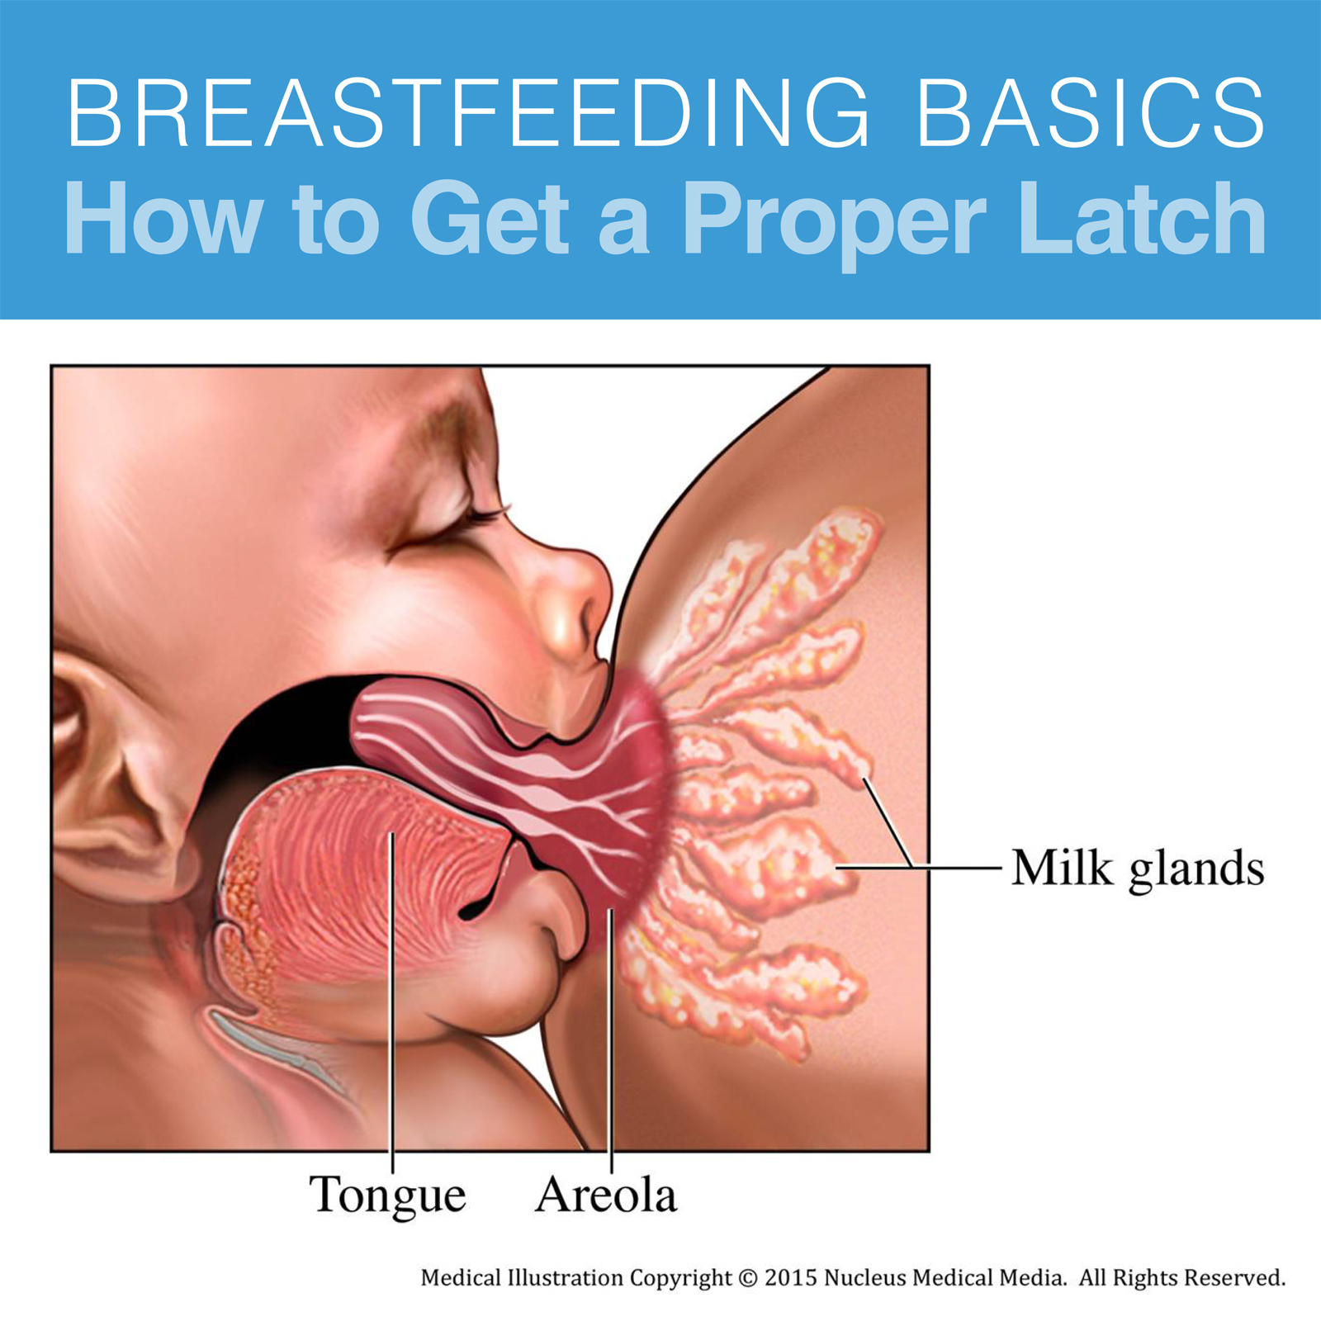

Slide 30
Supplementary foods
Babies can grow on breast milk alone for the first 6 months of life.
After that age, breast milk alone may not be enough; other foods need to be added with continuation of breast feeding for as long as possible, preferably 24 months.
Gradual foods introduction other than breast milk “weaning” is recommended.
In most communities, supplementary feeding starts by semisolid prepared from (the local staple food)

Slide 31
The weaning period poses two risks:
o Malnutrition: a common problem during the weaning period as the weaning foods are usually watery, less nutritive and less energy supplying than breast milk.
o Contamination: the risk of contamination of the weaning food is high, so diarrhea is common during this period. With diarrhea, some parents usually starve the infant, which aggravates malnutrition.

Slide 32
-To avoid these risks; the UNICEF developed the following guidelines' for safe supplementary feeding.
1. It should be started at the age of 6 months. By that age, the iron stores in the liver are depleted so the infant needs a diet rich in iron.
2. Abrupt weaning should be avoided. Only one new food is introduced at a time.
3.The nutritional value of the traditional weaning foods should be improved.
4. All foods offered to the infant should be freshly prepared.

Slide 33
Continued guidelines for safe supplementary feeding:
Breast- feeding should be continued until the end of the second year of life, together with supplements, as breast milk may be the only available clean source of animal protein.
Cleanliness & hygiene should be ensured during food preparation
Small quantities of the new food is introduced first and gradually increased. Infant starvation during diarrhea should be avoided.
With the beginning of weaning, the chances of another pregnancy are greatly increased, so an action for child spacing should be motivated.

Slide 34
FYI
The brain develops more rapidly when the child first enters school than at any other age!
False
The brain develops most rapidly before birth and in the first two years of life. The efforts to help the child learn at this age will benefit the child for their whole life.

