Slide 1
Cardiogenic Shock

Slide 2
Definition of Cardiogenic Shock
Inadequate tissue perfusion resulting from cardiac dysfunction
Clinical definition: decreased CO and tissue hypoxia in the presence of adequate intravascular volume
Hemodynamic definition: Sustained SBP<90 mm Hg, CI <2.2 L/min/m², PCWP > 15 mm Hg

Slide 3
How to identify Cardiogenic Shock
History
Physical Exam
EKG
Chest xray
Echocardiogram
Swan-Ganz Catheter

Slide 4
History: Who gets Cardiogenic Shock?
Acute MI
End-stage cardiomyopathy
Myocarditis
Prolonged cardiopulmonary bypass
Septic shock with myocardial depression
Valvular disease: AS, AR, MS, MR

Slide 5
Symptoms
Rapid shallow respiration
Severe shortness of breath
Loss of consciousness or fainting
Sweating
Pale skin
Cold extremities
Oliguria
Nausea, vomiting
Drowsiness, confusion, irritability (usually occurs late)
Diaphoresis, exertional dyspnea, or dyspnea at rest.
Syncope, palpitations, generalized anxiety, and depression .

Slide 6
PPHYSICAL EXAMINATIO
cyanosis , cold skin and mottled extremities.
Weak pulse and Hypotension (systolic BP < 100 mmHg).
Tachycardia (> 100/min)
Jugular venous distention and crackles in the lungs are usually present; peripheral edema also may be present.
Heart sounds are usually distant, and third and fourth heart sounds may be present.
A systolic murmur (acute mitral regurgitation or ventricular septal rupture).

Slide 7
Diagnosis
ECG : ST segment elevation suggesting acute MI / arrhythmias / LBBB/Q waves
Echocardiogram: can diagnose a variety of mechanical complications of MI, valve disease, estimate EF, pericardial perfusion,etc
Hemodynamic monitoring with a Swan-Ganz catheter may be indicated: PCWP, pulmonary artery pressure, cardiac output, cardiac index, SVR
CBC, LFT, KFT, Cardiac enzymes, ABGs, Cx-ray

Slide 8
Management :
Cardiogenic shock is an emergency requiring immediate resuscitative therapy .
All patients require admission to intensive care unit (ICU).
Percutaneous Coronary Intervention or coronary artery bypass are the treatment of choice for cardiogenic shock due to MI.
Thrombolytics is the second best.

Slide 9
Initial stabilization of the patient with suspected cardiogenic shock consists of :
1.venous access:
includes fluid resuscitation to correct hypovolemia and hypotension, unless pulmonary edema is present.
Central venous and arterial lines are often required.
Swan-Ganz catheterization and continuous percutaneous oximetry are routine
Electrolyte abnormalities should be corrected .
2.supplemental oxygen:
Many patients require endotracheal intubation and mechanical ventilation, if only to reduce the work of breathing and facilitate sedation and stabilization before cardiac catheterization.
3.continuous ECG monitoring:

Slide 10
4. pain relief: Morphine (1 to 2 mg every 5 minutes)
-Relieves pain and anxiety
-Reduces excessive sympathetic activity
-Decreases oxygen demand
- Decrease preload and afterload.
5. arrhythmia correct :
Atrial bradyarrhythmias or tachyarrhythmias or ventricular tachyarrhythmias can reduce cadiac output → so it should be corrected.
-antiarrhythmic drugs IV : Amiodarone, Procainamide, Lidocaine
- electrical cardioversion
-pacing
6. Thrombolytic Therapy: If the cause is likely an acute MI
Aspirin and heparin should be given immediately.
7. Hemodynamic Support:
Maintenance of adequate blood pressure is essential to break the vicious circle of progressive hypotension and further myocardial ischemia.

Slide 11
Vasopressors for hypotension which is unresponsive to fluids :
Norepinephrine and dopamine are considered first-line drugs for hypotension in this situation .
Dopamine acts as both an inotrope (particularly at 3 to 10 μg/kg/minute) and a vasopressor (10 to 20 μg/kg/minute).
Norepinephrine (0.02 to 1.0 μg/kg/minute) acts primarily as a vasoconstrictor, has a mild inotropic effect, and increases coronary flow

Slide 12
If tissue perfusion remains inadequate despit norepinephrine and dopamine, inotropic therapy should be initiated:
1.Dobutamine :(2.5 to 20 mg/kg/minute),
selective a1-adrenergic receptor agonist,:
improve myocardial contractility
increase cardiac output
it is the initial agent of choice in patients with a low-output syndrome and systolic blood pressures greater than 90 mm Hg.
Side effect :may exacerbate hypotension in some patients owing to its vasodilatory effects, and it can precipitate tachyarrhythmias.

Slide 13
2. Milrinone : (0.125 to 0.75 μg/kg/minute)
phosphodiesterase inhibitor,
has fewer chronotropic and arrhythmogenic effects than catecholamines
Has a long half-life and can cause hypotension; in patients whose clinical status is tenuous .
it is usually reserved for situations in which other agents have proved ineffective.

Slide 14
3.Levosimendan : (0.05 to 0.2 μg/kg/minute)
calcium sensitizer that has BOTH inotropic and vasodilatory properties and does not increase myocardial oxygen consumption.
More effective than dobutamine in treating low-output heart failure.

Slide 15
Intra-aortic Balloon Pump :
A device that gives mechanical support to the failing heart .
Often used for hemodynamic support (not definitive therpy)
Effects include :
Decreased afterload
Increased cardiac output
Decreased myocardial oxygen demand

Slide 16
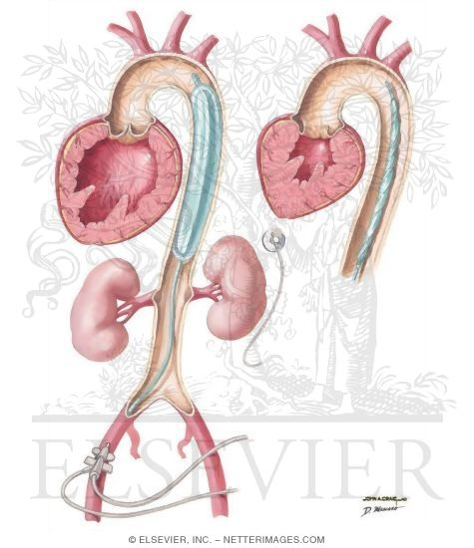
A balloon catheter is positioned in the descending thoracic aorta just distal to the subclavian artery .
It facilitates ventricular emptying by deflating just before the onset of systole (reducing afterload) and increases coronary perfusion by inflating at the onset of diastole (increasing diastolic pressure).
The net effect is enhanced myocardial oxygenation and increased cardiac output.

Slide 17
Reperfusion:
1. PCI “coronary angioplasty”
Benefit highest when performed early (within 90 minutes of hospital arrival)
2.CABG: coronary artery bypass graft
more likely to provide complete revascularization and achieves long-term survival rates comparable to PCI,

Slide 18
Surgery :
1.surgical valve repair or replacement:
For acute mitral regurgitation owing to papillary muscle rupture following MI
within 48 hours of the rupture.
2.Ventricular septal or free wall rupture, Placement of a septal occluding device may be helpful.
Cardiac tamponade : Pericardiocentesis

Slide 21
References :
*Step up to Medicine – Fourth edition
*Davidson’s Principles & Practice of Medicine 21 st edition
*http://emedicine.medscape.com/article/152191-overview#a0104

