Slide 1
Vitamins Water-soluble vitamins Lecture 3 (23 slides)
Dr. Eman Shaat
Professor of Biochemistry & Molecular Biology

Slide 2
Vitamins: classification
Vitamins grouped into two major categories:
Fat-soluble (4 fat soluble) Vitamin A, D, E, K.
Water-soluble (9 water soluble)
Vitamin B₁ (thiamine)
Vitamin B₂ (riboflavin)
Vitamin B₃ or Vitamin P or Vitamin PP (niacin)
Vitamin B₅ (panthotenic acid)
Vitamin B₆ (pyridoxine and pyridoxamine)
Vitamin B₇ or Vitamin H (biotin)
Vitamin B₉ or Vitamin M (folic acid)
Vitamin B₁₂ (cobalamin)
Vitamin C

Slide 3
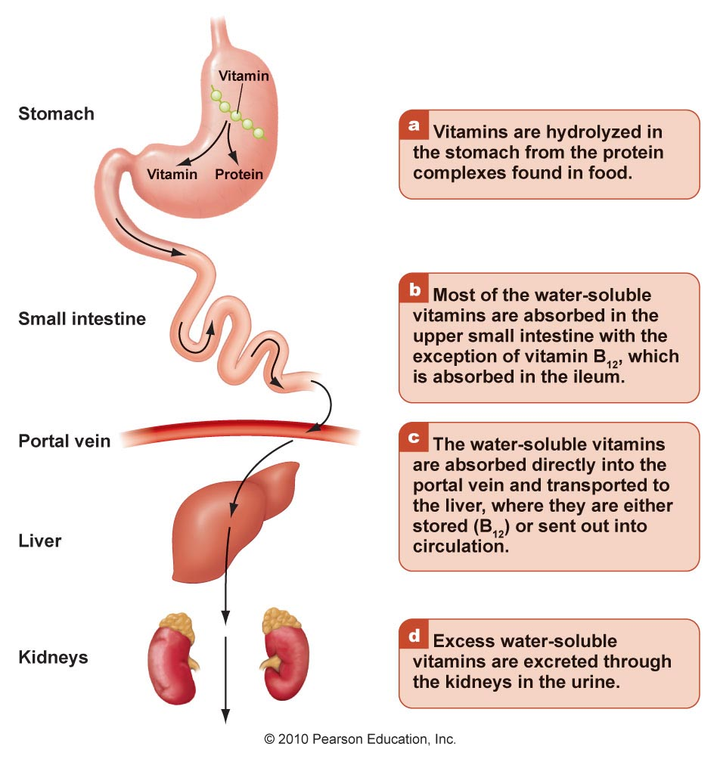
Digesting and absorbing water-soluble vitamins

Slide 4
Water-soluble vitamins Vitamin B1 (Thiamin)

Slide 5
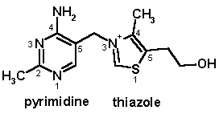
Thiamin (B1)
Chemistry:
a substituted pyrimidine joined by a methylene bridge to a substituted thiazole.
Requirements: 1-1.5 mg/day for adults. (Higher needs in pregnancy, high CHO diet)
Sources:
Plant sources: whole grains (unrefined cereal grains), beans, peas, nuts and bran.
Animal sources: liver, heart, kidney and milk.
Yeast
Activation (Co-enzyme):
Conversion of thiamin to its active form thiamin pyro-pphosphate
TPP

Slide 6
Absorption
Thiamine is released by the action of pyrophosphatase
At low concentrations, the process is carrier-mediated. At higher concentrations, absorption also occurs via passive diffusion.
It can be inhibited by alcohol consumption.
On serosal side of the intestine, its transport is dependent on Na⁺-dependent ATPase.
The majority of thiamine in serum is bound to proteins, mainly albumin.
Approximately 90% of total thiamine in blood is in RBC.
Cellular uptake
Thiamine uptake and secretion by cells of the blood and other tissues are mediated by a soluble thiamine transporters that is dependent on Na⁺. [Thiamin transporter-1 & 2 (human THTR-1 & 2)].
Storage: of thiamine occurs in muscle, heart, brain, liver, and kidneys.
Excretion: Thiamine and its metabolites are excreted in urine.

Slide 7
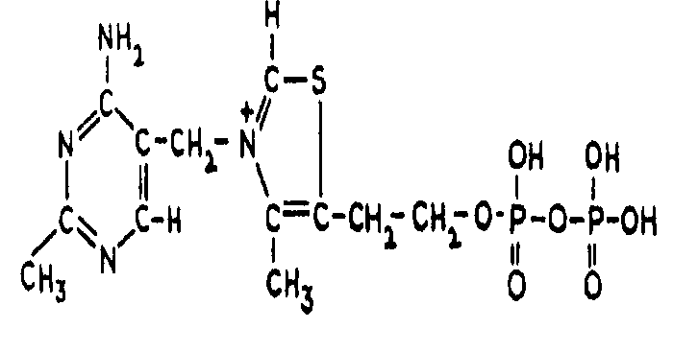
Thiamin: activation
Thiamin TPP
ATP-dependent thiamin
diphosphotransferase
Brain, liver
Thiamine + ATP → TPP + AMP (EC 2.7.6.2).
ATP
Oxidative decarboxylation of pyruvate
ETC
CO2
NAD⁺ NADH + H⁺
pyruvate
acetyl CoA
Pyruvate Dehydrogenase complex
(PDH)
Vit. (thiamin, lipoic, riboflavin, Niacin, pantothenic)
Co-enzymes (TPP, Lipoamide, FAD, NAD+, CoASH)

Slide 8
Thiamin: Function
TPP serves as a coenzyme transferring an activated aldehyde unit (transfer of two-carbon units):
Oxidative decarboxylation of α-keto acids as PDH.
Transketolase reaction (pentose phosphate pathway; PPP). It is used for the biosynthesis of pentose sugars deoxyribose and ribose.
Acetylcholine synthesis which is one of neurotransmitters and for myelin synthesis.
Important in:
Producing energy from carbohydrates
Nerve function
Muscle function
Appetite
Growth
Therapy: It can be used for treatment of Heart failure & Alzheimer disease.

Slide 9
Deficiency
Causes:
Low intake, malabsorption , and/ or defective phosphorylation to TPP.
Antithiamine factors : These are enzymes present in the viscera of shell fish and many microorganisms .They cause cleavage of thiamin producing pyrimidine and thiazole rings so they are called thiaminases. These antithiamine factors cause an isolated thiamine deficiency. Plant thiamine antagonists are heat-stable; for examples caffeic acid, and tannic acid. These compounds interact with the thiamine to oxidize the thiazole ring, thus rendering it unable to be absorbed.
Alcoholism : Chronic alcoholism gives the manifestation of moderate thiamine deficiency. This is called Wernike korsacoff , syndrome. Alcohol interferes with absorption.
Excessive loss (diuretics).

Slide 10
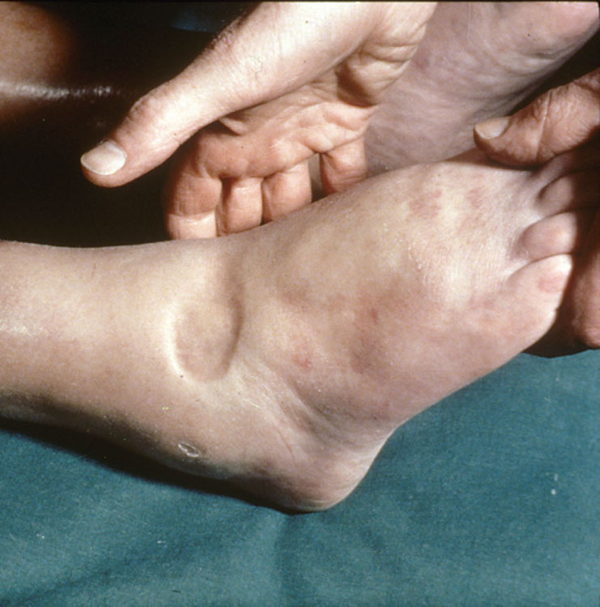
Manifestation of thiamine deficiency
Mild deficiency: leads to
Gastrointestinal complaints
Weakness.
2. Moderate deficiency:
Wernike korsacoff , syndrome
Peripheral neuropathy.
Mental abnormalities.
3. Severe thiamin deficiency:
A. Beriberi
Dry beriberi is characterized by advanced neuromuscular symptoms:
- Atrophy and weakness of the muscles. - Peripheral neuropathy. - Memory loss.
Wet beriberi: the previous symptoms (dry beriberi) are coupled
with oedema.
B. Wernike korsacoff’s syndrome

Slide 11
Water-soluble vitamins Vitamin B2 (Riboflavin)

Slide 12
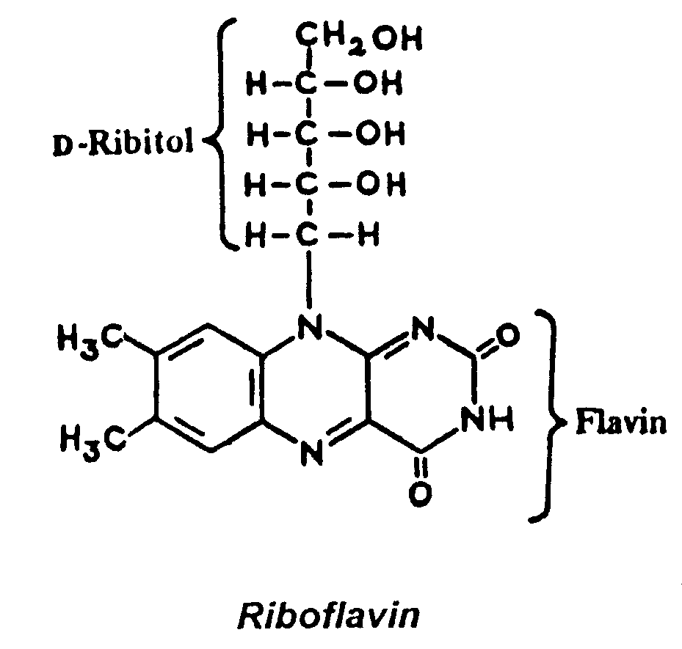
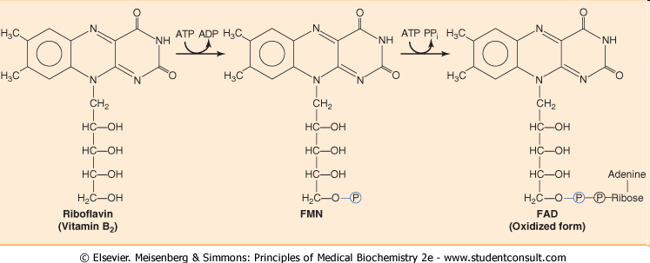
Vitamin B2 (Riboflavin)
Chemistry:It consists of a flavin ring attached to the sugar alcohol D-ribitol.
Co enzyme forms
Flavin mononucleotide (FMN) is formed by ATP-dependent phosphorylation of riboflavin.
Flavin adenine dinucleotide (FAD) is synthesized by a further reaction with ATP in which the AMP moiety of ATP is transferred to FMN. Biosynthesis of FMN and FAD occurs in most tissues.

Slide 13
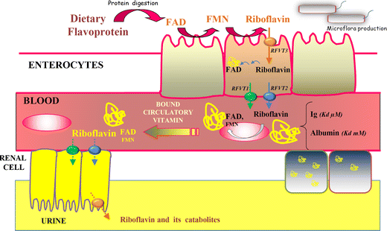
Absorption
In diet, riboflavin (RF) exists in the free and FMN and FAD forms. They are hydrolyzed to free Rf by intestinal phosphatases.
RF absorption in the intestines involve a speciﬁc carrier-mediated mechanism for Rf uptake located at the apical membrane & across the BLM.
Both RFT-1 (RF transporter1) and RFT-2 are expressed in intestine.
RFT-3 is more brain-speciﬁc.
Riboflavin in blood associates with albumin or globulins.

Slide 14
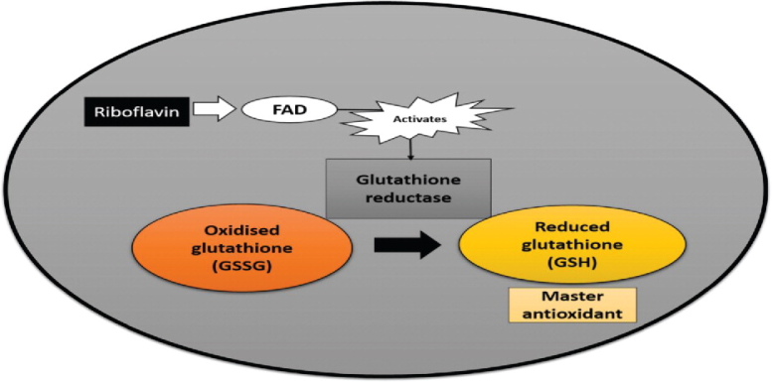
Riboflavin: Sources
Animal origin: liver and beef, milk, dairy products, fish, eggs.
Yeast
Plant origin: Green leafy vegetables, nuts,..
Function:
Involved in energy metabolism (ATP production): Participate in
Oxidative decarboxylation
Citric acid cycle
Beta-oxidation of fatty acids
Electron transport
Associated with antioxidant glutathione reductase (utilizes an FAD prosthetic group and NADPH to reduce GSSG to two GSH.)
GS–SG + NADPH + H⁺ → 2 GSH + NADP⁺
2
FAD

Slide 15
Vitamin B 2 (riboflavin)
1. Chemical structure of vitamin B2 is ……..
[flavin + ribitol ], fluorescent, light sensitive, heat stable.
2. Active form (Co-enzyme) of vitamin B2 is ……..
[FMN & FAD]
3. Its function is to act as ………
[prosthetic groups of oxidoreductases]
4. Reactions requiring FAD are:
a- [oxidative decarboxylation of a keto acids as PDH Energy (ATP)
b- [C.A.C.] Energy (ATP)
c- [ β -oxidation of F.A.] Energy (ATP)
2H
FMN FMNH2
FAD FADH2

Slide 16
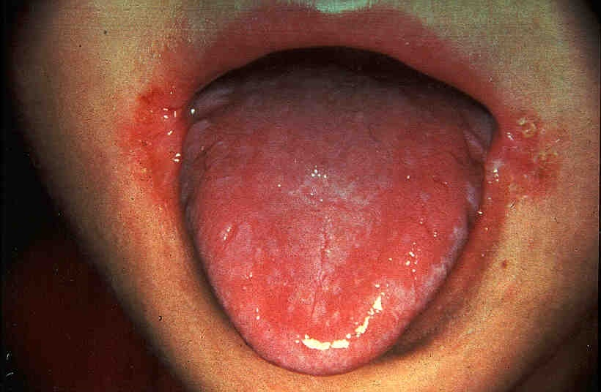
Riboflavin: symptoms of deficiency
Related to Energy production (skin & mucous membrane inflammation).
Glossitis & angular stomatitis (Inflammation of the lining of mouth and tongue).
Keratitis , dermatitis (Dry and scaling skin).
Cheilosis (cracked and red lips).
Ocular manifestations (vascularization of cornea)
N.B. :
Deficiency occurs in newborn infants with hyperbilirubinemia who are treated by phototherapy.

Slide 17
Water-soluble vitamins Vitamin B3 (Niacin ; Nicotinic acid)

Slide 18
Niacin
Niacinamid (nicotinamide)
Niacin (nicotinic acid)
Chemistry:
Nicotinic acid is a carboxylic acid derivative of pyridine.
Synthesis: PLP (vit. B6)
Tryptophan →→ → →→→→ Niacin (vit.B3) (insufficient)
most people require dietary sources of both tryptophan and niacin.
Sources:
Food stuffs containing nicotinic acid: as B₁
Tryptophan containing proteins
Functions: niacin required for the synthesis of NAD⁺ (nicotinamide adenine dinucleotide) and NADP⁺ (nicotinamide adenine di-nucleotide phosphate)
NAD⁺ and NADP⁺ are coenzymes of many oxidoreductase enzymes.
Generally, NAD⁺-linked dehydrogenases catalyze oxidoreduction reactions in oxidative pathways, e.g. the citric acid cycle.
Whereas NADP⁺-linked dehydrogenases are often found in pathways concerned with reductive synthesis e.g. the pentose phosphate pathway.
NAD⁺+ AH₂ ⎯⎯⎯⎯→ NADH + H⁺ + A

Slide 19
Structure of NAD+
NAD⁺ NADH+H⁺
NADP⁺ NADPH+H⁺
Nicotinamide Adenine
Ribose—P-------—---P----Ribose
AMP
Nicotinamide Adenine
Ribose—P-------—---P----Ribose-P
AMP + P

Slide 20
Reduction of NAD+
+
2H = H + [e + H+]
NAD+
R
H
CONH2
e
NADH + H+
N
R

Slide 21
Niacin
Reactions requiring NAD+ are:
a- [oxidative decarboxylation of a keto acids as
PDH] Energy (ATP)
b- [C.A.C.] Energy (ATP)
c- [beta oxidation of F.A.] Energy (ATP)
Reactions requiring co-enzyme NADP+/NADP+ as:
Glutathione reductase (NADPH + H+)
Folate reductase (NADPH + H+)
Retinal → retinol
intestinal niacin absorption process: intracellular protein-tyrosine-kinase-mediated pathway regulates vitamin uptake.

Slide 22
Niacin: deficiency
Causes of deficiency:
- hhh needs. - in elderly on very restricted diet.
- Malabsorption.
- in maize-dependant population.
- in vit. B6 def.
- Hartnup disease (decreased tryptophan absorption)
- INH (anti-TB) (decreased B6)
- Malignant carcinoid syndrome (increased tryptophan metabolism to serotonin)
Clinical use: Treatment of hyperlipidemia

Slide 23
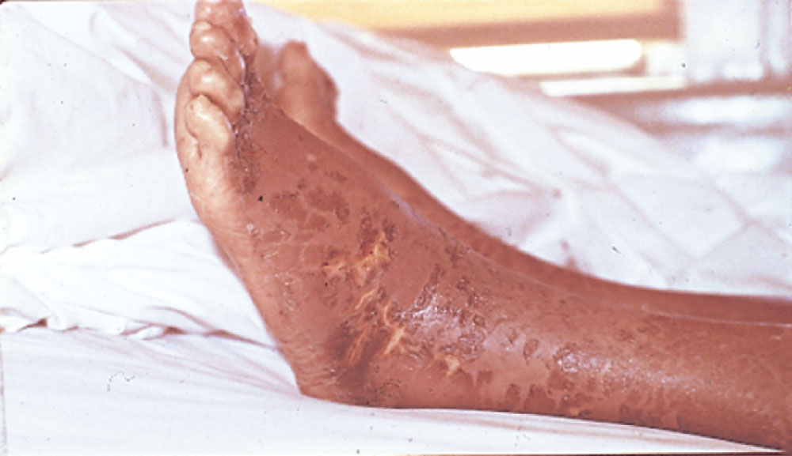
Niacin
Deficiencies found in southeast if subsisting on diet of corn ; niacin is bound by protein. Pelagra is very rare now
Deficiency:
Milder deficiencies of niacin cause:
Poor appetite, fatigue.
Dermatitis, Diarrhea.
Severe deficiencies lead to pellagra which is characterized by “the four D_{S}”: dermatitis, diarrhea and dementia (lack of concentration) & death.
Dermatitis is usually seen in skin areas exposed to sun light and is symmetric.
The neurologic symptoms start by nervous disorders and mental disturbances.
Thank you & Best wishes: Dr.Eman Shaat

