Slide 1
Biochemical aspects of kidney function by
Dr. Heba M. Abd EL Kareem Assistant Professor of Medical Biochemistry and Molecular Biology

Slide 2
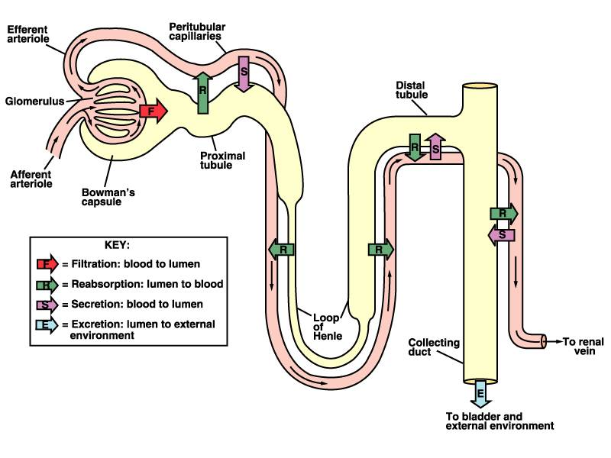
Introduction
Urine formation
Structures responsible for the urine formation:
glomeruli.
proximal convoluted tubule.
distal convoluted tubule.
Mechanism of urine formation:
filtration
reabsorption
secretion
Notes:
2

Slide 3
Glomeruli: site of filtration
Substances with molecular mass below 40,000 Da pass through the membrane of glomerulus.
About 120 mL/min or 180 L/day of blood is filtrated.
Filtration – passive process.
After filtration – primary urine (180 L/day)
TUBULES FUNCTION:
1. Proximal convoluted tubule:
Reabsorption
substances from the glomerular filtrate:
- ¾ of Na and water. - totally glucose. - most of amino acids. - varied amounts of electrolytes (Mg, Ca, K, Cl, HCO₃⁻) and small molecules (proteins, uric acid, urea)
Secretion:
K⁺, H⁺, ammonia, uric acid, certain organic bases, medicines (penicillin).

Slide 4
2. Distal Convoluted Tubule: here the final stage of optimal concentration control takes place for the balance of fluids and electrolytes.
Reabsorption: small amounts of salt, water, bicarbonates
Secretion: uric acid, ammonia, H⁺
This is the action place for
aldosterone - ↑ reabsorption of Na and secretion of K
ADH - ↑ permeability and water reabsorption.
3. Collector Duct:
ADH controls water reabsorption - determines urine concentration
Aldosterone controls Na reabsorption

Slide 5
Intercalated cells
There are two types of intercalated cells identified as type A (alpha) and type B (beta):
Principal cells: reabsorb Na⁺ and excrete K⁺. Principal cells are the major cell types that respond to the actions of aldosterone.
Type A: intercalated cells reabsorb K⁺ and HCO₃– and excrete H⁺.
Type B: intercalated cells function in opposition to type A cells such that they secrete HCO₃– and reabsorb H⁺.
The differences in function between type A and type B intercalated cells is due, in part, to the opposing distributions of various transporter proteins.

Slide 6
Kidney metabolism 1. Carbohydrate: a. Glycolysis
Utilization of glucose in cortex and medulla differs one from another.
Dominant type of glycolysis:
In cortex is aerobic and CO₂ formed in result.
In medulla is anaerobic and glucose converted to lactate by lactate dehydrogenase (LDH).
b. Gluconeogenesis:
Kidney cortex like liver appear to be unique in that it possess the enzymatic potential for both:
glucose synthesis (gluconeogenesis).
glucose degradation (glycolysis).

Slide 7
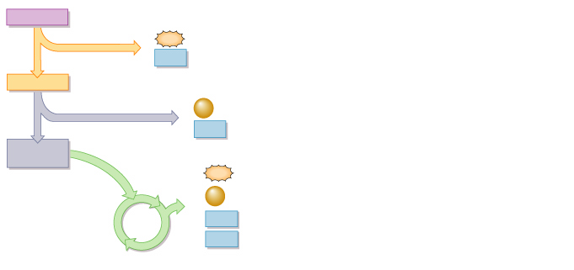
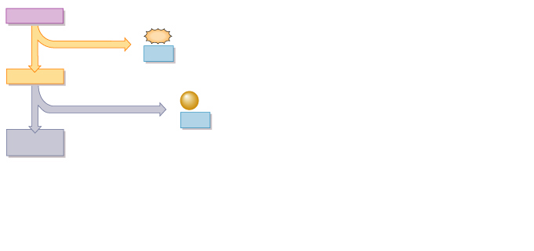
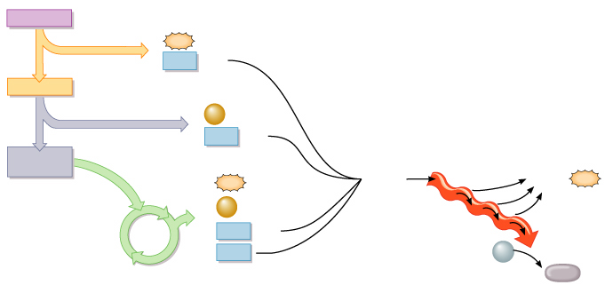
Glucose oxidation
Energy at substrate level
1 Glucose
reducing equivalents
1 Glucose
1 Glucose
1 Glucose
2
2
2
2
ATP
ATP
ATP
1
ATP
1
1
1
GLYCOLYSIS
GLYCOLYSIS
GLYCOLYSIS
GLYCOLYSIS
2
2
2
2
NADH
NADH
NADH
NADH
+ 2 H⁺
+ 2 H⁺
+ 2 H⁺
+ 2 H⁺
2 Pyruvic acid
2 Pyruvic acid
2 Pyruvic acid
2 Pyruvic acid
2
2
2
FORMATION
OF ACETYL
COENZYME A
FORMATION
OF ACETYL
COENZYME A
FORMATION
OF ACETYL
COENZYME A
CO₂
CO₂
2
CO₂
2
2
ATP
2
2
2
NADH
NADH
NADH
+ 2 H⁺
+ 2 H⁺
+ 2 H⁺
4
ELECTRON
TRANSPORT
CHAIN
2 Acetyl
coenzyme A
2 Acetyl
coenzyme A
2 Acetyl
coenzyme A
2
Electrons
32
ATP
2
ATP
ATP
e–
4
4
CO₂
3
CO₂
e–
3
e–
6
6
NADH
KREBS
CYCLE
NADH
KREBS
CYCLE
+ 6 H⁺
+ 6 H⁺
2
6
O₂
2
FADH₂
FADH₂
6
H₂O
reducing equivalents

Slide 8
b. Gluconeogenesis:
Definition: synthesis of glucose from non-carbohydrate precursors such as: 1-lactate. 2-glucogenic amino acids (Gln, Ala). 3-glycerol.
4-propionate.
Site: in liver (90%) & kidney cortex (10%)
Importance:
1. Gluconeogenesis is important when the dietary supply of glucose does not satisfy the metabolic demands.
Under these conditions, glucose is required by the CNS, the RBC, renal medulla and possibly, other tissues which cannot obtain all their energy requirements from fatty acids or ketone body oxidation.
2. gluconeogenesis may be important in the removal of excessive quantities of glucose precursors from the blood (lactic acid after severe exercise for example).
The ability of the kidney to convert certain organic acids to glucose, a neutral substance, is an example of a nonexcretory mechanism in the kidney for pH regulation.

Slide 9
Gluconeogenesis: liver vs renal cortex
Although the biosynthetic pathways are similar, there are several important differences in the factors, which regulate gluconeogenesis in the two organs.
1. The liver utilizes predominately pyruvate, lactate and alanine. The kidney cortex utilizes pyruvate, lactate, and glutamine.
2. Hydrogen ion activity has little effect upon hepatic gluconeogenesis, but it has marked effects upon renal gluconeogenesis.
Thus, when intracellular fluid pH is reduced (acidosis), the rates of gluconeogenesis in slices of renal cortex are markedly increased.

Slide 10
Kidney metabolism: 2. protein a. glutamine & ammonia
Gln is generated mainly in the skeletal muscle and also by the lungs and brain for the removal of NH4+.
• Cells with rapid turnover rate (tubular cells in kidney, enterocytes, cells of the immune system) are the major sites of Gln uptake
• Here, Gln serves as a fuel and a nitrogen donor for synthetases; in the kidney, the glutaminase reaction is particularly important
• Much of the unused nitrogen from Gln is built into Ala which carries the nitrogen to the liver where it is converted to urea.

Slide 11
Muscle
Lung
Brain
+
NH3
Glutamate
Glutamine
NH2
Gln synthetase
Kidney
intestine
Glutaminase
NH4+
=
H+
+
NH3
Glutamate
Excreted in urine

Slide 12
Protein metabolism: a. Glutamine & ammonia. Sources of blood ammonia:
1.From amino acids :
Transdeamination
Oxidative deamination
Non-oxidative deamination .
2.From glutamine:
Renal glutaminase
Intestinal glutaminase
3.From amines :
dietary amine
monoamine hormones by amine oxidase.
4. From catabolism of purines and
pyrimidines .
5.From bacterial action in the intestine either from
dietary protein residue
urea diffuses into the intestine.

Slide 13
Protein metabolism: a. Glutamine & ammonia. Fates of blood ammonia:
Amination of α-ketoacid to form non-essential amino acids and other biosynthetic reactions.
Glutamine synthesis in the brain, liver, muscle and renal tissues (4%).
The majority of NH₃ (90%) will produce urea in the liver by urea cycle.
Traces in blood (up to 100 ug / dl).
Excretion in urine.

Slide 14
From bacterial action in the intestine on protein
4 %
1 %
90 %
Excretion in urine
Sources and Fates of blood ammonia

Slide 15
Protein metabolism: a. Glutamine & ammonia. Renal ammonia:
Two sources contribute to the renal ammonia:
blood ammonia (is about one-third of excreted ammonia).
ammonia formed in the kidney through:
Glutaminase.
Glutamate dehydrogenase.
Ammonia secretion
Ammonia is secreted into the tubular lumen throughout the entire length of the nephron.
Secretion occurs both during normal acid-base balance and in chronic acidosis.
Metabolic acidosis is accompanied by an adaptive increase in renal ammonia production with a corresponding increase in urinary ammonium excretion.

Slide 16
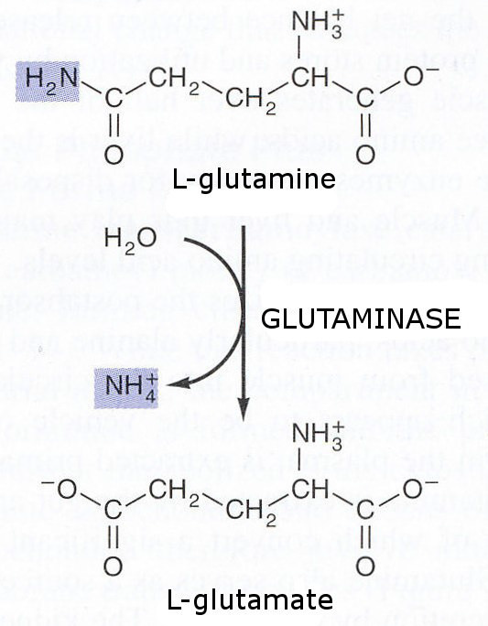
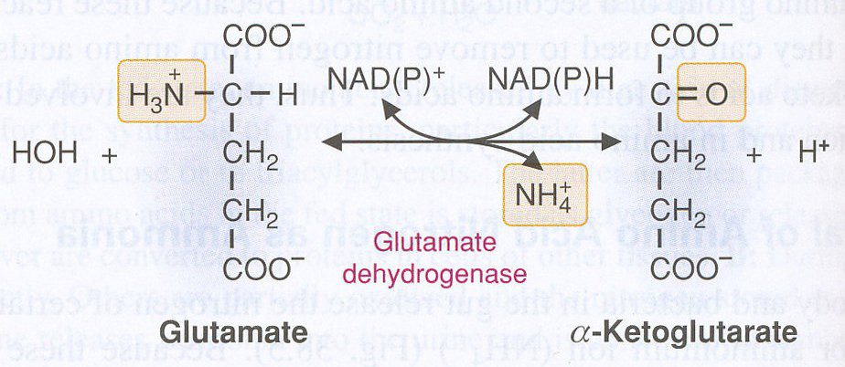
Ammonia release in the kidney
Ammonia production:
By glutaminase
By glutamate dehydrogenase

Slide 17
Glutamine as a fuel for the kidney

Slide 18
Protein metabolism: b. Creatine: synthesis
It is present in muscle as creatine phosphate (CP) which is a high-energy phosphate compound.
Synthesis: It is synthesized from:
1. Glycine.
2. The guanidino group of arginine.
3. The methyl group of S-adenosylmethionine (SAM).
Creatine formed in the liver is transported by blood to muscles where it is phosphorylated to phosphocreatine (phosphagen).
During rest (relaxed muscle), creatine is phosphorylated to store energy.
In contracting muscle the reaction is reversed to supply ATP.

Slide 19
Synthesis of Creatine Phosphate: 1
NH2
C NH
NH
CH2
CH2
H2NCH
COOH
NH2
CH2
COOH
1
Arginine
Glycine
Amidino transferase
Kidney
NH2
CH2
CH2
H2NCH
COOH
NH2
C NH
NH
CH2
COOH
Ornithine
Guanidinoacetate

Slide 20
NH2
C NH
NH
CH2
COOH
Methyl transferase
NH2
C NH
N-CH3
CH2
COOH
Liver
SAM
SAH
2
Guanidinoacetate
Creatine
ATP
3
Muscle
Creatine kinase
ADP
CP synthesis
NH~P
C NH
N-CH3
CH2
COOH
Creatine phosphate (CP)

Slide 21
Protein metabolism: b. Creatine. Function of CP
It provides a small but rapidly mobilized reserve of high-energy phosphates to maintain the intracellular level of ATP during the first few minutes of severe muscle contraction.
CP acts as a store of energy in the muscle because muscle can not store ATP which is used as an immediate source of energy for the contracting muscle.
The amount of CP in the body is proportional to muscle mass i.e. the amount of CP increases as the muscle mass increases.

Slide 22
Protein metabolism: b. Creatine. Catabolism
A low but constant percentage (~ 2%) of creatine and creatine phosphate is converted to creatinine which is excreted in urine.
Therefore, the amount of creatinine excreted in urine is proportional to the total CP content of the body, and thus can be used to estimate muscle mass.
Creatinine:
Creatinine is normally rapidly removed from blood and excreted in urine therefore, blood creatinine is used as a sensitive marker of kidney function.
high blood creatinine indicates kidney dysfunction.

Slide 23
NH2
C NH
N-CH3
CH2
COOH
C & CP catabolism
Creatine
Spontaneous
ATP
H2O
Muscle
Creatine kinase
ADP
NH
C NH
N-CH3
CH2
CO
NH~P
C NH
N-CH3
CH2
COOH
~2%
Spontaneous
Pi
Creatinine
Creatine phosphate
(anhydrous creatine)

Slide 24
Plasma levels of creatine & creatinine
normal plasma creatine level is 0.2 to 0.9 mg/dl
normal creatinine is 0.5 to 1.2 mg/dl.
Plasma creatinine level is a good index for renal function as its level is not affected by diet.
Creatinine clearance: it is calculated as:
Clearance creatinine = U/S x V
where:
U is the urine concentration of creatinine.
S is the serum creatinine concentration.
V is the volume of urine excreted per minute.
U and S are measured in the same units (mg/dl or SI units).
The clearance is expressed in ml/minute and is practically the same as the glomerular filtration rate.

Slide 25
Creatine in urine
At normal plasma levels, creatine is almost completely reabsorbed by renal tubules, thus it is not excreted in significant amounts in urine of normal adult.
Under normal physiological and some pathological conditions, creatine excretion in urine increases.
Causes of physiological creatinuria:
- In young children. - In pregnant females and early postpartum period. - prolonged administration of androgens, which reflects increased muscle mass.
Causes of pathological creatinuria:
All conditions of muscle wasting as in:
- Starvation. - Hyperthyroidism. - Diabetes mellitus.
- Fevers. - Degenerative muscle diseases (myopathies)

Slide 26
Creatine kinase (CK)
The plasma levels of CK are commonly determined in the diagnosis of myocardial infarction.
They are particularly useful when the ECG is difficult to interpret, such as when there have been previous episodes of heart disease.
CK occurs as three isoenzymes.
Each isoenzyme is a dimer composed of two polypeptides (B and M subunits)
Appearance of CK2 (MB) isoenzyme in plasma is specific for infarction of the myocardium.
CK isoenzyme shows a characteristic electrophoretic mobility.

