Slide 1
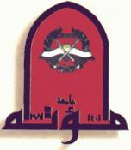
Second Year Endocrine system Biochemistry
Mutah University
Faculty of Medicine

Slide 2
Endocrine system Steroidogenesis lecture 7 (17 slides) (sex hormone synthesis) II. Testicular steroidogenesis. III. Ovarian steroidogenesis.
Dr. Eman Shaat
Professor of Biochemistry & Molecular Biology

Slide 3
II. Testicular Steroidogenesis

Slide 4
II. Testicular Steroidogenesis Production of steroids in the testis
The main steroid produced in the male is testosterone, from the testis. In addition, the testis makes some androstenedione, dihydrotestosterone, and estradiol.
In the male, there is peripheral conversion of testosterone to:
Dihydrotestosterone (in androgen target tissues, like muscle)
Estradiol (mostly in adipose tissue).
Organization of the testis:
The testis is organized into two main parts:
Seminiferous tubules: production of sperm cells, location of Sertoli cells.
Interstitial tissue: outside of the seminiferous tubules; the steroidogenic cell is the Leydig cell.

Slide 5
II. Testicular Steroidogenesis Leydig Cells: function & regulation
Leydig cells: LH stimulates Leydig cell steroidogenesis.
Leydig cells are unusual in that they rely on de novo synthesis of cholesterol more than other cells (50%). Thus, only about 50% of cholesterol used in steroid production is obtained from LDL.
The rate-limiting step, as in adrenal, is delivery of cholesterol to the inner mitochondrial membranes by StAR.
The production of androgens from cholesterol is identical to that in the adrenal, except that it continues from androstenedione to testosterone.
Testosterone circulates in plasma bound to albumin (50%) & sex hormone binding globulin (~44%; SHBG).But, it is only free steroid (~2%) that can diffuse into target cells & bind to receptors that is bioactive.
Metabolism of testosterone occurs in liver.

Slide 6
II. Testicular Steroidogenesis Testosterone & DHT biosynthesis
Dihydrotestosterone (DHT), is the most potent androgen, it is formed from testosterone, by the reduction of the A ring through the action of the enzyme 5α-Reductase (NADPH-dependent).
In many tissues, including prostate, external genitilia, and skin, this is the active form of the hormone.
Testosterone thus can be considered as pro-hormone since it is converted into a much more potent compound (DHT)and since most of this conversion occurs outside the testis.
The testes also produce 17 β -estradiol, in small amounts, but most of the estrogens produced by the male are derived from peripheral aromatization of testosterone.

Slide 7
II. Testicular steroidogenesis: biosynthesis and action
Testicular Androgens:
Pregnenolone is formed from cholesterol in mitochondria.
The conversion of pregnenolone to testosterone requires enzymes which are found in the ER of the testes cells.
The conversion of pregnenolone to testosterone may occur through the ∆4 "Progesterone Pathway“ or by DHEA or ∆ 5 pathway which appears to be most important in humans.
it requires the following 5 enzymes:
3 β -Hydroxysteroid dehydrogenase (3β-OHSD) & ∆5-4 Isomerase.
17α-Hydroxylase & C17,20 Lyase.
17β-Hydroxysteroid Dehydrogenase (17β-OHSD).

Slide 8
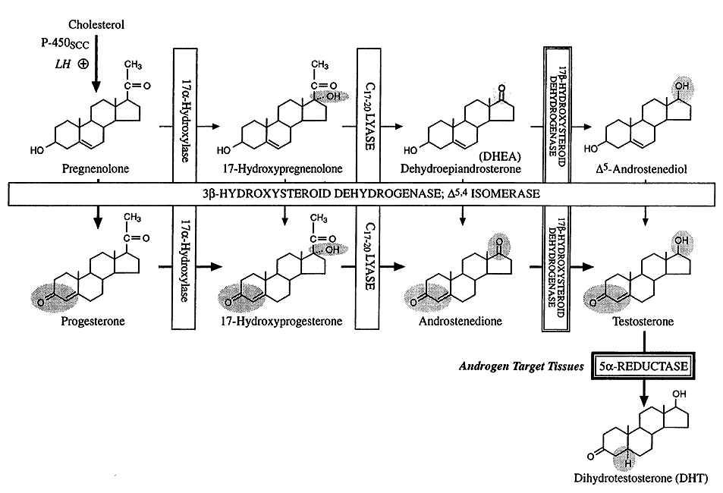
∆ 5 pathway
17 β-HSD
∆ 4 pathway
Testosterone biosynthesis

Slide 9
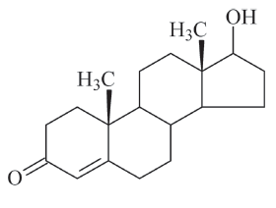
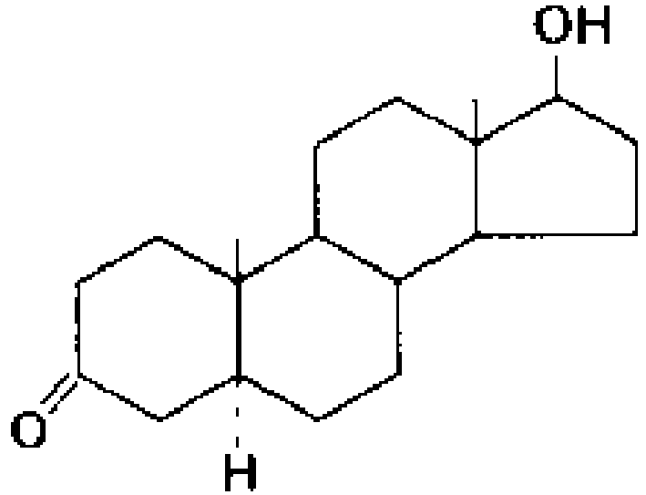
Testosterone → Dihydrotestosterone
In peripheral tissues
Testosterone
NADPH
5 α-reductase
Dihydrotestosterone

Slide 10
III. Ovarian Steroidogenesis

Slide 11
III. Ovarian steroidogenesis
The ovary produces estrogens (primarily estradiol), progesterone, and androgens.
It relies largely on LDL as a source of cholesterol for steroid synthesis (# testis).
Ovarian steroids are secreted primarily from ovarian follicles and corpora lutea.
Ovarian Follicle: The follicle is the basic functional unit of the ovary. It is composed of an oocyte, granulosa cells, and theca cells.
When the follicle ruptures, it becomes a corpus luteum.
Chemical Structure:
Each estrogen contains a phenolic A ring. The phenolic A ring is the principal structural feature responsible for selective, high-affinity binding to receptors.

Slide 12
Estrogen: sources
The most active naturally occurring hormones of these classes are 17β-estradiol (E2) and progesterone.
Estrogen is produced:
primarily by ovaries, the corpus luteum, and placenta.
in smaller amounts by other tissues such as the liver, adrenal glands, and the breasts.
In premenopausal women: The ovaries are the principal source of circulating estrogen, with estrodiol being the main secretory product.
In postmenopausal women, the principal circulating estrogen estrone, which is synthesized from dehydroepiandrosterone and secreted by the adrenals.
In pregnancy, relatively more estriol is produced (placenta).

Slide 13
Estrogen: synthesis
In the ovary (granulosa cell):
Estradiol is formed from the conversion of testosterone into estradiol by the enzyme cytochrome P450 aromatase. It requires O2 & NADPH.
However, granulosa cells do not have the enzyme 17α-hydroxylase/lyase, and thus cannot convert progesterone into androgens.
In the ovary (theca cell):
the androgens required for estrogen production in granulosa cells come from the neighboring theca cells.
Progesterone synthesis
1. After ovulation, the corpus luteum produces progesterone and estradiol, to support the uterine endometrium during pregnancy.
2. Progesterone is also produced from theca cells and granulosa cells. It is secreted as end product hormone because granulosa cells do not contain the enzymes necessary to convert progesterone to other steroids.

Slide 14
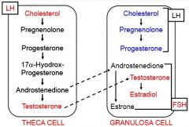
III. ovarian steroidogenesis: regulation
The rate of estradiol production from follicles varies greatly during the menstrual cycle.
Estradiol production is regulated by the effects of FSH on P450 aromatase.
Similarly, LH and FSH influence the expression of P450scc in granulosa cells.
17α-hydroxylase
17,20 lyase
Aromatase

Slide 15
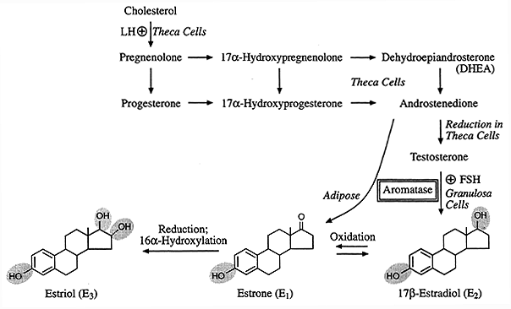
III. Estrogens: biosynthesis
16

Slide 16
General comments
Aromatase activity is present in adipose tissue, Liver, Skin & other tissues.
hhh aromatization may lead to estrogenization (liver cirrhosis, aging, obesity, …)
In obese men, overproduction of estrogen in fat cells can cause gynecomastia.
Aromatase inhibitors are promise drugs in breast cancer.

Slide 17
Pregnenolone
Progesterone
Cholesterol
Progesterone
Androstenedione
Testosterone
(pathway ends here in testes)
Estrone
(produced in both male and female adipose cells)
Estradiol
(pathway continues to here in ovaries)
Pathways for the synthesis of testosterone (testes) and estrogens; estradiol (ovaries) and estrone (adipose cells)
Best wishes
Dr. Eman Shaat

