Slide 1
Pathology lab

Slide 2
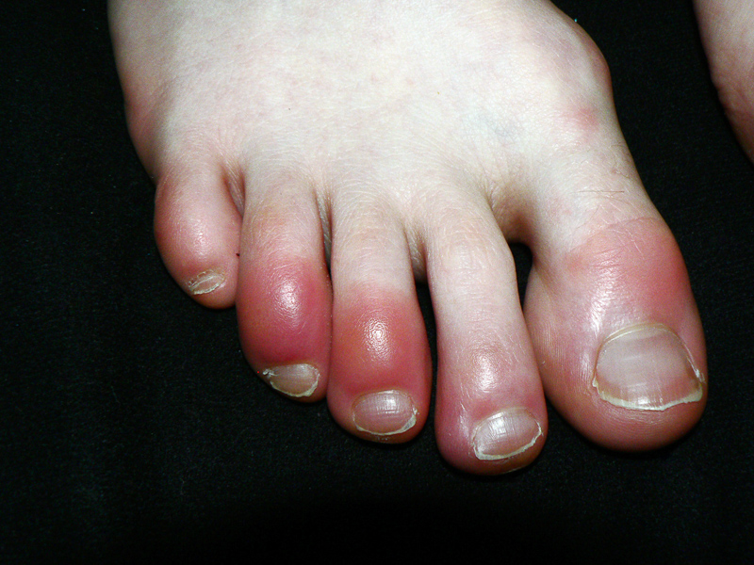

Slide 3
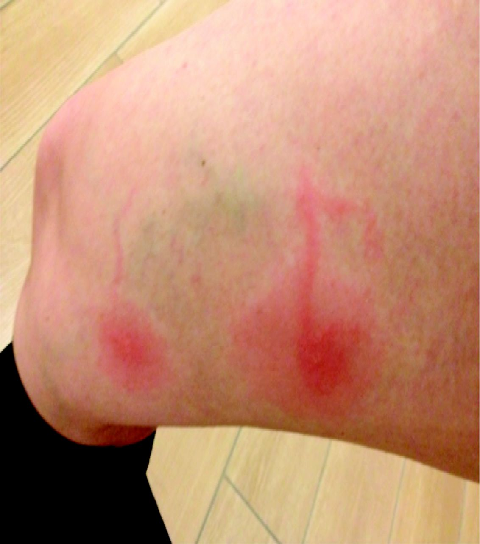

Slide 4
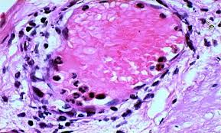
margination

Slide 5
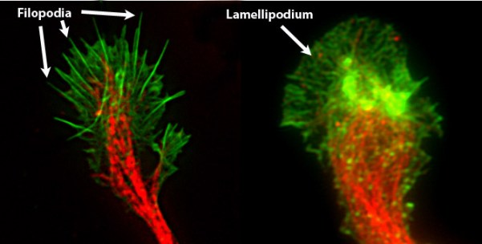
The key difference between lamellipodia and filopodia is that the lamellipodia are cytoskeletal actin projections present in the mobile edges of the cells while filopodia are thin cytoplasmic protrusions that extend from the leading edge of the mobile cells

Slide 6
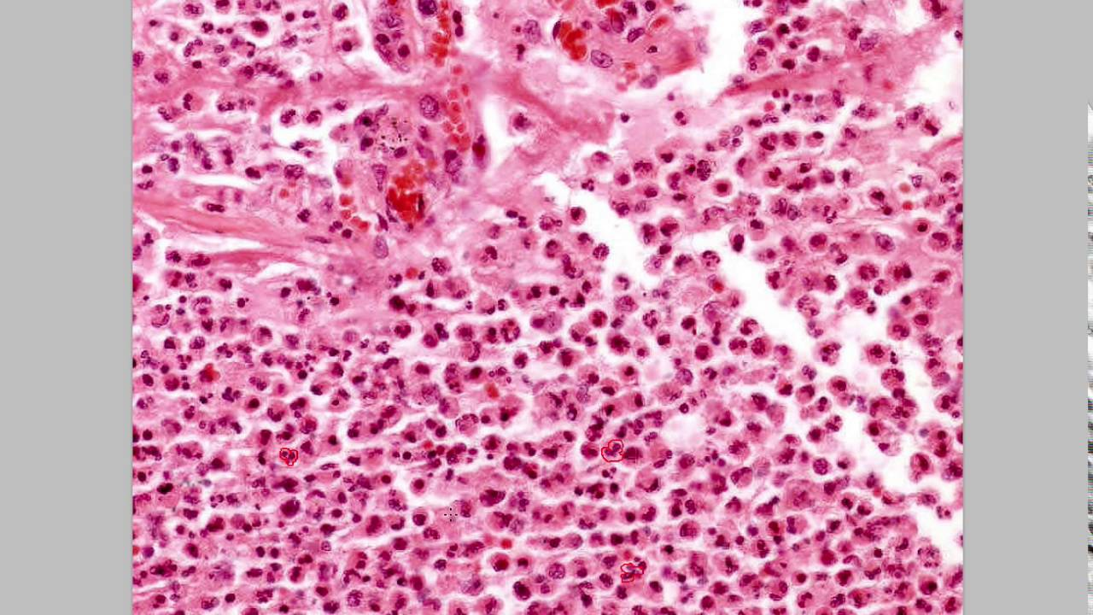
Acute inflammation In acute inflammation polymorphonuclear neutrophils usually predominate.

Slide 8
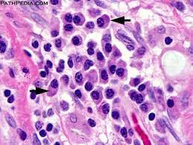
Chronic inflammation

Slide 9
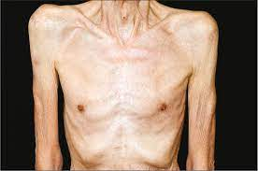
cachexia

Slide 10
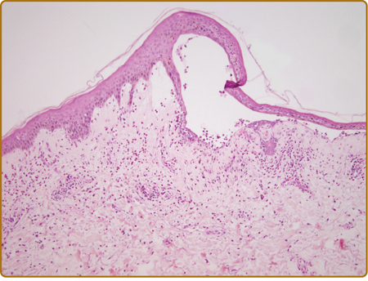
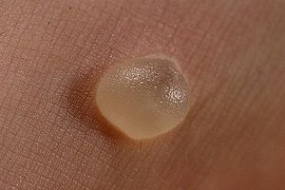
Serous Inflammation

Slide 11
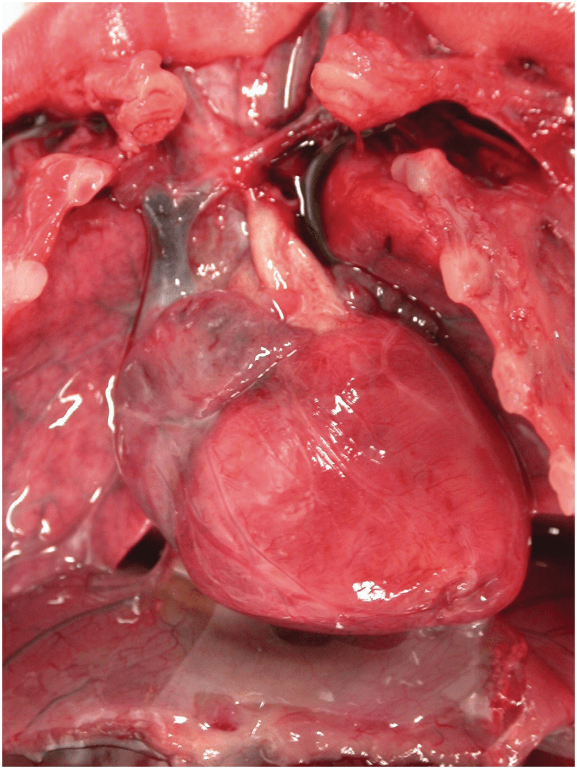
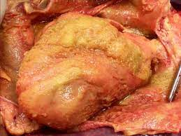
Fibrinous Inflammation
The pericardial surface is dry with a coarse granular appearance caused by fibrinous exudate
Normally, the visceral pericardium is translucent

Slide 12
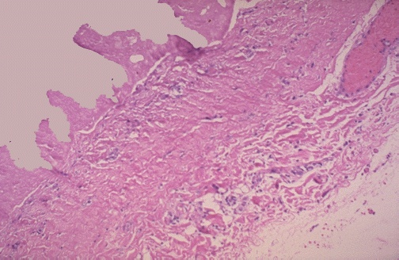
Fibrinous Inflammation
the pericardial surface here shows strands of pink fibrin extending outward. There is underlying inflammation.
fibrin appears as an eosinophilic meshwork of threads

Slide 13
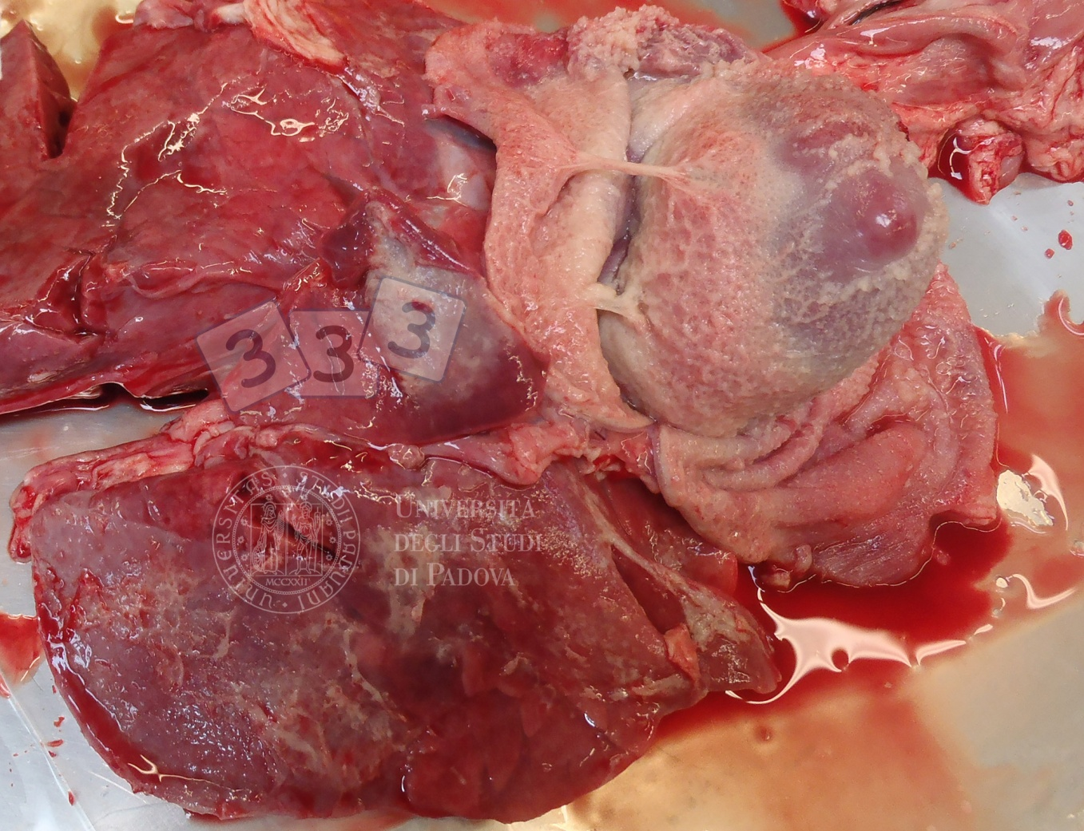
Conversion of the fibrinous exudate to scar tissue (organization) within the pericardial sac

Slide 14
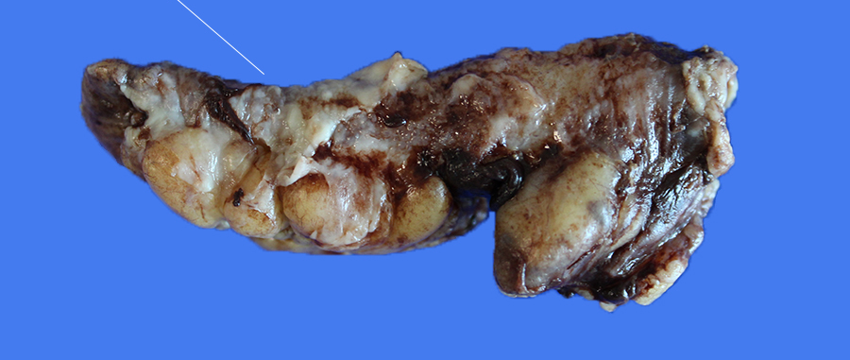
Gross: Appendix appears swollen and erythematous and a purulent exudate appears

Slide 15
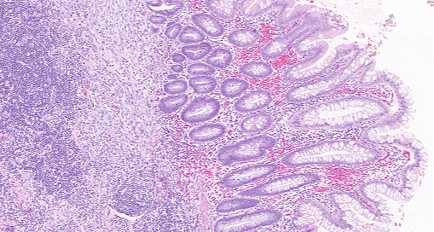
Histology; Variable acute inflammation with predominance of neutrophils; involves some or all layers of the appendiceal wall.

Slide 16
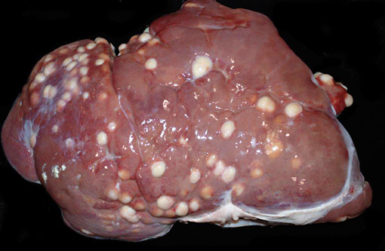
Gross Variably sized abscesses are distributed randomly throughout all lobes of the liver.

Slide 17
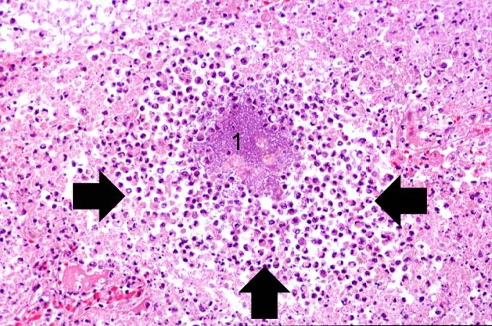
Abscess zones: 1.central region with necrotic leukocytes and tissue cells. 2. zone of preserved neutrophils . 3. outer most zone composed of vascular dilation, parenchymal and fibroblastic proliferation

Slide 18
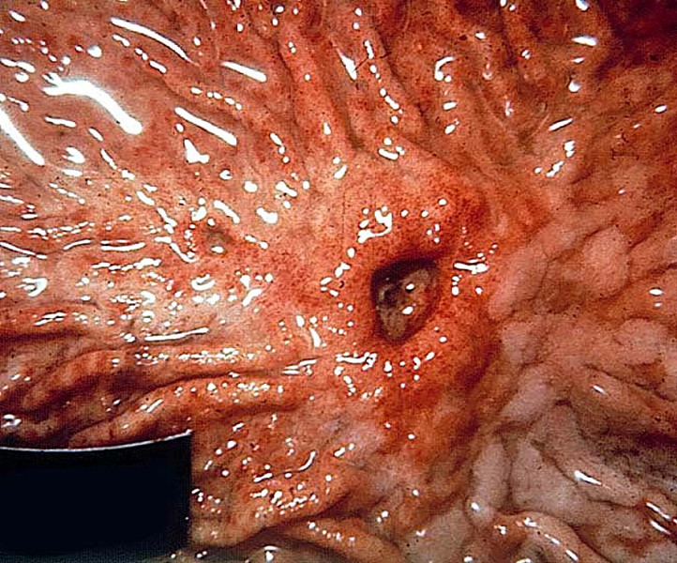
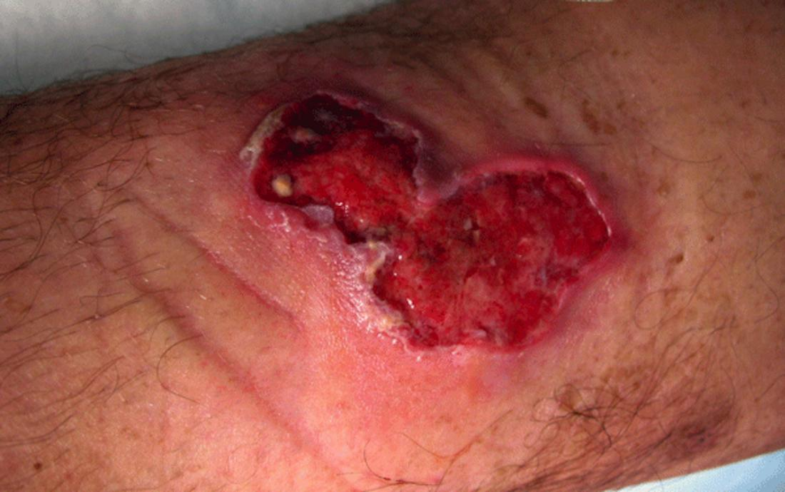
Gross ulcer: An ulcer is a local defect, or excavation, of the surface of an organ or tissue that is produced by the sloughing (shedding) of inflamed necrotic tissue.

Slide 19
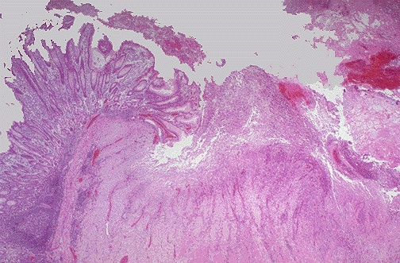
Histology; acute ulcer: intense polymorphonuclear infiltration and vascular dilation in the margins of the defect. Chronic ulcer: the margins and base of the ulcer develop fibroblast proliferation, scarring, and the accumulation of lymphocytes, macrophages, and plasma cells.

Slide 20
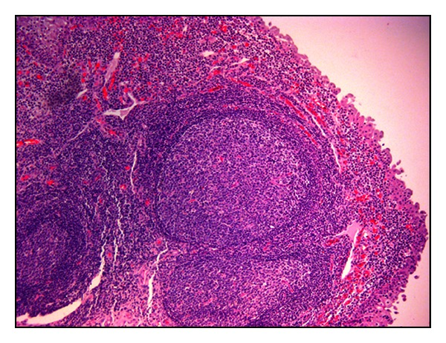
Tertiary lymphoid organs: definition, examples: Hashimoto thyroiditis, Helicobacter pylori gastritis

Slide 21
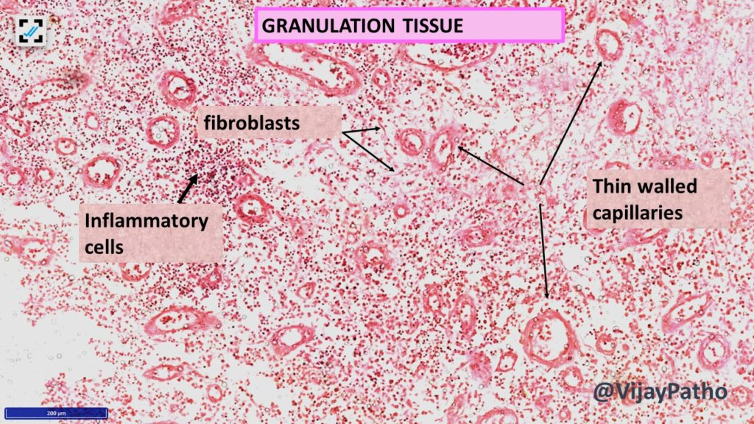

Slide 22
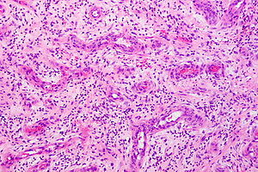

Slide 23
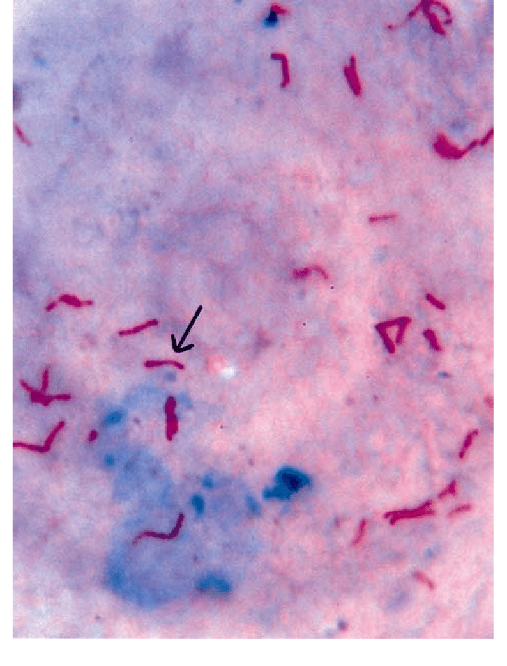
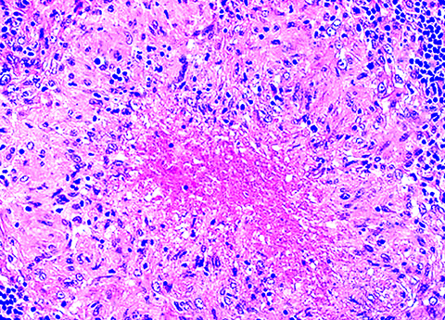
Granuloma formation is a cellular attempt to contain an offending agent that is difficult to eradicate

Slide 24
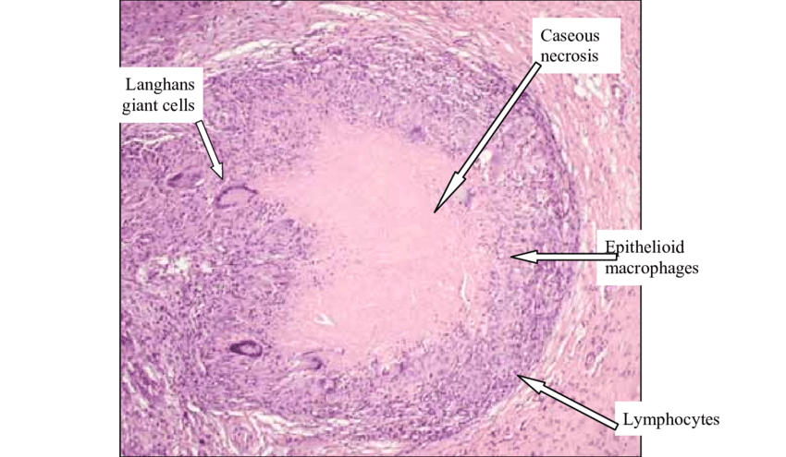

Slide 25
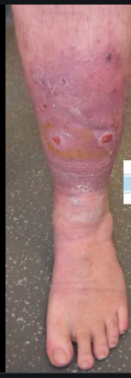
Venous leg ulcers: seen in chronic venous hypertension, which may be caused by severe varicose veins or congestive heart failure

Slide 26
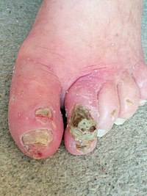
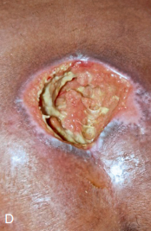
Arterial ulcers: develop in individuals with atherosclerosis of peripheral arteries, especially associated with diabetes.
Pressure sores:
caused by prolonged compression of
tissues against a bone, for example, in bedridden

Slide 27
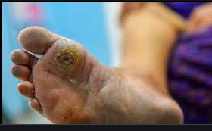
Diabetic ulcers: caused by: small vessel disease causing ischemia, neuropathy, systemic metabolic abnormalities, and secondary infections

Slide 28
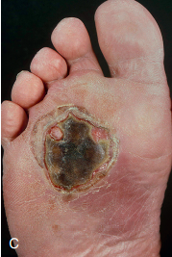
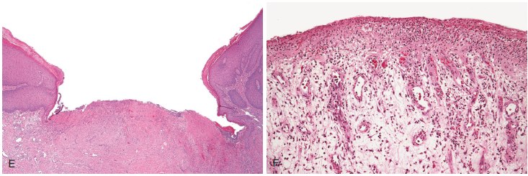
Morphology of Any ulcer
epithelial ulceration and extensive granulation tissue in the underlying dermis

Slide 29
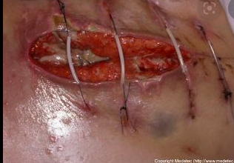
wound rupture (dehiscence): cause??

Slide 30
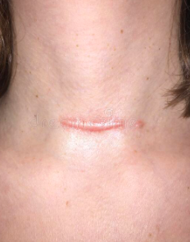
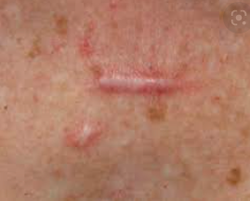
Hypertrophic scar

Slide 31
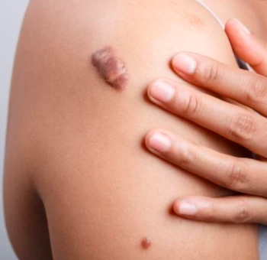
keloid

Slide 32
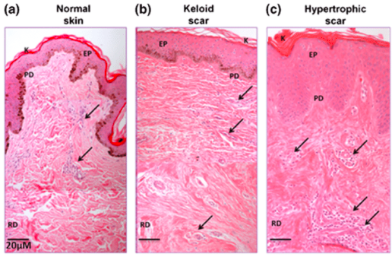
A. In normal skin, the characteristic random orientation and bundle formation of collagen fibres
B. increased number of thick collagen fibres arranged in bundles
C. The collagen fibres were arranged randomly and showed highly cellular zones

Slide 33
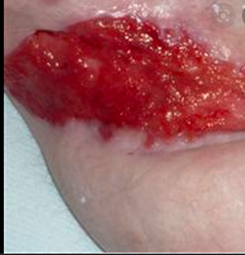
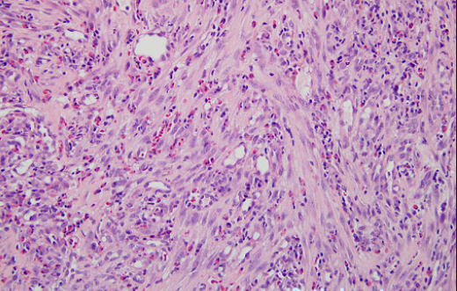
Exuberant granulation

Slide 34
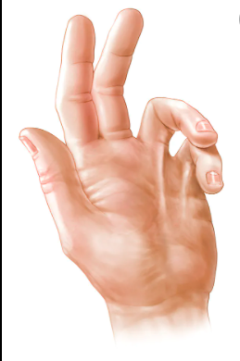
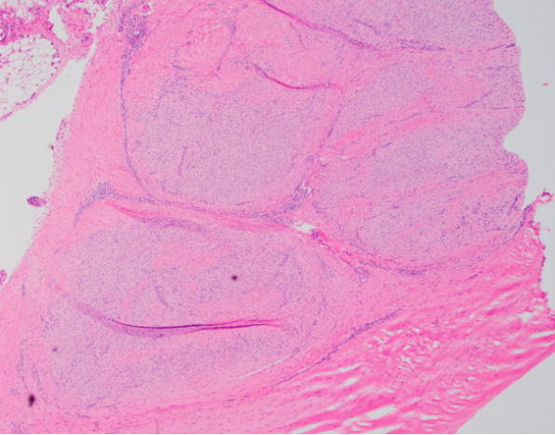
contracture

Slide 35
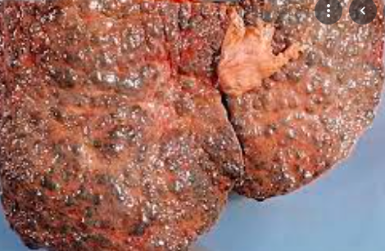
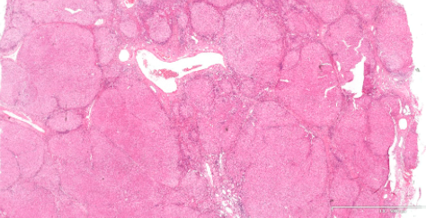
liver cirrhosis
diffuse disruption in architecture of the liver with bridging fibrous septa and parenchymal nodules formation.
Diffuse nodulation of liver
due to fibrous bands
subdividing liver into
regenerative nodules

Slide 36
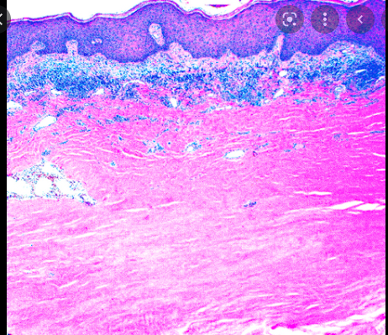
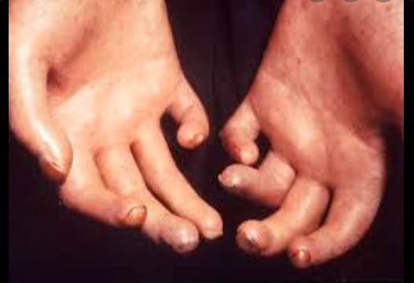
systemic sclerosis (scleroderma).
shortening and hardening of muscles, tendons, or other tissue, often leading to deformity and rigidity of joints.
thickened collagen bundles within papillary and reticular dermis

Slide 37
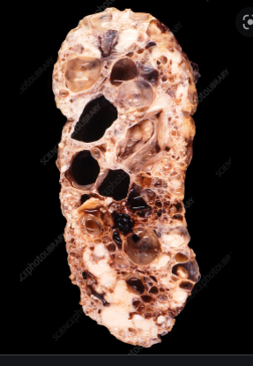
End-stage kidney disease Gross
enlarged kidneys with bosselated surface and composed of numerous subcapsular cysts

Slide 38
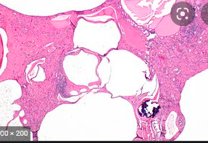
End-stage kidney disease histology
Cystic expansions of all portions of renal tubule and glomerular capsule, lined by atrophic epithelium.

Slide 39
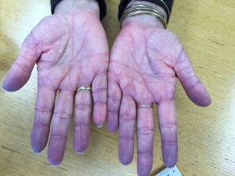
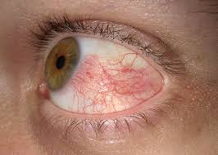
Hyperemia
Congestion

Slide 40
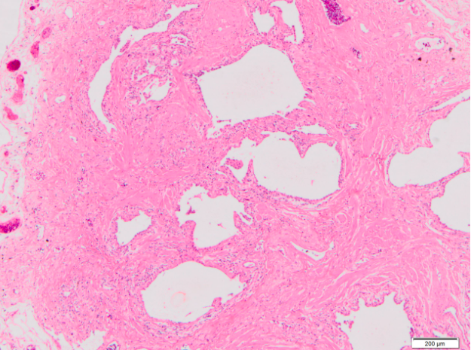
fibrosing diseases of the lung.
Grossly: Honeycomb, Cystic spaces with fibrotic wall
Histology: cystic spaces lined by bronchiolar epithelium and fibrotic wall

Slide 41
LUNG CONGESTION Cut surfaces of hyperemic or congested tissues feel wet and typically ooze blood

Slide 42
acute pulmonary congestion is marked by blood-engorged alveolar capillaries and variable degrees of alveolar septal edema and intraalveolar hemorrhage

Slide 43
chronic pulmonary congestion, the septa become thickened and fibrotic, and the alveolar spaces contain numerous macrophages laden with hemosiderin (“heart failure cells”) derived from phagocytosed red cells.

Slide 44
HEPATIC CONGESTION

Slide 45
centrilobular hepatocyte necrosis. Hemorrhage. hemosiderin-laden macrophages

Slide 46
peau d’orange caused by Infiltration and obstruction of superficial lymphatics by breast cancer

Slide 47
Elephantiasis massive edema caused by lymphatic obstruction by parasitic infection

Slide 48
Petechiae : are minute (1 to 2 mm in diameter) hemorrhages into skin, mucous membranes, or serosal surfaces .

Slide 49
Purpura are slightly larger (3 to 5 mm) hemorrhages.

Slide 50
Ecchymoses: are larger (1 to 2 cm) subcutaneous hematomas (also called bruises).

Slide 51
Mural thrombi: Thrombi occurring in heart chambers or in the aortic lumen

Slide 52
Venous thrombi (phlebothrombosis):

Slide 53
Cardiac Vegetations

Slide 54
lines of Zahn

Slide 55
DIC

Slide 56
Bone marrow embolus
Amniotic fluid emboli

Slide 57
DVT

Slide 59
Fat Embolism

Slide 60
Red infarction
1.Necrosis of alveolar walls - loss of nuclei.
2.Alveolar hemorrhage.
classic wedge-shaped infarct

Slide 61
Red infarction
dark brown, ovarian mass with a twisted, thickened left fallopian tube (arrows).
Hemorrhage and necrosis

Slide 62
white infarction

Slide 63
Papillomas

Slide 64
GASTROINTESTINAL POLYP

Slide 65
OVARIAN CYSTADENOMA

Slide 66
pleomorphic adenoma It contain epithelial components with islands of cartilage or bone

Slide 67
Fibroadenoma of the female breast contain: proliferating ductal elements (adenoma) embedded in loose fibrous tissue

Slide 68
Teratoma

Slide 69
Choristoma:
Hamartoma:

Slide 70
LIPOMA
chondroma

Slide 71
Well-differentiated squamous cell carcinoma
Pleomorphic malignant tumor

Slide 72
CARCINOMA IN-SITU

Slide 73
FIBROADENOMA

Slide 74
BREAST CANCER

Slide 75
Thyroid nodule
Follicular carcinoma
Follicular adenoma

Slide 76
MULTIFOCAL HEPATIC METASTSIS

Slide 77
Seeding of ovarian cancer
in peritoneal surface.

