Slide 1
GENERAL Virology
1
Virus structure & classification
By:
Prof. Dr. Ghada Fahmy Helaly
Microbiology & Immunology Department
Faculty of Medicine
Mu’tah University

Slide 2
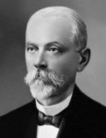
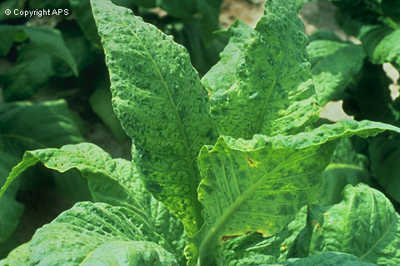
Introduction:
In 1884, Chamberland filter with pores smaller than bacteria
In 1892, the Russian biologist Dimitri Ivanovski used this filter to study what is now known to be tobacco mosaic virus.
Origins of viruses:
Regressive theory
Cellular origin theory
Coevolution theory

Slide 3
General Characteristics:
Wide diversity of shapes and sizes.
Small size: EM, 10 - 300 nanometres ( Filoviruses: length up to 1400 nm, diameters, 80 nm).
Filterable.
Obligate intracellular parasites: using the biosynthetic machinery of the host.
They contain molecular machinery for viral replication.
Protein coat.
No ribosomes, mitochondria or other organelles.
Only one type of nucleic acid.
Naked or enveloped (lipoprotein envelope).
Do not grow in size.

Slide 4
VIRUS STRUCTURE
Capsid and Symmetry:
A complete virus particle, known as a virion, consists of nucleic acid surrounded by a protective coat of protein called a capsid.
The capsid is made from identical protein subunits called capsomers, encoded by the viral genome.
The viral capsid proteins with viral nucleic acid is called a nucleocapsid.
Classified as helical, icosahedral, or complex.

Slide 5
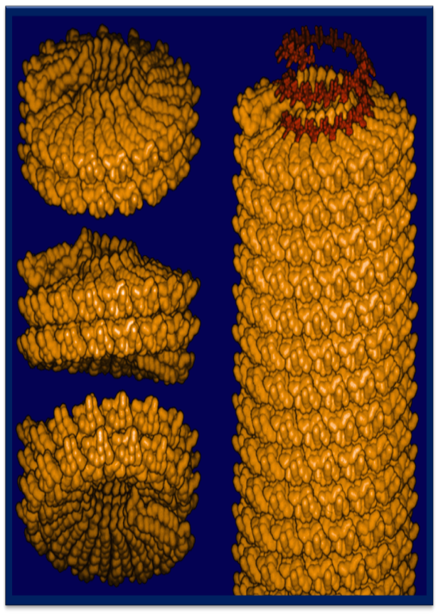
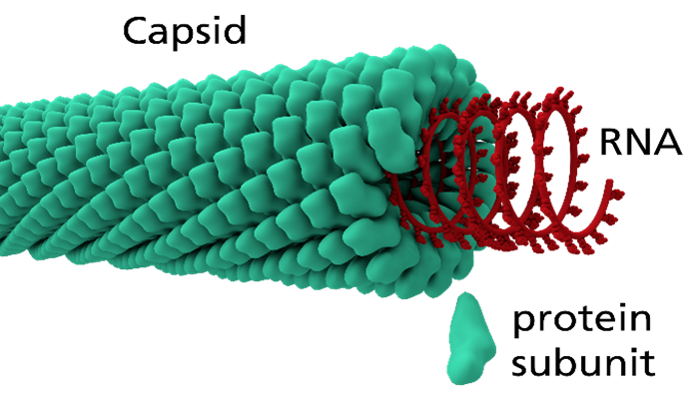
HELICAL:
Rod shaped, or filamentous virions, short and highly rigid, or long and very flexible.
Composed of a single type of capsomer stacked around a central axis to form a helical structure.
Tobacco mosaic virus is an example of a helical virus.

Slide 6
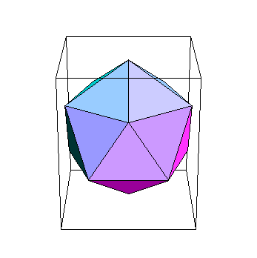
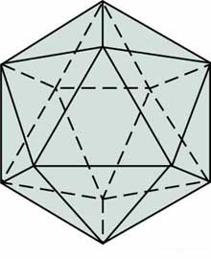
ICOSAHEDRAL:
Most animal viruses are icosahedral. Capsomeres are arranged in 20 triangles with 12 evenly spaced corners (Vertices). Each face is an equilateral triangle and every vertex of the icosahedron is formed by five triangular faces. Edges 30; Vertices 12; Faces 20.

Slide 7
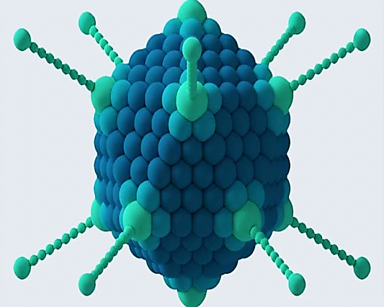

Slide 8
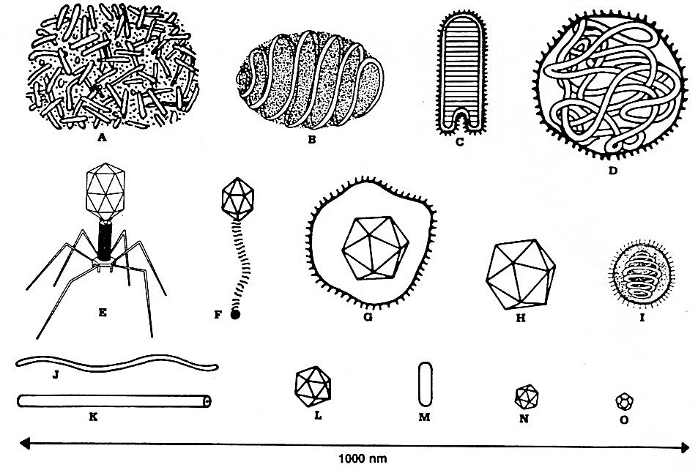
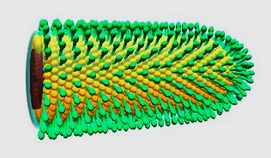
COMPLEX:
These viruses possess a capsid which is neither purely helical, nor purely icosahedral, and which may possess extra structures such as protein tails or a complex outer wall.
Some bacteriophages, poxviruses.

Slide 9
Functions of the capsid protein :
Protect viral nucleic acid.
Interact specifically with the viral nucleic acid for packaging.
Mediate the attachment of the virus to the cell ( host receptors) for entry to cell.
Antigenic determinants.
Stimulates antibody production.
Allow for release of nucleic acid upon entry into new cell.

Slide 10
Virus Envelopes:
Present in some but not all viruses
Composed of viral specific glycoproteins and host-cell-derived lipids.
The envelope contains almost no host protein.
Enveloped viruses → persistent infections.
It contains molecules to initiate infection, stimulus for antibody production, and serve as antigens; ether sensitive.

Slide 11
Envelope proteins :
a) Glycoproteins: Integral Membrane Proteins exposed on outer surface of the membrane. b) Matrix Proteins: are found at the inner face of the envelope.

Slide 12
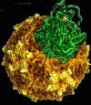
Viral Nucleic acids:
Parameters | Property
DNA RNA | Nucleic acid
Linear Circular Segmented | Shape
Single-stranded Double-stranded Double-stranded with regions of single-strandedness | Strandedness
Positive sense (+) Negative sense (−) Ambisense (+/−) | Sense

Slide 13
RNA usually smaller and more fragile than DNA viruses.
Each 1000 bp = kilobases, for single-stranded genomes, kb is used. For double-stranded genomes, kilobase pairs (kbp) is used.
RNA or single-stranded DNA viruses are either positive-sense or negative-sense. Positive-sense viral RNA is identical to viral mRNA and thus can be immediately translated by the host cell. Negative-sense viral RNA is complementary to mRNA and thus must be converted to positive-sense RNA by an RNA polymerase before translation.
.

Slide 14
Atypical virus like agents:
Defective viruses: composed of viral nucleic acid and proteins but can not replicate without a helper virus, which provide the missing function.
Pseudovirions: contain host cell DNA instead of viral DNA within the capsid.
Viroids : molecules of RNA , no capsid protein or envelope. Viroids are important pathogens of plants.
Prions: infectious protein molecules that do not contain DNA or RNA. They cause an infection in sheep called scrapie and cattle bovine spongiform encephalopathy ("mad cow" disease). In humans they cause kuru and Creutzfeld-Jacob disease.

Slide 15
VIRAL CLASSIFICATION:
Viruses infect all major groups of organisms.
Some viruses have a broader host range
None can cross the eukaryotic/prokaryotic boundary.
The oldest classification of viruses is based on the diseases they produce.

Slide 16
Universal System of Virus Taxonomy
International Committee on Taxonomy of Viruses [ICTV]:
Order (-virales)
Family (-viridae)
Subfamily (-virinae)
Genus (-virus)
Species (-virus)

Slide 17
The Baltimore classification of viruses is based on the mechanism of mRNA production. This classification places viruses into seven groups:
dsDNA viruses (e.g. Herpesviruses)
ssDNA viruses (+)sense DNA (e.g. Parvoviruses)
dsRNA viruses (e.g. Reoviruses)
(+)ssRNA viruses (+)sense RNA (e.g. Picornaviruses,)
(-)ssRNA viruses (-)sense RNA (e.g. Orthomyxoviruses)
ssRNA-RT viruses (+)sense RNA with DNA intermediate in life-cycle (e.g. Retroviruses)
dsDNA-RT viruses (e.g. Hepadnaviruses)

Slide 18
Five Basic Structural Forms of Viruses in nature:
Naked Icosahedral e.g. poliovirus
Naked helical e.g. tobacco mosaic virus
Enveloped Icosahedral e.g. herpes virus
Enveloped helical e.g. measles virus
Complex e.g. poxvirus

Slide 19
DNA Viruses
Family | Nucleic acid | Envelope | Capsid | Example
Parvoviridae | SS, linear | No | Icosahedral | B19
Papovaviridae | DS, circular | No | Icosahedral | Papillomavirus
Adenoviridae | DS, linear | No | Icosahedral | Adenovirus
Hepadnaviridae | DS, incomplete circular | Yes | Icosahedral | Hepatitis B virus
Herpesviridae | DS, linear | Yes | Icosahedral | HSV, CMV
Poxviridae | DS, linear | Yes | Complex | Smallpox virus

Slide 20
RNA Viruses
Family | Nucleic acid | Envelope | Capsid | Example
Picornavirus | SS linear, NS, +ve | No | Icosahedral | HAV
Calicivirus | SS linear, NS, +ve | No | Icosahedral | HEV
Reovirus | DS linear, 10S | No | Icosahedral | Rotavirus
Flavivirus | SS linear, NS, +ve | Yes | Icosahedral | HCV
Togavirus | SS linear, NS, +ve | Yes | Icosahedral | Rubella virus
Retrovirus | SS linear, 2S, +ve | Yes | Icosahedral | HIV
Orthomyxovirus | SS linear, 8S, -ve | Yes | Helical | Influenza virus
Paramyxovirus | SS linear, NS, -ve | Yes | Helical | Measles virus
Rhabdovirus | SS linear, NS, -ve | Yes | Helical | Rabies virus
Filovirus | SS linear, NS, -ve | Yes | Helical | Ebola virus
Coronavirus | SS circular, NS, +ve | Yes | Helical | Coronavirus
Arenavirus | SS circular, 2S, ± | Yes | Helical | LCMV
Bunyavirus | SS circular, 3S, -ve | Yes | Helical | Hantavirus
Deltavirus | SS circular, CC, -ve | Yes | Helical | HDV

Slide 21
DNA viruses:
Contain double-stranded DNA (except parvoviruses).
Naked viruses (except herpesviruses, poxviruses, and hepadnaviruses).
Icosahedral capsids and replicate in the nucleus (except poxviruses).

Slide 22
RNA viruses:
Contain single-stranded RNA (except reoviruses).
Enveloped (except caliciviruses, picornaviruses, and reoviruses).
Helical capsids (except picornaviruses, reoviruses, and togaviruses,???).
Classified positive(picornaviruses and retroviruses), negative (orthomyxoviruses and paramyxoviruses), or ambisense(arenaviruses).
Replicate in the cytoplasm (except orthomyxoviruses and retroviruses).

