Slide 1
Neonatal emergencies
Manar Omoush
Ansam Al-naimat
Roa’a Al-naimat
Eliza Dumour

Slide 2
Presentation
Intestinal obstruction
Bile stained vomiting
Abdominal distention
Failure to pass meconium

Slide 3
Causes
Mechanical
Extrinsic:
-Malrotation
-Volvulus Neonatorum
- Duplication
-Diaphragmatic Hernia
- Intussusceptions
Intraluminal: -Meconium Ileus -Meconium Plug
Intrinsic: -Atresia -Stenosis
Neurogenic Hirschsprung’s Disease
Functional obstruction
-Sepsis
-Electrolyte imbalance
-Neciotising enterocolitis (NEC)
-hypothyroidism.

Slide 4
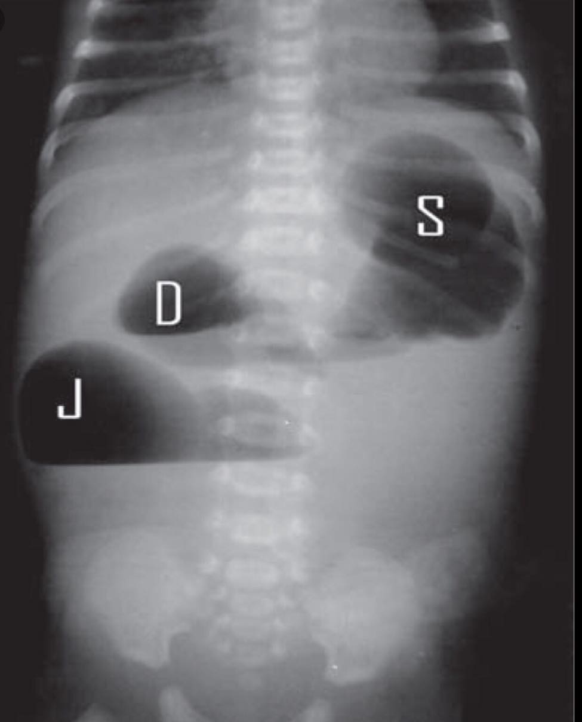
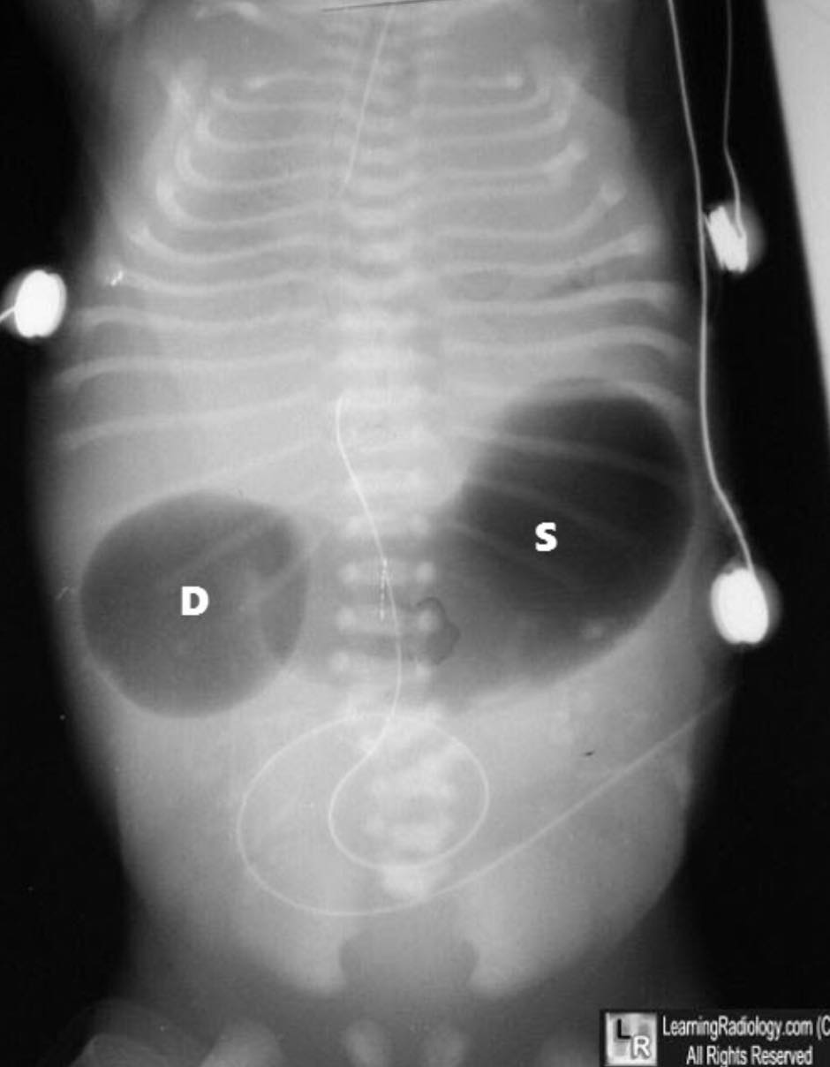
Duodenal obstruction

Slide 5
Duodenal & jejunum obstruction
treatment | Associations | Investigations and imaging | presentation | causes
duodenoduodenostomy | Polyhydraminos Down syndrome | Abdominal plain film .. Double bubble sign | Obstruction triade | Annular pancrease Malrotation Atresia stenosis | duodenal
Resection and anastomosis | meconium ileus, cloacal extrophy , abdominal wall defect | Abdominal plain film .. Multiple air fluid levels | Obstruction triade | atresia | Bowels (jejunum ,ileum)

Slide 6
Duodenal & jejunum obstruction
Treatment :
Nasogastric suction
Intraveinous fluid
Correction of electrolytes and acid-base balance
Treat sepsis
5. Surgery Pre-op.
- ECG , to look for cardiac anomalies .
- If in doubt get an upper GI contrast study . Post-op.
-Ng tube or gastrostomy tube .
- may have a trans anastomotic tube for early enteral feeding
- on iv fluid or TPN

Slide 7
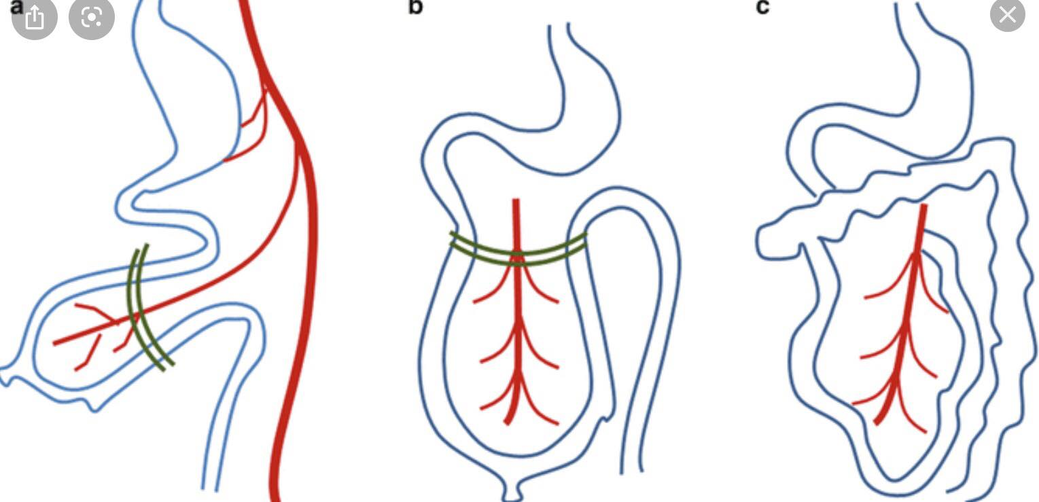
Malrotation

Slide 8
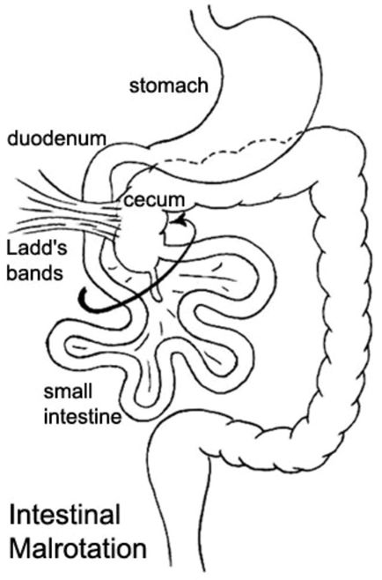
Malrotation

Slide 9
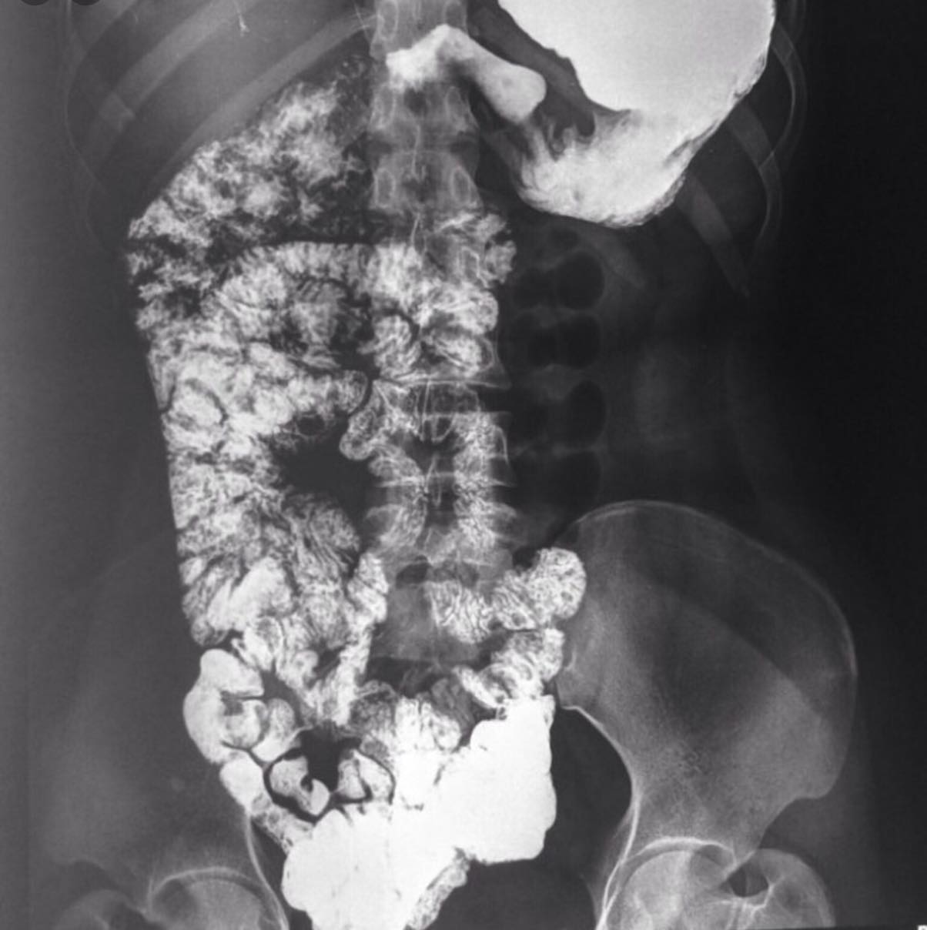

Slide 10
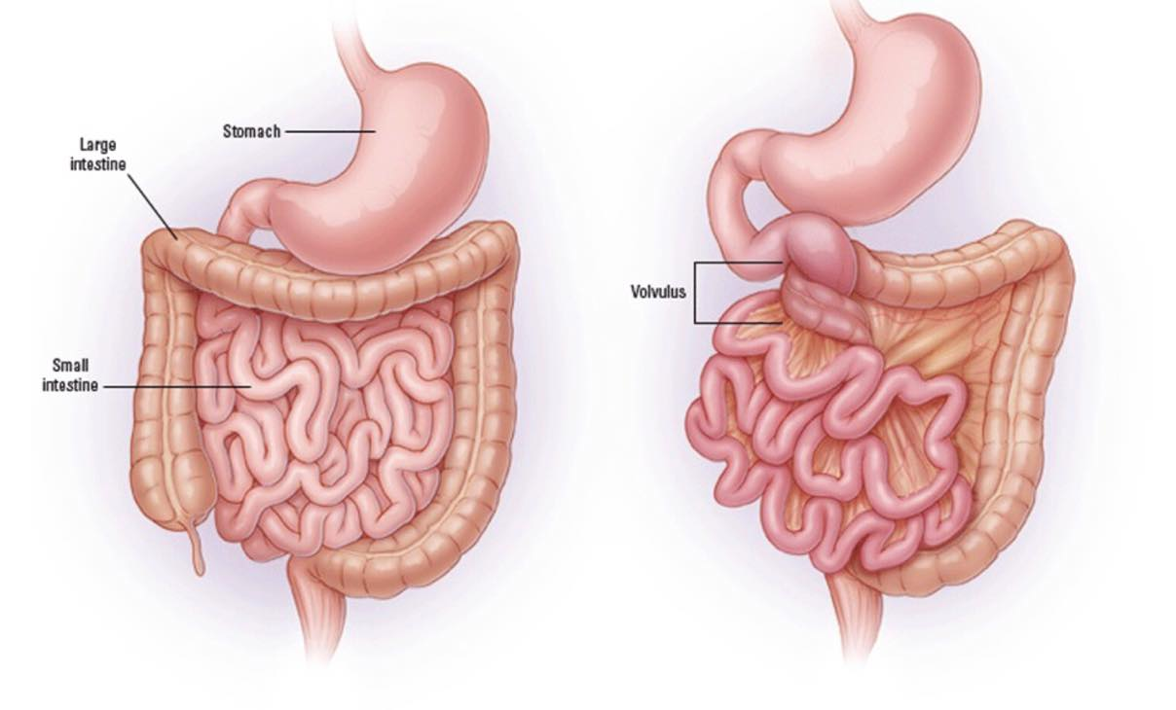
Volvulus neonatorum

Slide 11
Volvulus neonatorum
treatment | Associations | Investigations and imaging | presentation | causes
ladd’s procedures |  | dilated bowel loops -air fluid levels and decreased air distal to the obstruction | Obstruction triade Ill define mass | malrotation | Volvulus neonatorum

Slide 12
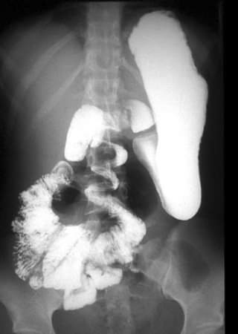
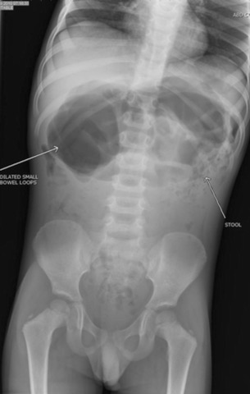

Slide 13
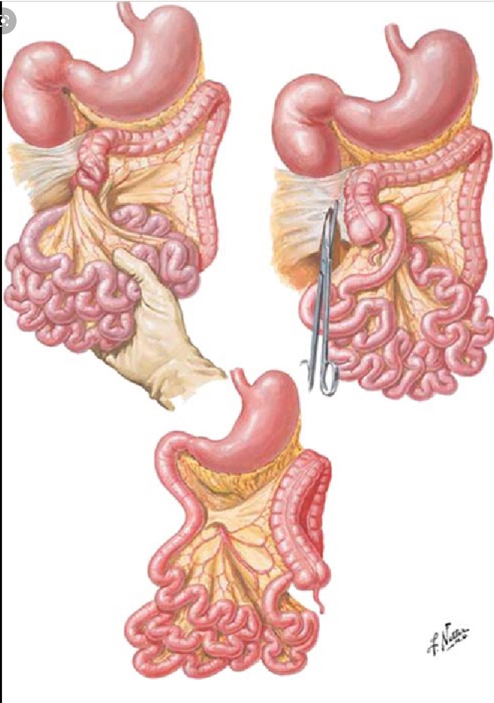
Treatment:
surgery - ladd’s procedures
Pre-op.
Resuscitate + IV antibiotics.
Post-op.
IV Fluid for at least 24 hours .
Antibiotic course according to findings at surgery .

Slide 14
Imperforated anus
treatment | Associations | Investigations and imaging | presentation | causes
Low defect : perineal anoplasty High defects : colostomy followed by posterior sagittal anorectoplasty | VACTERL Down’s syndrome Hirschsprung’s disease duodenal atrasia | Pelvic and spine X-Ray pronogram micturating cystourethrogram MRI | Obstruction symptoms Fistula symptoms Dx by perineal examination | congenital | Imperforated anus
Associated malformation :
VACTERL /Down’s syndrome / Hirschsprung’s disease / duodenal atrasia

Slide 15
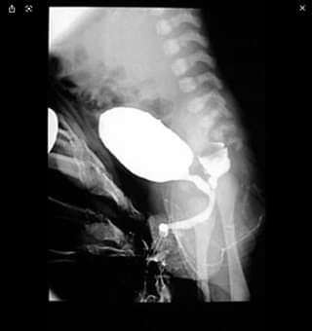
girls | boys
rectovestibular | Perineal fistula | Low defect (translevator)
rectovaginal | rectourethral | High defect (supralevator)

Slide 16
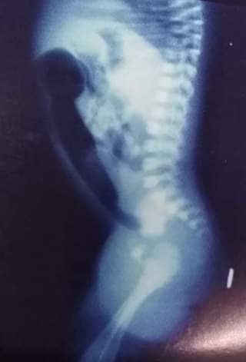
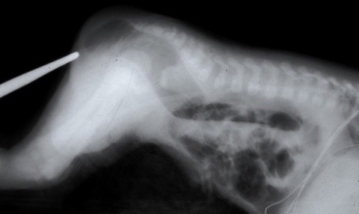

Slide 17
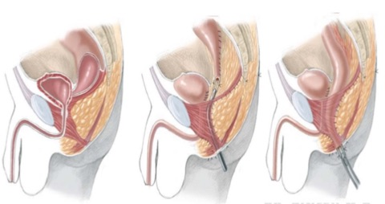
PSRP

Slide 18
Esophageal atresia and TOF
Complet interruption of the lumen.
With or without TOF
The condition is due to defect in division of proximal foregut into ventral tarcheo-bronchial tube & dorsal esophageal tube.
Incidence :1/3000-4000
Associated with vater and vacterl .
Accumulates of saliva in the upper pouch, spills over in to the trachea, aspiration of gastric content, pulmonary complication , abdominal distention .

Slide 20
Presentation
Excessive drooling (unable to swallow)follow by chocking and cough immediately after feeding.
Fine frothy white bubble of mucus at nostrils and lips.
Feeding cause choking and worsening of symptom.
Cough and cyanosis.
Regurgitation and aspiration of milk.
Any newborn presenting with frothy saliva should be considered a case of esophageal atresia until proven otherwise.

Slide 21
Diagnosis
Prenatally :Presented with polyhydramnios 60% and failure to visualize the stomach.
postnatally :On P/E= scaphoid abdomen (blind lower end)/distended abdomen (with lower connection ) dehydration, pneumonia (cause of death).
Dx= catheter test (arrest 10 cm form the nostril) if arrested 2 cm form nostril then choanal atresia
plan x-ray (increased fundus air or absent fundus air bubble) gastrograffin meal

Slide 23
In the chest film below the red arrow points to end of orogastric tube which is blocked from entering the distal esophagus by the patient's esophageal atresia. Note the lack of gas in the abdomen indicating that a fistulous tract does not connect the trachea to the distal esophagus.

Slide 24
Management

Slide 25
Management
(emergency case) = -Resuscitation and keep in prone position Sump suction put at upper pouch to continuous suction.
operation: -atresia with fistula= right thoracotomy at 4 intercostal space (retropleural )fistulotomy with end- end anastomosis.
atresia w/o fistula= gastrsotomy at birth, cervical esophagostomy , reconstructive surgery later at 6 months.

Slide 26
Diaphragmatic hernia
Failure of closure of pleuroperitoneal canals
The bowel loops herniated through the defect into the chest, impairing lung development.
1. Bockdalek hernia 95%
2.Morgagni hernia 5%
On P/E :
Scaphoid abdomen
Dull chest
Decrease air entry
Presence of intestinal sounds in chest
Apparent dextrocardia
Cyanosis and dyspnea.
Any infant presents with cyanosis ,respiratory distress and scaphoid abdomen in the absence of heart disease should be considered a case of diaphragmatic hernia until proven otherwise.

Slide 27
Can be dx antenatally= PolyHydramnois
Associated with
malrotation 90%
Cvs (ASD,VSD,TOF)
Cns (spina bifida, hydrocephlus, cerebral dysagnesis)
Chromosomal disorders ( trisomy 18 and 21)
Investigation
plain x ray
gastrogarffin meal

Slide 28
Management
Respiratory support with intubation and ventilation is usualy required.
A nasogastric tube should be passed.
Gas exchange and acid-base status should be assessed.
Acidosis may need correction with bicarbonate infusion.
Surgery should be considered early after resuscitation.
Hernia content are usually reduced via abdominal approach.
The diaphragm repaired with nonabsorbable suture or a synthetic patch if the defect too large.
Early respiratory failure is associated with poor prognosis.

Slide 29
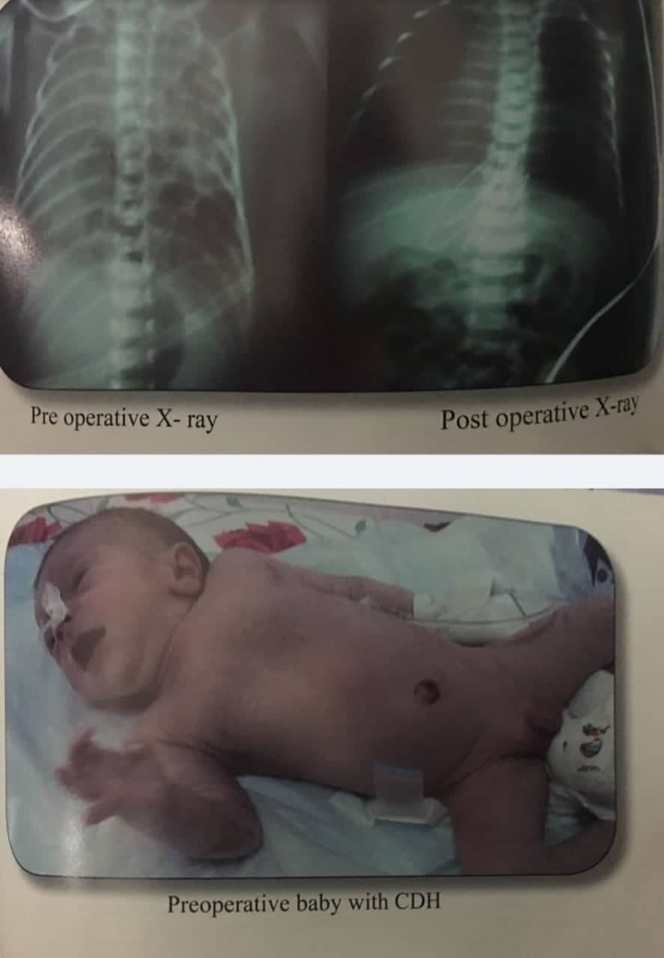

Slide 30
Common obvious developmental anomalies
1. Exomphalos ( omphalocele )
External herniation of abdominal viscera into the base of the umbilical cord through a central defect.
Presence of covering or sac (amnion and peritoneum).
Incidence: 1/ 5,000 live births.
Etiology :
Physiologic herniation : during embryonic life ( 5th week ) the structure of the midgut develop in the extra coelomic cavity through the umbilical cord
Failure of these organ to return causes herniation through the umbilical cord.
exact cause unknown
- Associated Congenital Anomalies: 75-80%
- chromosomal: trisomy 13, 15, 21
- cardiac anomalies: 20%
Diagnosis :
Considered spot diagnosis
Prenatal Alpha FP screening or detailed fetal US

Slide 31
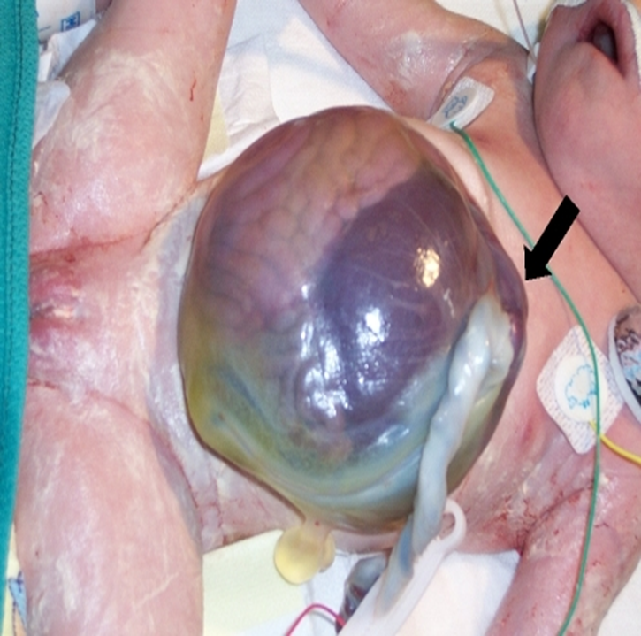
MAJOR VS MINOR ?

Slide 32
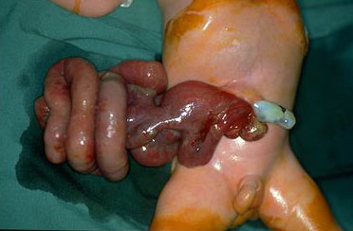
2. Gastroshiasis
Protrusion of gut through a 2-3 cm defect in the anterior abdominal wall lateral to the umbilicus, usually on the right .
Absence of covering or sac, so The appearance of the bowel provides some information with respect to the in utero timing of the defect.
Heat loss, ECF loss , Chemical peritonitis, infection.
Incidence: 1:3500 live births.
The associated anomalies`re rare and mostly are intestinal atresia.
This defect can readily be diagnosed on prenatal ultrasonography.

Slide 33
TREATMENT
Immediate postnatal management .
1. correcting hypovolemia : IV fluid
2. preventing hypothermia covered with saline-soaked gauze and the trunk should be wrapped circumferentially.
3. vital signs monitoring
In gastroshiasis and ruptured Exomphalos surgery is performed as soon as possible :
1. primary closure.
2. staged closure (Schuster procedure ) to avoid compartment syndrome ( increase intra abdominal pressure ) by : A. silastic silo formation over the exposed viscera.
B. myo-cutaneous mobilization flap
Nonoperative management of Omphalocoele with intact sac reserved for :
1- extremely large defects.
2- a small abdominal cavities.
3- high risk infants with associate congenital anomalies.

Slide 34
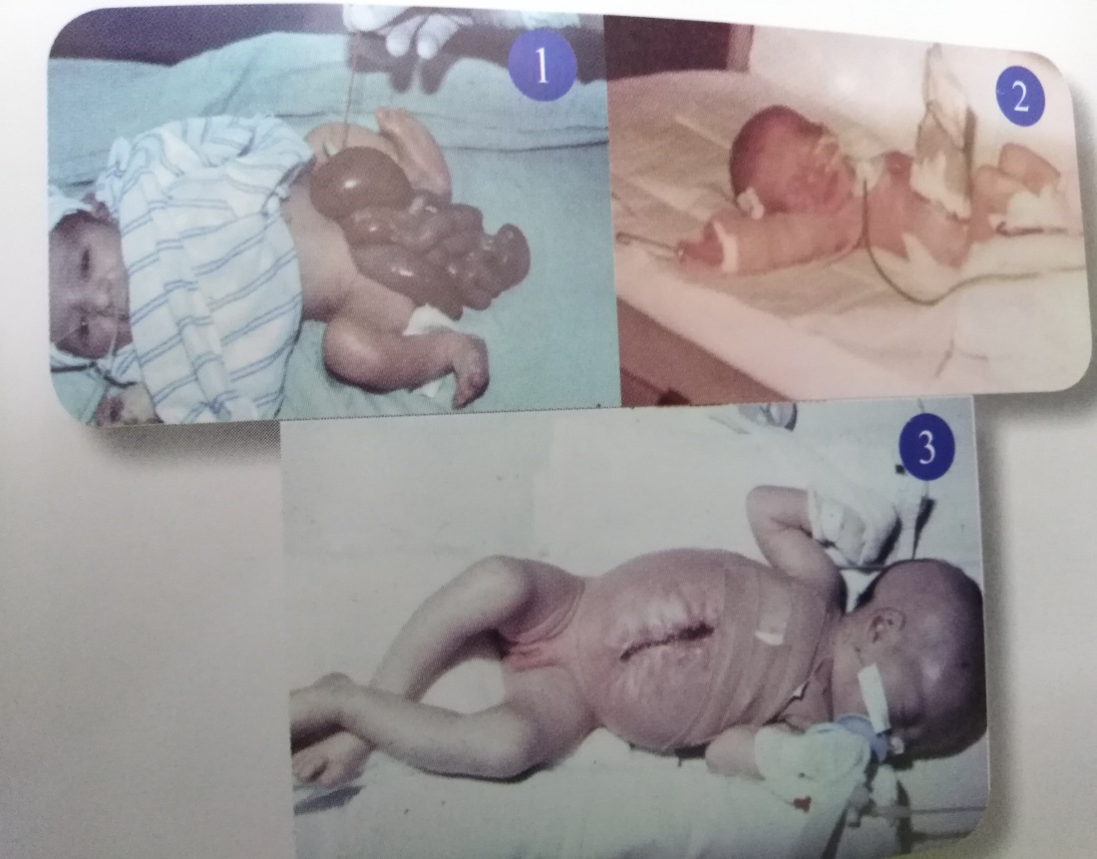
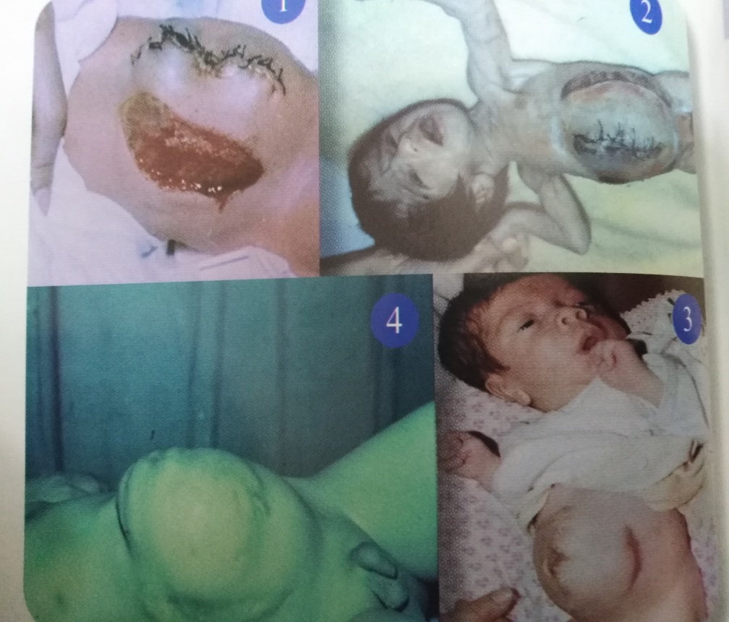
Pre-op.
Prophylactic antibiotic
Post-op.
NICU / ventilation in most neonates for 24-48 hrs
Fluid requirements may remain high
Prolonged pos-top ileus: TPN or PPN
Prevent infection: higher with silo
silastic silo formation
myo-cutaneous mobilization flap

Slide 35
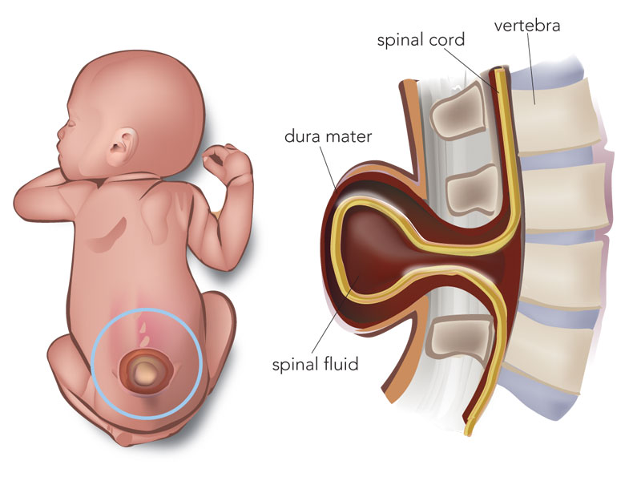
3. myelomeningocele
Herniation of the meninges and spinal cord through bony defect typically the lesion is raw and exposed
flacccid paralysis of the lower extremities , anaesthesia and absent DTRs in the lower extremities , club foot , hydrocephalus may have neurogenic bladder and paralysis of the Anal sphuncter
Risk factor : folate deficiency , obesity
Poorly controlled DM
diagnosis : vertebral X- ray and MRI .
MRI should include cranium / neck to
assess for chiari II malformation
which associated with 75% of cases .
Treatment : surgical correction
cover exposed tissue with sterile moistened sponge
Give broad- spectrum antibiotics and refer for
urgent correction
Most sever open spina bifida incomplete closure of posterior
wall of the vertebral canal

Slide 36
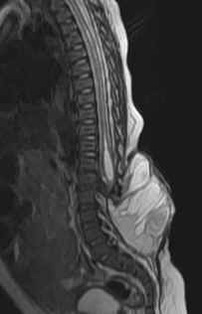
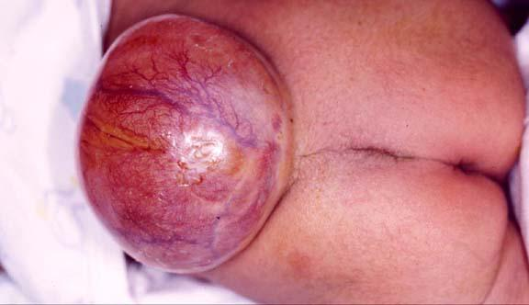
Pre-op :
- Routine labs
- Renal ultrasound
- Cranial and optic nerve ultrasound
- X – ray spine ( AP and lateral )
- Antibiotic prophylaxis
Post -op care :
- I.V. fluid for 24 hours
- Antibiotic prophylaxis
- Watch for expanding hydrocephalus
- Arrange physiotherapy
- Will need MCU and DEMSA in one month

Slide 37
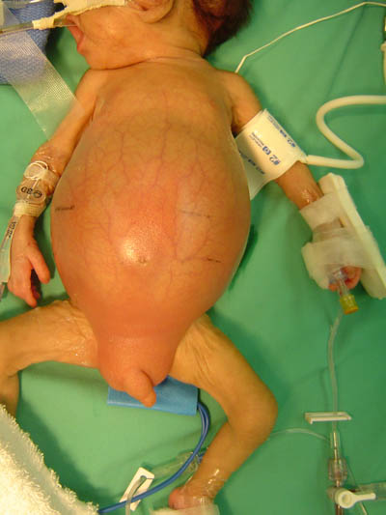
Necrotizing enterocolitis
(NEC)
which typically occurs in the second to third week of life in premature, formula-fed infants, is characterized by variable damage to the intestinal tract, ranging from mucosal injury to full-thickness necrosis and perforation ,NEC affects close to 10% of infants who weigh less than 1500 g, with mortality rates of 50% or more depending on severity, but may also occur in term and near-term babies.

Slide 38
-Risk factors :
1- Premature
2- Low birth weight / < 1.5 kg
3- Congenital Heart disease
Exchange transfusion .
- Common sites:
-Terminal ileum
- colon
- Pathological changes:
- Dilate bowel
- Fibrous exodate cover the serosal surface
- Patchy necrosis and heamorrhage
- subserosal gas collection
- Mucosal lceration
Notes:
النسبه 3 لكل الف

Slide 39
Presentation : | - Classicaly : Abdominal distention & bilious vomiting - Sign of sepsis (lethagic ,apnea ,bradycardia ,unstable tempreature ,hypotension ) - In progress : abdominal wall edema , erythematous , hematemesis , rectal bleeding )
Laboratory : | Metabolic acidosis Thrombocytopenia Leukopenia
X-Ray (plain) : | Bowel distention pneumatosis intestinalis Dilated intestinal loops Portal venous air Pneumoperitoneum & ascitis
Progress : | Healing by epithelization or scarring & stricture formation - Perforation and peritonitis

Slide 42
Workup ..
- Genral supportive care ( may need to be ventilated )
- stop all oral feeds
- NG tube and I.V fluids
- blood products as necessary and consider the TPN
- Broad spectrum antibiotics

Slide 43
Management :
Conservative
N/G decompression
TPN, I.V Fluid , blood and Antibiotics
Surgical Laporatomy
(if indicated )
Bowel resection
Stoma Formation

Slide 44
Surgery indications :
Free air in abdomen
Clinical deterioration (progressive acidosis due to ischemia )
Abdominal mass ( Fixed-loop sign )Erythema of the abdomen wall
A fixed and dilated loop of bowel that does not alter in size, shape, and position on repeated abdominal films is highly suggestive of mechanical bowel obstruction due to an aperistaltic segment of bowel (usually due to ischaemia or gangrene).

Slide 46
What is meconium?
Meconium ileus
It is the first intestinal discharge from newborns, which is a viscous, dark green substance composed Of:
Water which is the major liquid constituent, comprising 85-95% of meconium.
the remaining 5-15% of ingredients consists of solid constituents, primarily intestinal secretions (eg. Bile), mucosal cells, and solid elements of swallowed amniotic fluid, such as proteins and lipids.
Meconium is sterile and does not contain bacteria.
PH of meconium 5.5 to 7.0.
Normally meconium should pass after delivery, within the first 48 hours

Slide 47
Meconium ileus is a bowel obstruction that occurs when the meconium is even thicker and stickier than normal meconium, creating a blockage in a part of the small intestine (most commonly in the ileum).
Incidence :
- Meconium ileus accounts for 9–33% of all neonatal intestinal obstructions, with an incidence of 1:2500 newborns
- 16-20% of patients with CF

Slide 48
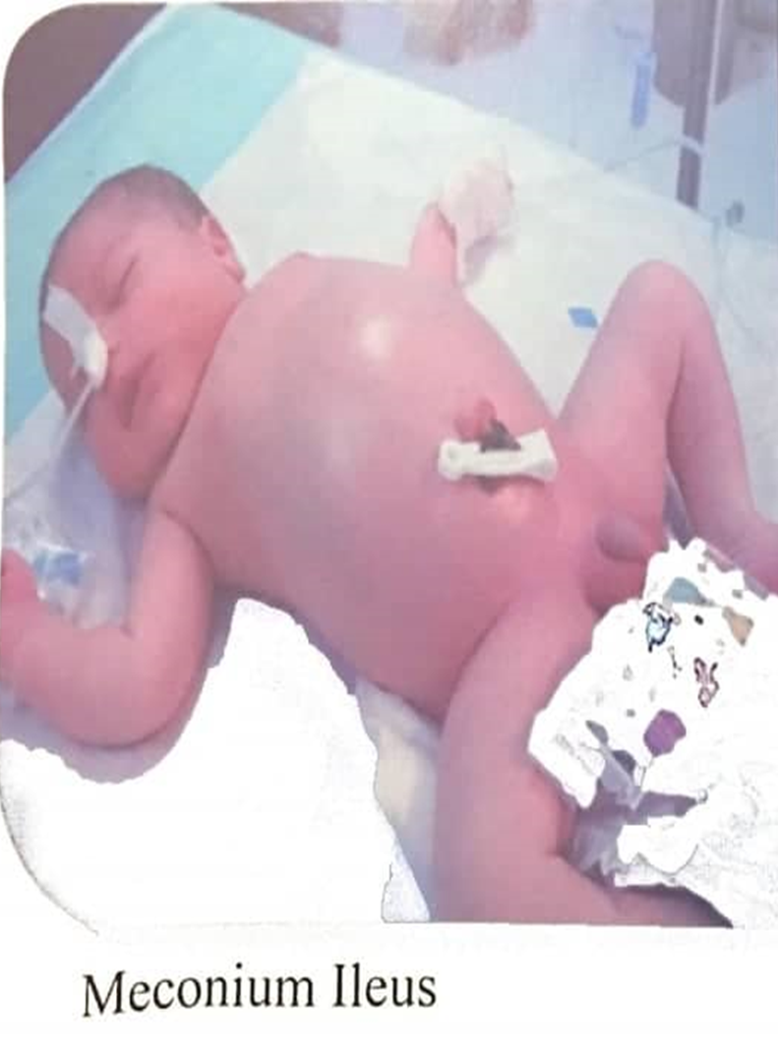
Clinical presentation:
These infants present shortly after birth with:
Progressive abdominal distension
Failure to pass meconium
Intermittent bilious vomiting
Palpable abdominal mass (Firm)

Slide 49
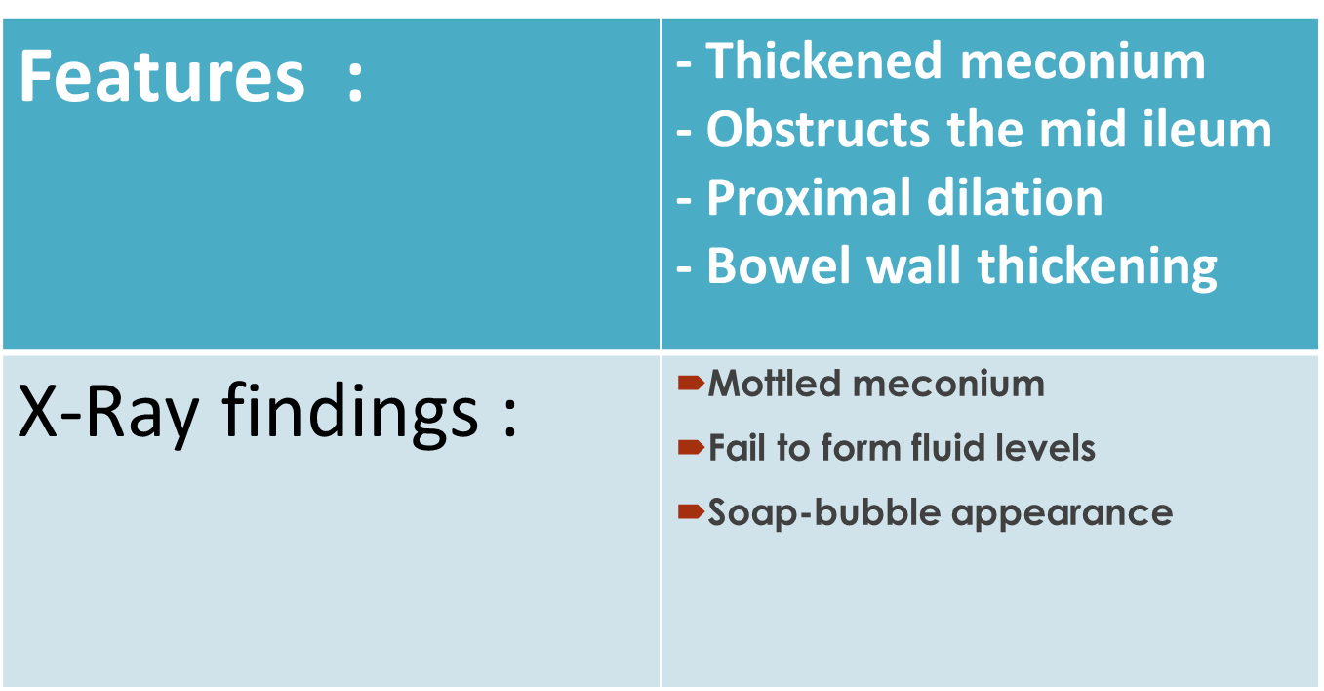
Meconium ileus can be either:
Simple (uncomplicated):
In which there is NO intestinal perforation

Slide 50
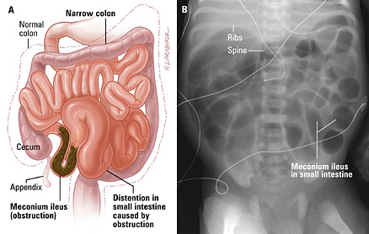
Soap bubble appearance on abdominal x-ray

Slide 52
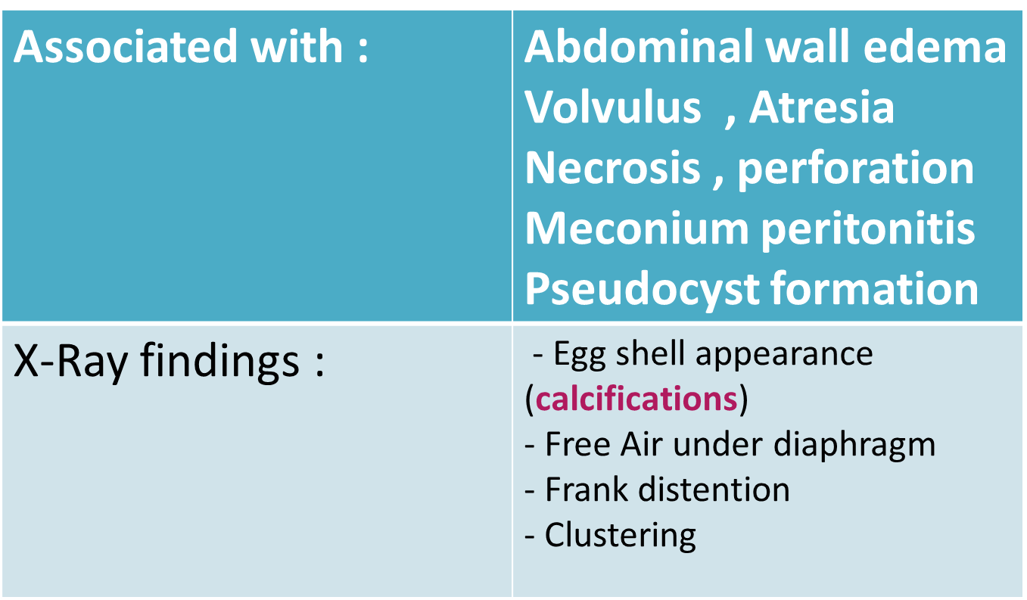
Complicated:
In which prenatal perforation of the intestine has occurred, causing meconium peritonitis, or vascular compromise of the distended ileum develops causing atresia and volvulus and predisposing to perforation.

Slide 53
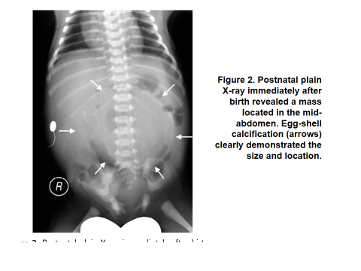

Slide 54
Management:
Non-surgical (if uncomplicated) :
- A dilute gastrografin or an isotonic contrast enema (under fluoroscopic control)
- Repeat the procedure at 12h intervals for 4-5 days (until all the meconium is evacuated)
- Replace fluid loss ( i.v. fluid) and prophylactic IV antibiotics
- Successful in 60%
Surgical :
If there is ileal atresia
not responding to conservative management
in case of perforation ( complicated )
Exploratory laparotomy → resection of the distended terminal ileum is performed and the meconium pellets are flushed from the distal bowel. At this point ileostomy and mucous fistula may be created from the proximal and distal ends, respectively.
- Intestinal continuity is usually restored within 6 weeks if bowel function resumes and the infant tolerates oral feeding.

Slide 55
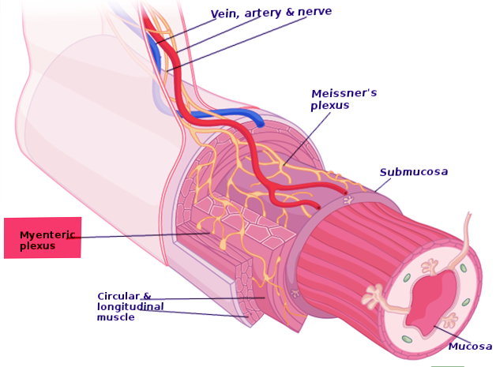
Hirschsprung’s disease
Congenital bowel innervation disorder characterized by the absence of ganglion cells in myenteric (Auerbach) and submucosal (Meissner) plexus in the distal colon. (aganglionosis)
The absence of ganglion cells is due to failure of migration of vagal neural crest cells into the developing gut.
The affected gut is tonically contracted causing functional bowel obstruction.
Incidence is approximately 1 in 5000 live births.
Down syndrome is the most frequent chromosomal abnormality associated with Hirschsprung's disease

Slide 56
Short aganglionic segment 75% →restricted to rectum and sigmoid colon
Long aganglionic segment 15% → involves the proximal colon
Total colonic aganglionosis 10% → affects the entire colon and a portion of terminal ileum

Slide 57
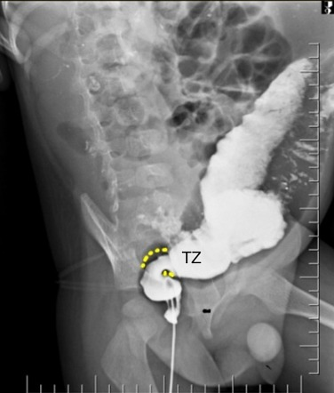
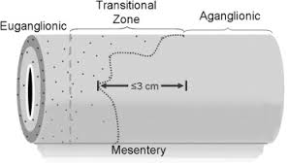

Slide 58
Clinical features:
Typically presents in the neonatal period with (complete functional obstruction) >90%:
delayed passage of meconium
Abdominal distention
Bilious vomiting
On digital rectal examination: a tight sphincter and an empty rectum with stool palpable higher up in the colon and an explosive passage of stool upon withdrawal of the examining finger (squirt sign).
But it may not be diagnosed until later in childhood or even adult life, when it manifests as severe chronic constipation (partial functional obstruction).

Slide 59
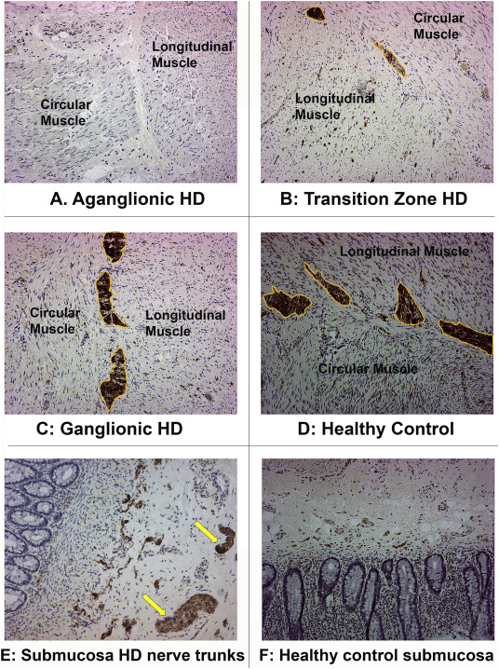
Diagnosis:
Erect abdominal x-ray: dilated bowel , air-fluid levels .
Barium enema : may show the extent of the aganglionic segment, +ve transition zone , barium retained over 24h in colon.
Histological examination of an adequate rectal biopsy (absence of ganglion cells / staining for acetylcholinesterase activity)
Hyperactivity of AChE is pathognomonic for Hirschsprung's disease. Therefore, histochemical staining together with H + E staining is the gold standard in HD diagnosis.

Slide 61
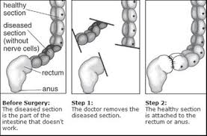
Management
Pre-op care :
1- large volume saline bowel washouts
2-prophylactic antibiotics
Pull-through operations can be done in a single stage (open, laproscopically or transanally) or several stages after first establishing a proximal stoma in normally innervated bowel.
Post-op care :
1- I.V fluids for 3-4 days
2- check labs while the patient on full IV fluids
Most patients achieve good bowel control but a significant minority experience residual constipation and/or faecal incontinence.
MOST of the mortality is related to the severe enterocolitis .

