Slide 1
RSM 2022-2023
Mycoplasma -Legionella -Chlamydia
Prof. Amin Aqel
Department of Microbiology and Pathology
Faculty of Medicine, Mutah University

Slide 2
Typical vs. Atypical Pneumonia
Typical pneumonia
People need to rest for several days to fight off the infection. Some cases require hospitalization
Appear suddenly and cause a more serious illness.
Reproductive cough
Affects the alveoli
Occurs in Immunocompetent
Symptoms are confined to the respiratory system
Atypical pneumonia
Do not usually require hospitalization, and a person is unlikely to be significantly ill. This is why it is often called walking pneumonia
Many people can function normally and do most of their everyday tasks with little difficulty.
have certain symptoms that others with typical pneumonia will often not have. These include a prominent headache, a low-grade fever, an earache, and a sore throat, dry cough.
Affects the interstitial tissue (parenchyma)
Occurs in Immunosuppressed
Symptoms are not confined to the respiratory system
Requires different antibiotics than typical pneumonia, which is commonly caused by the bacteria S. pneumonia.
Most are hospital acquired.

Slide 3
Mycoplasma

Slide 4
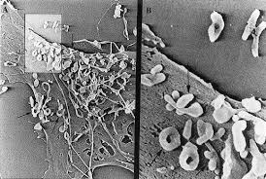
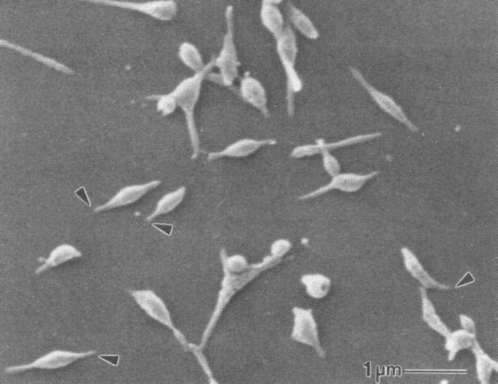
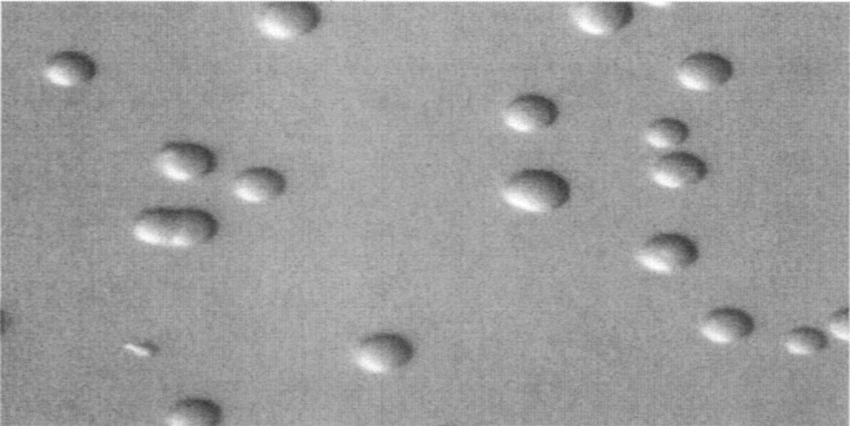
Morphology
The smallest prokaryotic organism.
Size: 0.2-0.3 um.
Polymorphic:
Spherical.
short rod.
pear shaped.
filamentous.
Lack cell wall
gram negative
Require complex media for growth.
Grow slowly by binary fission.

Slide 5
Classification of Mycolasma
Organism Diseases
1- M. Pneumoniae - Upper respiratory tract disease.
- Tracheobronchitis.
- Atypical pneumonia.
2- M. hominis - Pyelonephritis.
- Pelvic inflammatory disease.
- Postpartum fever.
3- M. genitalium - Non-gonococcal urethritis.

Slide 6
Pathogenesis of M. pneumoniae
Adherence: M. pneumoniae has specific protein (adhesin) localized at the tips of organism to attach it to the respiratory epithelium and erythrocytes. This adherence leads to:
1- Ceases of cilia Movement
2- Clearance mechanism stops coughing
Toxic metabolic products host cell damage
Immunopathogenesis: Activation of macrophages & stimulation of cytokine production
M. pneumoniae mostly affect school children with the highest infection rate among individuals aged 5-20 years

Slide 7
Clinical pictures
1- Tracheobronchitis: 70-80% of infection.
2- Primary atypical pneumonia:
- Approximately 10-20% of infection.
- Mild disease but of long duration.
- Rarely fatal.
- Presented with:
# Fever, headache, malaise.
# Persistent non reproductive cough.
# Sore throat, earache.
3- Rarely, other organs may be involved (CNS, joints, heart & pericardium) as a result of hematogenous spread.

Slide 8
Laboratory diagnosis
Direct
Indirect
Microscopical examination: not helpful due to absence of cell wall so the organism resists gram stain but can be stained with Giemsa.
Culture:
- it is difficult & time consuming. It takes 2-3 ws to give colonies with fried egg appearance.
Serology: is most useful in the diagnosis.
CFT or ELISA : for detection of IgM or rising titer of IgG.
Detection of cold agglutinins at a titer of 1/128 or higher indicates recent infection (autoantibodies against red blood cells that agglutinate this cell at 4ºC. It is positive in 50%.
Antigen detection by immunofluorescence test.
PCR.
Chest x ray.

Slide 9
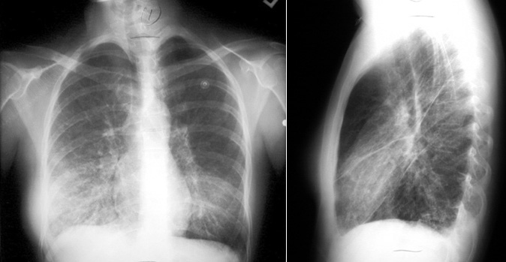
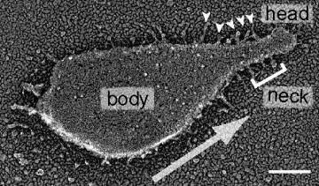

Slide 10
Treatment
1- Tetracycline or erythromycin
2- Fluoroquinolones

Slide 11
Legionella
pneumophilia

Slide 12
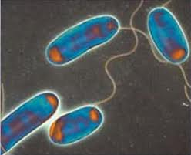
General characters
Gram negative rods causing outbreak of atypical pneumonia in hospitals.
Motile with polar flagella
Strict aerobe
Require for growth, media containing L- cysteine & iron

Slide 13
Epidemiology
1- Air borne
2- No man to man transmission.
3- High incidence is in summer.
4- Can cause outbreak at large scale.
5- Predisposing factors:
Smoking, alcohol, old age.
Disease: as chronic pulmonary disease
Immunocompromised status: AIDS, cancer, organ transplant.

Slide 14
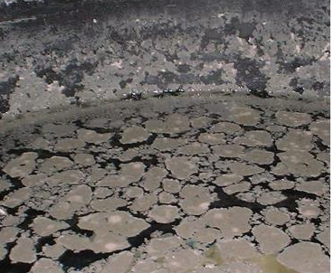
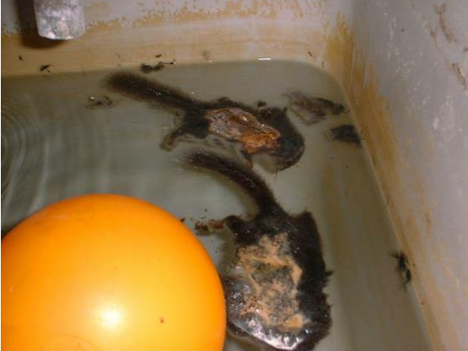
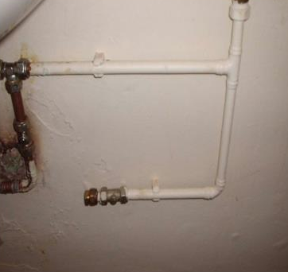
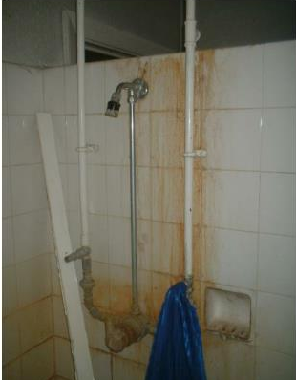
Habitat
CHAIN OF EVENTS Bacteria present in water system, slow moving / stagnant water, adequate food source, temperature range 20-50°C , aerosol formed, people present.
Examples on infected water sources:
Storage Tanks: Over capacity Stagnation Out of sight Poor flow Ambient temps
Showers: Operate at ideal temps Poor hygiene Infrequently used Prone to scaling Create aerosol
Dead pipe ends.

Slide 15
Mode of transmission & pathogenesis
L. pneumophilia enters cooling water system, so infection occurs due to inhalation of water aerosols contaminated by this organism
The organism multiplies within the phagosome in the alveolar macrophage and inhibits phagosomal lysosomal granules fusion
Severe cases associated with damage of vascular endothelium in brain & kidney.
CMI is the most important defense mechanism because of the intracellular growth & survival of the organism.

Slide 16
Clinical picture
Two forms of illness:
1- Pontiac fever:
Mild flue- like illness without pneumonia. Self limiting & not fatal
Symptoms: fever, cough, headache, malaise, myalgia.
Persist for about 1 week

Slide 17
2- Legionnaires’ disease (atypical pneumonia):
More severe form & can be fatal
Non specific symptoms:
Fever, fatigue, malaise, myalgia.
Respiratory symptoms:
Cough (dry non productive), hemoptysis, chest pain.
Systemic symptoms:
Neurologic & GI symptoms as headache, disorientation, confusion, nausea, vomiting, diarrhea & abdominal pain.

Slide 18
Laboratory diagnosis
Direct
Indirect
Microscopic Examination: of samples as bronchial aspirate, pleural fluid, lung biopsy, blood & water samples after staining with silver stain or Giemsa stain.
Culture of specimens on buffered charcoal yeast extract agar. It requires cysteine & iron to grow
Serological tests: Detection of IgM or rising titer of IgG by ELISA test.
Detection of legionella antigen in urine using ELISA (rapid, specific test).
PCR for detection of nucleic acids in sputum, urine & other specimens.
Biochemical reactions:
The organism is catalase & oxidase positive.

Slide 19
Treatment
Erythromycin or Azithromycin (Drug of choice) with or without rifampicin.
Fluoroquinolones.

Slide 20
Chlamydia pneumoniae

Slide 21
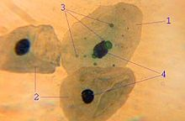
General characters
An obligate intracellular Gram –ve bacteria that infects human.
It is a major cause of atypical pneumonia.
In the past it considered as a virus due to:
- Their small size (0.2- 1 um).
- Can not synthesize ATP for energy so they need to multiply intracellular where the host cell or tissue culture provides energy & metabolites.
They possess both RNA and DNA, like bacteria
C. pneumoniae

Slide 22
Life cycle
1-Chlamydia pneumoniae elementary body (EB) is the infective stage.
2- Man infected by droplets infection.
3- Inside the lung, EB is taken by epithelial cells of respiratory tract by phagocytosis like process forming endosome.
5- EB transforms into a reticulate body (RB) that replicates within the endosome forming a large numbers of Ebs that seen in the host cells as intracytoplasmic inclusion bodies.
6- The EBs released back into the lung to infect new cells either in the same host or in a new host.
NB. EBs are able to infect new cells but can not replicate while RB replicates but not able to cause new infection.

Slide 23
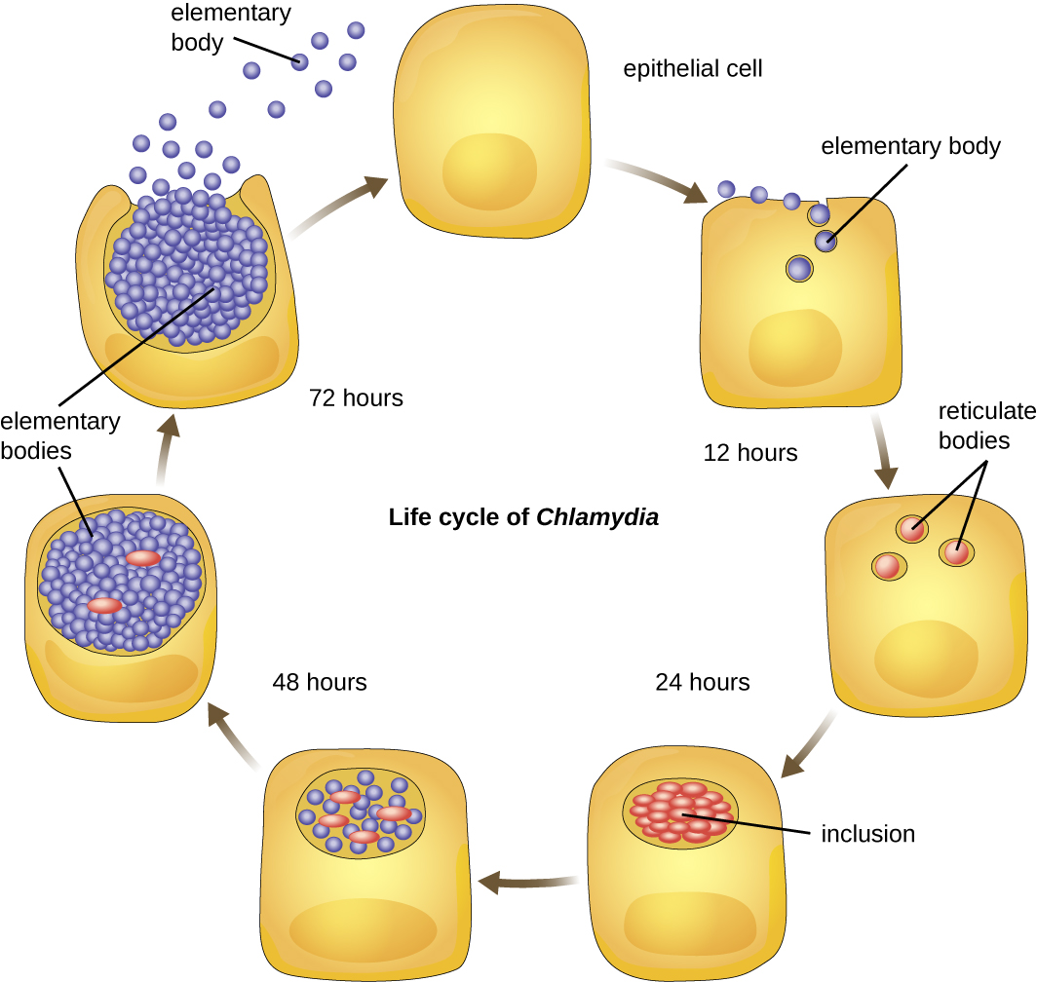
Life cycle of chlamydia

Slide 24
Pathogenesis & symptomatology
C. pneumoniae infect the epithelial cells of the respiratory tract causing bronchitis & atypical pneumonia.
C/P:
1- Most infection is asymptomatic.
2- Mild or moderate symptoms:
Prolonged non reproductive cough, fever, fatigue, bronchitis.
Less common pharyngitis, laryngitis & sinusitis.
Risk group: All ages but most common in school age children (5-15 years)

Slide 25
Diagnosis
1- Microscopic Examination: of the specimens ( sputum) to detect intra-cytoplasmic inclusion bodies using Giemsa stain or Immunofluorescence stain.
2- Detection of Chlamydia antigen by ELISA & IFT.
3- Cell culture: It can grow on HEP-2 to detect inclusion bodies.
4- Serological examination: Useful in the diagnosis of chlamydia pneumoniae.
5- PCR.

Slide 26
Treatment
Tetracyclines (drug of choice).
Erythromycin.

