Slide 1
Neuro Notes

Slide 2
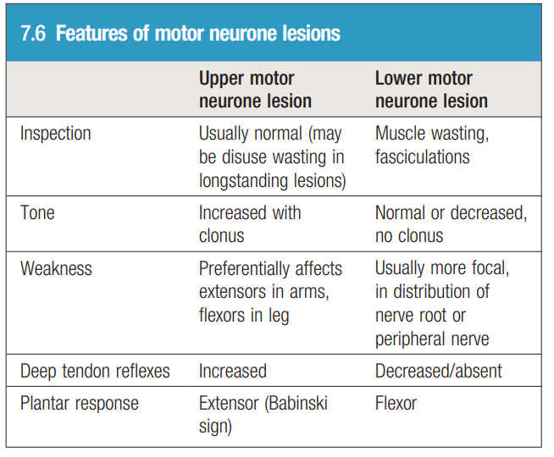
c

Slide 3
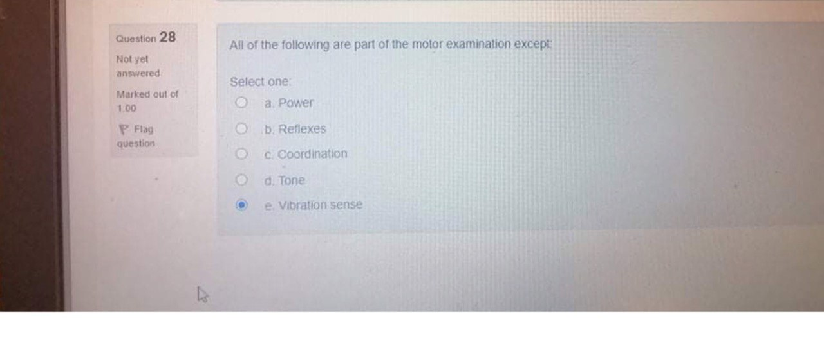
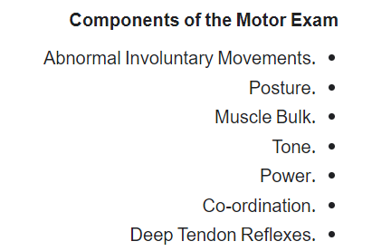
e

Slide 4
d

Slide 5
a
Suspected meningitis!
So you should do kernig's sign

Slide 6
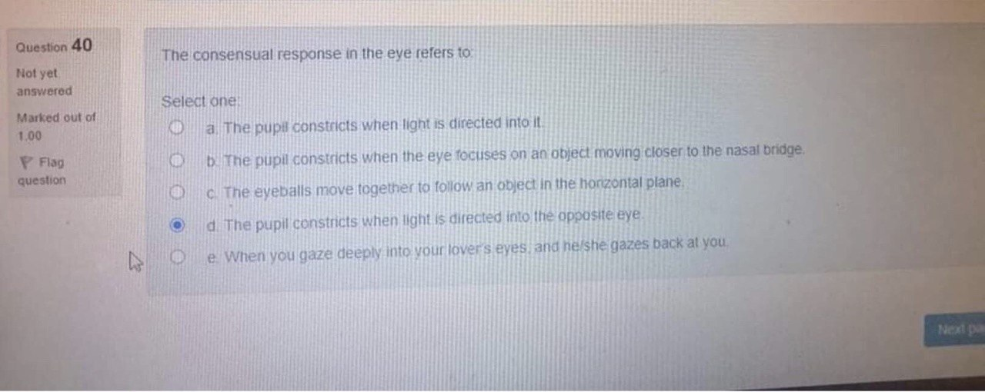
d
While the response from the opposite eye called consensual or indirect response

Slide 7
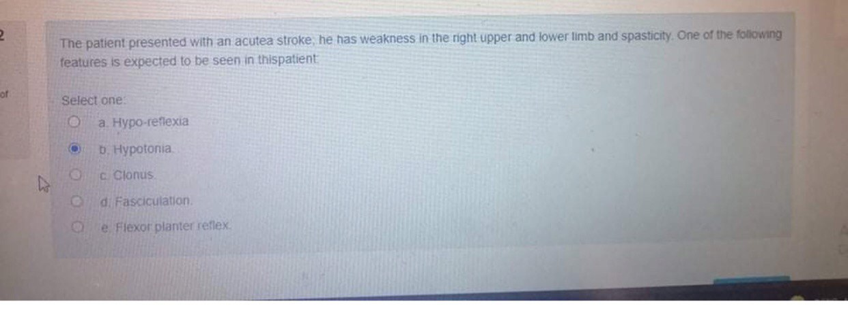
C it is UMNL

Slide 8
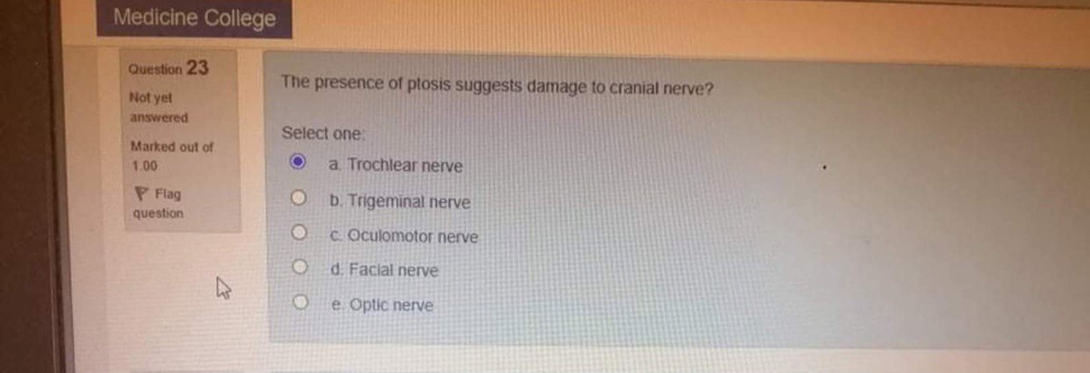
C

Slide 9
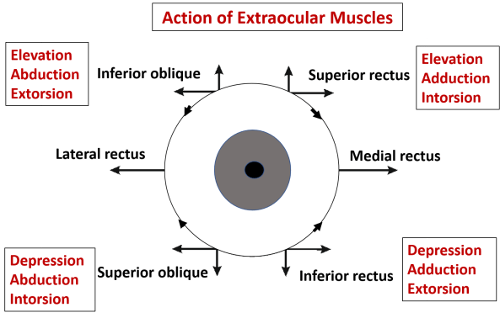
all of them innervated by oculomotor ( CN 3 )
Except Lateral rectus (abducent cn 6) Superior oblique ( trochlear cn 4) Exceptions ( LR6 SO4)

Slide 10
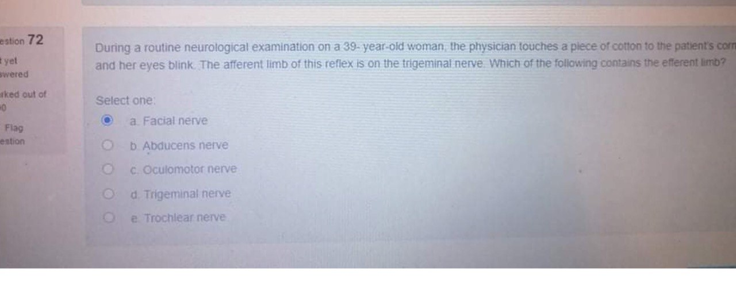

Slide 11
اعملوا نسخ لصق للرابط على اليوتيوب
https://www.youtube.com/watch?v=LjlqP1uMUo0

Slide 12
ضروري الرجوع لسلايدات الدكتور عمر الرواشدة
https://www.youtube.com/watch?v=sJBpai74tlU&t=606s
Cranial nerve examination geeky medics
https://www.youtube.com/watch?v=aPmQN2pqPsM
Macleod's clinical examination (cranial nerves)

Slide 13
Meningitis is an inflammation (swelling) of the protective membranes covering the brain and spinal cord. A bacterial or viral infection of the fluid surrounding the brain and spinal cord usually causes the swelling. However, injuries, cancer, certain drugs, and other types of infections also can cause meningitis. It is important to know the specific cause of meningitis because the treatment differs depending on the cause.
Early meningitis symptoms may mimic the flu (influenza). Symptoms may develop over several hours or over a few days.
Possible signs and symptoms in anyone older than the age of 2 include: مهماات
Sudden high fever
Stiff neck
Severe headache that seems different from normal
Headache with nausea or vomiting
Confusion or difficulty concentrating
Seizures
Sleepiness or difficulty waking
Sensitivity to light (photophobia)
No appetite or thirst
Skin rash (sometimes, such as in meningococcal meningitis)

Slide 14
Physical examination specifically for meningitis includes assessing neck stiffness, testing for Kernig and Brudzinski signs, and assessing jolt accentuation of headache.
These signs are positive in meningitis
بس اعرفوهم بشكل عام مع اسماءهم عشان اذا اجوا بالفاينل تعرفوا انه بحكي عن السحايا(meningitis)

