Slide 1
Diagnosis of the Parasitic infections
Mutah University
Faculty of Medicine
General Microbiology
2019-2020
Dr. Mohammad Odibate

Slide 2
Diagnosis of Parasitic Infections
Clinical
Laboratory
Purpose of laboratory diagnosis :
Confirmation of clinical suspicion.
Identification of unsuspected infection.

Slide 3
Specimens
Stool.
Blood.
Serum and plasma.
Others (anal swab, duodenal aspirate, sputum, urine, urogenital specimen).
Tissues and aspirates.

Slide 4
DIAGNOSIS
DIRECT
INDIRECT
MOLECULAR
Urine
Stool
Sputum
Biopsy
Blood
Aspirates
IHAT
LAT
IFAT
ELISA
CFT
DNA probes
PCR

Slide 5
Urine examination
Parasites detected in the terminal drops of urine :
Helminths:
Schistosoma haematobium eggs.
Enterobius vermicularis eggs in female patients.
Microfilaria of Wuchereria bancrofti.
Protozoa:
Trichomonas vaginalis trophozoite in female patients.
Temporary stains, such as methylene blue is helpful to see T. Vaginalis.
Note: Urine specimen should be centrifuged at 400 × g, the sediment mixed with a drop or two of saline, and examined by wet mount.

Slide 6
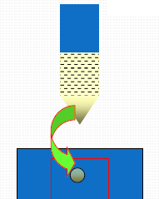
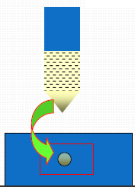
Urine examination

Slide 7
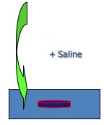
Urine examination
Urine examination
Other techniques:
Membrane Filter technique:
For concentration of Schistosoma eggs.
Fill a syringe with urine, pass the urine through a filter.
Remove the filter and place it on the slide, and examine it microscopically.

Slide 8
Stool examination
Sample collection:
Sample is collected in clean, dry container
Handled carefully
Samples in some cases fresh (amoeba, ciliates)
Liquid and soft stool examined within 15 min
Not mixed with urine or disinfectant (as they will kill trophozoites)
Preservation of stool specimens:
Aim:
To preserve protozoan morphology.
To prevent the continued development of some helminthic eggs and larvae.
The most common preservative used is 10% formalin.

Slide 9
Stool examination
Microscopic Examination of Faecal Specimens:
1- Direct Smears.
2- Direct wet mount

Slide 10
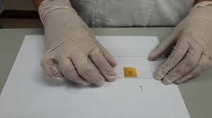
Stool examination
Direct Smears.
Principle
To assess the worm burden of a patient
To provide a quick diagnosis of a heavily infected specimen
To check organism motility
.

Slide 11
Stool examination
Direct wet mount:
Small amount of faeces
Few drops of saline
Sometimes add lugol’s iodine (nuclear details, glycogen vacuole in cyst).
Protozoa (trophozoite), cyst, eggs and larva of helminths.

Slide 12
Stool examination
Concentration methods
Used if parasites are scanty in the sample.
Two types:
1- Floatation (eggs and cyst float , solution of high specific gravity)
Saturated sodium chloride
Zinc sulphate centrifugation floatation (cyst, nematodes).
2- Sedimentation (solution of low specific gravity):
formol ether
Egg count in 1 gram

Slide 13
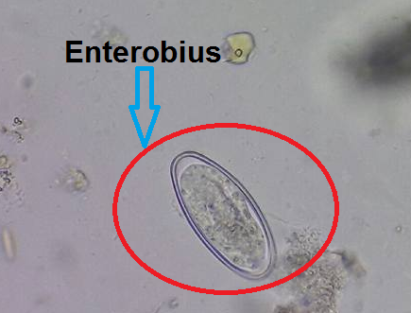
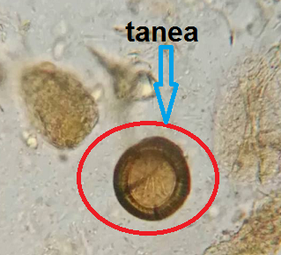
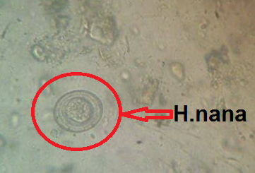
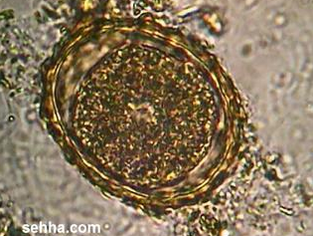
Stool examination
Microscopic Examination of Faecal Specimens: Direct Smears
Ascaris egg

Slide 14
Sputum examination
Sputum examination
Abnormally, it is purulent, bloody, contains rusty brown particles (Paragonimus).
Technique for examination:
Add on a sputum sample equal volume of NaOH to dissolve the mucus.
Leave this combination for a while, then centrifuge at 200xg for 5 minutes, then examine the sediment.
The specimen can be preserved in 10% formalin and a formalin-ethyl acetate

Slide 15
Sputum examination
Parasitology
Macroscopic
Microscopic
Appearance
Concentration
Bloody
Take the sediment
Rusty brown

Slide 16
Sputum examination
Parasites that could be detected in sputum:
The inhabitant in the lung:
Paragonimus
2. Migratory larvae:
Ascaris
Hook worm (Ancylostoma)
Strongyloides.
3. Parasites causing pathology in the lung:
Trophozoites of Entamoeba histolytica.
Hydatid sand due to rupture of hydatid cyst that could be present in the lung.

Slide 17
Blood examination
Fresh capillary blood of finger or ear lobe
Venous blood collected in EDTA (anticoagulant)
Blood sample will be used for :
Microscopic examination (Thin Smear, Thick smear, Wet mount for microfilaria).
Molecular diagnosis
Detection of parasite antigen
Isolation of organisms
Special tests

Slide 18
Blood examination
Two types of blood films can be made, thin and thick blood films:
Thick films.
Thin films.

Slide 19
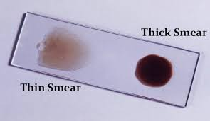
Thick blood film
Blood examination
Thin blood film
Screen large amount of blood (light infection)
Can be stained latter
In malaria Parasitized red blood cells

Slide 20
Blood examination
Parasites that could be detected in blood film:
Malaria
Trypanosoma (African and American).
Microfilaria of all types Filaria except Onchocerca volvulus.
Indian type of Leishmania donovani.

Slide 21
Examination of other Specimens
Lung and Liver
Aspiration from lung and liver could be examined for:
Pneumocytosis
Amoebiasis
Technique: The use of proteolytic enzymes is recommended to free the organisms from the aspirate material
Hydatid Disease
Lymph nodes, Spleen, Liver, Bone Marrow and Spinal Fliud: Aspirated material may be examined for presence of trypanosomes, leishmanial forms and amoebae.
Cutaneous Ulcers : Leishmaniasis

