Slide 1
Urogenital Tract Module Chlaymdia, Gardenella and ureaplasma Dr. Eman Albataineh Associate Prof. Immunology
Department of Microbiology
Mutah University

Slide 3
Notes:
HBT (Human Blood Tween) Bilayer Medium

Slide 13
Clue cells

Slide 16
GENITAL MYCOPLASMAS
Three Mycoplasma species,
Mycoplasma hominis,
Mycoplasma genitalium,
Ureaplasma urealyticum.
are human urogenital pathogens. They are often associated with sexually transmitted infections, or puerperal infections (that is, infections connected with, or occurring during childbirth or the period immediately following childbirth).

Slide 17
Ureaplasma urealyticum
is part of the normal genital flora of both men and women.
It stains gram negative, but that is because it lacks a cell wall.
It is found in about 70% of sexually active humans.
Symptoms can be "silent" or can cause noticeable symptoms such as discharge, burning, urinary frequency, urinary urgency, and pain.
Ureaplasma urealyticum is a common cause of urethritis when neither gonococcus nor chlamydia can be demonstrated, particularly in men.
In women, the organism has been isolated from the endometrium of patients with endometritis and from vaginal secretions of women who undergo premature labor or deliver low-birth-weight babies.
The infants are often colonized, and Ureaplasma urealyticum has been isolated from the infant’s lower respiratory tract and CNS both with and without evidence of inflammatory response.

Slide 18
Ureaplasma urealyticum
It had been associated with a number of diseases, including non-specific urethritis (NSU), infertility, stillbirth, premature birth.
They grow more rapidly than M. pneumoniae and can be distinguished by their carbon utilization patterns: M. hominis degrades arginine, whereas U. urealyticum hydrolyses urea.
Diagnosis; A biopsy or swab, which is tested in a lab, is used to diagnose Ureaplasma. The biopsy or swab may be taken from the vagina, uterine lining, urethra, or urine sample. Due to its small size, Ureaplasma is nearly impossible to see under a microscope. The urine sample or swab is subjected to a PCR test that looks for the DNA of the bacteria
Treatment:
A tetracycline, such as doxycycline, is effective for specific treatment

Slide 19
Urogenital Tract Module
Chlamydia
Dr. Eman Albataineh
Associate prof. in Immunology
Department of Microbiology and Immunology
Faculty of Medicine, Mu’tah University

Slide 20
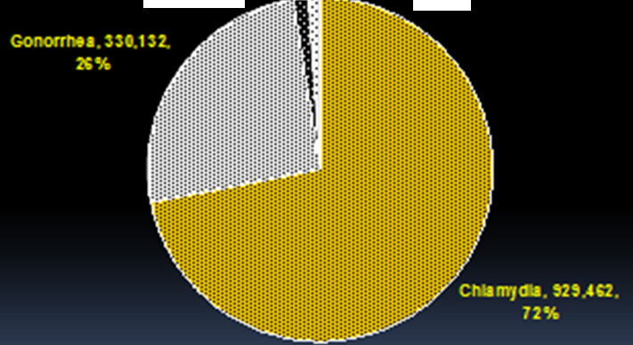
Epidemiology
Is a STDs
In USA over 900,000 cases are reported each year, which is three times the number for gonorrhea (2004)
The cases among males and females are higher than in gonorrhea
Prevalence in pregnant women 6% - 12%
Reinfection is frequent
Reported Sexually Transmitted Diseases, United States, 2004

Slide 21
Chlamydia curriculum
Obligatory intracellular bacteria
Intracellular replication that results in the death of the cell
weakly Gram-negative bacterium. It is ovoid in shape and nonmotile
Three species: C. trachomatis, C. psittaci, C. pneumoniae
Q: Why Chlamydia is an obligatory intracellular parasite?
No flavoproteins or cytochromes, therefore, lacking ATP-generating ability
Need to obtain ATP from the host cell.
Called energy parasites

Slide 22
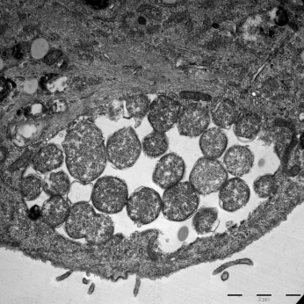
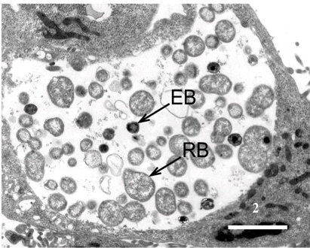
Chlamydial Morphologies and life cycle
Chlamydia curriculum
Takes on two forms in its life cycle:
1- Elementary body
about 0.3 um in diameter
infectious nonreplicating
condensed genetic material
released from ruptured infected cells
2- Reticulate Body
intracytoplasmic form 0.5 - 1.0 um
non-infectious replicating form
replication and growth in an inclusion body
diffuse genetic material
Host cell
RB
Inclusion body
48h post infection
Notes:
The infectious form of Chlamydia, the elementary body (EB) enters into the host cell via endocytosis. Upon entry, the EB convert into the metabolically active, non-infectious reticulate body (RB), which replicates within a vaculolar compartment, termed the inclusion.

Slide 23
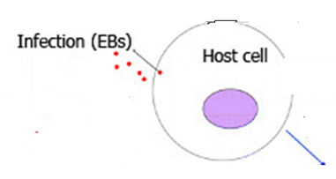
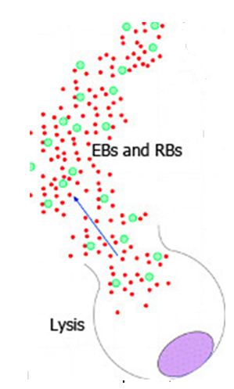
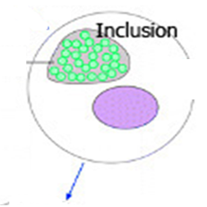
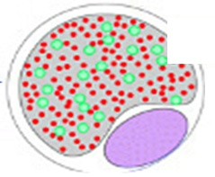
Chlamydia curriculum
Life cycle
48-72 hr

Slide 24
Clinical syndromes
Strains causing human diseases
C. trachomatis strains | Associated diseases
Ocular strains (A, B, Ba, C) | Conjunctivitis, trachoma, infant pneumonia,
Genital strains (D-K) | Nongonoccocal urithritis, Mucopurulent cervicitis, pelvic inflammatory disease (PID)
Genital strains (L1, L2, L3) | Lymphogranuloma venereum (LGV)

Slide 25
Clinical syndromes caused by C. trachomatis
Clinical syndromes
Men
Women
Infants

Slide 26
Pathogenesis
Chlamydiae have a tropism for epithelial cells of the endocervix and upper genital tract of women, and the urethra, rectum and conjunctiva of both sexes.
Once infection is established, there is a release of proinflammatory cytokines by infected epithelial cells.
This results in early tissue infiltration by PMNs, later followed by lymphocytes, macrophages, plasma cells and eosinophils.
If the infection progresses further (because of lack of treatment and/or failure of immune control), aggregates of lymphocytes and macrophages (lymphoid follicles) may form in the submucosa; these can progress to necrosis, followed by fibrosis and scarring.

Slide 27
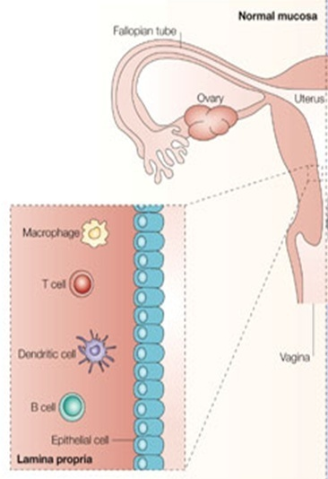
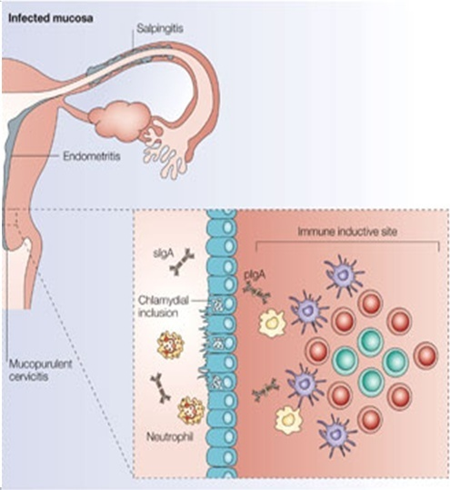
Pathogenesis
Normal
Infected
Notes:
Genital C. trachomatis infections typically last for many months in women. This has been attributed to several strategies by which C. trachomatis evades immune detection, including well-described methods by which C. trachomatis decreases the cell surface expression of the antigen presenting molecules major histocompatibility complex (MHC) class I, MHC class II, and CD1d in infected genital epithelial cells.

Slide 28
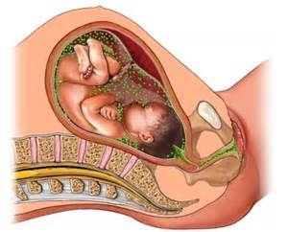
Pathogenesis
How does Chlamydia affect pregnancy?
Chlamydia can cause a pregnant woman to go into labor early or deliver a low-birth weight baby.
Chlamydia can spread from mother to baby during birth. This can cause pneumonia or a serious infection in the baby’s eye that may lead to blindness.
A pregnant woman can be treated to prevent transmission to the baby.

Slide 29
Clinical syndromes
In Men
Urethritis
The most common cause of nongonococcal urethritis (NGU) in men (40 to 96 percent)
More common than gonococcal infection
Majority (>50%) are asymptomatic
The incubation period is variable but is typically 5 to 10 days after exposure
Symptoms
mucoid or clear urethral discharge with bad smell
dysuria
Sometimes the discharge is so scant (thick, white, odorless, and curd-like) like cottage cheese . This is in contrast to the more copious and purulent urethral discharge and shorter (two to seven days) incubation period for gonococcal urethritis

Slide 30
Clinical syndromes
In Men
Epididymitis
Men with acute epididymitis typically have testicular pain and tenderness, hydrocele, and palpable swelling of the epididymis.
Prostatitis
Symptoms included
dysuria
urinary dysfunction
pain with ejaculation
pelvic pain

Slide 31
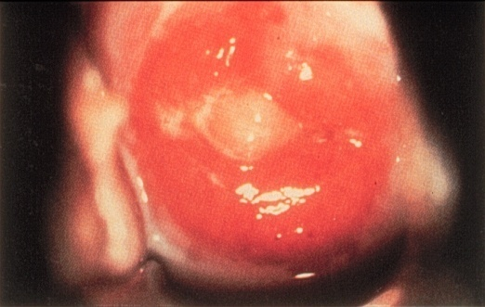
Clinical syndromes
In woman
Urethritis
Usually asymptomatic
Signs/symptoms, when present, include dysuria, frequency, pyuria
Cervicitis
Majority (70%-80%) are asymptomatic
Local signs of infection, when present, include:
mucopurulent endocervical discharge
cervical edema with erythema and friability
Cervicitis

Slide 32
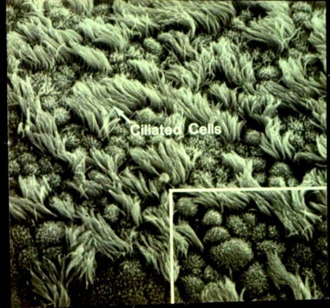
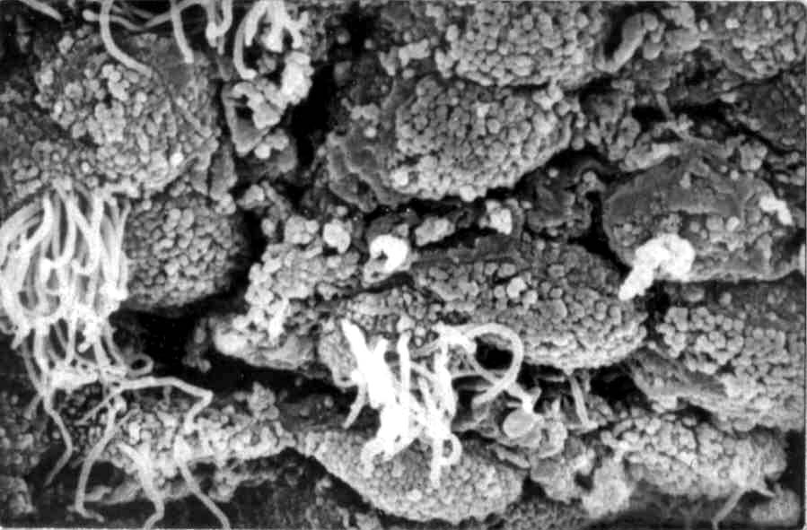
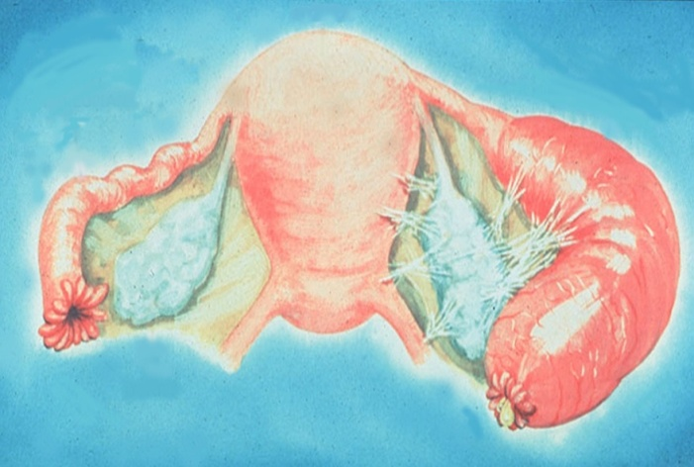
Complications in Women
Clinical syndromes
In woman
Pelvic Inflammatory Disease (PID)
Salpingitis
Endometritis
Normal fallopian tube
C. trachomatis infection (PID)
Acute Salpingitis

Slide 33
Clinical syndromes
Proctitis
Defined as inflammation of the distal rectal mucosa
The clinical presentation depends on the infecting chlamydial serovars
LGV serovars: anorectal pain, mucopurulent exudate, tenesmus, rectal bleeding and constipation. If left untreated, can lead to rectal fistulae and strictures
The non-LGV: the infections are usually asymptomatic
Reiter’s Syndrome (reactive arthritis )
Characterized by a triad of
Arthritis
nongonococcal urethritis
conjunctivitis

Slide 34
Clinical syndromes
Lymphogranuloma venereum (LGV)
primarily an infection of lymphatics and lymph nodes
It gains entrance through breaks in the skin, or it can cross the epithelial cell layer of mucous membranes.
The organism travels down to multiply in the lymph nodes
Stages
Primary stage
A self-limited painless genital ulcer that occurs at the contact site 3–12 days after infection
Unobserved in most cases
Heals in a few days

Slide 35
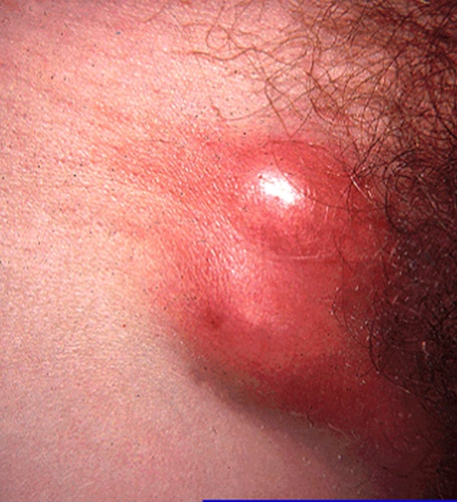
Clinical syndromes
Secondary stage
occurs 10–30 days later, but can present up to six months.
The infection spreads to the lymph nodes through lymphatic drainage pathways.
causing tender inguinal and/or femoral Lymphadenopathy
These changes may progress to necrosis
Third stage
Healing of necrosis takes place by fibrosis.
This can result in varying degrees of lymphatic obstruction and chronic edema
Causing genital elephantiasis

Slide 36
STDs comparison
Syphilis | firm painless ulceration 5–15 mm and sharply demarcated often, a painless nontender inguinal lymphadenopathy
Herpes genitalis | group of vesicles on an erythematous base after rupturing, they form an ulcer heal within 1–4 weeks
H. ducruyi | soft Painful deep purulent ulcers (2–20 mm) painfull Lymphadenopathy. Swollen lymph nodes can break through the skin and lead to large abscesses (collections of pus) that drain
LGV | painless ulcer (2–10 mm). the genital ulcers heal spontaneously. tender and painful lymphadenopathy is a typically symptom of LGV

Slide 37
diagnosis
The preferred method for chlamydia testing is the nucleic acid amplification test (NAAT) that detects the genetic material (DNA) of Chlamydia trachomatis
A urine test. A sample of your urine is analyzed in the laboratory for presence pyurea but no bacteria.
A swab. For women, your doctor takes a swab of the discharge from your cervix for culture or antigen testing for chlamydia.

Slide 38
diagnosis
Typical intracytoplasmic inclusions in Giemsa-stained cell.
polymerase chain reaction (PCR) in first-void urine.
Positive culture in McCoy or HeLa cells of body fluids or secretions.
Serology test in patients with presumed lymphogranuloma venereum.

Slide 39
Treatment
Tetracycline
Azithromycin
Erythromycin in children

