Slide 1
Acute Respiratory Distress Syndrome (ARDS)
Runeem al sunna
Wasan habashneh
Nadia rawashdeh

Slide 2
Definition
Acute and diffuse inflammatory damage into the alveolar-capillary barrier associated with a vascular permeability increase and reduced compliance, compromising gas exchange and causing hypoxemia
Rapidly progressive non-cardiogenic pulmonary edema.

Slide 3
Causes
1. Sepsis is the most common risk factor … can be secondary to many infections such as ( pneumonia,, urosepsis ,, wound infections ).
•Aspiration of gastric contents .
•Acute pancreatitis .
•Multiple blood transfusion .
•Water drowning .
•Drugs overdose like ( thiazide , amiodarone).

Slide 4
2. Sever trauma , fractures ( pelvis , femur ) . 3. Toxic inhalation. 4. Intracranial HTN. 5. Cardiopulmonary bypass.

Slide 5
Pathophysiology

Slide 7
Widespread alveolar damage involving the alveolar epithelial and capillary endothelial cells .
Leak of protein rich fluid resulting in interstitial and alveolar edema causing ‘Hayaline membrane ‘.
Influx of inflammatory cells (neutrophilic alveolitis ).
Damage to surfactants causes alveolar collapse .

Slide 8
Berlin definition
Hypoxemia that is refractory to oxygen therapy
Ratio of PaO2/FiO2 200-300 mild
100-200 moderate
Less than 100 severe
No evidence of CHF clinically or PCWP > or equal to 18 mm Hg
Bilateral diffuse pulmonary infiltrate on CxR
Respiratory symptoms that develop within 1 week of known insult

Slide 9
The main problem is the injury to the type two alveolar cell that is responsible for the production of the surfactant
that prevent the atelectasis,
So the problem is on the alveolar level.
patient with sepsis have highest risk in developing ARDS.

Slide 10
Clinical manifestation of ARDS:
Dysphea
Tachypnea
Progressive hypoxemia non responsive supplemental oxygen
Changes in the level of Consciousness
If precipitated by pneumonia: Fever &cough

Slide 11
physical finding Non specific in ARDS.
Always look for sepsis or any signs of infection acute abdomen iv lines winners ulcers decubitus one.
Distinguish between cardiogenic pulmonary edema & look for signs of volume overload congestive heart failure, edema, hepatomegaly
,

Slide 12
',
What is FiO2?
Fractional inspired O2 concentration
PEEP: positive end expiratory pressure.
The pressure in lung during expiration that keeps the compliance of the alveoli
The PEEP increase in a step wise fashion coordination with FiO2

Slide 13
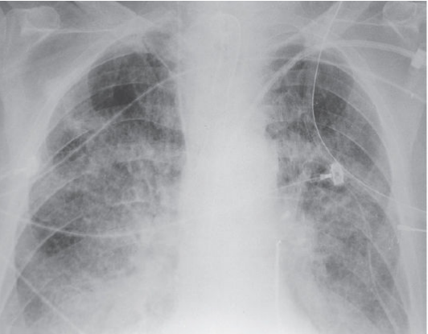
Investigation
1. Imaging
• CXR:
shows diffuse bilateral pulmonary infiltrates
• can also use CT scan or US :may be used to further evaluate the extent and distribution of lung
involvement ,help guide management decisions
and to rule out atelectasis, consolidation ,…..

Slide 14
Normal VS ARDS CXR
Normal
ARDS

Slide 15
2. ABG
• to assess oxygenation status in case of Hypoxemia ( PaO2<60)
to assess acid-base balance.
3.Echocardiography
may be performed to assess for the presence of pulmonary hypertension or right ventricular dysfunction, which can occur as a complication of ARDS.

Slide 16
Management
1.Oxygenation: try to keep O2 saturation > 90%.
2.Mechanical ventilation: The most important principles include using a high PEEP with low tidal volumes.
3.Treat the underlying cause (infection, sepsis, pneumonia)
4.Prevent complication
•Such as complications associated with mechanical ventilation( barotrauma, nosocomial pneumonia).
5. . Prone positioning for at least 16 hours/day for patients with severe ARDS

Slide 18
Thank you

