Slide 1
Pelvic inflammatory disease (PID)
Dr. Ahlam Al-Kharabsheh
Edited By : Noor Al-huda Esam Al-Karaki
Doctor's notes were added in orange color
OBS & GYN Department 2021

Slide 2
Pelvic inflammatory disease (PID) : disease of Nulliparous
***Acute infection of the upper genital tract structures in women, involving any or all of the uterus, oviducts, and ovaries; this is often accompanied by involvement of the neighboring pelvic organs. Involvement of these structures results in endometritis, salpingitis ( endothelium of tubes ) , oophoritis, peritonitis, perihepatitis and tubo-ovarian abscess.
→ By definition, PID is a community-acquired infection initiated by a sexually transmitted agent, distinguishing it from pelvic infections caused by medical procedures ( D&C , hysteroscopy and biopsy ), pregnancy ( manual retained placenta removal under GA ), and other primary abdominal processes ( rupture of colon , appendix).
Coincidence of active fallopian tube infection and ovulation → exposure of ovarian stromal and disturbance of ovarian capsule during ovulation → so the ovary will be infected from fimbriae . The body tries to isolate the inflamed area by omentum and broad ligament and creates boundaries → Tubo-overian abscess detected by US as adnexal mass , ectopic pregnancy or cyst etc .

Slide 3
PATHOGENESIS : The endocervical canal functions as a barrier protecting the normally sterile upper genital tract from the organisms of the dynamic vaginal ecosystem. Disturbance of this barrier ( cervical mucus plug ) provides vaginal bacteria with access to the upper genital organs via canalicular routes, infecting the endometrium, then endosalpinx, ovarian cortex, pelvic peritoneum, and their underlying stroma. This is the clinical entity of PID.
Acute PID is an ascending infection caused by cervical microorganisms (including Chlamydia trachomatis and Neisseria gonorrhoeae), as well as the vaginal microflora, including anaerobic organisms, enteric gram-negative rods, streptococci, genital mycoplasmas, and Gardnerella vaginalis, which is associated bacterial vaginosis. Bacterial vaginosis results in complex alterations of the normal vaginal flora, which may alter host defense mechanisms in the cervicovaginal environment
-Up to 75 % of cases occur within seven days of menses, during which time the quality of the cervical mucus favors the ascension of vaginal organisms. Epidemiologic data suggest that all community-acquired agents causing disturbance of the endocervical barrier are sexually transmitted.
During menstrual cycle the consistency of cervical mucus and immediately after it : thin , so there it’ll be a weak barrier , usually symptoms of PID present during or directly after menstrual bleeding

Slide 4
MICROBIOLOGY :
Initiating pathogens in pelvic inflammatory disease include Neisseria gonorrhoeae and Chlamydia trachomatis account for an estimated one-third of all cases of pelvic inflammatory disease, although in the majority of cases the etiology of PID is unknown.
● Mixed infection : Regardless of the initiating event, the microbiology of PID,
especially for clinical purposes, should be viewed and
treated as a mixed (facultative and anaerobic) polymicrobial
infection.
There is no isolated infection

Slide 5
RISK FACTORS :
PID is primarily a disease of sexually active women
1) Multiple sex partners : The most important risk factor increase the risk 3.4 folds .
→ Celibate women are not at risk for PID.
→ Women with longstanding monogamous relationships rarely develop PID.
2) Status of the partner : Approximately one-third of men with gonococcal or
chlamydial urethritis are asymptomatic. Having a symptomatic (dysuria, urethral
discharge) male partner greatly increases a woman's risk of PID.
3) Age: PID occurs in highest frequency among those 15 to 25 years of age; the
incidence in women older than the age of 35 is only one-seventh that in younger
women.
4) Previous PID: approximately one in four women with PID will suffer recurrence.

Slide 6
5) Contraceptive method :
● Barrier contraception : protects against PID. Condoms are the most effective,
preventing 50 % of endocervical gonococcal and chlamydial infections.
● Oral contraceptives: ( COCP , continuous ( no pill free period ))
associated with increased risk of subclinical PID. So come with long term complications
-might protect but not complete protection , it makes the bleeding lighter , so the period of this mucous well be short , with less contractions so the ascending motility will be decreased .
● Intrauterine device ( office procedure ) and tubal ligation: Modern intrauterine devices cause little,
if any, increased risk for PID. The risk of PID is primarily limited to the first three
weeks after IUD insertion and is uncommon thereafter.
In first month we give antibiotic if it persistent we have to change the contraception method
→ Long-term indwelling IUDs have been associated with pelvic actinomycosis,
a rare disease that can present as a pelvic mass with weight loss and constitutional symptoms.
● Progestin-based contraceptives: may decrease the risk of PID because progestin thickens cervical mucus, thereby possibly providing an enhanced barrier against ascending infection.

Slide 7
6) Bacterial vaginosis : is more common among women with PID.
Alteration of normal flora
Not increase the risk ,just associate with PID,
7) Sex during menses.
8) Vaginal douching. WHY ? :
1-Douching the micro-organisms upward
2-change ph.
3-mask the most important symptom ( vaginal discharge )
Tubal ligation : so we have two segments :
Distal one : no access to fallopian tube so decrease the risk
The second one : proximal to tube so the incidence same

Slide 8
CLINICAL FEATURES : 1) Lower abdominal pain : Is the cardinal presenting symptom in women with PID
● The onset of pain during or shortly after menses is particularly suggestive. → congestive secondary dysmenorrhea .
● Usually bilateral and rarely of more than two weeks' duration. ACUTE
below the umblicus
2) Abnormal uterine bleeding: occurs in one-third or more of patients with PID.
And Dyspareunia (deep after penetration , superficial )
3) On physical examination :
● Fever : about one-half of patients.>38.3
● Abdominal examination reveals diffuse tenderness greatest in the lower quadrants
which may or may not be symmetrical. + rigidity in case of peritoneal involvement
Rebound tenderness and decreased bowel sounds are common. Marked tenderness in the right upper quadrant does not exclude PID, since approximately 10 % of these patients have perihepatitis (Fitz-Hugh Curtis syndrome).caused by chlamydia .
-On pelvic examination, the finding of a purulent endocervical discharge and/or acute cervical motion and adnexal tenderness with bimanual examination is strongly suggestive of PID.
Two fingers inside the anterior vaginal fornix , and the second hand on the level of Symphysis pubis try to interrupt the uterus between your hand
Notes:
Other symptoms:
**deep dyspareunia
• abnormal vaginal bleeding, including post coital, inter-menstrual and menorrhagia
• abnormal vaginal or cervical discharge which is often purulent.

Slide 9
Subclinical PID :
● No symptoms.
● Defined histologically by the presence of neutrophils and plasma cells in endometrial
tissue.
● Subclinical PID severe enough to produce significant sequelae ( e.g,tubal factor
infertility ).
● Subclinical episodes are particularly common among oral contraceptive users.
Perihepatitis (Fitz-Hugh Curtis Syndrome) :
By blood , lymph or direct contact (peritonitis )
● It consists of infection of the liver capsule and peritoneal surfaces of the anterior
right upper quadrant, with minimal stromal hepatic involvement.
● Symptoms are typically the sudden onset of severe right upper quadrant abdominal
pain with a distinct pleuritic component, sometimes referred to the right shoulder. And right upper ¼ tenderness
● Aminotransferases are also usually normal.
● By laparoscopy: diagnosis accidentally manifests as a patchy purulent and fibrinous exudate in the acute
phase ("violin string" adhesions), most prominently affecting the anterior surfaces of
the liver (not the liver parenchyma). And anterior abdominal wall .
Without involvement of parenchyma

Slide 10
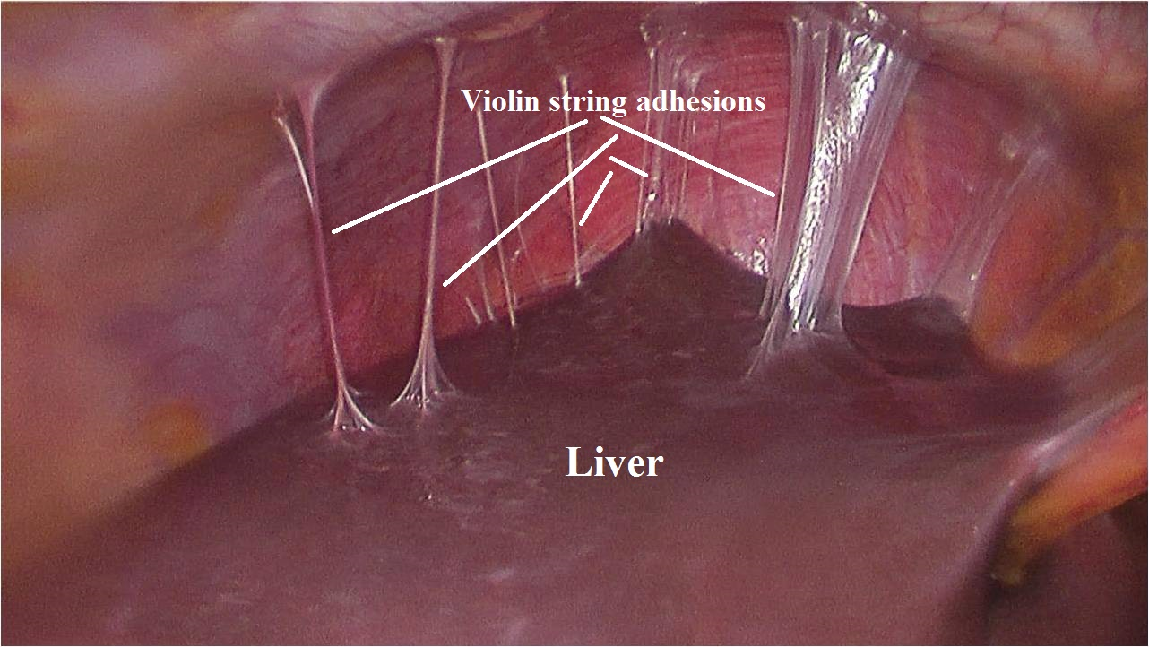

Slide 11
DIAGNOSTIC CONSIDERATIONS : Diagnosis of exclusion
● PID represents a spectrum of clinical disease, from Endometritis to fatal
intraabdominal sepsis.
● There are multiple gold standards in use to establish the diagnosis, because
no one among them is adequate alone. Older studies defining PID by a
single standard, such as laparoscopic visualization of gross salpingitis, are
now felt to lack sensitivity.
DD :
-Deep dyspareunia
-Endometritis : deep dyspareunia , secondary dysmenorrhea , menorrhagia and intermenstrual bleeding
-Appendicitis :25% have motion tenderness
-ectopic pregnancy
-Cervical infection : PCB and intermenstrual bleeding

Slide 12
1- Oral temperature >101° F (>38.3°C). 2- Abnormal cervical or vaginal mucopurulent discharge. 3-Presence of abundant numbers of white blood cells (WBCs) on saline microscopy of Vaginal secretions.15.000-20.000/microL 4- Elevated erythrocyte sedimentation rate (ESR). 5- Elevated C-reactive protein (CRP). 6- Demonstration of N. gonorrhoea or C. trachomatis in the genital tract
A minimal set of clinical criteria has been recommended by the CDC for empirical treatment of PID, including cervical motion tenderness or uterine or adnexal tenderness in the presence of lower abdominal or pelvic pain.with reproductive age
The following additional criteria can also be used to support a clinical diagnosis of PID:
By high vaginal swab or endocervical swab and culture

Slide 13
● Plasma cell endometritis :
Plasma cell endometritis (PCE) has been identified as an important
component of PID.
- PCE was documented in about 80-90% of women with PID.
- The density of the plasma cell infiltrate correlated with the clinical severity of
disease.
→ Patchy inflammation : blind endometrial biopsy will be insufficient.
Diagnostic criteria and guidelines:
Patients with pelvic pain and tenderness and any one or more of the following are currently considered "confirmed" cases:
Acute or chronic (plasma cell) endometritis or acute salpingitis on histologic
evaluation of a biopsy.
Gross salpingitis visualized at laparoscopy or laparotomy.
Isolation of pathogenic bacteria from a clean specimen from the upper genital tract
Inflammatory/purulent pelvic peritoneal fluid without another source.

Slide 14
DIAGNOSTIC TESTING : Noninvasive diagnostic tests for PID include general laboratory studies looking for signs of inflammation, culture testing and microscopy of cervical or vaginal secretions, and imaging studies.
1) Laboratory tests :
- pregnancy test to rule out ectopic pregnancy and complications of an intrauterine
pregnancy.
- CBC , ESR,CRP : Although PID is usually an acute process, less than half of PID
patients exhibit leukocytosis.
- Swabs ( high vaginal and endocervical ) : for microscopic examination, gram stain
and culture.( e.g., increased white blood cells (WBC) in vaginal fluid ).
- Nucleic acid amplification tests for C. trachomatis and N. gonorrhoeae.
- Urinalysis. Lower UTI , Cystitis
- Others : HIV testing/Hepatitis B surface antigen and surface antibody
Testing for syphilis.
-wet mount preparation to detect WBC in vaginal discharge
→ Negative endocervical or high vaginal swabs screening for Chlamydia trachomatis and Neisseria gonorrhoeae does not rule out upper tract
infection. → so you have to start with broad spectrum antibiotics

Slide 15
2) Imaging techniques :
● Transvaginal ultrasound : Sonographic findings consistent with PID are thickened
fluid-filled tubes/oviducts with or without free pelvic fluid or tuboovarian complex,
are useful to support a clinical diagnosis of PID.
- However, the absence of findings does not diminish the probability of PID and
should not be used as a reason to delay treatment.
Conclusion : There was no single test or combination that was both sensitive and
specific for the diagnosis of PID. However, certain combinations may
have a high negative predictive value.
Health care providers should maintain a low threshold for the diagnosis of PID
and that sexually active young women with the combination of lower abdominal,
adnexial, and cervical motion tenderness should receive empiric treatment.
US to rule out other causes : ectopic , Tubo-ovarian abscess

Slide 16
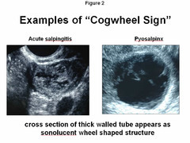
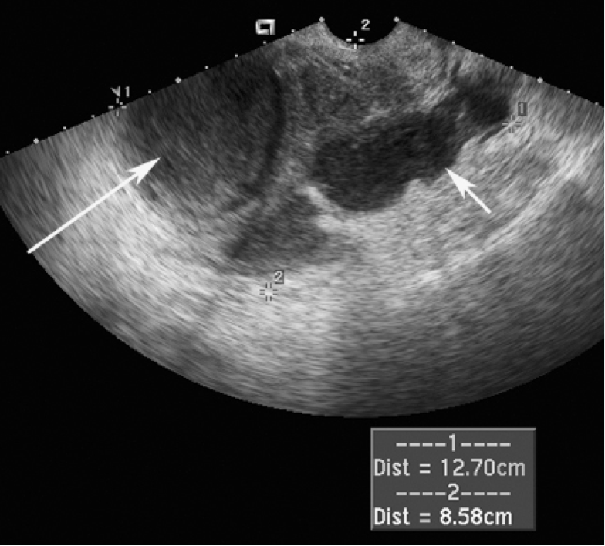
Chronic
By cross section of fallopian tube
ovary : Heterogeneous mass and thick capsule
sausage shape ,

Slide 17
In diagnosis ? We are mainly depend on the signs and symptoms ( clinically )
● Laparoscopy :
The sensitivity of laparoscopy to be as low as 50 % with a specificity approaching
100 %. Thus, laparoscopy has substantial value in confirming the diagnosis of PID but
is not sensitive enough to be considered a diagnostic gold standard.
- Recommend laparoscopy for the following:
1- A sick patient with high suspicion of a competing diagnosis (usually appendicitis).
2- An acutely ill patient who has failed outpatient treatment for PID.
3- Any patient not clearly improving after approximately 72 hours of inpatient
treatment for PID.
4-In case of Tubo-ovarian abscess and we need surgical intervention
Laparoscopic abnormalities consistent with PID (tubal erythema, edema,
adhesions; purulent exudate or cul-de-sac fluid; abnormal fimbriae)
why we don't use laparoscopy from the start ? because it's an infection which will be treated with antibiotic simply , but the complications of laparoscopy will overcome the benefits , so we use it in some cases :
Laparoscopy is highly sensitive in late and chronic PID not in the early
what else ? other than laparoscopy ? hysteroscopy with biopsy , once the Endometritis incidence more than 80%

Slide 18
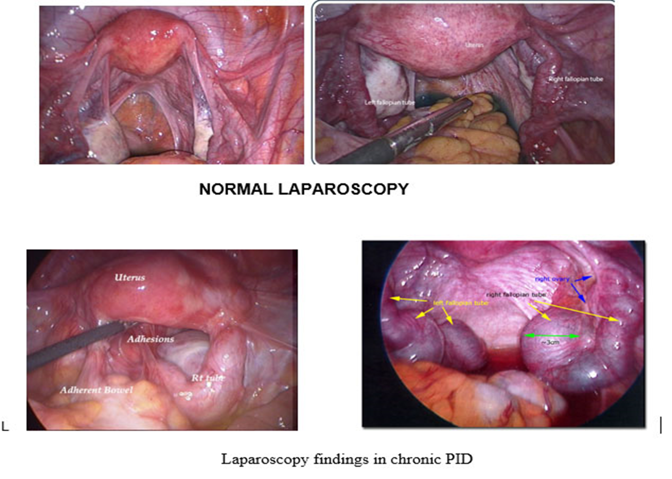
Pelvic fluid

Slide 19
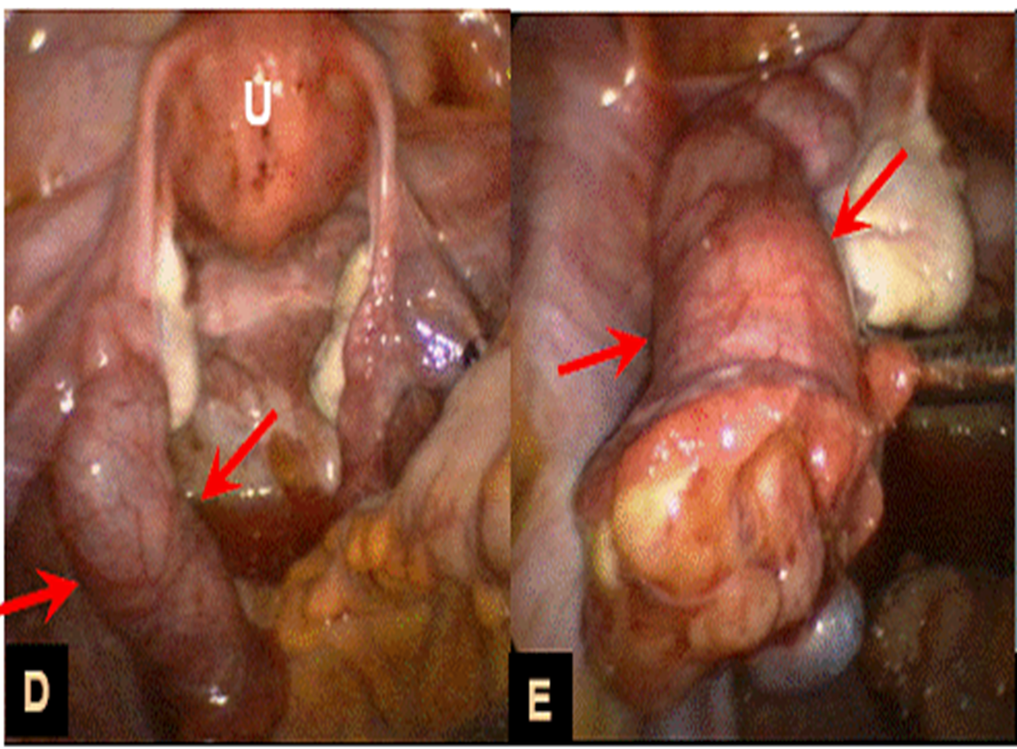

Slide 20
Long-term complications of PID
1) HYDROSALPINX , with infection ? Pyosalpinx
● After PID resolves, the damaged fallopian tube cilia can become blocked, filled with sterile
fluid, and become enlarged. Specially by chlamydia
● Hydrosalpinx may be associated with pain ( chronic ) or may be asymptomatic except for tubal
factor infertility.
● Hydrosalpinx in patients undergoing in vitro fertilization (IVF) has negative
consequences on the rates of pregnancy, implantation, early pregnancy loss,
preterm birth, and live delivery. So salpingectomy is recommended before IVF.
2) CHRONIC PELVIC PAIN :
● Defined as menstrual or non-menstrual pain of at least six months' duration that
occurs below the umbilicus and is severe enough to cause functional disability.
● One-third of women with PID develop chronic pelvic pain.
● While the precise etiology is unknown, the pain may result from scarring and
adhesions that develop from inflammation related to the infectious process.
In case of IVF , there is a recommendation to remove the tubes cause the fimbriae is blocked so the secretions go to endometrium and interfere with implantation .
Fibrin deposition → adhesions
By hystrosalpingiogram : we inject the dye through cervix then to abdominal cavity through the fimbriae : to assess the tubal patency

Slide 21
3) INFERTILITY :
● Both symptomatic and asymptomatic PID can cause permanent injury to the fallopian tube, especially the endosalpinx(response for secretion ).
● Changes to the fallopian tube, including loss of ciliary action, fibrosis, and occlusion,
lead to tubal infertility. There may be additional mechanisms of infertility, as well.
● Risk factors for tubal factor infertility and other long term complications:
1- Chlamydial infection: Among the microorganisms that cause PID, Chlamydia
trachomatis appears to carry the greatest risk of infertility. Approximately one in
four women with tubal factor infertility seeking care in an infertility clinic has
serum antibodies to C. trachomatis.
2- Delay in seeking care for PID : women with PID who delayed seeking treatment
>=3 days were threefold more likely to be diagnosed with infertility
than women who sought care in a timely manner.
3- Increasing number of PID episodes.
4- Severity of infection. Peritonitis , abscess .

Slide 22
4) ECTOPIC PREGNANCY : cilia damaged
● Tubal damage caused by PID increases the risk of tubal pregnancy, as well as
infertility, and the risk of ectopic pregnancy increased with the number of episodes
and severity of PID.
5) OVARIAN CANCER:
● A history of PID was associated with an almost two-fold increase in the risk of
ovarian cancer, with the highest risk in women with multiple episodes of PID.
● It is not known whether PID is an independent risk factor for ovarian cancer, as PID
increases the risk of low parity, nulliparity, nulligravidity, and infertility, which are
also risk factors for ovarian cancer.

Slide 23
Treatment of PID
● Clinicians should maintain a low threshold of suspicion for the diagnosis and empiric
treatment of PID since long-term complications are more common if treatment is
delayed.
● PID is a polymicrobial infection, which generally requires broad coverage,
particularly among those with severe disease requiring hospitalization.
● Treatment response is based on both short- and long-term outcomes.
1-Clinical cure is defined as "significant" or "complete improvement" in the
signs and/or symptoms of PID.
2-Microbiologic cure is defined as eradication of N. gonorrhoeae or C.
trachomatis, if present at baseline.
By swab
How to monitor ?

Slide 24
INDICATIONS FOR HOSPITALIZATION :
Recommended indications for hospitalization and parenteral antibiotics include :
● Pregnancy Highest risk in 1st trimester then the risk decrease due to thick mucosal plug and decidua
● Lack of response or tolerance to oral medications
● Non-adherence to therapy
● Inability to take oral medications due to nausea and vomiting
● Severe clinical illness (high fever, nausea, vomiting, severe abdominal pain) need parenteral .
● Complicated PID with pelvic abscess (including tuboovarian abscess)
● Possible need for surgical intervention or diagnostic exploration for alternative
etiology (eg, appendicitis)

Slide 25
Inpatient therapy :
Patients with severe PID should be hospitalized and treated with parenteral therapy :
First-line therapies: For patients with severe PID, the CDC recommends either of the following parenteral regimens, which result in clinical cure of acute disease in >90 % of PID cases :
● First line :Cefoxitin (2 g intravenously every 6 hours) or cefotetan (2 g IV every 12
hours) plus doxycycline (100 mg orally every 12 hours).
● Clindamycin (900 mg intravenously every 8 hours) plus gentamicin loading
dose (2 mg/kg of body weight) followed by a maintenance dose
(1.5 mg/kg) every 8 hours.
Single daily intravenous dosing of gentamicin may be substituted for three times daily dosing.
Ototoxicity , teratogenicity and nephrotoxicity

Slide 26
These inpatient regimens provide broad coverage, including streptococci, gram-negative enteric bacilli (E.coli, Klebsiella spp, and Proteus spp), and anaerobic organisms (ie, bacterial vaginosis-associated flora). --Antiemetic and antipyretic medications should be offered to those patients who are symptomatic. Transitioning from parenteral to oral therapy can usually be started after 24 hours of sustained clinical improvement, such as resolution of fever, nausea, vomiting, and severe abdominal pain, if present. Patients should complete a 14-day course of treatment with doxycycline (100 mg twice daily) as Outpatient .

Slide 27
PREGNANT PATIENTS :
While it is quite rare to have PID during pregnancy, the infection can occur in the first 12 weeks of gestation before the mucus plug and decidua seal off the uterus from ascending bacteria. As above, pregnancy is an indication for hospitalization and parenteral antibiotics for PID.
-Use 1st line therapy but azithromycin 1gm orally instead of doxycycline( contraindication in pregnancy ).
Orally 1 gram week apart ( two doses )

Slide 28
Outpatient therapy : Patients with mild or moderate PID are suitable candidates for oral therapy since clinical outcomes are equivalent with parenteral or oral therapy.
First-line regimens: The CDC recommends any of the following outpatient regimens, with or without metronidazole (500 mg twice a day for 14 days) :
● first line :Ceftriaxone 3rd generation of cephalosporin (250 mg intramuscularly in a single dose) plus doxycycline (100 mg orally
twice a day for 14 days).
● Cefoxitin (2 g intramuscularly in a single dose) concurrently with probenecid to reduce renal excretion (1 g orally in a single dose) plus doxycycline (100 mg orally twice a day for 14 days).
● Other parenteral third-generation cephalosporins, such as cefotaxime (1 gram
intramuscularly in a single dose) or ceftizoxime (1 gram intramuscularly in a single
dose) plus doxycycline (100 mg orally twice a day for 14 days).
To cover an-aerobs , in case of history of recent instrumental 2 weeks ago hysteroscopy with biopsy or surgical evacuation

Slide 29
DURATION OF THERAPY :
The optimal duration of therapy is unknown. Most studies have used 14 days of therapy and this duration has been maintained in the 2010 STD recommendations from the CDC.
PATIENT RELATED ISSUES :
1) Patient monitoring :
If outpatient therapy is selected, it is important to see the patient within 48 to 72
hours to be certain that clinical improvement has occurred ( reduction in
abdominal tenderness and reduction in cervical motion tenderness).
If no clinical improvement has occurred within 72 hours, hospitalization, parenteral therapy, and further diagnostic evaluation is recommended.
2) Medication adherence :
Compliance with a long course of oral antibiotics can be problematic. Patients
should be educated about the importance of medication adherence and clinical
outcomes. → to decrease risk of complications and recurrence

Slide 30
3) Counseling and screening :
Clinicians should counsel patients regarding the route of acquisition for sexually
transmitted infections, the concomitant need for partner treatment, and future safe
sex practices.
4) Sex partners :
Male sex partners of women with PID should be examined and treated if they had
sexual contact with the patient during the previous 60 days prior to the patient's
onset of symptoms, regardless of the woman’s sexually transmitted infection test
results.
Evaluation and treatment of the sex partner is essential to decrease the risk
of reinfection. Regimens should include antibiotics with activity against Neisseria
gonorrhoeae and Chlamydia trachomatis, such as ceftriaxone one shot (250 mg)
intramuscularly plus either azithromycin (1 gram) orally as a single dose
or doxycycline (100 mg) orally twice daily for seven days.
In case of ovarian abscess → Admission and aggressive parenteral antibiotics → No response ? Go for drainage ( transvaginally or laparoscope )
>40years and complete her family we can remove the tubes and ovary

