Slide 1
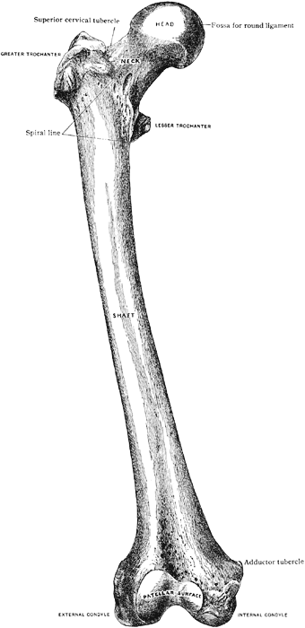
Lower limb fractures (femur fractures)
Moh’d Said dawod m.d.
Orthopedics and reconstructive surgery consultant
Faculty of Medicine , mutah University
Jan. 2021

Slide 2
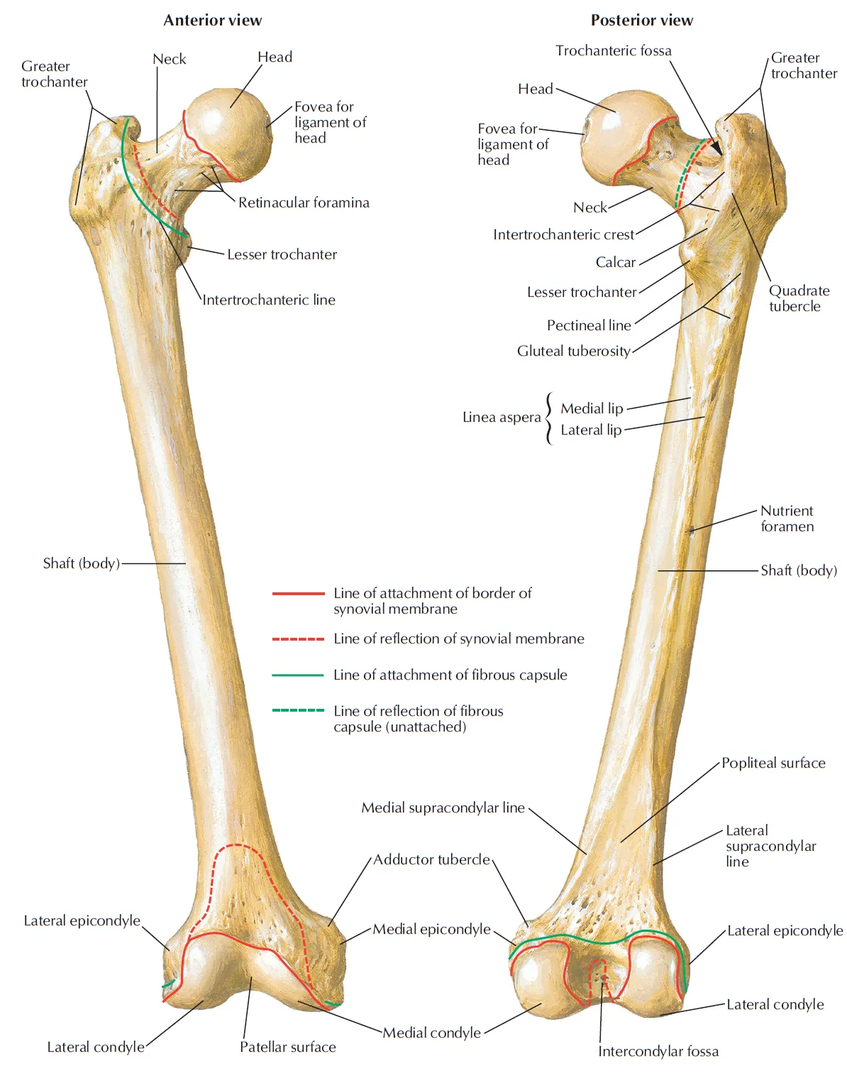
Anatomy

Slide 3
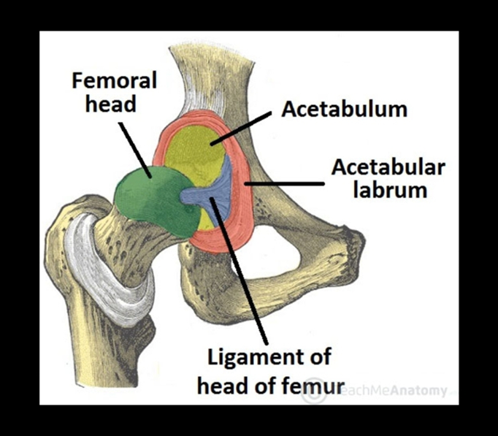
Hip dislocation
Hip joint inherently stable due to
bony anatomy
soft tissue constraints including
labrum
capsule
ligamentum teres

Slide 4
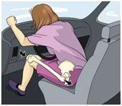
Hip dislocation
Epidemiology
rare, but high incidence of associated injuries
mechanism is usually young patients with high energy trauma

Slide 5
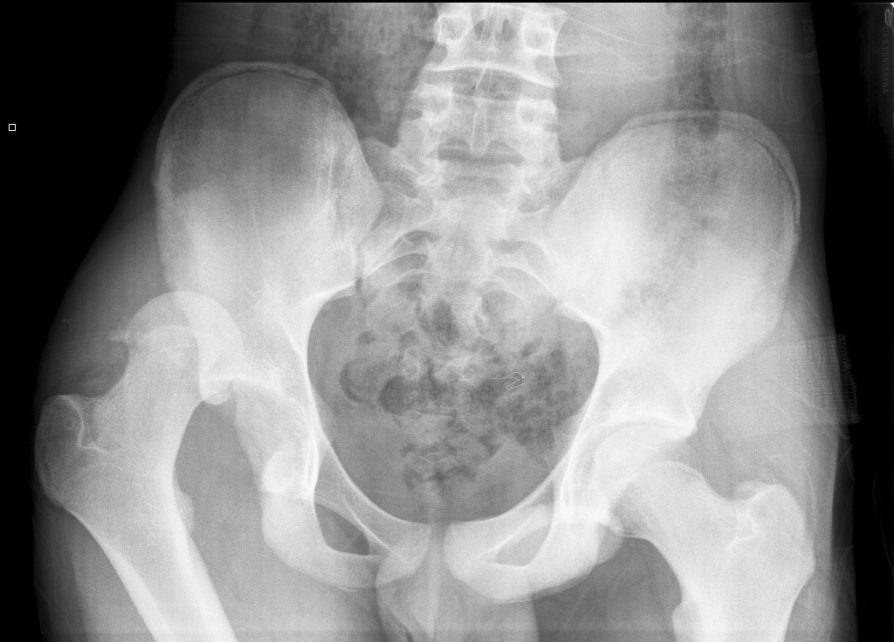
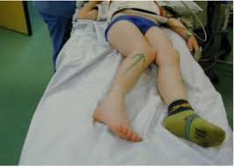
Hip dislocation
Presentation
posterior dislocation (90%)
Most common
Hip and leg in slight flexion, adduction, and internal rotation
10-20% sciatic nerve injury

Slide 6
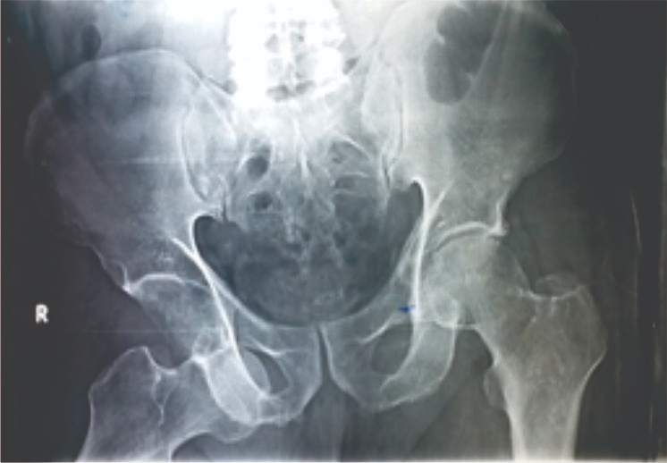
Hip dislocation
Anterior dislocation
Hip and leg in extension, abduction, and external rotation

Slide 7
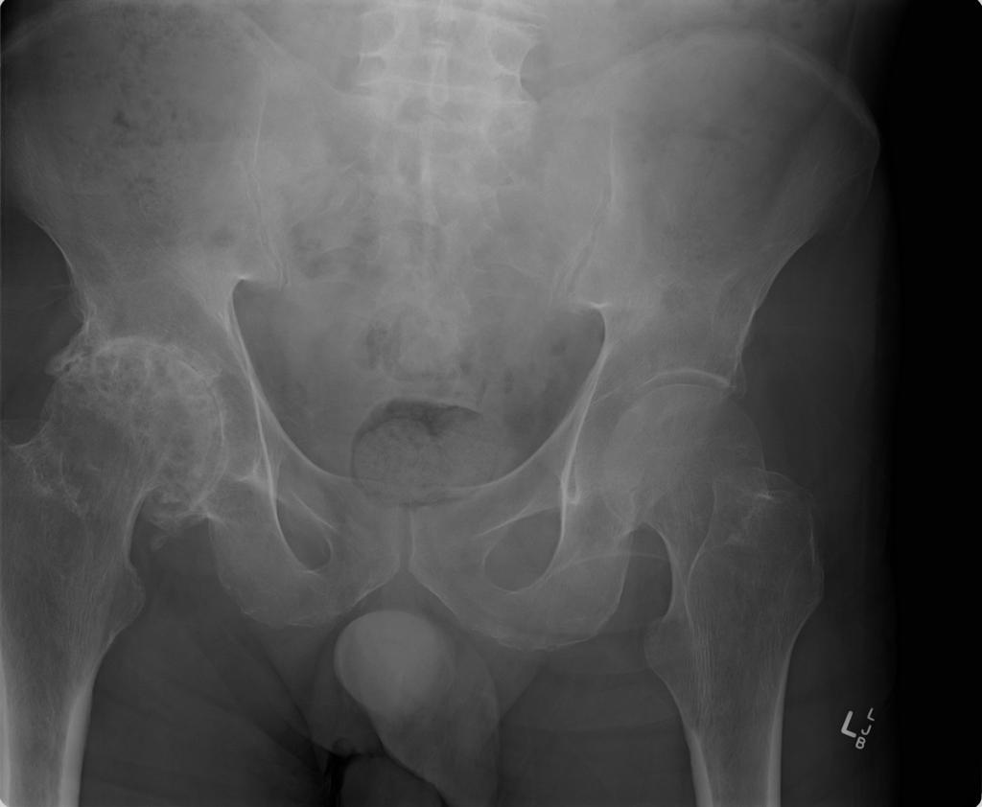
Hip dislocation
Complication
Post-traumatic arthritis
Femoral head osteonecrosis
Sciatic nerve injury
Recurrent dislocations

Slide 8
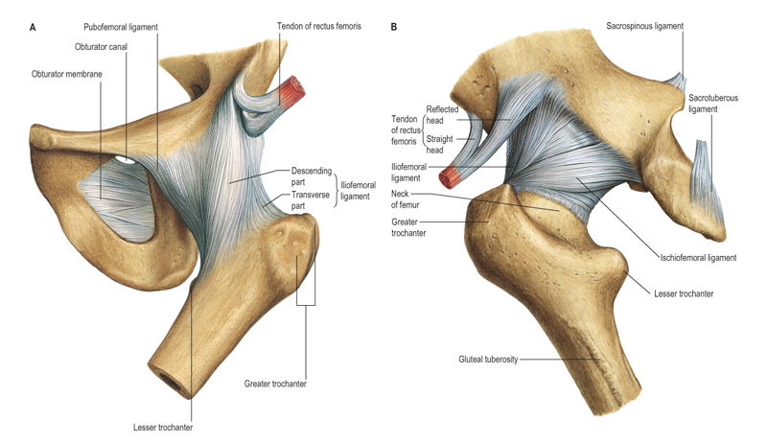
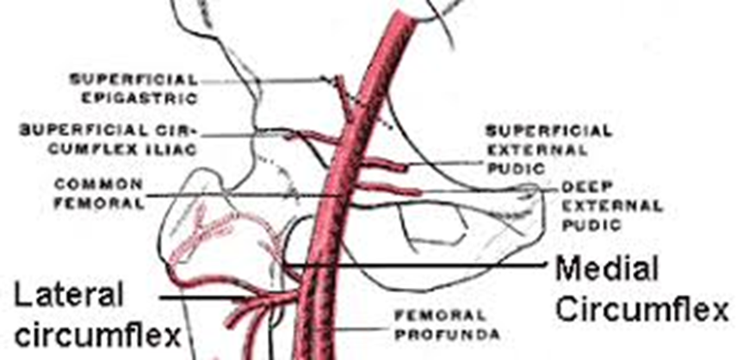
Femur Neck fracture
Anatomy And blood supply
major contributor is medial femoral circumflex (lateral epiphyseal artery)
some contribution to anterior and inferior head from lateral femoral circumflex
some contribution from inferior gluteal artery
small and insignificant supply from artery of ligamentum teres

Slide 9
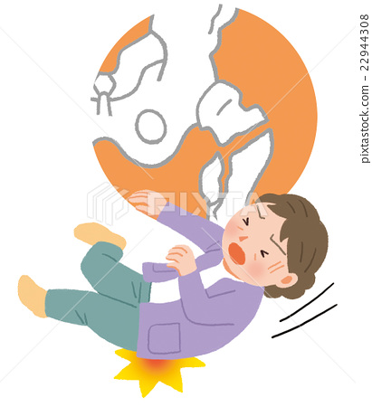
Femur Neck fracture
Mechanism
high energy in young patients
low energy falls in older patients. (Inssufficieny fracture)
Pathophysiology
healing potential
femoral neck is intracapsular, bathed in synovial fluid
lacks periosteal layer
callus formation limited, which affects healing

Slide 10
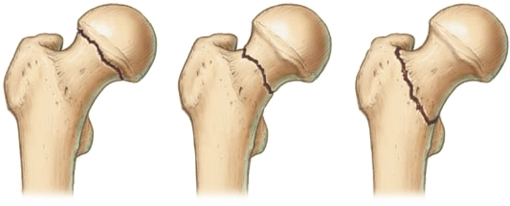
Femur Neck fracture

Slide 11
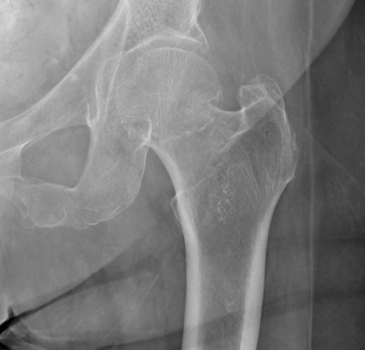
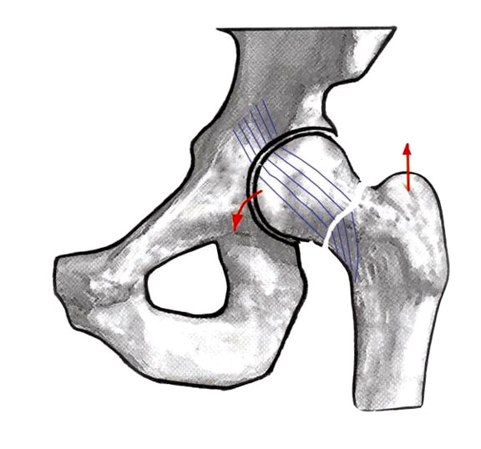
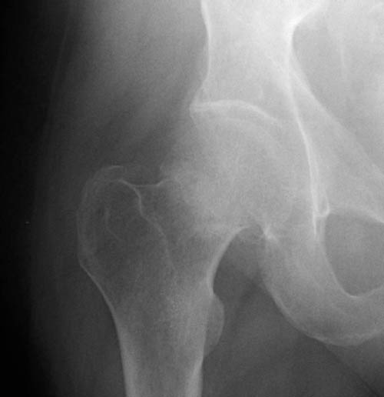
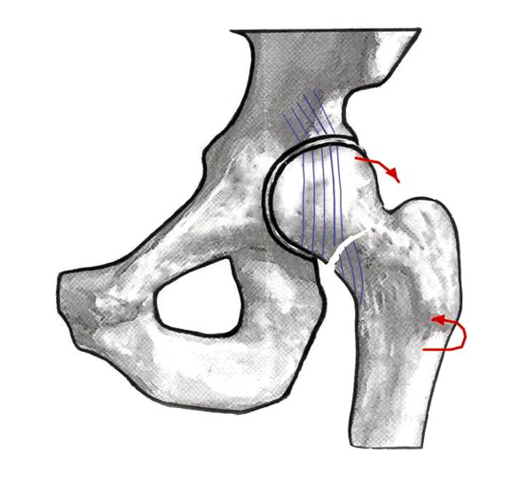
Femur Neck fracture

Slide 12
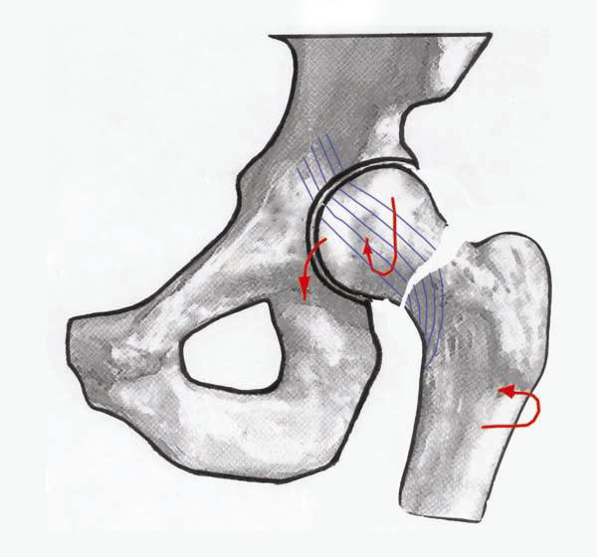
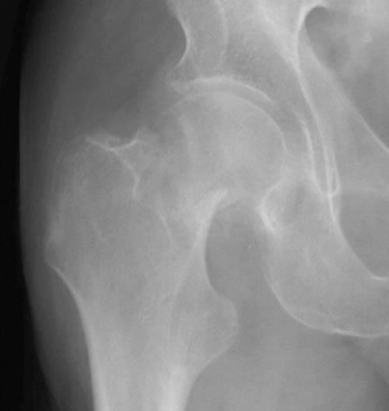
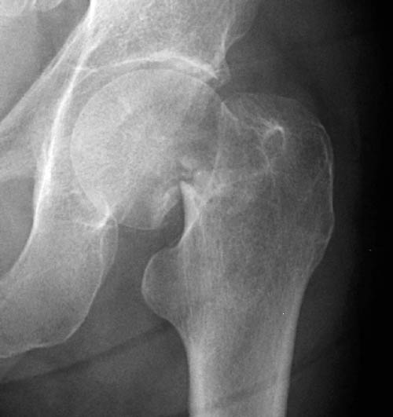
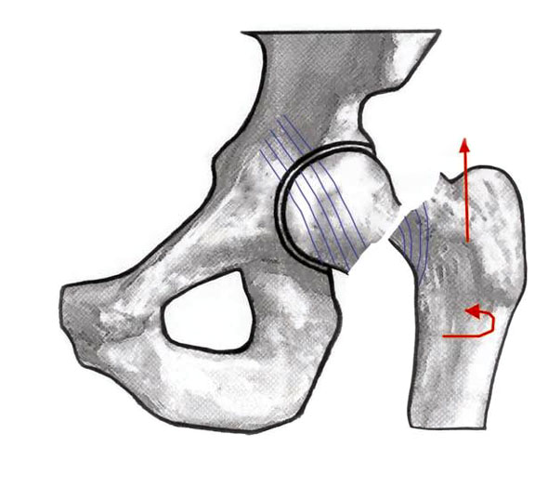
Femur Neck fracture
Type 3 complete partially displaced
Type 4 complete fully displaced

Slide 13
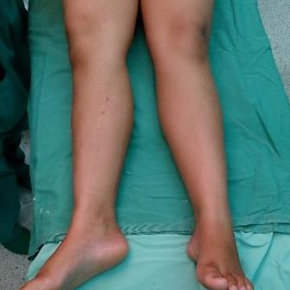
Femur Neck fracture
Presentation
Symptoms
impacted and stress fractures
slight pain in the groin or pain referred along the medial side of the thigh and knee
displaced fractures
pain in the entire hip region
Physical exam
impacted and stress fractures
no obvious clinical deformity
minor discomfort with active or passive hip range of motion, muscle spasms at extremes of motion
pain with percussion over greater trochanter
displaced fractures
leg in external rotation and abduction, with shortening

Slide 14
Femur Neck fracture
Prognosis
Mortality
~25-30% at one year.
predictors of mortality
pre-injury mobility is the most significant determinant for post-operative survival
in patients with chronic renal failure, rates of mortality at 2 years postoperatively, are close to 45%

Slide 15
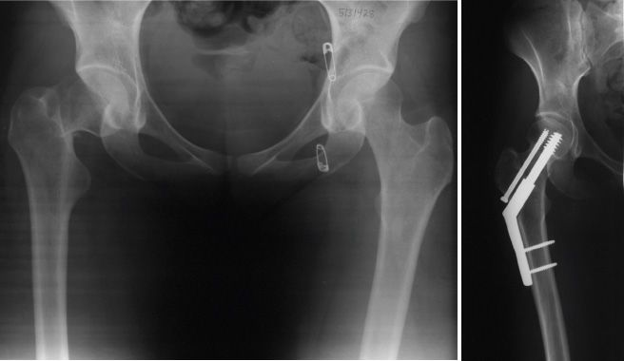
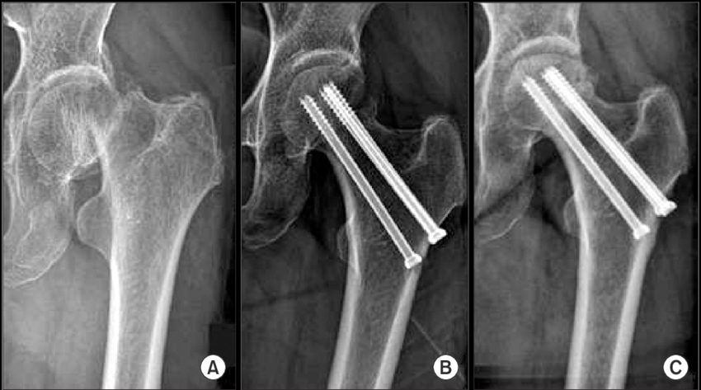
Femur Neck fracture Treatment
Nonoperative
may be considered in some patients who are non-ambulators, have minimal pain, and who are at high risk for surgical intervention
Operative
ORIF
displaced fractures in young or physiologically young patients
(ORIF indicated for most pts <65 years of age)

Slide 16
Femur Neck fracture
HEMiarthroplasty/ total hip arthroplasty

Slide 17
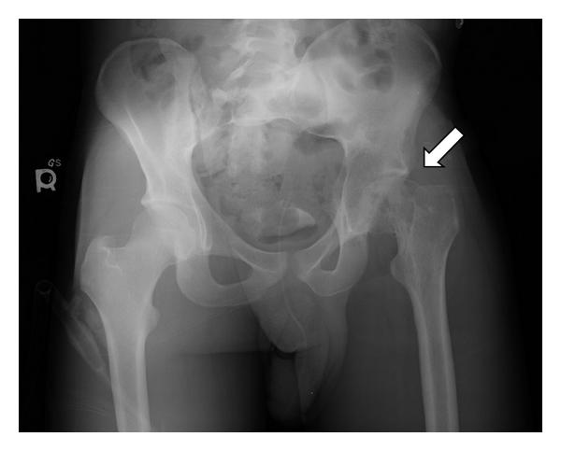
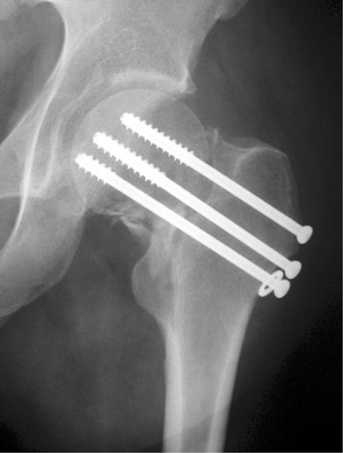
Femur Neck fracture
Osteonecrosis
Incidence of 10-45%
Increased risk with increase initial displacement
AVN can still develop in nondisplaced injuries and nonanatomical reduction
Nonunion
Incidence of 5 to 30%
Increased incidence in displaced fractures

Slide 18
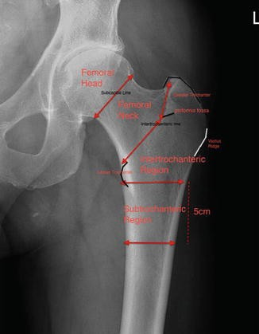
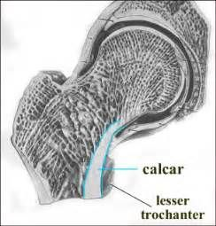
Intertrochanteric fracture
Osteology
Intertrochanteric area exists between greater and lesser trochanters
made of dense trabecular bone
calcar femorale
vertical wall of dense bone that extends from posteromedial aspect of femoral shaft to posterior portion of femoral neck
helps determine stable versus unstable fracture patterns

Slide 19
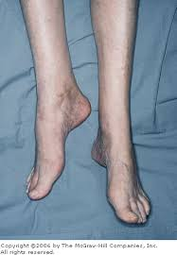
Intertrochanteric fracture
Pathophysiology
mechanism
elderly
low energy falls in osteoporotic patients
young
high energy trauma
Physical Exam
painful, shortened, externally rotated lower extremity

Slide 20
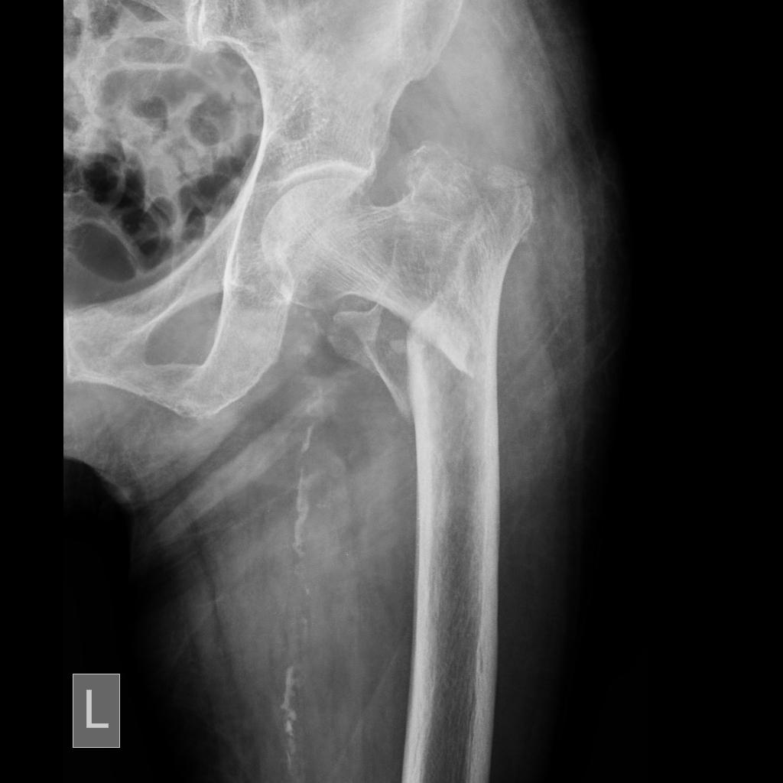
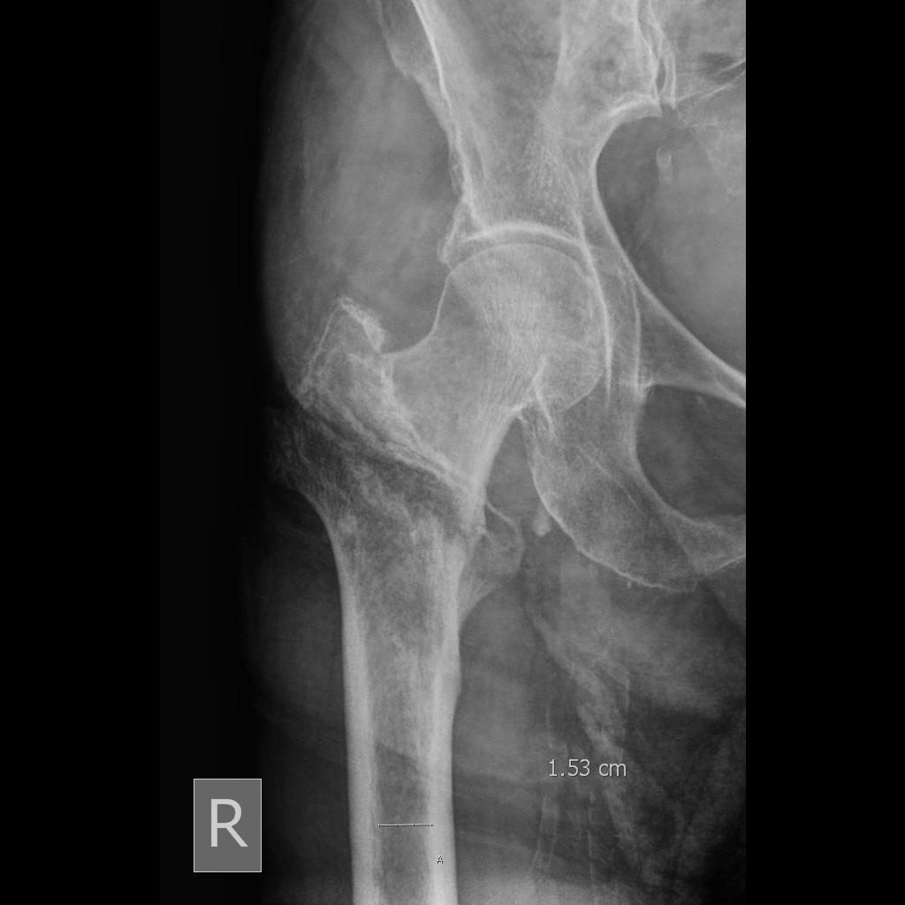
Intertrochanteric fracture

Slide 21
Intertrochanteric fracture
Nonoperative
nonweightbearing with early out of bed to chair
indications
nonambulatory patients
patients at high risk for perioperative mortality
outcomes
high rates of pneumonia, urinary tract infections, decubiti, and DVT

Slide 22
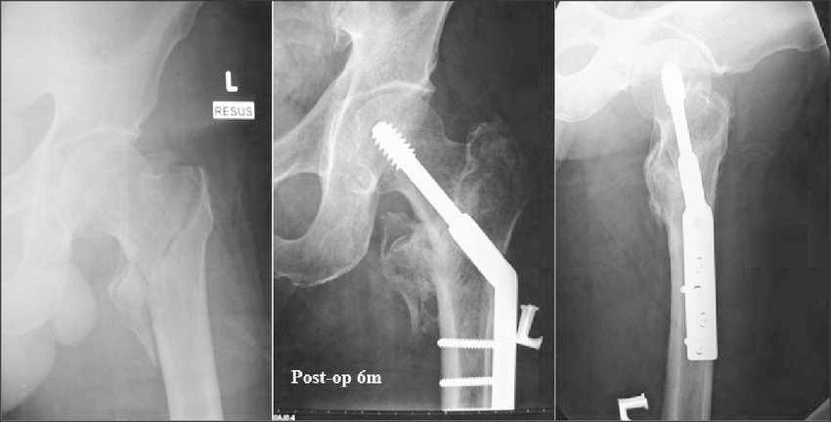
Intertrochanteric fracture
Operative
Sliding hip compression screw

Slide 23
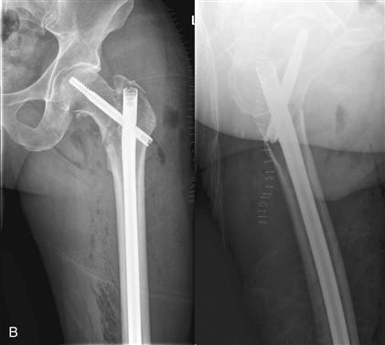
Intertrochanteric fracture
Intramedullary hip screw (cephalomedullary nail)

Slide 24
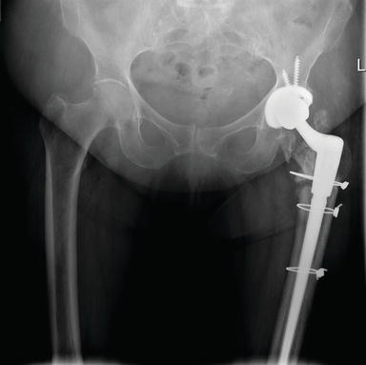
Intertrochanteric fracture
Arthroplasty
severely comminuted fractures
preexisting symptomatic degenerative arthritis
osteoporotic bone that is unlikely to hold internal fixation
salvage for failed internal fixation

Slide 25
Intertrochanteric fracture
Prognosis
nonunion and malunion rates are low
20-30% mortality risk in the first year following fracture
factors that increase mortality
male gender (25-30% mortality) vs female (20% mortality)
higher in intertrochanteric fracture (vs femoral neck fracture)
operative delay of >2 days
age >85 years
2 or more pre-existing medical conditions
ASA classification (ASA III and IV increases mortality)
(surgery within 48 hours decreases 1 year mortality. early medical optimization and co-management with medical hospitalists or geriatricians can improve outcomes )

Slide 26
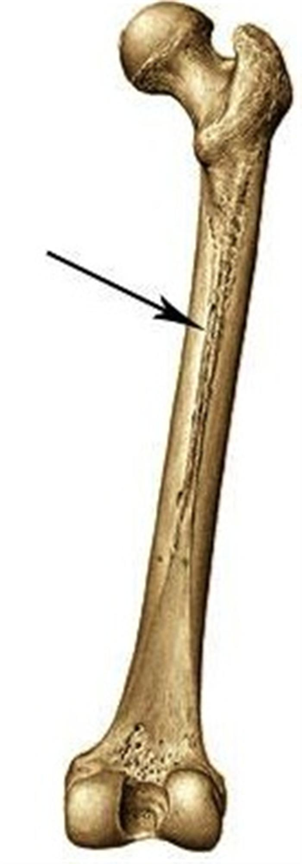
Femur shaft fracture
high-energy
most common in younger population
often a result of high-speed motor vehicle accidents

Slide 27
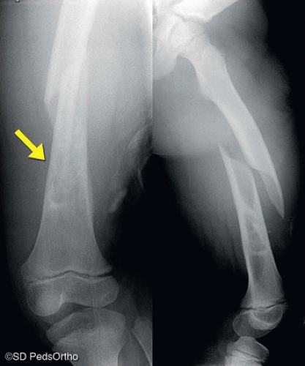
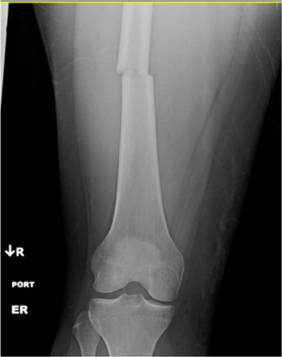
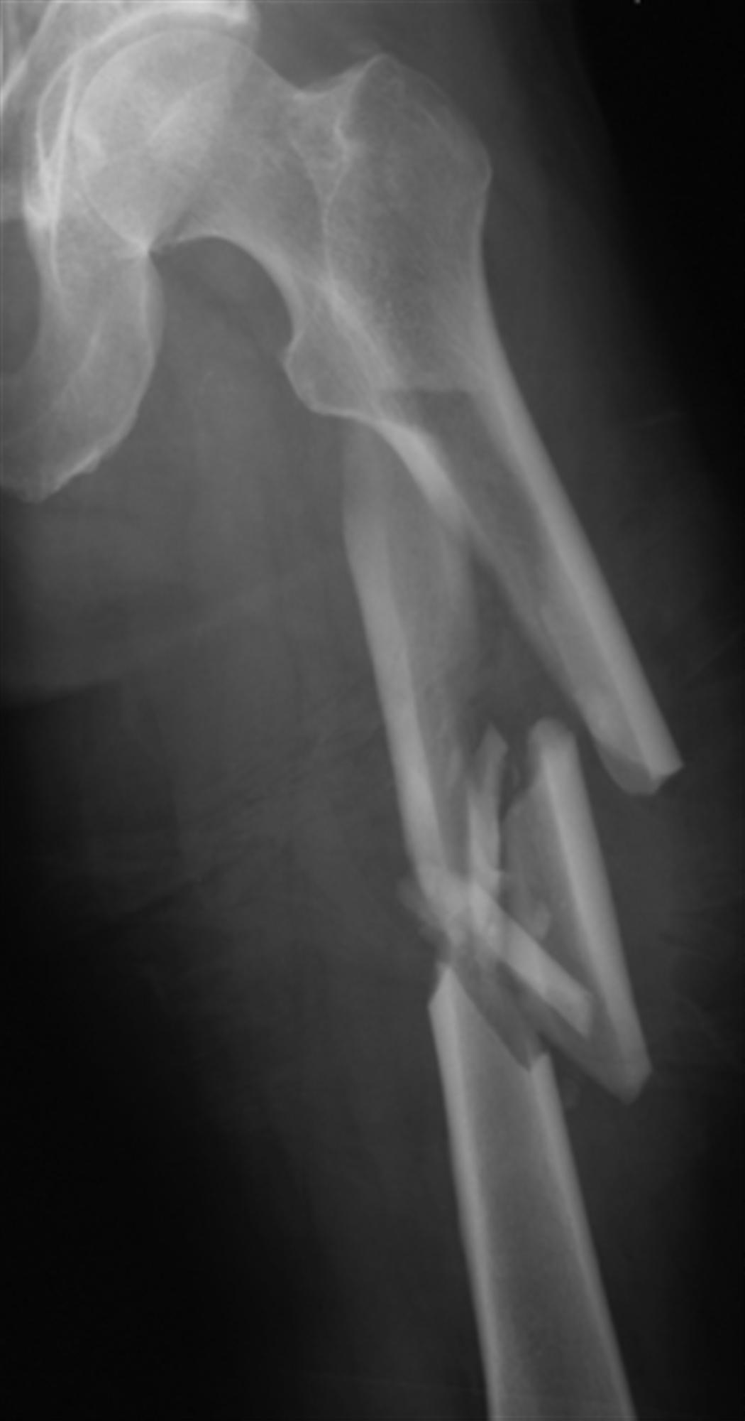
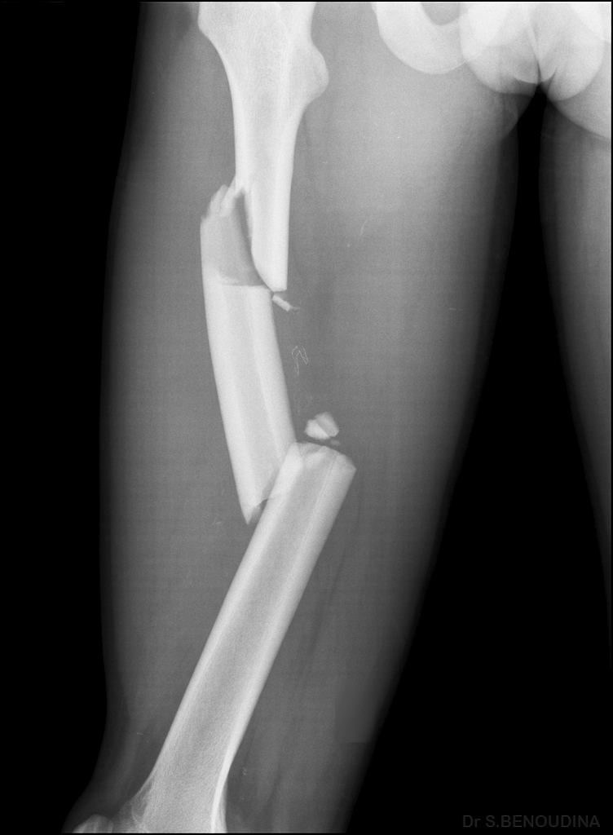
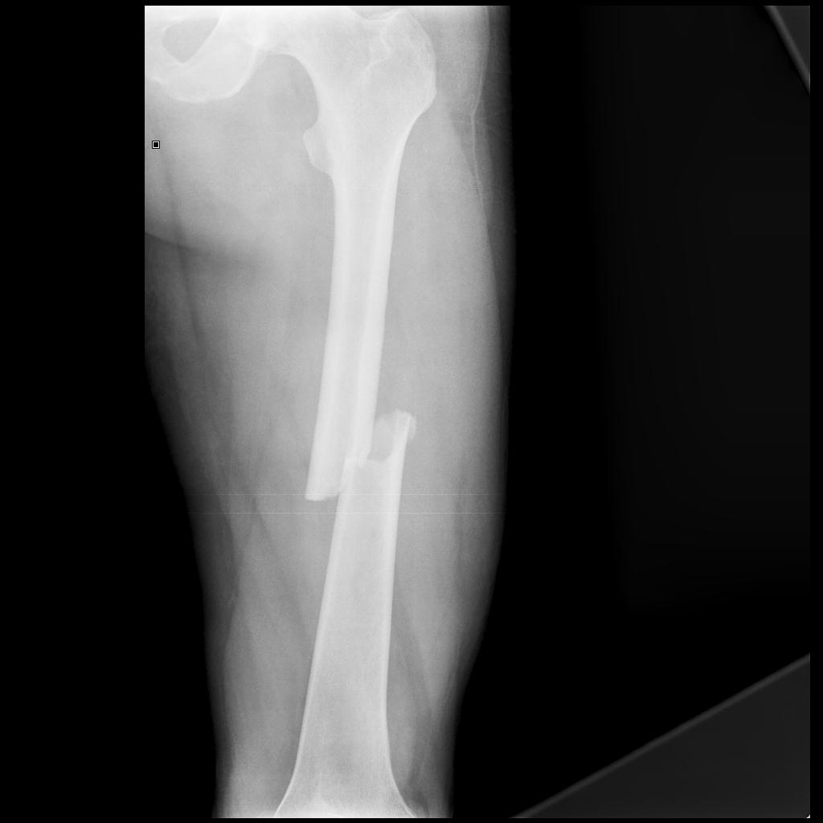
Femur shaft fracture
Transverse
pure bending moment
Spiral
rotational moment
Oblique
uneven bending moment
Segmental
4-point bending moment
Comminuted
high-speed crush or torsion mechanism

Slide 28
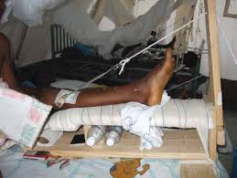
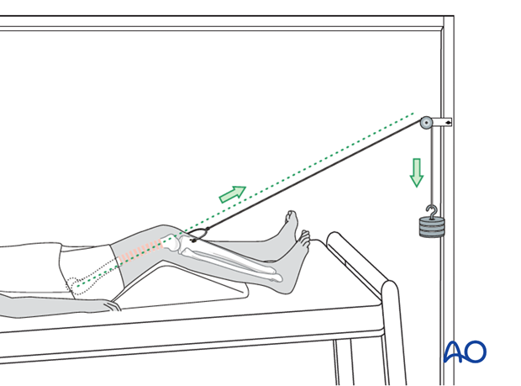
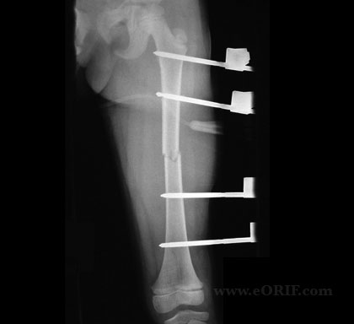
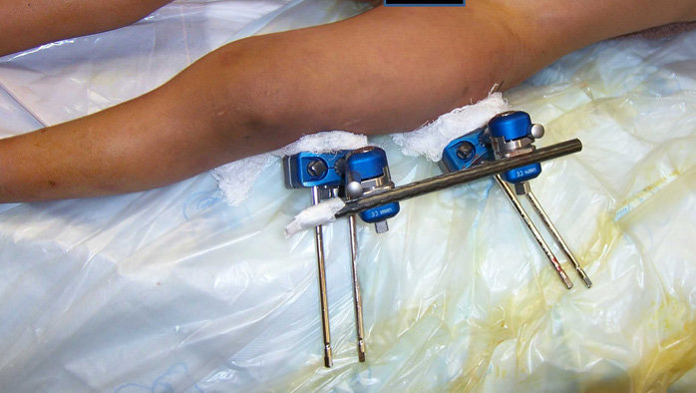
Femur shaft fracture
Hip spica.
(typically used in pediatric patients <5 years of age with length stable fractures)
Skeletal traction
External fixation

Slide 29
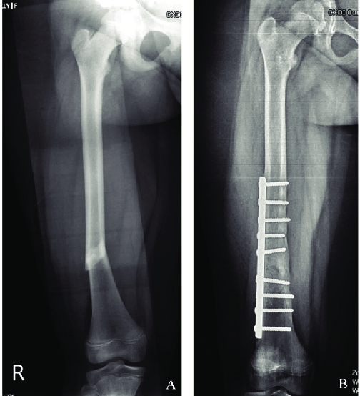
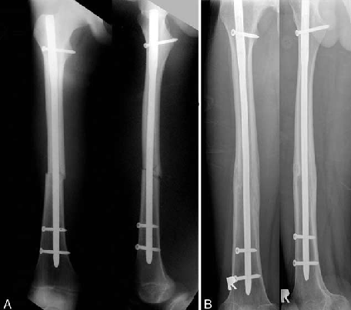
Femur shaft fracture
ORIF (plate)
Nail

Slide 30
Femur shaft fracture
Heterotopic ossification
Femoral artery or nerve injury
Malunion and rotational malalignment
Delayed union
Nonunion.
(incomplete healing within 9 months of injury or no evidence of healing on successive radiographs over 3 months)

Slide 31
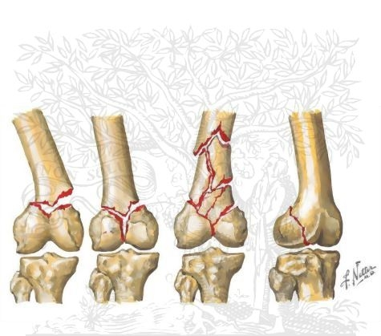
Distal femur fracture
traumatic injuries involving the region extending from the distal metaphyseal-diaphyseal junction to the articular surface of the femoral condyles
Pathophysiology
young patients
high energy with significant displacement
older patients
low energy, often fall from standing, in osteoporotic bone, usually with lesser degree of displacement

Slide 32
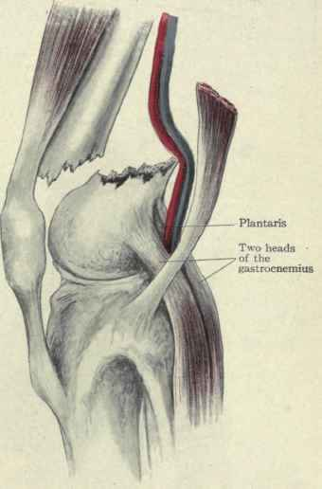
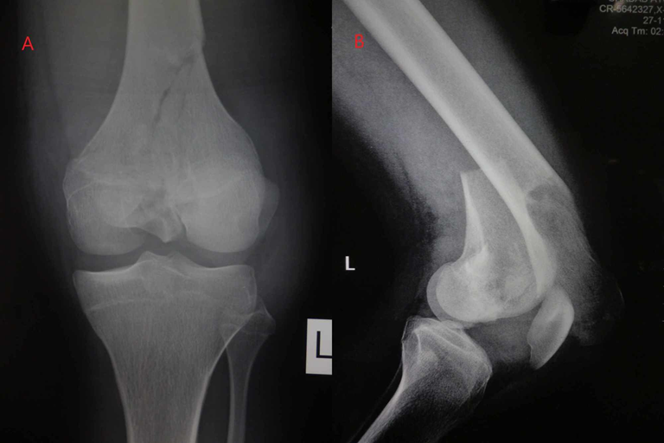
Distal femur fracture
History
patients commonly present after fall or traumatic event
Symptoms
common symptoms
pain of distal femur that is made worse with knee movement
inability to weight-bear
Physical exam
inspection
tenderness, swelling, ecchymosis of the distal thigh and knee
varus or valgus deformity
knee effusion may be present with intraarticular involvement
evaluate for wounds concerning for an open fracture
5-10% of supracondylar fractures
neurovascular exam

Slide 33
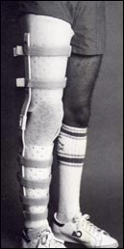
Distal femur fracture
Nonoperative
hinged knee brace
Indications (rare)
stable, nondisplaced fractures
nonambulatory patient
patient with significant comorbidities presenting an unacceptably high degree of surgical/anesthetic risk

Slide 34
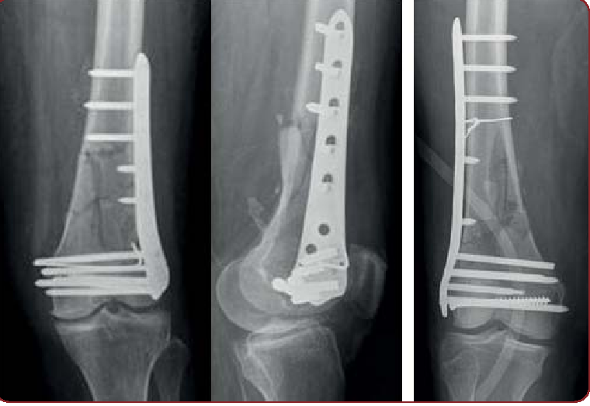
Distal femur fracture
open reduction internal fixation (ORIF)

Slide 35
Distal femur fracture
retrograde intramedullary nail

Slide 36
Distal femur fracture Complications
Knee pain/stiffness
Malunions
Nonunions

Slide 37
Thank you
be safe # stay_home

