Slide 1
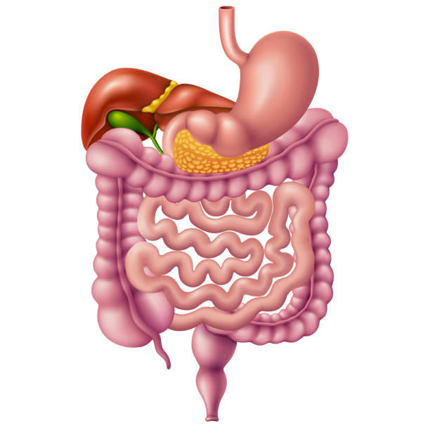
GIT Module 2021-2022 Parasitic Infections of the GIT
Dr. Mohammad Odaibat
Department of Microbiology and Pathology
Faculty of Medicine, Mutah University

Slide 2
Nematodes of medical importance
Intestinal
Tissue & Blood
With tissue stage:
Ascaris lumbricoides
Ancylostoma duodenale
Necator americanus
Strongyloides stercoralis
Trichinella spiralis
Without tissue stage:
Enterobius vermiculars
Trichuris trichiura
Wuchereria bancrofti
Brugia malayi
Loa loa
Onchocerca volvulus
Dracunculus medinensis
Trichinella spiralis
Larva migrans:
Ancylostoma spp.
Toxocara spp.
Small intestine
Large int.

Slide 3
Pathogenicity & Clinical Features:
Ascaris Iumbricoides
Ascariasis – infection of A. lumbricoides.
Majority of infections are asymptomatic.
Clinical disease is largely restricted to individuals with a high worm load.
Symptoms divided into three groups: those produced by:
Migrating larvae.
Intestinal phase.
Ectopic Ascariasis.

Slide 4
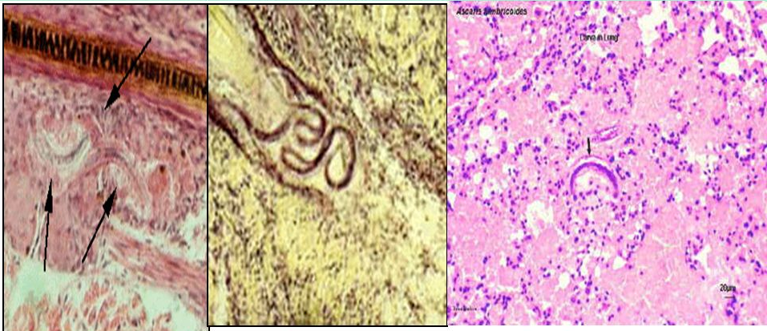
Ascaris Iumbricoides
Symptoms & Complications
Migrating larvae phase
Intestinal phase
1- Pneumonia (loeffler’s syndrome) – fever, cough, dyspnoea, blood tinged sputum that may contain larva, urticarial rash & eosinophilia.
2- Visceral larva migrans – if larvae enter systemic circulation (from pulmonary capillaries) to reach other organs like brain, spinal cord, heart, kidney.
Ectopic Ascariasis
Notes:
tching and a skin rash, are caused by sensitization (a type of “allergic” reaction) to the proteins and feces of the parasite

Slide 5
Ascaris Iumbricoides
Intestinal phase
Light infection  no symptmes
Intestinal symptoms
Malnutrition and underdevelopment of children with heavy infection .
Vit. A deficiency  night blindness
Colic , abdominal distension , vomiting, diarrhea or constipation, epigastric pain, dyspepsia (Invasion and subsequent blockage of the distal biliary tree, and less commonly the pancreatic duct).
Notes:
Ascaris lumbricoides is the most common parasite that causes pancreatitis. Ascariasis is due to infection by the human roundworm, Ascaris lumbricoides. Single or multiple worms may be involved. Invasion and subsequent blockage of the distal biliary tree, and less commonly the pancreatic duct, by the helminth causes obstruction to pancreatic enzyme outflow and pancreatic injury

Slide 6
Ascaris Iumbricoides
Ectopic Ascariasis
Due to migration of worm up into the stomach. It may :
be vomited out,
pass up through the esophagus at night & comes out through mouth or nose,
enter larynx to cause asphyxia.
migrate to other organs and cause appendicitis, cholecystitis, biliary colic, cholangitis, pancreatitis
Due to downward migration:
Obstruction of the appendix  appendicitis.
Anus  may pass with or without defecation.

Slide 7
Ascaris Iumbricoides
Complications
(1)
(2)
(3)
The products of living or dead worm  allergic manifestations (urticaria & asthma) & nervous irritability (insomnia and convulsion).
Intestinal obstruction
Perforation of the intestinal wall  peritonitis
Treatment
Mebendazole/ Albendazole – drug of choice but contraindicated in pregnancy & heavy infection
Piperazine citrate - suspected intestinal or biliary obstruction since this drug paralyzes worms to aid expulsion.
Levamisole

Slide 8
Nematodes of medical importance
Intestinal
Tissue & Blood
With tissue stage:
Ascaris lumbricoides
Ancylostoma duodenale
Necator americanus
Strongyloides stercoralis
Trichinella spiralis
Without tissue stage:
Enterobius vermiculars
Trichuris trichiura
Wuchereria bancrofti
Brugia malayi
Loa loa
Onchocerca volvulus
Dracunculus medinensis
Trichinella spiralis
Larva migrans:
Ancylostoma spp.
Toxocara spp.
Small intestine
Large int.

Slide 9
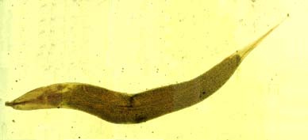
Enterobius vermicularis (Pin Worm)
Geographical Distribution:-
Cosmopolitan more common in temperate and cold climates than in warm climates.
Habitat:
Adult: small intestine (terminal ileum).
Gravid female: Caecum and rectum.
Eggs : In feces or deposited on perianal skin.

Slide 10
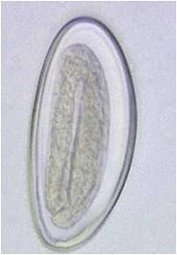
Enterobius vermicularis (Pathology)
Pathology:
Its infection rarely causes serious symptoms.
Due to migration of worm - Perianal, perineal & vaginal itching (pruritis) worsens at night.
Insomnia and restlessness
Worms in the appendix can cause appendicitis.
Prevention and Control:
Treating all members of a family in which infection has occurred.
Washing of the anal skin each morning soon after waking.
Washing of clothing worn at night.
Laboratory Diagnosis:
Finding eggs from perianal skin using cellulose adhesive tape.
Finding eggs and adult worms in the faeces.

Slide 11
Trichuris trichiura (The Whipworm)
Clinical features and Pathology:
Infection – Trichuriasis
Symptoms depend on worm burden:
Light infections:- Less than 10 worms – asymptomatic
Heavier infections:-
Chronic diarrhea
Intestinal ulceration with blood and mucus being passed in the feces
Iron deficiency anemia
Failure to develop at the normal rate.
Weight loss
Prolapse of the rectum.
Laboratory Diagnosis:-
- Finding the characteristic eggs in the faeces.

Slide 12
Strongyloides stercoralis (The dwarf thread worm)
Habitat: Has both free living and parasitic generations
Parasitic Adults: buried in the mucosal epithelium of the small intestine of man.
Rhabditiform larvae: Passed in the faeces and external environment.
Filariform larvae: soil and water (the infective stage).

Slide 13
Strongyloides stercoralis (The dwarf thread worm)
Clinical feature and Pathology
Causes strongyloidiasis.
The female adult worm by their invasion of the intestine cause inflammatory changes in the mucosa of small intestine leading to the development of gastrointestinal symptoms.
It is usually asymptomatic, in symptomatic cases shows the following phases:
Cutaneous phase: Infection caused by large number of larva produce itching and erythema at the site of infection within 24 hours of invasion.
Pulmonary phase: The migratory larva in the lung produces a considerable degree of host damage and injury to the alveoli and bronchial epithelium thereby producing bronchopneumonia and full blown pneumonitis.
Notes:
Clinical feature and Pathology: Causes strongyloidiasis, the disease
is also known as cochin china diarnhea because in the feces of french
cololnial troop who had been suffering in uncontrolled diarrhea in Cochin
China.
The female adult worm by their invasion of the intestine cause
inflammatory changes in the mucosa of small intestine leading to the
development of gastrointestinal symptoms.
It is usually asymptomatic, in symptomatic cases shows the following
phases:
1.Cutaneous phase: Infection caused by large number of larva produce
itching and erythema at the site of infection within 24 hours of invasion.
2. Pulmonary phase: The migratory larva in the lung produces a
considerable degree of host damage and injury to the alveoli and
bronchial epithelium thereby producing bronchopneumonia and full blown
pneumonitis.
3. Intestinal phase : Invasion by adult worms may produce abdominal
pain and mucus diarrhea which alleviate constipation. Indigestion,
nausea vomiting and anemia may also occur.
Heavy infection especially in children may result in malabsorbtion,
steatorrhea and dehydration.
Auto- and hyper-infection syndromes occurs when the immune status of
the host suppressed by either drugs, malnutrition or the concurrent
diseases:
In these conditions, larva invade and are found in many of the tissues
and serous cavities of the body producing a serious infection, which is
fatal. In auto- and hyper-infection the mucosal inflammation is severe.
The sigmoidal colon and rectum become frequently thickened and
edematous

Slide 14
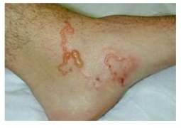
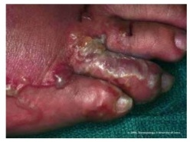
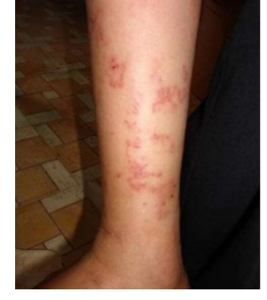
Strongyloides stercoralis (The dwarf thread worm)
C. Intestinal phase: Invasion by adult worms may produce abdominal pain and mucus diarrhea. Indigestion, nausea vomiting and anemia may also occur. Heavy infection especially in children may result in malabsorbtion, steatorrhea and dehydration.
Laboratory Diagnosis
Finding the larvae in faeces or in duodenal aspirates using direct or concentration method.
In hyper-infection syndrome the larva may be found in sputum and in other specimens.
Notes:
Clinical feature and Pathology: Causes strongyloidiasis, the disease
is also known as cochin china diarnhea because in the feces of french
cololnial troop who had been suffering in uncontrolled diarrhea in Cochin
China.
The female adult worm by their invasion of the intestine cause
inflammatory changes in the mucosa of small intestine leading to the
development of gastrointestinal symptoms.
It is usually asymptomatic, in symptomatic cases shows the following
phases:
1.Cutaneous phase: Infection caused by large number of larva produce
itching and erythema at the site of infection within 24 hours of invasion.
2. Pulmonary phase: The migratory larva in the lung produces a
considerable degree of host damage and injury to the alveoli and
bronchial epithelium thereby producing bronchopneumonia and full blown
pneumonitis.
3. Intestinal phase : Invasion by adult worms may produce abdominal
pain and mucus diarrhea which alleviate constipation. Indigestion,
nausea vomiting and anemia may also occur.
Heavy infection especially in children may result in malabsorbtion,
steatorrhea and dehydration.
Auto- and hyper-infection syndromes occurs when the immune status of
the host suppressed by either drugs, malnutrition or the concurrent
diseases:
In these conditions, larva invade and are found in many of the tissues
and serous cavities of the body producing a serious infection, which is
fatal. In auto- and hyper-infection the mucosal inflammation is severe.
The sigmoidal colon and rectum become frequently thickened and
edematous

Slide 15
Nematodes of medical importance
Intestinal
Tissue & Blood
With tissue stage:
Ascaris lumbricoides
Ancylostoma duodenale
Necator americanus
Strongyloides stercoralis
Trichinella spiralis
Without tissue stage:
Enterobius vermiculars
Trichuris trichiura
Wuchereria bancrofti
Brugia malayi
Loa loa
Onchocerca volvulus
Dracunculus medinensis
Trichinella spiralis
Larva migrans:
Ancylostoma spp.
Toxocara spp.
Small intestine
Large int.

Slide 16
Ancylostoma duodenale
Geographical distribution: Cosmopolitan, widely distributed in tropical and subtropical countries.
Habitat: Small intestine and particularly jejunum.
D.H: Man.

Slide 17
Pathogenesis and symptomatology
Disease: Ancylostomiasis
1-Skin invasion (ground itch)
It is a cutaneous lesion produced as a result of penetration of human skin by filariform larva of A. duodenale.
The most common sites are usually between the toes, dorsal surface of the foot and inter digital spaces of hands.
Clinically: Local dermatitis with irritation and itching followed by erythema, oedema and papular rash  vesicles or pustules due to 2ry bacterial infection.

Slide 18
2-Larval migratory phase
To the lung
(verminous pneumonia or loeffler's syndrome)
To general circulation
In heavy infection only, migrating hookworm larvae may pass to the left side of the heart  general circulation  distributed to different tissues of the body  eosinophilic granulomatous lesions around the larvae (visceral larva migrans).
Symptoms include fever, cough, dyspnea, haemoptysis and high eosinophilia.

Slide 19
3- Intestinal phase
Injury of the mucous membrane by cutting teeth and plates at the site of attachment  ulceration that may be infected  nausea, vomiting, pain, flatulence, constipation or diarrhea with black or red stool.
Anaemia  hypochromic microcytic iron deficiency &aneamia (due to blood loss).
Causes:
1-Each parasite sucks about 0.5 cc of blood daily.
2-Bleeding at the site of attachment due to the effect of anticoagulant secreted by the cephalic glands).
Hypoproteinaemia, nutritional oedema and signs of avitaminosis are due to impairment of food absorption and blood loss.
Retardation of physical, mental and sexual development in heavily infected children.

Slide 20
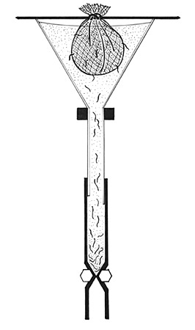
Laboratory diagnosis
Stool examination for egg detection by different methods:
Direct smear.
Concentration methods
Faecal cultures.
Stoll's counting technique for determination of the intensity of infection.
Examination of stool for larvae by Baermann's technique
Blood examination for anaemia

Slide 21
Treatment
Supportive treatment:
-High protein diet.
-Vitamins & iron.
Mebendazole
(Drug of choice)
In severe anaemia, blood transfusion may be needed

Slide 22
Strongyloides stercoralis
(Dwarf thread worm)
Mode of infection
Autoinfection (common in immunocompromised persons)
Penetration of the skin or mucous membrane of mouth by infective filariform larvae.
Internal
External
Where rhabditiform larvae may develop to filariform larvae (I.S) into the lumen of the small intestine, then penetrate the intestinal mucosa to reach the circulation.
Filariform larvae (I.S) come out the anus and penetrate the perianal skin to reach the circulation and complete the cycle

Slide 23
Pathogenesis and symptomatology
Disease: Strongyloidiasis or Cochin – China diarrhea
1-Skin invasion (ground itch)
Ground itch
Larva currens (racing larva)
At the site of larval penetration  Local dermatitis with irritation and itching followed by erythema, oedema and papular rash  vesicles or pustules due to 2ry bacterial infection.
It occurs when the filariform larva penetrates the perianal region with external autoinfection causing linear or tortuous urticarial lesions over the trunk, thigh and buttocks & rapidly disappeared.
First was described in 1876, identified in the feces of French colonial troops suffering from diarrhea in Cochin-China.

Slide 24
2-Larval migratory phase
To the lung
To general circulation
Verminous pneumonia or (Loeffler‘s syndrome)
+++++++++++++++++++++++++++++++++++++++++++++++++++++++++++++++++++++++++++++++++++++++++++++++++++++++++++++++++++++++++++++++++++++++++++++
Occasionally in heavy infection, migrating filariform larvae may pass to the left side of the heart  general circulation  distributed to different tissues of the body  eosinophilic granulomatous lesions around the larvae (visceral larva migrans).
Symptoms include fever, cough, dyspnoea, haemoptysis and high eosinophilia .

Slide 25
3-Intestinal phase
Penetration of the intestinal mucosa by the adult worm produces ulceration, mucosal oedema, bleeding and may be perforation.
Heavy infection: Epigastric pain and tenderness (duodinitis), nausea, vomiting and watery mucus diarrhea (Cochin-China diarrhea) alternates with constipation.
In chronic cases there is mucosal atrophy with fibrosis.
Light infection: Usually asymptomatic

Slide 26
Disseminated stronyloidiasis
(Hyper infection syndrome)
In immunocompromised patients the parasite produces massive number of rhabditiform larvae that develop into filariform larvae in the intestinal lumen (autoinfection)  penetrate the intestinal wall  reach the circulation  different organs as brain, lung, liver and kidney.
This condition is fatal and death occurs due to:
❶Massive increase of intestinal worm burden  intestinal perforation, peritonitis and paralytic ileums.
❷Invasion of CNS  meningitis& brain abscess.
❸Respiratory failure.
❹Septicaemia due to larval migration from the intestine.

Slide 27
Laboratory diagnosis
Direct methods
Indirect methods
Stool examination for rhabditiform larvae by direct smear and concentration methods.
Stool culture .
Duodenal aspiration reveals rhabditiform larvae.
Sputum examination or culture: during disseminated disease, all stages may be present in lung (rhabditiform larvae, filariform larvae, adults).
Eosinophilia (10-40%)
Serological testes (CFT, IHT, ELISA)

Slide 28
Treatment
Mebendazale.
Ivermectin.
Antihistaminic and antibiotics for cutaneous lesions.

