Slide 1
Inhalation injury
Mohammad khalid abed-alfattah
Mohammad badwan
Akram oran
Abedalrhman bdeir

Slide 2
Table of Contents
01
02
03
04
Introduction
Of inhalation injury
Management
CARBON MONOXIDE POISONING
Cyanide poisoning

Slide 3
Inhalation injury
Inhalation injury defined as damage caused by breathing in harmful gases, vapours, and particulate matter contianed in smoke

Slide 4
despite major advancements in burn care for the past several decades there remains a significant burden of disease attributable to inhalation injury, a round
one-third of all burn injury victims are smoke inhalation injuries .
Injuries to the upper airway may induce massive edema of the tongue and epiglottis and obstruct the supraglottis, Many of the consequences of smoke inhalation result from an inflammatory response involving mediators whose number and role remain incompletely understood.
Airway edema occurs during the late phases of resuscitation, mostly Manifest within the first 5 days after injury so The initial evaluation is a poor indicator of the severity of airway swelling.

Slide 5
Anatomically, Inhalation injuries are divided into three classes:
Thermal injury
chemical and particulate constituents of smoke
metabolic asphyxiation
Injuries to the upper airways, like mouth, oropharynx, and larynx
Injuries to the lower airways by micro particals.
(systemic toxicity)
Notes:
super-heated air usually causes injury only to airway structures above the carina. Injury to these airway structures may cause massive swelling of the tongue, epiglottis, and aryeepiglottic folds with obstruction.
chemical and particulate constituents of smoke: particulates are micro particles less than 0.5 micrometer that goes to prank heels and cause bronchospasm and surfactant loss and edema
Smoke-related toxins damage epithelial and capillary endothelial cells of the airway. Histologic changes resemble tracheobronchitis. Mucociliary transport is destroyed and bacterial clearance reduced.
metabolic asphyxiation:carbon monoxide (CO) and cyanide(systemic toxicity).

Slide 6
In Thermal injury the super-heated air usually causes injury only to airway structures above the carina. Injury to these airway structures may cause massive swelling of the tongue, epiglottis, and aryeepiglottic folds with obstruction.
chemical and particulate constituents of smoke: particulates are micro particles less than 0.5 micrometer that goes to prank heels and cause bronchospasm and surfactant loss and edema
Smoke-related toxins damage epithelial and capillary endothelial cells of the airway. Histologic changes resemble tracheobronchitis. Mucociliary transport is destroyed and bacterial clearance reduced, Alveolar collapse and atelectasis occur due to surfactant loss. Alveolar macrophages are stressed leading to inflammatory response with chemotaxins. Early inflammatory changes occurring in the airway are followed by a period of diffuse exudate formation. Bronchiolar edema may become severe. A combination of necrotizing bronchitis, bronchial swelling, and bronchospasm causes obstruction of large and small airways. Wheezing occurs with bronchial swelling and irritant receptor stimulation. Increased capillary permeability magnifies airway and pulmonary edema .

Slide 7
When to Suspect inhalation injury ?
In taking history :
any patient coming from any enclosed space fire .
Inhalation injury More common in the elderly, immobile, and children .
Raspy or hoarse voice
Facial burns (2nd degree or worse)
Carbonaceous sputum
The source of exposure : (smoke, flames, and/or possible chemicals)
Duration of exposure
burning sensation in nose or throat
Symptoms of odynophagia
systemic symptoms like a headache, delirium, hallucinations .
Notes:
Kids are at a high risk because they tend to hide in closets during a fire rather than escape. The elderly or immobile have physical barriers to escape.

Slide 8
When to Suspect inhalation injury ?
In physical examination:
facial and intranasal burns
soot in the mouth or sputum
accessory muscle usage.
tachypnea, cyanosis, stridor, and rhonchi/rales/wheezing.

Slide 9
When to Suspect inhalation injury ?
In work up :
Complete blood count (CBC)
Complete blood count (CBC)
Pulse oximetry (Arterial PaO2 < 60 mmHg)
Carboxyhemoglobin level (Carboxyhemoglobin >15%)
Cyanide level
Pulmonary function testing
Serial chest radiographs
Fiberoptic Bronchoscopy the standard for the diagnosis

Slide 10
The best tools presently available for diagnosis of inhalation injury are clinical presentation and bronchoscopic findings.
Initial evaluation is not a good indicator of the severity of obstruction that may occur later .
More recent studies have found a significant correlation between the severity of inhalation injury on FOB and mortality .
bronchoscopy has a role limited to obtaining lavage fluid for culture and assessing the degree of airway injury which may predict the outcome.
Aggressive use of bronchoscopy is highly effective in removing foreign particles and accumulated secretions that worsen the inflammatory response and may impede ventilation .
Actually on a review of the National Burn Repository of the American Burn Association to determine outcome differences in burn patients with inhalation injury and pneumonia who did and did not receive bronchoscopy : patient who underwent bronchoscopy had a decreased duration of mechanical ventilation compared to patients who did not have bronchoscopy , When patients having at least one bronchoscopy procedure were compared with those who did not undergo bronchoscopy, the patients receiving this test had a shorter length of intensive care unit and hospital stay.
Notes:
Bronchoscopy is an endoscopic technique of visualizing the inside of the airways for diagnostic and therapeutic purposes. An instrument is inserted into the airways, usually through the nose or mouth, or occasionally through a tracheostomy
What are the side effects of a bronchoscopy?
Common complications may include shortness of breath, a drop in oxygen level during the procedure, chest pain, and cough. In addition, if a lung biopsy is necessary, it may cause leakage of air called a pneumothorax and/or bleeding from the lung. Pneumothorax occurs in less than 1% of cases requiring lung biopsy.

Slide 11
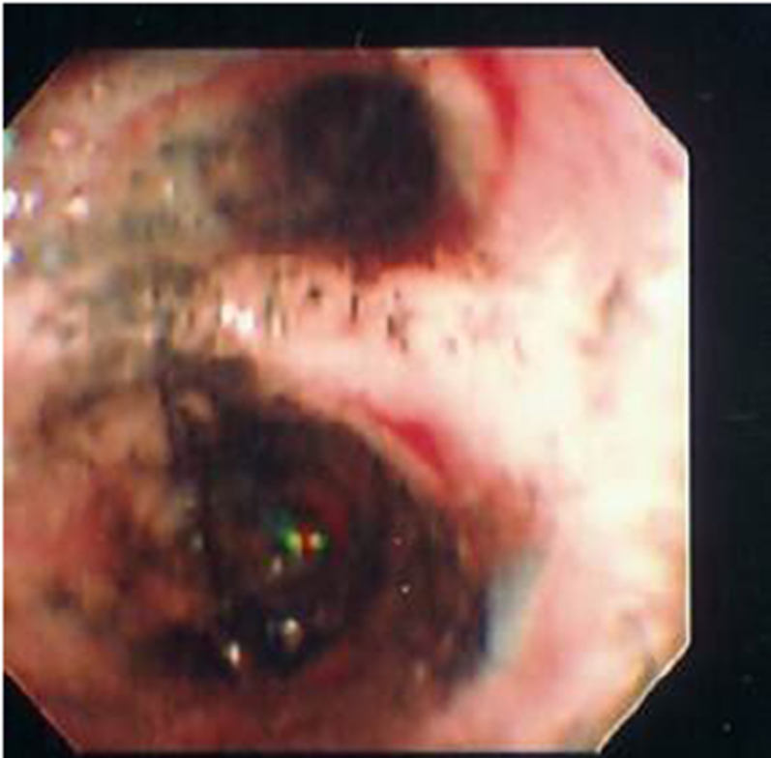
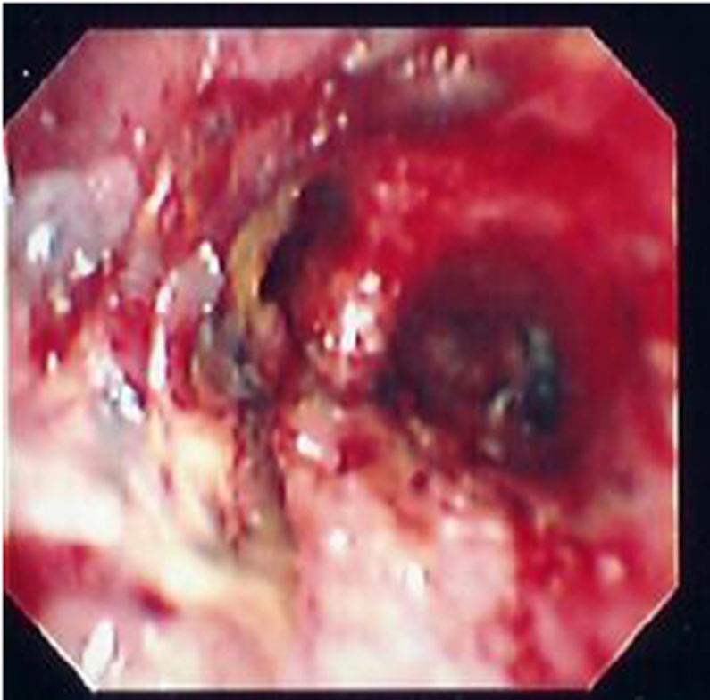
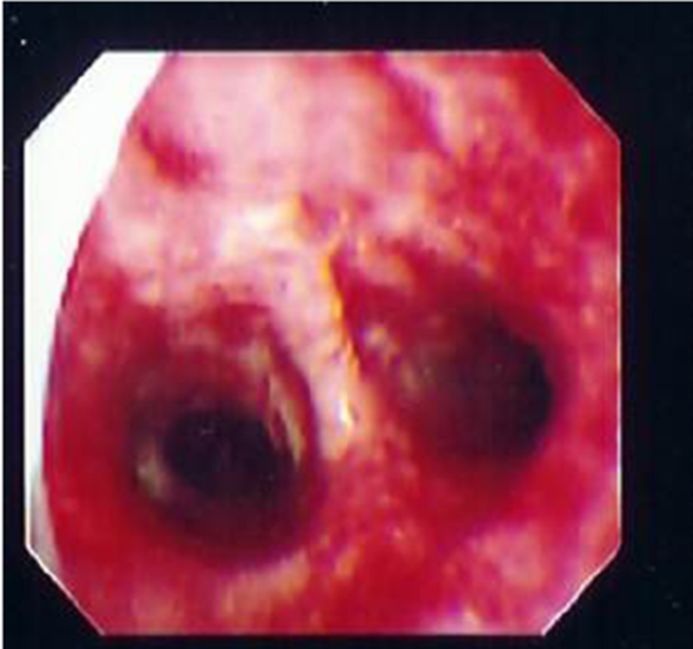
Its relative ease and availability allows the initial diagnosis to be made , and allows the inhalation injury to be followed serially .
A B C

Slide 12
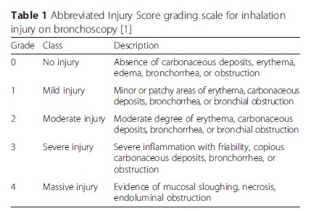

Slide 13
Thank you

Slide 14
Management mohammad badwan

Slide 15
Management
Limiting exposure and removing the patient from the exposure area, such as in a house fire or occupational exposure, and maintaining a secure airway are paramount. Airway protection should include considering early and preemptive intubation for patients with inhalation injury. Airway edema may occur suddenly as edema worsens, and often, the upper airways develop injury and obstruction earliest, prior to the parenchymal injury.

Slide 16
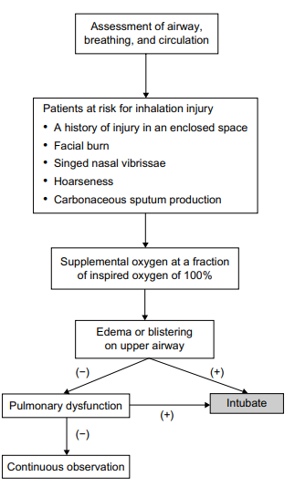

Slide 17
Management
removing the patient from the exposure area
Maintain secure airway: Intubation, tracheostomy if necessary
aggressive pulmonary hygiene for (edema, hemorrhage, and mucosal sloughing)
Bronchodilators (Beta-2-adrenergic agonists like albuterol and salbutamol)
steroids, in either inhaled or intravenous form, have not been proven beneficial in clinical studies.
antibiotics should be started promptly when an empiric diagnosis of pneumonia is made.
Carbon monoxide treatment includes high oxygen therapy.
antidote, hydroxocobalamin, may be given in patients with high suspicious of cyanide poisoning.

Slide 18
Initial management
Immediate and directed assessment of the respiratory or circulatory status of patients with smoke inhalation is required similar to standard assessment and management for all trauma patients. Although few specific strategies for inhalation injury exist, appropriate initial management can influence a favorable outcome. The goals of initial management are to ensure that the airway allows adequate oxygenation and ventilation, and to avoid ventilator-induced lung injury and substances that may complicate subsequent care

Slide 19
O2
Any patients who have suspicious inhalation injuries should receive supplemental O2 at an FiO2 of 100% . Any comatose patients who have suspicious CO or cyanide poisoning should be ventilated mechanically using 100% O2 . The purpose of such a high concentration of supplemental O2 is to quickly reverse hypoxia and to displace CO from hemoglobin. The next approach to presumed CO poisoning is to assess whether hyperbaric O2 therapy is indicated. The purpose of both supplemental oxygen and hyperbaric O2 therapy is to displace CO from hemoglobin

Slide 20
Intubation
Intubation should be considered if any of the following signs exist: *respiratory distress, *stridor, *hypoventilation, *use of accessory respiratory muscles, *blistering or edema of the oropharynx, or *deep burns to the face or neck . These findings show that the upper airway is at risk of progressive severe edema, which may compromise the patent airway. Patients with upper airway edema or hyperemia should be intubated promptly. Once intubated, the endotracheal tube should remain until the upper airway edema has disappeared.

Slide 21
Intubation
In contrast, even if upper airway redness or edema is absent, patients should be kept under close observation for 24 hours especially the first 8 hours after injury. During the observation period, there should be a low threshold for intubation because upper airway obstruction with asphyxiation caused by progressive upper airway edema is a lethal complication of thermal injury

Slide 22
Mechanical ventilation
Patients who require intubation because of upper airway edema, pulmonary dysfunction, or impaired mental status generally require mechanical ventilation. Although an ideal approach for respiratory support of patients with inhalation injuries does not exist, there are many ways to administer positive pressure ventilation and many papers have been written advocating one method over another in those patients. Positive end expiratory pressure (PEEP) is applied to improve hypoxemia related to alveolar hypoventilation. Improvement of hypoxemia as a result of intrapulmonary shunt requires interventions that open lung units for gas exchange. Optimal PEEP is the level of end expiratory pressure that may increase arterial oxygenation by preventing loss of lung compliance during mechanical ventilation, increasing functional residual capacity, and reducing venous admixture. PEEP levels should start at 8 cm H2 O and be increased in 2.5 cm increments.

Slide 23
Mechanical ventilation
It is important that patients with inhalation injuries are supported using techniques that do not further exacerbate respiratory failure. Limitations of pressure and acceptance of permissive hypercapnia are important. To recruit injured lung, a pressure-based strategy may be far more effective. The tidal volumes should be initiated at 6–8 mL/kg of predicted body weight. The plateau airway pressure of less than 30 cm H2 O should be considered.

Slide 24
There are some inhaled adjunctive agents, such as inhaled heparin, N-acetylcysteine, and beta-agonist. N-acetylcysteine is a mucolytic agent, which ruptures the mucoprotein in mucus. A retrospective study showed that heparin in combination with the use of N-acetylcysteine decreased re-intubation rates and improved mortality in pediatric patients with inhalation injury. However, another retrospective study indicated that treatment with N-acetylcysteine and heparin did not improve outcomes of patients with inhalation injury. It is still unclear whether nebulized heparin or N-acetylcysteine improves outcomes of patients with inhalation injury. nhaled bronchodilators such as beta-agonist may help manage bronchoconstriction caused in the injured lower airways by inhalation injury. *the use of nebulized albuterol or epinephrine caused a decrease in airway pressure and an improvement in P/F ratio.
Cont…

Slide 25
Cont…
Escharotomy may be required for patients with circumferential full-thickness burns of the anterolateral torso. In these patients, edema builds up under eschar during the resuscitation period, gradually constricting chest excursion and causing increased peak expiratory pressure. The treatment is thoracic escharotomy in either emergency room or operating theater, which results in restoration of chest compliance.

Slide 26
Complication :
Severity generally correlates with exposure time, Complication rates are higher in people with a history of underlying lung disease as well, such as COPD and asthma. Short-term complications(4-5days):pneumonia. Acute respiratory distress syndrome and pulmonary edema . Long-term complications(less common): subglottic stenosis, bronchiectasis, and bronchiolitis obliterans Patients who have been exposed to carbon monoxide are also known to have long-term neurological complications (1-3wks)

Slide 27
Thank you

Slide 28
CARBON MONOXIDE POISONING by :akram oran

Slide 29
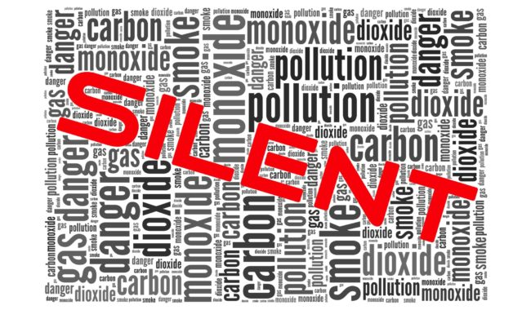
is a clear, odorless, tasteless and non irritating gas. Cause rapid loss of conscious

Slide 30
Sources: A-Endogenous: It is produced in the body as a byproduct of the degradation of heme (0.5-0.8%) B- Exogenous: It is produced by incomplete combustion of any carbonaceous material as gasoline, natural gas, kerosene, oil or propane.

Slide 31
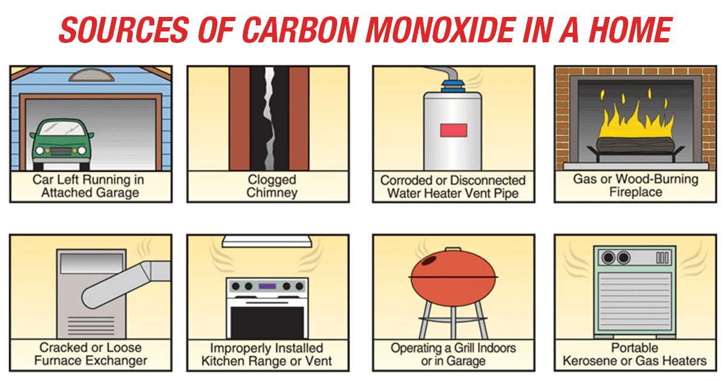
Notes:
Also in heavy smoker COHB 12%

Slide 32
Toxicokinetic
Carbon monoxide is readily absorbed from the lungs and rapidly bound to hemoglobin.
Elimination is mainly through respiratory system, only 1% is metabolized to carbon dioxide.
Its half life is about 4-5 hours on 21% room air O2.
80 minutes 100% O2.
22 minutes with hyperbaric O2.

Slide 33
Pathophysiology:
Carbon monoxide combines to hemoglobin producing carboxy- hemoglobin (COHb). It has an affinity to hemoglobin 200 to 250 times greater than oxygen. This will lead to decrease oxygen transport by blood causing tissue hypoxia.
High concentration of COHb shifts the oxyhemoglobin dissociation curve to the left, making oxygen less available to tissues by decreasing the ability of hemoglobin to release its oxygen content to the tissues.

Slide 34
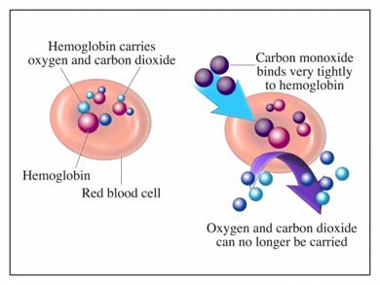
CO binds to myoglobin with an affinity 60 times greater than oxygen producing carboxymyoglobin which may cause myocardial impairment.
CO can bind to cytochrome oxidase leading to inhibition of the respiratory function of the cells which will increase cellular hypoxia.

Slide 35
Morbidity and mortality associated with carbon monoxide toxicity are the result of hypoxic states associated with interference with oxygen transport at the cellular level and compromise of electron transport within cells.
Other potential mechanisms include binding to myoglobin or hepatic cytochromes and peroxidation of cerebral lipids.
The extent of injury is dependent on the concentration of carbon monoxide, duration of exposure and underlying health status of the exposed individual

Slide 36
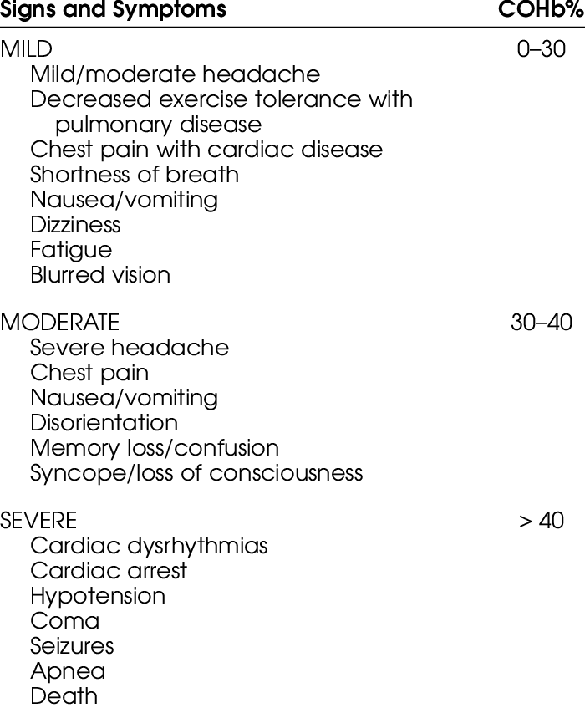
Clinical picture:
Non specific …..not correlate with the severity of toxicity
Death usually occurs with COHb level above 70%.
Clinical grading of CO poisoning:

Slide 37
Other classical signs
Cherry-red skin: after exposure to high levels (rare and usually seen postmortem)
Fundoscopic findings: bright red retinal vessels, retinal hemorrhages, papilledema (indicative of cerebral edema)
Symptoms of concurrent cyanide poisoning

Slide 38
Differential diagnosis:
Other asphyxiant gases.
Cerebrovascular accidents.
Myocardial infarction
Ethanol intoxication

Slide 39
Laboratory investigations:
1-Determination of COHb level by oximeter (normal level is from 0- 2.3% in non smokers)
2- Arterial blood gases.
3- Blood glucose.
4- Electrolytes level to diagnose metabolic acidosis.
5- ECG
6- Computed tomography (CT) or magnetic resonance imaging of the brain to diagnose brain lesions.
7- Chest X - ray.

Slide 40
Long term Sequalae of CO poisoning:
Patients may recover from acute CO poisoning and develop later delayed neurological manifestation 2 to 40 days from the original exposure.
These may be in the form of apathy, lack of concentration, memory disturbances, Parkinsonism, cortical blindness, peripheral neuropathy, movement disorders, aphasia, incontinence, dementia, psychosis or manic depression.
These may be due to damage to the basal ganglia, white matter or cerebellum. These complications may persist months to years and may resolve spontaneously.
The incidence of delayed neurological sequelae is correlated to the initial level of consciousness and duration of coma.

Slide 41
Management
Remove the patient from the source of exposure to fresh air.
Maintain respiratory function and stabilization of cardio-respiratory status.
The antidote is 100% oxygen inhalation by mask or endotracheal intubations if the patient needs artificial air way.
Oxygen therapy must be continued till the patient is asymptomatic or COHb level is below 15%.
Hyperbaric oxygen (100% oxygen at 3 atmosphere pressure) will reduce the half life of COHb to 22 minutes. It may also prevent the neurological sequel.
It is indicated in: (Pregnancy, Coma, Myocardial ischemia or arrhythmia, Presence of neurological symptoms).
Correct hypo or hyperglycemia.
Management of cerebral edema by mannitol or steroids.
Treat convulsions.
Notes:
COHb > 25%
Pregnency COHb >20%

Slide 42
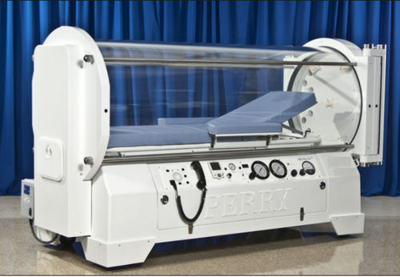

Slide 43
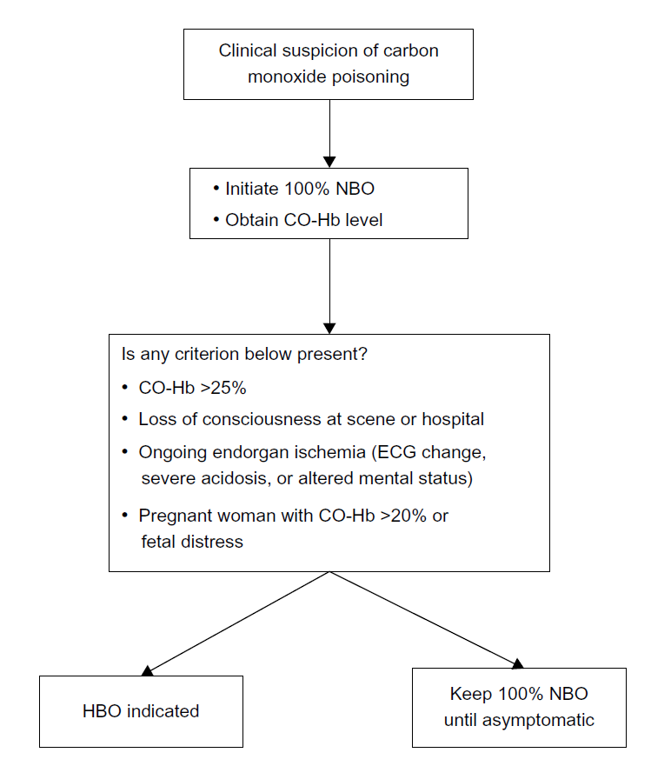

Slide 44
Thank you

Slide 45
Hydrocyanic Acid (HCN)
By : Abedalrhman Bdeir

Slide 46
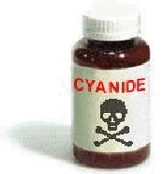
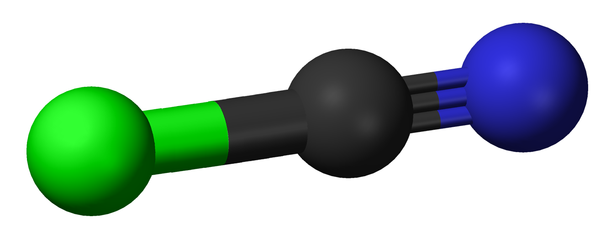
Forms of Cyanide
Solid
Gas
Liquid
Potassium cyanide
Sodium cyanide
Hydrogen Cyanide
Hydrogen cyanide

Slide 47
Facts:
Colourless gas with smell of bitter almond.
35 times more toxic than CO.
40% of population can not smell its odour due to genetic abnormality.
HCN is one of the most catastrophic and rapidly acting poisons ever known.
Sodium and potassium cyanides are changed to HCN by the action of gastric HCL to be toxic.

Slide 48
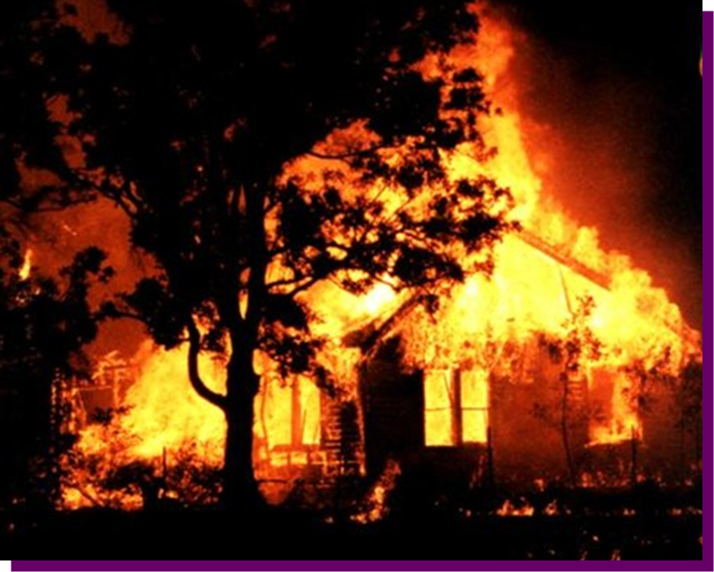
Mode of poisoning:
1-Cyanide production in a fire
Hydrogen cyanide is produced by incomplete combustion of nitrogen and carbon containing substances (-C≡N)
Natural Fibers (wool, silk, cotton, paper)
Synthetic polymers (nylon, polyurethane)
Synthetic rubber
Melamine (resins for molding, laminating, etc.)

Slide 49
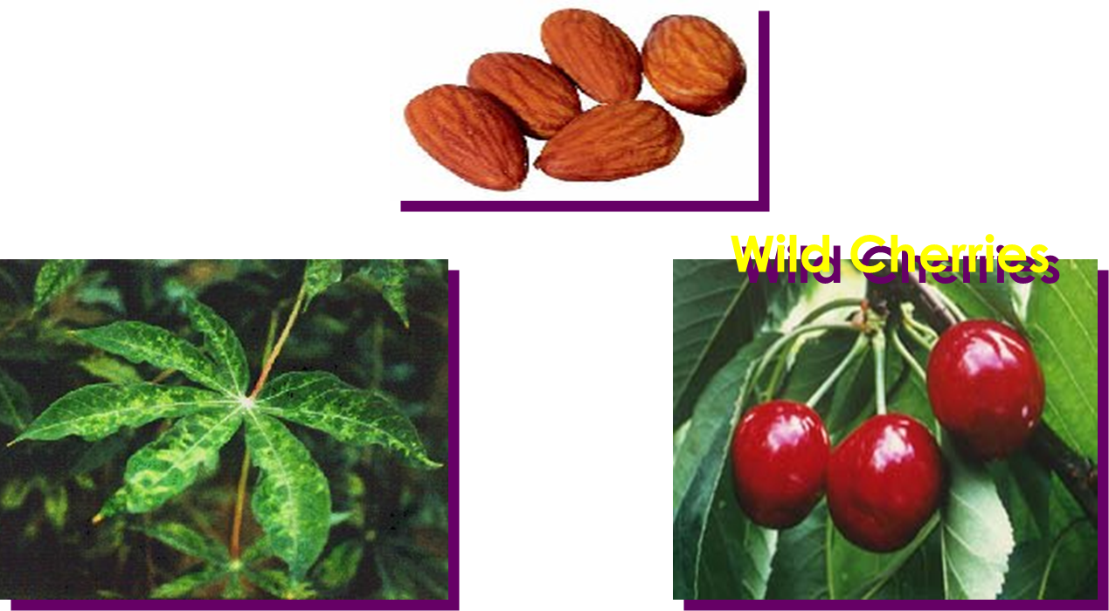
2-Drugs
Na-nitroprusside
Laetrile or amygdalin: anticancer
3-Plants: apple seeds
Almonds
Cassava

Slide 50
Hydrogen cyanide is produced during combustion of household materials containing both carbon and nitrogen.
It inhibits oxidative phosphorylation, thereby stopping aerobic respiration and leads to anaerobic respiration and subsequent metabolic acidosis and cell death.
The severity of cyanide poisoning depends on the amount of exposure, duration, and route.
It mainly causes central nervous system and cardiovascular system dysfunction.
Treatment for cyanide poisoning should be initiated in any patients with inhalation injury, unexplainable lactic acidosis, low arteriovenous O2 content difference
Cyanide poisoning should also be suspected if impaired consciousness cannot be explained only by CO poisoning.
The frequency of cyanide-related inhalation injury has led to the use of a cyanide antidote kit

Slide 51
Mechanism of action:
They unit with the ferric ions of cytochrome oxidase respiratory enzymes and cause paralysis of these enzymes, the result is the failure of the tissues to absorb their oxygen demands from the oxy-Hb of the arterial blood lead to cellular hypoxia. (hypoxia that doesn’t fully correct with supplemental O2 & increase anaerobic metabolism).

Slide 52
Clinical picture
CNS
CVS
GI
RS
Headache
Dizziness
Seizures
Coma
Hypertension early , bradycardia
Hypotension, later in course
Cardiovascular collapse
Nausea, vomiting
Caustic effects
Dyspnea
Tachypnea
Pulmonary edema
Apnea

Slide 53
Lab test :
Specific testing in cases of potential cyanide poisoning should also include the following;
Basic chemistries(eg,na+,cl-,k+,hco3-)and arterial blood gas to assess for anion gap metabolic acidosis (high anion gap metabolic acidosis)
Serum lactate concentration to confirm hyperlactatemia(lactate concentration of 8 mmol/l or greater have been shown to be both94% sensitive
and70% specific for cyanide poisoning in smoke inhalational victim)
Central venous blood gas ,if possible,to assess venous-arterial PO2 gradient(a narrowing of the venous-arterial po2 gradient venous hyperoxia
may be seen in the cyanide poisoning patient)

Slide 54
Diagnosis :
points are of major diagnostic importance:
(1) The sudden onset and catastrophic course.
(2) The characteristic odour of bitter almond.
(3) The bright red colour of the skin.
(4) Knowledge of the patient occupation and/or suicidal tendencies.
Note :Cyanide poisoning has no effect on O2-HB dissociation curve .
Note :Seizure are common in cyanide poisoning but are rare in carbon monoxide poisoning .also of note is that carbon monoxide does not affect the pupils ,but cyanide poisoning causes pupillary dilation.

Slide 55
Treatment :
Note : Do not perform mouth to mouth resuscitation in case of suspected cyanide toxicity
Treat hypotension with rapid IV boluses of isotonic fluid and vasopressors as needed.treat seizures with benzodiazepine (ef.diazepam 5 mg IV)
Hydroxocobalamin is a precursor of vitamin B12, which forms cyanocobalamin after binding cyanide. Cyanocobalamin is stable and promptly excreted in the urine. Hydroxocobalamin is recommended as the firstline agent in cyanide poisoning.
The dose of hydroxocobalamin administered intravenously is 70 mg/k.

Slide 56
Cyanide antidote should be administered when cyanide poisoning is clinically suspected. Cyanide antidote kits utilize oxidation of hemoglobin to methemoglobin and combination with cyanide to form cyanmethemoglobin. As cyanmethemoglobin disassociates, free cyanide is converted to thiocyanate using thiosulfate. And then, thiocyanate is excreted in the urine
The induction of methemoglobinemia is accomplished by the administration of amyl nitrate and sodium nitrate. Sodium nitrate at 10 mg/ kg and 1.65 mL/kg of 25% sodium thiosulfate should be administered intravenously.
Treatment with cyanide antidote kits is contraindicated in cases of concurrent CO toxicity , because the conversion of carboxyhemoglobin to methemoglobin may exacerbate hypoxia.
Hyperbaric Oxygen (HBO) : in severe cases or when antidotes fail .

Slide 57
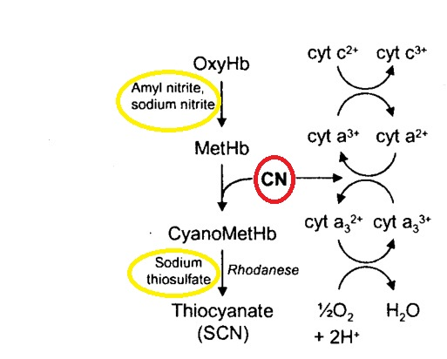

Slide 58
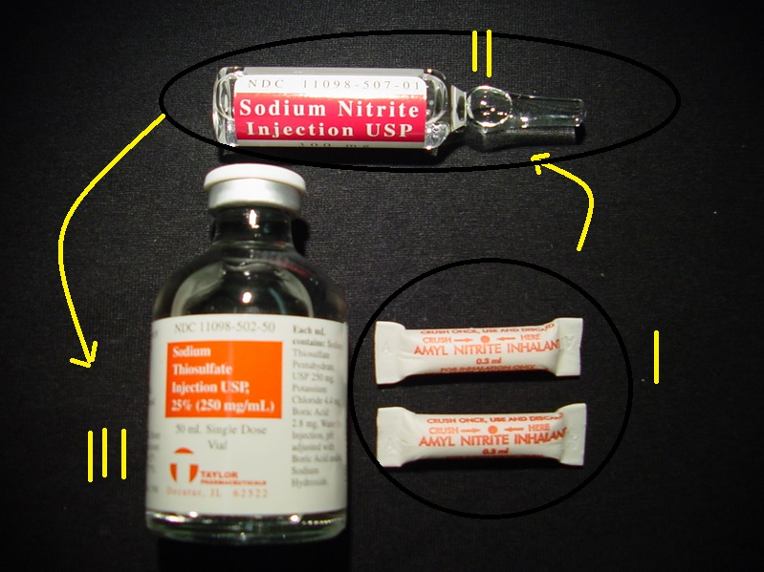
CYANIDE KITS

Slide 59
REFERENCES:
https://cdn.fbsbx.com/v/t59.2708-21/13438520_10153857684038095_835910890_n.pdf/1757-7241-21-31.pdf?_nc_cat=110&ccb=1-5&_nc_sid=0cab14&_nc_eui2=AeEO0zQcGFG9udAgAKvLnF9XAmgvDPvQ_OwCaC8M-9D87HPg_MEpMWzwy3tdI3RVZA21pfK_euHirm_55WuIeUK5&_nc_ohc=CYaxAGVQ5EIAX-Baok3&_nc_ht=cdn.fbsbx.com&oh=d6236473a15aba3846e2292aae64a01f&oe=6143A52E&dl=1
https://cdn.fbsbx.com/v/t59.2708-21/12655859_1100512996627685_1293079551_n.pdf/s13054-015-1077-4.pdf?_nc_cat=107&ccb=1-5&_nc_sid=0cab14&_nc_eui2=AeFKPmr5uNRVfgsMh-6ia1wKSTOb5cbwySpJM5vlxvDJKkwCcbia47beEiWk6EdxXl5Npn0e1SrJgziADKZq4ZcF&_nc_ohc=kMoFb-6s59gAX80yR5N&_nc_ht=cdn.fbsbx.com&oh=2ddc18fa0525bd6b7dbdfa66e19baef1&oe=61442325&dl=1
https://cdn.fbsbx.com/v/t59.2708-21/241833794_254213739959585_6653909566399138400_n.pdf/OAEM-74580-assessing-inhalation-injury-in-the-emergency-room_072015.pdf?_nc_cat=103&ccb=1-5&_nc_sid=0cab14&_nc_eui2=AeG89jc_k-zCq643zc6rx8Elrow4egppQHCujDh6CmlAcC175njefCvs04mxsIKEUbttoZw6t1iZBMq8FGRByRXs&_nc_ohc=vyZCPaMK4IwAX-STbNg&_nc_ht=cdn.fbsbx.com&oh=ebb99edee65d07ec6252af51eae90a48&oe=61439E9E&dl=1

Slide 60
.

