Slide 1
HEMOPTYSIS
Expectoration of sputum containing blood, varying in severity from slight streaking to frank bleeding.
It is an alarming symptom that may herald serious disease or massive hemorrhage.

Slide 2
HEMOPTYSIS CAUSES
Pulmonary
Airways diseases
bronchitis
bronchiectasis
cystic fibrosis
Neoplasms
bronchogenic carcinoma
bronchial carcinoid
Inflammatory disorders
tuberculosis
pneumonia
lung abscess
aspergilloma
Pulmonary vascular diseases
pulmonary thromboembolism
pulmonary vasculitis
arteriovenous malformations
Cardiovascular
Mitral stenosis
Congestive heart failure
Miscellaneous
Use of anticoagulants or fibrinolytics

Slide 3
Hemoptysis has to be differentiated from:
1- Epistaxis.
2- Spurious or false hemoptysis:its origin from above vocal cord 3- Hematemesis (Vomited blood).
Hemoptysis | Hematemesis
-Red, frothy, fresh bl. - Alkaline pH. - Resp. symptoms. - Bl. Streaked sputum | Dark & may contain food particles - Acidic pH. - GIT upset (dyspepsia). - Tarry stool.

Slide 4
I) Evaluation of the patient: A) Assessment of severity of hemoptysis: - Mild → occasionally blood-streaked sputum. - Moderate → persistent blood-streaked. - Massive → coughing up 150 cc or more at once. → 400 cc or more within 3 hours. → 600 cc or more within 24 hours N.B.: Massive hemoptysis can be recognized by: 1) Physical exam. → hypotension – tachycardia – tachypnea. 2) Rate of hemorrhage → collection of blood in sputum cups. 3) Chest X-ray → diffuse opacity → large amount. 4) Arterial blood gas analysis → hypoxemia in massive one. 5) Hemoglobin level → for blood transfusion.

Slide 6
Massive haemoptysis is a term reserved for a large volume of blood expectorated within a 24-h period, with the potential for morbidity and mortality stemming from haemodynamic instability, airway compromise and gaseous exchange abnormalities.
the most acceptable quantifiable definition refers to values ranging from 200 to 1000 ml over a 24-h period, to a bleeding rate of 100ml per hour

Slide 8
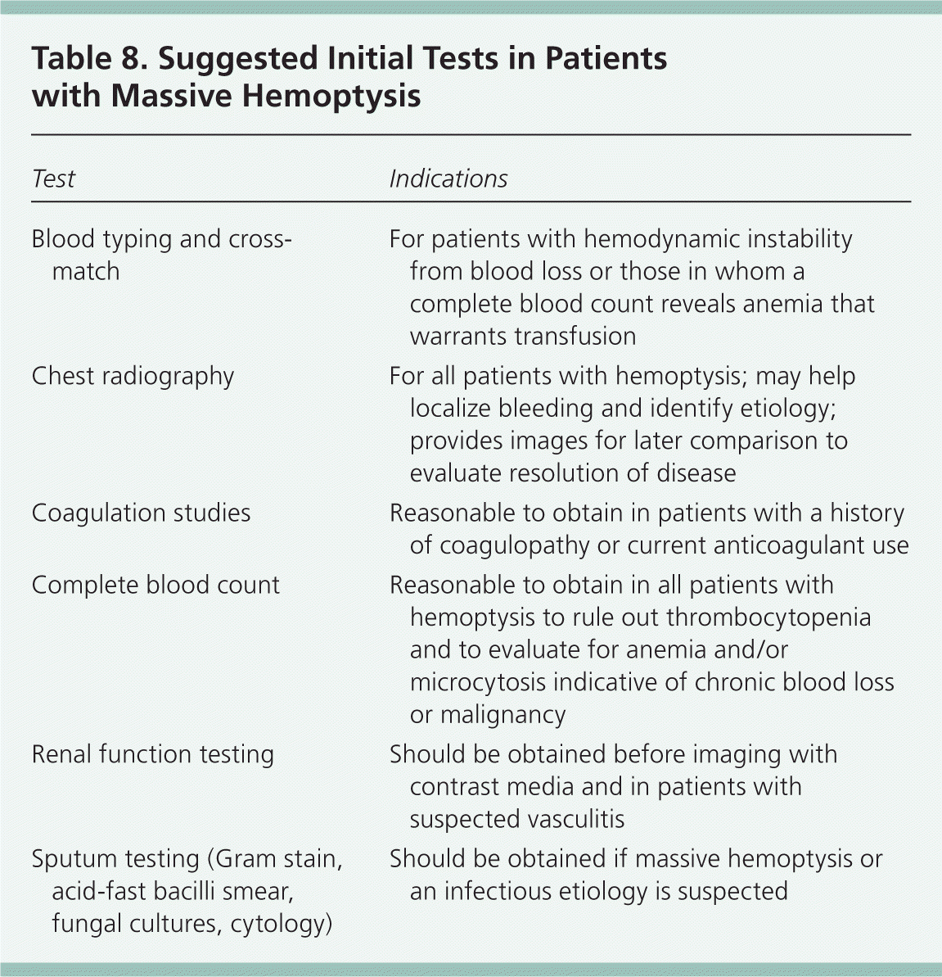

Slide 9
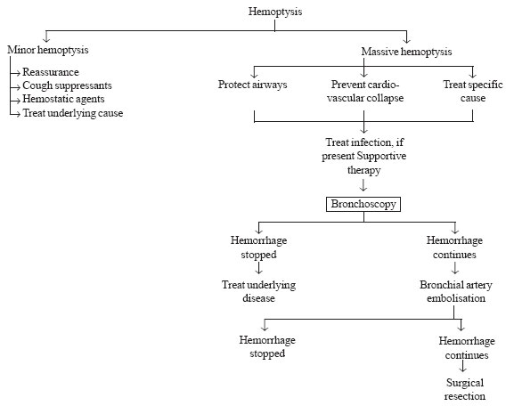

Slide 10
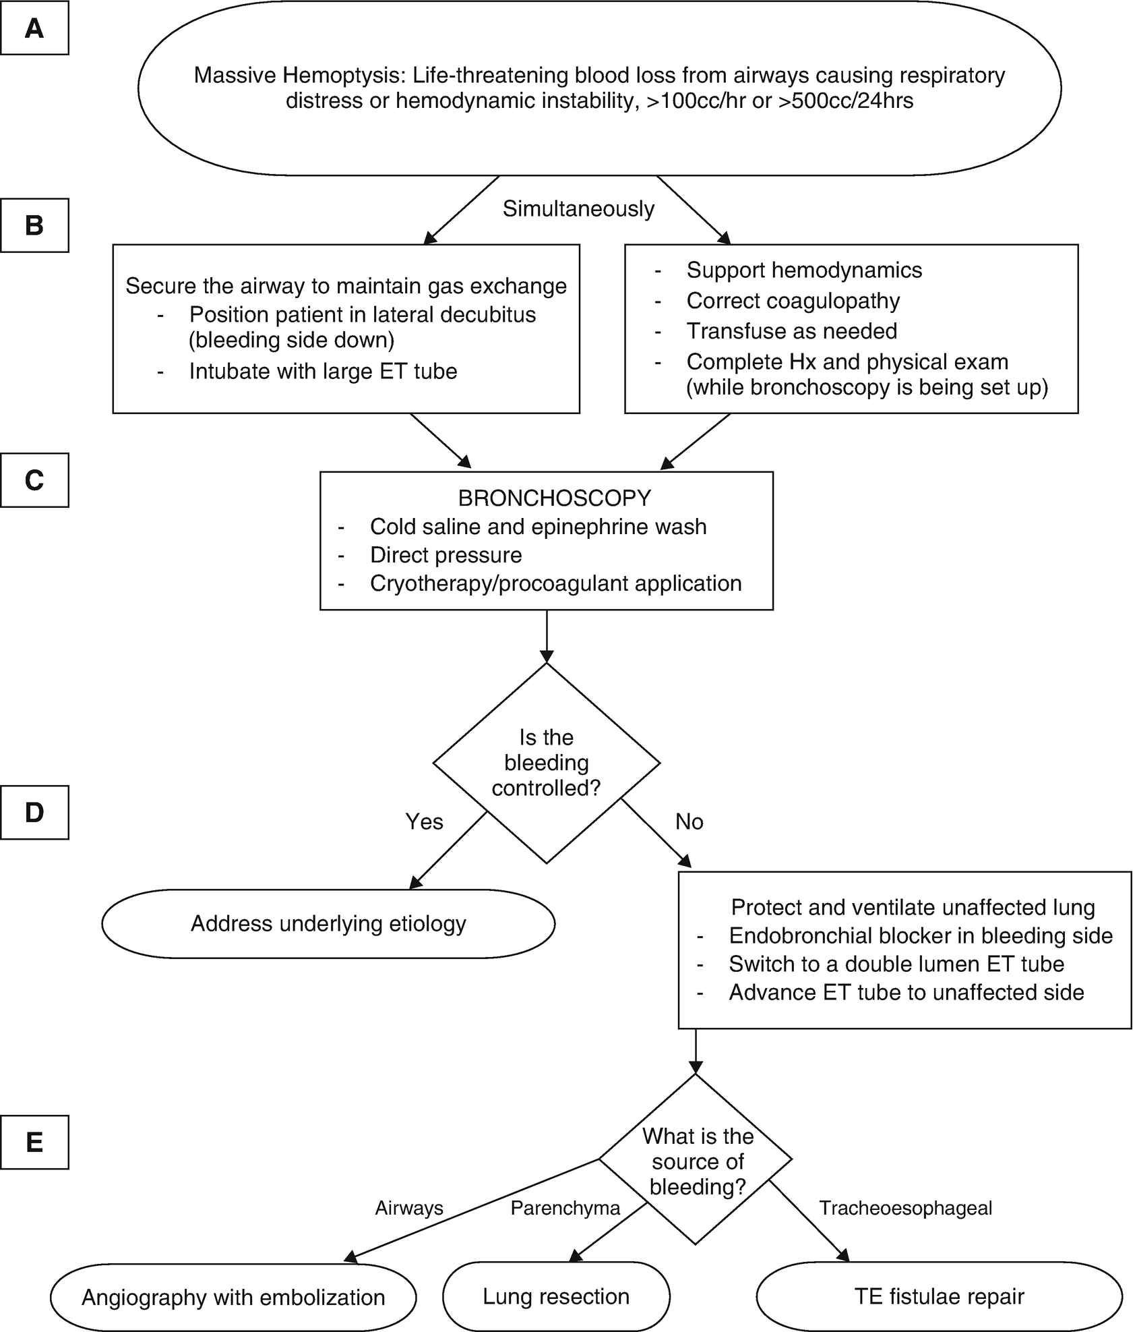

Slide 11
Causes of hemoptysis in tuberculosis

Slide 12
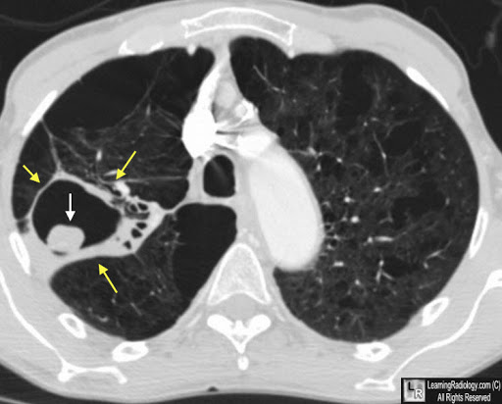
Pulmonary Mycetoma

Slide 13
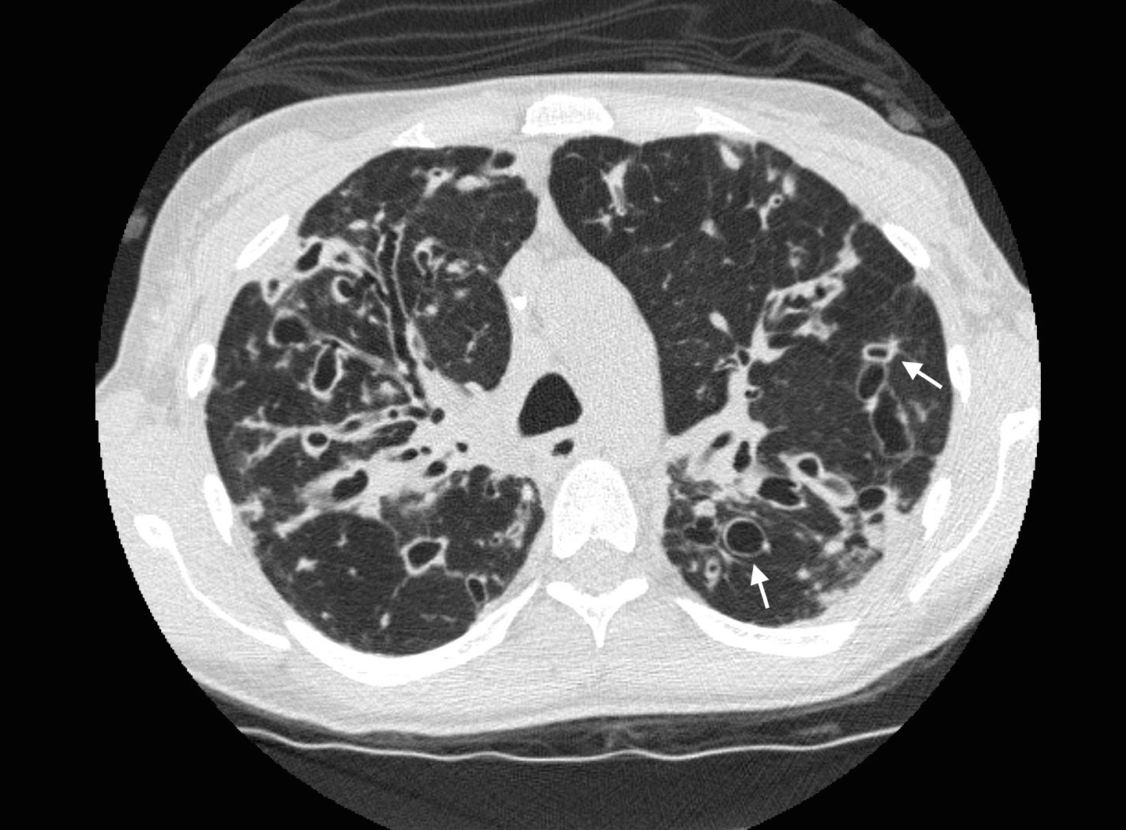
Bilateral bronchiectasis

Slide 14
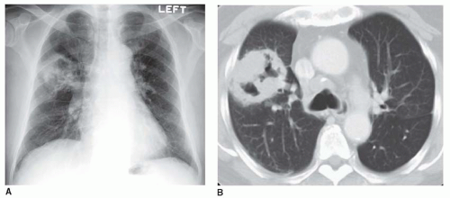
Cavitating bronchogenic carcinoma

Slide 15
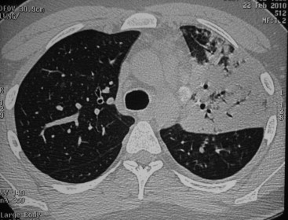
Tuberculous pneumonia

