Slide 1
Medical Ethics: Introduction
Dr Melad Gad Paulis
Professor of Forensic Science and Toxicology

Slide 2
Primum non nocere
Above all, don not harm

Slide 3
Definitions
The difference between Ethics and Moral 
The Greek word ethnos means habit, action, character.
The Latin word mos (morals) means habit or custom. Both words refer to the general area of right and wrong in the theory and practice of human behavior.
Morals refer to standards of behavior held or followed by individuals and groups.
Ethics refer to the science or study of morals and its activity in the academic context .

Slide 4
Traditional arrangements of the field of ethics:
Meta-ethics (nature of right or good, nature and justification of ethical issues)
Normative ethics ( standards, principles)
Applied ethics (actual application of ethical principles to a situation)

Slide 5
Ethics
Meta-ethics
Normative
Applied
Bioethics
Environmental
IT ethics
Business
Clinical ethics
Research ethics
Nursing ethics

Slide 6
Definitions:
What is Bioethics?
It is derived from Greek bio- life and ethicos moral.
The science/art that aims at identification, analysis, and resolution of the ethical issues in almost any field that is related to human life and health.
Medical ethics – is a system of moral principles that apply values and judgments to the practice of medicine . – It is the branch of bioethics that is related to the identification, analysis, and resolution of moral problems that arise in the healthcare of individual patients.

Slide 7
Ethical versus legal obligations
Parameters of Comparison | Legal | Ethical
Basis | Based on law | Based on principles
Effect of nonadherence | Not adhering is punishable. | Not adhering is not punishable.
Scope of choice | Lawfully mandatory | Voluntary
Form | Have written records | Totally abstract form.
Governed By | Government | Individual, Legal and Professional norms

Slide 8
IS STUDYING MEDICAL ETHICS REALLY IMPORTANT?
“As long as the physician is an educated and skillful clinician, ethics doesn’t matter.”
“Ethics is learned in the family, not in medical school.”
“Medical ethics is learned by observing how senior physicians act, not from books or lectures.”
“Ethics is important, but our curriculum is already too crowded and there is no room for ethics teaching.”

Slide 9
WHY ARE MEDICAL ETHICS SO IMPORTANT
https://neal.fun/absurd-trolley-problems/

Slide 10
WHY ARE MEDICAL ETHICS SO IMPORTANT
Medical ethics guide physician through decision-making and through interaction and conduct with patients.
Ethics provide us with moral compass the guide us through medical situations that are not straightforward.
Violations of medical ethics can threaten your job, medical license, or even constitute a crime.

Slide 11
Ethical case scenario 1
A very famous 90-year-old businessman has been repeatedly admitted to the ICU after suffering from an end-stage lung cancer. In his last admission, you were the doctor in charge. He was accompanied by one of his 14 sons who told you that they have been hiding from him (and other family members) the fact that he has got cancer, and they have told him that he has a chronic chest infection that will be treated by rest and antibiotics. They asked you not to tell him, otherwise he may die of shock, and his market competitors may abuse this information to damage his financial status. Later, another son of the patient, from a different wife to that of the elder son, approached you and asked you about the diagnosis of his father.
What would you do?

Slide 12
Ethical case scenario 2
A resident in her obstetrics and gynecology rotation was faced with a case of a 28-year-old pregnant woman of 13 weeks gestational age, who is already a mother of three healthy children. The woman was diagnosed with ovarian cancer stage 2. The oncologists made a recommendation to the obstetric team to terminate the pregnancy to initiate chemotherapy. The women refused chemotherapy and insisted on continuation of pregnancy.
What is the best decision?

Slide 13
Case scenario 3
A 23-year-old medical student was in his last year of medical school. He was asked to perform a procedure he hadn't done before. His mentor was called away from the operating room about an urgent matter and the young student made a mistake, which led to a complication that caused the woman patient to lose her life.
Case scenario 4
A 30-year-old female patient went through an aggressive chemotherapy session and hysterectomy after she was diagnosed with a rare form of cancer. Later, her oncologist told her she had been mistakenly diagnosed.

Slide 14
What will we study?
Your ethical and legal considerations toward your patients, colleagues, and profession.
Patients’ rights.
Ethical consideration in research.
Euthanasia.
Abortion.
Organ transplantations.
Professional secrecy.

Slide 15
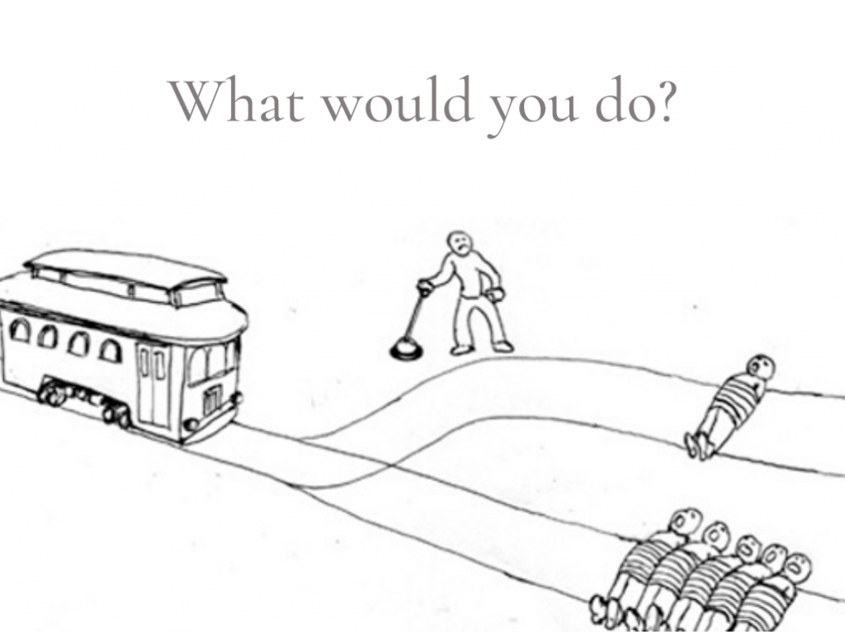
Trolley problem

Slide 16
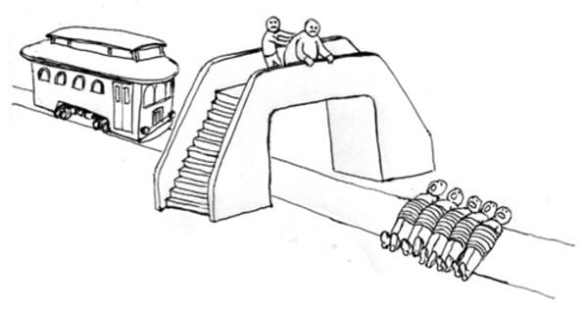
Trolley problem

Slide 17
Ethical theories
ACT
AGENT CONSEQUENCES
3 QUESITIONS MAY HELP TO ANSWER “IS THIS ETHICAL”
Consequences of the action (utilitarian theory).
Is the ACT itself ethical ”deontology theory”.
Is the acting agent (physician) a virtuous one.

Slide 18
Utilitarian theory
Also called Teleological, Greek word, Telos, meaning end or consequence.
Consequences alone that determine what is right or wrong.
The greatest good for the greatest number of the community.
Seek for the greatest aggregate welfare of the community as whole.
Problems: how to define what is good and may sacrifice the rights of minority for the seek of happiness of majority.

Slide 19
Deontological theory
Deontological theory: Non-consequentialism: Derived from the Greek word, Deon, meaning duty. Considers that some acts are right or wrong independent of their consequences.
Looks to one’s obligation to determine what is ethical and answers the question: What should I do and why should I do it?

Slide 20
The virtue theory (Character-based ethics)
A right act is the action a virtuous person would do in the same circumstances, in contrast to the approach that emphasizes duties or rules (deontology) or that emphasizes the consequences of actions (consequentialism).
Suppose it is obvious that someone in need should be helped. A utilitarian will point to the fact that the consequences of doing so will maximize well-being, a deontologist to the fact that, in doing so the agent will be acting in accordance with a moral rule such as “Do unto others as you would be done by” and a virtue ethicist to the fact that helping the person would be charitable.

Slide 21
Main ethical points
Acts are ethically right
Examples from practice
when
…
Utilitarianism
Actions not morally right
They achieve overall
Patients with public
(Consequentialism)
in themselves
-
they
amount of good (or the
health
-
threatening
become morally right if
least overall harm) for the
disease are quarantined
they produce certain
greatest number
for the sake of the good
consequences
of the general public
Deontology (Duty
-
based)
Consequences are
They follow a set of duties
Doctors are bound to “the
morally irrelevant, i.e.,
and rules that are
duty to serve? their
they don't determine the
applicable to anyone in
patients, even if there is
ethical nature of action by
the community without
risk attached to this duty.
themselves
exceptions
Doctors have the “duty to
do good” for their
patients
Virtue
-
based Ethics
Emphasizes moral
The acts are done by a
Smoking doctors cannot
character
-
not just moral
moral person, not just
advise their patients not
action
simply to be done morally
to smoke. If smoking is
morally wrong, then the
moral person should not
do it

Slide 22
General principles of medical ethics

Slide 23
1- Autonomy
Case:
A 26-year-old male has been involved in a RTA, in which he sustained blunt force trauma to his head as his head hit the front windscreen of his car. He did not lose consciousness – he is fully responsive and has no indications of neurological damage.
He has a significant head wound that is bleeding continuously. This patient has refused treatment on the grounds that he feels “fine” and is refusing to have sutures to close his head wound. He would like to leave the Department.
What is your opinion?
Even though the best interests of this patient would be served by undergoing a CT scan and having sutures, he is an adult with full mental capacity, and so we must respect his patient autonomy in choosing to leave the Department. We cannot prevent him from leaving, and if we did it would be unlawful detainment.
This principle states that any competent person should be given the freedom to decide on any decision that is related to his/her body and/or health. is the human right of a patient to control access to his/her body and what is done to him or her.

Slide 24
3 conditions should be fulfilled to obtain correct autonomy:
Capacity usually refers to the mental competencies that are needed for a human to make rational decisions, which includes the ability to understand the information about an intended intervention (or medical condition), appreciate the risks associated with the proposed intervention (medical condition, or research).
Disclosure. the information given to the patient, who is supposed to take a decision are simple and understandable.
Voluntariness refers to the importance of having the freedom to take these decisions without any pressure the emotional and social pressure conveyed by other family members or the health care team.

Slide 25
Beneficence
Beneficence means Physicians have a duty to act in the best interest of their patients.
Why Is Beneficence Important?
because it ensures that healthcare professionals consider individual circumstances and remember that what is good for one patient may not necessarily be great for another.
Think about these cases:
An eight-year-old child has been admitted to hospital with a significant open fracture to his left leg. The limb is deformed with significant bleeding and the patient is extremely distressed. The parents are demanding immediate action be taken. 2 options are present:
Limb amputation to stop life threatening bleeding and avoid severe infection.
Blood transfusion and try to stop bleeding and treat the fracture.

Slide 26
Another example:
A female aged 33 years old. She was treated from infertility and get pregnant at 22 weeks. She discovered that she has breast cancer and should start anticancer treatment which is contraindicated in pregnancy. Oncologist advised her to perform abortion. She decided to postpone treatment and continue pregnancy. What is her best interest?

Slide 27
Non-Maleficence
The principle of nonmaleficence is captured by the Latin maxim, primum non nocere: “above all, do no harm.”
Non-maleficence states that a medical practitioner has a duty to do no harm or allow harm to be caused to a patient through neglect.
is the sister to beneficence and is often considered as an inseparable pillar of ethics.
Non-maleficence differs from beneficence in that it acts as a threshold for treatment. If a treatment causes more harm than good, then it should not be considered. This contrasts with beneficence, where we consider all valid treatment options and then rank them in order of preference.

Slide 28
Case scenario
A 52-year-old man collapses in the street complaining of severe acute pain in his right abdomen. A surgeon happens to be passing and examines the man, suspecting that he is on the brink of rupturing his appendix. The surgeon decides the best course of action is to remove the appendix in situ, using his trusty pen-knife.
From a beneficence perspective, successful removal of the appendix in situ would certainly improve the patient’s life.
But from a non-maleficence perspective, let’s examine the potential harms to the patient:
The environment is unlikely to be sterile, so the risk of infection is extremely high
The surgeon has no other clinical staff available or surgical equipment meaning that the chances of a successful operation are already lower than in normal circumstances

Slide 29
Justice
We have a duty to treat all fairly, distributing the risks and benefits equally. Patients in similar situations should be offered similar care unless justifying circumstances are involved, such as for emergency cases.

Slide 30
Consent:
Any physical examination needs permission or consent of the patient otherwise the doctor may be guilty of assault (battery) if he touches or even attempts to touch an unwilling person.

Slide 31
Definitions
Autonomy as the basis of informed consent.
Consent is a decision of a competent patient to accept the medical procedures proposed. The patient has the right to refuse the proposed treatment. Both consent and refusal must be informed, i.e., based on full disclosure of the details of the proposed treatment, including its benefits and risks.
Children with some degree of competence can assent to treatment, which signifies their agreement with what their parents, their legal decision makers, have decided.
Competence: is the intellectual capacity to understand, analyze, and judge information.
Paternalism is a negative attitude that was common among physicians and has now almost disappeared. The paternalistic physician assumes that he knows what is best for the patient and should make treatment decisions without reference to the patient. Paternalism is a violation of the patient's autonomy rights.

Slide 32
Types of consent:
*Implied consent: where a person comes to visit a doctor or asks the physician to visit him, (does not extend to intimate or to invasive examinations)
*Expressed consent:
Expressed written consent.(surgical interference or complex diagnostic procedures)
Expressed verbal consent.( witnessed by another person)

Slide 33
Medical interference without consent:
In an emergency, such as an accident where the victim is in extremis على حافة الموت, unconscious or shocked…….to save life or preserve health
Routine medical examination of new prisoner to exclude infectious diseases. In addition, Pilot & airplane crew, Food dealers

