Slide 1
Pulmonary Hypertension
Done by: Dina Naser
Raghad Abu Rokbah
Sajedah

Slide 2
Pulmonary hypertension
An elevated mean pulmonary arterial pressure (mPAP) > 20 mm Hg at rest.
Normal vlaue :10–14 mm Hg
Female more than male .

Slide 3
Etiology
Increased pulmonary vascular resistance
#Hypoxic pulmonary vasoconstriction: chronic hypoxic pulmonary vasoconstriction → airway smooth muscle hypertrophy (medial hypertrophy) and pulmonary vascular bed destruction → ↑ pulmonary vascular resistance (e.g., COPD, obstructive sleep apnea)
#Increased pulmonary vessel pressure → right heart hypertrophy → right heart failure (cor pulmonale) and arrhythmias → death
# Inflammation (e.g., COPD) → ↑ inflammatory cell infiltration of intima → thickened endothelial wall → intimal fibrosis

Slide 4
Increased pulmonary venous pressure:
• volume or pressure overload from left-sided heart disease (e.g. mitral valve regurgitation)
Increased pulmonary blood flow :
#Left-to-right shunt (e.g., ASD, VSD, PDA) •
#Portopulmonary hypertension
#Sickle cell anemia: Individuals with SCD have an anemia-induced increase in cardiac output .
.

Slide 5
Classification
Pulmonary arterial hypertension (Group 1 PH)
Idiopathic.
-Hereditary (e.g., BMPR2 loss-of-function mutation)
-DRUG :Methamphetamine (and possibly amphetamines and cocaine) Sympathomimetic appetite suppressants , Chemotherapeutic agents
Left heart disease
(Group 2 PH)
-Congestive heart failure (CHF)
-heart diseases
Chronic lung diseases (Group 3 PH)
- Obstructive lung diseases
- Restrictive lung diseases
-High altitude

Slide 6
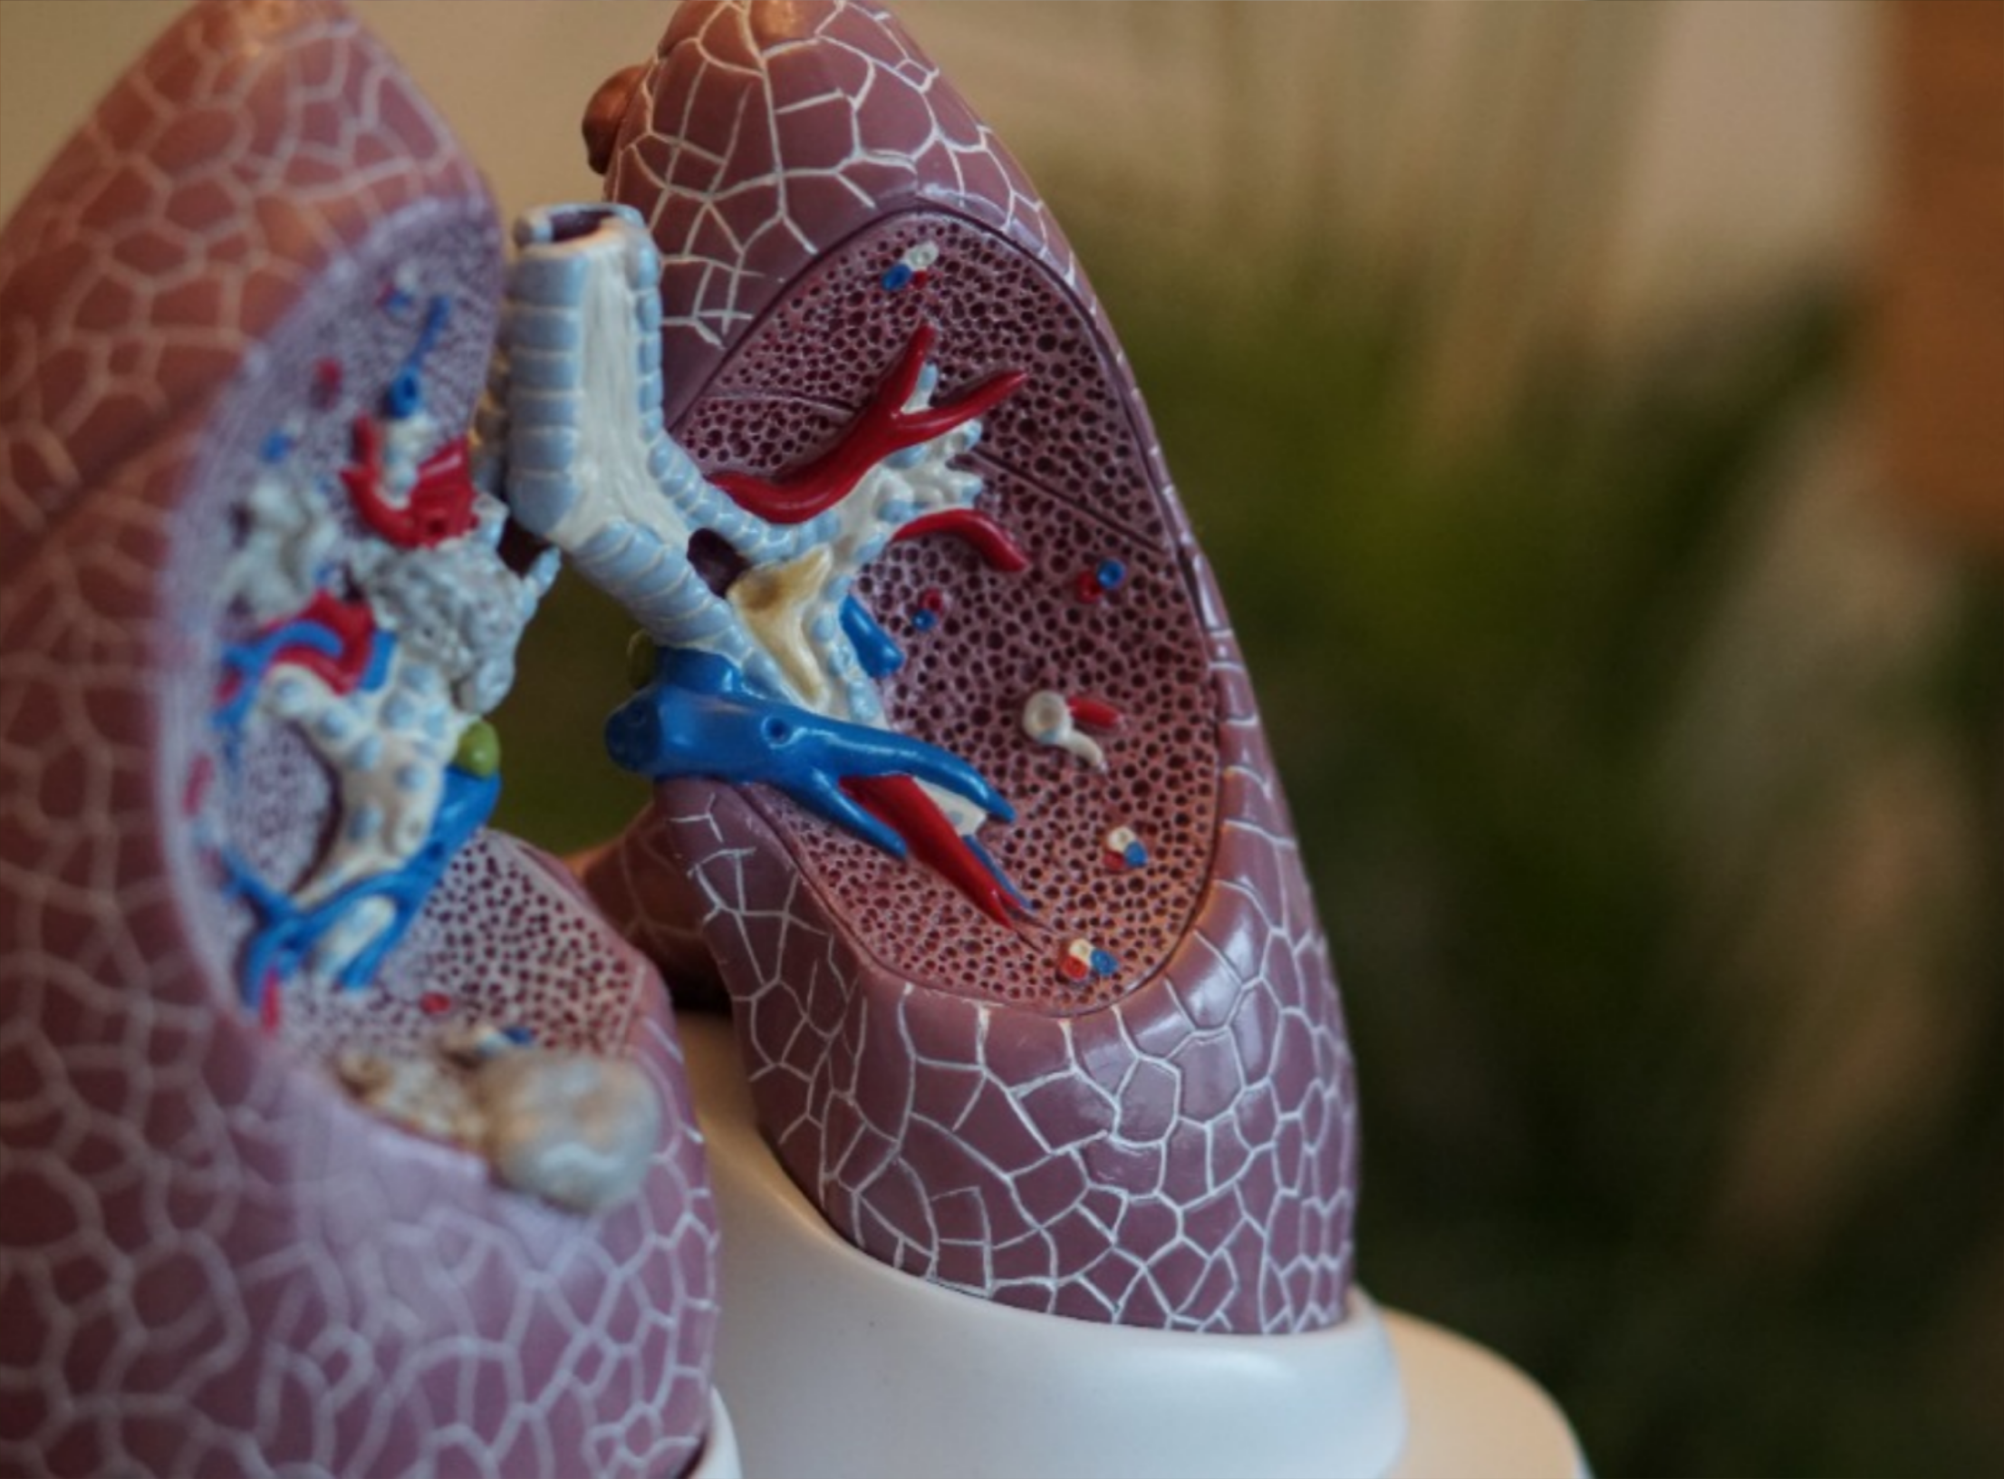
Classification
Pulmonary artery obstruction
(Group 4 PH)
Chronic thromboembolic pulmonary hypertension (CTEPH) (recurrent PE)
Unclear multifactorial mechanisms (Group 5 PH)
-Hematologic disorders
-Systemic disorders (sarcoidosis)
-Metabolic disorders chronic kidney disease)

Slide 7
Diagnosis
Clinical features
-Patients with early PH may be asymptomatic.
-Dyspnea and/or syncope on exertion
-Chest pain
-Fatigue
-Cyanosis
+ Clinical features of underlying etiology (e.g., COPD, OSA, PE)

Slide 8
Physical examination
_ Loud and palpable second heart sound (often split)
-Jugular vein distention
-Nail clubbing
-Parasternal heave
-If rt. Sided heart failure : peripheral edema , hepatojugular reflux

Slide 9
Diagnosis :
*PH is often diagnosed during the evaluation of more common differential diagnoses and etiologies of dyspnea, chest pain, and fatigue (e.g., COPD, CHF, cardiomyopathy, PE, OSA)
*If clinical suspicion is high for PH, perform transthoracic echocardiography (TTE) to noninvasively identify markers of elevated pulmonary artery pressure

Slide 10
Transthoracic echocardiography (TTE)
typically accurate enough to make a diagnosis of PH and guide therapy.
first-line study in all patients with suspected PH
findings :
Dilated pulmonary artery
hypertrophy of RA and RV
Abnormal movement of IV septum (due to increased right ventricular volume

Slide 11
Right heart catheterization
Confirmatory test for pulmonary hypertension
Findings: mPAP > 20 mm Hg at rest is considered diagnostic for PH.
ECG
Typically shows nonspecific changes secondary to increased right ventricular workload
Right ventricular hypertrophy
Right-axis deviation
P pulmonale Incomplete or complete right bundle branch block • S1Q3T3
May also show signs of underlying etiology, e.g., ischemic heart disease

Slide 12
Chest x-ray
may help to support the diagnosis of PH.
Right heart hypertrophy : Prominent right heart border
Vascular changes : Enlarged central pulmonary arteries
Signs of the underlying cause (e.g., nodular opacities in interstitial lung disease, hyperinflation in COPD, pulmonary venous congestion in left heart disease
Investigations of the underlying cause

Slide 17
Thank you
Credit | Image: Unsplash

