Slide 1
GIT practical slides 2nd year 2021
LAB - 1

Slide 2
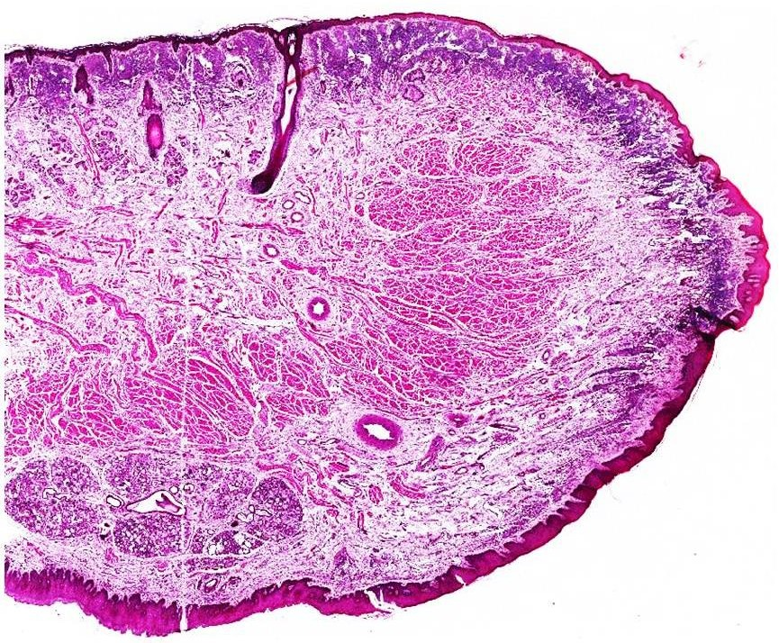
T.S of Lip
**Orbicularis oris (under the voluntary control)
Skin : keratinized stratified squamous epithelium
Hair follicle
Lip margin
Q: This section can be thought that is represents the tongue , so How to differentiate between tongue section and lip section ?
A: through the presence of hair follicles , there is no hair follicles in the tongue so this is a section of the lip
**dorsum of the tongue is rough due to the presence of papillae
Labial glands
(minor salivary gland, secrete mucus to lubricate the oral cavity )
**Minor salivary glands secrete 10% of saliva in a constant rate
Mucous membrane:
Non-keratinized stratified squamous epithelium
(there is no hair follicles, sweat glands, sebaceous glands in m.m)

Slide 3
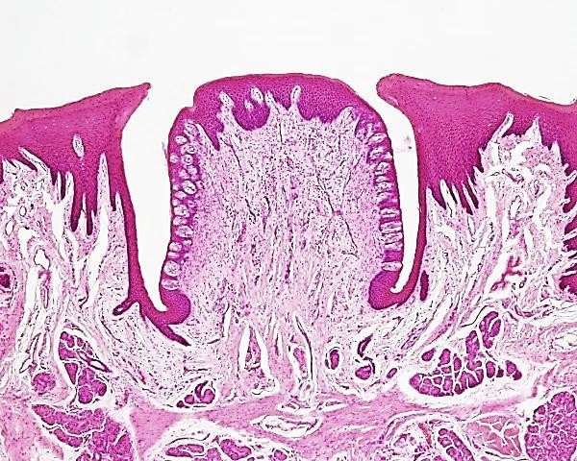
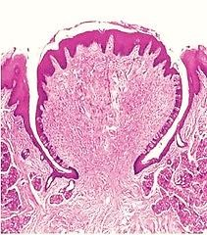
Circumvallate papillae
Q: How do you know that this section represents circumvallate papillae not other papillae?
A: They don’t project on the surface
**info about circumvallate papillae :
1) Large 2) surrounded by trench 3) teste buds present on the lateral sides of the papillae 4) contain Von Ebner glands which secrete the serous
Von Ebner glands

Slide 4
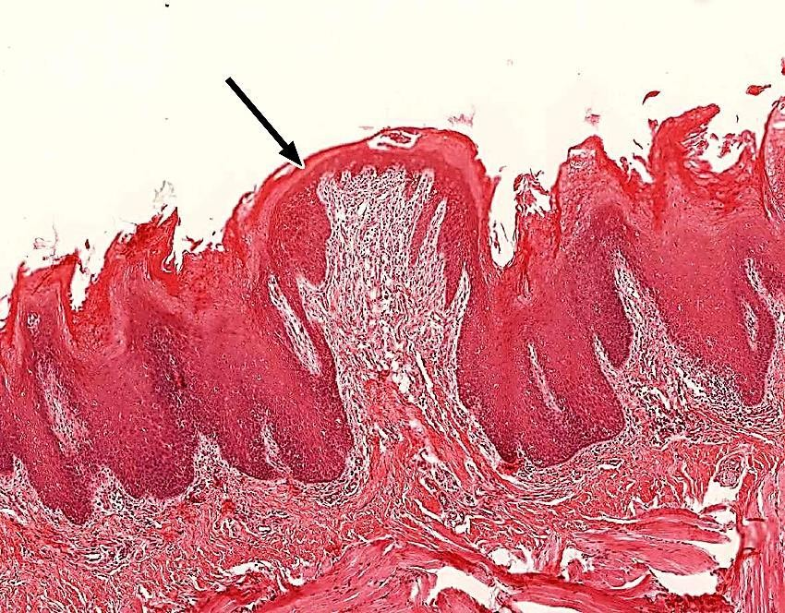
Fungiform papillae
**Info about fungiform papillae:
1) Mushroom-shaped 2) contain taste buds on the upper surface 3) found on ant 2/3 of the tongue among Filiform papillae​

Slide 5
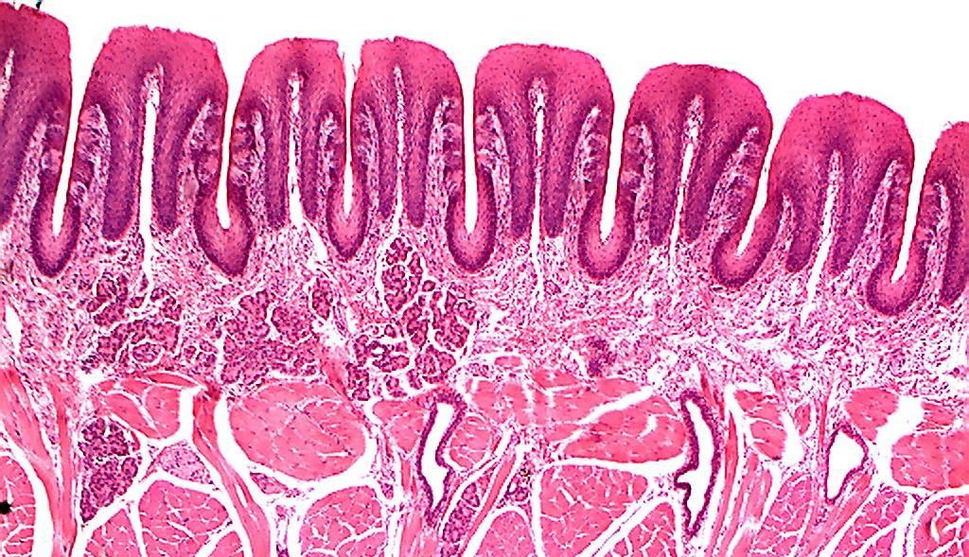
Foliate papillae
Taste buds
**Info about foliate papillae:
1) Cuboidal-shaped 2) taste buds present on the lateral sides 3) contain Von Ebner glands 4) found on sides of tongue ​5) This type is at high risk for oral cancer​
Von Ebner glands

Slide 6
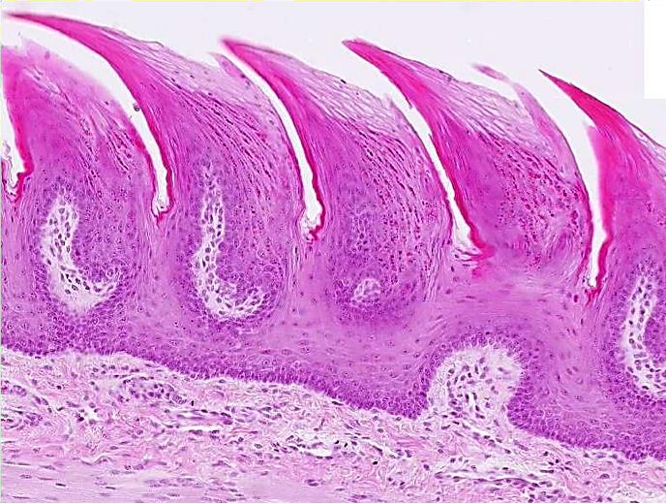
Filiform papillae
Epithelium : keratinized stratified squamous epithelium, No taste buds
**info about filiform papillae:
1) The only one contain NO taste buds 2) the only keratinized one 3) rough 4) mechanical receptor ​

Slide 7
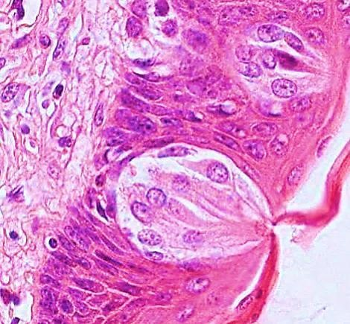
Taste buds
Taste pore and hairlets get out of it
** Info about taste buds:
1) Oval structure 2) inside it there is sensory cells 3) hairlets help the taste cells in determining what we taste

Slide 8
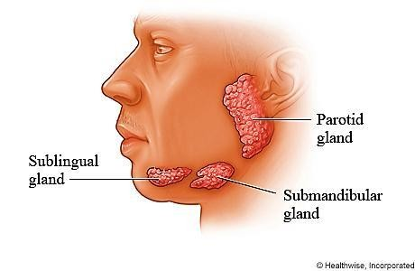
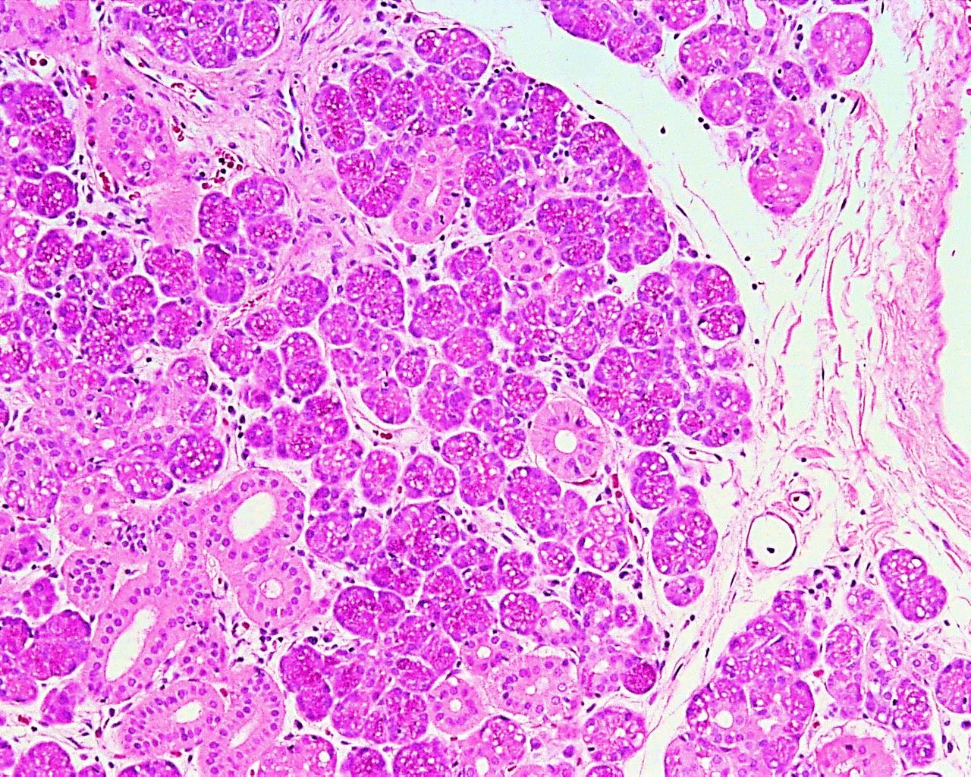
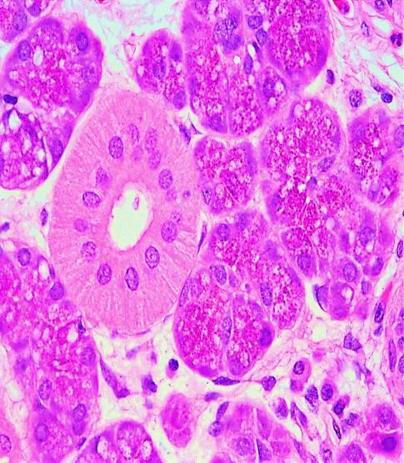
Parotid salivary gland
Acini of parotid salivary gland secrete SEROUS
Serous acini
Acini of parotid salivary gland
Striated ducts

Slide 9
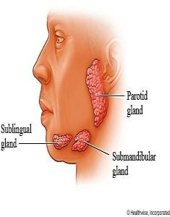
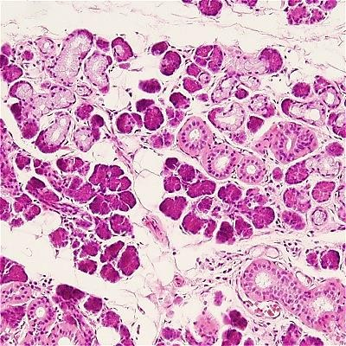
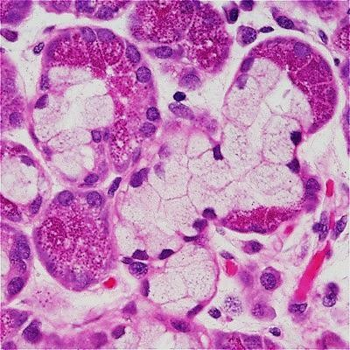
Submandibular salivary gland
Mixed muco-serous acini
Prof Dr. Hala Elmazar, 2019
Serous demilune (Cresent of
Gianuzzi
**Submandibular salivary acini can present as mucus acini and serous acini OR crescent of Gianuzzi
9

Slide 10
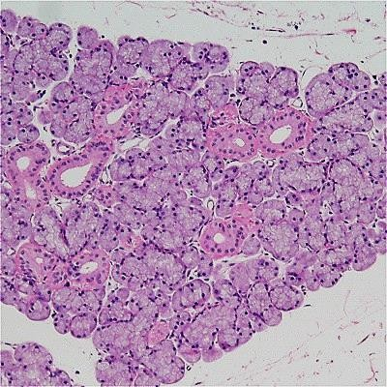
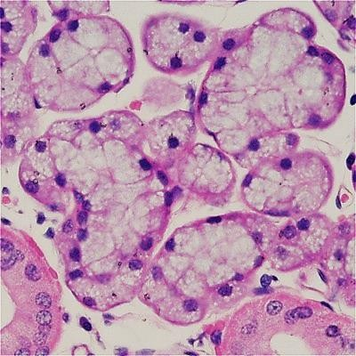
Sublingual salivary gland
Most of sublingual acini is mucus acini (90%) , crescent of Gianuzzi may present , serous acini present in a very little amount
Mucous acini
Prof Dr. Hala Elmazar
10

