Slide 1
CARDIOGENIC SHOCK
TAMER JAAFREH
MAHA AL-HAJES
WALA`A NAWAISEH

Slide 2
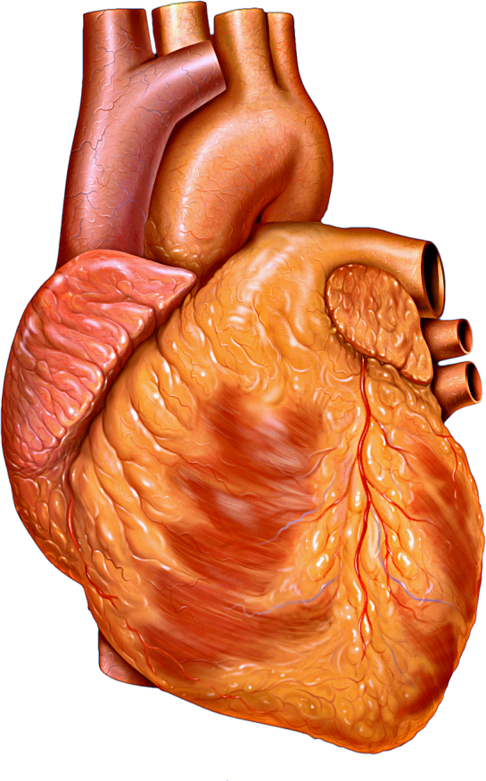
SHOCK “ CIRCULATORY FAILURE ”
Generalized inadequate blood flow through the body that leads to multiple organ failure as well as life-threatening complications, especially because too little oxygen and other nutrients are delivered to the tissue cells and failed to meet the metabolic requirements of them. Hypotension is a common presentation of shock but the terms are not synonymous
Circulatory shock can occur either by
1) Decrease cardiac output 2) Without decrease cardiac output

Slide 3
DECREASE CARDIAC OUTPUT
1. Cardiac abnormalities that decrease the ability of the heart to pump blood. These abnormalities include, MI but also toxic states of the heart, severe heart valve dysfunction, heart arrhythmias, and other conditions.
The circulatory shock that results from diminished cardiac pumping ability is called cardiogenic shock.
2. Factors that decrease venous return also decrease cardiac output because the heart cannot pump blood that does not flow into it. The most common cause of decreased venous return is diminished blood volume, but venous return can also be reduced as a result of decreased vascular tone, especially of the venous blood reservoirs, or obstruction to blood flow at some point in the circulation, especially in the venous return pathway to the heart.

Slide 4
CIRCULATORY SHOCK WITHOUT DIMINISHED CARDIAC OUTPUT
cardiac output is normal or even greater than normal, yet the person is in a state of circulatory shock.
This situation can result from:
(1) excessive metabolic rate, so even a normal cardiac output is inadequate
(2) abnormal tissue perfusion patterns, so most of the cardiac output is passing through blood vessels besides those that supply the local tissues with nutrition.

Slide 5
MAIN CATEGORIES OF SHOCK ACCORDING TO THE CAUSE
Hypovolemic shock: poor intake or excess loss of fluid as bleeding from traumatic injury ,diarrhea or severe anemia where there is not enough blood to carry oxygen through the body
Cardiogenic shock : poor pumping function or circulatory overload
Distinctive shock : Due to abnormal distribution of blood flow within the small blood vessels (low SVR and normal or high cardiac output state) ,It includes septic, neurogenic , anaphylactic shock and severe hepatic failure
Obstructive shock : Blood flow to or from the heart is blocked (i.e., massive PE, cardiac tamponade, tension pneumothorax)

Slide 6
ACUTE CIRCULATORY FAILURE (CARDIOGENIC SHOCK)
It is a state of end-organ hypoperfusion that occurs when the heart is unable to generate a cardiac output sufficient to provide adequate blood flow to the extremities and vital organ as a result of severe impairment of ventricular pump function Tissue demand > Tissue perfusion It is important to separate the shock state, in which tissue perfusion is inadequate, from hypotension, in which tissue metabolic demands may be met by increasing cardiac output or decreasing systemic resistance.

Slide 7
CAUSES OF CARDIOGENIC SHOCK
After acute MI ( MOST COMMON CAUSE )
Decompensated heart failure
After cardiac arrest
Arrhythmias
Mechanical abnormalities :
Tamponade (infarction and rupture of the free wall)
Acquired ventricular septal defect ( infarction and rupture of septum)
Acute mitral regurgitation ( infarction and rupture of papillary muscles )

Slide 8
RISK FACTORS
Elderly people
History of heart disease
Female
Other medical conditions : diabetes, hypertension, obesity, pneumothorax, sepsis.
Race or ethnicity
Medical procedure

Slide 9
SIGNS AND SYMPTOMS
Tachycardia
Decrease in BP
Lactic acidosis
Oliguria
Autonomic symptoms, including nausea, vomiting, and sweating
Pulmonary congestion manifested as rales on pulmonary examination
Engorged neck veins ( JVP elevated)
signs of volume overload
Cool, clammy extremities
Delirium and altered mental status
Peripheral pulses are rapid and faint and may be irregular if arrhythmias are present
heart sounds are distant, and third and fourth heart sounds may be present

Slide 10
DIAGNOSIS
laboratory studies:
complete blood cell (CBC) count
biochemical profile: electrolytes, renal function (eg, urea and creatinine levels), and liver function tests (eg, bilirubin)
Cardiac enzymes, which include creatine kinase (CK) and its subclasses, troponin, myoglobin, and LDH
Lactate: An elevated serum lactate level is an indicator of shock
ECG : ST segment elevation suggesting acute MI / arrhythmias / LBBB/Q waves
Echocardiogram: can diagnose a variety of mechanical complications of MI, valve disease, estimate EF, pericardial perfusion,etc

Slide 11
MANAGEMENT
Supplemental oxygen.
Pain relief: Morphine.
Fluid resuscitation to correct hypovolemia and hypotension, unless pulmonary edema is present.
Continuous ECG monitoring.
Vasopressors for hypotension which is unresponsive to fluids: Norepinephrine and dopamine are considered first-line drugs.
inotropic: Dobutamin.

Slide 12
MANAGEMENT
Continue
Antiarrhythmic drugs: Amiodarone, Procainamide, Lidocaine
Thrombolytic Therapy: If the cause is likely an acute MI Aspirin and heparin should be given immediately.
Intra-aortic Balloon Pump
PCI (coronary angioplasty)
CABG (coronary artery bypass graft)
surgical valve repair or replacement

Slide 13
THANK YOU

