Slide 1
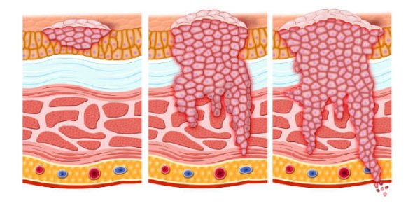
Dr. Eman Krieshan, M.D. 5-1-2022
Neoplasia 6

Slide 2
ETIOLOGY OF CANCER: CARCINOGENIC AGENTS
Carcinogenic agents inflict genetic damage, which lies at the heart of carcinogenesis.
Three classes of carcinogenic agents have been identified:
(1) chemicals.
(2) radiant energy.
(3) microbial products.

Slide 3
1. Chemical Carcinogens
Chemical Carcinogens are subdivided into:
A. Direct-Acting Agents:
Direct-acting agents require no metabolic conversion to become carcinogenic. e.g., alkylating agents).
B. Indirect-Acting Agents :
chemicals that require metabolic conversion to an ultimate carcinogen, e.g benzo[a]pyrene formed during the combustion of tobacco .
Polycyclic hydrocarbons that are present in smoked meats and fish

Slide 4
Another important examples of indirect-acting carcinogens.
The aromatic amines and azo dyes with bladder cancer.
Aflatoxin B1 from Aspergillus with hepatocellular carcinoma .
nitrites used as food preservatives are suspected to be carcinogenic.

Slide 5
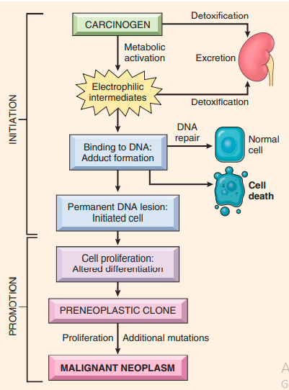
Mechanisms of Action of Chemical Carcinogens
Most chemical carcinogens are mutagenic.

Slide 6
2. Radiation Carcinogenesis
Radiation, whatever its source (UV rays of sunlight, radiographs, nuclear fission, radionuclides), is an established carcinogen.
Biologically, doublestranded DNA breaks seem to be the most important form of DNA damage caused by radiation

Slide 7
A follow-up study of survivors of Hiroshima and Nagasaki disclosed a markedly increased incidence of leukemia, thyroid, breast, colon, and lung carcinomas.
Therapeutic irradiation of the head and neck can give rise to papillary thyroid cancers years later.

Slide 8
3. Viral and Microbial Oncogenesis
Many DNA and RNA viruses have proved to be oncogenic and its include:
A. Oncogenic RNA Viruses.
B. Oncogenic DNA Viruses.
c. Helicobacter pylori.

Slide 9
A. Oncogenic RNA Viruses:
Human T-cell leukemia virus type 1 (HTLV-1).
It cause adult T-cell leukemia/lymphoma (ATLL) .
HTLV-1 has tropism for CD4+ T cells, and hence this subset of T cells is the major target for neoplastic transformation.
Leukemia develops in only 3% to 5% of the infected individuals, typically after a long latent period of 40 to 60 years

Slide 10
b. Oncogenic DNA Viruses
Five DNA viruses are strongly associated with human cancer:
HPV.
Epstein-Barr virus (EBV).
Kaposi sarcoma herpes virus [HHV-8]).
polyoma virus called Merkel cell virus.
hepatitis B virus (HBV)

Slide 11
1. Human Papilloma virus(HPV)
They are subdivided into:
low-risk HPVs (type 6,11):
cause genital warts have, it low malignant potential
high-risk HPVs (types 16 and 18):
cause squamous cell carcinoma of the cervix and anogenital region and oropharyngeal cancers.

Slide 12
The oncogenic potential of HPV can be related to products of two early viral genes, E6 and E7:
Oncogenic activities of E6:
the E6 protein binds to and mediates the degradation of p53
Oncogenic activities of E7:
It binds to the RB protein promoting progression through the cell cycle

Slide 13
2. Epstein-Barr Virus
EBV, a member of the herpesvirus family, was the first virus linked to a human tumor, Burkitt lymphoma.
EBV is implicated in the pathogenesis of :
lymphomas in immunosuppressed patients.
Hodgkin lymphoma.
uncommon T-cell and NK-cell tumors
nasopharyngeal carcinoma
a subset of gastric carcinoma.

Slide 14
pathogenesis
EBV uses the complement receptor CD21
to attach to and infect B cells
That leads to polyclonal B cell proliferation
generation of immortal B lymphoblastoid cell lines

Slide 15
3. Hepatitis B and Hepatitis C Viruses
The epidemiologic evidence linking chronic HBV and hepatitis C virus (HCV) infection with hepatocellular carcinoma is strong .
the dominant effect seems to be immunologically mediated chronic inflammation with hepatocyte death, leading to regeneration and genomic damage.

Slide 16
Although the immune system generally is thought to be protective, recent work has demonstrated that in the setting of unresolved chronic inflammation, as occurs in viral hepatitis or chronic gastritis caused by H. pylori , the immune response may become maladaptive, promoting tumorigenesis.

Slide 17
4. Helicobacter pylori
H. pylori infection is implicated in the genesis of both gastric adenocarcinomas and gastric lymphomas (MALT lymphoma).
The scenario for the development of gastric adenocarcinoma is involves increased epithelial cell proliferation on a background of chronic inflammation.

Slide 18
CLINICAL ASPECTS OF NEOPLASIA
The importance of neoplasms ultimately lies in their effects on patients.
both malignant and benign tumors may cause problems because of :
(1) location and impingement on adjacent structures.
(2) functional activity such as hormone synthesis or the development of paraneoplastic syndromes.
(3) bleeding and infections when the tumor ulcerates through adjacent surfaces.
(4) symptoms that result from rupture or infarction.
(5) cachexia or wasting

Slide 19
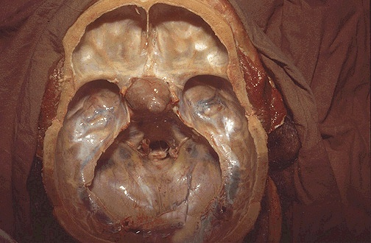
Effects of Tumor on Host
1. location:
A small (1-cm) pituitary adenoma can compress and destroy the surrounding normal gland, giving rise to hypopituitarism.
A 0.5-cm leiomyoma in the wall of the renal artery may encroach on the blood supply, leading to renal ischemia and hypertension.

Slide 20
2. Signs and symptoms related to hormone production , e.g;
Neoplasm arising in the beta cells of the pancreatic islets of Langerhans can produce hyperinsulinism.
3. A tumor may ulcerate through a surface, with consequent bleeding or secondary infection.

Slide 21
Cancer Cachexia
Many cancer patients suffer progressive loss of body fat and lean body mass, accompanied by profound weakness, anorexia, and anemia—a condition referred to as cachexia.
current evidence indicates that cachexia results from the action of soluble factors such as cytokines produced by the tumor and the host, rather than reduced food intake

Slide 22
In patients with cancer, calorie expenditure remains high, and basal metabolic rate is increased, despite reduced food intake.
It is suspected that TNF produced by macrophages mediate cachexia

Slide 23
Paraneoplastic Syndromes
Symptom complexes that occur in patients with cancer and that cannot be readily explained by local or distant spread of the tumor or by the elaboration of hormones indigenous to the tissue of origin of the tumor.
The neoplasms most often associated with Paraneoplastic Syndromes are:
lung .
breast cancers .
hematologic malignancies

Slide 24
The most common paraneoplastic syndromes are :
Hypercalcemia.
Cushing syndrome.
nonbacterial thrombotic endocarditis.

Slide 25
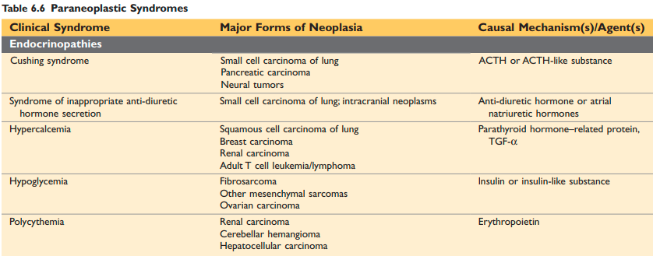

Slide 26
Grading and Staging of Cancer
Systems have been developed to express, the level of differentiation, or grade, and extent of spread of a cancer within the patient, or stage, as parameters of the clinical gravity of the disease and clinical aggressiveness .

Slide 27
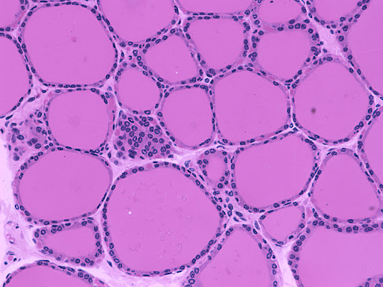
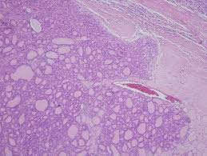
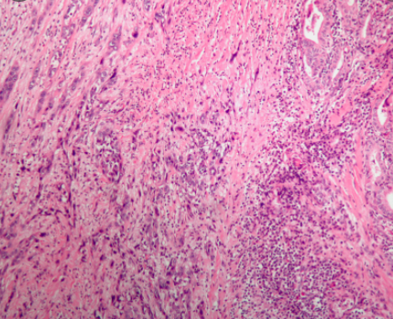
Grading of a cancer is based on the degree of differentiation of the tumor cells, and generally range from two categories (low grade and high grade).

Slide 28
The major staging system currently in use is the American Joint Committee on Cancer Staging, TNM system
The staging of solid cancers is based on:
the size of the primary lesion (T for primary tumor)
its extent of spread to regional lymph nodes(N for regional lymph node).
presence or absence of blood borne metastases (M for metastases).

Slide 29
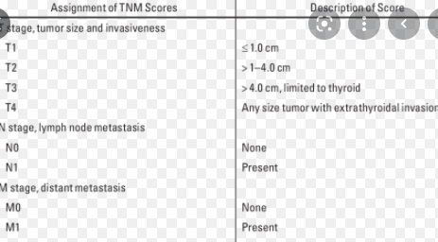

Slide 30
Laboratory Diagnosis of Cancer
Tumor Markers:
Biochemical assays for tumor-associated enzymes, hormones, and other tumor markers in the blood cannot be utilized for definitive diagnosis of cancer; however, they are used as:
screening tests.
monitoring the response to therapy
detecting disease recurrence.

Slide 31
examples
PSA, used to screen for prostatic adenocarcinoma.
CEA which is elaborated by carcinomas of the colon, pancreas, stomach, and breast.
AFP which is produced by hepatocellular carcinomas.

Slide 32
Molecular Diagnosis
An increasing number of molecular techniques are being used for the diagnosis of tumors and for predicting their behavior.
1. Diagnosis of malignancy:
E.g PCR-based detection of BCR-ABL transcripts can confirm the diagnosis of chronic myeloid leukemia .

Slide 33
2. Prognosis and behavior:
Certain genetic alterations are associated with a poor prognosis, e.g HER2 and NMYC, expression breast cancers and neuroblastomas, respectively.
3. Diagnosis of hereditary predisposition to cancer, e.g BRCA1

